Slide 1

PRESENTATION SKILLS
WEEK 5

Slide 2
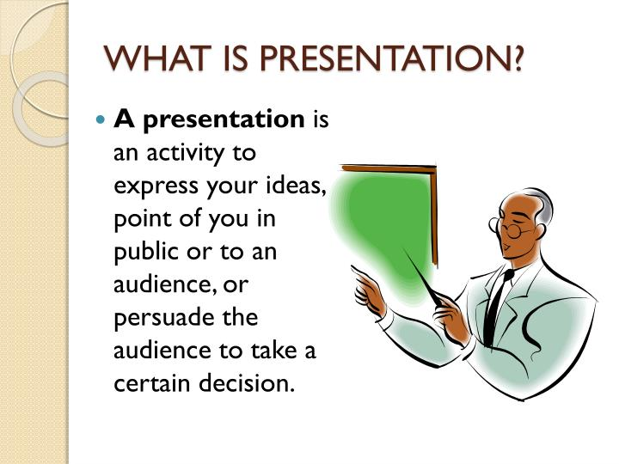
WHAT IS PRESENTATION?
An opportunity to communicate your views or ideas to the audience.

Slide 3
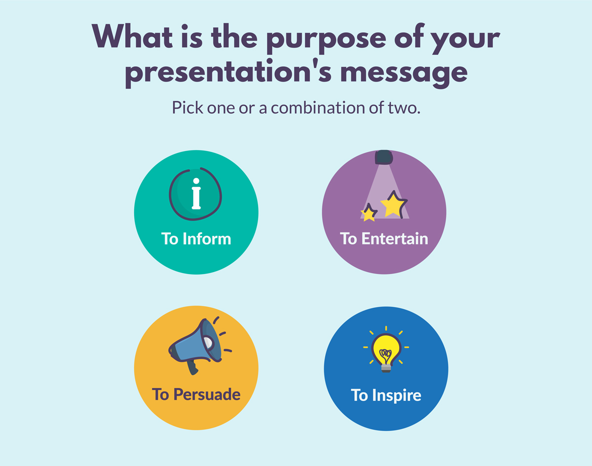
PURPOSE OF PRESENTATION
The purpose of the presentation varies according to the situations.

Slide 4

PROBLEMS /ISSUES

Slide 5

#1

Slide 6

#2 TIME MANAGEMENT

Slide 7

#3 LANGUAGE

Slide 8

#4 SLIDES

Slide 9

# 5 PAPER READING

Slide 10

#6 MONOTONOUS DELIVERY

Slide 11

#7 LACK OF COORDINATION

Slide 12

#8 HANDLING QUESTION AND ANSWER SESSION

Slide 13
WAYS FOR EFECTIVE PRESENTATION
First and most important way is to plan your presentation.
Determine your purpose
Know your audience
Organize it properly
Rehearse , Rehearse, Rehearse

Slide 14
SEQUENCE OF PRESENTATION
Introduction
2. Central discussion
3.Conclusion

Slide 15

INTRODUCTIO N

Slide 16
1. USE A LINK-BACK MEMORY FORMULA:
The best way to do is by throwing in a simple story showing who you are, where you come from and why the things you say will matter.
This is the best way to connect to your audience at the start.
Human brain loves a good story, and humans are more inclined to listen and retain the information told this way.

Slide 17
EXAMPLE
My name is Joanne, and I’m the Head of Marketing at company XYZ. Five years ago I was working as a waitress, earning $10/hour and collecting rejection letters from editors. About ten letters every week landed to my mailbox. You see, I love words, but decent publisher thought mine were good enough. Except for the restaurant owner. I was very good at up-selling and recommending dishes to the customers. My boss even bumped my salary to $15/hour as a token of appreciation for my skill.
And this made me realize: I should ditch creative writing and focus on copywriting instead. After loads of trial and error back in the day, I learned how to write persuasive copy. I was no longer getting rejection letters. I was receiving thousands of emails saying that someone just bought another product from our company. My sales copy pages generated over $1,500,000 in revenue over last year. And I want to teach you how to do the same”

Slide 18
2. TEST THE STEREOTYPE FORMULA
Introduce yourself by sharing an obvious stereotype about your profession.
This cue will help you connect with your audience better and make them chuckle a bit and set a lighter mood for the speech to follow.

Slide 19
EXAMPLE
My name is ___, and I am a lead software engineer at our platform [Your Job Title]. And yes, I’m that nerdy type who never liked presenting in front of large groups of people. I would rather stay in my den and write code all day long. [Stereotype].
But hey, since I have mustered enough courage…let’s talk today about the new product features my team is about to release….

Slide 20
3. OPEN WITH A HOOK
Wow your audience, by sharing something that they would not expect to hear.
Can start with a some statement for example:
You will live seven and a half minutes longer than you would have otherwise, just because you watched this talk.
State some mind-boggling stat makes an undeniable strong impact.

Slide 21
4. USE AN ABSORBING VISUAL
Compelling visuals are very important to make a presentation impactful.
Visuals are powerful medium of communication and the best way to captivate the attention of your audience.
EXAMPLE: Global pollution. To make a strong introduction can be started with the following visual:

Slide 22
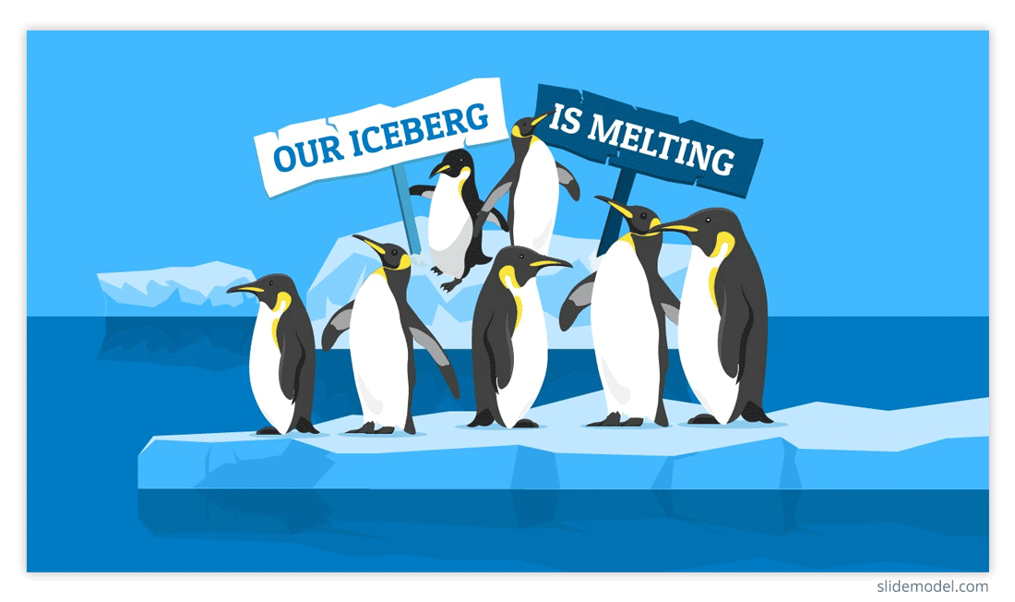
“Seven of nine snow samples taken on land in Antarctica found chemicals known as PFAs, which are used in industrial products and can harm wildlife”

Slide 23

5. ASK A WHAT IF … QUESTION
The “what if” combination carries massive power. It gives your audience a sense of what will happen if they choose to listen to you and follow your advice.

Slide 24
CENTRAL PART OF PRESENTATION
Supporting evidence
Examples
Proper linkages between the ideas
Feedback and questions from audience
Attention to, and focus on audience, are they listening…

Slide 25
CONCLUSION
To effectively conclude your presentation take questions and then finish the closing part that is as powerful as the beginning of your presentation.
Three tips to conclude your presentation with a strong impact.

Slide 26
CONCLUSION
A QUOTE: Use a quote that will stay with your audience members long after they leave the room.
A CALL TO ACTION: Use the last few minutes of the presentation to reinforce the call to action you seek. Examples :
“Join the fight” “Donate today”
“begin the journey” “Improve the process”

Slide 27
CONCLUSION
3. A COMPELLING STORY:
Ending your presentation on a story--especially if that story is personal or illustrates how the content presented affects others--is the best way to conclude

Slide 28
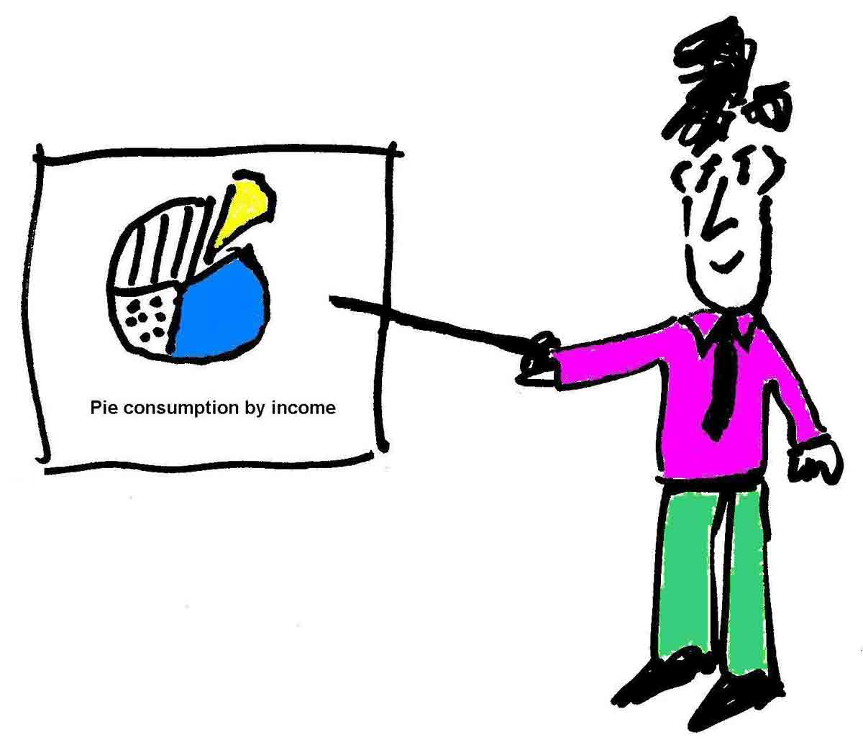
CREATE EFFECTIVE VISUAL-AIDS
PowerPoint Slides
Pictures
Videos
Graphs/charts
Sketches
White board

Slide 29
TIPS FOR POWERPOINT
Make sure that your PowerPoint slides are effective and forceful and yet simple.
Add text to support verbal communication.
For PowerPoint Ariel, Calibri and Times New Roman are recommended.
Italics are difficult to read on screen.
Do not use so many different colors on slides for written text.

Slide 30
TIPS FOR POWERPOINT
Text size should be big.
Avoid too many Fonts and Styles.
Keep it Simple
Too much artwork may distract your audience.

Slide 31
GENERAL TIPS
Control of Information:
Know your subject well
Know what you are talking about
Practice
Believe in yourself.

Slide 32
GENERAL TIPS
Vocal Techniques :
Clear and Loud
Use Pauses
Control on your Pitch
Body Language:
Make eye contact
Use your hands… but don’t go crazy
Maintain good Posture
If possible move around but slowly.

Slide 33
GENERAL TIPS
Physical Appearance:
Dress formally
Look Interesting
Facial Expressions:
Make sure your expressions are Natural

Slide 34


