Slide 1

Pre-writing techniques
Dania Anwar

Slide 2
OUTLINE
Pre-writing
Two important factors
Five Steps of Prewriting

Slide 3
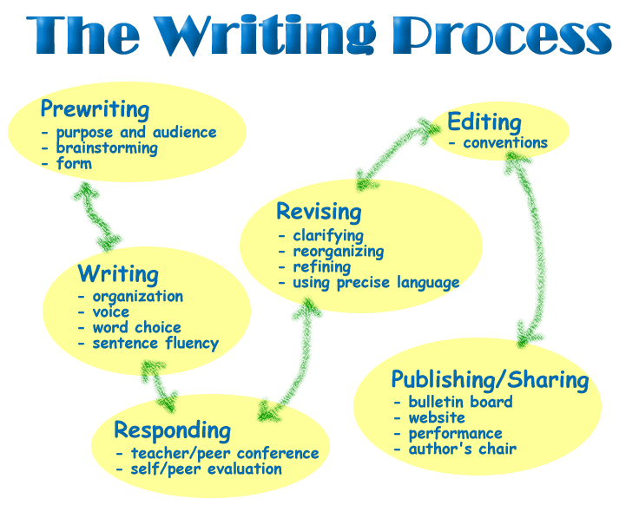
PRE-WRITING

Slide 4
PRE-WRITING
The first stage of writing process where writers focus on generating ideas.

Slide 5
PRE-WRITING
Dr Kryder’s book “Office of Assertion”
He defines Prewriting as the work of invention. He further describes invention as the work of discovering what you are going to argue, the work you have to do before you can compose a thesis or outline your argument.

Slide 6
PRE-WRITING: PURPOSE
The first consideration is determining your purpose. This is the reason why you are writing. When you think about your purpose you begin to make decisions about form, content, tone, organization, length etc.
Try to answer these two questions:
What do you want to accomplish?
Why are you sending this message?

Slide 7
PRE-WRITING: AUDIENCE
To write effectively it is always best to assume who you are writing to. You must recognize who your readers are and anticipate their expectations, background and knowledge of the topic.

Slide 8
PRE-WRITING
We pre-write to get lots of content down on paper so we can pull the strongest points out and put them in the pieces of writing.

Slide 9
Advantages
It helps you when you are tired of staring at the blank page
It helps you when you have a writer’s block (also known as writing anxiety)
When you don’t understand any topic at all or have no clue how to handle the topic.
When you are anxious about outside stressors. (It can help to focus on the task)
When you want to explore your own ideas.

Slide 10
5 STEPS OF PRE-WRITING
1. Brainstorming/ Brain dump/ Freewriting
2. Clustering
3. Looping
4. Conversation
5. Research

Slide 11

1. BRAINSTORMING/BRIAN DUMP
Any or all ideas in your brain now dumped on the page.
This is the step for a reason: It clears out our mind.
Random, can be related the topic or not.
You try to focus on the topic but you don’t necessarily stay on the topic because that’s what brain dump means.

Slide 12
ADVANTAGES OF BRAINSTORMING
You can come up with a great idea while jotting down many different points
Or if you don’t get any innovative idea you will be able to clear out mind and mind will now be in a better position to think and focus.

Slide 13
2. Clustering
Clustering works best when you already have some knowledge or experience with your topic. You can use clustering after you brainstorm to help map topics and sub-topics

Slide 14
WHAT DO YOU REALLY DO IN CLUSTERING?
We make bubble- maps
Takes one point from the brain dump and puts it in the middle bubble.
In this stage we try to get more focused than brainstorming.
Here we try to see the relationship between the ideas.
These ideas are then going to help me later with the development of paragraphs and with the examples as well.

Slide 15
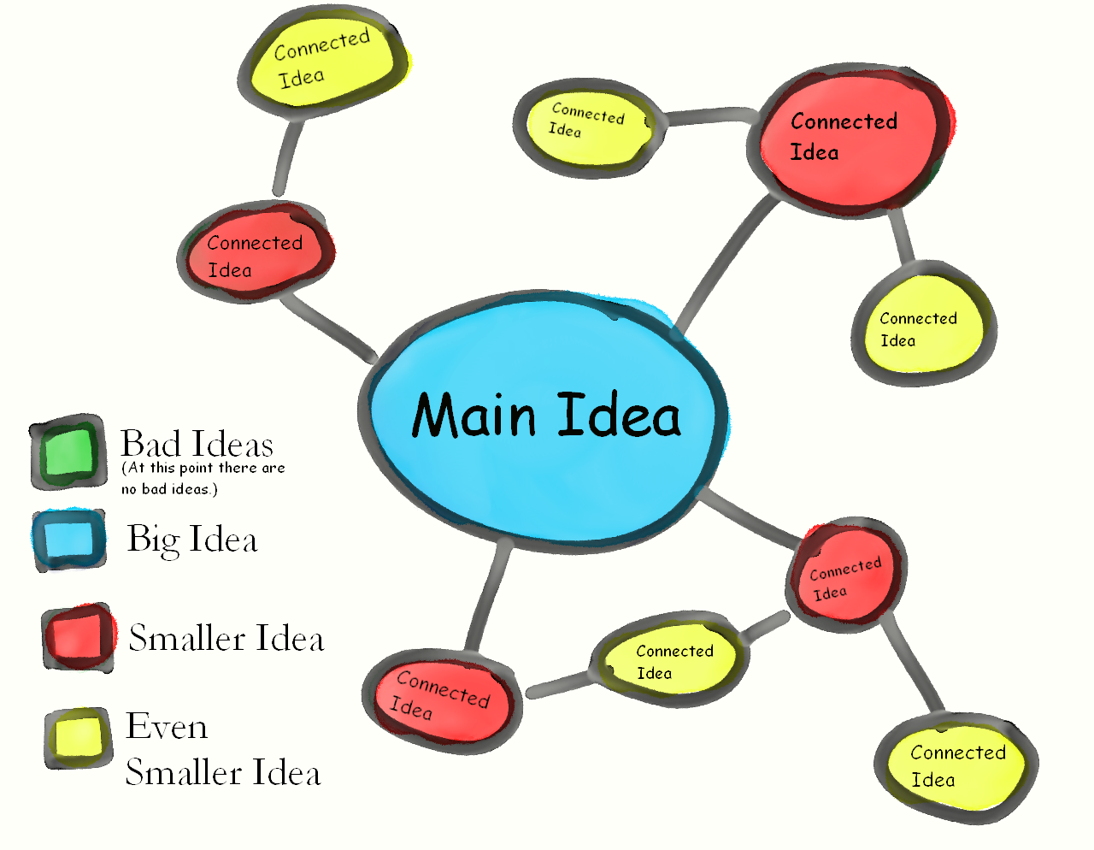

Slide 16
3. LOOPING
Take one point from brain dump or cluster and try to get more specific to bring in more clarity.
You can make as many loops as you want to bring in clarity

Slide 17

LOOPING
LOOP-2
LOOP-1
LOOP-3

Slide 18
4. Conversation
You handover notebook or notes to your peer and ask him/her to write down their responses on your brainstorming, clusters and loops.
If you are doing it orally then you have to write it down on your own.
We try to gather more ideas through conversations.
This way we can widen out viewpoint.

Slide 19

4. Conversation

Slide 20
5. Research
Preliminary Research
Formal Research

Slide 21
THANK YOU

