Slide 1

ART OF PUBLIC SPEAKING
WEEK 5
Part 2

Slide 2
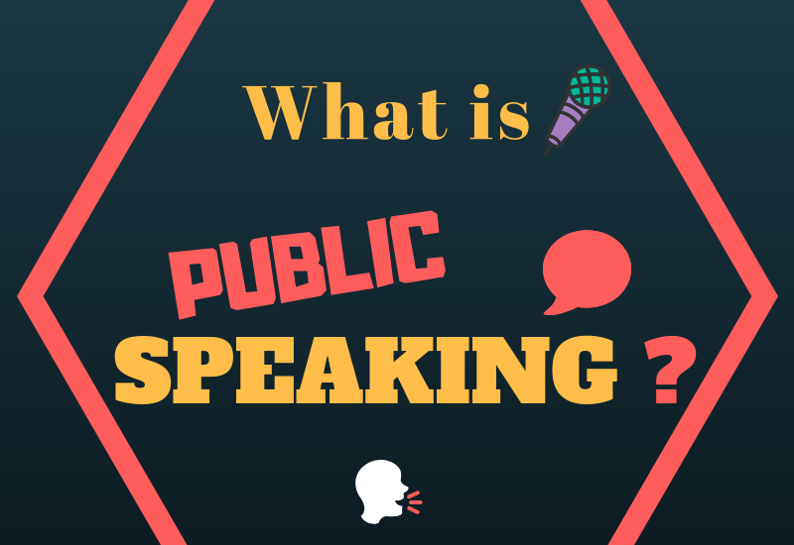
WHAT IS PUBLIC SPEAKING?
Process of speaking to a group of people in a structured, deliberate manner intended to inform, influence or entertain the listeners.

Slide 3

PURPOSE
Purpose of Public Speaking can range from
Simply transmitting information
To motivate people to act
To simply telling a story

Slide 4
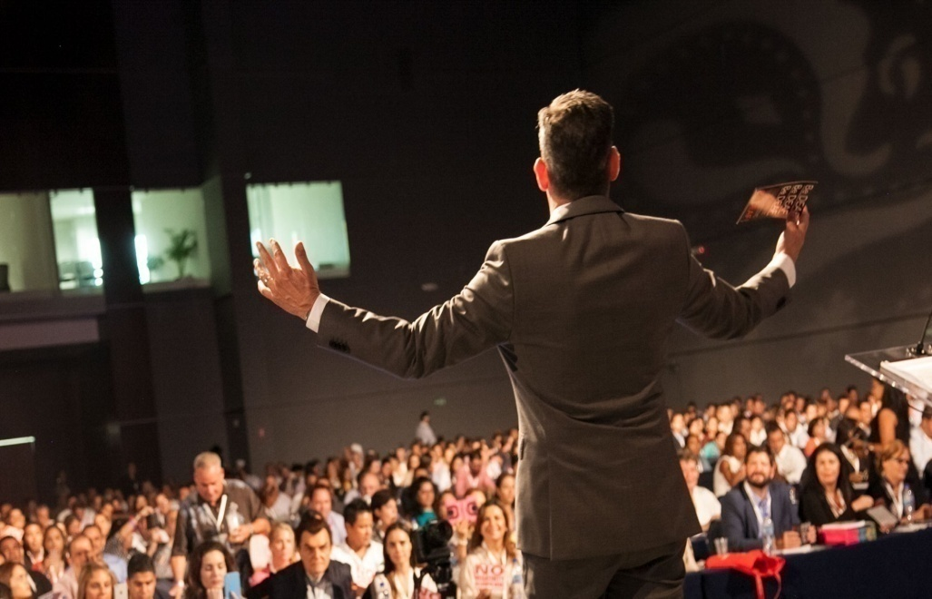

WHERE IT CAN BE USED
It can be used in any of the following scenarios
• Seminar in Schools and Colleges
• Chief guest’s Speech in any function
• Presentation in Office

Slide 5
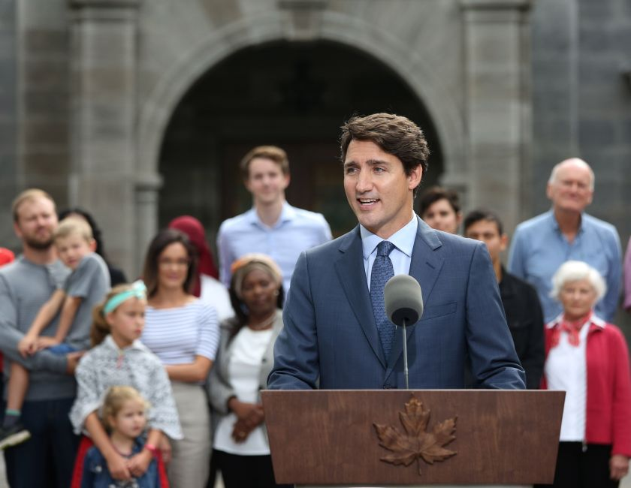
WHERE IT CAN BE USED
Thanksgiving in any function
Motivational Speech as a Leader
Politician Vote Campaign

Slide 6
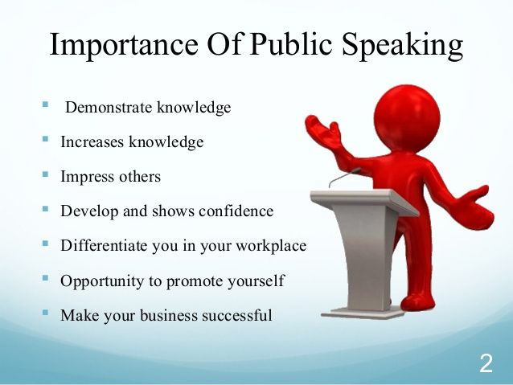
BENEFITS OF PUBLIC SPEAKING
Improve self confidence.
Influence your world
Make advancements in your career
Make yourself more comfortable around other people
Demonstrate your Knowledge
Create your own supporters

Slide 7
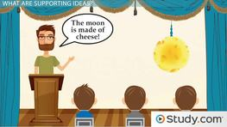
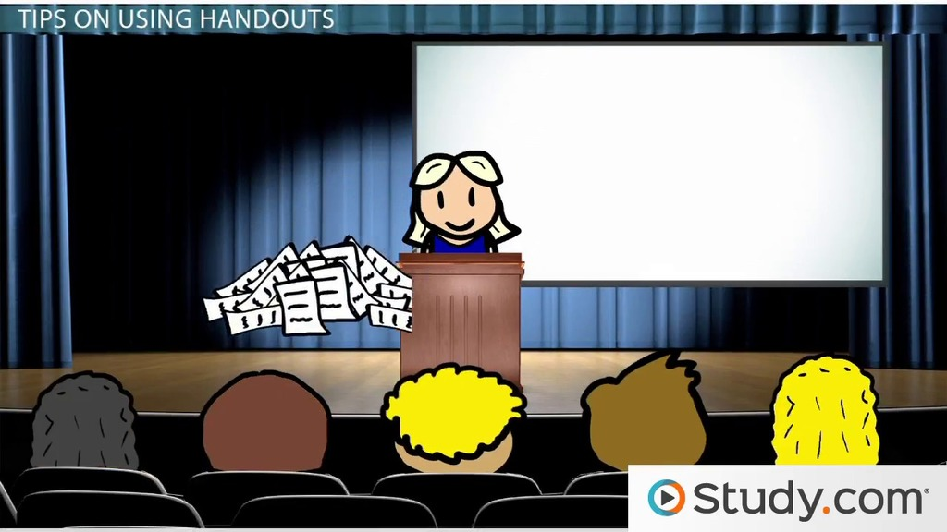
TYPES OF PUBLIC SPEAKING
There are 3 Important types of Public Speaking
Informative
Persuasive
Entertaining
However, there are other types of Public Speaking also such as
Ceremonial
Extemporaneous
Demonstrative
Motivational

Slide 8
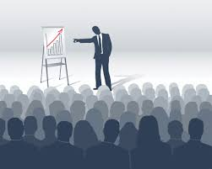
INFORMATIVE PUBLIC SPEAKING
When a person gives a speech before an audience to impart information on a particular topic or issue, it said to be an informative speech.
EXAMPLES:
Business presentations,
seminars in colleges,
class presentations in schools are some examples of informative speeches

Slide 9
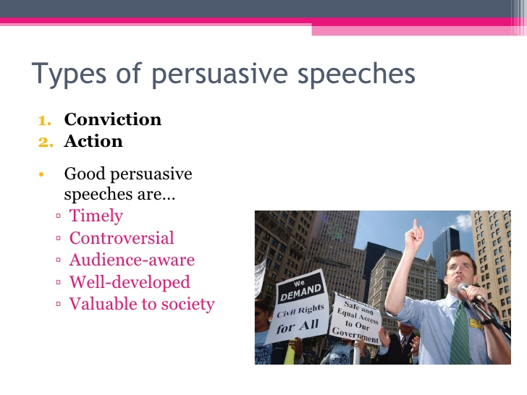
PERSUASIVE PUBLIC SPEAKING
Persuasive speeches are those where one tries to persuade or convince a group of people. These speeches aim to influence and change the opinions of the audience.
Persuasive speeches are most commonly used by sales and marketing people to attract the interest of potential clients in their products.

Slide 10

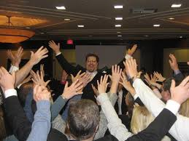
ENTERTAINING PUBLIC SPEAKING
Entertaining Speeches are those where one tries to commemorate or humor the listeners. The Speaker make them happy through Jokes and Short Stories.
Standup comedy shows are examples of Entertaining Public Speech

Slide 11
TYPES OF PUBLIC SPEAKING
CEREMONIAL : It is given on special occasions like wedding, funerals, graduation parties, retirement parties etc.
EXTEMPORANEOUS : It is the type of public speaking where speaker carefully prepares the presentation but delivers the material in a spontaneous, conversational manner that highlights natural interaction with the audience.

Slide 12
TYPES OF PUBLIC SPEAKING
DEMONSTRATIVE: It is very much similar to informative speech. The main difference lies in including a demonstration of how to do the thing you’re teaching.
Examples: How to bake a cake, how to start your own blog. How to do …anything.
MOTIVATIONAL : Motivational speech is given to influence and motivate people.

Slide 13
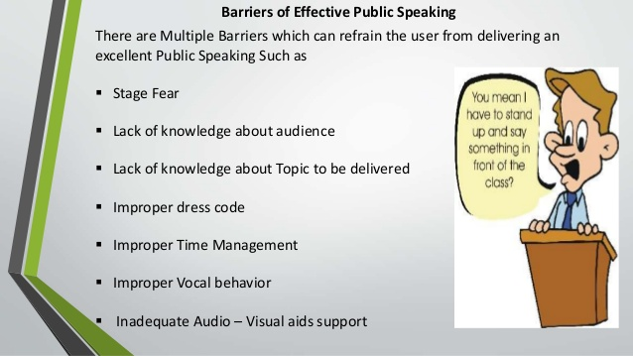
BARRIERS OF EFFECTIVE PUBLIC SPEAKING
There are Multiple Barriers which can refrain the user from delivering an excellent Public Speaking Such as
Stage Fear
Lack of knowledge about audience
Lack of knowledge about Topic to be delivered
Improper dress code
Improper Time Management
Improper Vocal behavior
Inadequate Audio – Visual aids support

Slide 14

GUIDELINES FOR EFFECTIVE PUBLIC SPEAKING
Know your audience
Knowing your audience makes the experience easier Knowing as much as you can about their knowledge, their age, the number of people you will be lecturing or speaking to. If you get some idea of what they hope to achieve from the speech, then that will help you to prepare in a more effective way.

Slide 15

CHOOSE A PROPER TOPIC
It’s always good to choose the topic wisely Consider the Occasion, Consider the audience’s level of knowledge about the Topic, Consider your Purpose and Consider whether the audience would be interested about the Topic.

Slide 16

DO ENOUGH RESEARCH OVER THE TOPIC
The better prepared you are for your speech the better the speech will be. It is better to be over prepared than under prepared. Write everything down that you want to say, including jokes and Examples.

Slide 17

BE PREPARED FOR ALL THE QUESTIONS
Be aware than any holes in your research will be noticed and questioned by someone in the audience. Never assume “no one will notice” or “no one will ask about that”. Always assume someone will ask. Try and think of all the questions you could be asked and make sure that you have an answer.

Slide 18
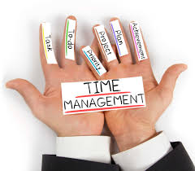
TIME MANAGEMENT
You will be given a time for your speech, sometimes these are flexible (between 10-15 minutes for example) which is good, as going over time is bad manners. You cannot rush your speech to finish as this will affect delivery, and you do not want to be stopped before the end.

Slide 19

PREPARE A NOTE FOR YOURSELF
There is nothing wrong in holding a piece of paper while you present It’s always good to have a personal note so that your mind would not go blank
However, always read your notes before you arrive at the venue so it is fresh in your mind which will eliminate a total reliance on notes.

Slide 20

DELIVER WITH CONFIDENCE
Concentrate on the message, not the medium. Focus your attention away from your own anxieties and concentrate on your message and your audience. Don’t apologize for any nervousness or problem—the audience probably never noticed it.

Slide 21

GIVE ENOUGH TIME FOR QUESTIONS
(If Necessary) Allocate necessary time for audience to question you Don’t be too defensive when you face questions that you did not anticipate. Handle all the questions in a relaxed and effective manner.

Slide 22

CONCLUDE PROPERLY
Thank the Audience. Prepare and practice how you will conclude. Ending your speech strongly will improve the effectiveness of your presentation and clearly signal to the audience that you're done And… Don’t forget to say THANK YOU ALL!

Slide 23
CONTENT: SOURCE CREDIBILITY
Source Credibility is important for effective public speaking.
Source credibility is the audience’s perception of your effectiveness as a speaker.

Slide 24
SOURCE CREDIBILITY
Four aspects of credibility:
Competence: The degree to which the speaker is perceived as skilled, reliable, experienced, qualified, authoritative and informed.
Trustworthiness: The degree to which the speaker is perceived to be honest, fair, sincere, honourable, friendly and kind.

Slide 25
SOURCE CREDIBILITY
Dynamism: The extent to which the speaker is perceived as bold, active, energetic, strong, emphatic and assertive.
Common Ground: It is also known as co-orientation. The degree to which the speaker’s values. Beliefs, attitudes and interests are shared with the audience.

Slide 26
ORGANIZATION OF SPEECH
Three important parts of a speech:
Introduction
Body
Conclusion

Slide 27
INTRODUCTION
The first part of your speech where you fulfil the five functions of an introduction.
Gain attention
Arouse interest
State the purpose or thesis
Establish qualifications
Forecast development and organization

Slide 28
GAINING AND MAINTAINING AUDIENCE ATTENTION
Bring to the presentation the object or person about which you are going to speak.
Invite your audience to participate.
Let your clothing relate to your presentation
Exercise your audience’s imagination.
Start with sight or sound.
Arouse audience’s curiosity.
Show a very short video.
Present a brief quotation or have the audience read something you provided.

Slide 29
AROUSING AUDIENCE’S INTEREST
Show how the topic is related to the audience.
STATING THE PURPOSE OR THESIS
Necessary especially for informative speeches.
Makes the audience easily understand your purpose.

Slide 30
ESTABLISHING YOUR QUALIFICATIONS
Experience. Education
Research Training
Experts Important for credibility
FORECASTING DEVELOPMENT AND ORGANIZATION
Provides a preview of the main points.
Audience feels more comfortable when they know what to expect.

Slide 31
THE CENTRAL BODY
Largest portion of the speech, which contains the arguments, evidence and main content.
FUNCTIONS
Increase what an audience knows about the topic (informative)
Change an audience’s attitudes or actions about a topic (persuasive)
Present a limited number of arguments, stories, and/ or ideas
Provide support for your arguments and or /ideas
Indicate the sources of your information, arguments and supporting materials

Slide 32
CONCLUSION
Forewarn the audience that you are about to finish (brake light-function)
Remind the audience of your central idea and main points of your presentation/speech.
Specify what the audience should think or do in response to your speech.
End the speech in the manner that makes audience members want to think and do as you recommend

