Slide 1
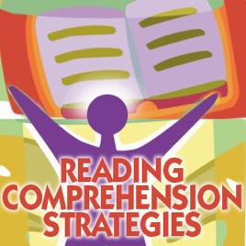
READING AND COMPREHENSION STRATEGIES
WEEK 2

Slide 2
KEYWORDS
READING COMPREHENSION
The ability to translate It involves the ability to
text into sounds or spoken derive meanings from
words. those words.
Both of them goes hand in hand.
Together makes an effective reader.

Slide 3
THREE MAJOR STAGES
Before reading
During Reading
3. After Reading

Slide 4

BEFORE READING
This stage will get you ready to think about the text.
P review
A ctivate prior knowledge
W rite down wonders/predictions
S et a purpose/speed

Slide 5
BEFORE READING
PREVIEWING
Looking at the text features, that include title, subtitles, pictures, other graphics, captions etc.
SETTING A PURPOSE OF READING
Decide why you are reading the text. For some information, to create something etc. The decision will ultimately help you to figure out how you are going to read it .

Slide 6
BEFORE READING
ACTIVATE PRIOR KNOWLEDGE
What you already know about the topic
Make you able to make connections with the present text in a better way
You understand and remember better
WRITE DOWN WONDERS/MAKE PREDICTIONS
Write down curiosities, questions and guesses about the text
Reading will get more interesting

Slide 7

DURING READING
Visualizing
Making Inferences
Monitoring Comprehension
Questioning
Clarifying

Slide 8

VISUALIZING
To create image in your minds about what is happening in the text.
You may not remember author’s words but you will remember the visuals you created.

Slide 9
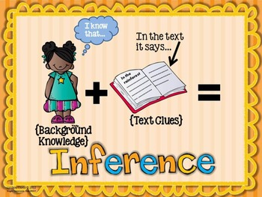
MAKING INFERENCES
Inferring is making educated guesses based on the new information that we read and personal experiences.

Slide 10
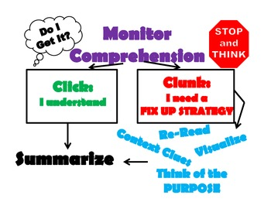
MONITORING COMPREHENSION
Monitor understanding
Whether you understand what you’ve read? If no, then fix up strategies.
Think about the purpose and check if you’re getting the information you needed.

Slide 11

QUESTIONING
Keep asking questions about the text and find and infer the answers as you are reading.
Different types of questions readers can ask from monitoring comprehension-type questions to analyzing the writer’s style.

Slide 12

CLARIFYING
Make things clear
Go back and read the confusing section slowly
Look up a word you don’t know
Read on to see if further information helps you
If you still can’t figure it out, ask for help.

Slide 13
AFTER READING STRATEGIES
Finding the main idea
Summarizing
Reacting to what you’ve read
Making connections

Slide 14
AFTER READING STRATEGIES
FINDING THE MAIN IDEA
Locate and infer the major idea/thought of the text.
Sometimes, it isn’t stated explicitly , so think about the details and create a sentence that states the main idea.
2. SUMMARIZING
State the main idea and the important details in the logical order.

Slide 15
AFTER READING STRATEGIES
3. REACTING TO WHAT YOU’VE READ
Extend your thinking, how does it make you feel?
Can you use the information you read?
What new question does the text make you wonder about?

Slide 16
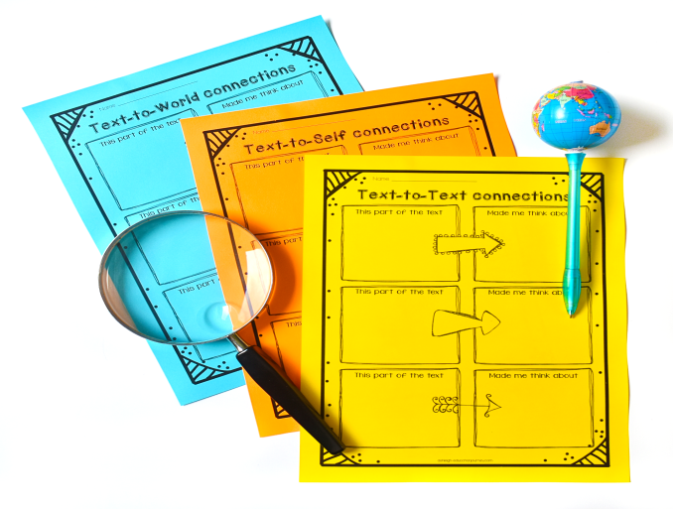
AFTER READING STRATEGIES
4. MAKING CONNECTIONS
Find Similarities.
Text-to-self: does it remind you
of something that happened to you?
Text-to-text: Remind you of something you’ve already read.
Text-to-world: reminds you of something in the news or historical event.

Slide 17
