Slide 1
Introduction LECTURE 1 LECTURE 2

Slide 2
TODAY'S LECTURE OUTCOMES
Course Outline
Criteria for Evaluation throughout semester
Introduction to Language Skills
Listening Skill
Speaking Skill
Reading Skill
Writing Skill

Slide 3
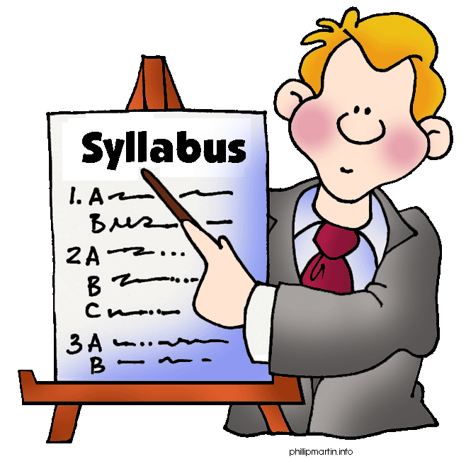

COURSE OUTLINE

Slide 4


ASSIGNMENTS, PRESENTATIONS

Slide 5
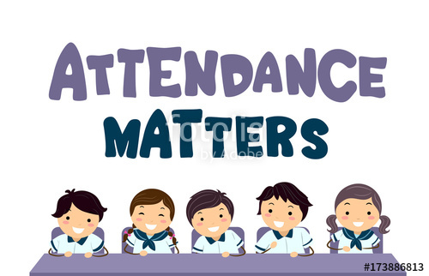
ATTENDENCE RULES
75%

Slide 6

INTRODUCTION TO LANGUAGE SKILLS
Four basic Language skills
Listening skill 3. Reading skill
Speaking skill 4. Writing Skill

Slide 7
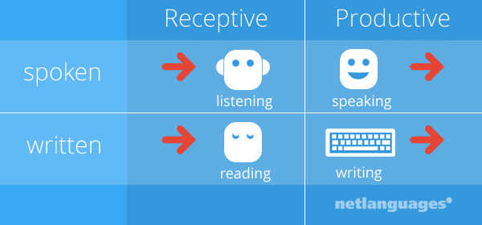
LANGUAGE SKILLS

Slide 8
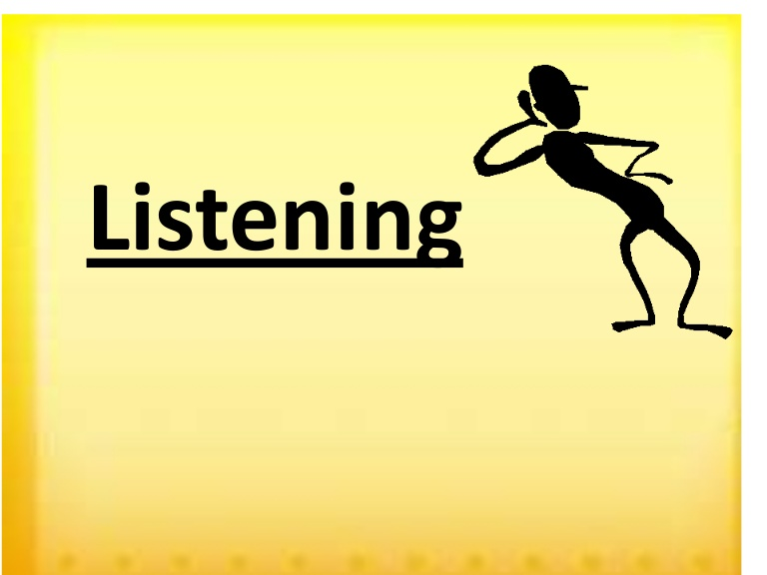
LISTENING SKILL
Most important communication skill.
We probably spend more time using
our listening skills than any other kind
of skill.
Like other skills, practice is the key to
master this skill.
Real listening is an active process.

Slide 9
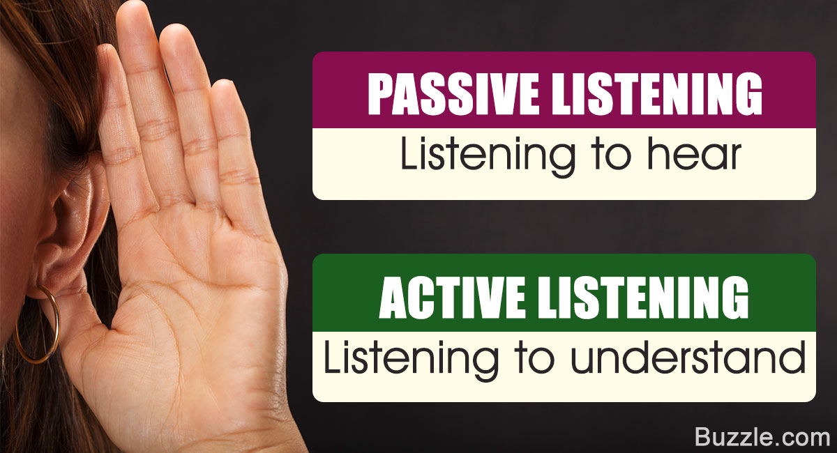
LISTENING SKILL

Slide 10
Listening skill: definition
Listening is not just about being quiet while someone else is speaking.
It is the process of receiving, constructing meaning from, and responding to spoken or non-verbal messages.
Listening is a very much active process.

Slide 11
TYPES OF LISTENING
Discriminative Listening: where one identify the difference between various sounds and familiar and unfamiliar language.
Comprehension Listening: involves attaching meaning to what is being listened to. It may also include comprehending the non-verbal messages being conveyed by the speaker.
Evaluative Listening: It involves evaluating the message being received.

Slide 12
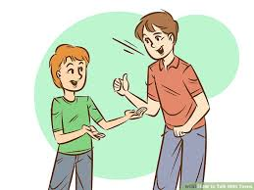

SPEAKING SKILLS
Most interactive skill
It helps a person to grow socially in his/her personal and professional life.

Slide 13
Speaking skill : definition
Speaking is the process of building and sharing meaning through the use of verbal and non-verbal symbols , in different contexts.
It is the act of generating words that can be understood by the listeners.

Slide 14
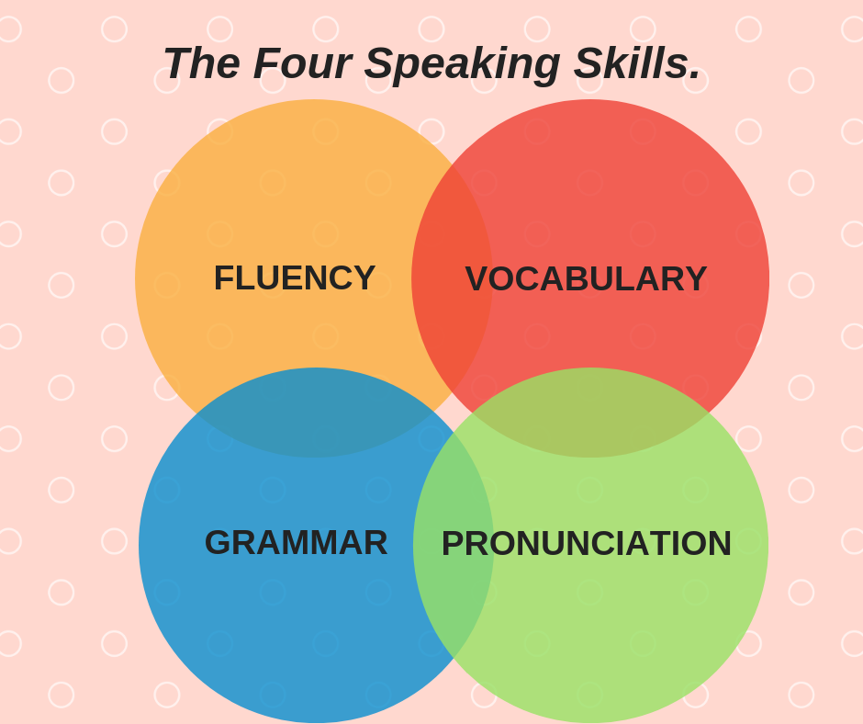
Speaking skills

Slide 15

Reading skill
Reading is an active process, in which readers shift between sources of information, (what they know and what the text says), elaborate meaning and strategies, check their interpretation and use the social context to focus their response.

Slide 16
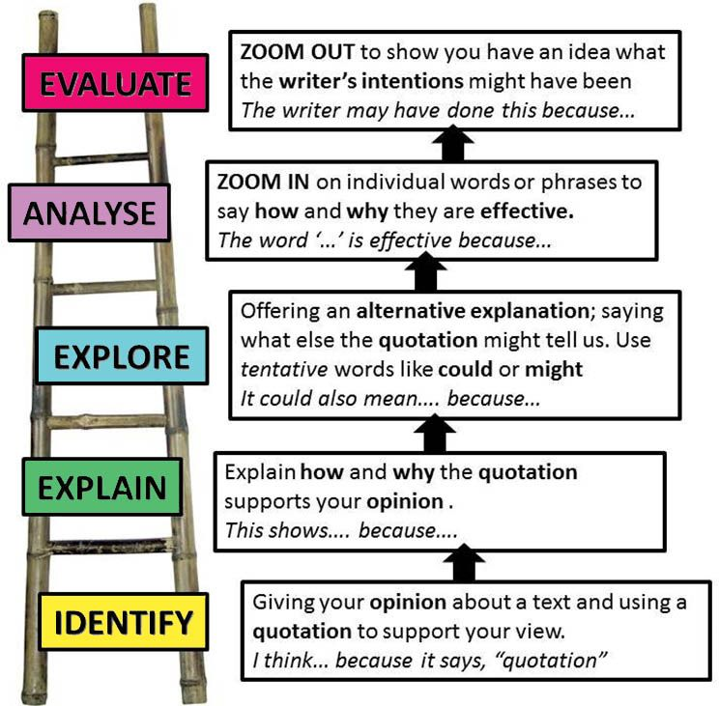
Reading skill

Slide 17
Types of reading
Scanning: quick reading
Skimming: where we try to make an understanding without reading every single word. Skip through certain sentences.
Extensive Reading: Detailed study of any topic to get the gist of the whole topic.
Intensive reading: Careful reading when we try to grasp the meaning that are behind the lines.

Slide 18

Writing skill
The process of writing can be defined as the arrangement of letters, symbols or sequences to convey a meaningful information.
OR
To communicate specific information or ideas by utilizing the specific formats of language, symbols etc.

Slide 19
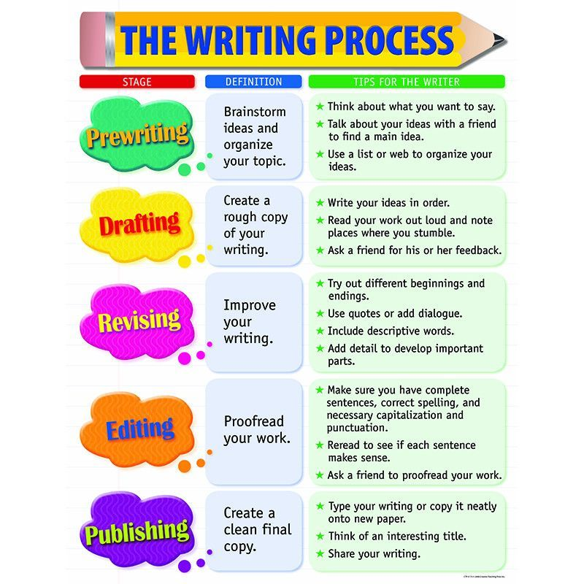
Writing process

Slide 20
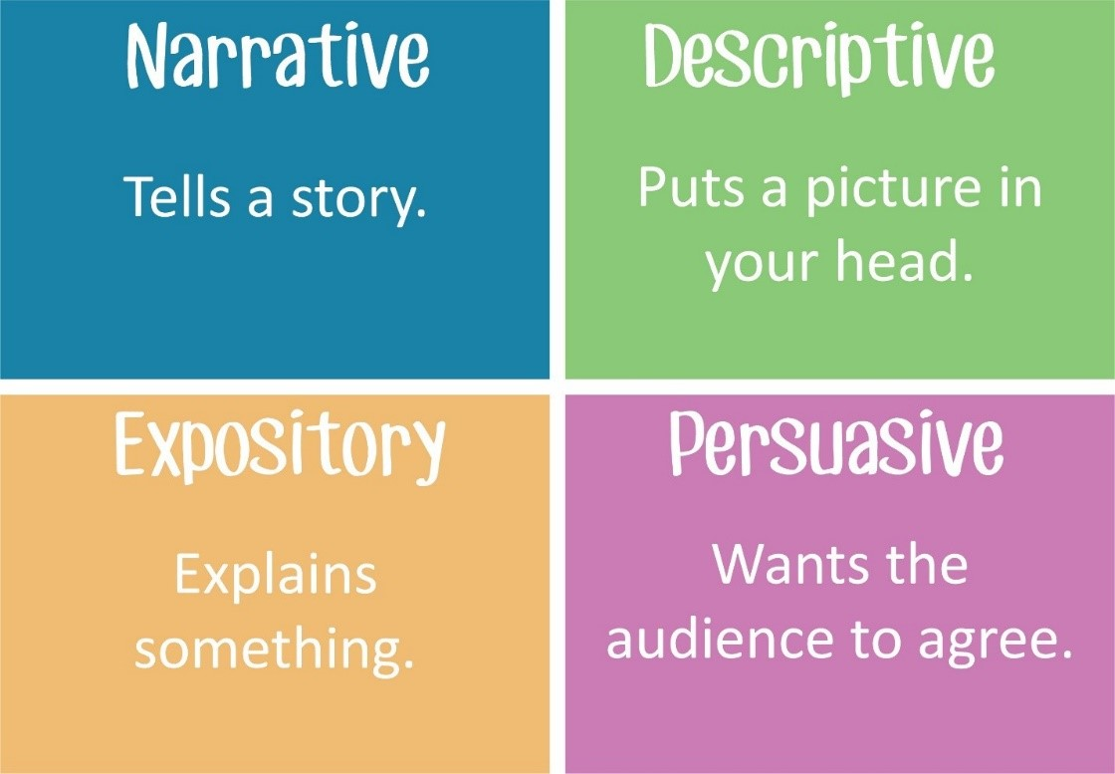
Types of writing:

Slide 21
THANK YOU

