Slide 1
PARAGRAPH WRITING
Week 12

Slide 2
PARAGRAPH
Collection of sentences.
These sentences are put together to present a single Main Idea.

Slide 3
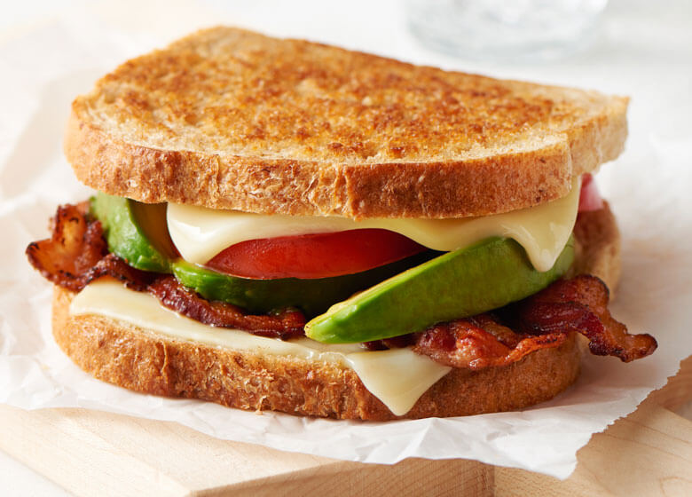
IMPORTANT COMPONENTS OF PARAGRAPH
Topic Sentence
Supporting Sentences
Conclusion

Slide 4
TOPIC SENTENCE
First sentence of the paragraph.
Identifies the topic.
The main idea of the paragraph is stated here.
States what will be said about the topic.

Slide 5
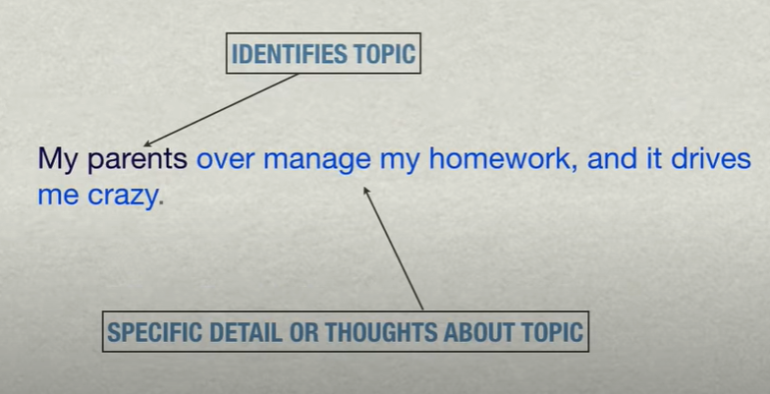
Example

Slide 6
BODY OF THE PARAGRAPH
Body sentences give all the details and thoughts you have on the topic.
Can be of two types
Specific details and supporting facts.
Your own thoughts about the details and facts.

Slide 7
SPECIFIC DETAILS AND SUPPORTING FACTS.
Facts, quotes, examples from a source.
Evidence that supports your thinking.
Comes right after the topic sentence.

Slide 8
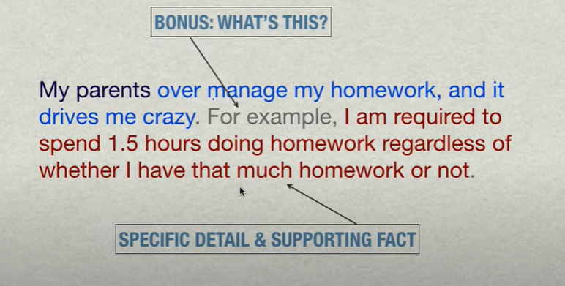
EXAMPLE

Slide 9
EXAMPLE
Transition phrase
In addition, my parents review all of my completed assignments before I am allowed to have a free time.
Is it an opinion or fact ?

Slide 10
PERSONAL THOUGHTS
Your own thoughts about details and facts.
Comes after the supporting details and facts.
Important part of your paragraph.

Slide 11
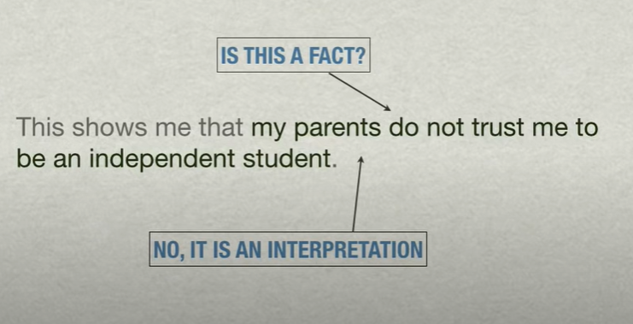
EXAMPLE

Slide 12
EXAMPLE
As a result, I feel uncomfortable, which causes frequent arguments during homework time.
Fact or opinion ?

Slide 13
CLOSING SENTENCE
Last sentence of the paragraph.
It should clearly identify the connection between the specific details and interpretation in the body and the idea you put forth in the topic sentence.

Slide 14
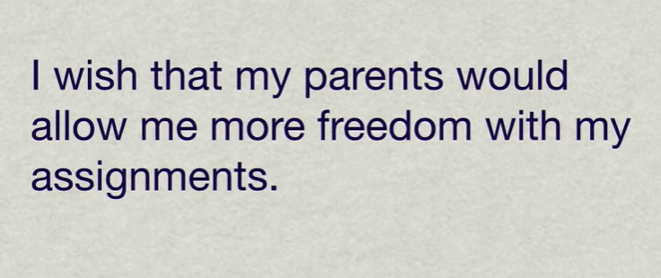
CONCLUDING SENTENCE

Slide 15
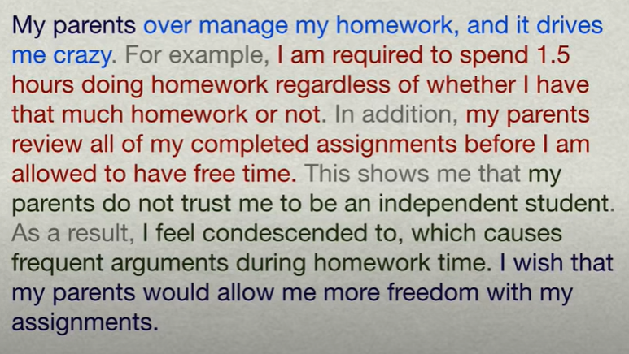
COMPLETE PARAGRAPH

Slide 16
EFFECTIVE PARAGRAPH
Presents single idea
Begins with the topic sentence that makes this single idea evident.
Contains support in the form of sentences that convey this single idea.
Is strategically organized to maintain flow.
Use transition words.
Use of synonyms and antonyms

Slide 17
THANK YOU

