Slide 1
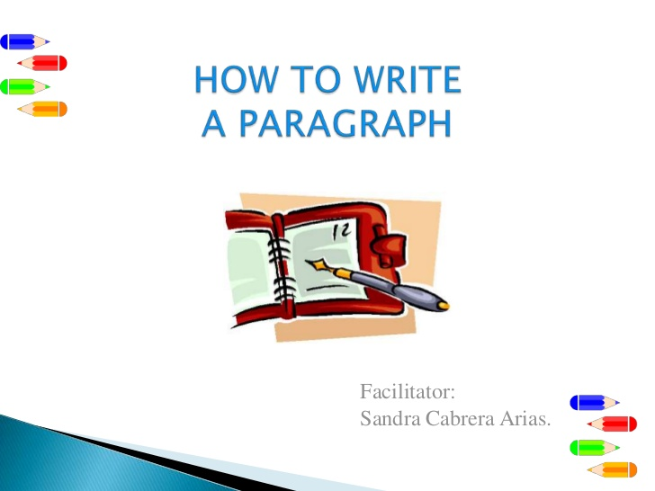
WAYS TO EFFECTIVELY WRITE cohesion and coherence
Week 12

Slide 2

COHESION AND COHERENCE
Cohesion and Coherence is what holds your writing together.
Makes it easy for the reader to understand and follow your train of thought.

Slide 3
COHESION
It creates unity in writing.
It basically links things together:
Example of glue
Within a sentence
Sentence to sentence
Paragraph to Paragraph

Slide 4
HOW TO CREATE COHESION
COHESION: Following tools can be used to create linkages in your sentences.
Transition and linking words/ phrases:
e.g Nevertheless, Admittedly, Having said that, On the contrary, Furthermore etc.
These words shows the reader proper direction. Are you adding, going in opposite direction etc.

Slide 5
HOW TO CREATE COHESION
CONJUNCTIONS:
While, after, even though, Because etc
Words like these create relationship within the sentence and even sentence to sentence.

Slide 6
FUNCTION OF COHESION
Function of cohesion is to make relationships evident and clear to reader that why you put different ideas next to each other.

Slide 7
EXAMPLE
Thus, the benefits of outsourcing particular components in the manufacturing process make sense for many companies in the country.
On the other hand, the benefits are even more pronounced when one takes into consideration ….

Slide 8
EXAMPLE
Thus, the benefits of outsourcing particular components in the manufacturing process make sense for many companies in the country.
On the other hand, the (These)benefits are even more pronounced when one takes into consideration ….

Slide 9
COHERENCE
It’s a more general idea of clarity and balance.
All of the ideas have to work together to create a unified whole of a writing piece.

Slide 10
COHERENCE
Logical, connected flow of ideas.
One paragraph should have one central focus and that central focus should be made very clear in the topic sentence.
Every idea should be connected to the other to make proper understanding of the whole writing material.

Slide 11
COHERENCE
If something has coherence, its parts are well-connected and all heading in the same direction. Without coherence, a discussion may not make sense or may be difficult for the audience to follow.

Slide 12


