Slide 1
TYPES OF WRITING
WEEK 12

Slide 2
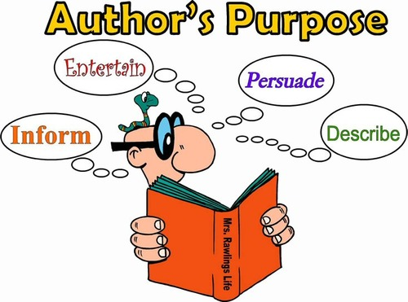
PURPOSE

Slide 3
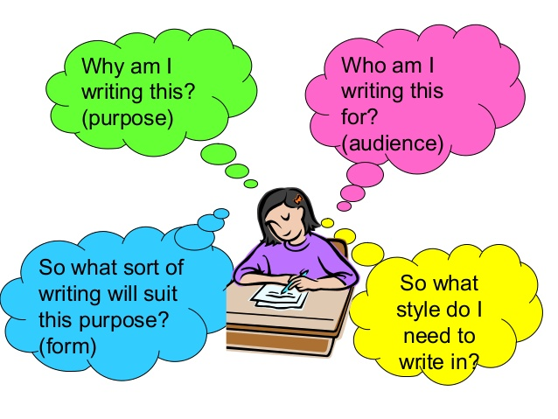
WHAT HELPS IN THE IDENTIFICATION OF TYPE OF WRITING?

Slide 4
TYPES OF WRITING
Persuasive Writing
Expository Writing
Descriptive Writing
Narrative Writing

Slide 5

NARRATIVE WRITING
Main purpose of this writing is to tell a story.
Can be real or imaginary
We can create different characters in this type.
Mostly it answers the question “what happened then”.

Slide 6
NARRATIVE WRITING
Exposition
Rise of Action
Fall of action
Conflict
Climax
Resolution

Slide 7
SOME IMPORTANT TIPS
Be organized.
Include clarity in your writing so the readers can follow your lead.
Include a clear point of view
EXAMPLES :

Slide 8
EXPOSITORY WRITING
Main purpose of this writing is to explain.
It’s a subject-oriented writing style in which authors tell us about specific topic or subject without voicing their personal opinions.
Most common type of writing.

Slide 9
EXPOSITORY WRITING
Usually explains something in a process.
Is often equipped with facts and figures.
Is usually in a logical order and sequence
Examples: Text-book writing, How-to articles, Recipes, some technical writings.

Slide 10
EXPOSITORY WRITING: EXAMPLE
Many people associate the taste of pumpkins with fall. In October, companies from Starbucks to McDonalds roll out their pumpkin-flavored lattes and desserts. Here is how to make an easy pumpkin pie using only five ingredients. First, make sure you have all of the ingredients.

Slide 11
EXPOSITORY WRITING: EXAMPLE
Everyone knows that the best part about fall is all of the pumpkin-flavored desserts. Pumpkin pie is the best fall treat because it is not only delicious but also nutritious. Pumpkin is filled with vitamin A, which is essential for a healthy immune system and good vision.

Slide 12
DESCRIPTIVE WRITING
The primary purpose we achieve through this writing is to describe a person, place or thing in such a way that it creates a picture in reader’s mind.
In this writing in order to capture the event, we involve our g=five senses in order to play close attention.

Slide 13
DESCRIPTIVE WRITING
A good description shows us characteristics, it doesn’t just tell us about them.
For example, what it looks like or how it sounds or tastes.
Poetry, diary writing, nature writing are some good examples.

Slide 14
DESCRIPTIVE WRITING: EXAMPLE
The iPhone 6 is unexpectedly light. While size of its screen is bigger than those of the iPhones that came before, it is thinner, and its smooth, rounded body is made of aluminum, stainless steel, and glass. The casing comes in a whitish silver, gold, or a color the company calls “space gray,” the color of the lead of a pencil, with darker gray accents.

Slide 15
DESCRIPTIVE WRITING: EXAMPLE
So you just brought home a new smartphone. The first thing you will want to do when purchasing a new cell is buy a case. Cracking your screen is an awful feeling, and protection is inexpensive when you compare it to the costs of a new phone.

Slide 16
PERSUASIVE WRITING
Persuasive writing's main purpose is to convince.
It contains opinions of the author.
Contains justifications and reasons.

Slide 17
PERSUASIVE WRITING
Persuasive writing equipped with reasons, arguments and justifications.
In persuasive writing, the author takes a stand and asks you to agree with his or her point of view.
It often asks for readers to do something about the situation. (this is called a call to action)

Slide 18
PERSUASIVE WRITING: EXAMPLE
Following the 2012 Olympic Games hosted in London, the UK Trade and Investment department reported a £9.9 billion boost to the economy. Although it is expensive to host the Olympics, if done right, they can provide real jobs and economic growth. This city should consider placing a bid to host the Olympics

Slide 19
PERSUASIVE WRITING: EXAMPLE
According to legend, the Olympics were founded by Hercules. Now almost 100 countries participate in the Games, with over two million people attending. So cities from Boston to Hamburg begin considering their bid to be a host city more than 10 years in advance.

Slide 20
ARGUMENTATIVE WRITING
A reasoned and logical way of demonstrating that the writer’s position, belief or conclusion is valid.

Slide 21
GENERAL CHARACTERISTICS
Presents evidence for the argument to let the reader know why it is favorable.
Makes claims based on factual evidence.
Often compare ideas to establish a position.
Logic-based

Slide 22
ELEMENTS OF ARGUMENTATION
Claim
Counterclaim
Refutation

Slide 23
THANK YOU

