Slide 1

COMMON SENTENCE ERRORS
Week 13

Slide 2
OUTCOMES
SENTENCE
TYPES ON THE BASIS OF PURPOSE
STRUCTURAL TYPES
COMMON ERRORS.

Slide 3
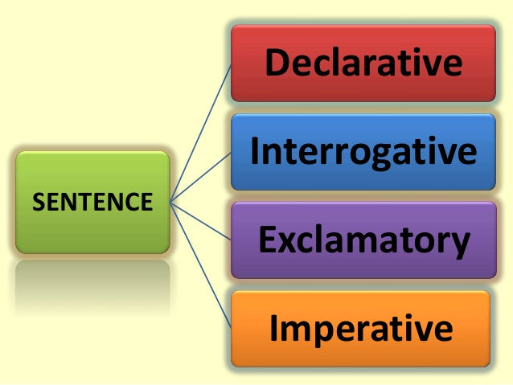
SENTENCE

Slide 4
TYPES
Declarative sentences are in the form of a statement.
Declares or state a fact, arrangement or opinion.
Tells something/ provide information
EXAMPLES:
I’ll meet you in the train station
We have a program in the morning
Interrogative sentences are in the form of a question.
How are you ?
Where are you going ?

Slide 5
TYPES
Exclamatory sentences shows strong feelings, great emotion or excitement
Oh! I forgot about the meeting.
What a beautiful day!
Imperative sentence is the one which expresses command, direction or request.
It tells someone to do something
Be nice to your friends.
Go to the store.
You should study hard

Slide 6
CLAUSE
A group of words, includes a subject and a verb, and forms a sentence or part of the sentence.
I swim.
I like grapes.
We are happy.

Slide 7
TYPES OF CLAUSES
Can stand alone as a sentence.
Expresses a complete thought.
Cannot stand alone a sentence.
Depend on Independent clause for complete meaning.
Independent Clause
Dependent Clause

Slide 8
EXAMPLES
We are happy.
We are going to the store.
After She picks me up, mum is taking me to buy shoes.
When Bill visits, we’ll surprise him with a birthday party.

Slide 9
SIMPLE SENTENCE
Contains a subject and a verb
Contains a complete thought.
One Independent clause.
Example:
The cat ate my sandwich.
I like to play cricket.

Slide 10
COMPOUND SENTENCE
Two or more independent clauses join together to make a compound sentence.
Or, two or more simple sentences join together with the help of conjunction they make a compound sentence.
Example
She dictated, and I typed.
I cooked dinner and he washed the dishes.

Slide 11
COMPLEX SENTENCE
One independent clause and one dependent clause.
Example
Because he wanted to earn money, he went abroad.
When the cake is brown, take it out of the oven.

Slide 12
WHAT IS A Modifier?
Describes some other word or phrase in a sentence.
Any kind of description that we don’t necessarily need but just make the sentence more specific.

Slide 13
EXAMPLE
Amy’s favorite red purse, the one she always carries, was stolen last week.
Amy’s favorite red: describes the purse
Always: describes the verb carries
Last: describes week
The one she always carries: a descriptive phrase, describes ‘purse’.

Slide 14
Modifiers
Words, phrases or clauses that provide description in sentences.

Slide 15

EXAMPLES (WORD MODIFIER)
The bicycle.
The new bicycle.
The cool, new bicycle.
He rides his bicycle.
He rarely rides his bicycle.
WORDS

Slide 16
EXAMPLES (PHRASE MODIFIER )
The bicycle in the hallway.
He sat on the broom.
PHRASE

Slide 17
EXAMPLES (CLAUSE MODIFIER )
He came when the moon appeared.
After visiting minar-e-Pakistan, Bill was so happy.

Slide 18
TYPES OF Modifiers
MISPLACED MODIFIERS
DANGLING MODIFIERS

Slide 19
MISPLACED MODIFIER
A misplaced modifier is a problem with the word order.
A modifier in the wrong place.
Can affect the meaning of the sentence.

Slide 20
EXAMPLE of MISPLACED MODIFIER
They only want to grow tomatoes in their garden.

Slide 21
EXAMPLE of MISPLACED MODIFIER
They want to only grow tomatoes in their garden.
They don’t want to eat tomatoes in the garden.
They don’t want to smell tomatoes in the garden.
They want to grow only tomatoes in their garden.

Slide 22
EXAMPLE # 2
There was a book on the shelf that I hadn’t seen since my childhood.

Slide 23
EXAMPLE # 2 solution
On the shelf there was a book that I hadn't seen since my childhood.
(Make your sentence as clear as possible)

Slide 24
SOME TIPS TO AVOID THESE MISTAKES
Find the modifiers in your sentence.
Find the thing they are modifying.
Does the position of the modifier make the meaning unclear?
Is your modifier as close as possible to the thing it is modifying?

Slide 25
DANGLING MODIFIER
When a modifying word, phrase or clause has nothing to modify in the sentence. That’s why doesn’t fit logically in the sentence.

Slide 26
EXAMPLE # 1
Walking down the beach, the sunset was beautiful.

Slide 27
EXAMPLE # 1 SOLUTION
While I was walking down the beach, the sunset was beautiful.

Slide 28
EXAMPLE # 2
Sitting by the fire, the marshmallows were roasting nicely.
Sitting by the fire, the campers were roasting marshmallows.

Slide 29
PARALLELISM
Balance between ideas in a sentence.
Grammatical balance between ideas.
If you have series of ideas in a sentence, you have to match
Nouns with nouns
Verbs with verbs
Clauses with clauses etc.

Slide 30
EXAMPLE # 1
Three things that makes me happy are playing with my kids , a good cup of coffee, and when I discover new music.

Slide 31
EXAMPLE (SOLUTION)
Three things that makes me happy are playing with my kids, drinking a cup of coffee and discovering new music.

Slide 32
EXAMPLE # 2
Employees should be treated fairly and with respect.

Slide 33
EXAMPLE (SOLUTION)
Employees should be treated fairly and respectfully.
Employees should be treated with fairness and with respect.

Slide 34
EXAMPLE # 3
She likes to read but not write.
She likes to read but not to write.

Slide 35
RUN-ON SENTENCES
Strings of multiple complete sentences without sufficient punctuation.
Putting too many sentences together without proper words or punctuation.
Two independent clauses connected without proper punctuation.

Slide 36
EXAMPLE
The weather in summer is beautiful here people come from all over the world to enjoy the beaches.

Slide 37
Solutions
The weather in summer is beautiful here. People come from all over the world to enjoy the beaches.
The weather in summer is beautiful here, and people come from all over the world to enjoy the beaches.

Slide 38
Example # 2
In my country is very cold in winters.

Slide 39
Solution
In my country, it is very cold in winters.

