Slide 1
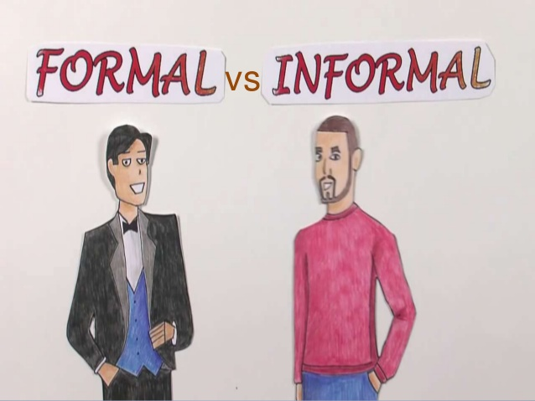
FORMAL VS INFORMAL WRITING
WEEK 4
Dania Anwar

Slide 2
LEARNING OUTCOMES
WHY is it important to know the style according to situation.
WHAT two major factors must take in consideration while writing/communicating.
COMAPARISON between Formal and Informal writing.

Slide 3

BACKGROUND KNOWLEDGE
Think about how do you communicate in different situations?
Do you use same tone, words, phrases, attitude to communicate with your friends, family or teacher, boss ?

Slide 4
WHY ?
Those who do not know how to communicate in different situations?
Are unable to influence people.
Are not able to get desired attention from listeners for proper understanding.

Slide 5
WHY ?
Better communication skills not only help to deliver your message but it also helps to understand others and learn things in a better way.

Slide 6
KNOW YOUR AUDIENCE
When we communicate with others, we need to consider with whom we are communicating. That person or persons are our audience.

Slide 7
EXAMPLES
Use Formal Writing When:
Writing professionally (reaching out to a client or prospect)
Academic writings (essays, research papers, etc.)
Job applications (resume writing, CVs, and cover letters)
Reaching out to someone you do not know.
Use Informal Writing When:
Writing to a friend
Sharing a story or writing a personal blog
Instructed to do so (if in school)
Writing dialogue and conversations
Writing an outline

Slide 8
KNOW YOUR PURPOSE
When we are communicating, we also need to think about our purpose for communicating.
Sometimes we communicate to entertain
Sometimes we communicate to inform
Sometimes we communicate to persuade

Slide 9
AUDIENCE & PURPOSE
To determine whether we should communicate informally or formally, we combine what we know about BOTH our audience and the purpose for our communication. Then, we pick the style that we think will best open our audience up to listen to our ideas.

Slide 10
AUDIENCE & PURPOSE
Generally, communication with friends and relatives should be informal. Communication with strangers, people in authority, or co-workers is most often formal.
However, communication with a purpose to entertain is usually informal regardless of the audience.
There are also a few times when it may be better to use an informal style of communication to persuade or inform strangers, people in authority, or co-workers. These times would be when you are informing or persuading them about something that is not a serious issue or topic.

Slide 11
AUDIENCE & PURPOSE
Here are some general examples. Remember, there are exceptions to the general rules.
Audience | Purpose | Best Style to Use
Friends | Entertain | Informal
Teacher | Inform | Formal
Parents | Inform | Informal
Stranger(s) | Inform | Formal
Principal | Persuade | Formal
Friends | Inform | Informal
Stranger(s) | Persuade | Formal

Slide 12
FORMAL VS. INFORMAL WRITING
So, what is the difference between formal and informal writing?
We will discuss by comparing them.

Slide 13
FORMAL WRITING STYLE | INFORMAL WRITING STYLE
1. The tone is polite, but impersonal | The tone is more personal
2. Avoids using contractions and slang | Freely uses contractions and slang
3. Avoids using abbreviations | Freely uses abbreviations
4. Maintains a serious tone | May use humor or more casual tone
5. Uses proper punctuation and capitalization | Do not use proper punctuation and capitalization
6. Avoids using first and second person pronouns (I, you, we, and me). Often uses “one” or “the reader” instead. | Freely uses first and second person pronouns

Slide 14
FORMAL WRITING STYLE | INFORMAL WRITING STYLE
7. Sentence structure tends to be varied and includes lengthy and complex sentences | Sentence structure tends to be shorter; writing approximates the structure and rhythm of spoken English
8. Word choice tends to be precise or technical | Word choice may be more vague; colloquial phrases may be used
9. Found most often in scholarly books and articles, technical reports, research papers, and legal documents | Found most often in personal e-mail and in some business correspondence, nonfiction books of general interest, and mass-circulation magazines

Slide 15
Formal vs. Informal Writing
Formal Writing Style | Informal Writing Style
The tone is polite, but impersonal | The tone is more personal
Examples:
Formal
To Whom it May Concern,
Many people enjoy amusement parks.
Studies show many people spend too much time on the computer.
Informal
Dear Grandma,
You like amusement parks, right?
Do you spend too much time on the computer like many people do?

Slide 16
Formal vs. Informal Writing
Formal Writing Style | Informal Writing Style
Avoids using contractions and slang | Freely uses contractions and slang
Examples:
Formal
It is important to do homework.
Going to an amusement park was a thrilling experience.
It does not take a genius to figure this out.
Informal
It’s important to do homework.
Going to an amusement park was cool!
It doesn’t take a genius to get this.

Slide 17
Formal vs. Informal Writing
Formal Writing Style | Informal Writing Style
Maintains a serious tone | May use humor or more casual tone
Examples:
Formal
Thank you for sending the package. It was a thoughtful thing to do.
A person should want others to take time to read what they write.
Informal
Thanks for the cool package.
Who would be crazy enough to write something that nobody reads?

Slide 18
Formal vs. Informal Writing
Formal Writing Style | Informal Writing Style
Avoids using first and second person pronouns (I, you, we, and me). Often uses “one” or “the reader” instead. | Freely uses first and second person pronouns
Examples:
Formal
When one is preparing to cook, washing one’s hands should be step one.
The author advises the reader not to judge a book by its cover.
Informal
When you are preparing to cook, wash your hands first.
I think that you should not judge a book by its cover.

Slide 19
Formal vs. Informal Writing
Formal Writing Style | Informal Writing Style
Sentence structure tends to be varied and includes lengthy and complex sentences | Sentence structure tends to be shorter; writing approximates the structure and rhythm of spoken English
Examples:
Formal
The lunch served in the cafeteria today was not very appetizing. The food was over cooked, smelled terrible, and tasted awful. Instead of serving students substandard food, the school should look into bringing in food from a caterer or local restaurant if at all possible.
Informal
Lunch in the cafeteria today was nasty. It looked, smelled, and tasted bad. The school shouldn’t serve nasty food like that. They should bring in food from a restaurant or something.

Slide 20
Formal vs. Informal Writing
Formal Writing Style | Informal Writing Style
Word choice tends to be precise or technical | Word choice may be more vague; colloquial phrases may be used
Examples:
Formal
The lunch served in the cafeteria today was not very appetizing. The food was over cooked, smelled terrible, and tasted awful. Instead of serving students substandard food, the school should look into bringing in food from a caterer or local restaurant if at all possible.
Informal
Lunch in the cafeteria today was nasty. It looked, smelled, and tasted bad. The school shouldn’t serve nasty food like that. They should bring in food from a restaurant or something.

Slide 21

IDENTIFY

Slide 22

IDENTIFY

Slide 23
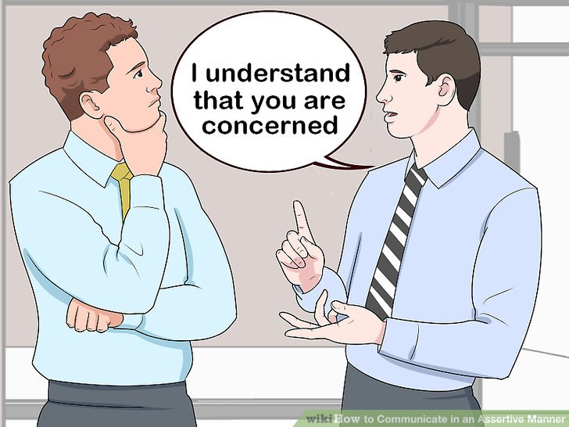
IDENTIFY

Slide 24

IDENTIFY

