Slide 1
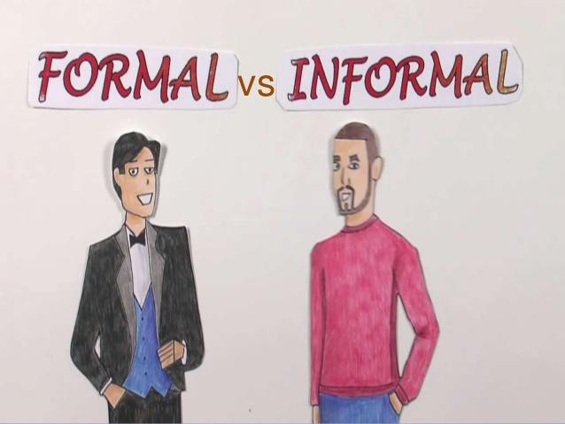
FORMAL VS INFORMAL WRITING
WEEK 4
ACTIVITIES

Slide 2
ACTIVITY # 1

Slide 3
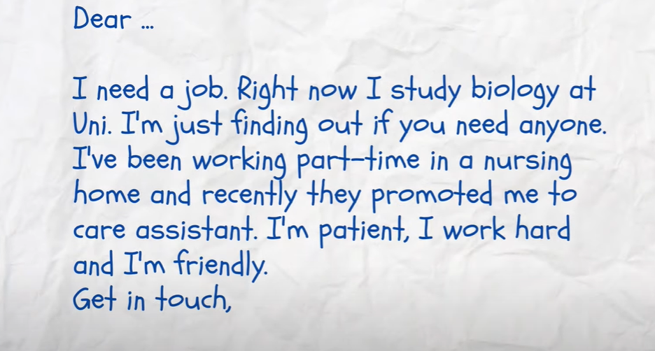
IDENTIFY THE STYLE AND CHANGE IT INTO OTHER WAY

Slide 4
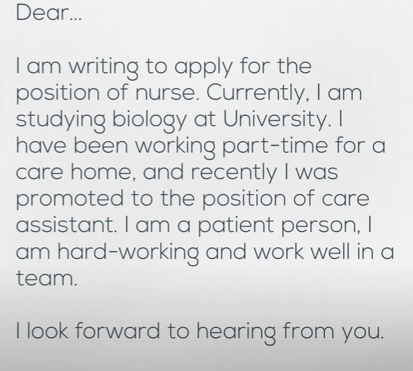
SOLUTION

Slide 5
ACTIVITY # 2

Slide 6
IDENTIFY THE STYLE AND CHANGE IT INTO OTHER WAY
Abraham Lincoln was a great president because he always spoke his mind, fought for civil rights, and wore fabulous hats. I would have voted for him.

Slide 7
SOLUTION
Abraham Lincoln was a great president cuz he'd always speak his mind, fight for civil rights, and wear fab hats. i would've voted for him.
1. two contractions: he'd, fab
2. two capitalizations: lincoln, i
3. two text talk, simplified langage: fab, cuz

Slide 8
ACTIVITY # 3

Slide 9
CHANGE THESE SENTENCES INTO FORMAL ONE
Grab me another slice of pizza.
Gimme the book!
I can’t wait to go camping this weekend!
My family and I had a very pleasant weekend at the beach.

Slide 10
SOLUTION
Can I please have another slice of pizza?
Please hand me that book.
I am looking forward to go camping in the Everglades this weekend.
We had the best time ever!

Slide 11
ACTIVITY # 4

Slide 12
PHRASAL VERBS
Phrasal verbs are very common in spoken English. However, they’re usually less formal than their one-word verb equivalents. In formal writing, writers often prefer to use single-word verbs, such as examine or devise, rather than phrasal verbs, such as look at or come up with.

Slide 13
PHRASAL VERBS
PHRASAL VERBS | ONE WORD EQUIVALENT
Ask for
Go ahead
Set up
Deal with
Find out
Go on
Go away

Slide 14
SOLUTION
PHRASAL VERBS | ONE WORD EQUIVALENT
Ask for | request
Go ahead | proceed
Set up | establish
Deal with | handle
Find out | Discover
Go on | Continue
Go away | Depart

Slide 15
CHANGE THE FOLLOWING BY USING ONE WORD EQUIVALENT
1. A primary education system was set up throughout Ireland as early as 1831.
2. This will cut down the amount of drug required and so the cost of treatment.
3. The material amenities of life have gone up in Western society.
4. The press reflected the living culture of the people; it could influence opinion and reinforce existing attitudes but it did not come up with new forms of entertainment.
5. Thus, he should have looked into how the patient has coped previously.

Slide 16
SOLUTION
1. A primary education system was established throughout Ireland as early as 1831
2. This will reduce the amount of drug required and so the cost of treatment.
3. The material amenities of life have increased in Western society.
4. The press reflected the living culture of the people; it could influence opinion and reinforce existing attitudes but it did not create new forms of entertainment.
5. Thus, he should have investigated how the patient has coped previously.

Slide 17
THANK YOU

