Slide 1
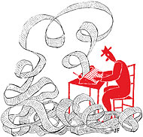
Personal writings
WEEK 8

Slide 2
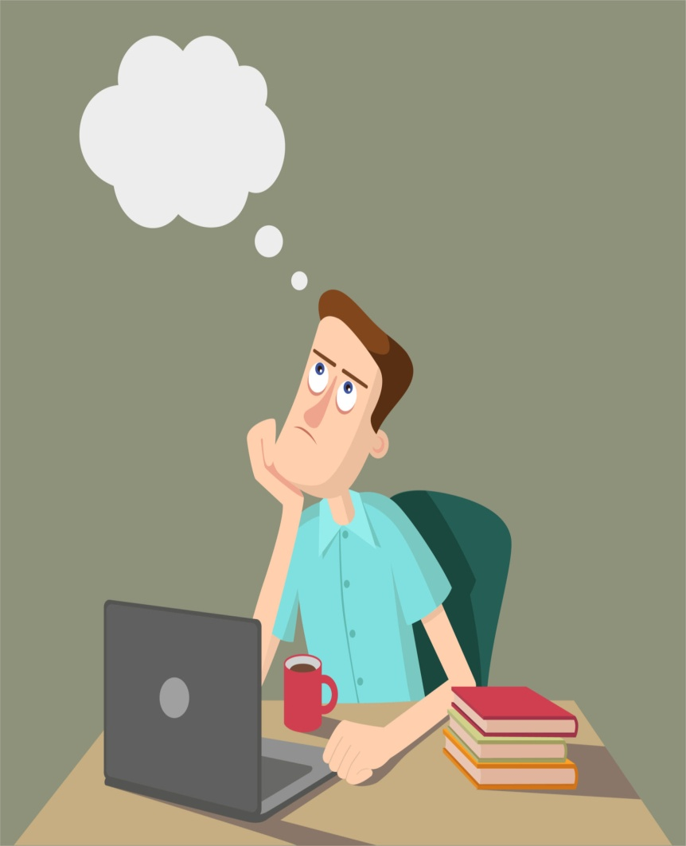
THINK AND CREATE.

Slide 3
DEFINITION
Personal writings varies by topics and genres, however generally it can be defined as :
A piece of writing that can be based on an experience that results in a lesson you have been through. Primarily it contains subjective responses- an individual reactions to something, an event, a person, place, concept usually without the use of any other resources.

Slide 4
PERSONAL WRITINGS
The construct of personal theories is put forward as an innovative pedagogical tool for connecting theory to practice through reflective writing.

Slide 5
CHARACTERISTICS
Real. Reflections of your life events
e. g Writing stories that you experienced and writing things that are personal to you.
Personal insights and beliefs
e.g Writing on some topics that are reflective of your personal feelings and emotions related the subject matter.

Slide 6
CHARACTERISTICS
Experiences you have had and relevant experiences
e.g Writing about the events or any experience that you have had in the past that can be pleasant or sad.
Something that affected you deeply
e.g writing about something that changed your life and your whole point of view

Slide 7
CHARACTERISTICS
Personal achievements
e.g writing to tell your personal story or any previous achievements.
Exploring aspects of your life
e.g can be used to create a personal identity or to present your personal perspective regarding different aspects of life.

Slide 8
WRITE ABOUT YOURSELF [WRITING PROMPT]
PRACTICE
For this writing practice, use the following creative writing prompt:
Write about yourself. Describe yourself, your surroundings, your frame of mind, your emotional state, but write it all in the third person (he/she, not I/me).
Write for fifteen minutes. When you’re finished, share.
Happy writing!

Slide 9
EXAMPLE
He sits where he always sits. In the corner by wall where he can sip his coffee and watch the others on their business meetings or coffee dates. He writes or else intends to write while he checks facebook and his email until overcome by guilt to actually write. He used to relish these moments, the coffee shop moments, they were easy afternoons full of artistic feeling. He was doing it. Finally doing it. But then life continues and the coffee became the office and writing became, as all activity eventually becomes, work. It was good work, work he was good at, but still. Work. He wonders if it will amount to anything.
There are some days when he sits, watching the people, listening to some semi-obscure band, and something clicks and he is overcome by gratefulness. “Thank you. Thank you. Thank you for this life.” Or on a spring day when the buds are in the trees and he walks in the town square, brainstorming or talking to a business contact, and he marvels that he is alive and gets to experience moments such as these. “Thank you. Thank you,” he whispers under his breath. But most of the time, at his best, he is only able to say, “Thank you for the pain. Thank you for the toil. Thank you for the confusion and boredom and hopes not achieved, not achieved yet.” The problem with desire is that you either have too much or too little, rarely just enough.

Slide 10
TONE
Personal writing does not have to be serious or depressing. The writing style signifies the style of the writer.
Tone is basically the way the author expresses his attitude through his writing.
Tone in writing is not much different than the tone of our voice.
Every adjective or verb that is used, the sentence structure and the imagery will show the tone of the writer.

Slide 11
IDENTIFY TONE
The extract is from a story. Read carefully and identify the tone of the writing.
And the trees all died. They were orange trees. I don’t know why they died, they just died. Something wrong with the soil possibly or maybe the stuff we got from the nursery wasn’t the best. We complained about it. So we’ve got thirty kids there, each kid had his or her own little tree to plant and we’ve got these thirty dead trees. All these kids looking at these little brown sticks, it was depressing.

Slide 12
IDENTIFY
2nd Extract
Read carefully and identify the tone of this extract.

Slide 13
But I feel peaceful. Your success in the ring this morning was, to a small degree, my success. Your future is assured. You will live, secure and safe, Wilbur. Nothing can harm you now. These autumn days will shorten and grow cold. The leaves will shake loose from the trees and fall. Christmas will come, and the snows of winter. You will live to enjoy the beauty of the frozen world, for you mean a great deal to Zuckerman and he will not harm you, ever. Winter will pass, the days will lengthen, the ice will melt in the pasture pond. The song sparrow will return and sing, the frogs will awake, the warm wind will blow again. All these sights and sounds and smells will be yours to enjoy, Wilbur—this lovely world, these precious days..."

Slide 14
ACTIVITY # 2 : SIX WORD STORY
Six-word stories are a great way to practice your writing without actually having to write much. They can also be used to warm up before working on a novel or short story.
“For sale: baby shoes, never worn.”
A great website you can use is sixwordstories.net.

Slide 15
PROMPTS FOR SIX WORD STORY
Was famous once, but died young
Free time, wasted time, no time.
Sealed letters that still remain unopened.(six word story)
I will color the world tomorrow.
I've found the meaning of life!
Dreamed of tomorrow. Forgot about today.

Slide 16
EXAMPLE OF PERSONAL WRITING
PERSONAL NARRATIVE
It’s all about you. Reflective writing
It includes:
Main character which is you.
Describes an event or experience.
Includes a personal reaction, comments and observation.

Slide 17
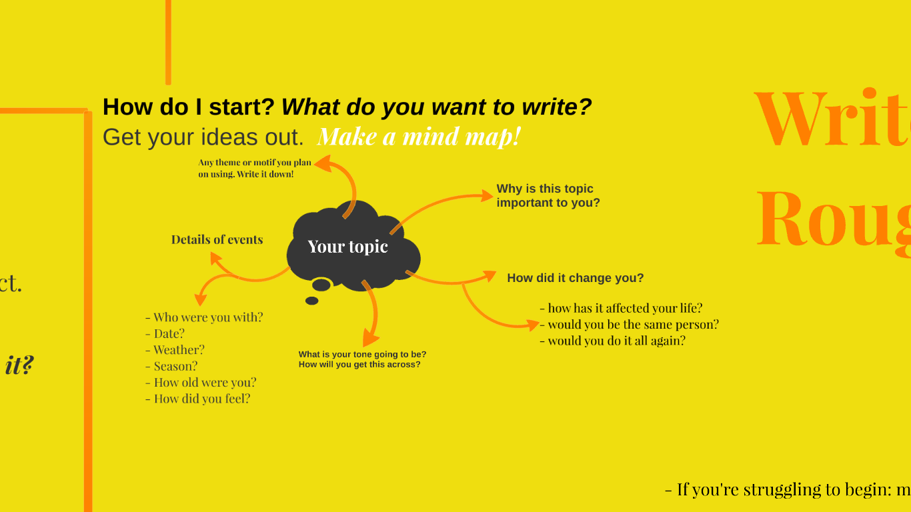
ACTIVITY # 3

Slide 18
HOME TASK
Read examples of personal writings.
You have to analyze how the writer has incorporated tone, imagery, word choice, sentence structure, punctuation and various other techniques into their writings?
Judge it: was it good, what made it good ? Was it bad? What made it bad? Justify why you think the writer did well or not? What could they have done differently?

