Slide 1
Chapter 1
Introducing C
When someone says “I want a programming language in which I need only say what I wish done,” give him a lollipop.
Copyright © 2008 W. W. Norton & Company.
All rights reserved.

Slide 2
Origins of C
C is a by-product of UNIX, developed at Bell Laboratories by Ken Thompson, Dennis Ritchie, and others.
Thompson designed a small language named B.
B was based on BCPL, a systems programming language developed in the mid-1960s.
Copyright © 2008 W. W. Norton & Company.
All rights reserved.
Notes:
-Unix was written in assembly language
-the experience motivated need for a higher-level language
- BCPL ("Basic Combined Programming Language"

Slide 3
Assembly vs. Machine Code
Machine code: set of instructions executed directly by a computer's central processing unit (CPU).
Assembly language: low-level programming language in which there is a very strong (generally one-to-one) correspondence between the language and the architecture's machine code instructions.
Copyright © 2008 W. W. Norton & Company.
All rights reserved.
Notes:
-Each assembly language is specific to a particular computer architecture.
-In contrast, most high-level programming languages are generally portable across multiple architectures but require interpreting or compiling. Assembly language may also be called symbolic machine code.
-Assembly language is converted into executable machine code by a utility program referred to as an assembler. The conversion process is referred to as assembly, or assembling the source code.
-Assembly time is the computational step where an assembler is run.
-Assembly language uses a mnemonic to represent each low-level machine instruction or opcode, typically also each architectural register, flag, etc.

Slide 4
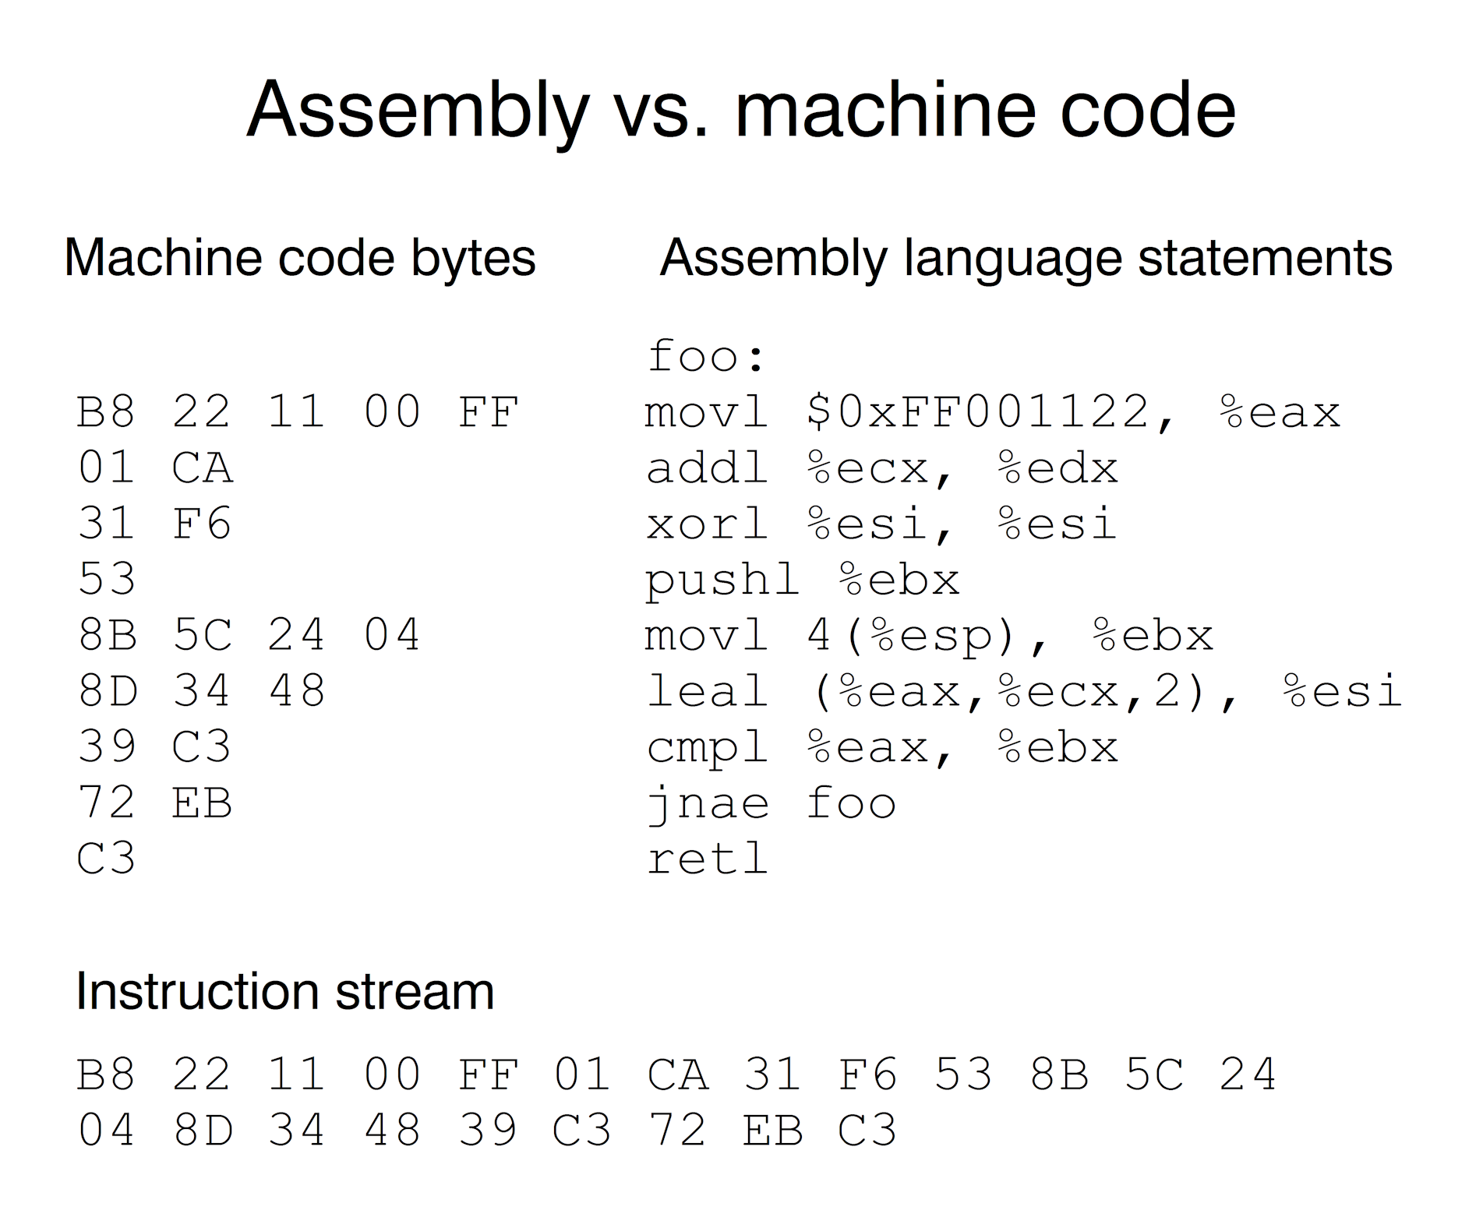

Copyright © 2008 W. W. Norton & Company.
All rights reserved.
Notes:
-Online disassembler service: https://www.onlinedisassembler.com/static/home/
-foo: Foo (pronounced FOO) is a term used by programmers as a placeholder for a value that can change, depending on conditions or on information passed to the program.(https://searchapparchitecture.techtarget.com/definition/foo-in-software-programming)

Slide 5
Origins of C
By 1971, Ritchie began to develop an extended version of B.
He called his language NB (“New B”) at first.
As the language began to diverge more from B, he changed its name to C.
The language was stable enough by 1973 that UNIX could be rewritten in C.
Copyright © 2008 W. W. Norton & Company.
All rights reserved.

Slide 6
Standardization of C
K&R C
  Described in Kernighan and Ritchie, The C Programming Language (1978)
  De facto standard
C89/C90
  ANSI standard X3.159-1989 (completed in 1988; formally approved in December 1989)
  International standard ISO/IEC 9899:1990
C99
  International standard ISO/IEC 9899:1999
  Incorporates changes from Amendment 1 (1995)
Copyright © 2008 W. W. Norton & Company.
All rights reserved.
Notes:
-Compilers produced for other machines.
-The compiler dilemma – K&R was fuzzy about certain topics and different compilers treated them differently. Ergo need for standardization.
-Otherwise portability would be negatively affected.

Slide 7
C-Based Languages
C++ includes all the features of C, but adds classes and other features to support object-oriented programming.
Java is based on C++ and therefore inherits many C features.
C# is a more recent language derived from C++ and Java.
Perl has adopted many of the features of C.
Copyright © 2008 W. W. Norton & Company.
All rights reserved.
Notes:
-In object-oriented programming, a class is an extensible program-code-template for creating objects, providing initial values for state (member variables) and implementations of behavior (member functions or methods).
-When an object is created by a constructor of the class, the resulting object is called an instance of the class, and the member variables specific to the object are called instance variables, to contrast with the class variables shared across the class.
-Analogous to philosophical conception of categories.
-C# - Microsoft vs. Java (http://www.javaworld.com/article/2074908/sun--microsoft-settle-java-lawsuit.html)

Slide 8
Properties of C
Low-level
Small
Permissive
Copyright © 2008 W. W. Norton & Company.
All rights reserved.
Notes:
-Higher level languages *hide* machine-level concepts
-Provides limited set of features compared to other languages (spec in K&R = 49 pages)
-Comparatively little abstraction
-Relies on “libraries” – which build on standard features
-C assumes you know what you are doing

Slide 9
Strengths of C
Efficiency
Portability
Power
Flexibility
Standard library
Integration with UNIX
Copyright © 2008 W. W. Norton & Company.
All rights reserved.
Notes:
-Efficiency – quick, effective, requiring limited resources
-Thanks to UNIX association – and standardization
-Large collection of data types and operators
-Flexible – used for a variety of applications, e.g. embedded systems to commercial data processing
-Very powerful standard libraries

Slide 10
Weaknesses of C
Programs can be error-prone.
Programs can be difficult to understand.
Programs can be difficult to modify.
Copyright © 2008 W. W. Norton & Company.
All rights reserved.
Notes:
-Other languages specifically designed to avoid C mistakes
-Flip side of C’s power and freedom and flexibility
-With great power comes great responsibility…
-C was designed specifically for programmers in a time when there was very little interactive computing
-International Obfuscated C Code Contest – www.ioccc.org
-Modern languages support maintenance far better – not a concern in C’s time

Slide 11
Effective Use of C
Learn how to avoid pitfalls.
Use software tools (lint, debuggers) to make programs more reliable.
Take advantage of existing code libraries.
Adopt a sensible set of coding conventions.
Avoid “tricks” and overly complex code.
Stick to the standard.
Copyright © 2008 W. W. Norton & Company.
All rights reserved.

Slide 12

Bugs and Debugging
Copyright © 2008 W. W. Norton & Company.
All rights reserved.

