Slide 1
Chapter 2
C Fundamentals
Copyright © 2008 W. W. Norton & Company.
All rights reserved.

Slide 2
Program: Printing a Pun
#include <stdio.h>
int main(void)
{
printf("To C, or not to C: that is the question.\n");
return 0;
}
This program might be stored in a file named pun.c.
The file name doesn’t matter, but the .c extension is often required.
Copyright © 2008 W. W. Norton & Company.
All rights reserved.
Notes:
-Pun: a joke exploiting the different possible meanings of a word or the fact that there are words that sound alike but have different meanings.
-""you can make your own antifreeze by stealing her blanket" is a pun guaranteed to get some groans“
UNIX and MULTICS : A pun on Multics to sound like eunuchs, as Unix was considered to be an emasculated Multics (see multi- and uni-). Probably coined by Brian Kernighan in 1970.

Slide 3
Compiling and Linking
Before a program can be executed, three steps are usually necessary:
  Preprocessing. The preprocessor obeys commands that begin with # (known as directives)
  Compiling. A compiler then translates the program into machine instructions (object code).
  Linking. A linker combines the object code produced by the compiler with any additional code needed to yield a complete executable program.
The preprocessor is usually integrated with the compiler.
Copyright © 2008 W. W. Norton & Company.
All rights reserved.
Notes:
-Preprocessor – a bit like an editor – putting a stamp on paperwork, paperwork for a courier parcel, etc.

Slide 4
Compiling and Linking Using cc
To compile and link the pun.c program under UNIX, enter the following command in a terminal or command-line window:
% cc pun.c
The % character is the UNIX prompt.
Linking is automatic when using cc; no separate link command is necessary.
Copyright © 2008 W. W. Norton & Company.
All rights reserved.

Slide 5
Compiling and Linking Using cc
After compiling and linking the program, cc leaves the executable program in a file named a.out by default.
The -o option lets us choose the name of the file containing the executable program.
The following command causes the executable version of pun.c to be named pun:
% cc -o pun pun.c
Copyright © 2008 W. W. Norton & Company.
All rights reserved.

Slide 6
The GCC Compiler
GCC is one of the most popular C compilers.
GCC is supplied with Linux but is available for many other platforms as well.
Using this compiler is similar to using cc:
% gcc -o pun pun.c
Copyright © 2008 W. W. Norton & Company.
All rights reserved.
Notes:
-Alternative option for Windows: http://www.mingw.org/

Slide 7
Integrated Development Environments
An integrated development environment (IDE) is a software package that makes it possible to edit, compile, link, execute, and debug a program without leaving the environment.
For starters – online IDEs!
Copyright © 2008 W. W. Norton & Company.
All rights reserved.
Notes:
-Convenient!
-https://www.jdoodle.com/c-online-compiler
-https://www.onlinegdb.com/online_c_compiler

Slide 8
The General Form of a Simple Program
Simple C programs have the form
directives
int main(void)
{
statements
}
Copyright © 2008 W. W. Norton & Company.
All rights reserved.

Slide 9
The General Form of a Simple Program
C uses { and } in much the same way that some other languages use words like begin and end.
Even the simplest C programs rely on three key language features:
  Directives
  Functions
  Statements
Copyright © 2008 W. W. Norton & Company.
All rights reserved.

Slide 10
Directives
Before a C program is compiled, it is first edited by a preprocessor.
Commands intended for the preprocessor are called directives.
Example:
#include <stdio.h>
<stdio.h> is a header containing information about C’s standard I/O library.
Copyright © 2008 W. W. Norton & Company.
All rights reserved.
Notes:
-https://en.wikipedia.org/wiki/Prime_Directive
-I/O = input/output
-C has no built-in input/output functions
Inputs – keyboard
Outputs – display, audio
-Wikipedia link - https://en.wikipedia.org/wiki/C_file_input/output#gets
-WITH ANGULAR BRACKETS – e.g. #include<stdio.h> -This is used when we want to check the default folder (generally the bin/include folder) for the .h file.
-If you have created a separate .h file and which is in the same folder ,as the source code , then you can use #include”headername.h” .It forces the compiler to first search in the same folder and then into the default folder .

Slide 11
Directives
Directives always begin with a # character.
By default, directives are one line long; there’s no semicolon or other special marker at the end.
Copyright © 2008 W. W. Norton & Company.
All rights reserved.

Slide 12
Functions
A function is a series of statements that have been grouped together and given a name.
Some functions compute a value, others undertake a task
Library functions are provided as part of the C implementation.
A function that computes a value uses a return statement to specify what value it “returns”:
return x + 1;
Copyright © 2008 W. W. Norton & Company.
All rights reserved.
Notes:
-building blocks of a program, subroutines!
-example of task – print to screen!
-give this a name? function (increment-by-one) -- > f(y) = x+1
-analogous to use of functions in mathematics
-some functions in C compute values, others do a task
-e.g. abstract the role of individual components and steps and combine everything into an overall purpose or function

Slide 13
The main Function
The main function is mandatory.
main is special: it gets called automatically when the program is executed.
main returns a status code; the value 0 indicates normal program termination.
If there’s no return statement at the end of the main function, many compilers will produce a warning message.
Copyright © 2008 W. W. Norton & Company.
All rights reserved.
Notes:
Think of main as a ‘default task’
-Status code returned to OS – normal program termination
-int main (void)
-int – main function returns an integer value
-void – main has no arguments

Slide 14
Statements
A statement is a command to be executed when the program runs.
pun.c uses only two kinds of statements. One is the return statement; the other is the function call.
Asking a function to perform its assigned task is known as calling the function.
pun.c calls printf to display a string:
printf("To C, or not to C: that is the question.\n");
Copyright © 2008 W. W. Norton & Company.
All rights reserved.

Slide 15
Statements
C requires that each statement end with a semicolon.
  There’s one exception: the compound statement.
Directives are normally one line long, and they don’t end with a semicolon.
Copyright © 2008 W. W. Norton & Company.
All rights reserved.
Notes:
-Why semicolon? So that compiler knows where the statement ends. Analogous to use of full stop or period in English.
-Why use semi-colon? Probably because period is used as decimal point!
-Unlike directives – which are one line long by default – no semicolon needed

Slide 16
Printing Strings
When the printf function displays a string literal—characters enclosed in double quotation marks—it doesn’t show the quotation marks.
printf doesn’t automatically advance to the next output line when it finishes printing.
To make printf advance one line, include \n (the new-line character) in the string to be printed.
Copyright © 2008 W. W. Norton & Company.
All rights reserved.
Notes:
-String literal = sentence

Slide 17
Printing Strings
The statement
printf("To C, or not to C: that is the question.\n");
could be replaced by two calls of printf:
printf("To C, or not to C: ");
printf("that is the question.\n");
The new-line character can appear more than once in a string literal:
printf("Brevity is the soul of wit.\n --Shakespeare\n");
Copyright © 2008 W. W. Norton & Company.
All rights reserved.

Slide 18
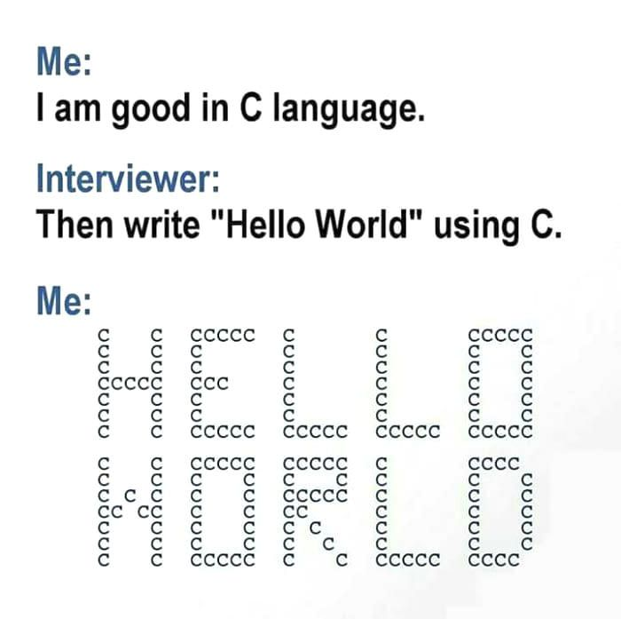
Copyright © 2008 W. W. Norton & Company.
All rights reserved.

Slide 19
Comments
A comment begins with /* and end with */.
/* This is a comment */
Comments may appear almost anywhere in a program, either on separate lines or on the same lines as other program text.
Comments may extend over more than one line.
/* Name: pun.c
Purpose: Prints a bad pun.
Author: K. N. King */
Copyright © 2008 W. W. Norton & Company.
All rights reserved.
Notes:
-Documentation! Authorship, purpose, function, etc.
-Have to be specially marked so that they are ignored by the compiler

Slide 20
Comments
Warning: Forgetting to terminate a comment may cause the compiler to ignore part of your program:
printf("My "); /* forgot to close this comment...
printf("cat ");
printf("has "); /* so it ends here */
printf("fleas");
Copyright © 2008 W. W. Norton & Company.
All rights reserved.
Notes:
-Output – “My fleas”

Slide 21
Comments in C99
In C99, comments can also be written in the following way:
// This is a comment
This style of comment ends automatically at the end of a line.
Advantages of // comments:
  Safer: there’s no chance that an unterminated comment will accidentally consume part of a program.
  Multiline comments stand out better.
Copyright © 2008 W. W. Norton & Company.
All rights reserved.

Slide 22
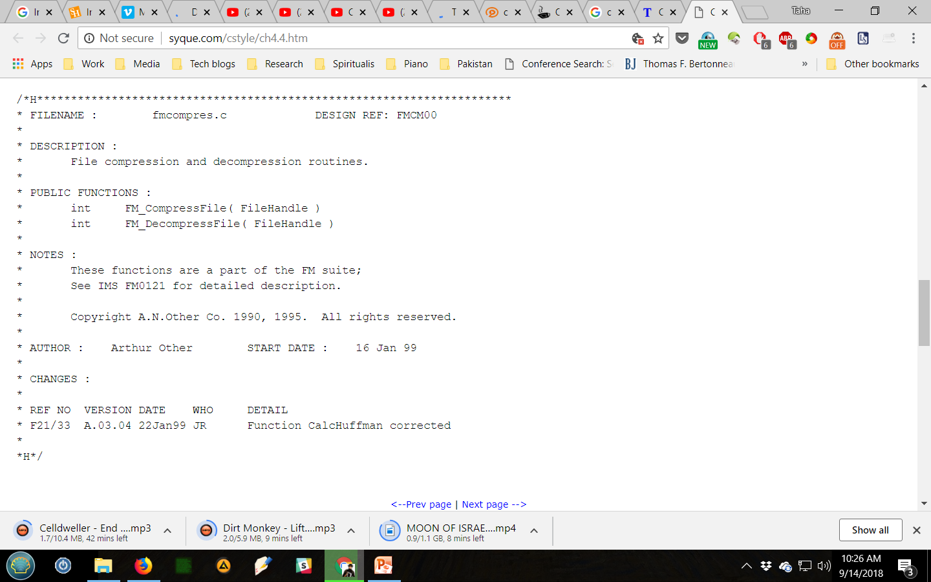
Box Comments
Copyright © 2008 W. W. Norton & Company.
All rights reserved.
Notes:
-H stands for – header comment

Slide 23

Copyright © 2008 W. W. Norton & Company.
All rights reserved.

Slide 24
Variables and Assignment
Most programs need to a way to store data temporarily during program execution.
These storage locations are called variables.
Copyright © 2008 W. W. Norton & Company.
All rights reserved.
Notes:
-Similar to concept of variable in mathematical functions but not quite…mathematical variables have a name and a value.
-In computer programming, a variable or scalar is a storage location paired with an associated symbolic name (an identifier), which contains some known or unknown quantity of information referred to as a value. The variable name is the usual way to reference the stored value; this separation of name and content allows the name to be used independently of the exact information it represents. The identifier in computer source code can be bound to a value during run time, and the value of the variable may thus change during the course of program execution.
-Compilers have to replace variables' symbolic names with the actual locations of the data. While a variable's name, type, and location often remain fixed, the data stored in the location may be changed during program execution.
-Think of it as a bin or bucket – variables in this context have 1) name, 2) type, 3) location, 4) value

Slide 25
Types
Every variable must have a type.
C has a wide variety of types, including int and float.
A variable of type int (short for integer) can store a whole number such as 0, 1, 392, or –2553.
  The largest int value is typically 2,147,483,647 but can be as small as 32,767.
Copyright © 2008 W. W. Norton & Company.
All rights reserved.
Notes:
-Type values may depend on architecture of machine
-For instance, for 16 bit machines – -32767 to 32767 (number of values = 2^16)

Slide 26
Types
A variable of type float (short for floating-point) can store much larger numbers than an int variable.
Also, a float variable can store numbers with digits after the decimal point, like 379.125.
Drawbacks of float variables:
  Slower arithmetic
  Approximate nature of float values
Copyright © 2008 W. W. Norton & Company.
All rights reserved.
Notes:
-Representation error refers to the fact that some (most, actually) decimal fractions cannot be represented exactly as binary (base 2) fractions. This is the chief reason why Python (or Perl, C, C++, Java, Fortran, and many others) often won’t display the exact decimal number you expect:
>>> 0.1 + 0.2 = 0.30000000000000004
Why is that? 1/10 and 2/10 are not exactly representable as a binary fraction.
-(https://docs.python.org/2/tutorial/floatingpoint.html)

Slide 27
Declarations
Variables must be declared before they are used.
Variables can be declared one at a time:
int height;
float profit;
Alternatively, several can be declared at the same time:
int height, length, width, volume;
float profit, loss;
Copyright © 2008 W. W. Norton & Company.
All rights reserved.
Notes:
-Declaration – type and name
-Semicolon after declaration

Slide 28
Declarations
When main contains declarations, these must precede statements:
int main(void)
{
declarations
statements
}
In C99, declarations don’t have to come before statements.
Copyright © 2008 W. W. Norton & Company.
All rights reserved.
Notes:
-You can put a declaration, followed by a statement, then another declaration, etc.
-Why? - newer programming techniques – only declare variables when they are first needed

Slide 29

Assignment
A variable can be given a value by means of assignment:
height = 8;
The number 8 is said to be a constant.
Before a variable can be assigned a value—or used in any other way—it must first be declared.
height = 8;
int height;
Copyright © 2008 W. W. Norton & Company.
All rights reserved.

Slide 30
Assignment
A constant assigned to a float variable usually contains a decimal point:
profit = 2150.48;
It’s best to append the letter f to a floating-point constant if it is assigned to a float variable:
profit = 2150.48f;
Failing to include the f may cause a warning from the compiler.
Copyright © 2008 W. W. Norton & Company.
All rights reserved.
Notes:
-f included for greater accuracy (pg. 32)
-A floating point literal in your source code is parsed as a double. Assigning it to a variable that is of type float will lose precision. A lot of precision, you're throwing away 7 significant digits. The "f" postfix let's you tell the compiler: "I know what I'm doing, this is intentional. Don't bug me about it".

Slide 31
Assignment
An int variable is normally assigned a value of type int, and a float variable is normally assigned a value of type float.
Mixing types (such as assigning an int value to a float variable or assigning a float value to an int variable) is possible but not always safe.
Copyright © 2008 W. W. Norton & Company.
All rights reserved.

Slide 32
Example
For a quadratic equation
x2 – 4.0000000 x + 3.9999999 = 0
the exact roots to 10 significant digits are
r1 = 2.000316228 and r2 = 1.999683772
for float values:
2.00000 2.00000
for double values:
2.00032 1.99968
Copyright © 2008 W. W. Norton & Company.
All rights reserved.
Notes:
-List of C data types - https://en.wikipedia.org/wiki/C_data_types
float is a 32 bit IEEE 754 single precision Floating Point Number1 bit for the sign, (8 bits for the exponent, and 23* for the value), i.e. float has 7 decimal digits of precision.
double is a 64 bit IEEE 754 double precision Floating Point Number (1 bit for the sign, 11 bits for the exponent, and 52* bits for the value), i.e. double has 15 decimal digits of precision.

Slide 33
Assignment
Once a variable has been assigned a value, it can be used to help compute the value of another variable:
height = 8;
length = 12;
width = 10;
volume = height * length * width;
/* volume is now 960 */
The right side of an assignment can be a formula (or expression, in C terminology) involving constants, variables, and operators.
Copyright © 2008 W. W. Norton & Company.
All rights reserved.

Slide 34
Printing the Value of a Variable
printf can be used to display the current value of a variable.
To write the message
Height: h
where h is the current value of the height variable, we’d use the following call of printf:
printf("Height: %d\n", height);
%d is a placeholder indicating where the value of height is to be filled in.
Copyright © 2008 W. W. Norton & Company.
All rights reserved.
Notes:
-Placement of \n – printf will advance to next line after printing value of height

Slide 35
Printing the Value of a Variable
%d works only for int variables; to print a float variable, use %f instead.
By default, %f displays a number with six digits after the decimal point.
To force %f to display p digits after the decimal point, put .p between % and f.
To print the line
Profit: $2150.48
use the following call of printf:
printf("Profit: $%.2f\n", profit);
Copyright © 2008 W. W. Norton & Company.
All rights reserved.

Slide 36
Printing the Value of a Variable
There’s no limit to the number of variables that can be printed by a single call of printf:
printf("Height: %d Length: %d\n", height, length);
Copyright © 2008 W. W. Norton & Company.
All rights reserved.

Slide 37
Program: Computing the
Dimensional Weight of a Box
Shipping companies often charge extra for boxes that are large but very light, basing the fee on volume instead of weight.
The usual method to compute the “dimensional weight” is to divide the volume by 166 (the allowable number of cubic inches per pound).
The dweight.c program computes the dimensional weight of a particular box:
Dimensions: 12x10x8
Volume (cubic inches): 960
Dimensional weight (pounds): 6
Copyright © 2008 W. W. Norton & Company.
All rights reserved.
Notes:
-If box’s dimensional weight > actual weight, shipping fee is charged based on dimensional weight.
-166 = divisor for international shipments.

Slide 38
Program: Computing the
Dimensional Weight of a Box
Division is represented by / in C, so the obvious way to compute the dimensional weight would be
weight = volume / 166;
In C, however, when one integer is divided by another, the answer is “truncated”: all digits after the decimal point are lost.
  The volume of a 12” × 10” × 8” box will be 960 cubic inches.
  Dividing by 166 gives 5 instead of 5.783.
Copyright © 2008 W. W. Norton & Company.
All rights reserved.
Notes:
-Rounding is downwards
-How do you round things up? What if volume is 166? Or 167?

Slide 39
Program: Computing the
Dimensional Weight of a Box
One solution is to add 165 to the volume before dividing by 166:
weight = (volume + 165) / 166;
A volume of 166 would give a weight of 331/166, or 1, while a volume of 167 would yield 332/166, or 2.
Copyright © 2008 W. W. Norton & Company.
All rights reserved.

Slide 40
dweight.c
/* Computes the dimensional weight of a 12" x 10" x 8" box */
#include <stdio.h>
int main(void)
{
int height, length, width, volume, weight;
height = 8;
length = 12;
width = 10;
volume = height * length * width;
weight = (volume + 165) / 166;
printf("Dimensions: %dx%dx%d\n", length, width, height);
printf("Volume (cubic inches): %d\n", volume);
printf("Dimensional weight (pounds): %d\n", weight);
return 0;
}
Copyright © 2008 W. W. Norton & Company.
All rights reserved.

Slide 41
Initialization
Some variables are automatically set to zero when a program begins to execute, but most are not.
A variable that doesn’t have a default value and hasn’t yet been assigned a value by the program is said to be uninitialized.
Attempting to access the value of an uninitialized variable may yield an unpredictable result.
With some compilers, worse behavior—even a program crash—may occur.
Copyright © 2008 W. W. Norton & Company.
All rights reserved.
Notes:
-Accessing an uninitialized variable - might show up a random value!

Slide 42
Initialization
The initial value of a variable may be included in its declaration:
int height = 8;
The value 8 is said to be an initializer.
Any number of variables can be initialized in the same declaration:
int height = 8, length = 12, width = 10;
Each variable requires its own initializer.
int height, length, width = 10;
/* initializes only width */
Copyright © 2008 W. W. Norton & Company.
All rights reserved.

Slide 43
Printing Expressions
printf can display the value of any numeric expression.
The statements
volume = height * length * width;
printf("%d\n", volume);
could be replaced by
printf("%d\n", height * length * width);
Copyright © 2008 W. W. Norton & Company.
All rights reserved.
Notes:
-You can always replace a value with an expression of the same type.

Slide 44
Reading Input
scanf is the C library’s counterpart to printf.
scanf requires a format string to specify the appearance of the input data.
Example of using scanf to read an int value:
scanf("%d", &i);
/* reads an integer; stores into i */
The & symbol is usually (but not always) required when using scanf.
Copyright © 2008 W. W. Norton & Company.
All rights reserved.
Notes:
-printf also requires a format string – i.e. what form the data will take.
-&operator = location – more on this much later in the course

Slide 45
Reading Input
Reading a float value requires a slightly different call of scanf:
scanf("%f", &x);
"%f" tells scanf to look for an input value in float format (the number may contain a decimal point, but doesn’t have to).
Copyright © 2008 W. W. Norton & Company.
All rights reserved.

Slide 46
Program: Computing the Dimensional Weight of a Box (Revisited)
dweight2.c is an improved version of the dimensional weight program in which the user enters the dimensions.
Each call of scanf is immediately preceded by a call of printf that displays a prompt.
Copyright © 2008 W. W. Norton & Company.
All rights reserved.

Slide 47
dweight2.c
/* Computes the dimensional weight of a box from input provided by the user */
#include <stdio.h>
int main(void)
{
int height, length, width, volume, weight;
printf("Enter height of box: ");
scanf("%d", &height);
printf("Enter length of box: ");
scanf("%d", &length);
printf("Enter width of box: ");
scanf("%d", &width);
volume = height * length * width;
weight = (volume + 165) / 166;
printf("Volume (cubic inches): %d\n", volume);
printf("Dimensional weight (pounds): %d\n", weight);
return 0;
}
Copyright © 2008 W. W. Norton & Company.
All rights reserved.

Slide 48
Program: Computing the Dimensional Weight of a Box (Revisited)
Sample output of program:
Enter height of box: 8
Enter length of box: 12
Enter width of box: 10
Volume (cubic inches): 960
Dimensional weight (pounds): 6
Note that a prompt shouldn’t end with a new-line character.
Copyright © 2008 W. W. Norton & Company.
All rights reserved.
Notes:
-Prompt should normally not end with a new-line character – user should enter input on the same line.
-When user presses Enter, cursor advances to next line automatically.
-Program fails if user enters nonnumeric input.

Slide 49
Defining Names for Constants
dweight.c and dweight2.c rely on the constant 166, whose meaning may not be clear to someone reading the program.
Using a feature known as macro definition, we can name this constant:
#define INCHES_PER_POUND 166
Copyright © 2008 W. W. Norton & Company.
All rights reserved.
Notes:
-For example, dimensional weight for a domestic shipment = 194!
-#define is a preprocessing directive!

Slide 50
Defining Names for Constants
When a program is compiled, the preprocessor replaces each macro by the value that it represents.
During preprocessing, the statement
weight = (volume + INCHES_PER_POUND - 1) / INCHES_PER_POUND;
will become
weight = (volume + 166 - 1) / 166;
Copyright © 2008 W. W. Norton & Company.
All rights reserved.
Notes:
-Similar to how preprocessor works in case of #include directive – includes function code in actual file

Slide 51
Defining Names for Constants
The value of a macro can be an expression:
#define RECIPROCAL_OF_PI (1.0f / 3.14159f)
If it contains operators, the expression should be enclosed in parentheses.
Using only upper-case letters in macro names is a common convention.
Copyright © 2008 W. W. Norton & Company.
All rights reserved.

Slide 52
Program: Converting from
Fahrenheit to Celsius
The celsius.c program prompts the user to enter a Fahrenheit temperature; it then prints the equivalent Celsius temperature.
Sample program output:
Enter Fahrenheit temperature: 212
Celsius equivalent: 100.0
The program will allow temperatures that aren’t integers.
Copyright © 2008 W. W. Norton & Company.
All rights reserved.
Notes:
-Temperatures that are not integers – that’s why 100 is expressed as 100.0.

Slide 53
celsius.c
/* Converts a Fahrenheit temperature to Celsius */
#include <stdio.h>
#define FREEZING_PT 32.0f
#define SCALE_FACTOR (5.0f / 9.0f)
int main(void)
{
float fahrenheit, celsius;
printf("Enter Fahrenheit temperature: ");
scanf("%f", &fahrenheit);
celsius = (fahrenheit - FREEZING_PT) * SCALE_FACTOR;
printf("Celsius equivalent: %.1f\n", celsius);
return 0;
}
Copyright © 2008 W. W. Norton & Company.
All rights reserved.

Slide 54
Program: Converting from
Fahrenheit to Celsius
Defining SCALE_FACTOR to be (5.0f / 9.0f) instead of (5 / 9) is important.
Note the use of %.1f to display celsius with just one digit after the decimal point.
Copyright © 2008 W. W. Norton & Company.
All rights reserved.
Notes:
-Formula - T_{(°C)} = (T_{(°F)} - 32) × 5/9
-Putting f in SCALE_FACTOR computation is important since C truncates result and rounds down when two integers are divided.
-Truncated value of 5/9 = 0!

Slide 55
Identifiers
Names for variables, functions, macros, and other entities are called identifiers.
An identifier may contain letters, digits, and underscores, but must begin with a letter or underscore:
times10 get_next_char _done
It’s usually best to avoid identifiers that begin with an underscore.
Examples of illegal identifiers:
10times get-next-char
Copyright © 2008 W. W. Norton & Company.
All rights reserved.

Slide 56
Identifiers
C is case-sensitive: it distinguishes between upper-case and lower-case letters in identifiers.
For example, the following identifiers are all different:
job joB jOb jOB Job JoB JOb JOB
Copyright © 2008 W. W. Norton & Company.
All rights reserved.
Notes:
-All 8 of these identifiers can be used in the same program!

Slide 57
Identifiers
Many programmers use only lower-case letters in identifiers (other than macros), with underscores inserted for legibility:
symbol_table current_page name_and_address
Other programmers use an upper-case letter to begin each word within an identifier:
symbolTable currentPage nameAndAddress
C places no limit on the maximum length of an identifier.
Copyright © 2008 W. W. Norton & Company.
All rights reserved.

Slide 58
Keywords
The following keywords can’t be used as identifiers:
auto enum restrict* unsigned
break extern return void
case float short volatile
char for signed while
const goto sizeof _Bool*
continue if static _Complex*
default inline* struct _Imaginary*
do int switch
double long typedef
else register union
*C99 only
Copyright © 2008 W. W. Norton & Company.
All rights reserved.
Notes:
-These keywords have specific functionality.
-Some libraries may also include specific identifiers which may cause conflict.

Slide 59
Keywords
Keywords (with the exception of _Bool, _Complex, and _Imaginary) must be written using only lower-case letters.
Names of library functions (e.g., printf) are also lower-case.
Copyright © 2008 W. W. Norton & Company.
All rights reserved.

Slide 60
Layout of a C Program
A C program is a series of tokens.
Tokens include:
  Identifiers
  Keywords
  Operators
  Punctuation
  Constants
  String literals
Copyright © 2008 W. W. Norton & Company.
All rights reserved.
Notes:
-Token – group of characters that cannot be split up without changing their meaning.
-token = symbolic entity.

Slide 61
Layout of a C Program
The statement
printf("Height: %d\n", height);
consists of seven tokens:
printf Identifier
( Punctuation
"Height: %d\n" String literal
, Punctuation
height Identifier
) Punctuation
; Punctuation
Copyright © 2008 W. W. Norton & Company.
All rights reserved.

Slide 62
Layout of a C Program
The amount of space between tokens usually isn’t critical.
At one extreme, tokens can be crammed together with no space between them, except where this would cause two tokens to merge:
/* Converts a Fahrenheit temperature to Celsius */
#include <stdio.h>
#define FREEZING_PT 32.0f
#define SCALE_FACTOR (5.0f/9.0f)
int main(void){float fahrenheit,celsius;printf(
"Enter Fahrenheit temperature: ");scanf("%f", &fahrenheit);
celsius=(fahrenheit-FREEZING_PT)*SCALE_FACTOR;
printf("Celsius equivalent: %.1f\n", celsius);return 0;}
Copyright © 2008 W. W. Norton & Company.
All rights reserved.
Notes:
-All of main could be put in one line!

Slide 63
Layout of a C Program
The whole program can’t be put on one line, because each preprocessing directive requires a separate line.
Compressing programs in this fashion isn’t a good idea.
In fact, adding spaces and blank lines to a program can make it easier to read and understand.
Copyright © 2008 W. W. Norton & Company.
All rights reserved.
Notes:
-Examples from code handout?

Slide 64
Layout of a C Program
C allows any amount of space—blanks, tabs, and new-line characters—between tokens.
Consequences for program layout:
  Statements can be divided over any number of lines.
  Space between tokens (such as before and after each operator, and after each comma) makes it easier for the eye to separate them.
  Indentation can make nesting easier to spot.
  Blank lines can divide a program into logical units.
Copyright © 2008 W. W. Norton & Company.
All rights reserved.
Notes:
-Indentation – nesting for functions, subroutines, and modules.

Slide 65
Layout of a C Program
Although extra spaces can be added between tokens, it’s not possible to add space within a token without changing the meaning of the program or causing an error.
Writing
fl oat fahrenheit, celsius; /*** WRONG ***/
or
fl
oat fahrenheit, celsius; /*** WRONG ***/
produces an error when the program is compiled.
Copyright © 2008 W. W. Norton & Company.
All rights reserved.

Slide 66
Layout of a C Program
Putting a space inside a string literal is allowed, although it changes the meaning of the string.
Putting a new-line character in a string (splitting the string over two lines) is illegal:
printf("To C, or not to C:
that is the question.\n");
/*** WRONG ***/
Copyright © 2008 W. W. Norton & Company.
All rights reserved.

