Slide 1
Chapter 9
Functions
Copyright © 2008 W. W. Norton & Company.
All rights reserved.

Slide 2
Introduction
A function is a series of statements that have been grouped together and given a name.
Each function is essentially a small program, with its own declarations and statements.
Advantages of functions:
  A program can be divided into small pieces that are easier to understand and modify.
  We can avoid duplicating code that’s used more than once.
  A function that was originally part of one program can be reused in other programs.
Copyright © 2008 W. W. Norton & Company.
All rights reserved.

Slide 3
Defining and Calling Functions
Before we go over the formal rules for defining a function, let’s look at three simple programs that define functions.
Copyright © 2008 W. W. Norton & Company.
All rights reserved.

Slide 4
Program: Computing Averages
A function named average that computes the average of two double values:
double average(double a, double b)
{
return (a + b) / 2;
}
The word double at the beginning is the return type of average.
The identifiers a and b (the function’s parameters) represent the numbers that will be supplied when average is called.
Copyright © 2008 W. W. Norton & Company.
All rights reserved.

Slide 5
Program: Computing Averages
Every function has an executable part, called the body, which is enclosed in braces.
The body of average consists of a single return statement.
Executing this statement causes the function to “return” to the place from which it was called; the value of (a + b) / 2 will be the value returned by the function.
Copyright © 2008 W. W. Norton & Company.
All rights reserved.

Slide 6
Program: Computing Averages
A function call consists of a function name followed by a list of arguments.
  average(x, y) is a call of the average function.
Arguments are used to supply information to a function.
  The call average(x, y) causes the values of x and y to be copied into the parameters a and b.
An argument doesn’t have to be a variable; any expression of a compatible type will do.
  average(5.1, 8.9) and average(x/2, y/3) are legal.
Copyright © 2008 W. W. Norton & Company.
All rights reserved.

Slide 7
Program: Computing Averages
We’ll put the call of average in the place where we need to use the return value.
A statement that prints the average of x and y:
printf("Average: %g\n", average(x, y));
The return value of average isn’t saved; the program prints it and then discards it.
If we had needed the return value later in the program, we could have captured it in a variable:
avg = average(x, y);
Copyright © 2008 W. W. Norton & Company.
All rights reserved.

Slide 8
Program: Computing Averages
The average.c program reads three numbers and uses the average function to compute their averages, one pair at a time:
Enter three numbers: 3.5 9.6 10.2
Average of 3.5 and 9.6: 6.55
Average of 9.6 and 10.2: 9.9
Average of 3.5 and 10.2: 6.85
Copyright © 2008 W. W. Norton & Company.
All rights reserved.

Slide 9
average.c
/* Computes pairwise averages of three numbers */
#include <stdio.h>
double average(double a, double b)
{
return (a + b) / 2;
}
int main(void)
{
double x, y, z;
printf("Enter three numbers: ");
scanf("%lf%lf%lf", &x, &y, &z);
printf("Average of %g and %g: %g\n", x, y, average(x, y));
printf("Average of %g and %g: %g\n", y, z, average(y, z));
printf("Average of %g and %g: %g\n", x, z, average(x, z));
return 0;
}
Copyright © 2008 W. W. Norton & Company.
All rights reserved.

Slide 10
Program: Printing a Countdown
To indicate that a function has no return value, we specify that its return type is void:
void print_count(int n)
{
printf("T minus %d and counting\n", n);
}
void is a type with no values.
A call of print_count must appear in a statement by itself:
print_count(i);
The countdown.c program calls print_count 10 times inside a loop.
Copyright © 2008 W. W. Norton & Company.
All rights reserved.

Slide 11
countdown.c
/* Prints a countdown */
#include <stdio.h>
void print_count(int n)
{
printf("T minus %d and counting\n", n);
}
int main(void)
{
int i;
for (i = 10; i > 0; --i)
print_count(i);
return 0;
}
Copyright © 2008 W. W. Norton & Company.
All rights reserved.

Slide 12
Program: Printing a Pun (Revisited)
When a function has no parameters, the word void is placed in parentheses after the function’s name:
void print_pun(void)
{
printf("To C, or not to C: that is the question.\n");
}
To call a function with no arguments, we write the function’s name, followed by parentheses:
print_pun();
The parentheses must be present.
The pun2.c program tests the print_pun function.
Copyright © 2008 W. W. Norton & Company.
All rights reserved.

Slide 13
pun2.c
/* Prints a bad pun */
#include <stdio.h>
void print_pun(void)
{
printf("To C, or not to C: that is the question.\n");
}
int main(void)
{
print_pun();
return 0;
}
Copyright © 2008 W. W. Norton & Company.
All rights reserved.

Slide 14
Function Definitions
General form of a function definition:
return-type function-name ( parameters )
{
declarations
statements
}
Copyright © 2008 W. W. Norton & Company.
All rights reserved.

Slide 15
Function Definitions
The return type of a function is the type of value that the function returns.
Rules governing the return type:
  Functions may not return arrays.
  Specifying that the return type is void indicates that the function doesn’t return a value.
If the return type is omitted in C89, the function is presumed to return a value of type int.
In C99, omitting the return type is illegal.
Copyright © 2008 W. W. Norton & Company.
All rights reserved.

Slide 16
Function Definitions
As a matter of style, some programmers put the return type above the function name:
double
average(double a, double b)
{
return (a + b) / 2;
}
Putting the return type on a separate line is especially useful if the return type is lengthy, like unsigned long int.
Copyright © 2008 W. W. Norton & Company.
All rights reserved.

Slide 17
Function Definitions
After the function name comes a list of parameters.
Each parameter is preceded by a specification of its type; parameters are separated by commas.
If the function has no parameters, the word void should appear between the parentheses.
Copyright © 2008 W. W. Norton & Company.
All rights reserved.

Slide 18
Function Definitions
The body of a function may include both declarations and statements.
An alternative version of the average function:
double average(double a, double b)
{
double sum; /* declaration */
sum = a + b; /* statement */
return sum / 2; /* statement */
}
Copyright © 2008 W. W. Norton & Company.
All rights reserved.

Slide 19
Function Definitions
Variables declared in the body of a function can’t be examined or modified by other functions.
In C89, variable declarations must come first, before all statements in the body of a function.
In C99, variable declarations and statements can be mixed, as long as each variable is declared prior to the first statement that uses the variable.
Copyright © 2008 W. W. Norton & Company.
All rights reserved.

Slide 20
Function Definitions
The body of a function whose return type is void (a “void function”) can be empty:
void print_pun(void)
{
}
Leaving the body empty may make sense as a temporary step during program development.
Copyright © 2008 W. W. Norton & Company.
All rights reserved.

Slide 21
Function Calls
A function call consists of a function name followed by a list of arguments, enclosed in parentheses:
average(x, y)
print_count(i)
print_pun()
If the parentheses are missing, the function won’t be called:
print_pun; /*** WRONG ***/
This statement is legal but has no effect.
Copyright © 2008 W. W. Norton & Company.
All rights reserved.

Slide 22
Function Calls
A call of a void function is always followed by a semicolon to turn it into a statement:
print_count(i);
print_pun();
A call of a non-void function produces a value that can be stored in a variable, tested, printed, or used in some other way:
avg = average(x, y);
if (average(x, y) > 0)
printf("Average is positive\n");
printf("The average is %g\n", average(x, y));
Copyright © 2008 W. W. Norton & Company.
All rights reserved.

Slide 23
Function Calls
The value returned by a non-void function can always be discarded if it’s not needed:
average(x, y); /* discards return value */
This call is an example of an expression statement: a statement that evaluates an expression but then discards the result.
Copyright © 2008 W. W. Norton & Company.
All rights reserved.

Slide 24

Copyright © 2008 W. W. Norton & Company.
All rights reserved.

Slide 25
Function Calls
Ignoring the return value of average is an odd thing to do, but for some functions it makes sense.
printf returns the number of characters that it prints.
After the following call, num_chars will have the value 9:
num_chars = printf("Hi, Mom!\n");
We’ll normally discard printf’s return value:
printf("Hi, Mom!\n");
/* discards return value */
Copyright © 2008 W. W. Norton & Company.
All rights reserved.

Slide 26
Function Calls
To make it clear that we’re deliberately discarding the return value of a function, C allows us to put (void) before the call:
(void) printf("Hi, Mom!\n");
Using (void) makes it clear to others that you deliberately discarded the return value, not just forgot that there was one.
Copyright © 2008 W. W. Norton & Company.
All rights reserved.

Slide 27
Program: Testing Whether a Number Is Prime
The prime.c program tests whether a number is prime:
Enter a number: 34
Not prime
The program uses a function named is_prime that returns true if its parameter is a prime number and false if it isn’t.
is_prime divides its parameter n by each of the numbers between 2 and the square root of n; if the remainder is ever 0, n isn’t prime.
Copyright © 2008 W. W. Norton & Company.
All rights reserved.

Slide 28
prime.c
/* Tests whether a number is prime */
#include <stdbool.h> /* C99 only */
#include <stdio.h>
bool is_prime(int n)
{
int divisor;
if (n <= 1)
return false;
for (divisor = 2; divisor * divisor <= n; divisor++)
if (n % divisor == 0)
return false;
return true;
}
Copyright © 2008 W. W. Norton & Company.
All rights reserved.

Slide 29
int main(void)
{
int n;
printf("Enter a number: ");
scanf("%d", &n);
if (is_prime(n))
printf("Prime\n");
else
printf("Not prime\n");
return 0;
}
Copyright © 2008 W. W. Norton & Company.
All rights reserved.

Slide 30
Function Declarations
C doesn’t require that the definition of a function precede its calls.
Suppose that we rearrange the average.c program by putting the definition of average after the definition of main.
Copyright © 2008 W. W. Norton & Company.
All rights reserved.

Slide 31
Function Declarations
#include <stdio.h>
int main(void)
{
double x, y, z;
printf("Enter three numbers: ");
scanf("%lf%lf%lf", &x, &y, &z);
printf("Average of %g and %g: %g\n", x, y, average(x, y));
printf("Average of %g and %g: %g\n", y, z, average(y, z));
printf("Average of %g and %g: %g\n", x, z, average(x, z));
return 0;
}
double average(double a, double b)
{
return (a + b) / 2;
}
Copyright © 2008 W. W. Norton & Company.
All rights reserved.

Slide 32
Function Declarations
When the compiler encounters the first call of average in main, it has no information about the function.
Instead of producing an error message, the compiler assumes that average returns an int value.
We say that the compiler has created an implicit declaration of the function.
Copyright © 2008 W. W. Norton & Company.
All rights reserved.

Slide 33
Function Declarations
The compiler is unable to check that we’re passing average the right number of arguments and that the arguments have the proper type.
Instead, it performs the default argument promotions and hopes for the best.
When it encounters the definition of average later in the program, the compiler notices that the function’s return type is actually double, not int, and so we get an error message.
Copyright © 2008 W. W. Norton & Company.
All rights reserved.

Slide 34
Function Declarations
One way to avoid the problem of call-before-definition is to arrange the program so that the definition of each function precedes all its calls.
Unfortunately, such an arrangement doesn’t always exist.
Even when it does, it may make the program harder to understand by putting its function definitions in an unnatural order.
Copyright © 2008 W. W. Norton & Company.
All rights reserved.

Slide 35
Function Declarations
Fortunately, C offers a better solution: declare each function before calling it.
A function declaration provides the compiler with a brief glimpse at a function whose full definition will appear later.
General form of a function declaration:
return-type function-name ( parameters ) ;
The declaration of a function must be consistent with the function’s definition.
Here’s the average.c program with a declaration of average added.
Copyright © 2008 W. W. Norton & Company.
All rights reserved.

Slide 36
Function Declarations
#include <stdio.h>
double average(double a, double b); /* DECLARATION */
int main(void)
{
double x, y, z;
printf("Enter three numbers: ");
scanf("%lf%lf%lf", &x, &y, &z);
printf("Average of %g and %g: %g\n", x, y, average(x, y));
printf("Average of %g and %g: %g\n", y, z, average(y, z));
printf("Average of %g and %g: %g\n", x, z, average(x, z));
return 0;
}
double average(double a, double b) /* DEFINITION */
{
return (a + b) / 2;
}
Copyright © 2008 W. W. Norton & Company.
All rights reserved.

Slide 37
Function Declarations
Function declarations of the kind we’re discussing are known as function prototypes.
C also has an older style of function declaration in which the parentheses are left empty.
A function prototype doesn’t have to specify the names of the function’s parameters, as long as their types are present:
double average(double, double);
It’s usually best not to omit parameter names.
Copyright © 2008 W. W. Norton & Company.
All rights reserved.

Slide 38
Function Declarations
C99 has adopted the rule that either a declaration or a definition of a function must be present prior to any call of the function.
Calling a function for which the compiler has not yet seen a declaration or definition is an error.
Copyright © 2008 W. W. Norton & Company.
All rights reserved.

Slide 39
Arguments
In C, arguments are passed by value: when a function is called, each argument is evaluated and its value assigned to the corresponding parameter.
Since the parameter contains a copy of the argument’s value, any changes made to the parameter during the execution of the function don’t affect the argument.
Copyright © 2008 W. W. Norton & Company.
All rights reserved.

Slide 40
Arguments
The fact that arguments are passed by value has both advantages and disadvantages.
Since a parameter can be modified without affecting the corresponding argument, we can use parameters as variables within the function, reducing the number of genuine variables needed.
Copyright © 2008 W. W. Norton & Company.
All rights reserved.

Slide 41
Arguments
Consider the following function, which raises a number x to a power n:
int power(int x, int n)
{
int i, result = 1;
for (i = 1; i <= n; i++)
result = result * x;
return result;
}
Copyright © 2008 W. W. Norton & Company.
All rights reserved.

Slide 42
Arguments
Since n is a copy of the original exponent, the function can safely modify it, removing the need for i:
int power(int x, int n)
{
int result = 1;
while (n-- > 0)
result = result * x;
return result;
}
Copyright © 2008 W. W. Norton & Company.
All rights reserved.

Slide 43
Arguments
C’s requirement that arguments be passed by value makes it difficult to write certain kinds of functions.
Suppose that we need a function that will decompose a double value into an integer part and a fractional part.
Since a function can’t return two numbers, we might try passing a pair of variables to the function and having it modify them:
void decompose(double x, long int_part,
double frac_part)
{
int_part = (long) x;
frac_part = x - int_part;
}
Copyright © 2008 W. W. Norton & Company.
All rights reserved.

Slide 44
Arguments
A call of the function:
decompose(3.14159, i, d);
Unfortunately, i and d won’t be affected by the assignments to int_part and frac_part.
Chapter 11 shows how to make decompose work correctly.
Copyright © 2008 W. W. Norton & Company.
All rights reserved.

Slide 45
Argument Conversions
C allows function calls in which the types of the arguments don’t match the types of the parameters.
The rules governing how the arguments are converted depend on whether or not the compiler has seen a prototype for the function (or the function’s full definition) prior to the call.
Copyright © 2008 W. W. Norton & Company.
All rights reserved.

Slide 46
Argument Conversions
The compiler has encountered a prototype prior to the call.
The value of each argument is implicitly converted to the type of the corresponding parameter as if by assignment.
Example: If an int argument is passed to a function that was expecting a double, the argument is converted to double automatically.
Copyright © 2008 W. W. Norton & Company.
All rights reserved.

Slide 47
Argument Conversions
The compiler has not encountered a prototype prior to the call.
The compiler performs the default argument promotions:
  float arguments are converted to double.
  The integral promotions are performed, causing char and short arguments to be converted to int. (In C99, the integer promotions are performed.)
Copyright © 2008 W. W. Norton & Company.
All rights reserved.

Slide 48
Argument Conversions
Relying on the default argument promotions is dangerous.
Example:
#include <stdio.h>
int main(void)
{
double x = 3.0;
printf("Square: %d\n", square(x));
return 0;
}
int square(int n)
{
return n * n;
}
At the time square is called, the compiler doesn’t know that it expects an argument of type int.
Copyright © 2008 W. W. Norton & Company.
All rights reserved.

Slide 49
Argument Conversions
Instead, the compiler performs the default argument promotions on x, with no effect.
Since it’s expecting an argument of type int but has been given a double value instead, the effect of calling square is undefined.
The problem can be fixed by casting square’s argument to the proper type:
printf("Square: %d\n", square((int) x));
A much better solution is to provide a prototype for square before calling it.
In C99, calling square without first providing a declaration or definition of the function is an error.
Copyright © 2008 W. W. Norton & Company.
All rights reserved.

Slide 50
Array Arguments
When a function parameter is a one-dimensional array, the length of the array can be left unspecified:
int f(int a[]) /* no length specified */
{
…
}
C doesn’t provide any easy way for a function to determine the length of an array passed to it.
Instead, we’ll have to supply the length—if the function needs it—as an additional argument.
Copyright © 2008 W. W. Norton & Company.
All rights reserved.

Slide 51
Array Arguments
Example:
int sum_array(int a[], int n)
{
int i, sum = 0;
for (i = 0; i < n; i++)
sum += a[i];
return sum;
}
Since sum_array needs to know the length of a, we must supply it as a second argument.
Copyright © 2008 W. W. Norton & Company.
All rights reserved.

Slide 52
Array Arguments
The prototype for sum_array has the following appearance:
int sum_array(int a[], int n);
As usual, we can omit the parameter names if we wish:
int sum_array(int [], int);
Copyright © 2008 W. W. Norton & Company.
All rights reserved.

Slide 53
Array Arguments
When sum_array is called, the first argument will be the name of an array, and the second will be its length:
#define LEN 100
int main(void)
{
int b[LEN], total;
…
total = sum_array(b, LEN);
…
}
Notice that we don’t put brackets after an array name when passing it to a function:
total = sum_array(b[], LEN); /*** WRONG ***/
Copyright © 2008 W. W. Norton & Company.
All rights reserved.

Slide 54
Array Arguments
A function has no way to check that we’ve passed it the correct array length.
We can exploit this fact by telling the function that the array is smaller than it really is.
Suppose that we’ve only stored 50 numbers in the b array, even though it can hold 100.
We can sum just the first 50 elements by writing
total = sum_array(b, 50);
Copyright © 2008 W. W. Norton & Company.
All rights reserved.

Slide 55
Array Arguments
Be careful not to tell a function that an array argument is larger than it really is:
total = sum_array(b, 150); /*** WRONG ***/
sum_array will go past the end of the array, causing undefined behavior.
Copyright © 2008 W. W. Norton & Company.
All rights reserved.

Slide 56
Array Arguments
A function is allowed to change the elements of an array parameter, and the change is reflected in the corresponding argument.
A function that modifies an array by storing zero into each of its elements:
void store_zeros(int a[], int n)
{
int i;
for (i = 0; i < n; i++)
a[i] = 0;
}
Copyright © 2008 W. W. Norton & Company.
All rights reserved.

Slide 57
Array Arguments
A call of store_zeros:
store_zeros(b, 100);
The ability to modify the elements of an array argument may seem to contradict the fact that C passes arguments by value.
Chapter 12 explains why there’s actually no contradiction.
Copyright © 2008 W. W. Norton & Company.
All rights reserved.

Slide 58
Array Arguments
If a parameter is a multidimensional array, only the length
of the first dimension may be omitted.
If we revise sum_array so that a is a two-dimensional array, we must specify the number of columns in a:
#define LEN 10
int sum_two_dimensional_array(int a[][LEN], int n)
{
int i, j, sum = 0;
for (i = 0; i < n; i++)
for (j = 0; j < LEN; j++)
sum += a[i][j];
return sum;
}
Copyright © 2008 W. W. Norton & Company.
All rights reserved.

Slide 59
Array Arguments
Not being able to pass multidimensional arrays with an arbitrary number of columns can be a nuisance.
We can often work around this difficulty by using arrays of pointers.
C99’s variable-length array parameters provide an even better solution.
Copyright © 2008 W. W. Norton & Company.
All rights reserved.

Slide 60
Variable-Length Array Parameters (C99)
C99 allows the use of variable-length arrays as parameters.
Consider the sum_array function:
int sum_array(int a[], int n)
{
…
}
As it stands now, there’s no direct link between n and the length of the array a.
Although the function body treats n as a’s length, the actual length of the array could be larger or smaller than n.
Copyright © 2008 W. W. Norton & Company.
All rights reserved.

Slide 61
Variable-Length Array Parameters (C99)
Using a variable-length array parameter, we can explicitly state that a’s length is n:
int sum_array(int n, int a[n])
{
…
}
The value of the first parameter (n) specifies the length of the second parameter (a).
Note that the order of the parameters has been switched; order is important when variable-length array parameters are used.
Copyright © 2008 W. W. Norton & Company.
All rights reserved.

Slide 62
Variable-Length Array Parameters (C99)
There are several ways to write the prototype for the new version of sum_array.
One possibility is to make it look exactly like the function definition:
int sum_array(int n, int a[n]); /* Version 1 */
Another possibility is to replace the array length by an asterisk (*):
int sum_array(int n, int a[*]); /* Version 2a */
Copyright © 2008 W. W. Norton & Company.
All rights reserved.

Slide 63
Variable-Length Array Parameters (C99)
The reason for using the * notation is that parameter names are optional in function declarations.
If the name of the first parameter is omitted, it wouldn’t be possible to specify that the length of the array is n, but the * provides a clue that the length of the array is related to parameters that come earlier in the list:
int sum_array(int, int [*]); /* Version 2b */
Copyright © 2008 W. W. Norton & Company.
All rights reserved.

Slide 64
Variable-Length Array Parameters (C99)
It’s also legal to leave the brackets empty, as we normally do when declaring an array parameter:
int sum_array(int n, int a[]); /* Version 3a */
int sum_array(int, int []); /* Version 3b */
Leaving the brackets empty isn’t a good choice, because it doesn’t expose the relationship between n and a.
Copyright © 2008 W. W. Norton & Company.
All rights reserved.

Slide 65
Variable-Length Array Parameters (C99)
In general, the length of a variable-length array parameter can be any expression.
A function that concatenates two arrays a and b, storing the result into a third array named c:
int concatenate(int m, int n, int a[m], int b[n],
int c[m+n])
{
…
}
The expression used to specify the length of c involves two other parameters, but in general it could refer to variables outside the function or even call other functions.
Copyright © 2008 W. W. Norton & Company.
All rights reserved.

Slide 66
Variable-Length Array Parameters (C99)
Variable-length array parameters with a single dimension have limited usefulness.
They make a function declaration or definition more descriptive by stating the desired length of an array argument.
However, no additional error-checking is performed; it’s still possible for an array argument to be too long or too short.
Copyright © 2008 W. W. Norton & Company.
All rights reserved.

Slide 67
Variable-Length Array Parameters (C99)
Variable-length array parameters are most useful for multidimensional arrays.
By using a variable-length array parameter, we can generalize the sum_two_dimensional_array function to any number of columns:
int sum_two_dimensional_array(int n, int m, int a[n][m])
{
int i, j, sum = 0;
for (i = 0; i < n; i++)
for (j = 0; j < m; j++)
sum += a[i][j];
return sum;
}
Copyright © 2008 W. W. Norton & Company.
All rights reserved.

Slide 68
Variable-Length Array Parameters (C99)
Prototypes for this function include:
int sum_two_dimensional_array(int n, int m, int a[n][m]);
int sum_two_dimensional_array(int n, int m, int a[*][*]);
int sum_two_dimensional_array(int n, int m, int a[][m]);
int sum_two_dimensional_array(int n, int m, int a[][*]);
Copyright © 2008 W. W. Norton & Company.
All rights reserved.

Slide 69
Using static in Array Parameter
Declarations (C99)
C99 allows the use of the keyword static in the declaration of array parameters.
The following example uses static to indicate that the length of a is guaranteed to be at least 3:
int sum_array(int a[static 3], int n)
{
…
}
Copyright © 2008 W. W. Norton & Company.
All rights reserved.

Slide 70
Using static in Array Parameter
Declarations (C99)
Using static has no effect on program behavior.
The presence of static is merely a “hint” that may allow a C compiler to generate faster instructions for accessing the array.
If an array parameter has more than one dimension, static can be used only in the first dimension.
Copyright © 2008 W. W. Norton & Company.
All rights reserved.

Slide 71
Compound Literals (C99)
Let’s return to the original sum_array function.
When sum_array is called, the first argument is usually the name of an array.
Example:
int b[] = {3, 0, 3, 4, 1};
total = sum_array(b, 5);
b must be declared as a variable and then initialized prior to the call.
If b isn’t needed for any other purpose, it can be annoying to create it solely for the purpose of calling sum_array.
Copyright © 2008 W. W. Norton & Company.
All rights reserved.

Slide 72
Compound Literals (C99)
In C99, we can avoid this annoyance by using a compound literal: an unnamed array that’s created “on the fly” by simply specifying which elements it contains.
A call of sum_array with a compound literal (shown in bold) as its first argument:
total = sum_array((int []){3, 0, 3, 4, 1}, 5);
We didn’t specify the length of the array, so it’s determined by the number of elements in the literal.
We also have the option of specifying a length explicitly:
(int [4]){1, 9, 2, 1}
is equivalent to
(int []){1, 9, 2, 1}
Copyright © 2008 W. W. Norton & Company.
All rights reserved.

Slide 73
Compound Literals (C99)
A compound literal resembles a cast applied to an initializer.
In fact, compound literals and initializers obey the same rules.
A compound literal may contain designators, just like a designated initializer, and it may fail to provide full initialization (in which case any uninitialized elements default to zero).
For example, the literal (int [10]){8, 6} has 10 elements; the first two have the values 8 and 6, and the remaining elements have the value 0.
Copyright © 2008 W. W. Norton & Company.
All rights reserved.

Slide 74
Compound Literals (C99)
Compound literals created inside a function may contain arbitrary expressions, not just constants:
total = sum_array((int []){2 * i, i + j, j * k}, 3);
A compound literal is an lvalue, so the values of its elements can be changed.
If desired, a compound literal can be made “read-only” by adding the word const to its type:
(const int []){5, 4}
Copyright © 2008 W. W. Norton & Company.
All rights reserved.

Slide 75
The return Statement
A non-void function must use the return statement to specify what value it will return.
The return statement has the form
return expression ;
The expression is often just a constant or variable:
return 0;
return status;
More complex expressions are possible:
return n >= 0 ? n : 0;
Copyright © 2008 W. W. Norton & Company.
All rights reserved.

Slide 76
The return Statement
If the type of the expression in a return statement doesn’t match the function’s return type, the expression will be implicitly converted to the return type.
  If a function returns an int, but the return statement contains a double expression, the value of the expression is converted to int.
Copyright © 2008 W. W. Norton & Company.
All rights reserved.

Slide 77
The return Statement
return statements may appear in functions whose return type is void, provided that no expression is given:
return; /* return in a void function */
Example:
void print_int(int i)
{
if (i < 0)
return;
printf("%d", i);
}
Copyright © 2008 W. W. Norton & Company.
All rights reserved.

Slide 78
The return Statement
A return statement may appear at the end of a void function:
void print_pun(void)
{
printf("To C, or not to C: that is the question.\n");
return; /* OK, but not needed */
}
Using return here is unnecessary.
If a non-void function fails to execute a return statement, the behavior of the program is undefined if it attempts to use the function’s return value.
Copyright © 2008 W. W. Norton & Company.
All rights reserved.

Slide 79
Program Termination
Normally, the return type of main is int:
int main(void)
{
…
}
Older C programs often omit main’s return type, taking advantage of the fact that it traditionally defaults to int:
main()
{
…
}
Copyright © 2008 W. W. Norton & Company.
All rights reserved.

Slide 80
Program Termination
Omitting the return type of a function isn’t legal in C99, so it’s best to avoid this practice.
Omitting the word void in main’s parameter list remains legal, but—as a matter of style—it’s best to include it.
Copyright © 2008 W. W. Norton & Company.
All rights reserved.

Slide 81
Program Termination
The value returned by main is a status code that can be tested when the program terminates.
main should return 0 if the program terminates normally.
To indicate abnormal termination, main should return a value other than 0.
It’s good practice to make sure that every C program returns a status code.
Copyright © 2008 W. W. Norton & Company.
All rights reserved.

Slide 82
The exit Function
Executing a return statement in main is one way to terminate a program.
Another is calling the exit function, which belongs to <stdlib.h>.
The argument passed to exit has the same meaning as main’s return value: both indicate the program’s status at termination.
To indicate normal termination, we’d pass 0:
exit(0); /* normal termination */
Copyright © 2008 W. W. Norton & Company.
All rights reserved.

Slide 83
The exit Function
Since 0 is a bit cryptic, C allows us to pass EXIT_SUCCESS instead (the effect is the same):
exit(EXIT_SUCCESS);
Passing EXIT_FAILURE indicates abnormal termination:
exit(EXIT_FAILURE);
EXIT_SUCCESS and EXIT_FAILURE are macros defined in <stdlib.h>.
The values of EXIT_SUCCESS and EXIT_FAILURE are implementation-defined; typical values are 0 and 1, respectively.
Copyright © 2008 W. W. Norton & Company.
All rights reserved.

Slide 84
The exit Function
The statement
return expression;
in main is equivalent to
exit(expression);
The difference between return and exit is that exit causes program termination regardless of which function calls it.
The return statement causes program termination only when it appears in the main function.
Copyright © 2008 W. W. Norton & Company.
All rights reserved.

Slide 85
Recursion
A function is recursive if it calls itself.
The following function computes n! recursively, using the formula n! = n × (n – 1)!:
int fact(int n)
{
if (n <= 1)
return 1;
else
return n * fact(n - 1);
}
Copyright © 2008 W. W. Norton & Company.
All rights reserved.

Slide 86
Recursion
To see how recursion works, let’s trace the execution of the statement
i = fact(3);
fact(3) finds that 3 is not less than or equal to 1, so it calls
fact(2), which finds that 2 is not less than or equal to 1, so
it calls
fact(1), which finds that 1 is less than or equal to 1, so it
returns 1, causing
fact(2) to return 2 × 1 = 2, causing
fact(3) to return 3 × 2 = 6.
Copyright © 2008 W. W. Norton & Company.
All rights reserved.

Slide 87
Recursion
The following recursive function computes x^{n}, using the formula x^{n} = x × x^{n–1}.
int power(int x, int n)
{
if (n == 0)
return 1;
else
return x * power(x, n - 1);
}
Copyright © 2008 W. W. Norton & Company.
All rights reserved.

Slide 88
Recursion
We can condense the power function by putting a conditional expression in the return statement:
int power(int x, int n)
{
return n == 0 ? 1 : x * power(x, n - 1);
}
Both fact and power are careful to test a “termination condition” as soon as they’re called.
All recursive functions need some kind of termination condition in order to prevent infinite recursion.
Copyright © 2008 W. W. Norton & Company.
All rights reserved.

Slide 89
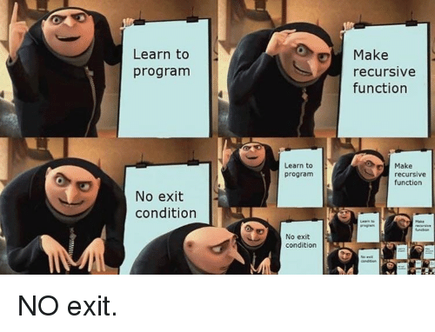
Termination Condition
Copyright © 2008 W. W. Norton & Company.
All rights reserved.

Slide 90
The Quicksort Algorithm
Recursion is most helpful for sophisticated algorithms that require a function to call itself two or more times.
Recursion often arises as a result of an algorithm design technique known as divide-and-conquer, in which a large problem is divided into smaller pieces that are then tackled by the same algorithm.
Copyright © 2008 W. W. Norton & Company.
All rights reserved.

Slide 91
The Quicksort Algorithm
A classic example of divide-and-conquer can be found in the popular Quicksort algorithm.
Assume that the array to be sorted is indexed from 1 to n.
Quicksort algorithm
  1. Choose an array element e (the “partitioning element”), then rearrange the array so that elements 1, …, i – 1 are less than or equal to e, element i contains e, and elements i + 1, …, n are greater than or equal to e.
  2. Sort elements 1, …, i – 1 by using Quicksort recursively.
  3. Sort elements i + 1, …, n by using Quicksort recursively.
Copyright © 2008 W. W. Norton & Company.
All rights reserved.

Slide 92
The Quicksort Algorithm
Step 1 of the Quicksort algorithm is obviously critical.
There are various methods to partition an array.
We’ll use a technique that’s easy to understand but not particularly efficient.
The algorithm relies on two “markers” named low and high, which keep track of positions within the array.
Copyright © 2008 W. W. Norton & Company.
All rights reserved.

Slide 93
The Quicksort Algorithm
Initially, low points to the first element; high points to the last.
We copy the first element (the partitioning element) into a temporary location, leaving a “hole” in the array.
Next, we move high across the array from right to left until it points to an element that’s smaller than the partitioning element.
We then copy the element into the hole that low points to, which creates a new hole (pointed to by high).
We now move low from left to right, looking for an element that’s larger than the partitioning element. When we find one, we copy it into the hole that high points to.
The process repeats until low and high meet at a hole.
Finally, we copy the partitioning element into the hole.
Copyright © 2008 W. W. Norton & Company.
All rights reserved.

Slide 94
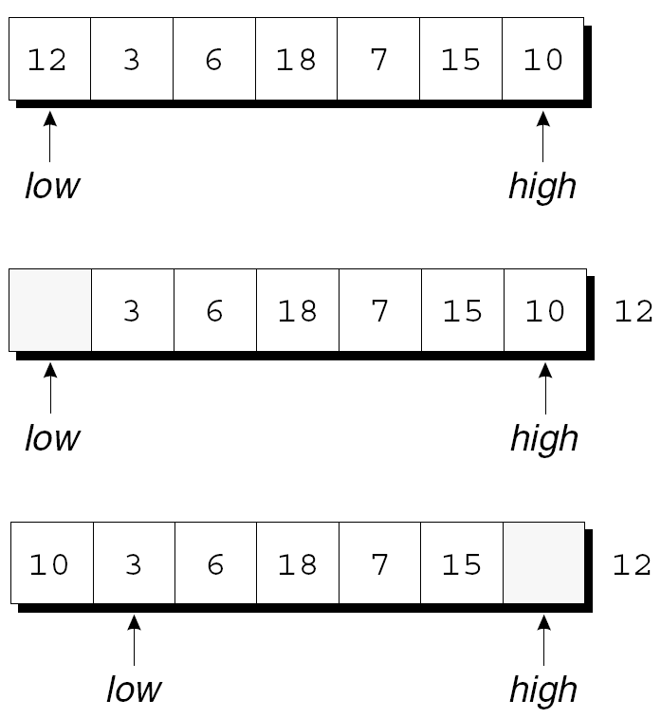
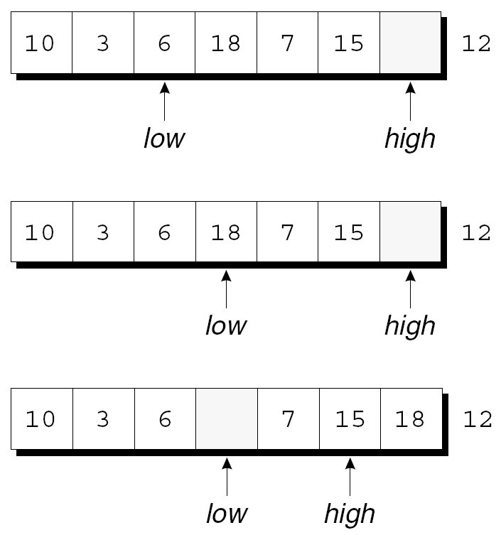
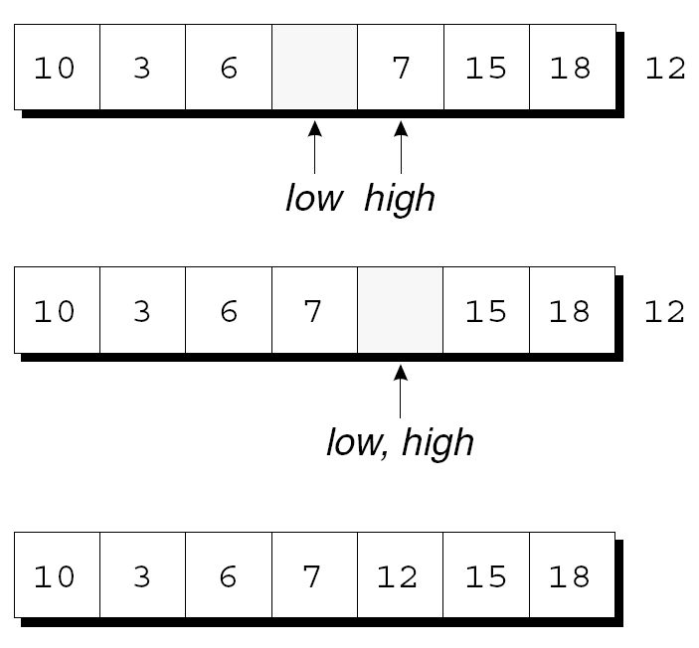
The Quicksort Algorithm
Example of partitioning an array:
Copyright © 2008 W. W. Norton & Company.
All rights reserved.

Slide 95
The Quicksort Algorithm
By the final figure, all elements to the left of the partitioning element are less than or equal to 12, and all elements to the right are greater than or equal to 12.
Now that the array has been partitioned, we can use Quicksort recursively to sort the first four elements of the array (10, 3, 6, and 7) and the last two (15 and 18).
Copyright © 2008 W. W. Norton & Company.
All rights reserved.

Slide 96
Program: Quicksort
Let’s develop a recursive function named quicksort
that uses the Quicksort algorithm to sort an array of integers.
The qsort.c program reads 10 numbers into an array, calls quicksort to sort the array, then prints the
elements in the array:
Enter 10 numbers to be sorted: 9 16 47 82 4 66 12 3 25 51
In sorted order: 3 4 9 12 16 25 47 51 66 82
The code for partitioning the array is in a separate function named split.
Copyright © 2008 W. W. Norton & Company.
All rights reserved.

Slide 97
qsort.c
/* Sorts an array of integers using Quicksort algorithm */
#include <stdio.h>
#define N 10
void quicksort(int a[], int low, int high);
int split(int a[], int low, int high);
int main(void)
{
int a[N], i;
printf("Enter %d numbers to be sorted: ", N);
for (i = 0; i < N; i++)
scanf("%d", &a[i]);
quicksort(a, 0, N - 1);
printf("In sorted order: ");
for (i = 0; i < N; i++)
printf("%d ", a[i]);
printf("\n");
return 0;
}
Copyright © 2008 W. W. Norton & Company.
All rights reserved.

Slide 98
void quicksort(int a[], int low, int high)
{
int middle;
if (low >= high) return;
middle = split(a, low, high);
quicksort(a, low, middle - 1);
quicksort(a, middle + 1, high);
}
Copyright © 2008 W. W. Norton & Company.
All rights reserved.

Slide 99
int split(int a[], int low, int high)
{
int part_element = a[low];
for (;;) {
while (low < high && part_element <= a[high])
high--;
if (low >= high) break;
a[low++] = a[high];
while (low < high && a[low] <= part_element)
low++;
if (low >= high) break;
a[high--] = a[low];
}
a[high] = part_element;
return high;
}
Copyright © 2008 W. W. Norton & Company.
All rights reserved.

Slide 100
Program: Quicksort
Ways to improve the program’s performance:
  Improve the partitioning algorithm.
  Use a different method to sort small arrays.
  Make Quicksort nonrecursive.
Copyright © 2008 W. W. Norton & Company.
All rights reserved.

