Slide 1


Slide 2
Islamic Banking and Conventional banking
Is there any difference?
By:
Muhammad Umer
Muhammad Ahmed Mohsin
Tariq Umar
Danial Ahmed
Saad Bakhtiar

Slide 3
1400 years ago, people thought that trading and interest were the same.
But Allah has eradicated this thinking and says in the Quran:
“That is because they say, ‘Trade is (just) like interest.
But Allah has permitted trade and has forbidden interest.”
Al Baqarah: 275

Slide 4

What's a Bank?
A bank is a financial institution that uses money deposited by customers for investment, pays it out when required, makes loans with varying conditions, and exchanges currency.
Main Categories:
Conventional Banking (Based on lending money on interest)
Islamic Banking (Based on the Islamic principles of Quran and Sunnah)

Slide 5
Conventional Banking
DEFINITION:
Conventional Banks (CBs) borrow money from depositors at a low interest rate and lend them to borrowers at a high interest rate
Banks are a very important part of the economy because they provide vital services for both consumers and businesses.
Just like any other business, the goal of a bank is to earn a profit for its owners. For most banks, the owners are their shareholders.

Slide 6
Working
To explain these points let’s take small example. Suppose you receive a paycheck of 10,000$.
You do not want the money right now. So, we will deposit that money in the bank. The bank will give you a 5% interest on that money.
Suppose someone is need of money. The bank will provide your money to that person by just keeping 10% of your cash reserves in the bank.
Hence, your bank account on numbers will show 10,000$ and 9,000$ are given to that person as a loan.
Thus, a cash flow of 19,000$ in the market and bank created this money out of thin air.

Slide 7
Base of Conventional Banking
So basically, the conventional banking is based primarily based on interest.
Then the question arises that how do the Islamic banks work?
The answer is that the Islamic banks are based on trade and they earn their profits through trade.
Now the banks lend the money you deposited to business and charge them higher interest rates.
The difference between the interest on deposited money to the interest on lent money makes up the profit for these banks.
The main idea behind this is to have more deposits which, henceforth, create more loans.

Slide 8
Fractional Reserve Banking
The banks lend out our money to businesspeople and charge interest on them. So, this may result in loss of our money if the business drowns in loss?
Well, the answer is basically that the banks keep out 10% of our deposits as reserves called fractional reserves.
These reserves our decided by Federal Reserve Bank. Moreover, the government provides a contract to the banks that if they go bankrupt then the government will help them.
Thus, this gives banks an edge to invest in risky business because they have a backup for them.
The drawback of fractional reserve banking is that if all the people come for transaction of the money all at the same time thus the bank will go bankrupt

Slide 9
Why Do Banks Take Interest?
Why Islam had forbidden interest but still banking systems are dependent on it?
While the main focus of the conventional banking is to operate as borrowers and lenders, the central role of Islamic banking is to operate as traders.
The trading activities include the leasing of assets, sale of commodities, investing into business and providing services.
In Islam the earnings come from the profit of sale whereas the interest is just the transfer of money where the lender has full hold over the lent money.

Slide 10
Why Islam Prohibited Interest and Not Profit
The source of profit is purely knowledge and skill whereas the source of interest is the control over the quantity of money only.
Profit brings on a creation in value and increases the living standards whereas the interest is the unjust transfer of money.
The profit does not always want the additional money but the interest forces you to give the additional money and the interest is not payable in aggregates
The interest money develops competition among the people and the wealth remains accumulated in a few hands whereas the profit distributed wealth among the people and the sense of accumulation of wealth decreases.
The biggest advantage of profit over the interest is that profit is the all positive sum game. That means that profit to one person is not loss to another person. Whereas the interest is the zero-sum game or maybe negative sum game because the loaner is indebted to more amount than payed.
The profit is determined after you have made it whereas the interest is upfront that means it is determined before the loan.

Slide 11
Demanding Benchmarks
The conventional system of banking is based on demanding benchmarks rather than targeting benchmarks.
This means that the investor decides ex-ante the profit he is going to get from the investment despite suffering a loss.
Thus, if banks decide the amount of profit before the investment then that profit is also included in interest because it is ex-ante not ex-post.
If the businessman is unable to deliver the loan with interest in given amount of time, then that piece of property of equal value is snatched from the business owner.
Now in targeted benchmark the profit is targeted and is tried to achieved. Though if we fail to turn up the profit there is no penalty on that because it was only intended to be achieved.

Slide 12
Leasing in Conventional Banking
A lease is a contract outlining the terms under which one party agrees to rent property owned by another party. It guarantees the lessee, the person the asset is leased to, use of an asset and guarantees the bank, the owner of the asset, regular payments for a specified period in exchange.
In conventional banking, the expenses incurred in the process of purchase of asset are paid by the Customer, and also the penalty charges taken from Customer on late payment are taken as income by the Bank.
This exploits the lessee because unrestricted power has been given to Bank to terminate the lease unilaterally. The unjust and exploiting behavior of people has been condemned by the Prophet (PBUH):
Ali ibn Abi Talib reported: The Messenger of Allah, peace and blessings be upon him, said;
“Verily, Allah is kind and he loves kindness. He grants reward for kindness what is not given for harshness.”
Musnad Ahmad 904

Slide 13
Saving Accounts
There is a special type of account in banks called “saving accounts” which basically increases your money without you doing anything and by “lending” the money.
Savings accounts also earn interest, so it pays to keep any unneeded funds in a savings account instead of accumulating cash in your checking account.
The bank invests a portion of your money into other businesses or gives loans to others with your money. And eventually they give you your money back with a fixed interest rate.
The Prophet (S.A.W) said;
"Certainly a time will come when people will not bother to know from where they earned the money, by lawful means or unlawful means."
Sahih al-Bukhari 2083

Slide 14
The Use of Credit Cards
The simplest way to think of a credit card is as a type of short term loan. When you open a credit card account, your credit card company gives you a set credit limit. Credit cards let you borrow money up to the set limit, which must be repaid.
You'll be charged interest if you don't pay your full statement balance by its due date. Certain scholars argue that credit cards are impermissible as one is entering into a fundamentally impermissible contract.
Others deem credit cards permissible to the extent one does not actually borrow from the credit card company. The act of borrowing some money from someone interest-free is not itself impermissible – so long as you’re sure you’ll be able to pay the money back at the end and before the interest kicks in.
Prophet (S.A.W) was reported by Abu Hurairah to say:
“People will be resurrected (and judged) according to their intentions.”
Sahi al Bukhari Book 37, Hadith 130

Slide 15
How people may be inclined to Conventional Banking
In Non-Islamic banks: The bank says: $10,000 compounded on a Monthly basis over the course of 5 years at a 4% interest rate would be worth: $12,210. They tell you let's make the monthly payment $200. They calculate the interest every month.
What some Islamic banks do is: The bank says I will buy the car for $10,000, would you buy it for $15,000? We don't call it interest, its profit. If you say yes they will buy it. You still have the option to refuse buying it from the bank. The $15,000 will be split into 60 payments of $250.
So basically they aren’t doing any work, except buying a car and selling it for much more and at times exploiting the person in need. Modern Islamic banks may disguise interest as profit, and continue exploiting the poor even more than non-Islamic banks.

Slide 16
Conclusion on Conventional Banking
The jurists who consider this relationship to be financial lending formulate it as a loan which has brought benefit to the lender. Thus, its ruling would be based on it being unlawful usury. But some hold different opinions, because some considered this a matter of necessities that are permissible for a Muslim to undertake whenever he is forced to, which is deduced from the words of God:
“But if anyone is forced to eat such things by hunger, rather than desire or excess, he commits no sin.” Surah al Baqarah [2:173]
Other jurists maintain that this does not fall under the heading of necessities since necessity is legally defined as ‘something without which one would perish or come close to perishing’. Some of the jurists amongst this group maintain that it is permissible, based upon the principle of need being given the status of necessities - whether those needs are common or individual.

Slide 17
Conclusion on Conventional Banking
“But those who take usury will rise up on the Day of Resurrection like someone tormented by Satan’s touch. That is because they say, ‘Trade and usury are the same,' but God has allowed trade and forbidden usury. Whoever, on receiving God’s warning, stops taking usury may keep his past gains—God will be his judge—but whoever goes back to usury will be an inhabitant of the Fire, there to remain.” [2:275]
Surah al Baqarah [2: 275]
However, the controversy revolves around the true nature of what is derived from banks: Whether it is an instance of usury and invalid contracts (which are unlawful); or a new form of contract which would be permissible if it achieves the interests of the parties involved and is free of anything which is legally prohibited. A person should avoid such controversial topics and have good intensions and do research on the bank before partnering up and forming a relation with them.

Slide 18
Islamic Banking
Definition:
It refers to those finance and banking activities that adhere and comply with the Shariah.
Shariah:
The Shariah are those set-specific instructions according to which the Muslims live their life. Such laws are derived from the following sources;
Sources:
The Quran
The Sunnah and Hadiths of the Prophet (PBUH)
Fiqah (Interpretations of Quran and Hadiths by Scholars)
Qiyas (Relating the past with Modern Era)

Slide 19
Riba & Its Types
Definition:
Literally, it means ‘increase’.
It is an Arabic word, which can be translated to usury, i.e. the interest that is fixed on some product or commodity.
It is of two types:
Riba-an-Nasiyah:
The increased amount while returning a loan
Riba-al-Fadl:
Plenitude taking in trade of homogenous commodities

Slide 20
Fundamental Principles of Islamic Banking
Inviolability of Pact
Profit and Loss Sharing
Absence of Riba (Interest)
Economic Purpose/Activity
Fairness
No Investment in Prohibited Industries
Profit through Equity Participation
Zakat

Slide 21
Methods of Operation
Islamic banks are financing institutes just like the conventional banks, but they have their own policy and procedure based on the guidelines of shariah.
Some of the Method an Islamic bank can implement during an agreement are:
Mudharaba
Qarz
Murabaha
Ijarah
Ijarah Wal Iqtina
Musawamah
Istisna
Musharakah
Bai Muajjal
Bai Salam

Slide 22
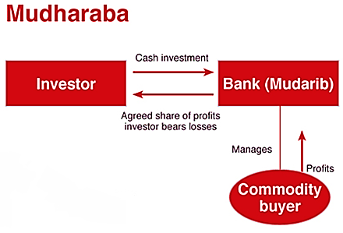
Mudharaba
Derived from the Arabic “daraba” which means travelling for business.
One party invests wealth the other provides service.
Qarz
Qarz means loan.
Under this agreement the depositor can keep its money with either of the two conditions, i.e. assurance (Amanah), or protection (Wadiah).
Amanah: The bank cannot use the money. And Full amount is refunded.
Wadiah: Bank can use money but depositor have no right on the money.

Slide 23
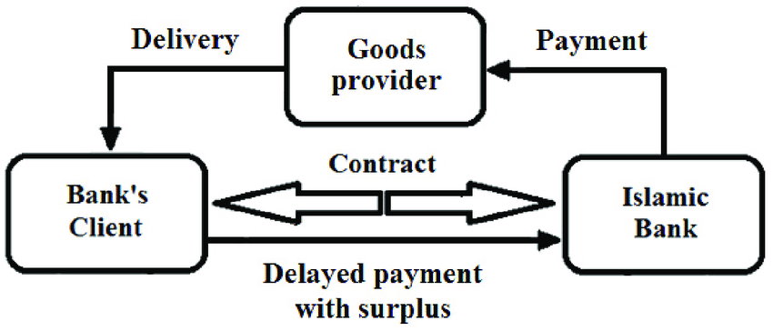
Murabaha
Referred to as ‘cost-plus financing’.
The cost and profit is declared in advance.
Ijarah
Literally, means ‘giving some product on rent’.
Two types:
The employer (musta’jir) pay for the services of his employee (ajir).
Giving some asset or property to someone on rent. In English we have the word ‘leasing’ for it.

Slide 24
Ijarah Wal Iqtina
An agreement in which a Shariah Bank provide some asset to the client and the client pays for it in installments. Upon the completion of installments, the ownership of the asset is transferred to the client. The rental price contains the original price of the asset plus profit for the bank.
Muswamah
It can be defined as a general sale, in which the two parties negotiate the price.
Same as Murabaha , the only difference the retailer does not have to show the original value, other settings are same as Murabaha.

Slide 25
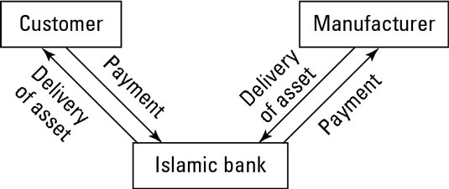
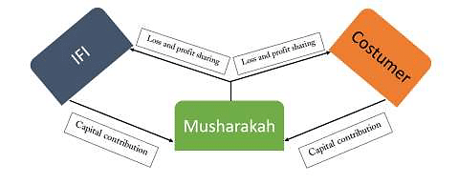
Istisna’
Mostly related to construction related agreements.
Date of delivery fixed.
Quality Guaranteed.
Payment done in the beginning.
Can not be cancelled one-sidedly.
Musharakah
Literal meaning “partnership or having shares in something”.
It is a solution for the interest culture.
Profit and Loss sharing.

Slide 26
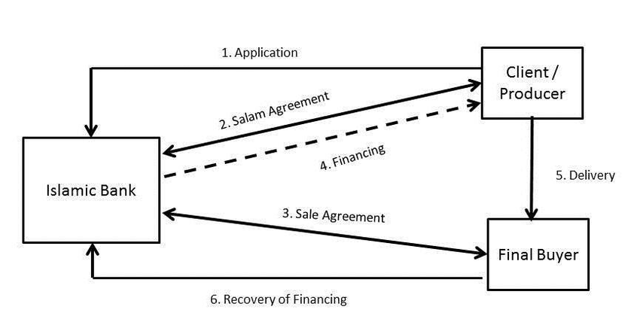
Bai Salam
A sale contract in which payment is done in advance and goods to be delivered later.
Mostly related to the crops.
Objections on quality have to entertained.
Cannot be on products like Gold/Silver.
Bai Mujjal
Lexically, it refers to credit sale.
In such agreement, the bank provides the service or asset at the time of agreement, and payment is given by the costumer at some later point in time.
The original price and profit is predefined.

Slide 27
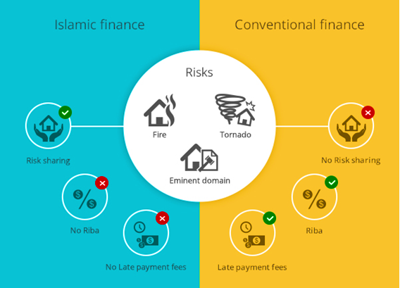
Similarities and Differences

Slide 28
General Comparison
Islamic banking
Conventional Banking
Operates on the principles of Islamic laws of Shariah.
Earns through Profit & Loss Sharing (PLS) system.
Operates on the manmade principles, that are, naturally, unethical
Earns profit through interests

Slide 29
Operatory Differences
Islamic banking
Conventional Banking
It can be done through the following methods:
Sale of Commodities
Leasing of assets
Proving services
Investment into Business
It is mostly done by giving loans on interests and earning through the profit gained.

Slide 30
Deposits
Islamic banking
Conventional Banking
Reward on saving money from the deposits for depending upon the deposits through Mudarabah or Musharakah.
The reward on saving money is fixed due to fixed interest.

Slide 31

Earning in Islamic banking

Slide 32

Earning in Conventional Banking
Interest Rates

Slide 33
Thank You!

