Slide 1

School of Electrical Engineering and Computer Science
Department of Electrical Engineering
EE-371 : Control Systems
Lecture#07,08
(Transfer Functions of Electro Mechanical Systems)
Chapter #02
Text Book: Control Systems Engineering by Norman S. Nise 5th Edition
Instructor: Ms Neelma Naz
Class: BEE 12 C/D

Slide 2
Transfer Functions for Systems with Gears

Slide 3
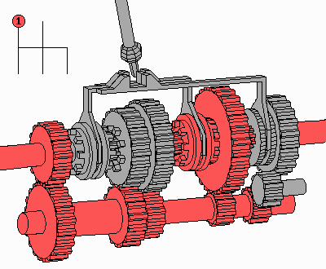
Manual Transmission Mechanism
The mechanism also called as “stick shift” is used in cars to change gears manually

Slide 4
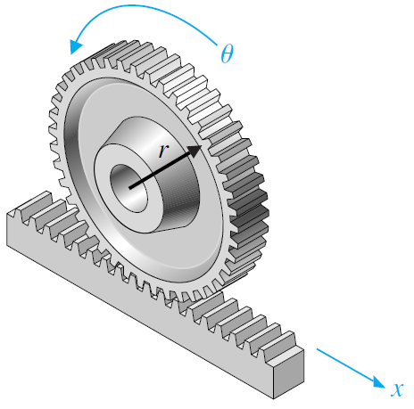
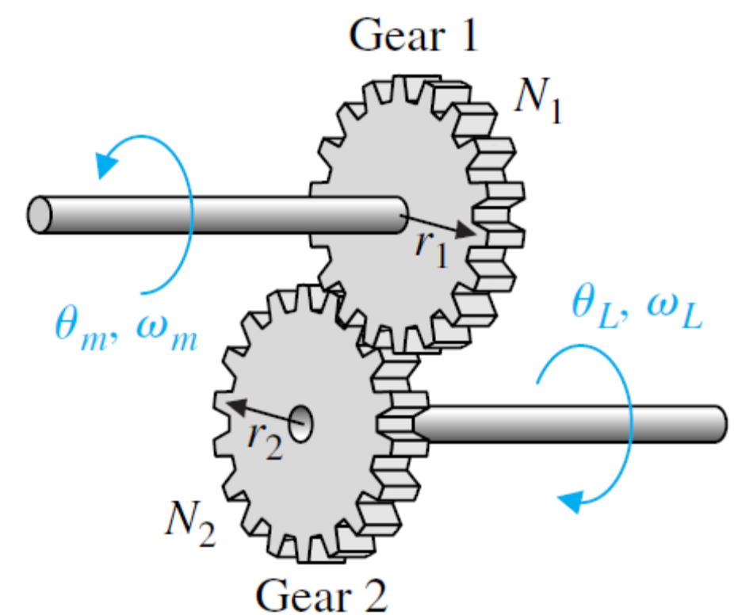
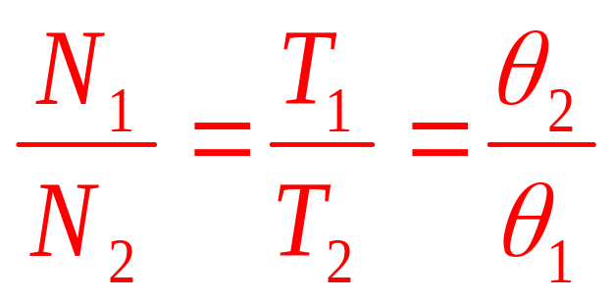

Slide 5
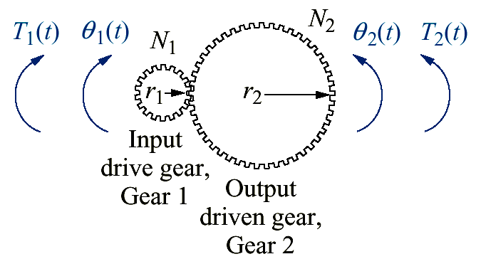
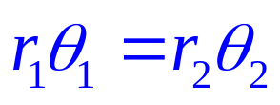
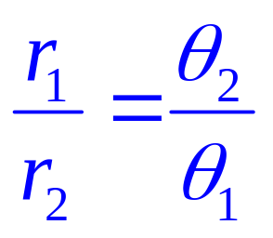
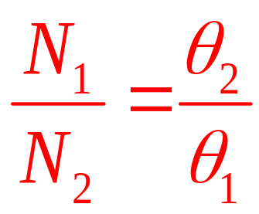
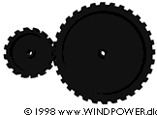
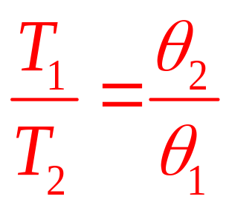
A gear system

Slide 6
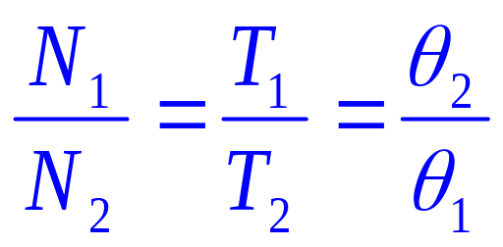
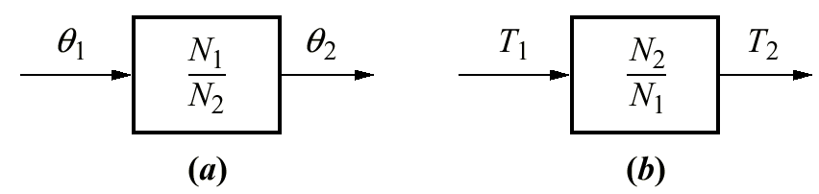
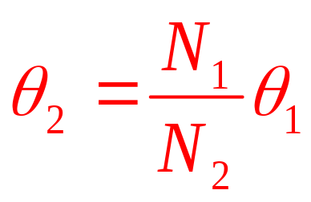
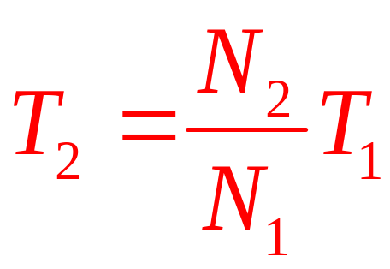
Transfer functions for
a. angular displacement in lossless gears and
b. torque in lossless gears

Slide 7
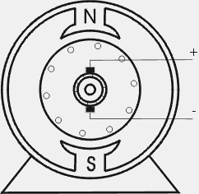
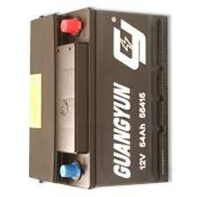
Which system has More Torque Less Speed? Why?

Slide 8
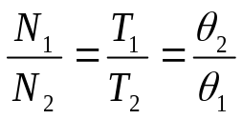
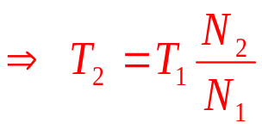
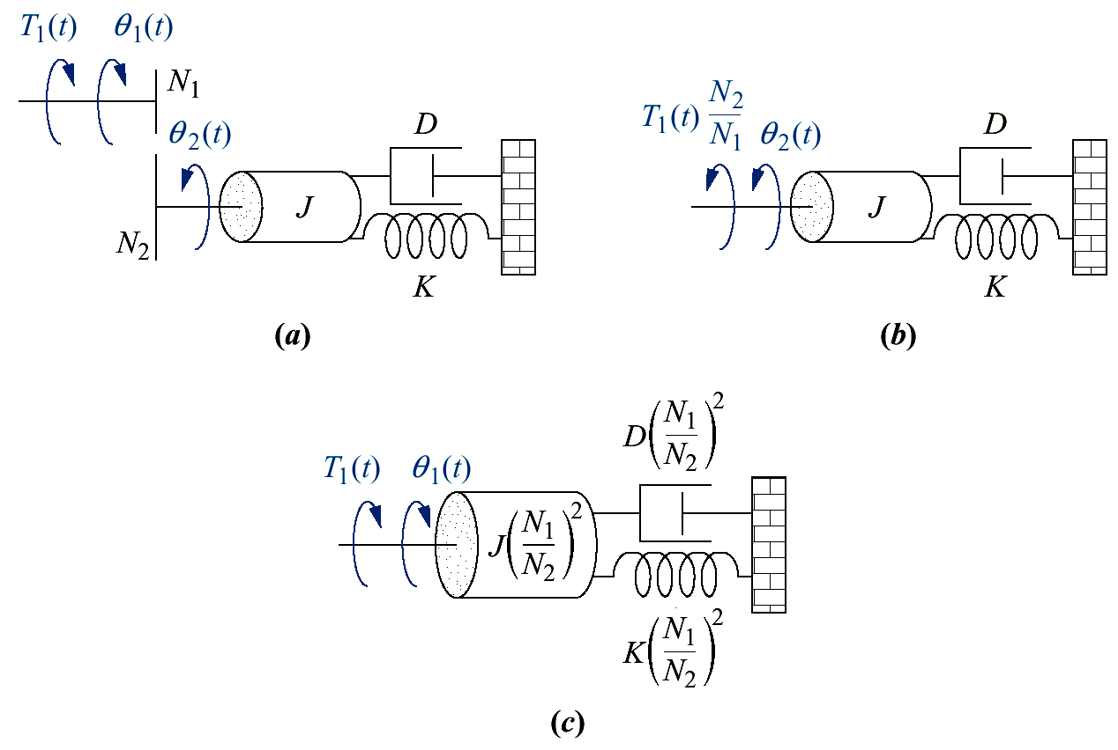
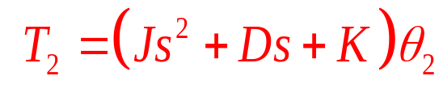
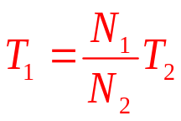
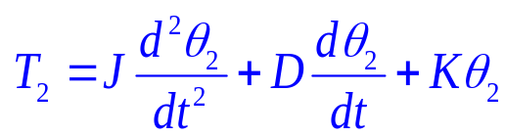
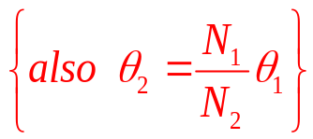
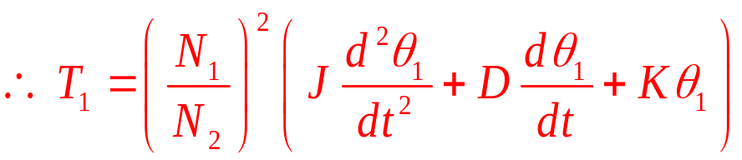
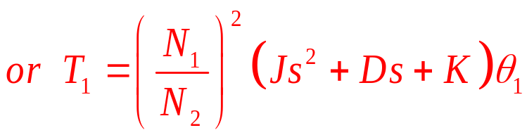
Gears Eliminated
(a) Rotational system driven by gears
Equivalent system at the output (input torque reflected to output)
Gears Eliminated
(c) Equivalent system at the input (impedances reflected to input)

Slide 9
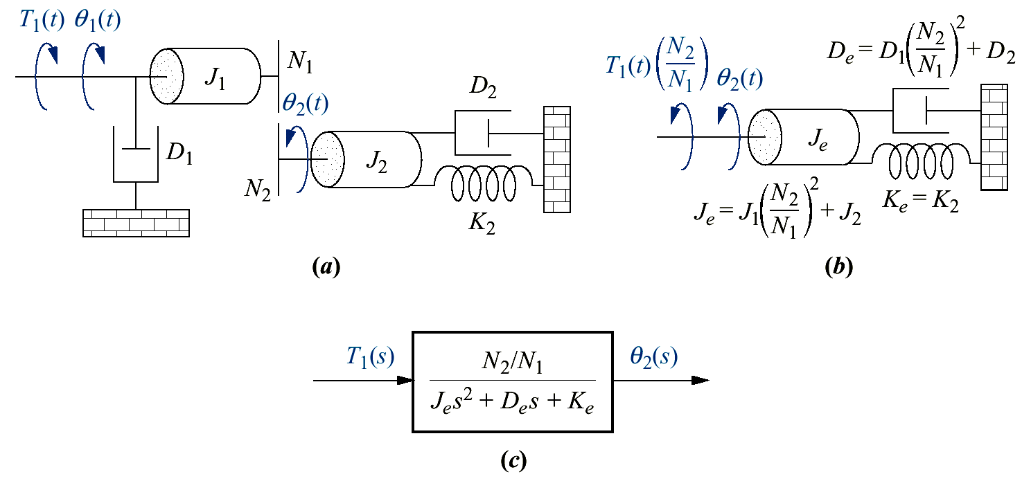
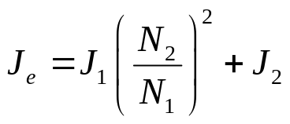
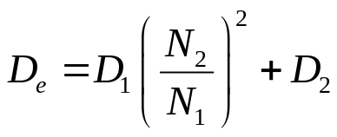

Example 2.21
system after reflection of torques and impedance to the output shaft
Rotational mechanical system with gears
block diagram

Slide 10
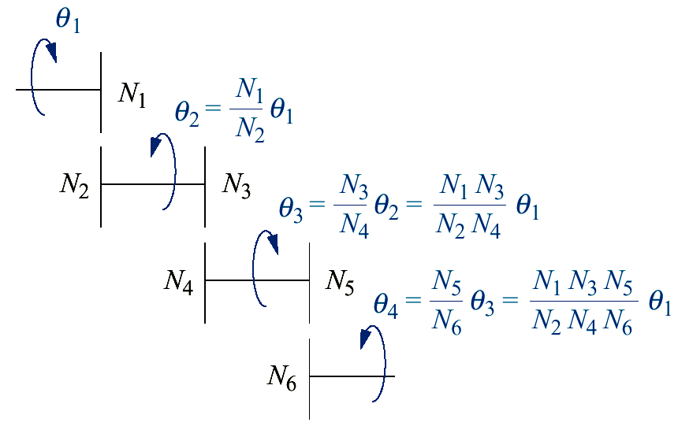
Gear train

Slide 11
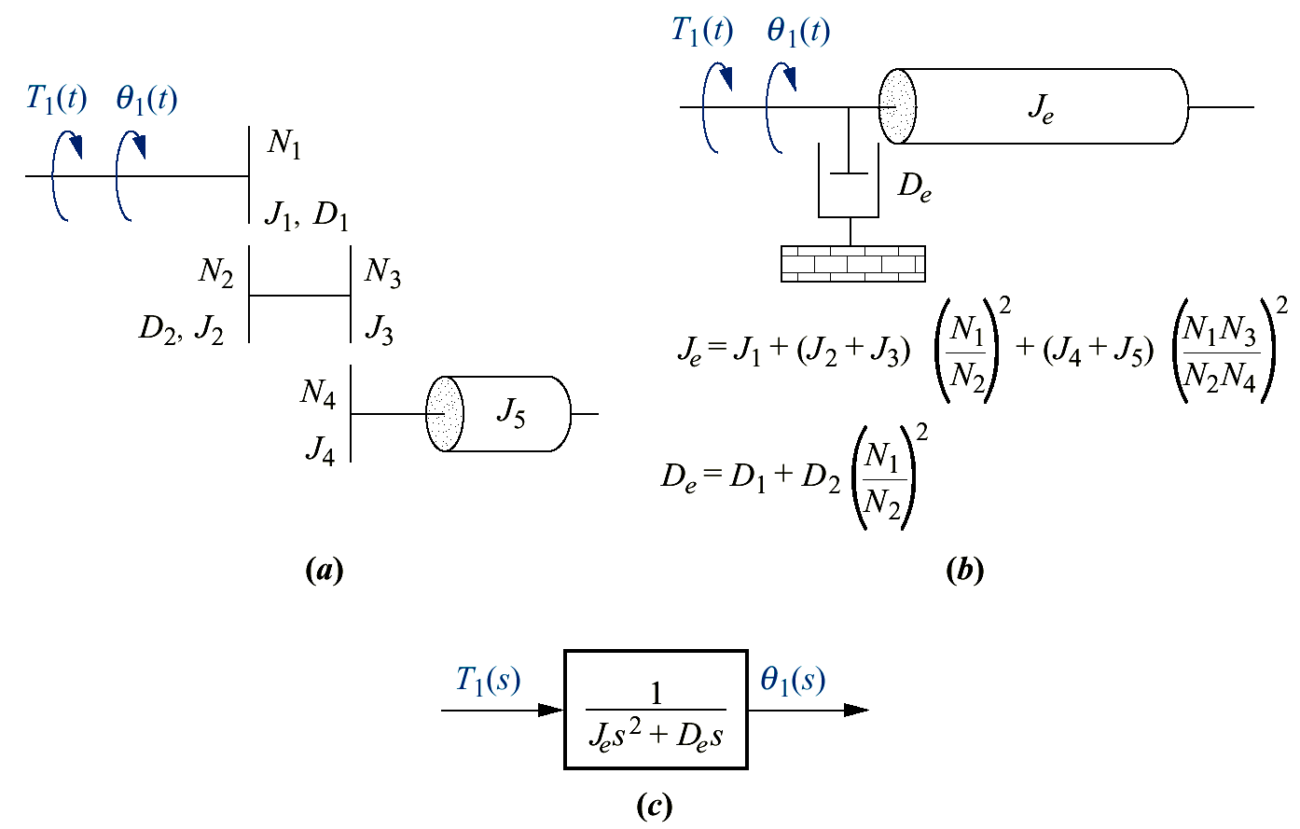
a. System using a gear train;
b. equivalent system at the input;
c. block diagram

Slide 12
Electromechanical System Transfer Functions

Slide 13
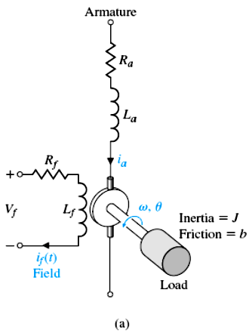
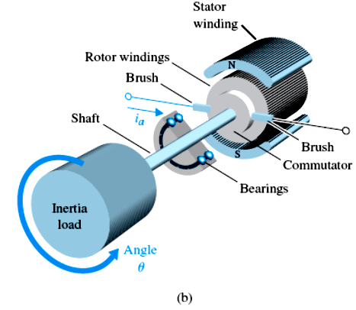
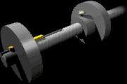

Slide 14
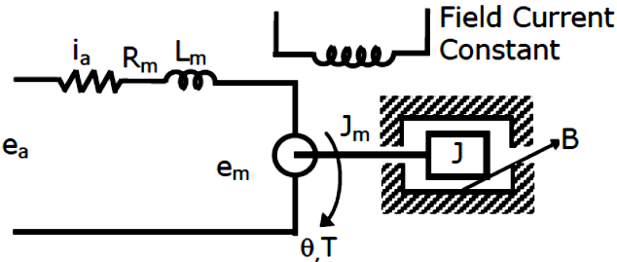





There are two types of dc motor used in control systems:
The field control
The armature control
Armature Controlled dc motor
?

Slide 15

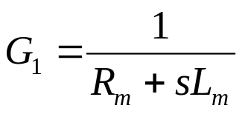

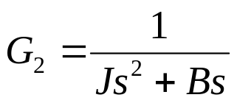


E_{a}
-E_{m}
T
ϴ
E_{a}
I_{a}
K_{T}
-
E_{m}
K_{m}s

Slide 16
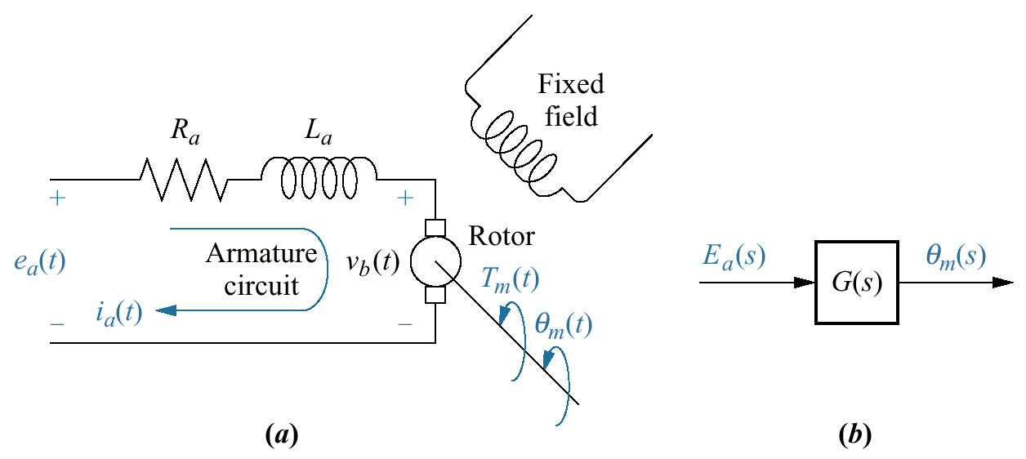
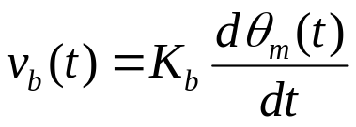


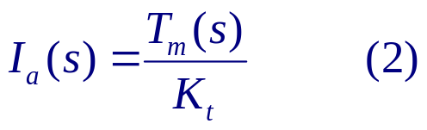


Figure 2.35
DC motor: a. schematic b. block diagram
v_{b}(t) the back electromotive force (back emf)
K_{b} is a constant of proportionality , known as back emf constant
T_{m} is the torque developed by the motor
K_{t} is the motor torque constant
Loop Equation
Substituting V_{b}(s) and I_{a}(s) from (1) and (2)

Slide 17
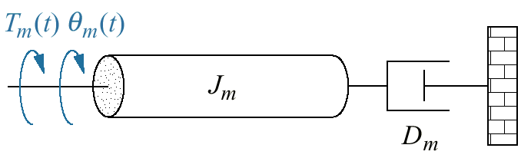


Figure 2.36
Typical equivalent mechanical loading on a motor
(3)
Substituting for T_{m}(s) in (3)

Slide 18




Neglecting L_{a}
How to evaluate the constants ???
J_{m} , D_{m}
K_{t}/R_{a} , K_{b}

Slide 19
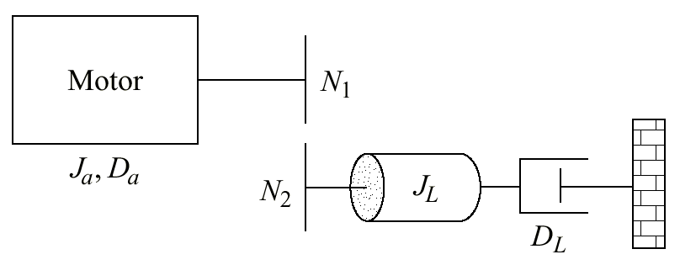

Figure 2.37
DC motor driving a rotational mechanical load
J_{m} , D_{m}

Slide 20
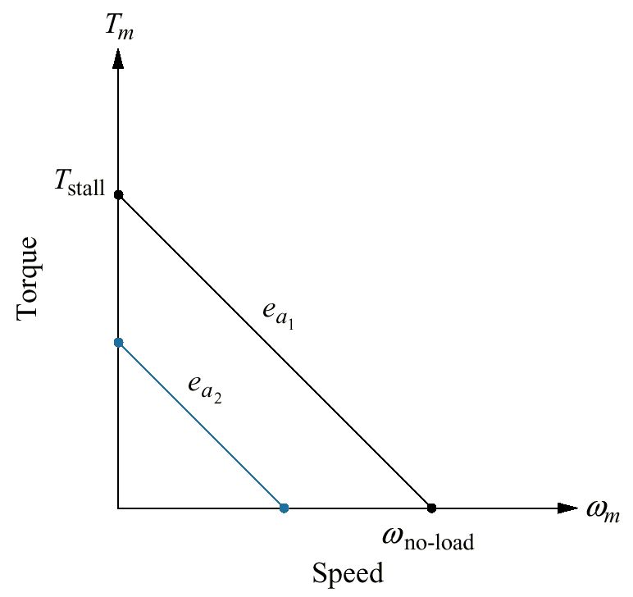


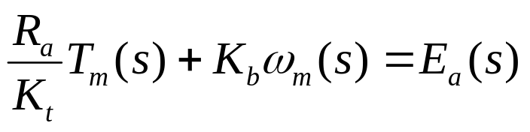
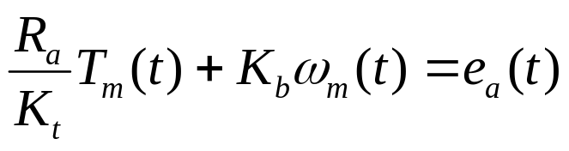


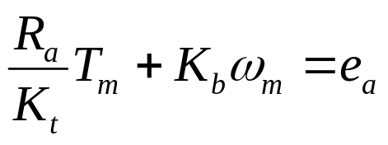


Figure 2.38
Torque-speed curves with an armature voltage, e_{a}, as a parameter
K_{t}/R_{a} , K_{b} ??
In steady state
can be found from a dynamometer test of the motor

Slide 21
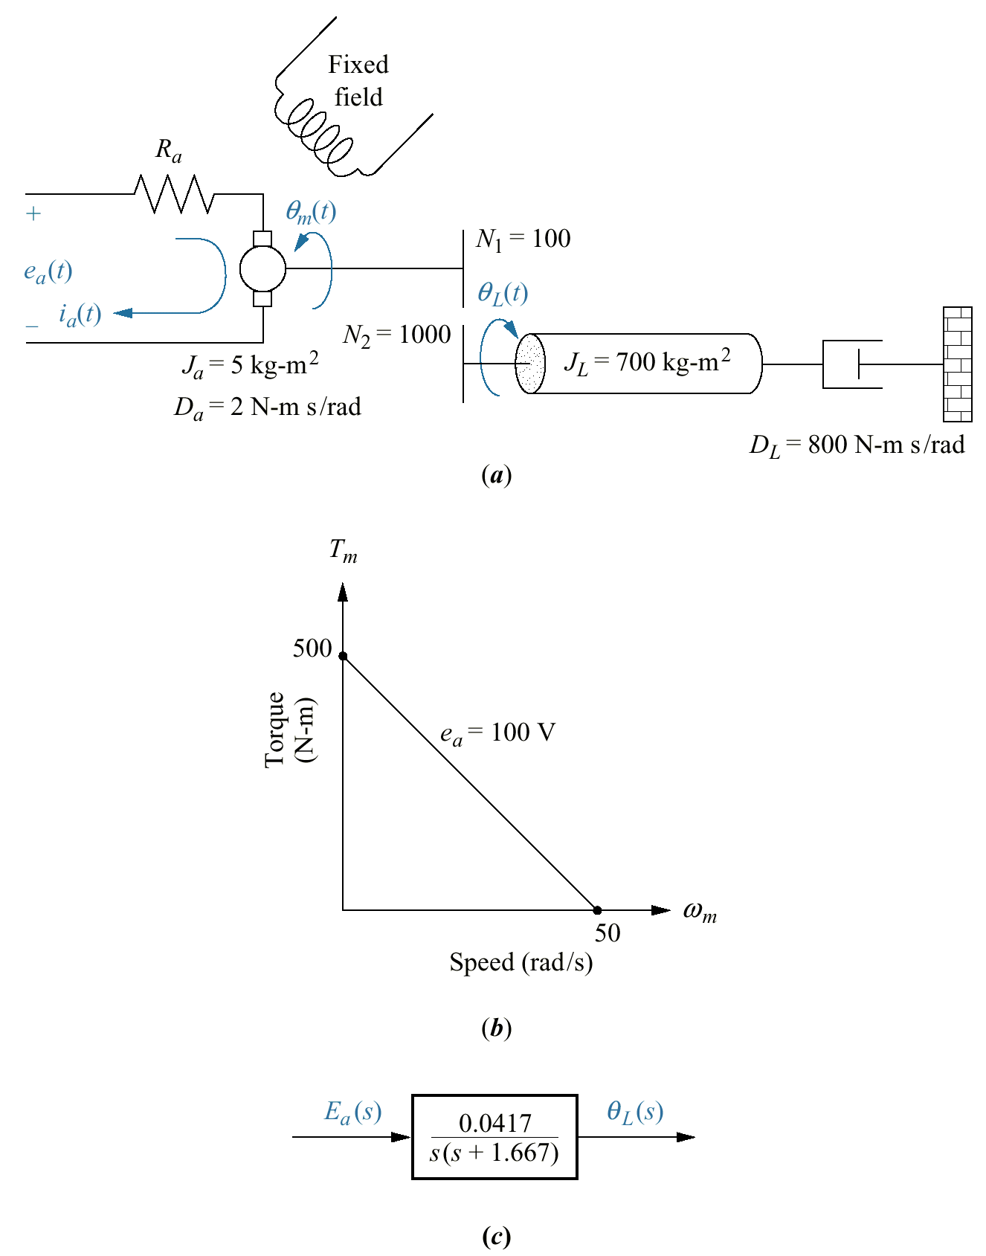





Example 2.23
Transfer Function—DC Motor and Load
PROBLEM: Given the system and torque-speed curve of Figure 2.39(a) and (b), find the transfer function, Ɵ_{L}(s)/Ea(s).
SOLUTION: Begin by finding the mechanical constants, J_{m} and D_{m}.
The total inertia at the armature of the motor is:
The total damping at the armature of the motor is:
From the torque speed curve

Slide 22


Figure 2.39 a. DC motor and load; b. torque-speed curve; c. block diagram

Slide 23
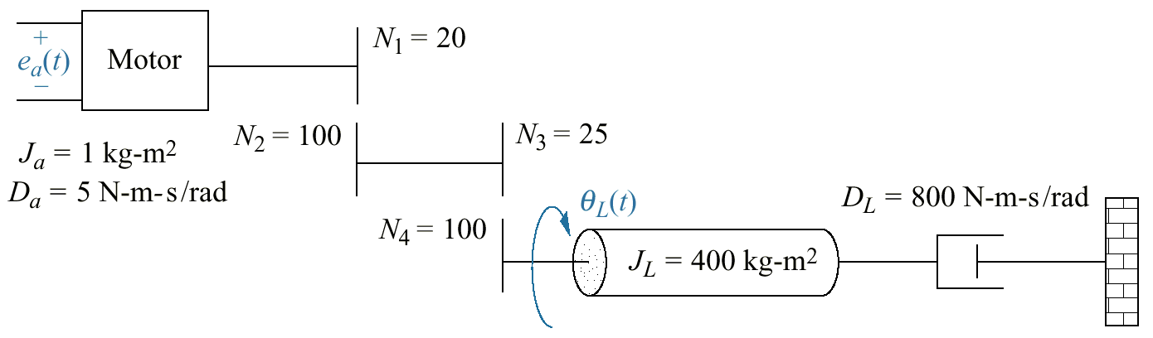
Figure 2.40
Electromechanical system for
Skill-Assessment
Exercise 2.11
Home Assignment
(submit)

Slide 24


