Slide 1
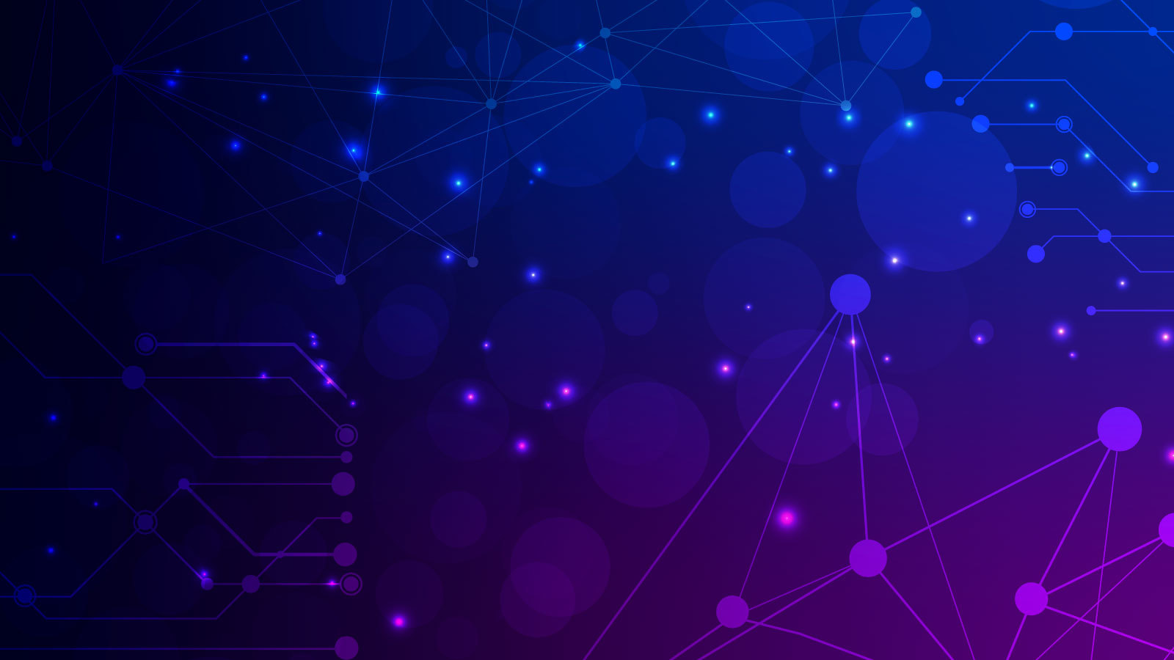
Deep Reinforcement Learning for Dynamic Resource Allocation in Wireless Networks
Group Members
Muhammad Ahmed Mohsin (333060)
Muhammad Umer (345834)
Tariq Umar (334943)

Slide 2
Introduction
Limitations of Conventional Algorithms
Reinforcement Learning Agents Analyzed
Deep Q-Network (DQN)
Proximal Policy Optimization (PPO)
Recurrent Replay Distributed DQN (R2D2)
Resource Allocation in Wireless Networks

Slide 3
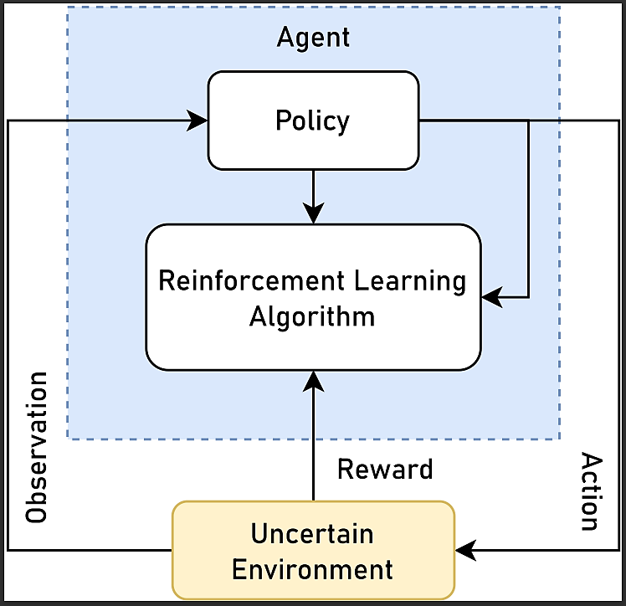
Reinforcement Learning
Reward-based learning
Reinforcement Learning Agent Characteristics
Lesser mathematical complexity
Captures state of the environment

Slide 4
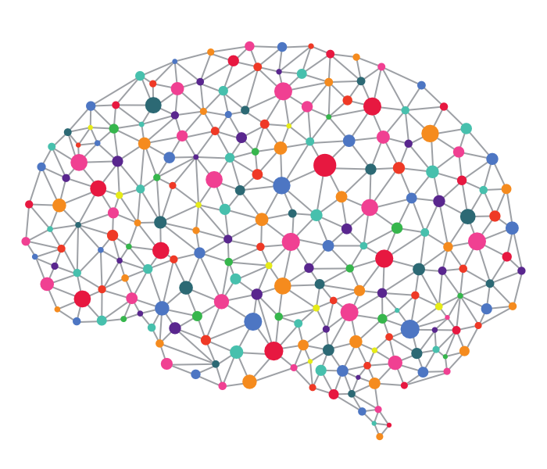
Why Reinforcement Learning?
Can explore a wider range of possible solutions
Can adapt to changes in system dynamics over time and they learn from their mistakes
More robust to noise and disturbances
Compared to PID Controllers
PID controllers are limited to finding a global optimum
PID controllers cannot adapt to changes in system dynamics
PID controllers are more sensitive to noise and disturbances

Slide 5

Environment
The environment is a Massive MIMO wireless network with N base stations (BSs), M antennas per BS, and K users per cell.
The BSs are connected to a central controller (agent)
The channels between the BSs and the users are modeled as Rayleigh fading channels
Task
Maximize the sum rate of the served users subject to power constraints
Action space is the set of all possible power allocations to the BSs
Observation space is the set of all possible channel states and user data rates
Reward is the sum rate of the served users (bps)

Slide 6
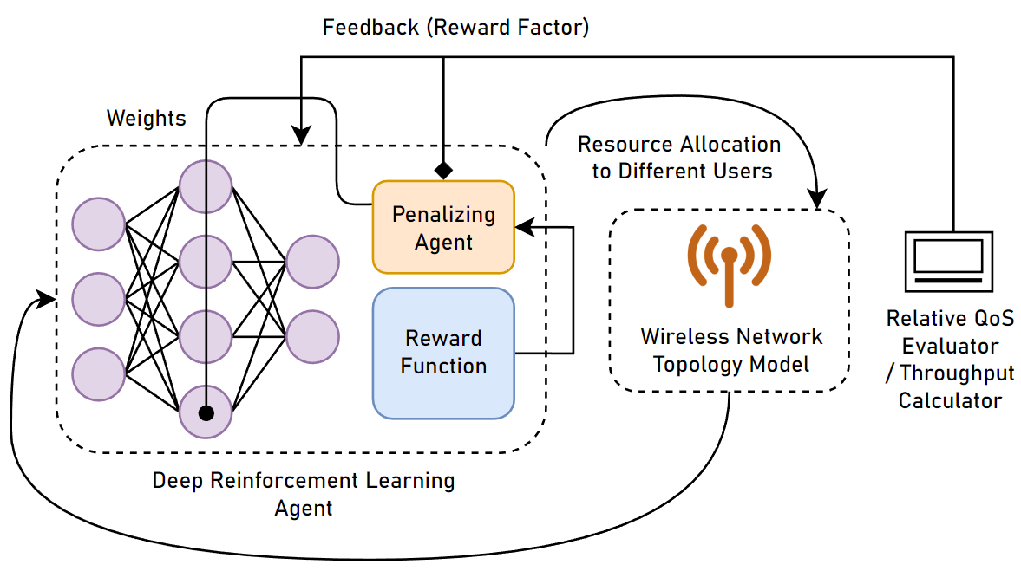
Block Diagram

Slide 7

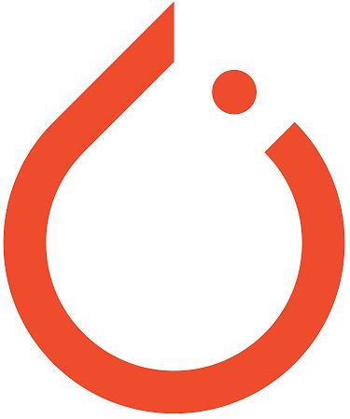
RL Agents
Policy-based Agents: learn a policy function π(a∣s) that maps states to actions. The goal is to find a policy that maximizes the expected return.
Value-based Agents: learn a value function V(s) that estimates the expected return from a state. The goal is to find a value function that is as accurate as possible.
Actor-critic Networks: combine the strengths of policy-based and value-based agents. They learn a policy function π(a∣s) and a value function V(s) simultaneously.
Employed Agents
PPO (Proximal Policy Optimization)
DQN (Deep Q-Network)
R2D2 (Recurrent Replay Distributed DQN)

Slide 8
Employed Agent (PPO)
Parameters
Policy-based model-free reinforcement learning algorithm
Stochastic policy gradient method
Uses clipped surrogate objective function
Robust to high variance
Algorithm
Initialize policy π and critic V
Repeat
Sample a batch of observations from the environment
Estimate the advantage function A(s,a)
Update the policy parameters θ to maximize the clipped surrogate objective function
Until convergence

Slide 9
Employed Agent (DQN)
Parameters
Value-based reinforcement learning algorithm
Uses a neural network to approximate the Q-function
Off-policy and bootstrapping
Experience replay
Fixed target network
Algorithm
Initialize Q-network
Repeat
Initialize replay memory
While not done training:
Play an episode of the environment
Store the experience tuples in the replay memory
Sample a batch of experience tuples from the replay memory
Update the Q-network parameters using the Bellman equation
Until convergence

Slide 10
Employed Agent (R2D2)
Parameters
Recurrent DQN with an Attention layer to handle long-term dependencies
Distributed training with multiple actors and a single learner
Prioritized experience replay to focus on the most informative experiences
N-step Q-learning to reduce the variance of the estimates
Algorithm
Initialize Q-network
Repeat
Initialize replay memory
While not done training:
Play an episode of the environment
Store the experience tuples in the replay memory
Sample a batch of experience tuples from the replay memory
Update the Q-network parameters using the Bellman equation
Until convergence

Slide 11
Results: Performance & Evaluation Criterion
Minimum Episode Reward: lowest possible reward that an agent can achieve in a single episode
Relative Speed of the Agent: number of steps it takes to reach the desired reward.
Stability: measure of how much the reward varies from episode to episode

Slide 12
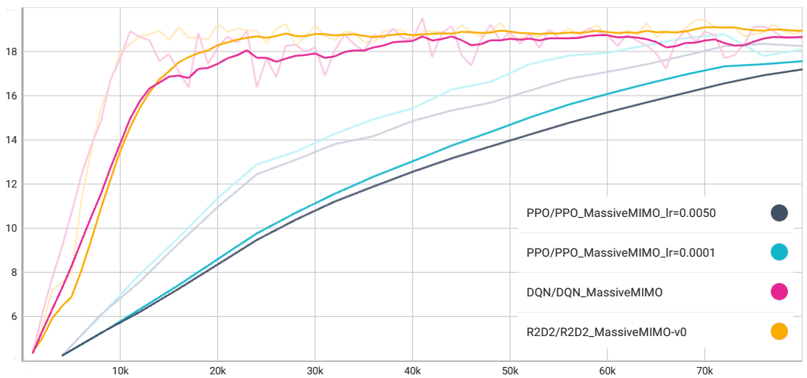
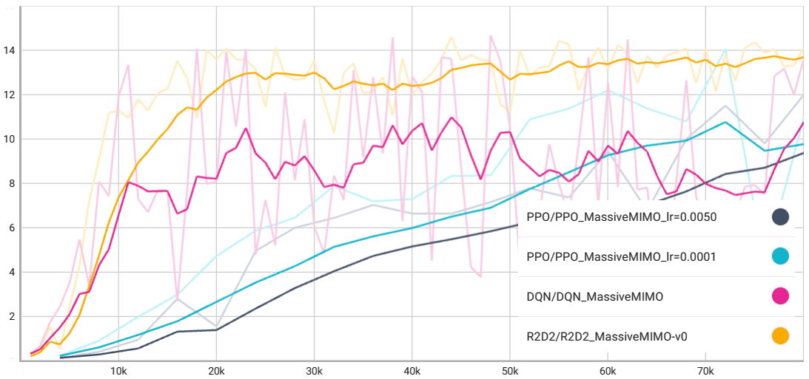
Results (Mean & Min)
Minimum Episode Reward
Mean Episode Reward

Slide 13
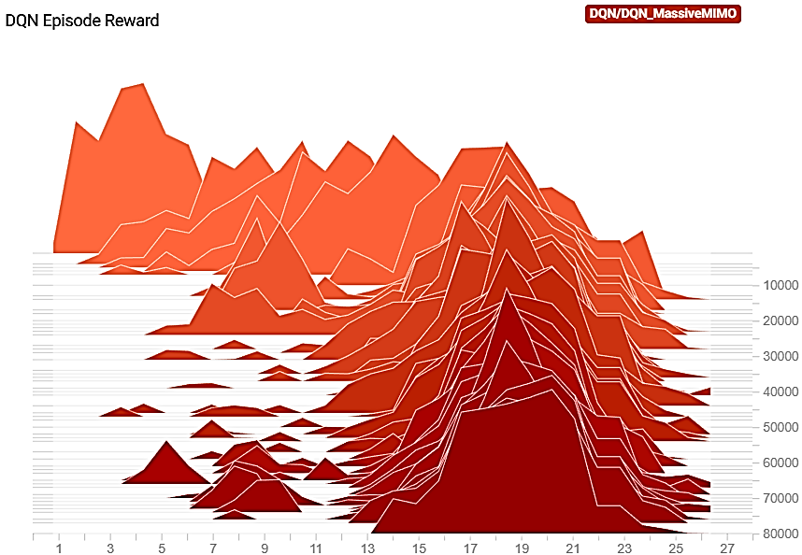
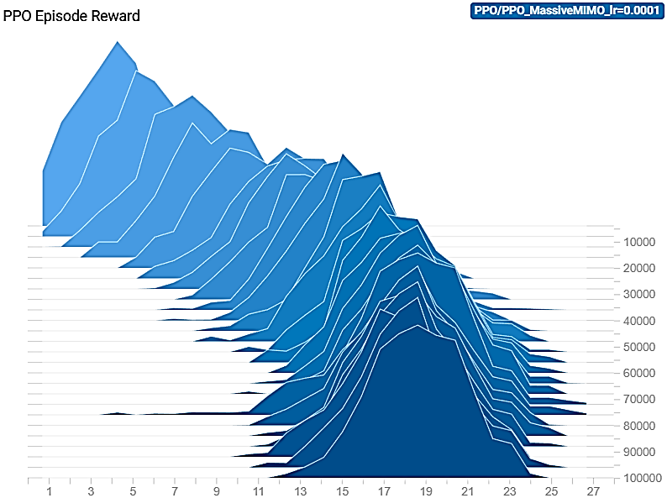
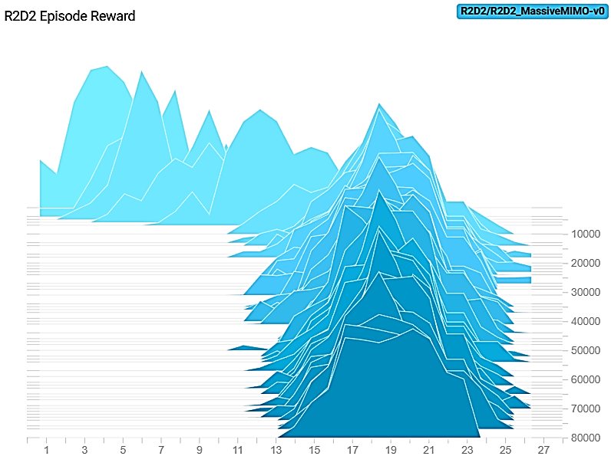
Results (Reward Distributions)

Slide 14
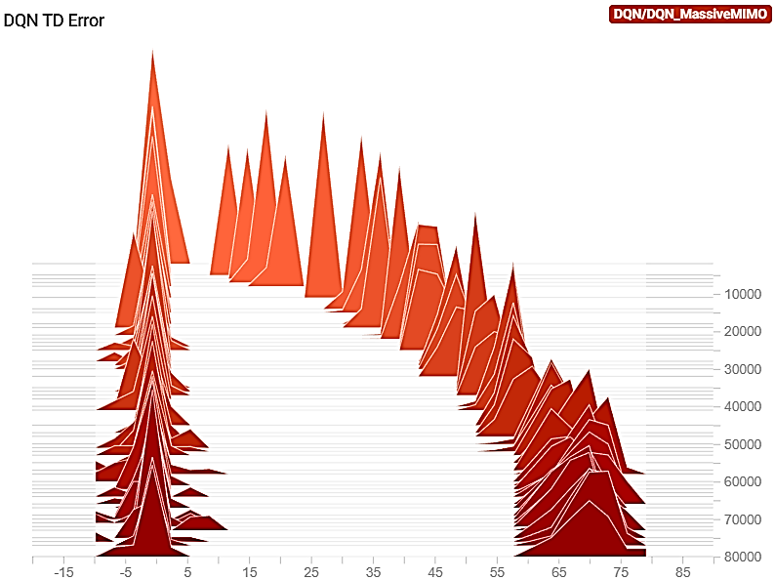
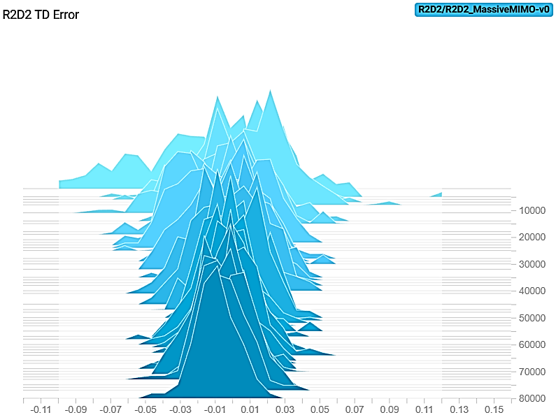
Results (TD Error)

Slide 15
Conclusion
DRL algorithms can provide more efficient resource allocation in wireless communication systems
Choice of algorithm and learning rate significantly affect the system's performance
R2D2, a variant of DQN, outperforms DQN and PPO in achieving the desired reward most stably and the fastest

Slide 16
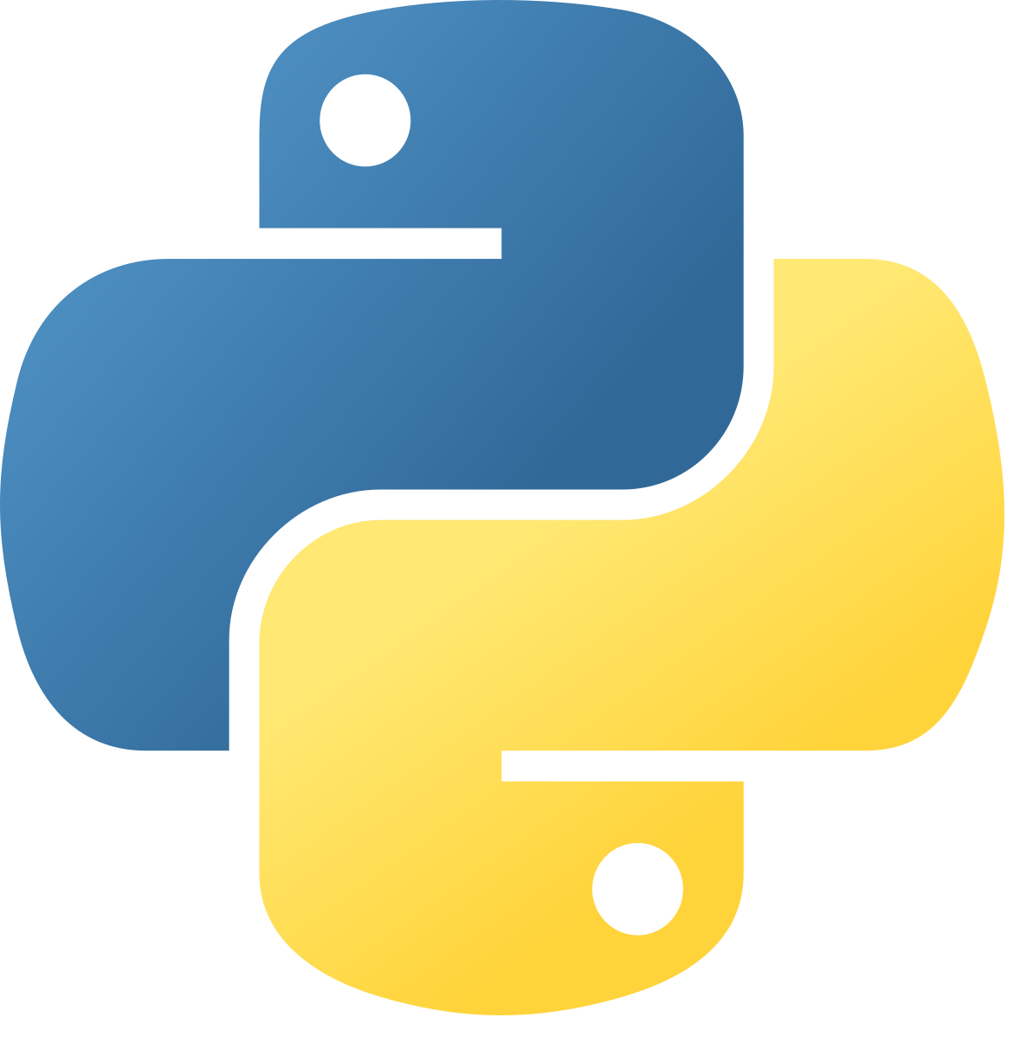
References
N. Zhao, Y.-C. Liang, D. Niyato, Y. Pei, M. Wu, and Y. Jiang, “Deep reinforcement learning for user association and resource allocation in heterogeneous cellular networks,” IEEE Transactions on Wireless Communications, vol. 18, no. 11, pp. 5141–5152, 2019.
F. Guo, F. R. Yu, H. Zhang, H. Ji, M. Liu, and V. C. Leung, “Adaptive resource allocation in future wireless networks with blockchain and mobile edge computing,” IEEE Transactions on Wireless Communications, vol. 19, no. 3, pp. 1689–1703, 2019.
A. M. Rahimi, A. Ziaeddini, and S. Gonglee, “A novel approach to efficient resource allocation in load-balanced cellular networks using hierarchical drl,” Journal of Ambient Intelligence and Humanized Computing, vol. 13, no. 5, pp. 2887–2901, 2022.
F. Wilhelmi, B. Bellalta, C. Cano, and A. Jonsson, “Implications of decentralized q-learning resource allocation in wireless networks,” in 2017 ieee 28th annual international symposium on personal, indoor, and mobile radio communications (pimrc). IEEE, 2017, pp. 1–5

Slide 17
Feedback
Thank You
Any Questions?

