Slide 1


Slide 2


Numerical Methods
National University of Science and Technology, Islamabad

Slide 3
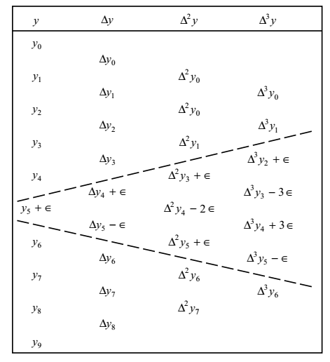
Numerical Methods
National University of Science and Technology, Islamabad

Slide 4
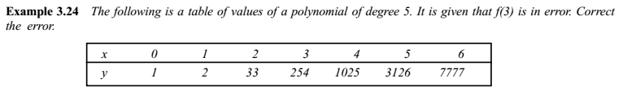
Numerical Methods
National University of Science and Technology, Islamabad

Slide 5

Numerical Methods
National University of Science and Technology, Islamabad

Slide 6
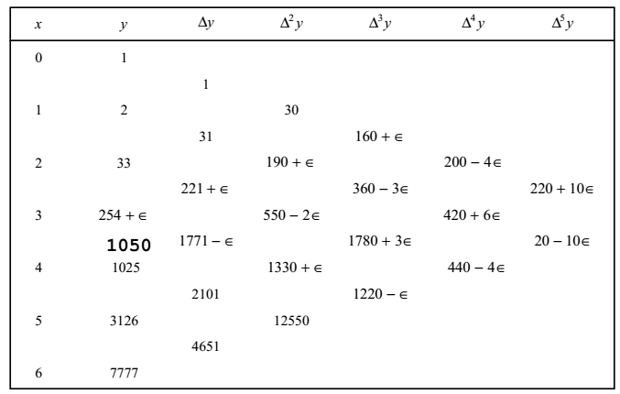
Numerical Methods
National University of Science and Technology, Islamabad

Slide 7
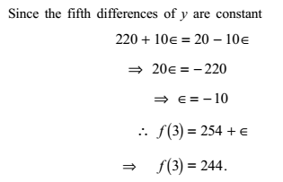
Numerical Methods
National University of Science and Technology, Islamabad

Slide 8
Numerical Methods
If it is not given in the question that at which entry (functional value)
we have an error then how you will find the entry having error and
up to which order difference will be taken in forward difference table.
National University of Science and Technology, Islamabad

Slide 9
Numerical Methods
Perform the forward difference in the table till we obtain differences such that its sum is zero.
If the order of forward difference operator is even then highlight the difference value
of highest magnitude in that column and draw a parallel line to it. The entry (functional value) lies
on this line have an error.
3. Compute this error by writing this value of highest magnitude in term of Binomial coefficient and error.
4. Subtract this error from the entry and correct it.
5. If the order of forward difference operator is odd then highlight the difference values
of highest magnitude in that column and draw parallel lines from that entries. Entry lies between these
lines have an error.
6. Compute the error as 3 and 4.
National University of Science and Technology, Islamabad

Slide 10
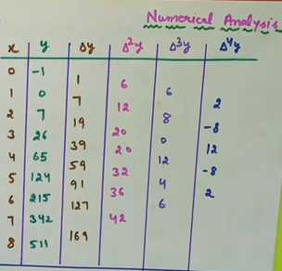
Numerical Methods
National University of Science and Technology, Islamabad

Slide 11
Numerical Methods
Question: Locate the error in forward difference table and correct the entry.
y | 2 | 5 | 10 | 18 | 26 | 37 | 50
National University of Science and Technology, Islamabad

Slide 12


Numerical Methods
2
 | 3
5 |  | 2
 | 5 |  | 1
10 |  | 3
 | 8 |  | -3
18 |  | 0
 | 8 |  | 3
26 |  | 3
 | 11 |  | -1
37 |  | 2
 | 13
50
National University of Science and Technology, Islamabad

Slide 13
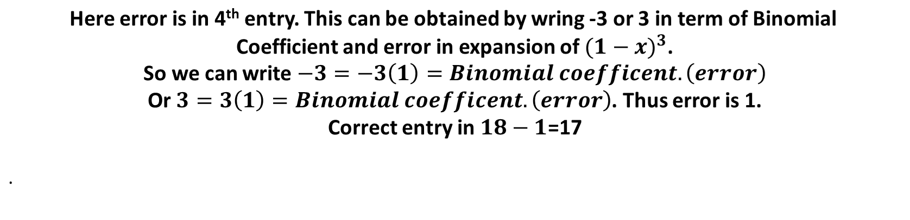
Numerical Methods
National University of Science and Technology, Islamabad

Slide 14
Numerical Methods
Question: Locate the error in forward difference table and correct the entry.
x | 0 | 1 | 2 | 3 | 4 | 5 | 6 | 7 | 8
y | -1 | 0 | 7 | 26 | 65 | 124 | 215 | 342 | 511
National University of Science and Technology, Islamabad

Slide 15
Numerical Methods
How to compute missing entry in forward difference table
Question: Estimate the missing term in forward difference table associated with polynomial of degree 5
x | 1 | 2 | 3 | 4 | 5 | 6 | 7
y | 2 | 4 | 8 |  | 32 | 64 | 128
National University of Science and Technology, Islamabad

Slide 16
Numerical Methods
HINTS: As polynomial is of degree 5, so its 5th order forward difference will be constant and its
6th order forward difference operator yields zero.
National University of Science and Technology, Islamabad

Slide 17
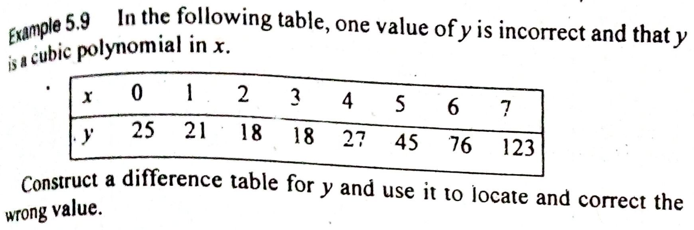
Numerical Methods
National University of Science and Technology, Islamabad

Slide 18
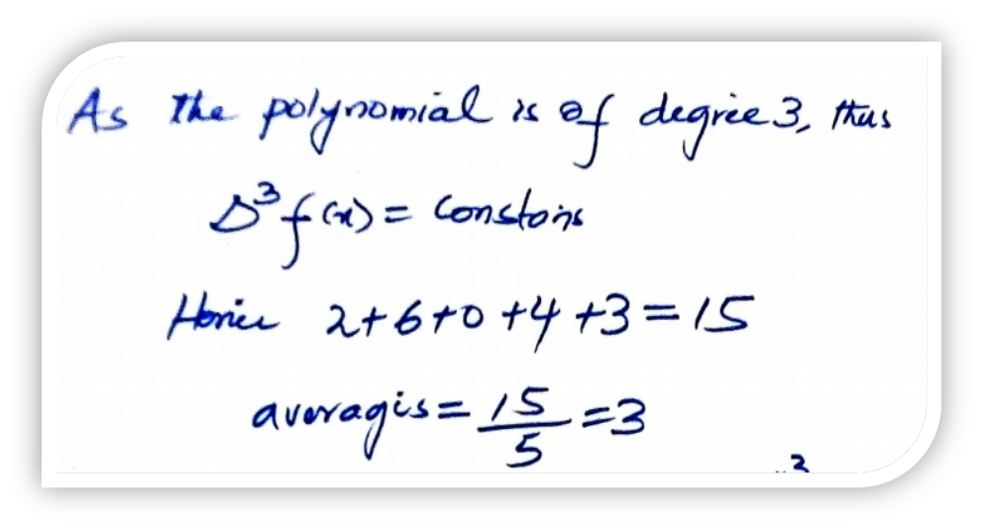
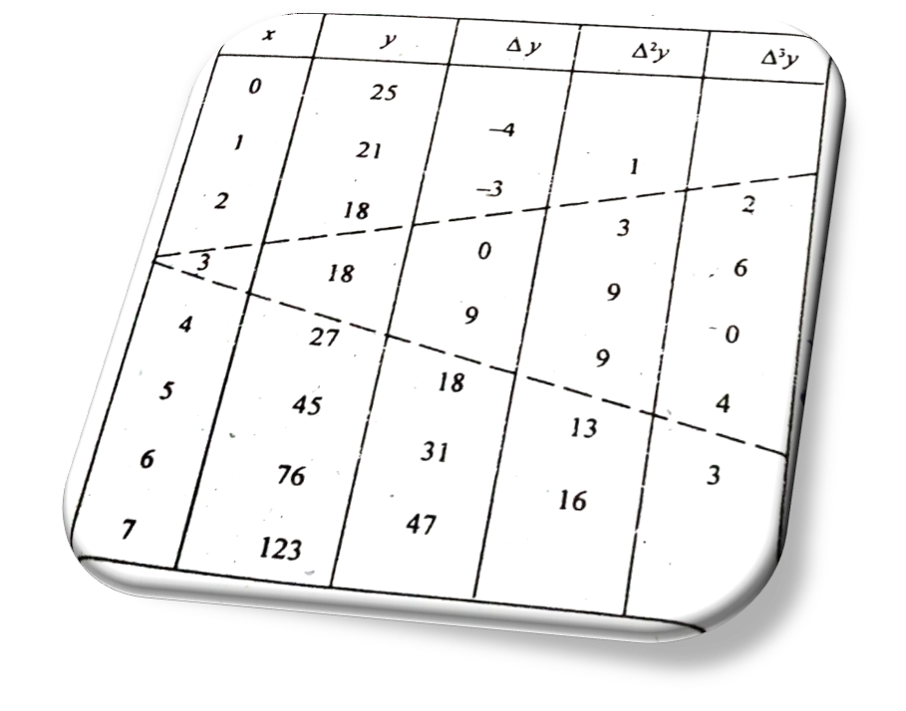
Numerical Methods
National University of Science and Technology, Islamabad

Slide 19
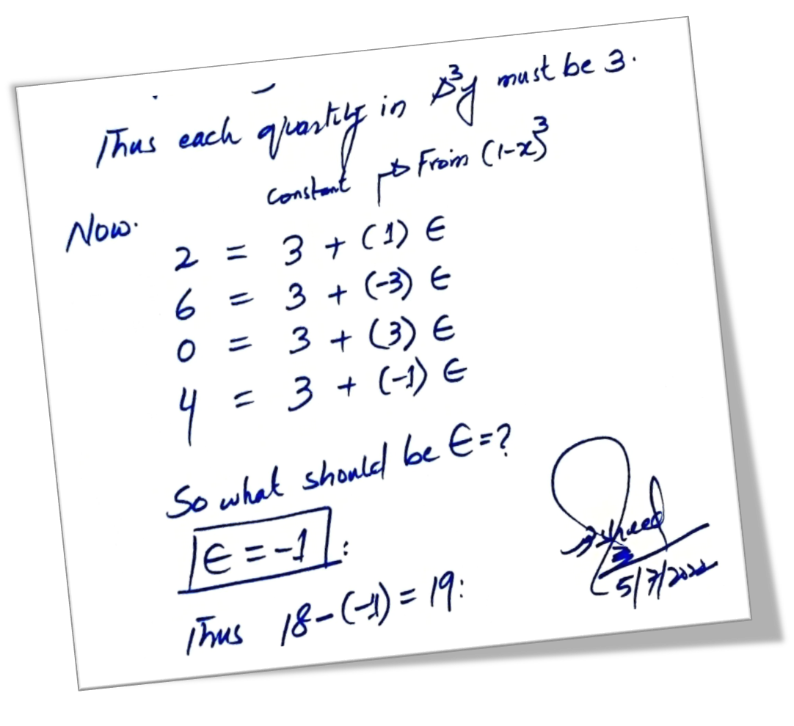

Numerical Methods
National University of Science and Technology, Islamabad

Slide 20
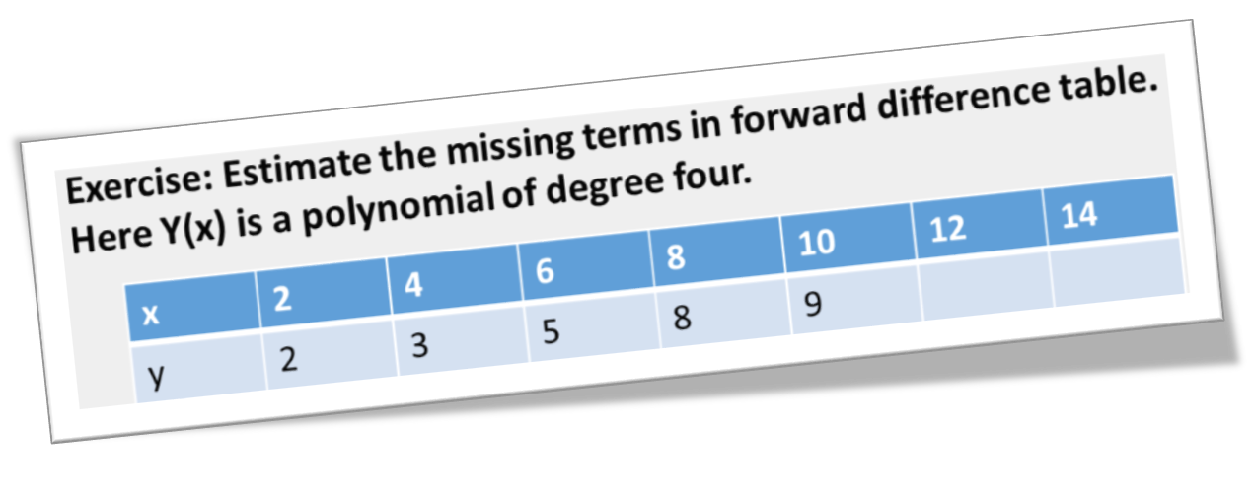
Numerical Methods
National University of Science and Technology, Islamabad

