Slide 1


Slide 2






Numerical Methods
Interpolation: Let we have n+1 data sets (points)
Satisfying but we don’t know the explicit nature of , then we find out
this by some technique and call it such that both and agree at
given arguments ( ). This process is called interpolation and
is called interpolating polynomial or interpolant.
We will use different formulas for constructing interpolating polynomials by using
finite differences.
National University of Science and Technology, Islamabad

Slide 3
Numerical Methods
Methods (formulas) for Interpolation
Newton’s Forward Difference Interpolation Formula (NFDIF)
Newton’s Backward Difference Interpolation Formula (NBDIF)
Newton’s Divided Difference Interpolation Formula (NDDIF)
Lagrange's or Lagrangian Interpolation Formula
Note that the first two formulas are used for interpolation when equally spaced intervals,
3rd one is used for unequally spaced intervals while 4th one is used for both equally and
unequally spaced intervals
National University of Science and Technology, Islamabad

Slide 4
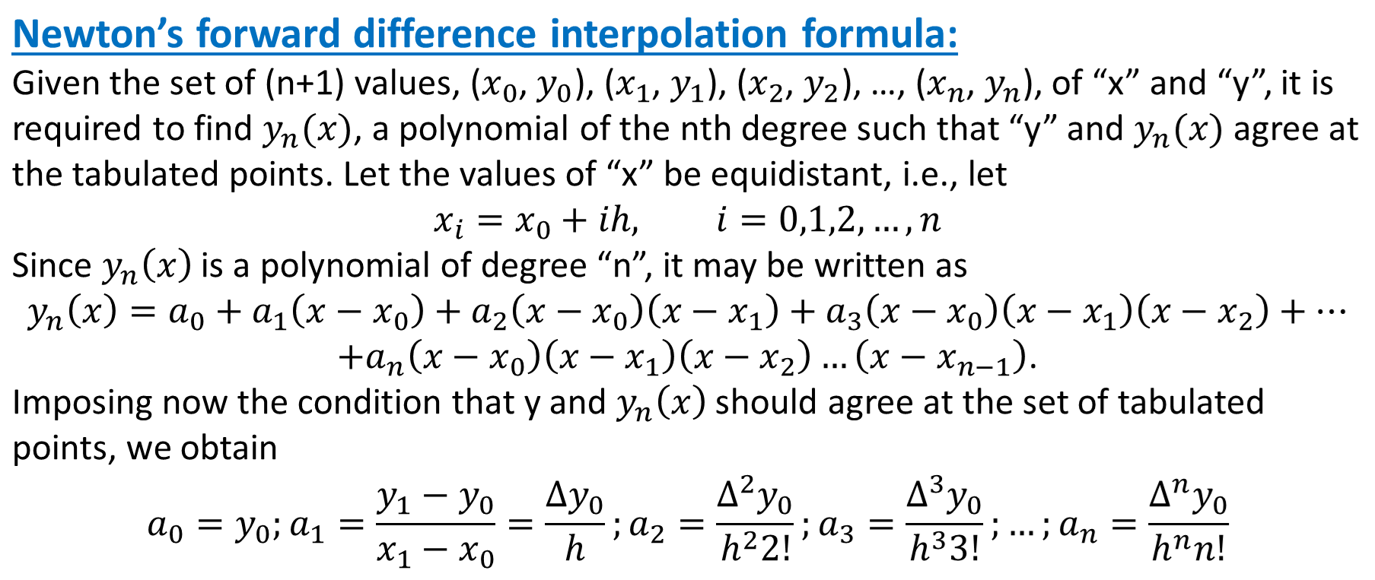
Numerical Methods
National University of Science and Technology, Islamabad

Slide 5
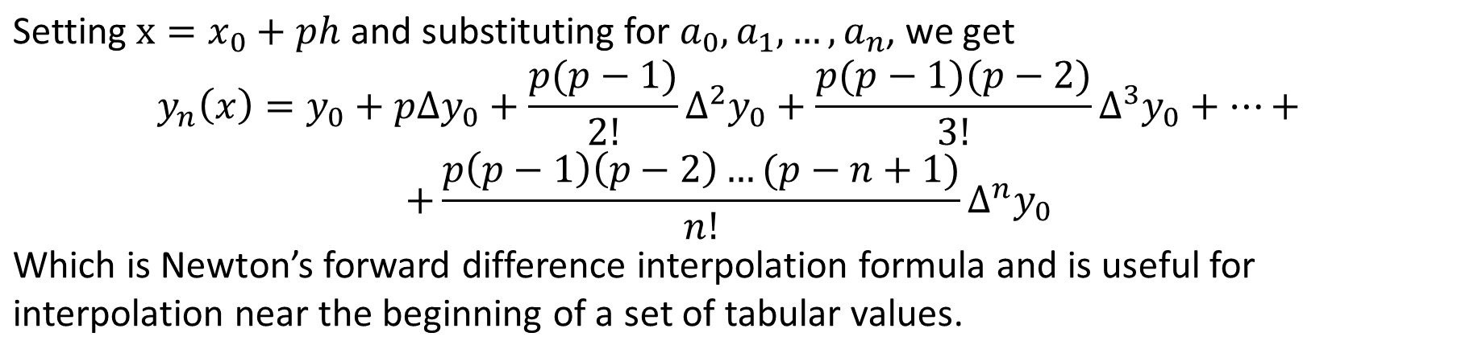
Numerical Methods
National University of Science and Technology, Islamabad

Slide 6
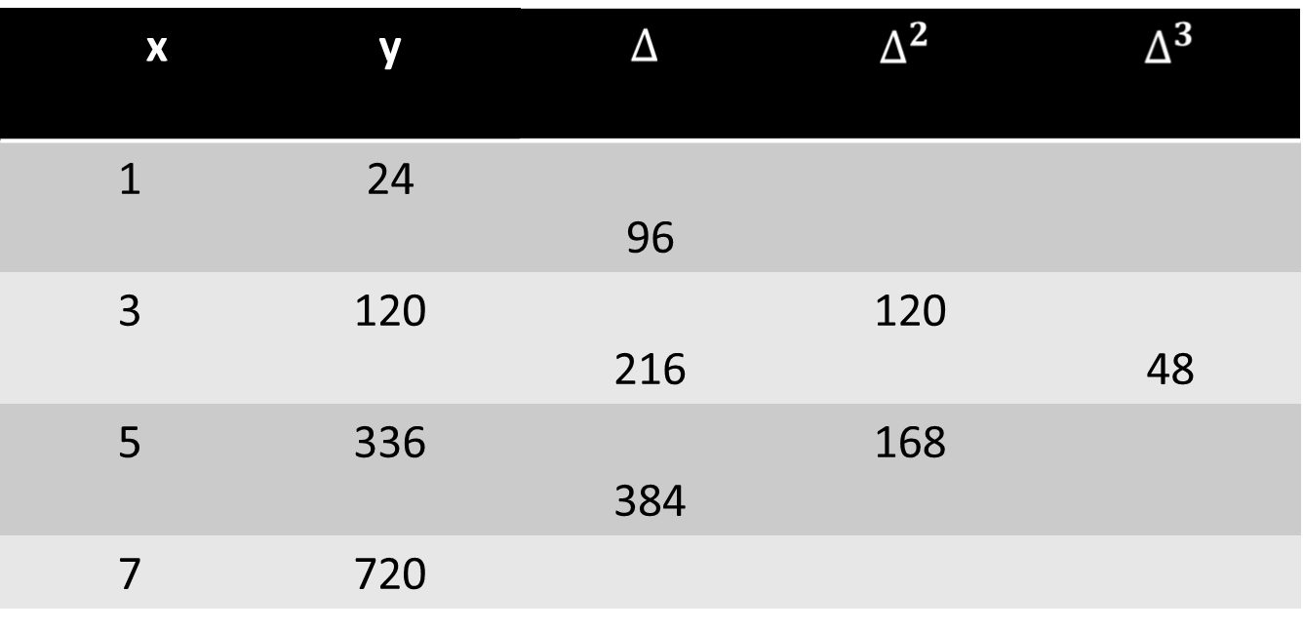
Numerical Methods
Example:
Find the cubic polynomial which takes the following values:
y(1) = 24, y(3) = 120, y(5) = 336, and y(7) = 720. Hence obtain the value of y(8).
National University of Science and Technology, Islamabad

Slide 7
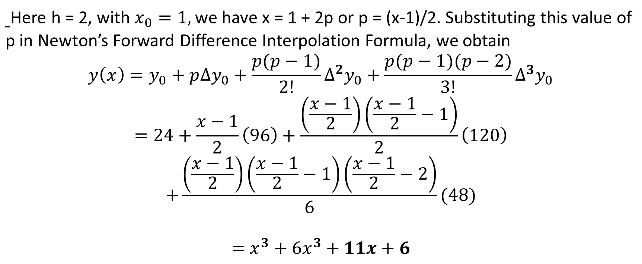
Numerical Methods
National University of Science and Technology, Islamabad

Slide 8
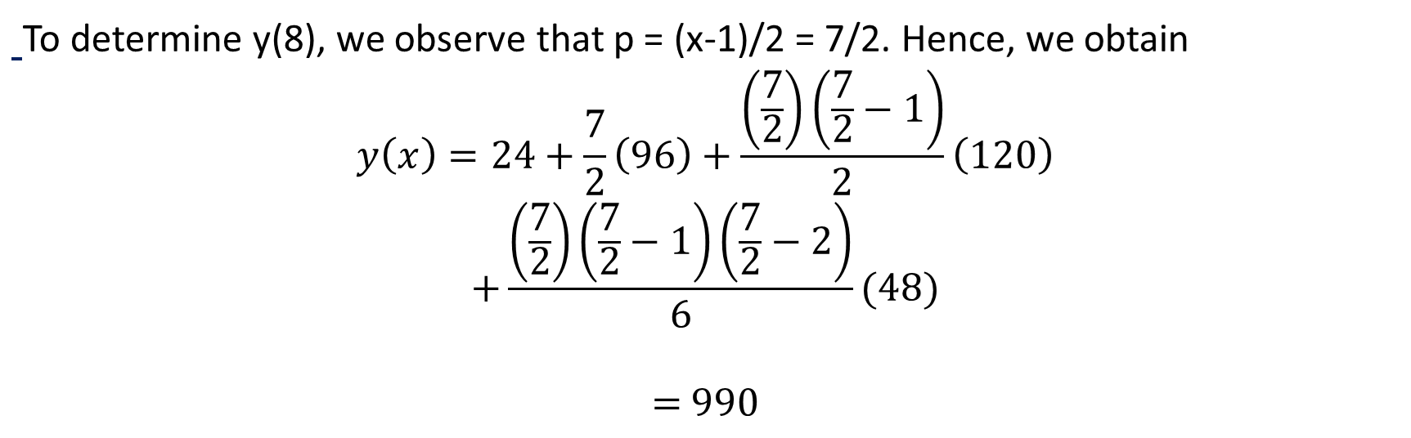
Numerical Methods
National University of Science and Technology, Islamabad

Slide 9
Numerical Methods
Class Task:
Find the polynomial which approximate the following values:
y(3) = 13, y(4) = 21, y(5) = 31, and y(6) = 43.
National University of Science and Technology, Islamabad

Slide 10
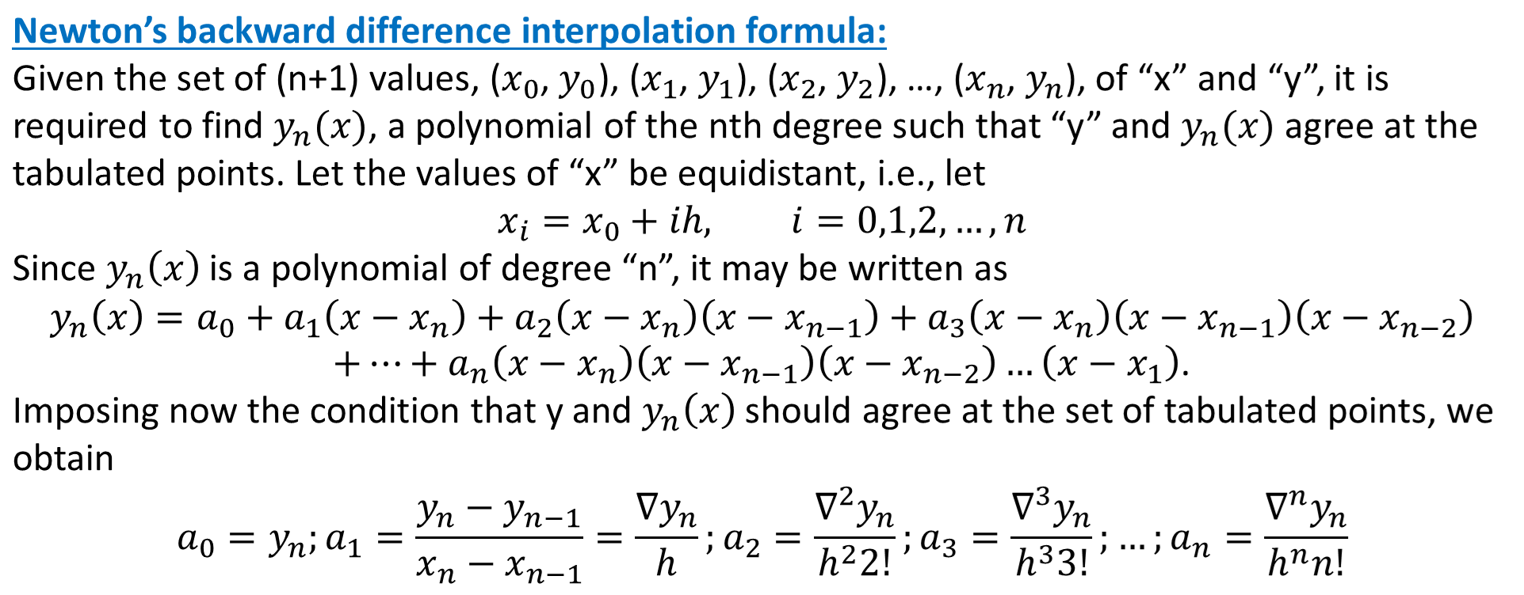
Numerical Methods
National University of Science and Technology, Islamabad

Slide 11
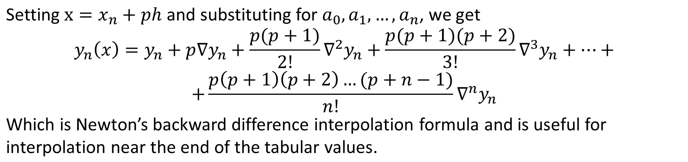
Numerical Methods
National University of Science and Technology, Islamabad

Slide 12
Numerical Methods
Class Task:
Find the polynomial which approximate the following values by using
Newton’s backward difference interpolations formula and then
evaluate y(5.5):
y(3) = 13, y(4) = 21, y(5) = 31, and y(6) = 43.
National University of Science and Technology, Islamabad

Slide 13
Numerical Methods
Home Task
Attempt all problem related to Forward difference interpolation and Backward difference interpolation formulas.
National University of Science and Technology, Islamabad

