Slide 1


Slide 2
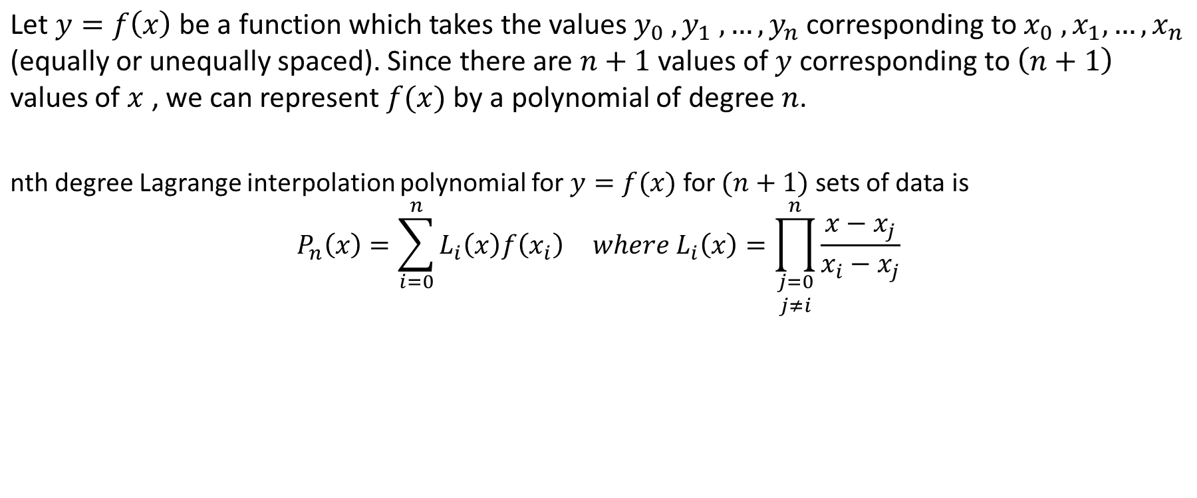

Numerical Methods
LAGRANGE INTERPOLATION FORMULA
National University of Science and Technology, Islamabad

Slide 3
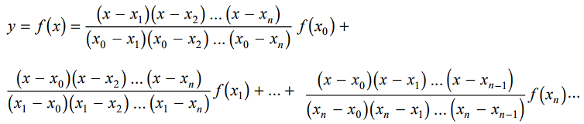
Numerical Methods
LAGRANGE INTERPOLATION FORMULA
National University of Science and Technology, Islamabad

Slide 4
Numerical Methods
National University of Science and Technology, Islamabad

Slide 5
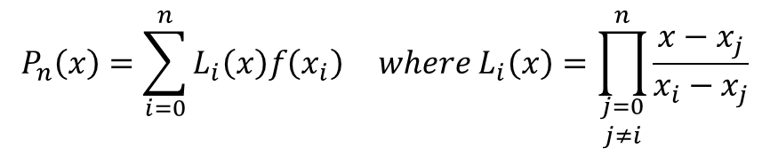
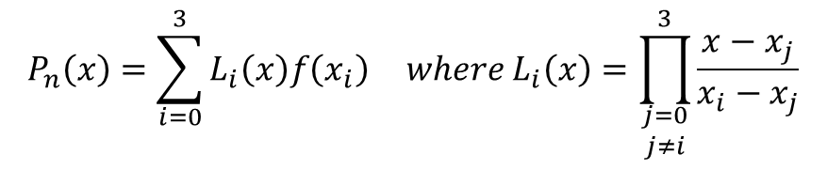
Numerical Methods
By Lagrange Interpolation formula for (n+1) data points we have
For 4-data points we have
National University of Science and Technology, Islamabad

Slide 6
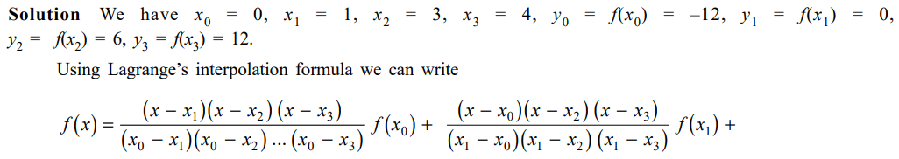

Numerical Methods
National University of Science and Technology, Islamabad

Slide 7
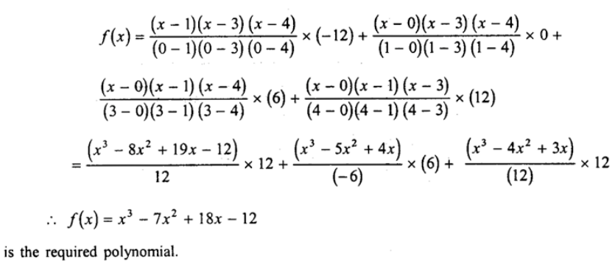
Numerical Methods
National University of Science and Technology, Islamabad

Slide 8
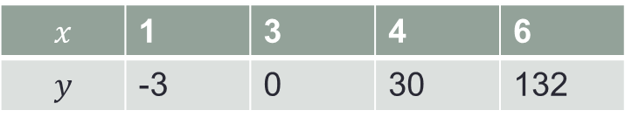
Numerical Methods
Example 1: Find Lagrange Interpolation polynomial fitting the points given in the following table.
National University of Science and Technology, Islamabad

Slide 9
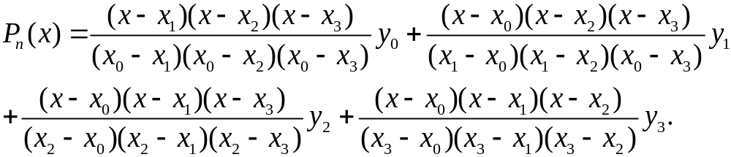
Numerical Methods
National University of Science and Technology, Islamabad

Slide 10
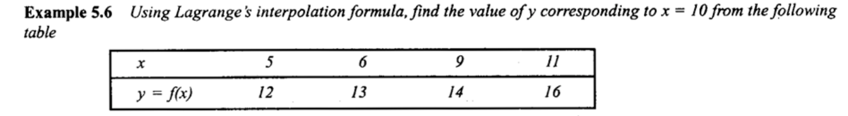
Numerical Methods
National University of Science and Technology, Islamabad

Slide 11
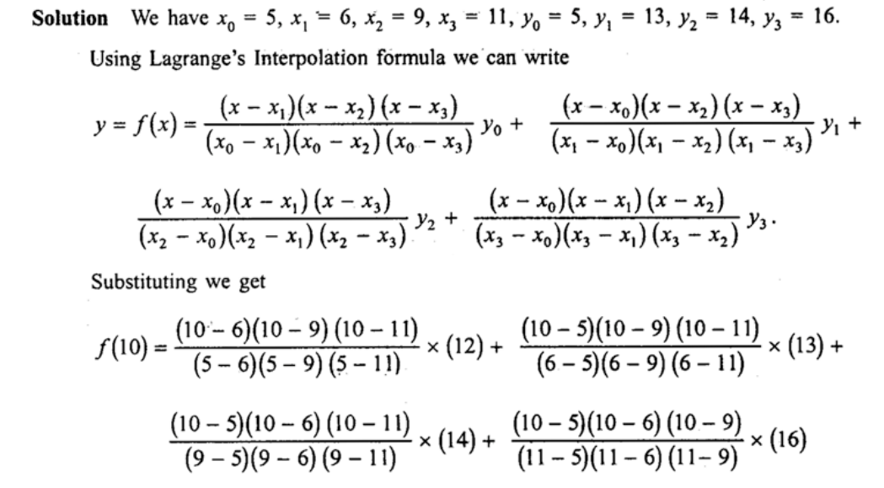
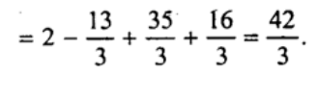
Numerical Methods
National University of Science and Technology, Islamabad

Slide 12
Numerical Methods
Example 2: From the following table, estimate the number of students who obtained
marks between 49 and 52.
Marks | 30-40 | 40-50 | 50-60 | 60-70 | 70-80
Number of Students | 31 | 42 | 51 | 35 | 31
National University of Science and Technology, Islamabad

Slide 13
Numerical Methods
Example 3: The population of a certain community corresponding to different years is given in below table. Find population increase between 1946 to 1948.
year | 1911 | 1921 | 1931 | 1941 | 1951 | 1961
Population in thousands | 12 | 15 | 20 | 27 | 33 | 52
National University of Science and Technology, Islamabad

Slide 14
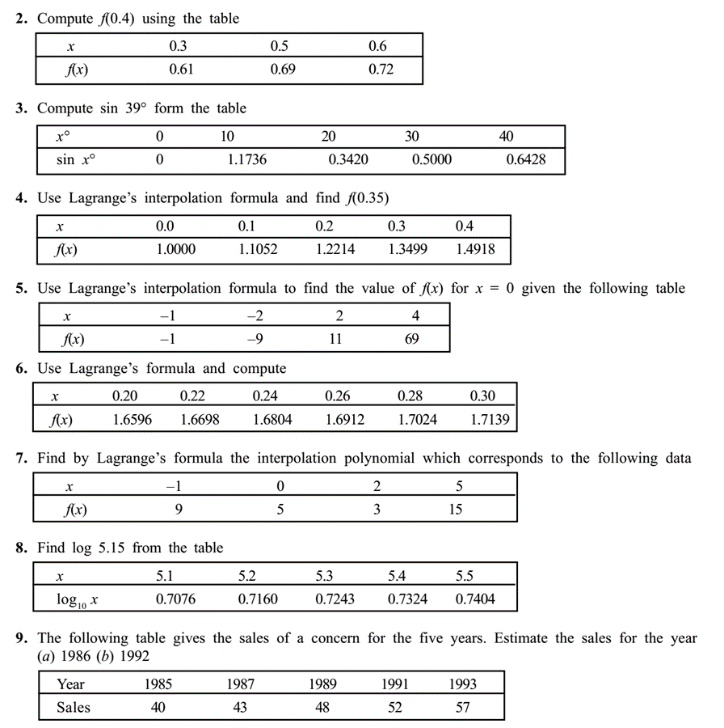
Numerical Methods
National University of Science and Technology, Islamabad

Slide 15
Numerical Methods
Note: Lagrange interpolation formula in used for unequally spaced as well as unequally spaced
points or intervals. Also Inverse Lagrange interpolation formula is used for finding
argument against entry.
Inverse Lagrange interpolation formula can be obtained by interchanging x and y
In Lagrange formula.
National University of Science and Technology, Islamabad

