Slide 1


Slide 2
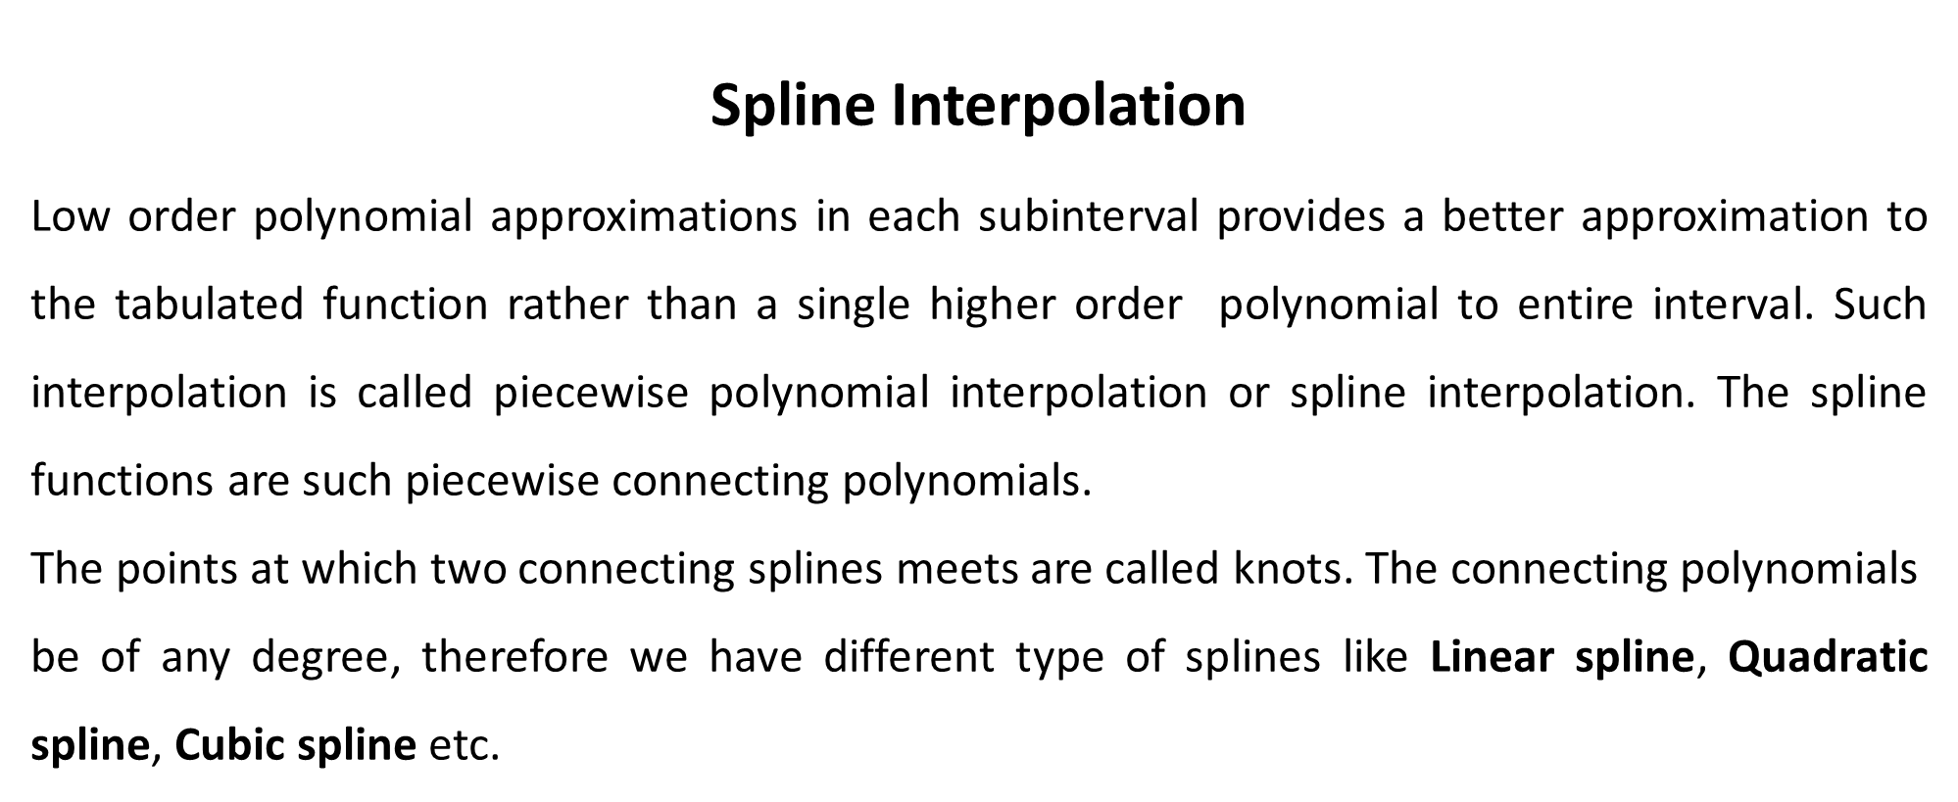

Numerical Methods
National University of Science and Technology, Islamabad

Slide 3
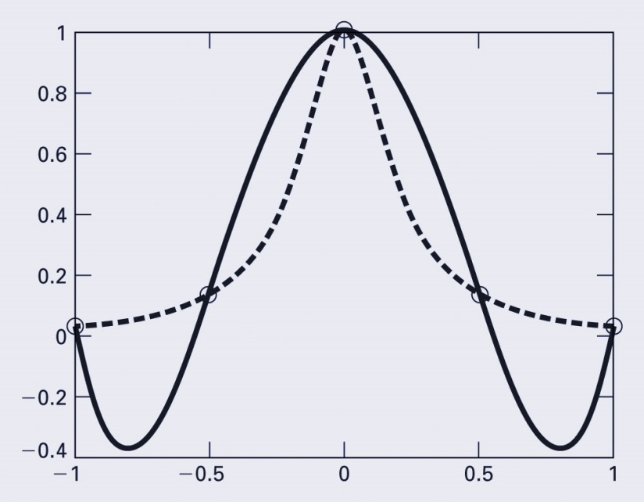
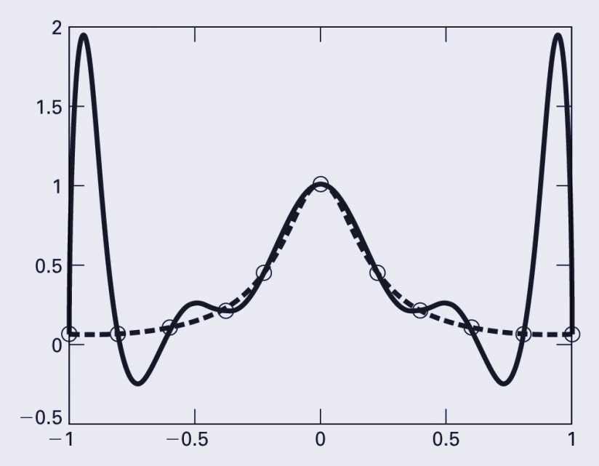
Numerical Methods
Higher-order polynomials can not only lead to round-off errors due to ill-conditioning, but can also introduce oscillations to an interpolation or fit where they should not be.
The dashed line represents a function, the circles represent samples of the function, and the solid line represents the results of a polynomial interpolation
National University of Science and Technology, Islamabad

Slide 4
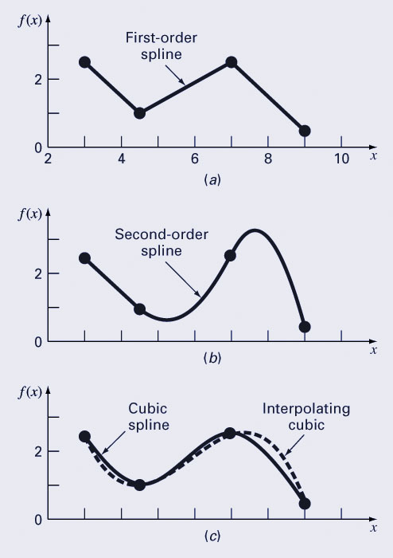
Numerical Methods
Spline is an alternative approach to use a single
(n-1)^{th} order polynomial to interpolate between n points.
Apply lower-order polynomials in a piecewise fashion to subsets of data points. The connecting polynomials are called spline functions.
Linear Spline Interpolation
Quadratic Spline Interpolation
Cubic Spline Interpolation
National University of Science and Technology, Islamabad

Slide 5
Numerical Methods
Linear Splines
Suppose we have n+1 data points, then if we construct linear splines between two consecutive points then all possible splines are n. As splines are linear then there will be 2 unknown coefficients (constants) in each spline. Thus total number of unknowns are 2n.
To compute these 2n unknowns we needs 2n equations. These equations are obtained by the following constraints.
Each spline passes through 2 points.
This constraint yield 2n equations out of 2n.
National University of Science and Technology, Islamabad

Slide 6
Numerical Methods
Example: For data set (1,-8), (2,-1) and (3,18), find the linear splines and
determine the approximate values of y(2.5).
National University of Science and Technology, Islamabad

Slide 7
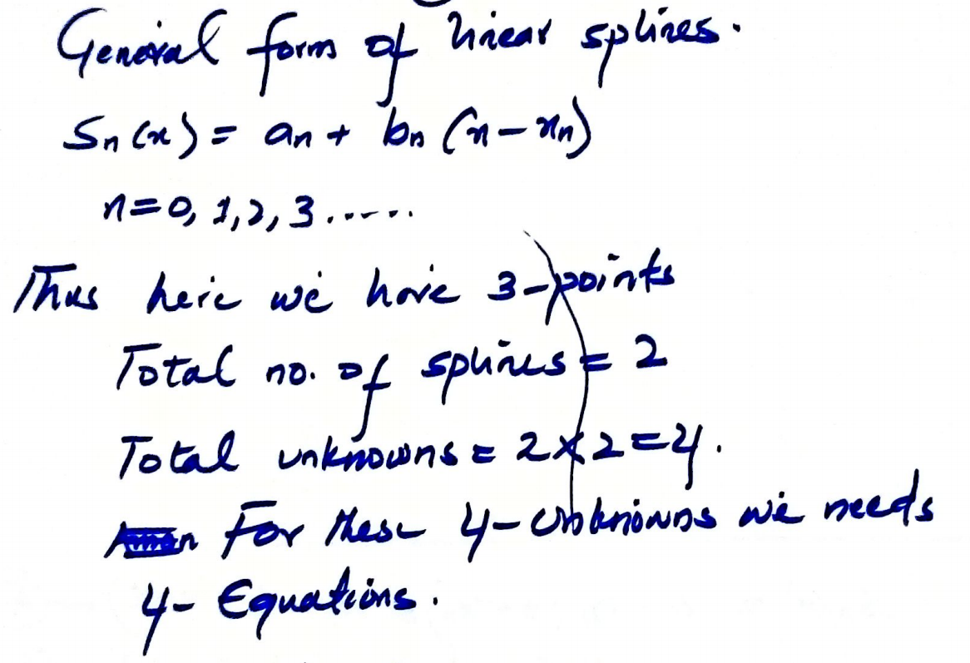
Numerical Methods
National University of Science and Technology, Islamabad

Slide 8
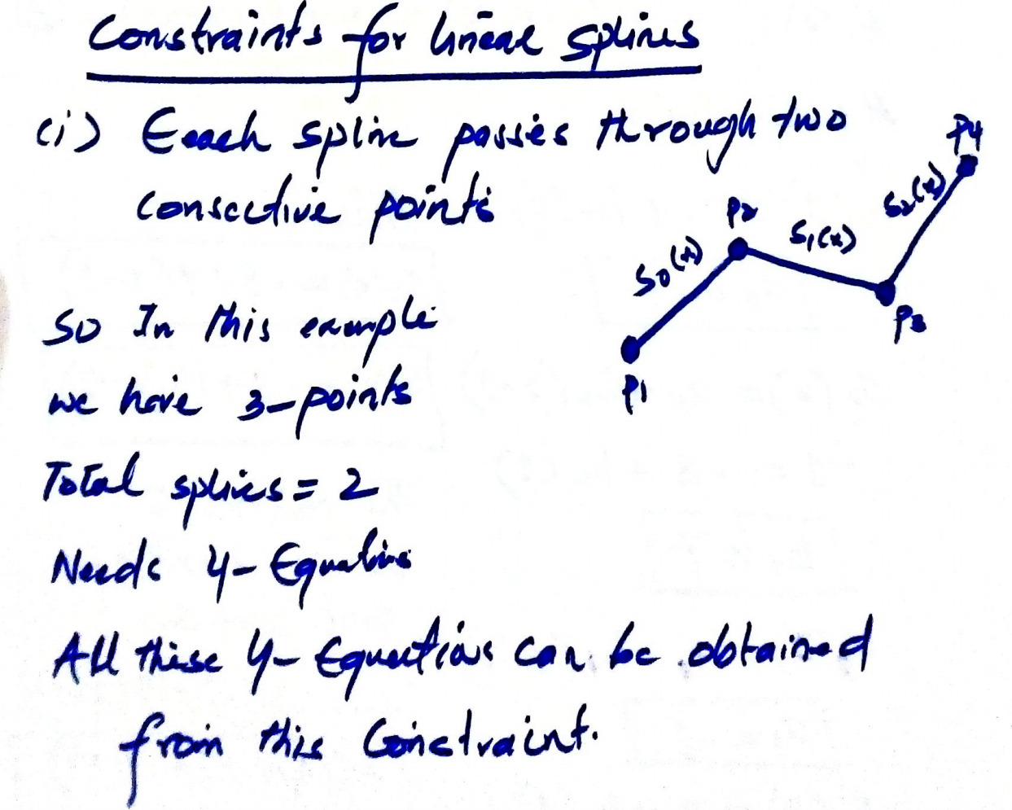
Numerical Methods
National University of Science and Technology, Islamabad

Slide 9
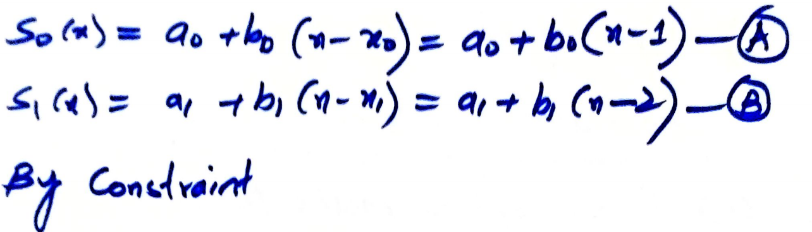
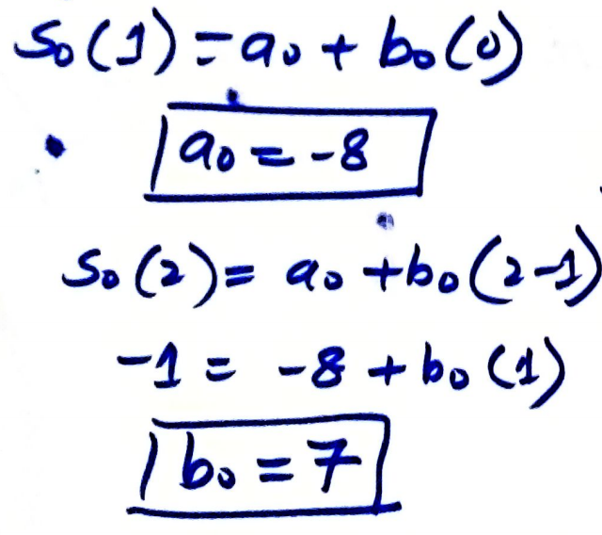
Numerical Methods
National University of Science and Technology, Islamabad

Slide 10
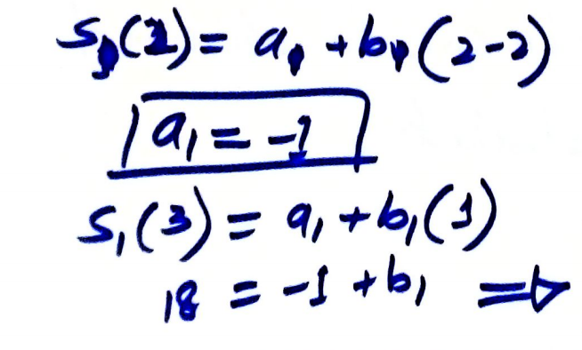
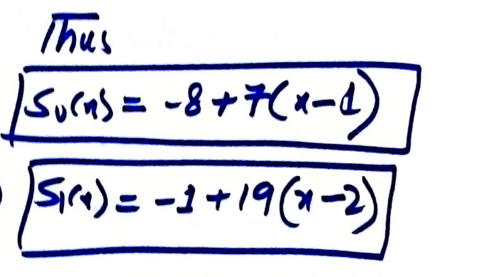

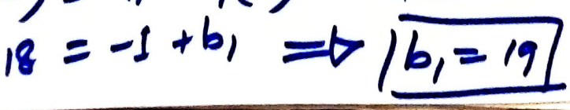
Numerical Methods
National University of Science and Technology, Islamabad

Slide 11
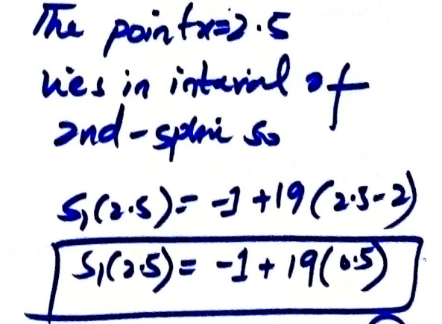
Numerical Methods
National University of Science and Technology, Islamabad

Slide 12
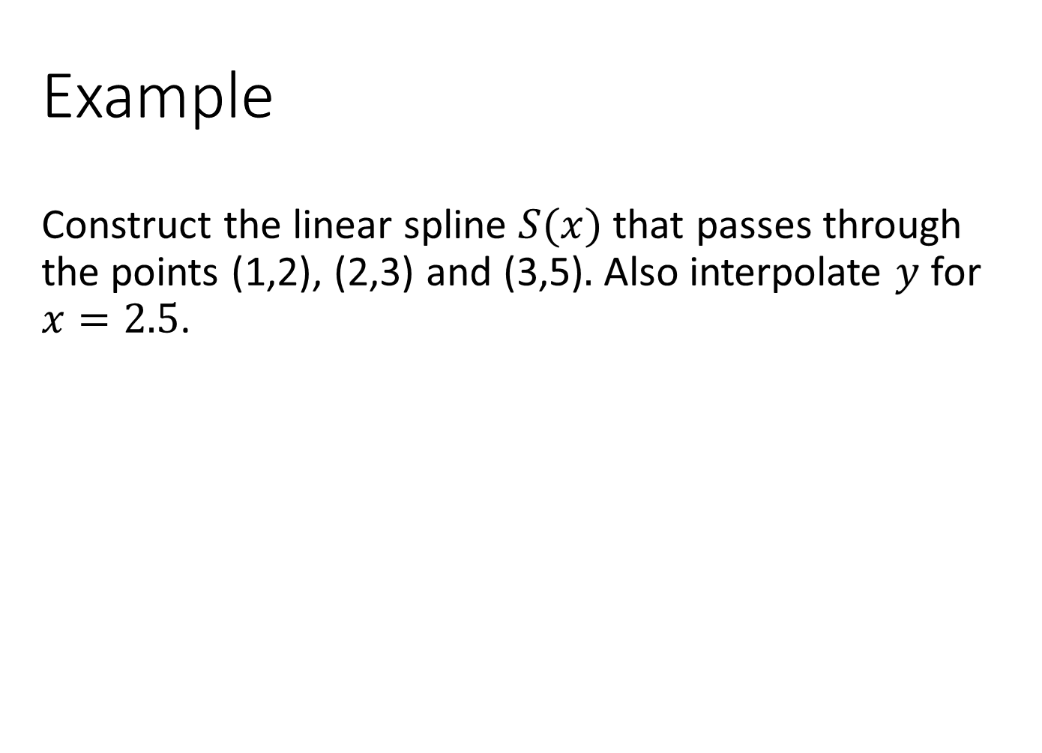
Numerical Methods
National University of Science and Technology, Islamabad

Slide 13
Numerical Methods
Example: The velocity of a rocket is given as function of time.
Using linear splines to find
Velocity at t=16.
Acceleration at t=16.
Distance travelled by rocket between t=11 and t=16.
T (in seconds) | V(in meter per second)
0 | 0
10 | 227.04
15 | 362.78
20 | 517.35
22.5 | 602.97
30 | 901.67
National University of Science and Technology, Islamabad

Slide 14
Numerical Methods
Attempt some problem on Quadratic spline interpolation for practice.
National University of Science and Technology, Islamabad

