Slide 1


Slide 2
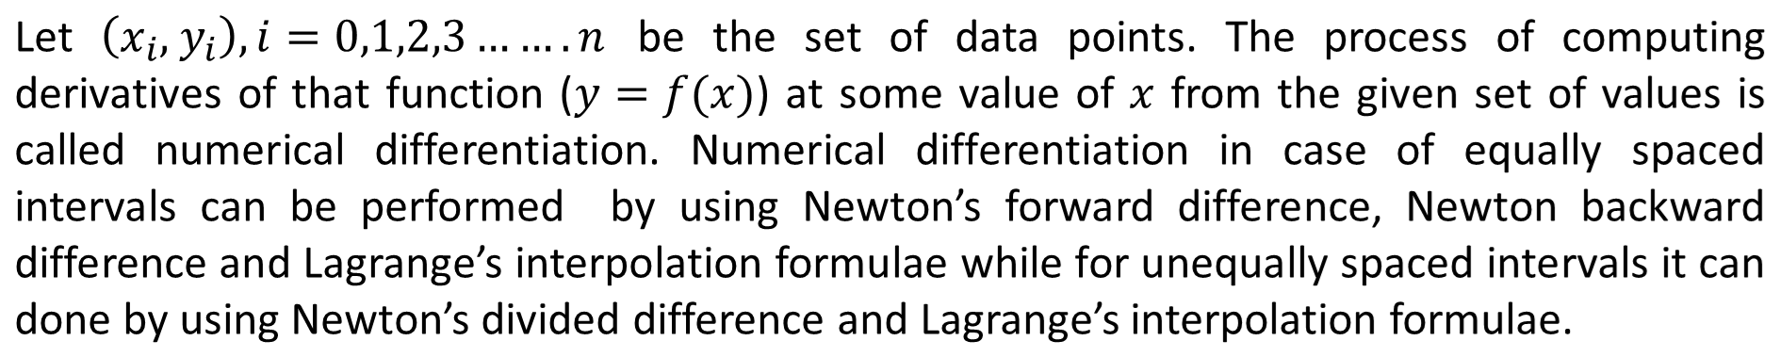

Numerical Differentiation using difference Interpolation formulas
Numerical Methods
National University of Science and Technology, Islamabad

Slide 3
Numerical differentiation for unequally spaced intervals
Numerical Methods
In case of unequally spaced intervals, we use Lagrange’s or Newton’s divided difference
for interpolating polynomial and then compute its derivative at the specific point given
National University of Science and Technology, Islamabad

Slide 4
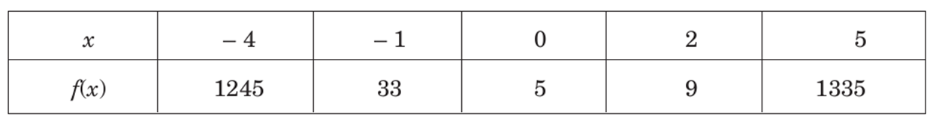
Numerical Methods
Problem
Solution
In the previous slides using Newton’s Divided Difference Formula we have already calculated the interpolating polynomial.
National University of Science and Technology, Islamabad

Slide 5
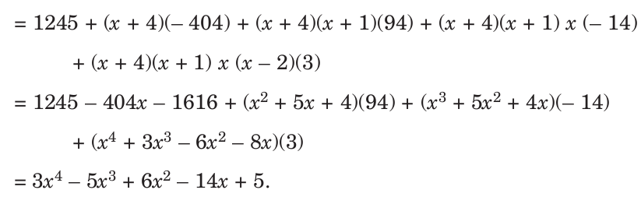
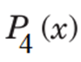
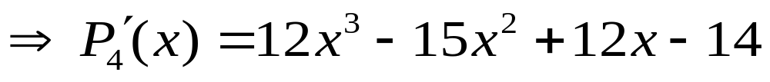
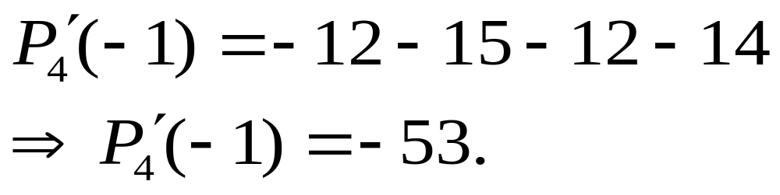
Numerical Methods
Now
National University of Science and Technology, Islamabad

Slide 6
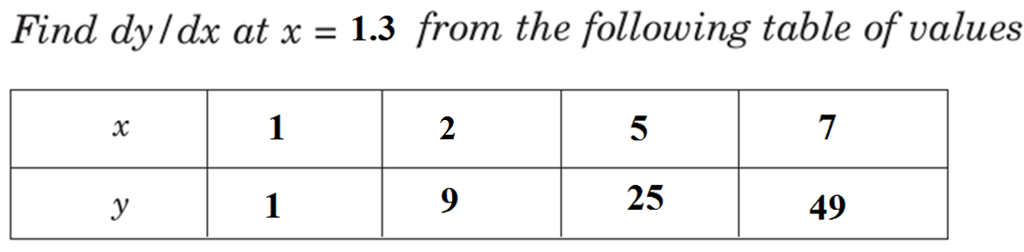
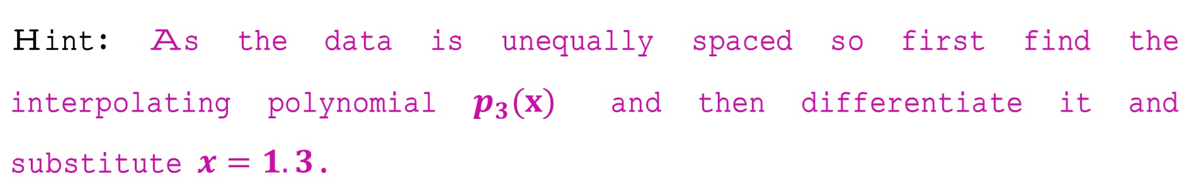
Numerical Methods
Practice Problem
National University of Science and Technology, Islamabad

Slide 7
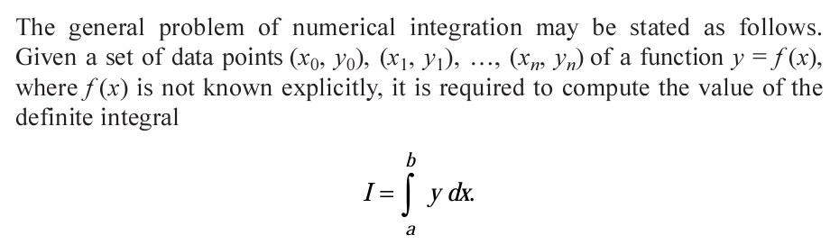
Numerical Methods
Numerical Integration
National University of Science and Technology, Islamabad

Slide 8
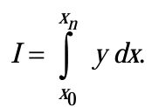
Numerical Methods
Here we have derived a general formula for numerical integration using Newton’s Forward Difference formula.
National University of Science and Technology, Islamabad

Slide 9
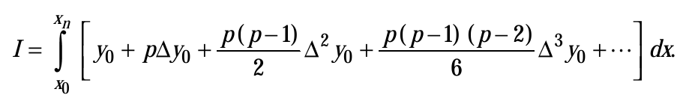
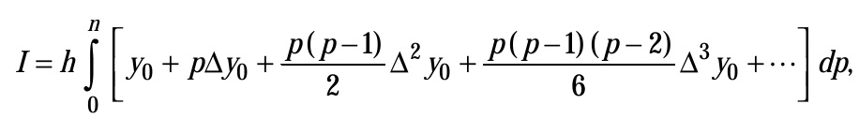
Numerical Methods
National University of Science and Technology, Islamabad

Slide 10

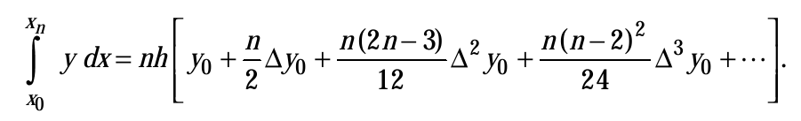
Numerical Methods
This general formula is called Newton’s Cotes formula and from this general formula, we can obtain different integration formulas by taking various cases of n.
National University of Science and Technology, Islamabad

Slide 11
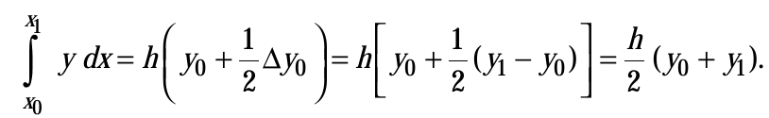
Numerical Methods
Trapezoidal Rule
Setting n=1 in Newton’s Cotes formula and neglecting second order and higher differences
we get
National University of Science and Technology, Islamabad

Slide 12
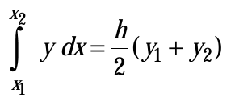
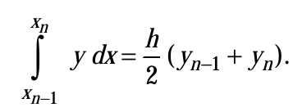
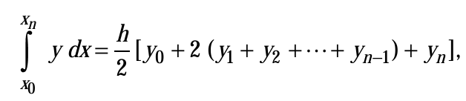
Numerical Methods
National University of Science and Technology, Islamabad

Slide 13
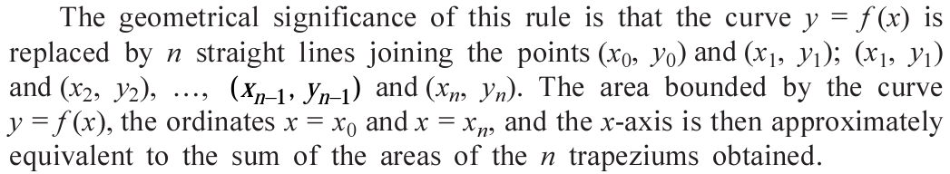
Numerical Methods
National University of Science and Technology, Islamabad

Slide 14


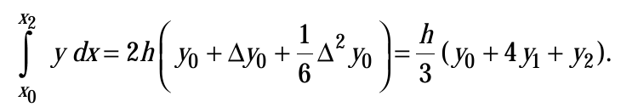
Numerical Methods
Simpson’s Rule
in the general formula.
National University of Science and Technology, Islamabad

Slide 15

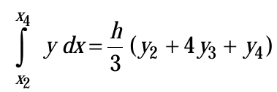

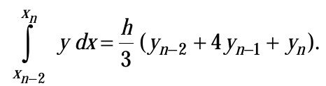
Numerical Methods
National University of Science and Technology, Islamabad

Slide 16

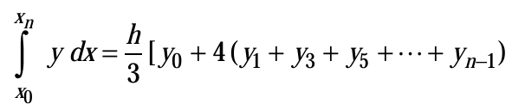



Numerical Methods
National University of Science and Technology, Islamabad

Slide 17
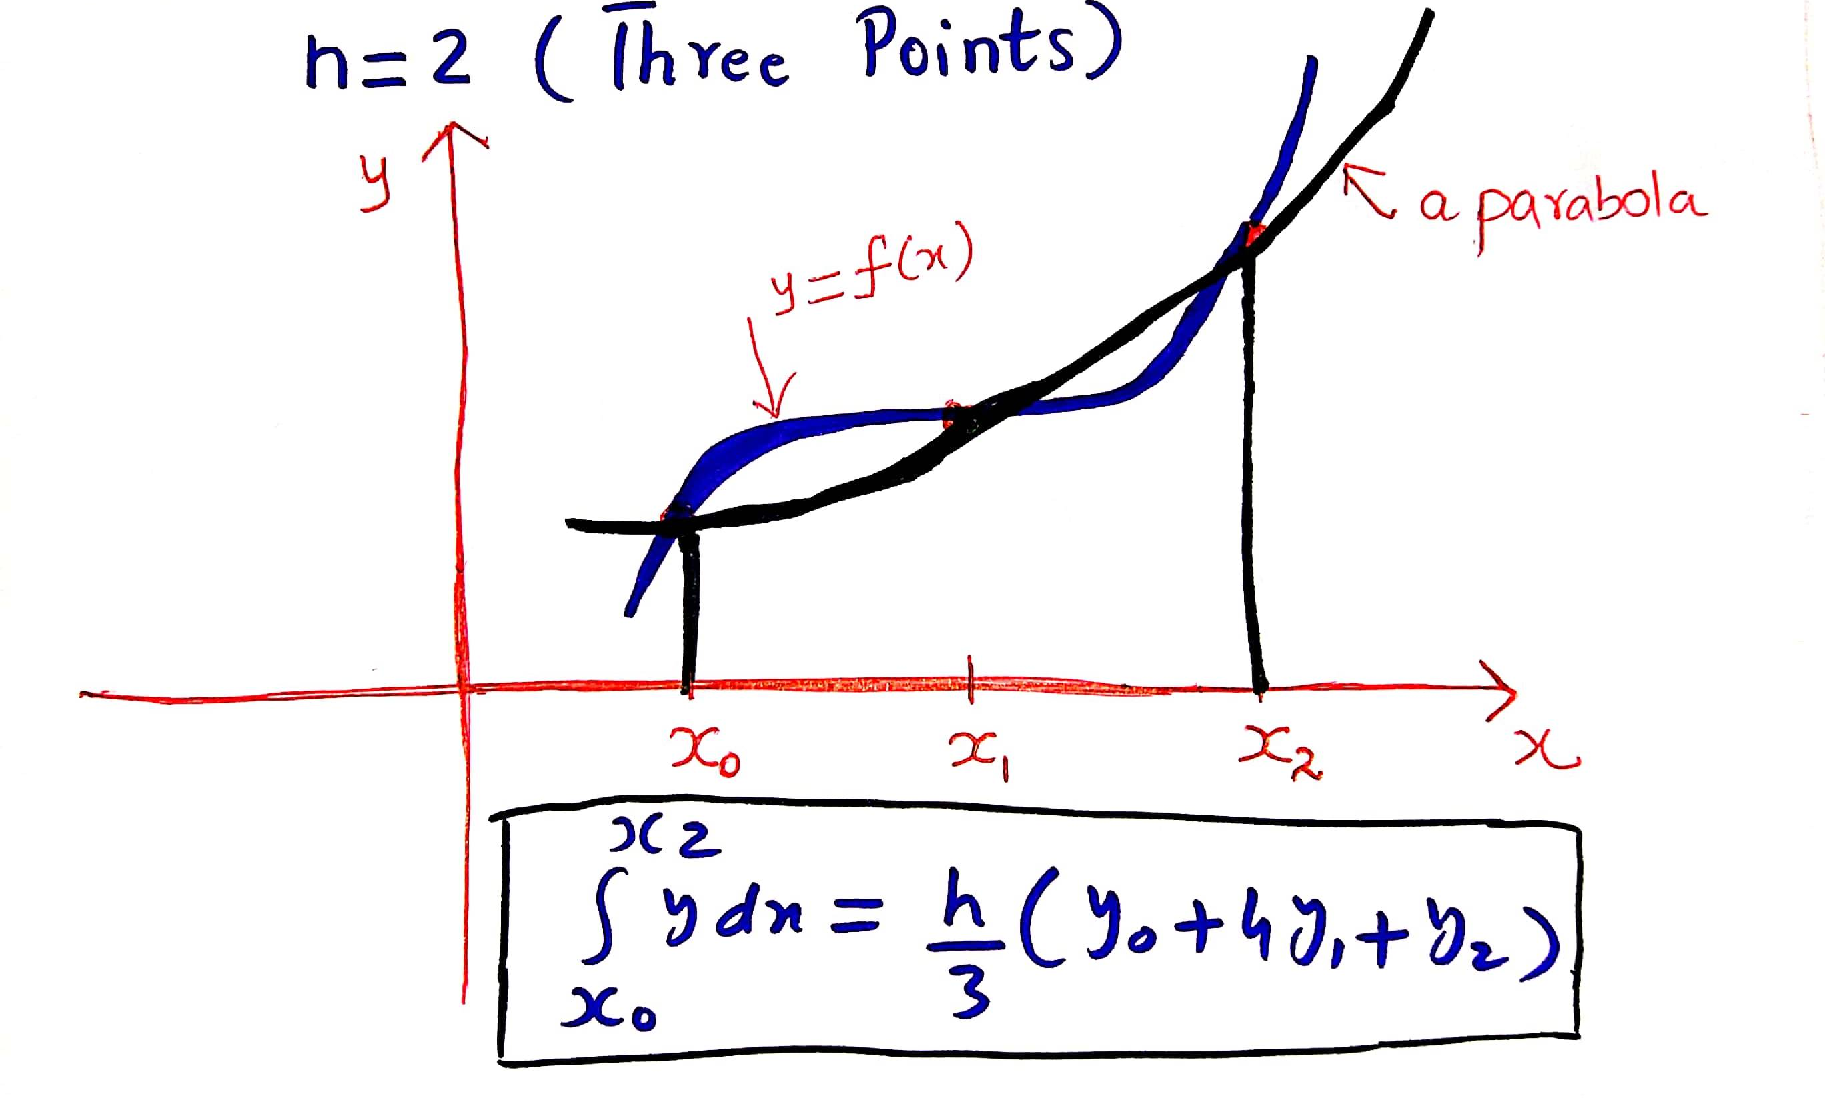
Numerical Methods
Geometrical Interpretation of Simpson’s Rule
National University of Science and Technology, Islamabad

Slide 18
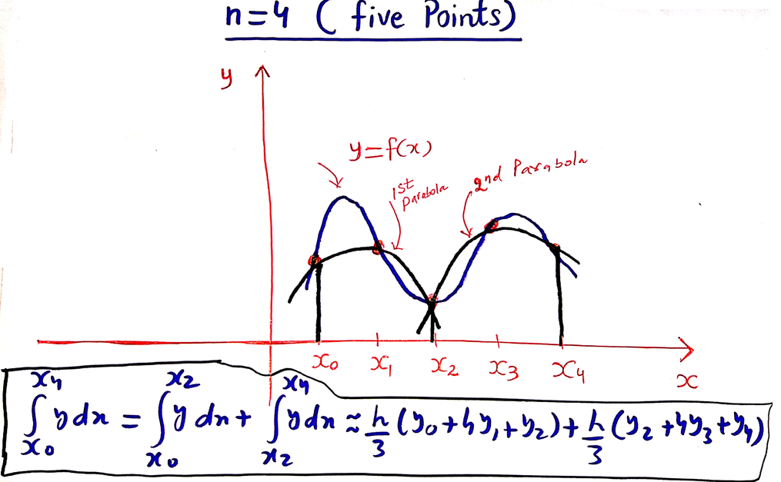
Numerical Methods
National University of Science and Technology, Islamabad

Slide 19

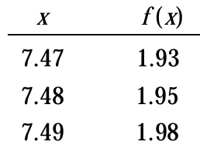
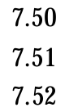

Numerical Methods
Problem
National University of Science and Technology, Islamabad

Slide 20
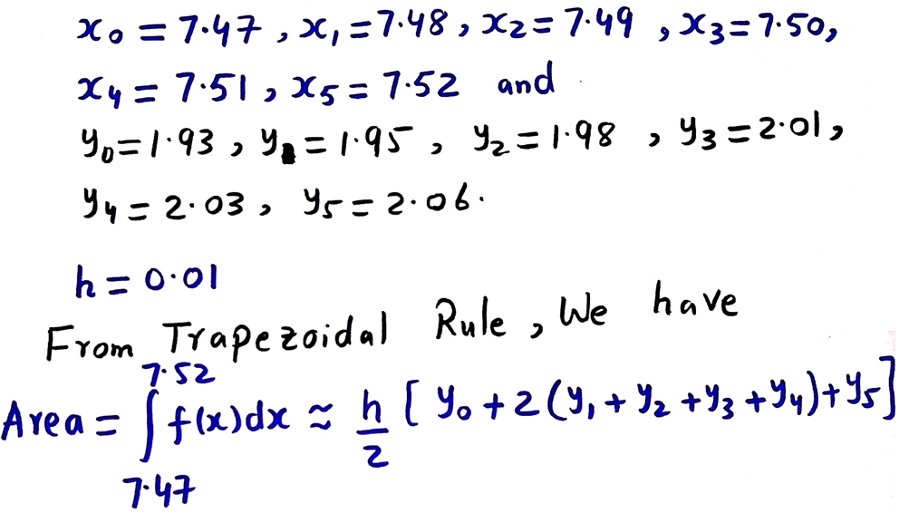
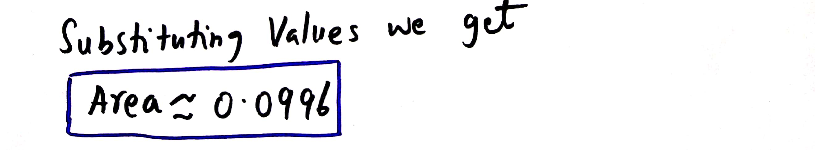
Numerical Methods
Solution
National University of Science and Technology, Islamabad

Slide 21
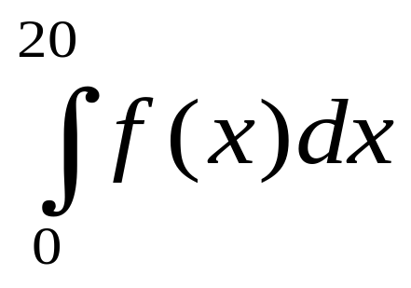
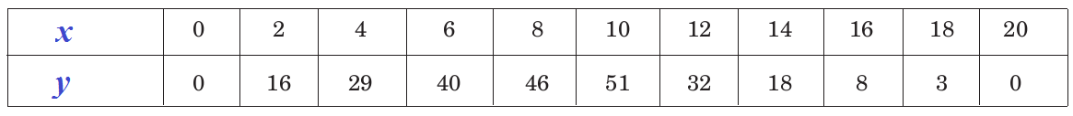
Numerical Methods
Problem
Use Simpson’s Rule to approximate the following integral from the data given below in the table.
National University of Science and Technology, Islamabad

Slide 22
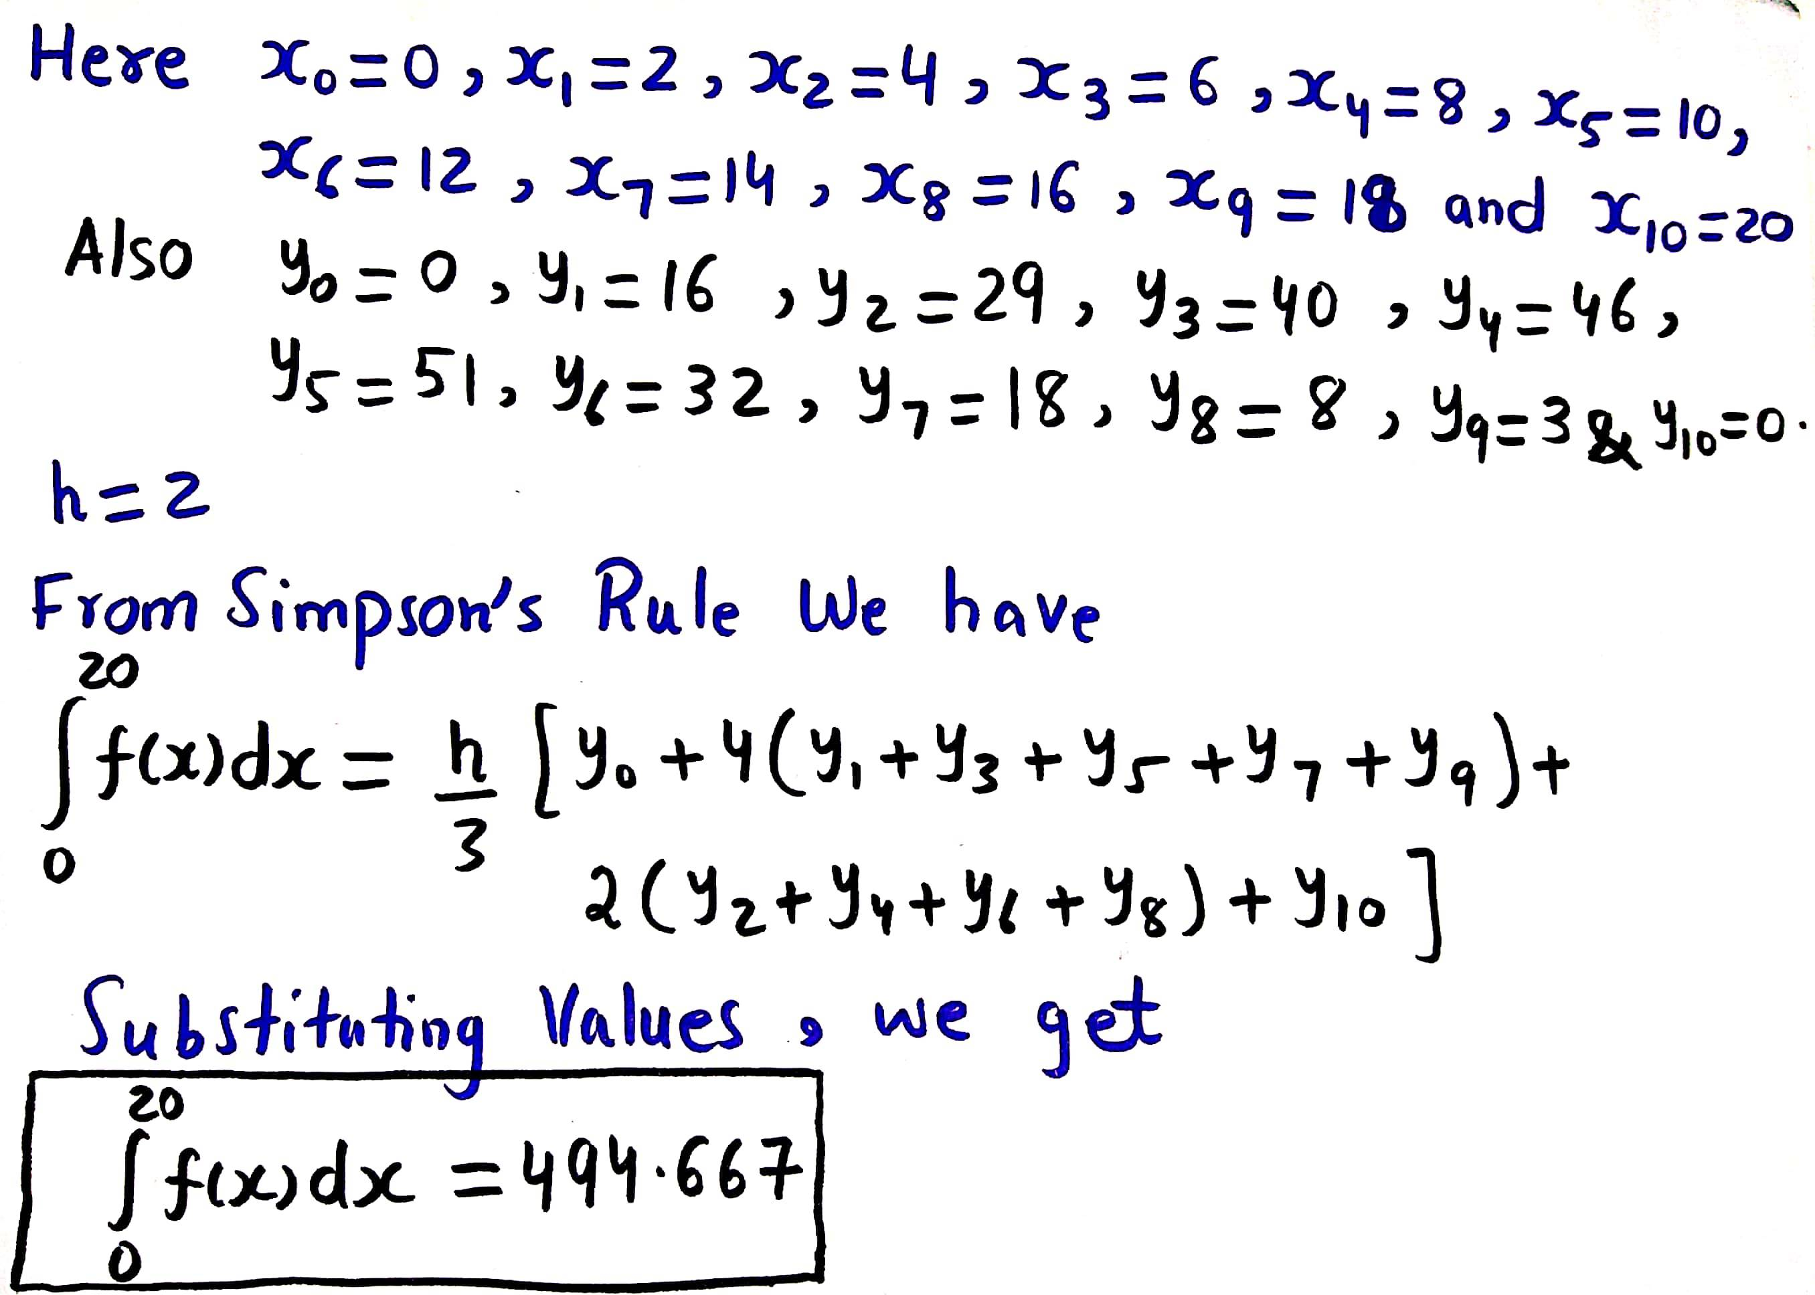
Numerical Methods
Solution
National University of Science and Technology, Islamabad

Slide 23
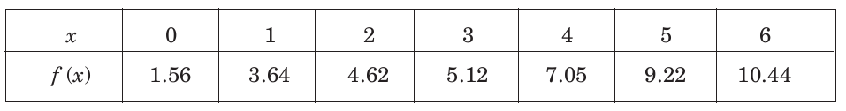
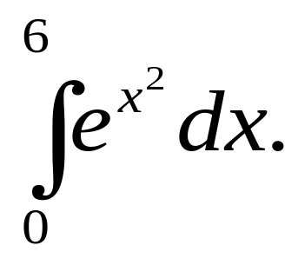
Numerical Methods
Practice Problems
Problem 1
Problem 2
Use Trapezoidal Rule to approximate the integral
National University of Science and Technology, Islamabad

Slide 24
Numerical Methods
Practice Problems
Problem 3
Use Simpson’s Rule to evaluate the integral in problem 1.
Problem 4
Use Simpson’s Rule to evaluate the integral in problem 2.
National University of Science and Technology, Islamabad

Slide 25

Numerical Methods
Problem
Practice Problems
National University of Science and Technology, Islamabad

