Slide 1


Slide 2
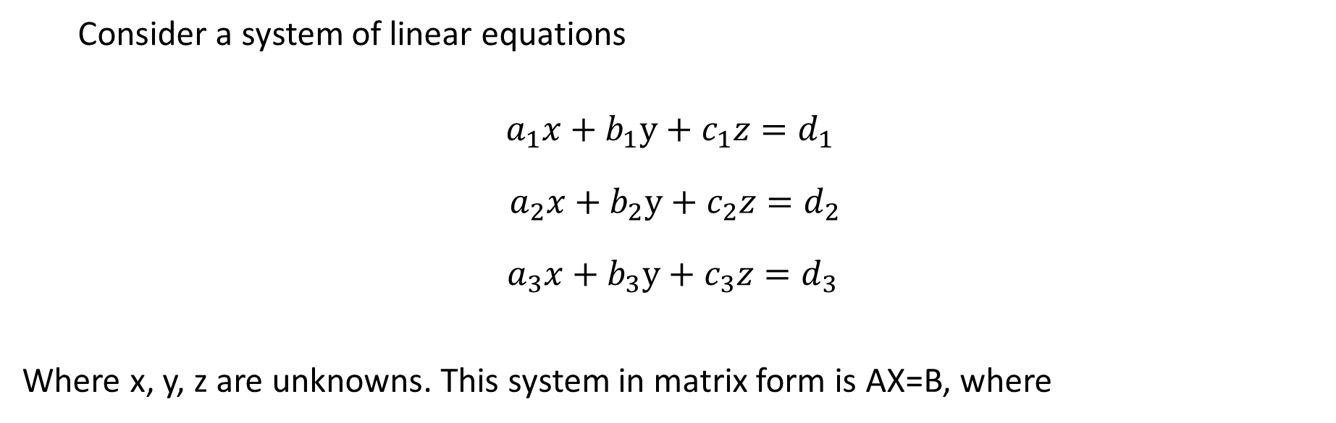

Numerical Methods
Consider a system of linear equations
System of Linear Equations
National University of Science and Technology, Islamabad

Slide 3
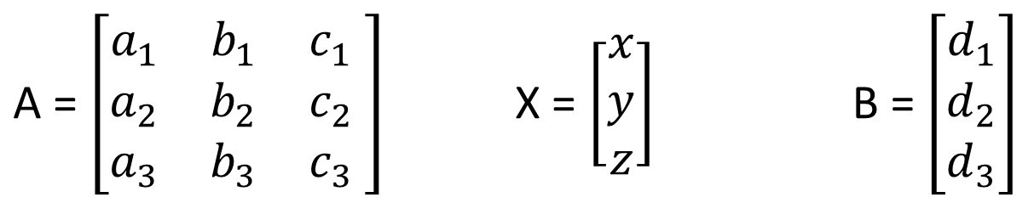
Numerical Methods
National University of Science and Technology, Islamabad

Slide 4
Numerical Methods
Methods for solutions of System of Equations
Numerical Integration
Direct Methods (LU-Factorization/LU-Decomposition Methods (Doulittle’s Method and Crout’s Mehtod), Cholisky’s Method)
Iterative Methods (Jacobi’s Method and Gauss-Seidel Method)
National University of Science and Technology, Islamabad

Slide 5
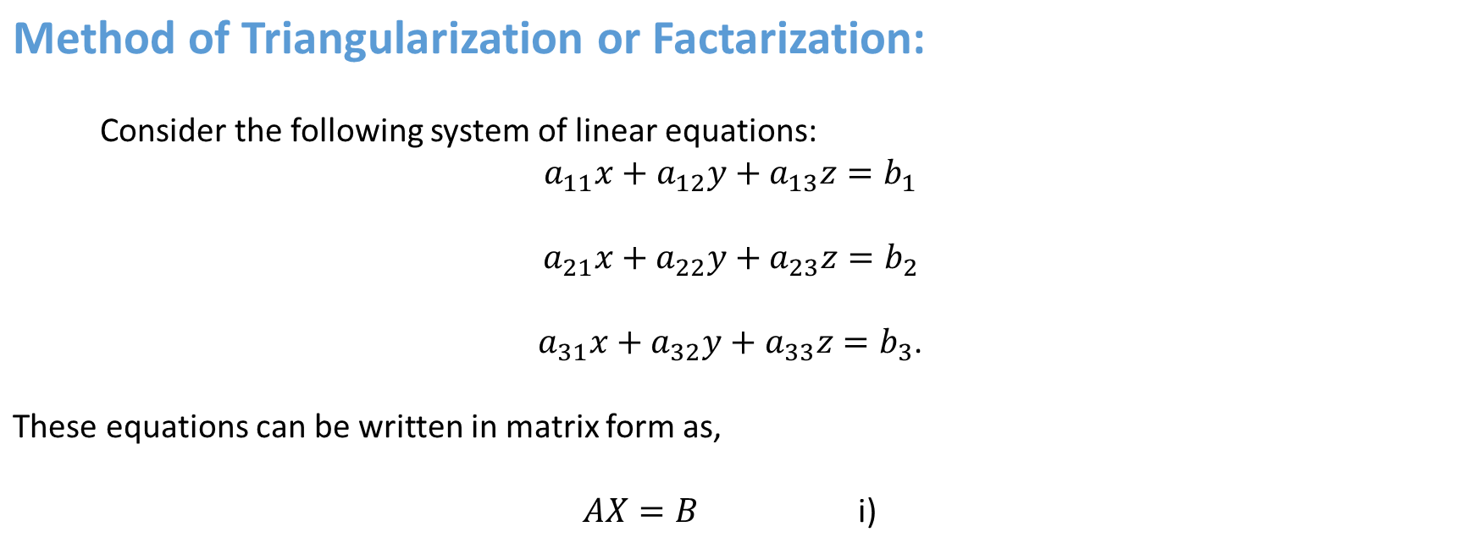
Numerical Methods
National University of Science and Technology, Islamabad

Slide 6
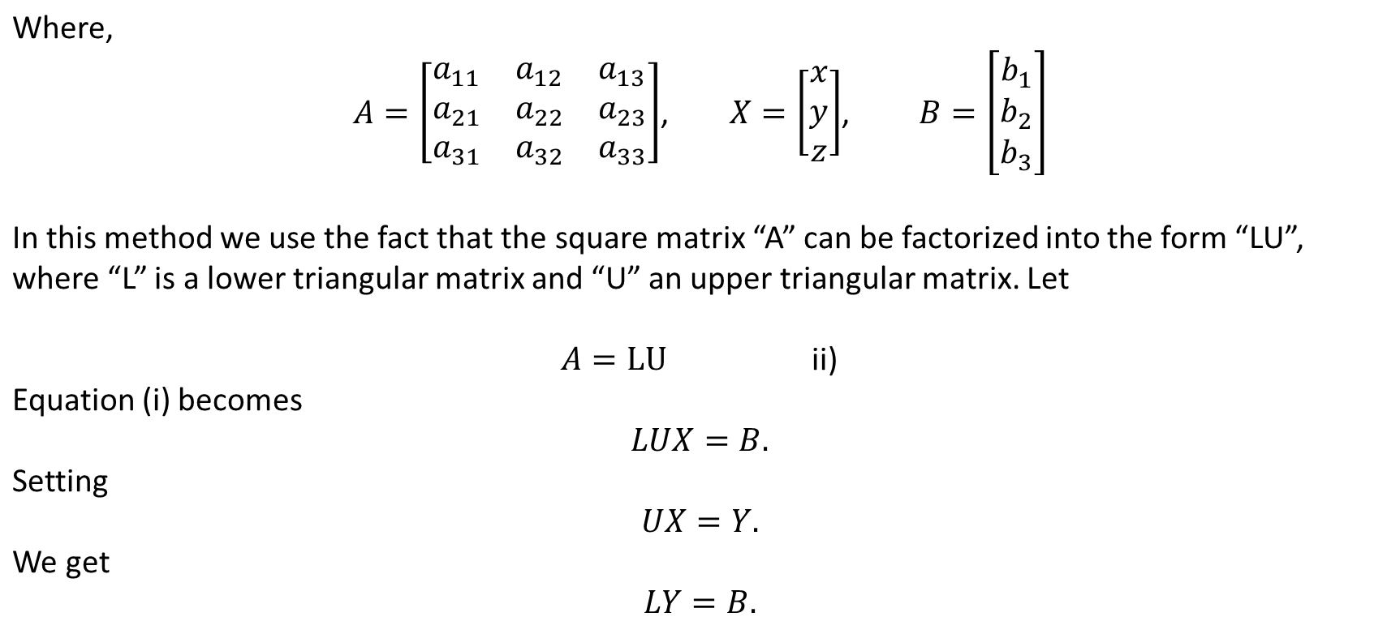
Numerical Methods
National University of Science and Technology, Islamabad

Slide 7
Numerical Methods
Types of Triangularization Methods
Doulittle’s Method
Croute’s Method
Cholesky’s Method
National University of Science and Technology, Islamabad

Slide 8
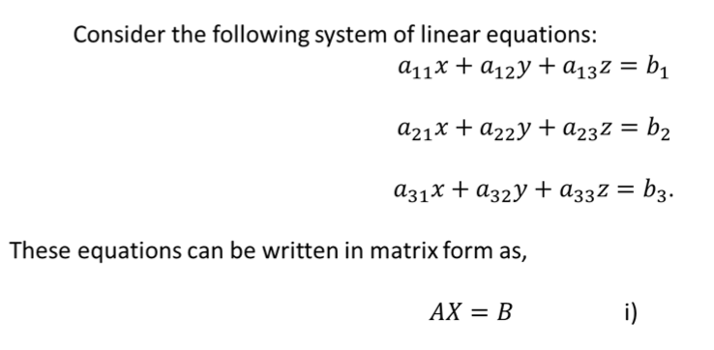
Numerical Methods
Doulittle’s Method
National University of Science and Technology, Islamabad

Slide 9
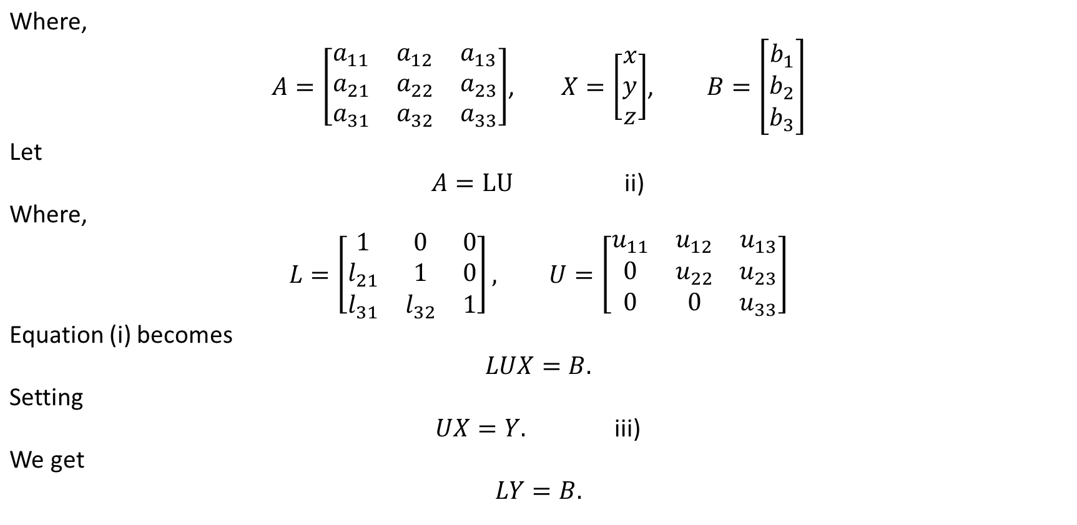
Numerical Methods
National University of Science and Technology, Islamabad

Slide 10
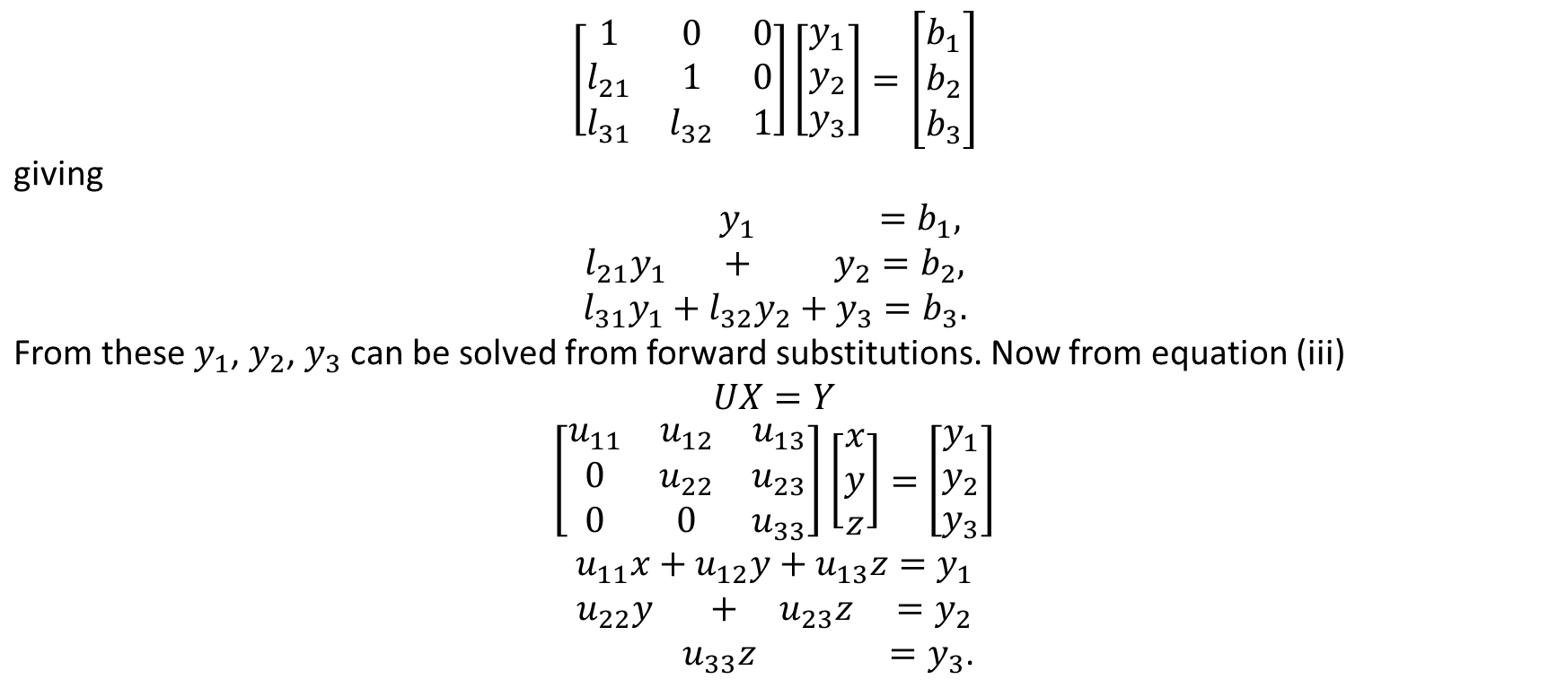
Numerical Methods
National University of Science and Technology, Islamabad

Slide 11
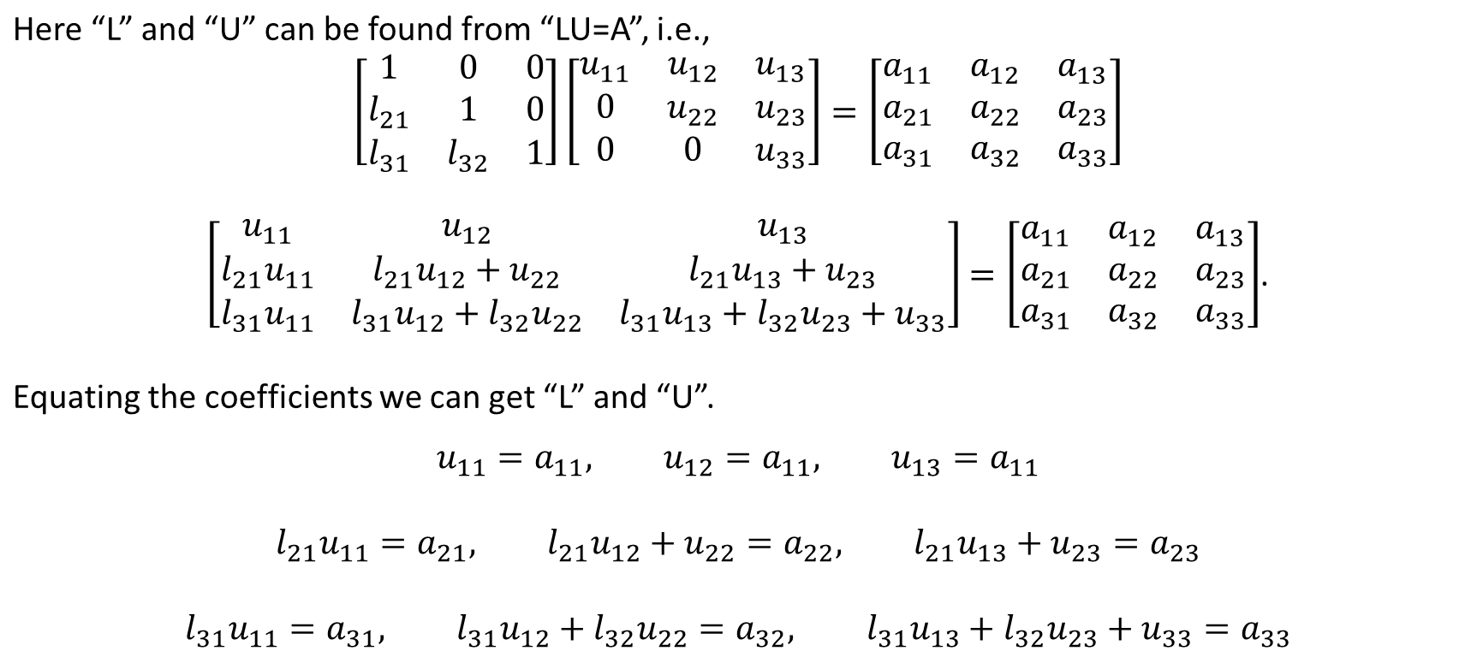
Numerical Methods
National University of Science and Technology, Islamabad

Slide 12
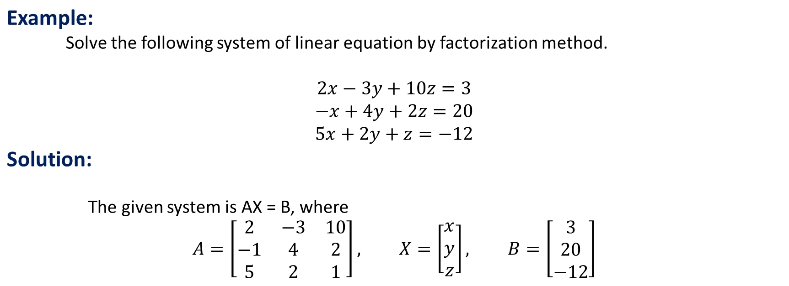
Numerical Methods
National University of Science and Technology, Islamabad

Slide 13
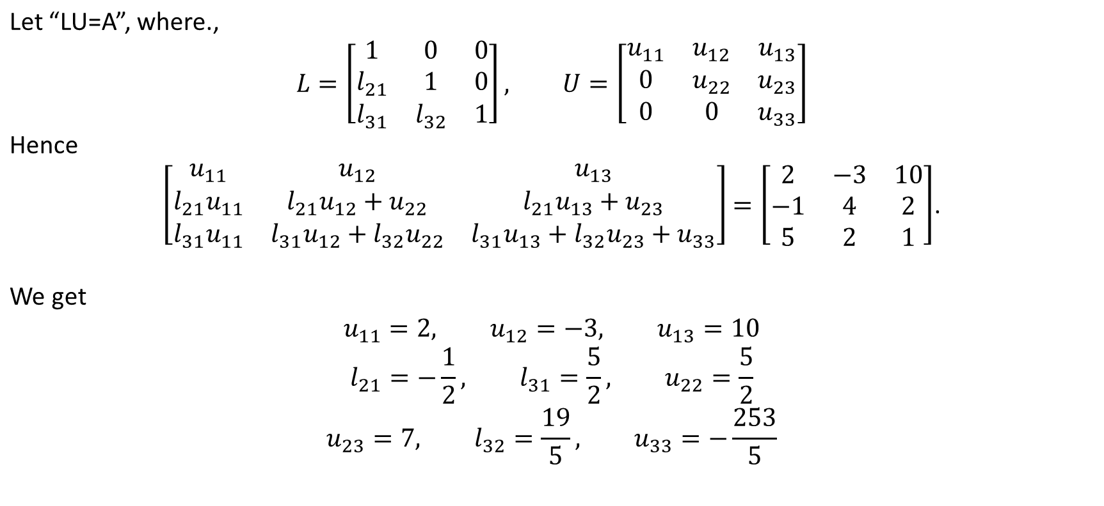
Numerical Methods
National University of Science and Technology, Islamabad

Slide 14
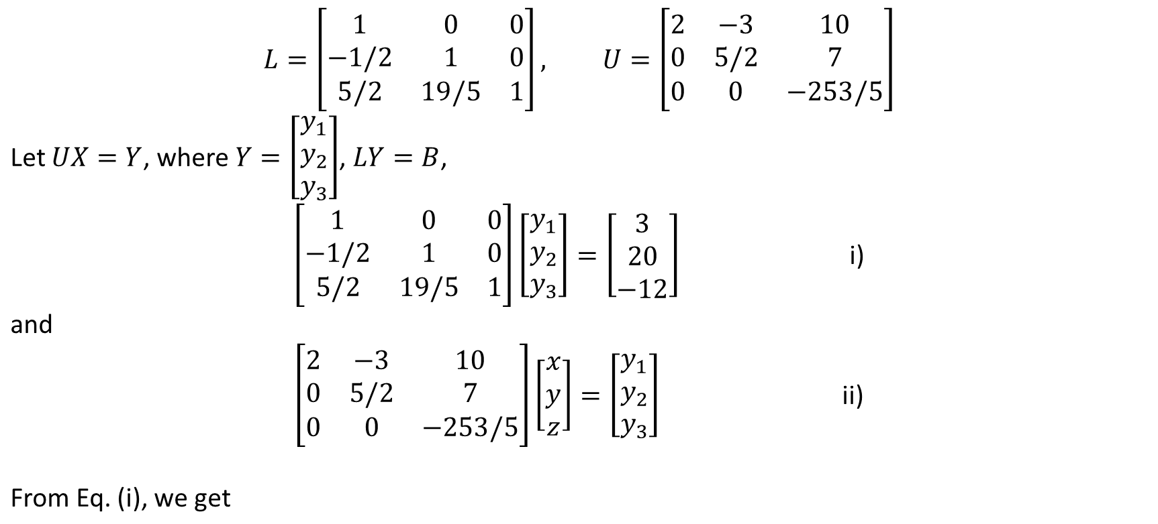
Numerical Methods
National University of Science and Technology, Islamabad

Slide 15
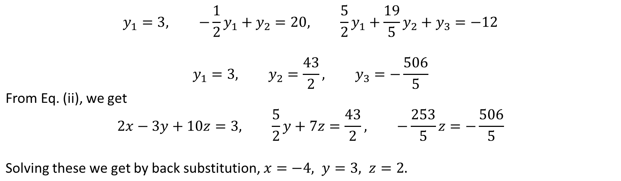
Numerical Methods
National University of Science and Technology, Islamabad

Slide 16
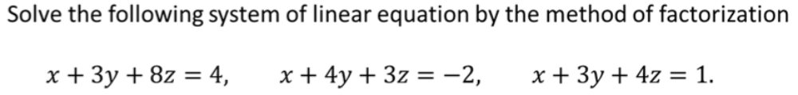
Numerical Methods
Class Task
National University of Science and Technology, Islamabad

Slide 17
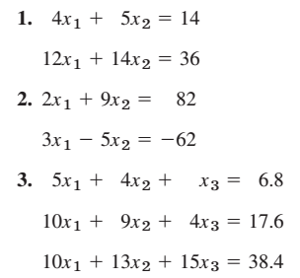
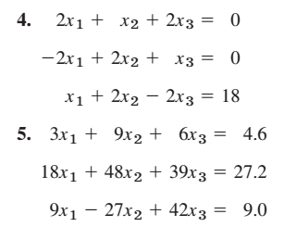
Numerical Methods
Solve the following system of linear equations by Doolittle’s Method
National University of Science and Technology, Islamabad

Slide 18
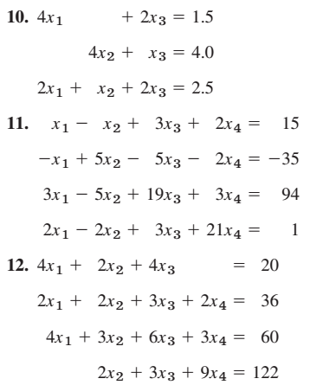
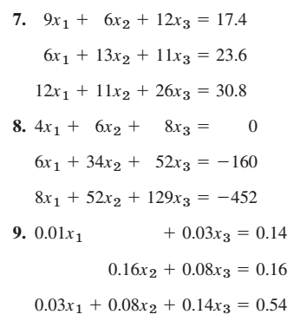
Numerical Methods
Solve the following system of linear equations by Doolittle’s Method
National University of Science and Technology, Islamabad

