Slide 1


Slide 2
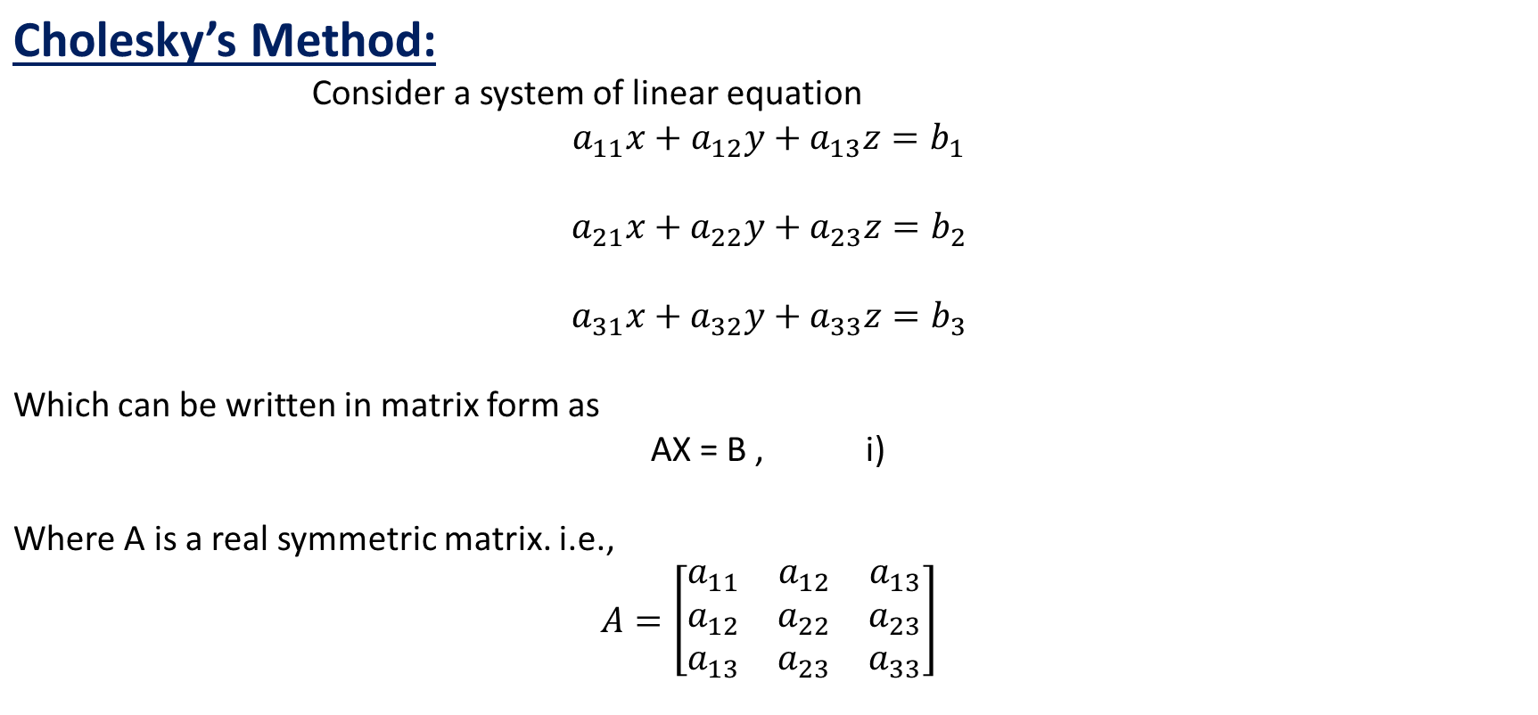

Numerical Methods
National University of Science and Technology, Islamabad

Slide 3
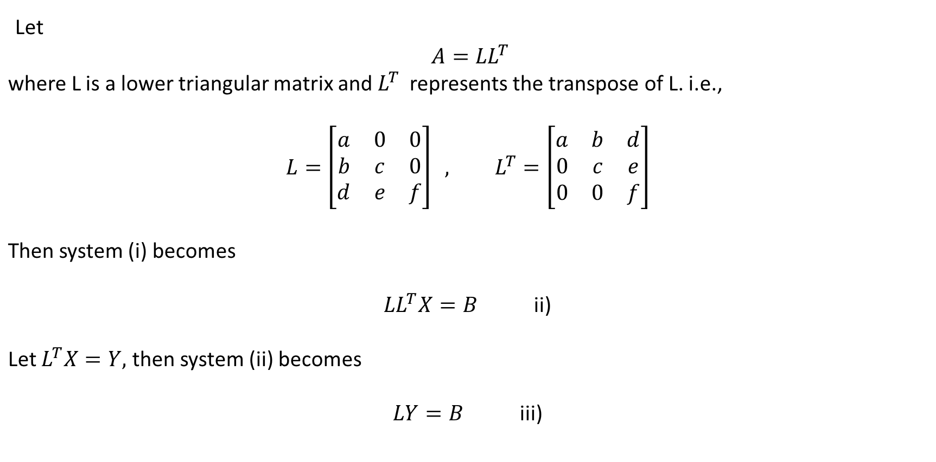
Numerical Methods
National University of Science and Technology, Islamabad

Slide 4
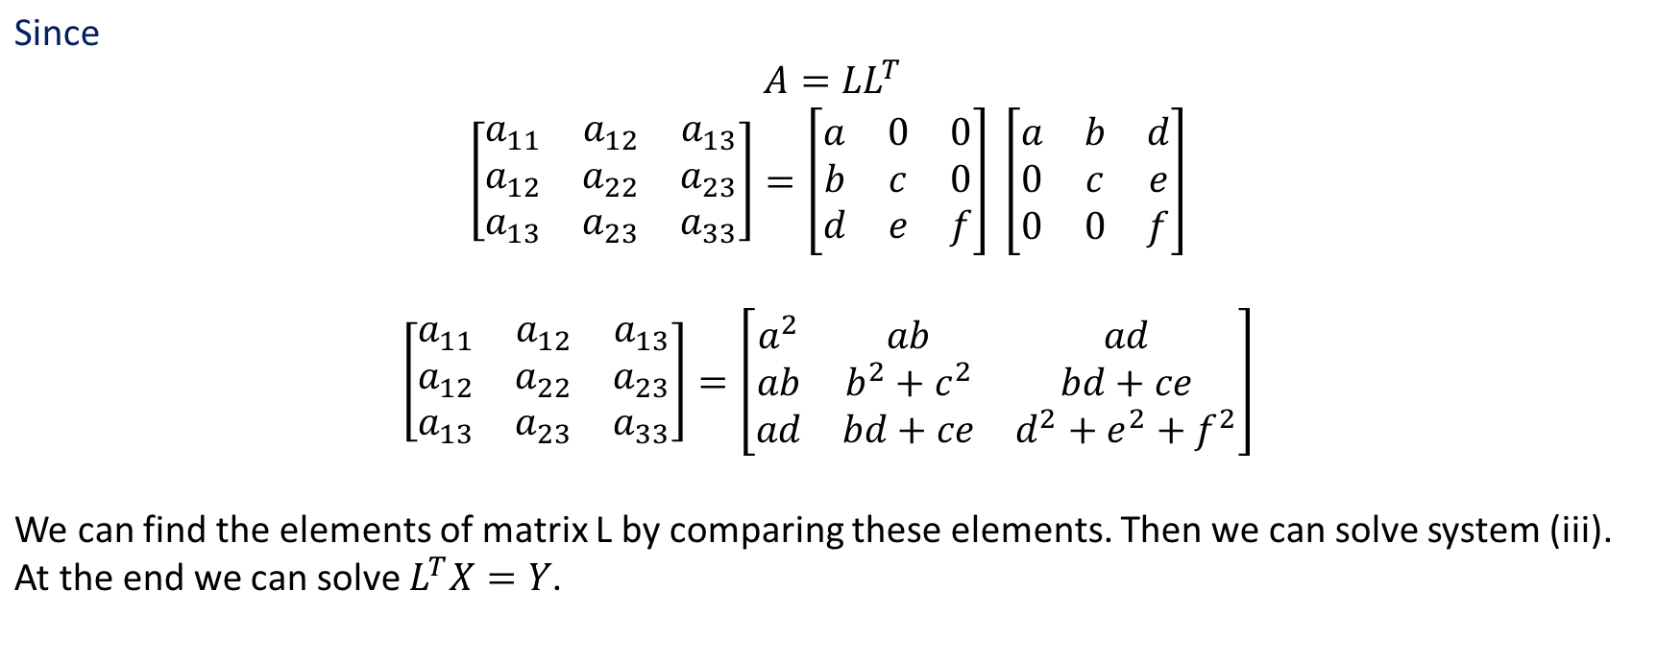
Numerical Methods
National University of Science and Technology, Islamabad

Slide 5
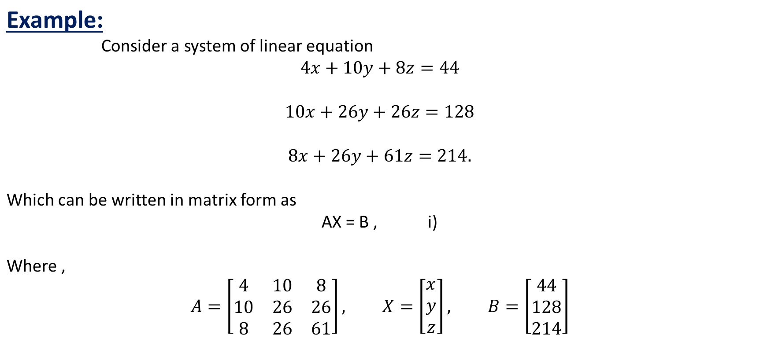
Numerical Methods
National University of Science and Technology, Islamabad

Slide 6
Numerical Methods
National University of Science and Technology, Islamabad

Slide 7
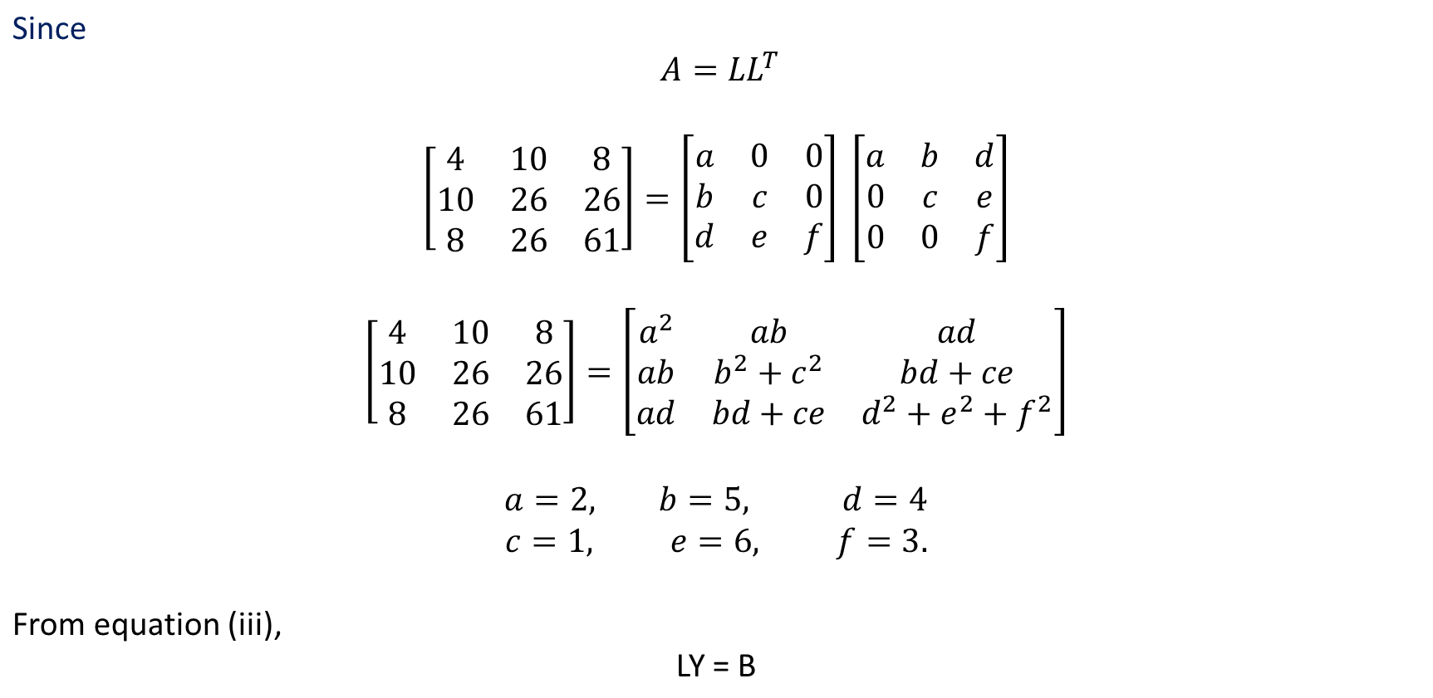
Numerical Methods
National University of Science and Technology, Islamabad

Slide 8
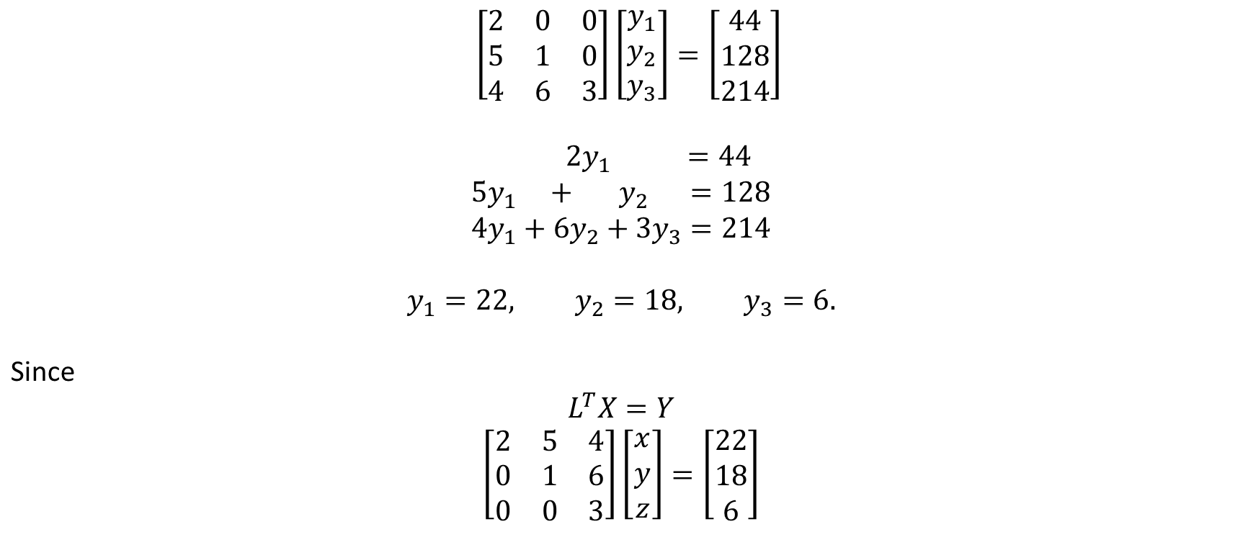
Numerical Methods
National University of Science and Technology, Islamabad

Slide 9

Numerical Methods
National University of Science and Technology, Islamabad

Slide 10
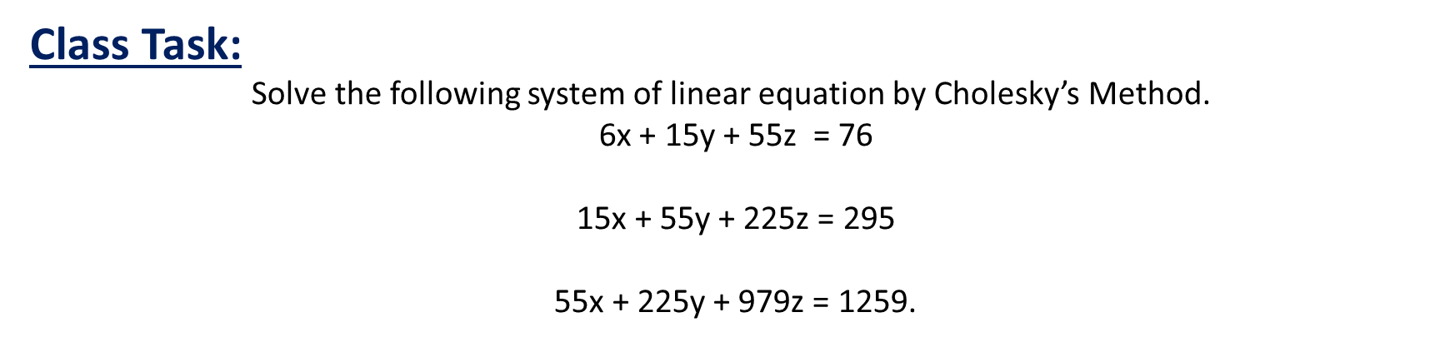
Numerical Methods
National University of Science and Technology, Islamabad

Slide 11
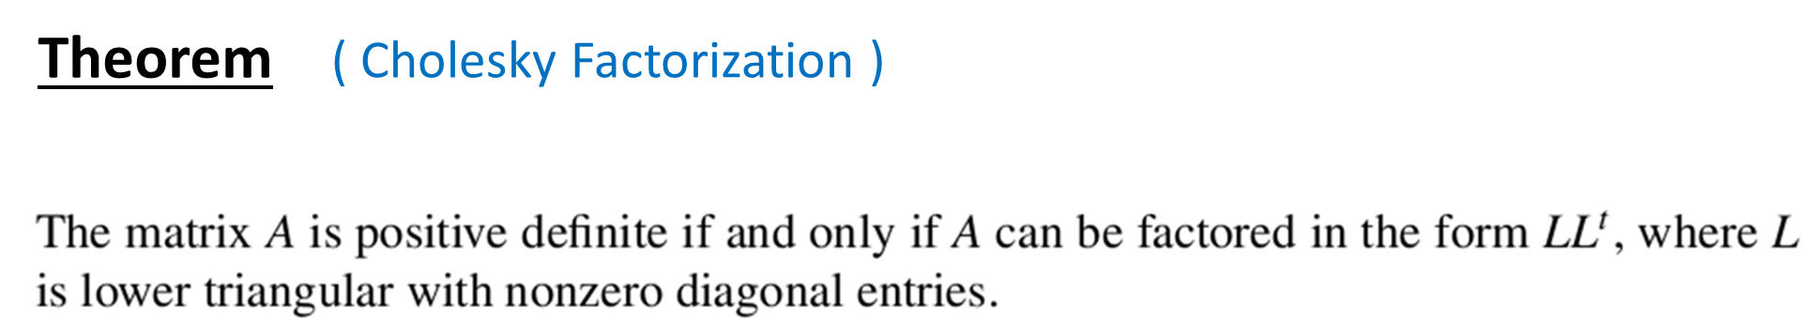
Numerical Methods
National University of Science and Technology, Islamabad

Slide 12
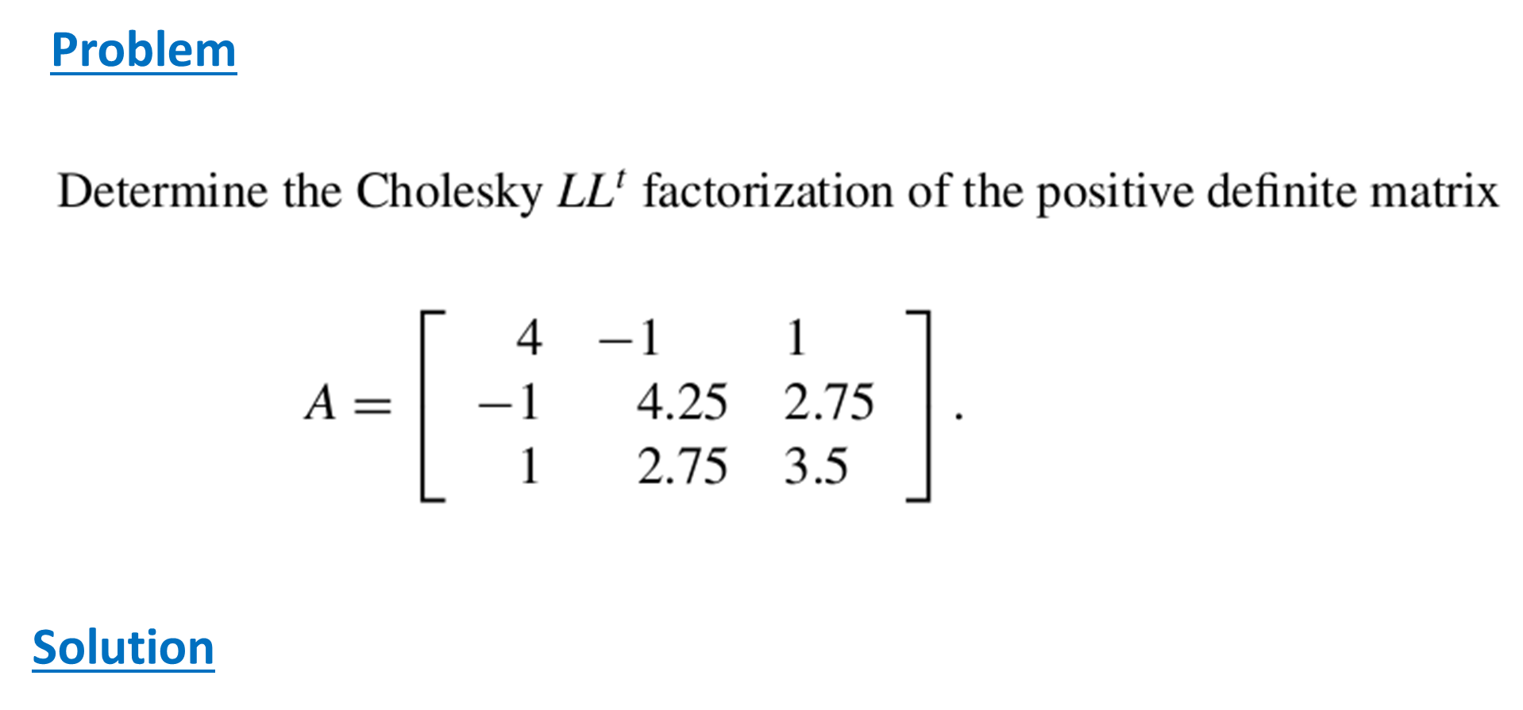
Numerical Methods
National University of Science and Technology, Islamabad

Slide 13
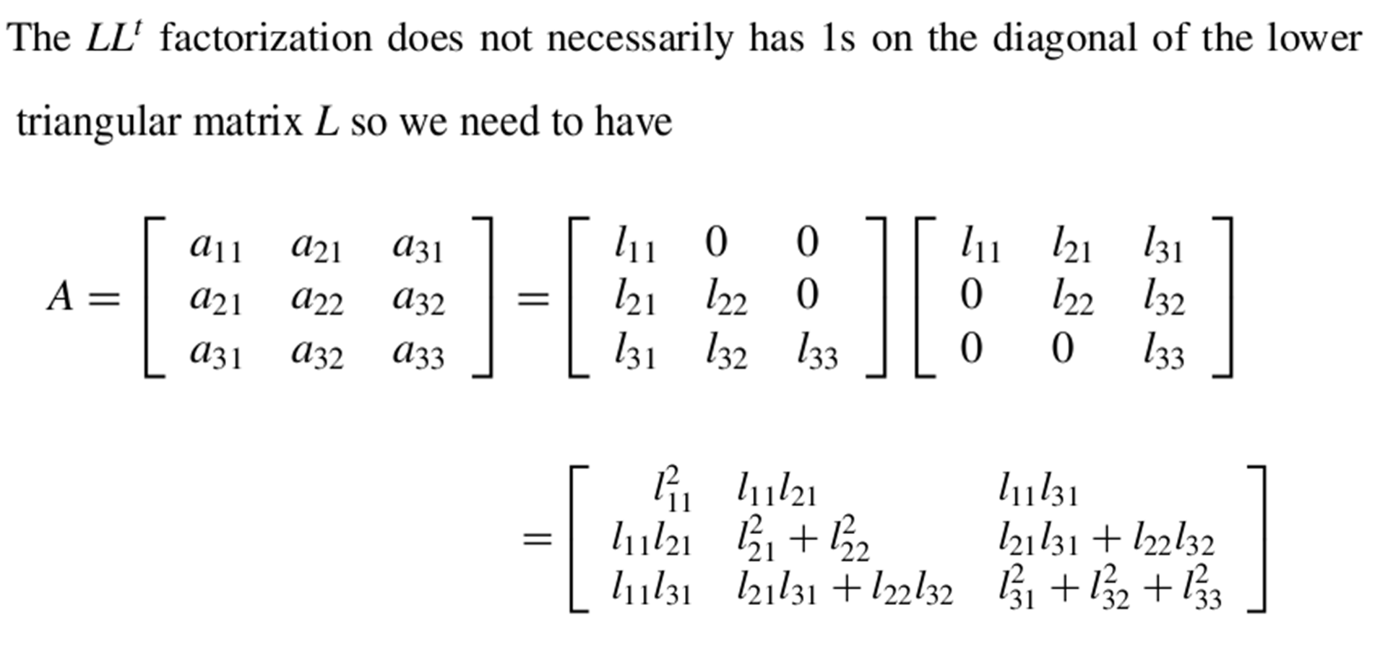
Numerical Methods
National University of Science and Technology, Islamabad

Slide 14
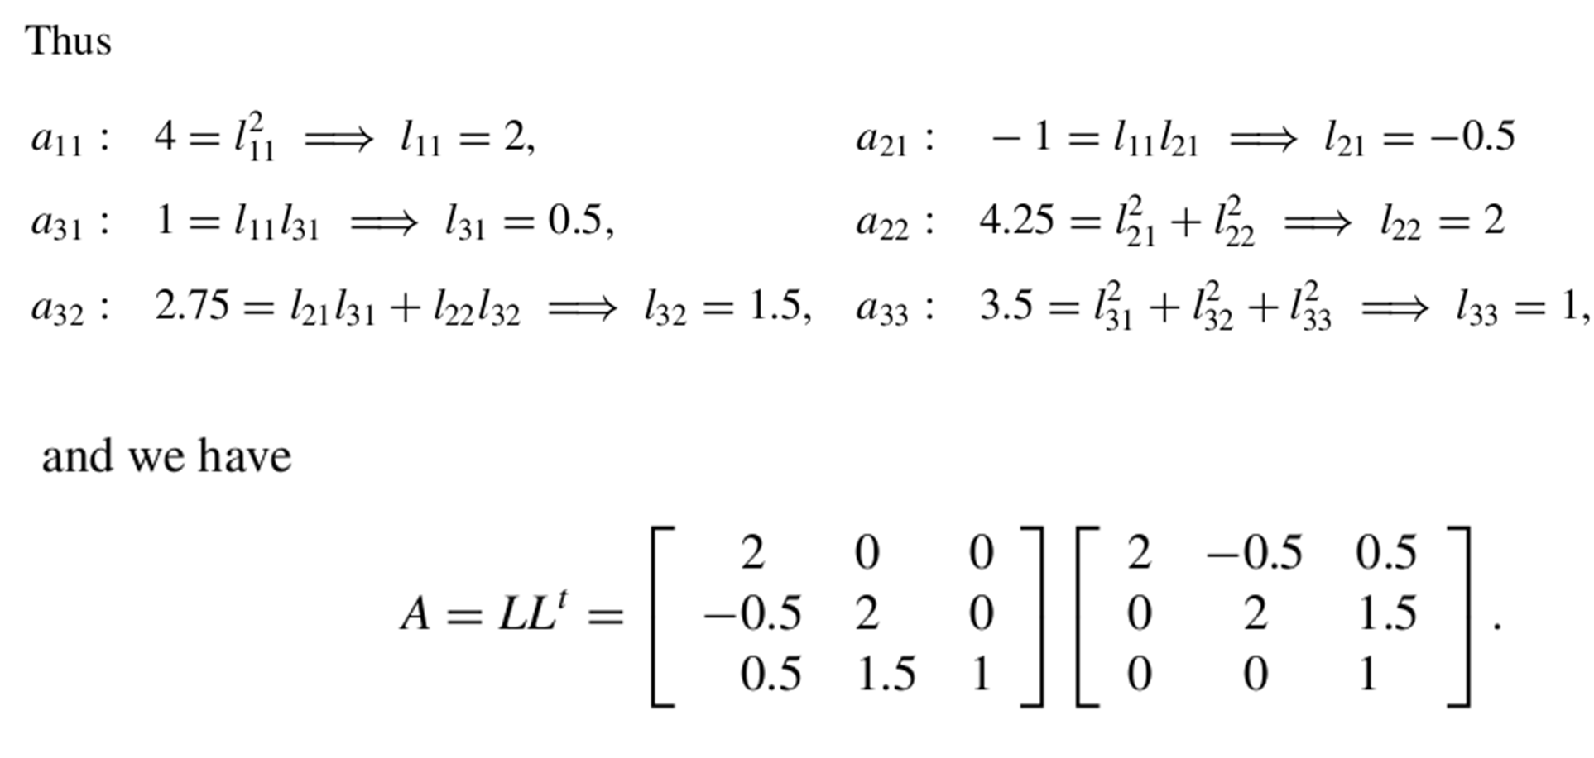
Numerical Methods
National University of Science and Technology, Islamabad

Slide 15
Numerical Methods
Solve the following system of linear equations by Cholisky’s Method
Q. 1
25x+15y-5z=35
15x+18z=33
-5x+11z=6
Q. 3
x+2y+3z=5
2x+8y+22z=6
3x+22y+82z=-10
Q. 2
x+y+z=3
x-y+z=4
x+y-z=5
National University of Science and Technology, Islamabad

Slide 16
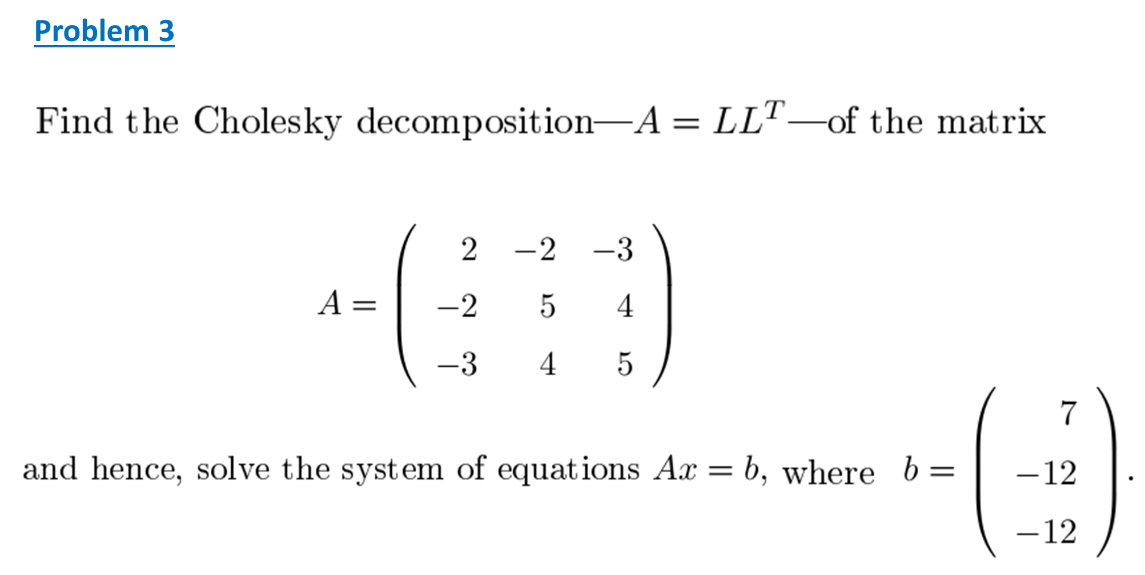
Numerical Methods
National University of Science and Technology, Islamabad

Slide 17












Numerical Methods
Temperature distribution Problems
Assumptions
Plate is perfectly insulated at
boundaries
Use average at compass points
Perform Mathematical Modeling
Solve the problem by Direct Methods
National University of Science and Technology, Islamabad

