Slide 1


Slide 2
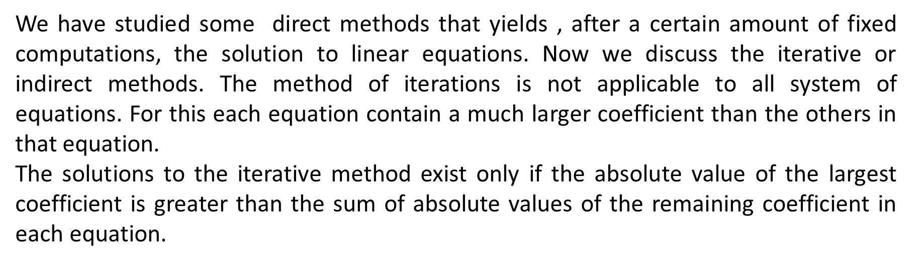


Numerical Methods
Iterative Methods
National University of Science and Technology, Islamabad

Slide 3
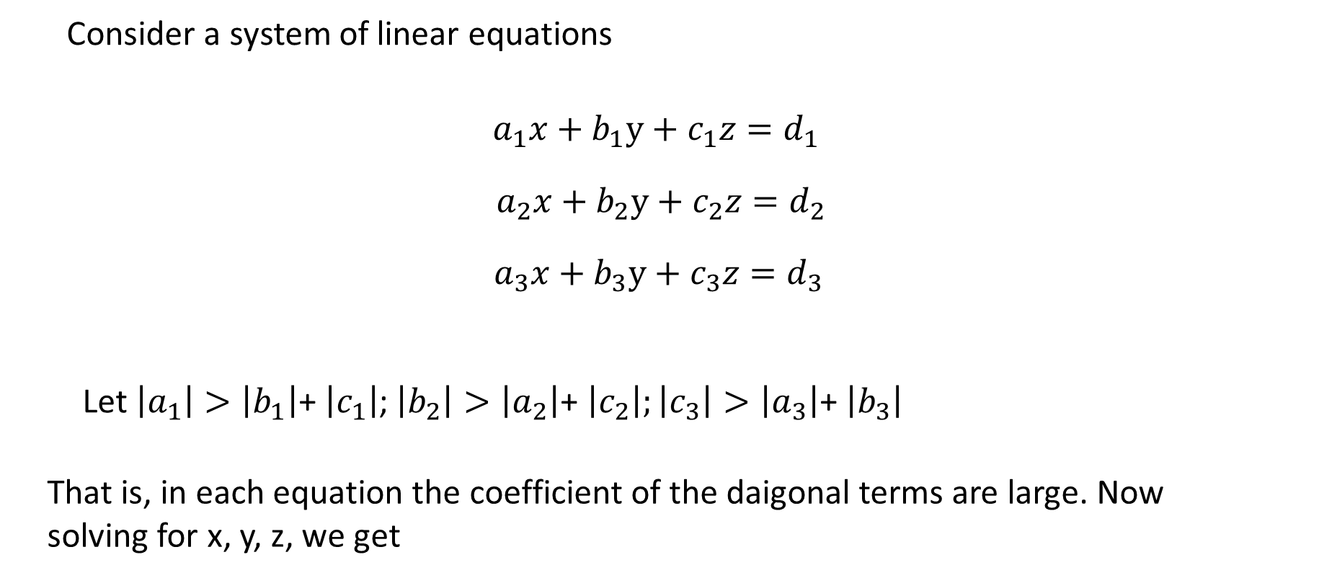
Numerical Methods
Jacobi Method of iterative
National University of Science and Technology, Islamabad

Slide 4
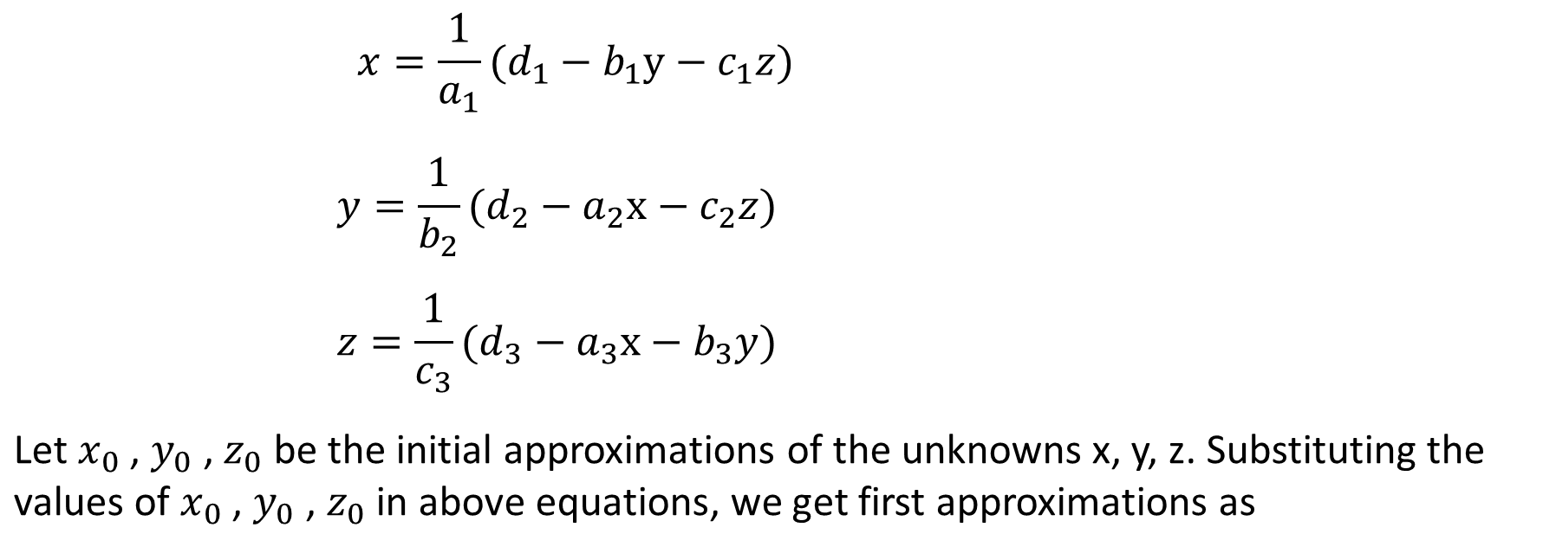
Numerical Methods
National University of Science and Technology, Islamabad

Slide 5
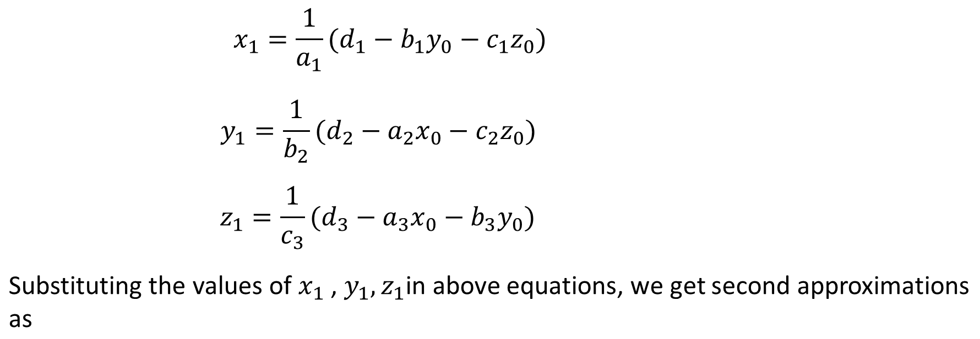
Numerical Methods
National University of Science and Technology, Islamabad

Slide 6
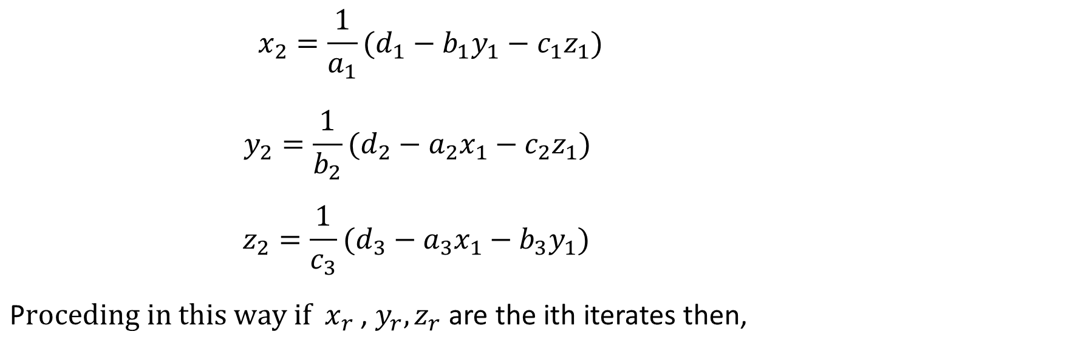
Numerical Methods
National University of Science and Technology, Islamabad

Slide 7
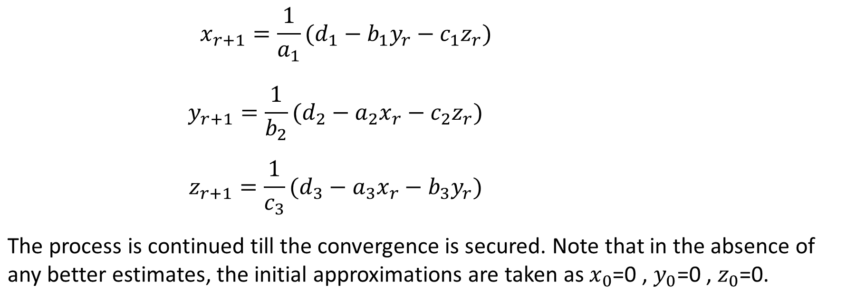
Numerical Methods
National University of Science and Technology, Islamabad

Slide 8
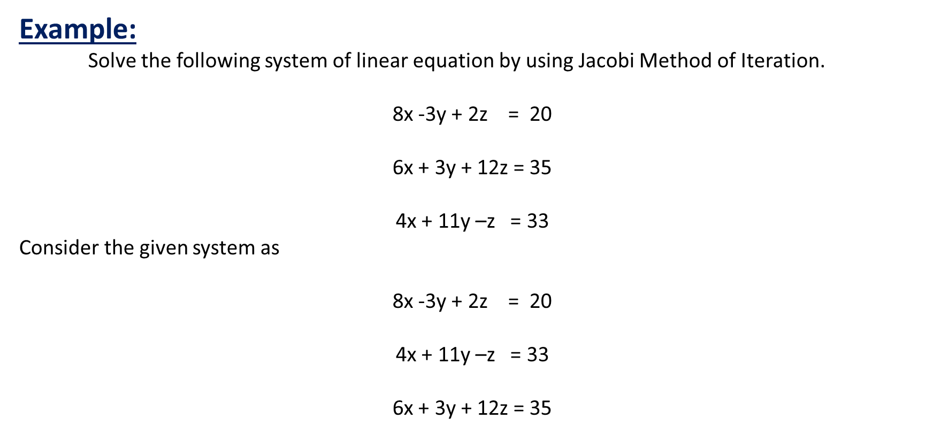
Numerical Methods
National University of Science and Technology, Islamabad

Slide 9
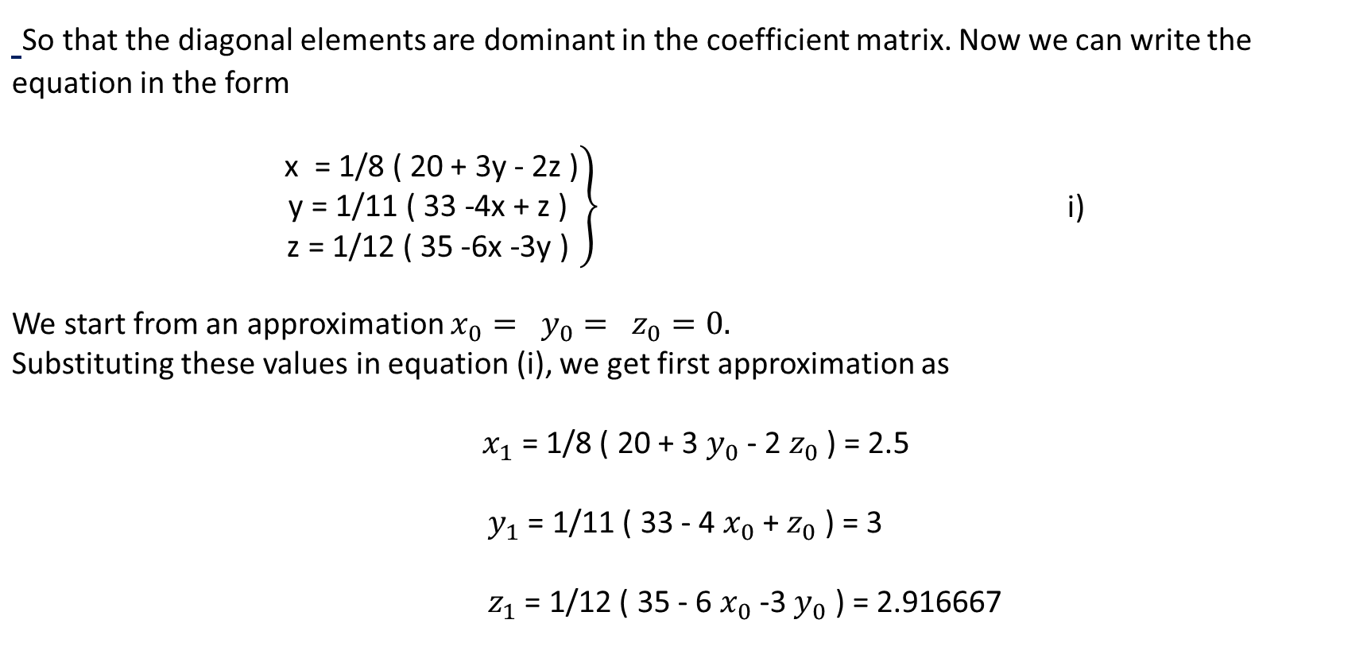
Numerical Methods
National University of Science and Technology, Islamabad

Slide 10
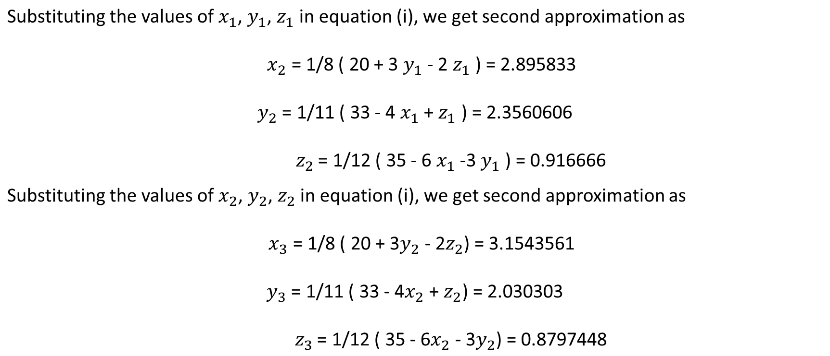
Numerical Methods
National University of Science and Technology, Islamabad

Slide 11
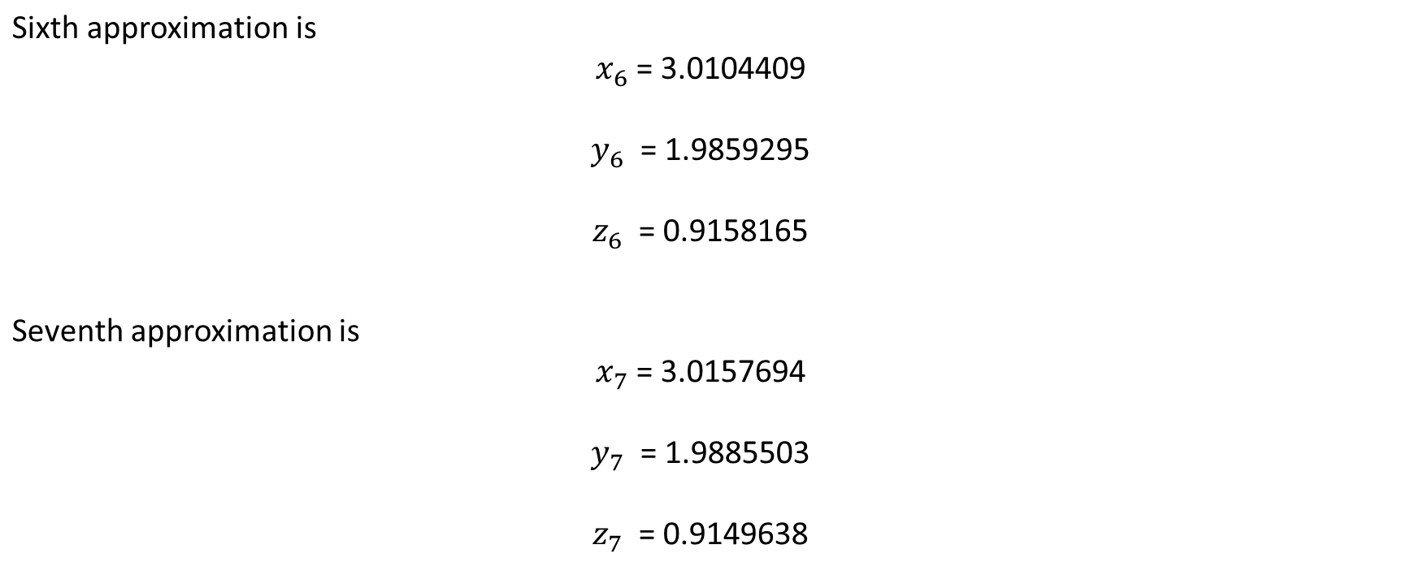
Numerical Methods
National University of Science and Technology, Islamabad

Slide 12
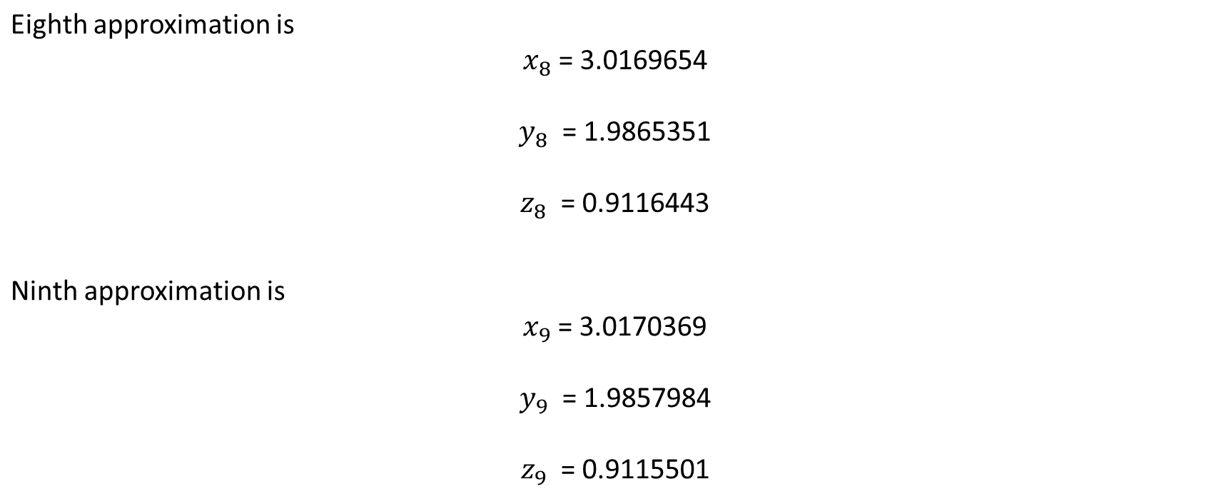
Numerical Methods
National University of Science and Technology, Islamabad

Slide 13
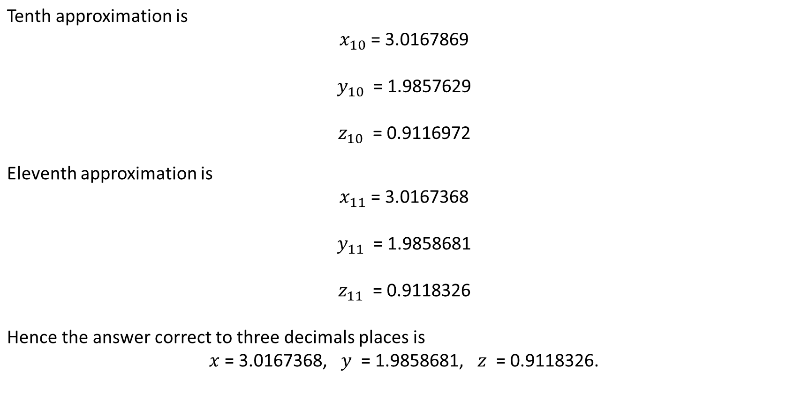
Numerical Methods
National University of Science and Technology, Islamabad

Slide 14
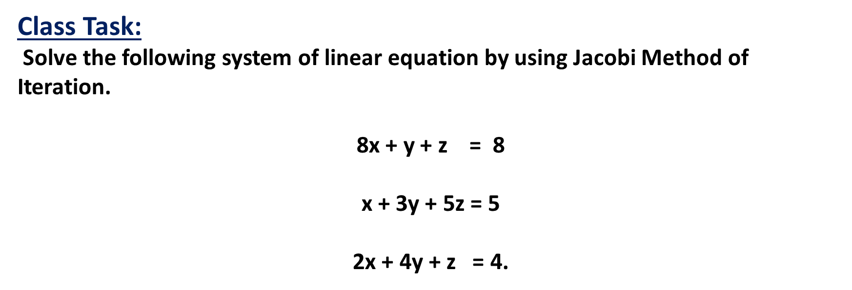
Numerical Methods
National University of Science and Technology, Islamabad

Slide 15
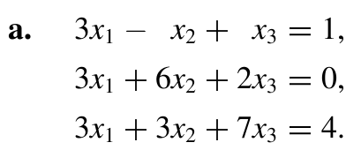

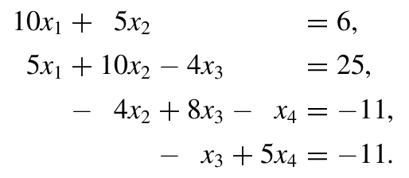
Numerical Methods
Problem 1
National University of Science and Technology, Islamabad

