Slide 1


Slide 2


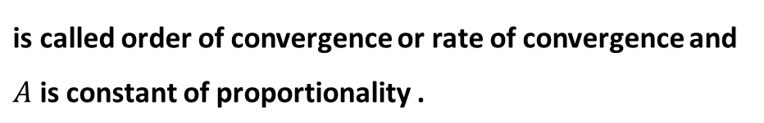

Numerical Methods
Rate of convergence or order of convergence of Numerical methods
Rate of convergence is the rate or speed at which the approximate root by a
numerical method approaches toward exact root.
OR
It is the rate at which the error decreases in each iteration of a numerical method.
It is basically a relation between error in current and previous iteration.
Mathematically
National University of Science and Technology, Islamabad

Slide 3
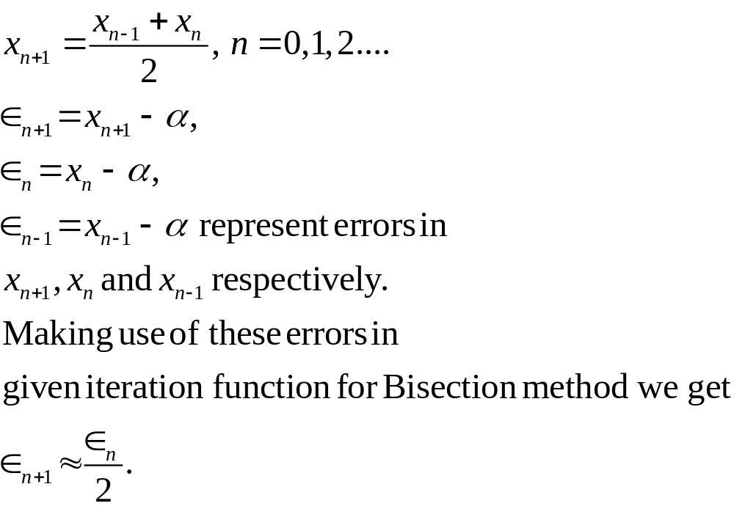
Numerical Methods
Rate of convergence of Bisection method
Iteration function for approximate roots by using Bisection method is
National University of Science and Technology, Islamabad

Slide 4
Numerical Methods
Thus the order of convergence of bisection method is 1.
Physically it shows that if r-th root is correct to 1 decimal place, r+1-th
root will be correct to two decimal places and r+2-th root will be
correct to three decimal points ad so on.
National University of Science and Technology, Islamabad

Slide 5
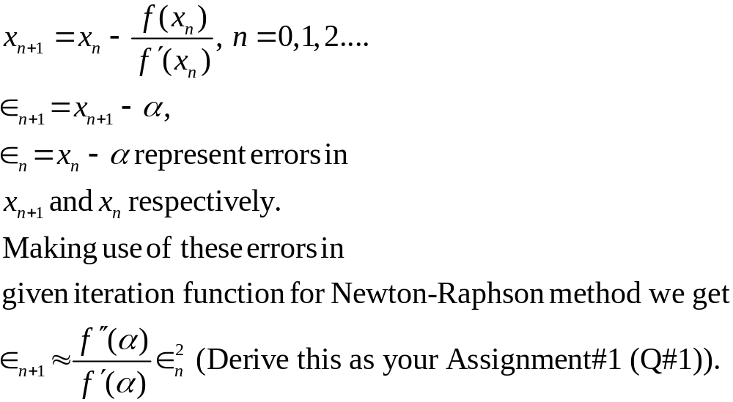
Numerical Methods
Rate of convergence of Newton-Raphson Method
Iteration function for approximate roots by using Newton-Raphson method is
National University of Science and Technology, Islamabad

Slide 6
Numerical Methods
Thus the order of convergence of Newton-Raphson method is 2. Physically it shows that if r-th root is correct to 2 significant figures, r+1-th root will be correct to 4 significant figures and r+2-th root will be correct to 6 significant figures and so on.
National University of Science and Technology, Islamabad

Slide 7
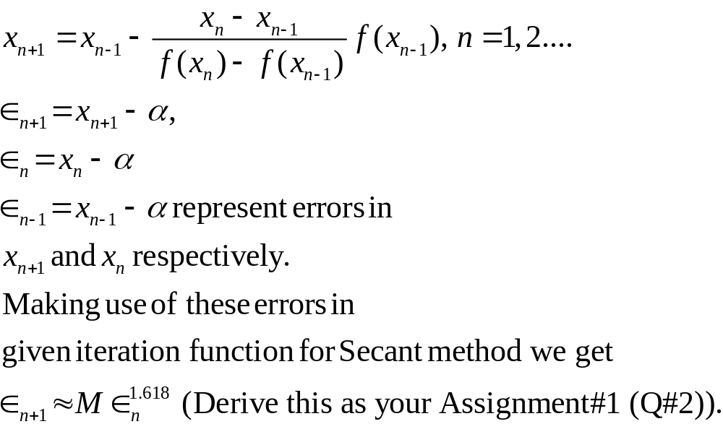
Numerical Methods
Rate of convergence of Secant Method
Iteration function for approximate roots by using Secant method is
National University of Science and Technology, Islamabad

Slide 8
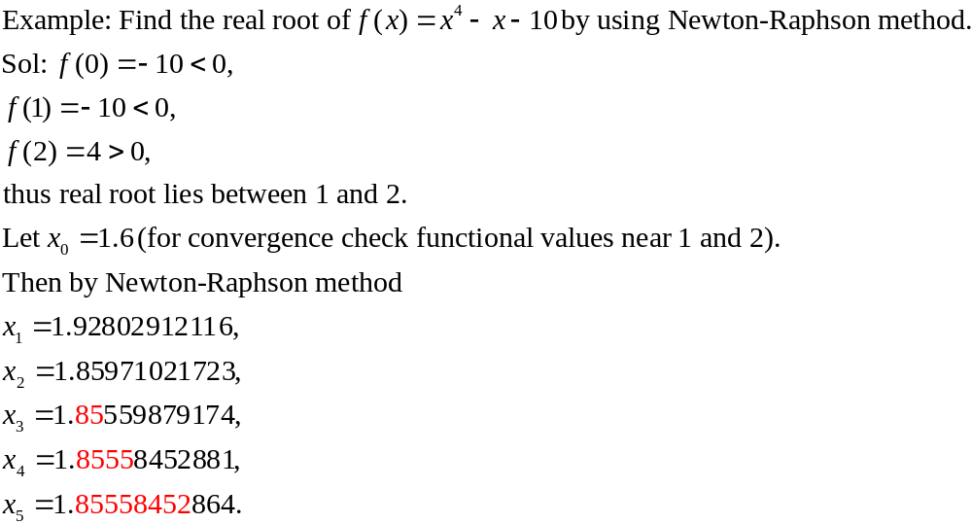
Numerical Methods
National University of Science and Technology, Islamabad

Slide 9
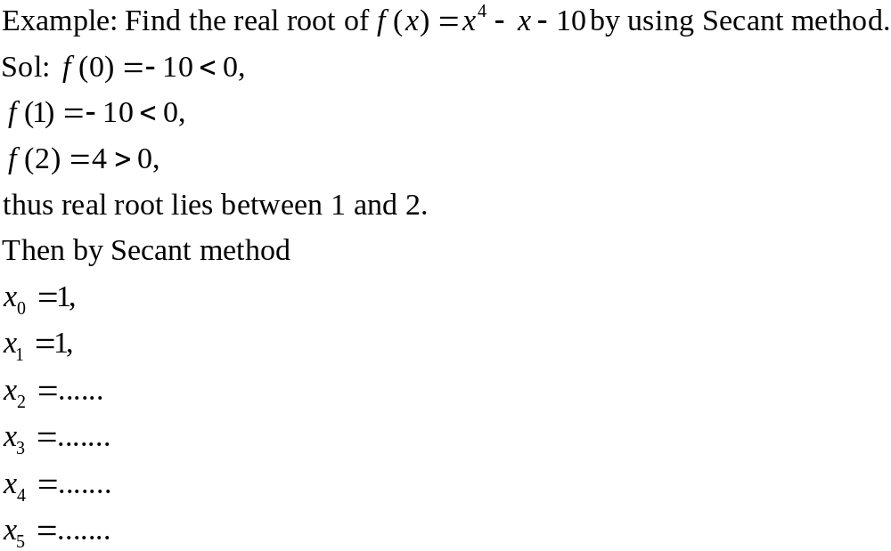
Numerical Methods
National University of Science and Technology, Islamabad

Slide 10
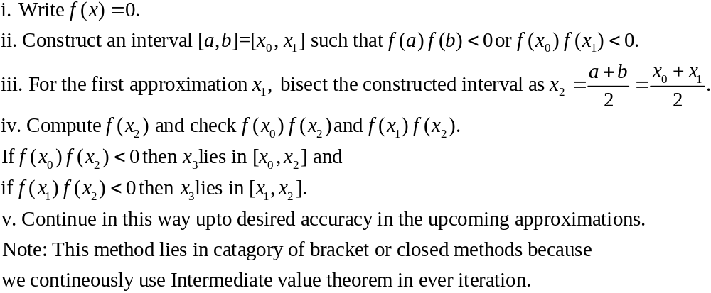
Numerical Methods
Algorithm of Numerical Methods
1. Bisection Methods
National University of Science and Technology, Islamabad

Slide 11
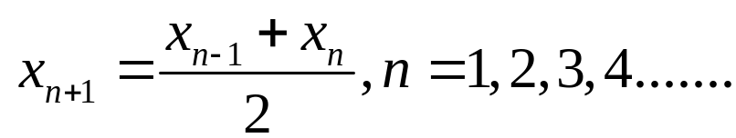
Numerical Methods
General formula or Iteration function for Bisection Methods
National University of Science and Technology, Islamabad

Slide 12
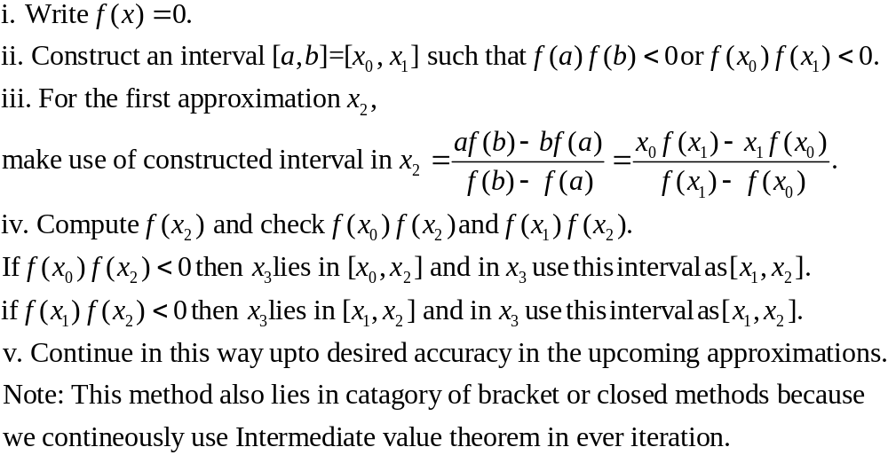
Numerical Methods
2. Regula-Falsi or False position Methods
National University of Science and Technology, Islamabad

Slide 13
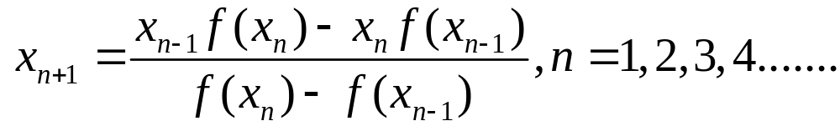
Numerical Methods
General formula or Iteration function for Regula-Falsi Methods
National University of Science and Technology, Islamabad

Slide 14
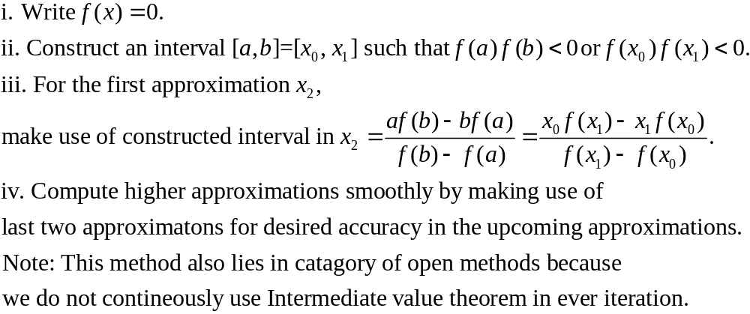
Numerical Methods
3. Secant Methods
National University of Science and Technology, Islamabad

Slide 15
Numerical Methods
General formula or Iteration function for Secant Methods
National University of Science and Technology, Islamabad

Slide 16
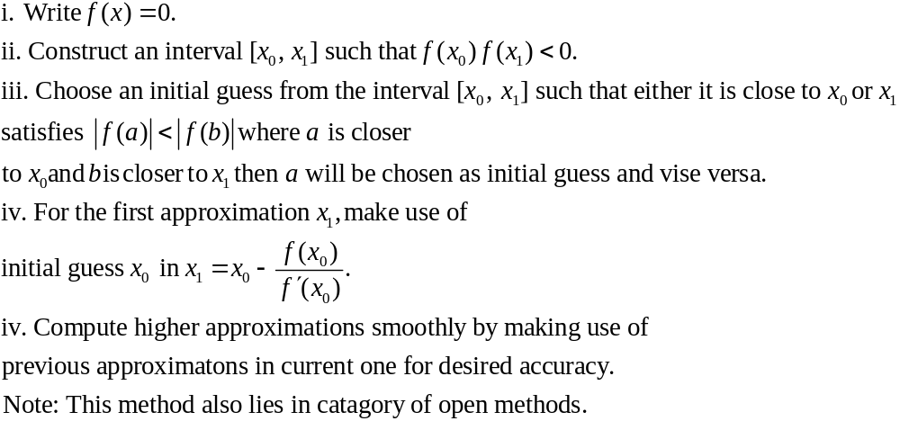
Numerical Methods
4. Newton-Raphson Methods
National University of Science and Technology, Islamabad

Slide 17
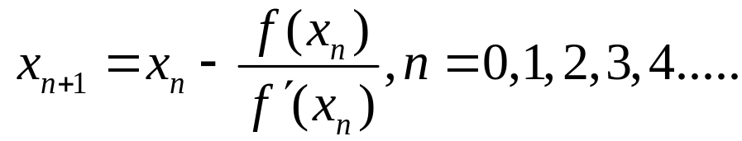
Numerical Methods
General formula or Iteration function for Newton-Raphson method
National University of Science and Technology, Islamabad

Slide 18
Numerical Methods
Task: Attempt the example given in this lecture by all these numerical methods
and perform 4 iterations.
National University of Science and Technology, Islamabad

