Slide 1



AeCC
Autoencoders for Compressed Communication
Presented by
Muhammad Umer
Muhammad Ahmed Mohsin

Slide 2
Introduction
Core objective is to investigate the integration of Vision Transformers (ViTs) in the compression and communication of images (current case: Imagenette)
We propose and explore the workings of DAE-ViT model, a combination of Denoising Autoencoders and Vision Transformers, and assess its efficacy in image reconstruction and denoising
The primary evaluation metrics employed are the Structural Similarity Index (SSI) for reconstruction quality and Peak Signal-to-Noise Ratio (PSNR) for assessing transmitted image quality

Slide 3
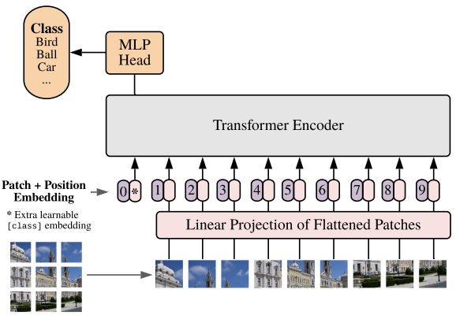
Vision Transformer: Overview
Image Splitting: Divides image into fixed-size patches
Patch Embedding: Flattens patches and projects them into a latent space
Positional Embedding: Adds positional information to patches
Transformer Encoder: Processes patch embeddings with multiple attention layers
Classification Head: Uses an extra "classification token" for final prediction
Paper: An Image is Worth 16x16 Words: Transformers for Image Recognition at Scale

Slide 4
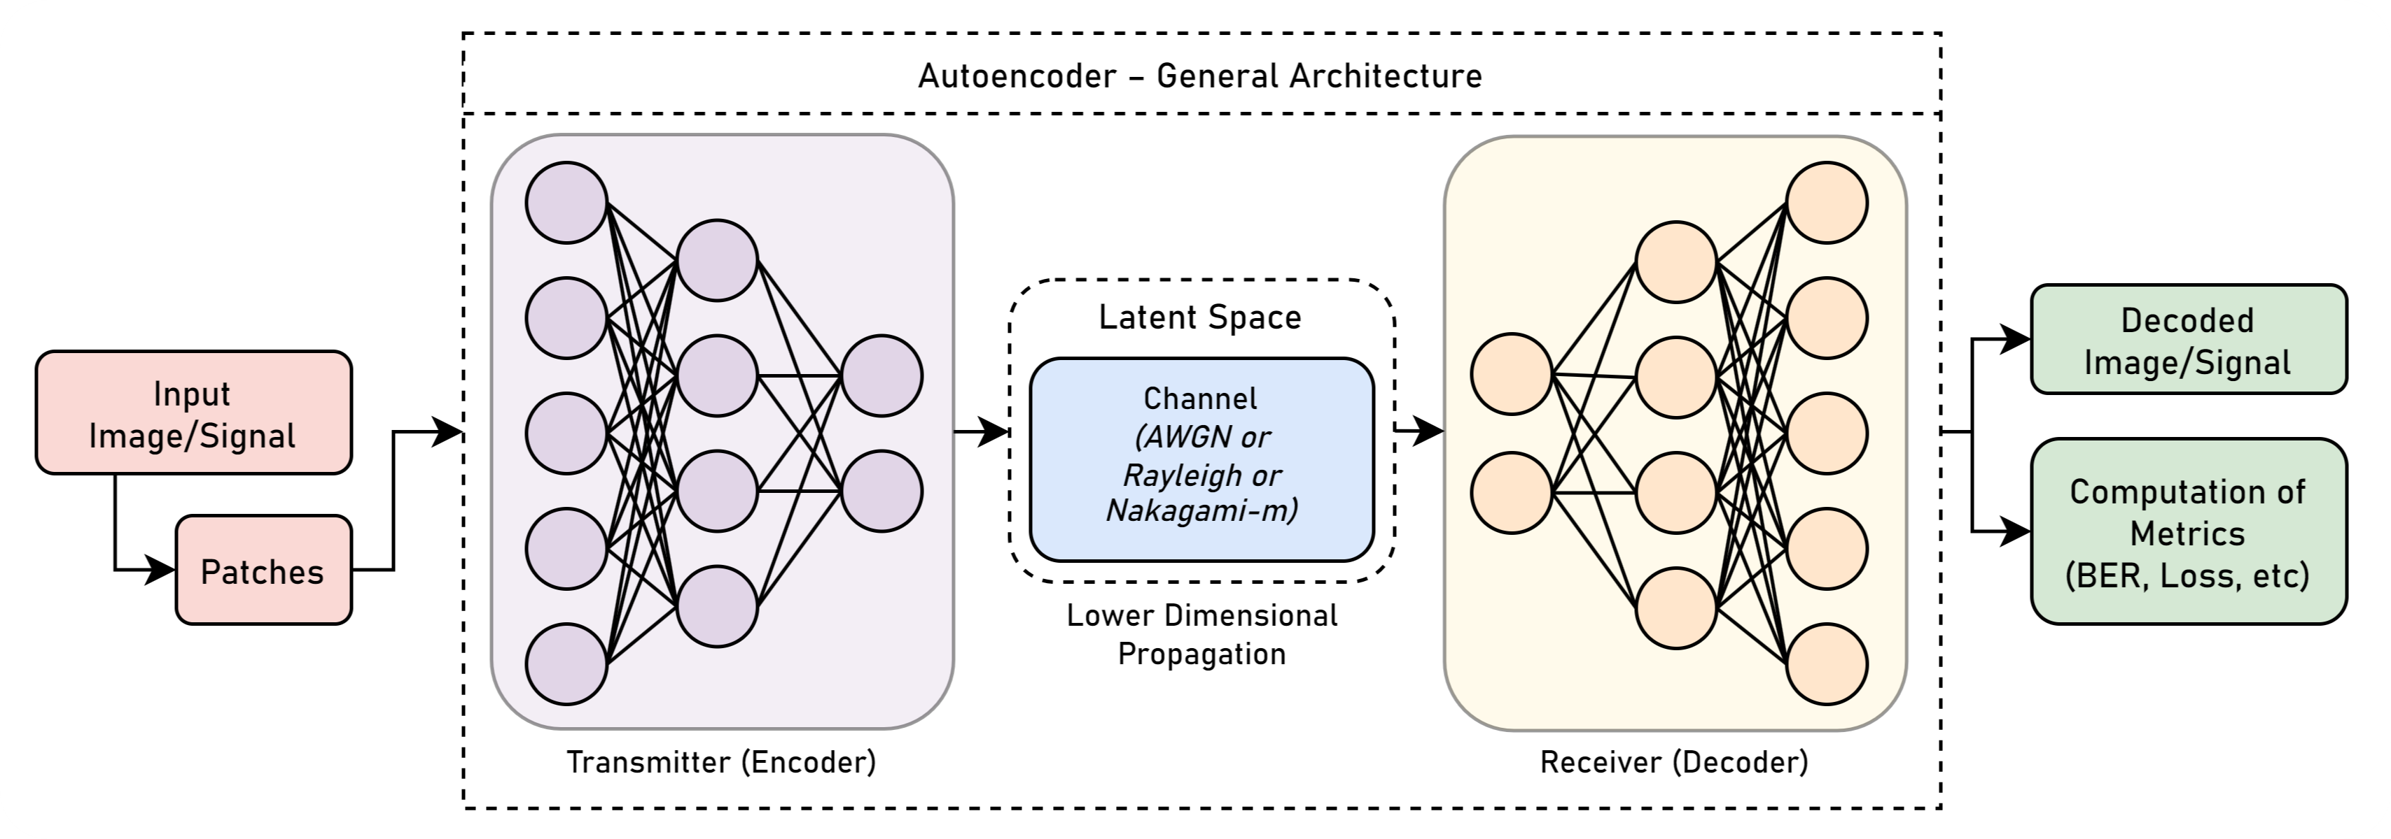
AeCC Workflow
Vision Transformers

Slide 5
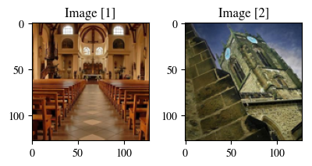
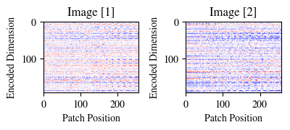
Encoder
Role in Image Compression
Incorporates positional-embeddings to determine position of patches
Implements transformer-based encoding to represent images in a compressed format
Importance of Feature Extraction
Extracts essential features from images for effective compression
Dimensionality reduction through MLP heads

Slide 6
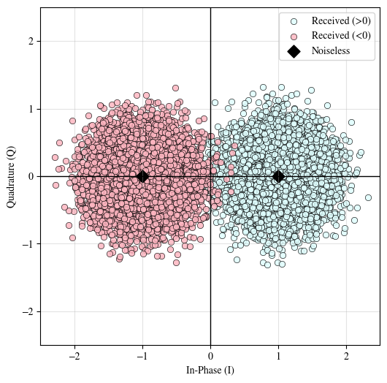
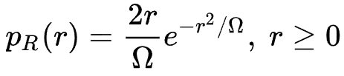

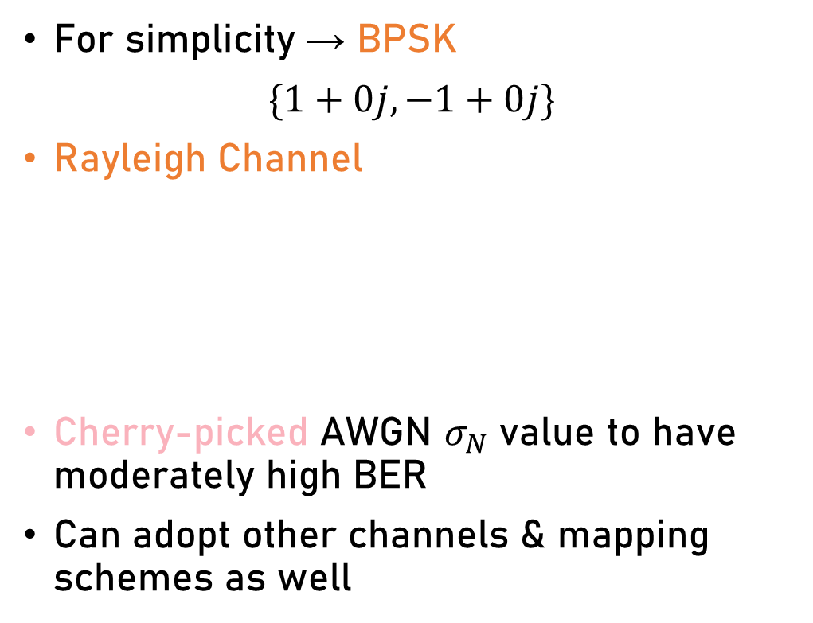
Wireless Channel
For simplicity → BPSK
$$\{1+0j, −1+0j\}$$
Rayleigh Channel
Cherry-picked AWGN $σ_{N}$ value to have moderately high BER
Can adopt other channels & mapping schemes as well

Slide 7
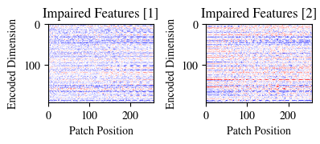

Decoder
Image Reconstruction and Denoising
Inverse of the Encoder (Upscales)
Learns channel distribution and effectively mitigates the impairments
Seamless Image Recovery
Ensures smooth and seamless recovery of images from their compressed representation
Attention blocks allow for transitioning from the latent representation to a fully reconstructed image

Slide 8
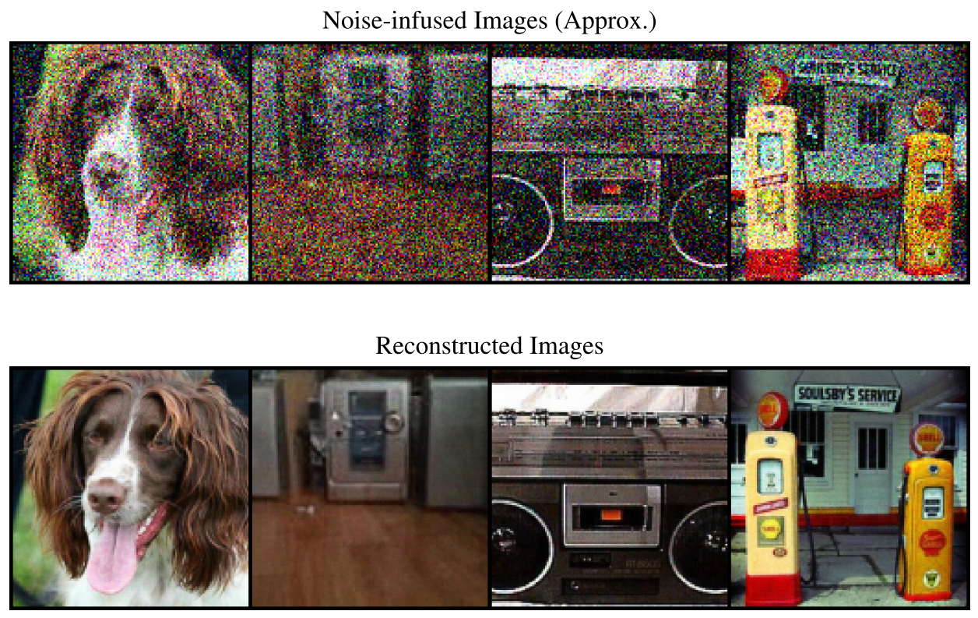
Results
Since channel impairments cannot be accurately mapped back to the input, an approximate representation of noisy images is adopted

Slide 9
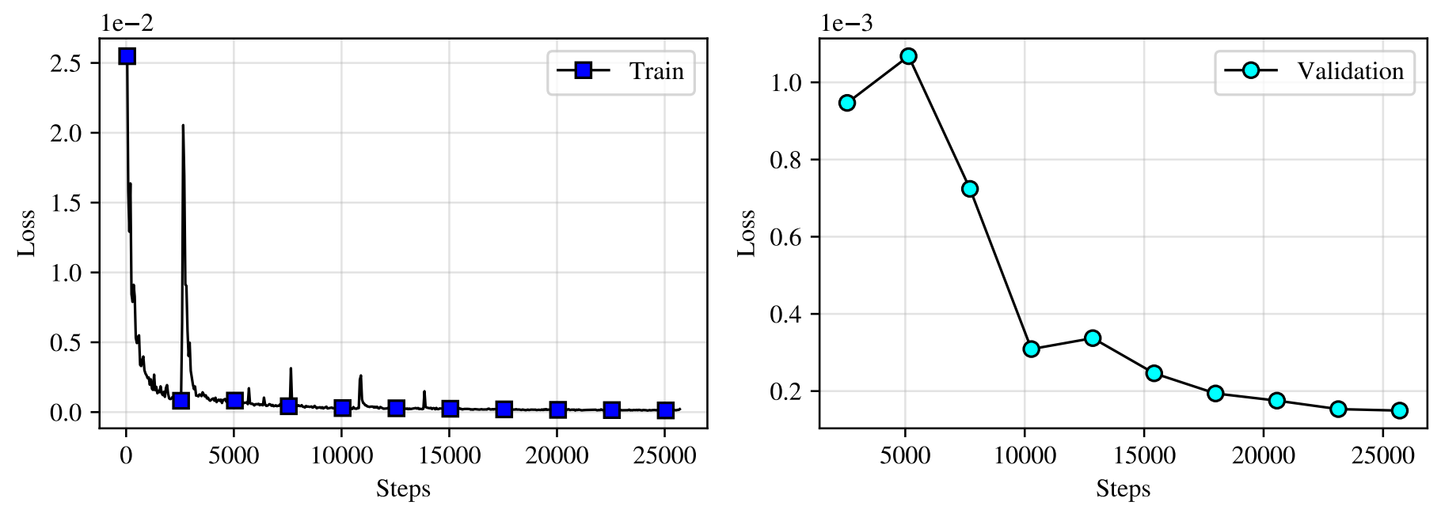
Results [ Loss Curves ]
Mean Squared Error (MSE)

Slide 10
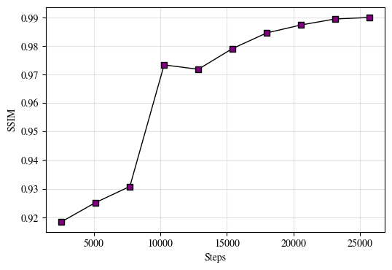
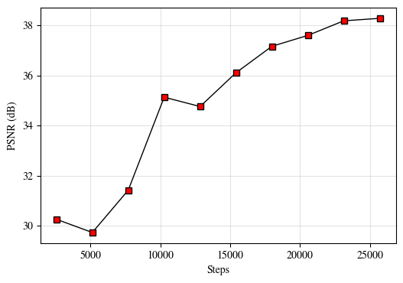
Results [ SSIM & PSNR ]
Structural Similarity Index
(SSIM)
Peak Signal-to-Noise Ratio
(PSNR)

Slide 11

Conclusion & Future Work
AeCC offers an alternate way to transmit images with a trainable compression factor
Allows for at-receiver reconstruction validation (SSIM & PSNR)
Current Limitations & Solutions
Does not take into account variable and dynamic nature of the wireless channels (overfits to Rayleigh)
Solution – Continual learning ^{[1]}
Need better and optimal ways to resize images, OR make the input image size variable
^{[1]} Continual Learning is a concept to learn a model for multiple tasks without forgetting knowledge obtained from the preceding tasks

Slide 12
References
Saber, Hamid, Homayoon Hatami, and Jung Hyun Bae. "List Autoencoder: Towards Deep Learning Based Reliable Transmission Over Noisy Channels." In GLOBECOM 2022-2022 IEEE Global Communications Conference, pp. 1454-1459. IEEE, 2022.
Cheng, Z., Sun, H., Takeuchi, M., & Katto, J. (2018, June). Deep convolutional autoencoder-based lossy image compression. In 2018 Picture Coding Symposium (PCS) (pp. 253-257). IEEE.

Slide 13
Thank You
Any Questions?

