Slide 1
Project Quality Management
Definition:
    PMBOK** – Quality is a degree to which a set of inherent characteristics fulfill requirements.
        OR
    A degree to which a project fulfill requirements.
    Quality management includes creating and following policies and procedures to ensure that the project meets the defined needs it was intended to meet from the customers perspective.
    ** Project Management Body of Knowledge is a set of standard terminology and guidelines for project management.

Slide 2
Project Quality Management
Modern quality management compliments (completes or
brings to perfection) project management. Both disciplines
recognize the importance of:
Customer satisfaction.
Prevention over correction.
Management Responsibility.
Continuous improvement.
  The plan-do-check-act cycle

Slide 3
Project Quality Management
Cost of Quality (COQ)
  It is considered to be the primary quality measurement tool. By bringing together the costs of wastes, scrap, rework, inspection and other costs, one can demonstrate the accumulation of expenses to convince management over the importance of quality management.
  To verify that a product or service meets the customer’s requirements requires the measurement of the costs of quality. For simplicity’s sake, the costs can be classified as “the cost of conformance” and “the cost of nonconformance.”
  Conformance costs include items such as training, indoctrination, verification, validation, testing, maintenance, calibration, and audits.
  Nonconforming costs include items such as scrap, rework, warranty repairs, product recalls, and complaint handling.

Slide 4
Project Quality Management
Example:
  Trying to save a few project dollars by reducing conformance costs could prove disastrous. For example, an American company won a contract as a supplier of Japanese parts. The initial contract called for the delivery of 10,000 parts. During inspection and testing at the customer’s (i.e., Japanese) facility, two rejects were discovered. The Japanese returned all 10,000 components to the American supplier stating that this batch was not acceptable. In this example, the nonconformance cost could easily be an order of magnitude greater than the conformance cost. The moral is clear: Build it right the first time.

Slide 5
Project Quality Management
Classification of cost of quality:
  Prevention costs are the up-front costs oriented toward the satisfaction of customer’s requirements with the first and all succeeding units of product produced without defects. Included in this are typically such costs as design review, training, quality planning, surveys of vendors, suppliers, and subcontractors, process studies, and related preventive activities.
  Appraisal costs are costs associated with evaluation of product or process to ascertain how well all of the requirements of the customer have been met. Included in this are typically such costs as inspection of product and lab test.

Slide 6
Project Quality Management
  Internal failure costs are those costs associated with the failure of the processes to make products acceptable to the customer, before leaving the control of the organization. Included in this area are scrap, rework, repair, downtime, defect evaluation, evaluation of scrap, and corrective actions for these internal failures.
  External failure costs are those costs associated with the determination by the customer that his requirements have not been satisfied. Included are customer returns and allowances, evaluation of customer complaints, inspection at the customer, and customer visits to resolve quality complaints and necessary corrective action.
Useful only if the cost of conformance is less than the cost of non-conformance.
Logically!!!

Slide 7
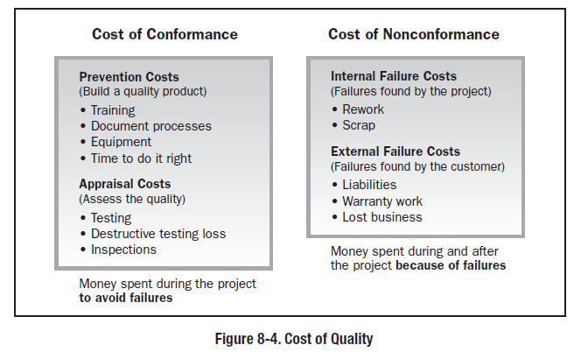
Project Quality Management

Slide 8
Project Quality Management PROCESSES
Plan Quality
Perform Quality Assurance
Perform Quality Control

Slide 9
Plan Quality
It is the process of identifying quality requirements and/ or standards for the
project, product and project management efforts and documenting how the
project will demonstrate compliance.
Quality Planning is identifying which quality standards are relevant to the
project and determining how to satisfy them.
Examples:
  Project Management standard: Project Management Body of Knowledge (PMBOK) by Project Management Institute, NCSPM (National Competency Standards in Project Management) by Australian Institute of Project Management
  Technical Standards: ASCE (American society of civil engineer), ASME (American society of mechanical engineering), AISC (American institute of steel correction), NFPA (National fire protection association), OSHA (Occupational Safety and Health Administration), ISO 9000 (Quality Standards). IEC (International electro technical commission, headquartered in Geneva, Switzerland is the organization that prepares and publishes international standards for all electrical, electronic and related technologies).

Slide 10
Perform Quality Assurance
It is the process of auditing the quality requirements and the results from quality control measurements to ensure appropriate quality standards and operational definitions are used.
The question to be asked in this are:
  “ Are we following the quality standards? ” - Auditing
  “ Is there any room for improvement? ” – Continuous Improvement
Quality assurance is the establishment of a quality system to provide confidence that the project will satisfy the relevant quality standards

Slide 11
Perform Quality Control
It is the process of monitoring and recording results of executing the quality activities to assess performance and recommend necessary changes. Quality control is performed throughout the project.
Quality control is often performed by a quality control department or similarly titled organizational unit.
It is the process of ensuring a certain level of quality in a product or service. It looks for products or services that do not meet the standards of quality. Control means measure, and that is the major function of this process.

