Slide 1

School of Electrical Engineering and Computer Science
Department of Electrical Engineering
EE-260 : Electrical Machines
Lecture#01
Introduction
Instructor: Neelma Naz
Class: BEE 12 C/D

Slide 2
The Prophet Muhammad (peace be upon him) said:
"God, His angels and all those in Heavens and on Earth, even ants in their hills and fish in the water, call down blessings on those who instruct others in beneficial knowledge." - Al-Tirmidhi, Hadith 422

Slide 3
EE-260 ELECTROMECHANICAL SYSTEMS
Course Instructor: Ms. Neelma Naz
(BEE- UCE&T, BZU, Multan-2011)
(MS(Control Systems) -College of Electrical & Mechanical Engineering, NUST, Islamabad – 2013)
(PhD): Robotics & Intelligent Machine Engineering (In-Process)
Contact Information:
Office: A-213, Faculty Block, SEECS
Email address: neelma.naz@seecs.edu.pk

Slide 4
Lecture Days: Mon , Tue , Wed
Consultation Hours: Every Tuesday 1500 to 1700Hrs or via email
Course Material: course material will be uploaded on LMS.
Try to be present at all lectures and all Labs!
All presented material is relevant to your Exam.

Slide 5
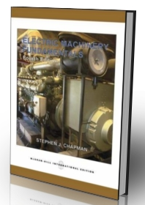
LAB SCHEDULE:
Lab Engineer: Engr. Mughees Ahmad
Lab Days: Friday
Recommended Books:
Text Book:
Electric Machinery Fundamentals, 4th/5th edition, by S. J. Chapman
Ref Book:
Electric Machinery and Transformers, 3rd Edition, by B. S. Guru, H. R. Hiziroglu

Slide 6
LMS Enrolment Key:
Enrolment Code :856192743

Slide 7
INT
Students Introduction

Slide 8
Today’s Lecture
Course Description
CLOs & PLOs
Grading policy
Factors about studying
Motivation

Slide 9
Course Description:
 | The course will give you the introduction to Electromechanical Systems. The main objectives of this course are: to analyze transformer circuits and describe their practical application in single phase and three phase systems. (2) to describe the principle of operation of AC and DC machines. (3) to analyze the effect of machine parameters on the performance of a given AC or DC machine in terms of speed, torque, power and efficiency.
Main Topics to be Covered:
1. Introduction to electro-magnetic theory | 4. Induction Motor
2. Transformers | 5. DC Machines
3. Synchronous Generator

Slide 10
 | Course Learning Outcomes:
CLO | Description After the completion of the course the students will be able to: | BT Level | PLOs
1. | Describe fundamental concepts, theories and laws of magnetics & magnetically coupled circuits. | C2 | 1
2. | Analyze the characteristics and operation of transformers and derive their equivalent circuits. | C4 | 2
3. | Analyze the characteristics and operation of synchronous machines and derive their three phase equivalent circuits. | C4 | 2
4. | Analyze the characteristics and derive the equivalent circuits of three phase induction motors, DC machines and single-phase machines. | C4 | 2
5. | Analyze and interpret experimental data acquired during conduct of electrical machines experiments | P3 | 4
6. | Implement & Test different electric machines using state of the art LabVolt tools and Test Equipment | P4 | 5
7. | Exhibit good professional and ethical behavior while adhering to lab safety rules. | A3 | 8
8. | Function effectively both individually and as a member of a team | A3 | 9

Slide 11
Grading Policy
Lectures
Nature of Examination | Weightage (%age)
ESE | 50
MSE | 30
Assignments | 6
Quizzes | 14
Lab
Lab Work | 70
Lab Exam / Project | 30

Slide 12
Grading Policy
Assessment Modules, Weightages, and Mapping to CLOs
Assessments/CLOs | CLO1 | CLO2 | CLO3 | CLO4 | CLO5 | CLO6 | CLO7 | CLO8
Quizzes: 14% of the theory part | √ | √ | √ | √
Assignments: 6% of the theory part | √ | √ | √ | √
MSE: 30% of the theory part | √ | √ | √
Labs:25% of the course |  |  |  |  | √ | √ | √ | √
End Semester Exam:50% of theory part | √ | √ | √ | √

Slide 13
Facts about studying
• Studying is an activity of students.
• The objective of a lecture is not that the lecturer can tell his
story without interruption.
• Following lectures in an inactive way of Studying
• Preparing lectures is an effective way of studying.

Slide 14
Motivation
Why do we talk about machines and not motors or generators?
Why is this course important?
Many Applications
Over 30 machines in house - where?
Industry
Transportation
Positioning
Generation

Slide 15
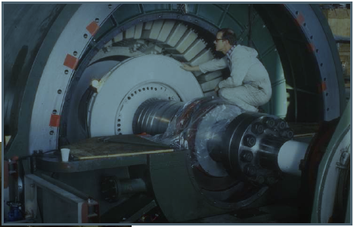
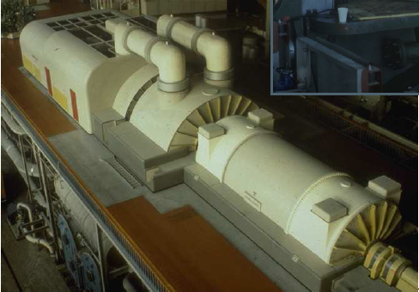
GENERATION

Slide 16
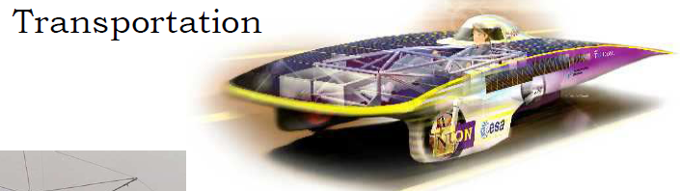
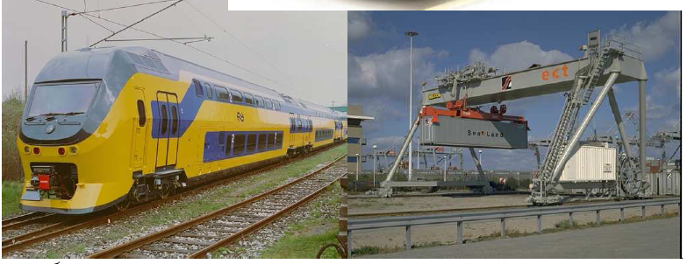

Slide 17
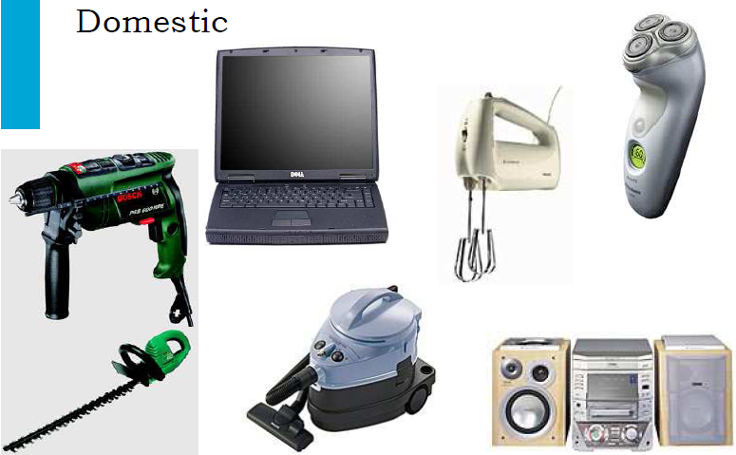

Slide 18
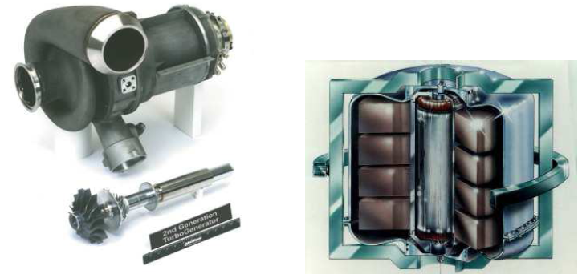
High speed generator and flywheel
for hybrid vehicles
http://www.explainthatstuff.com/flywheels.html

Slide 19
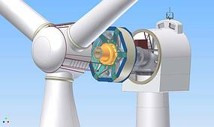
Generators for (direct-drive) wind
turbines
http://www.setec-dresden.com/index.php?id=226

Slide 20
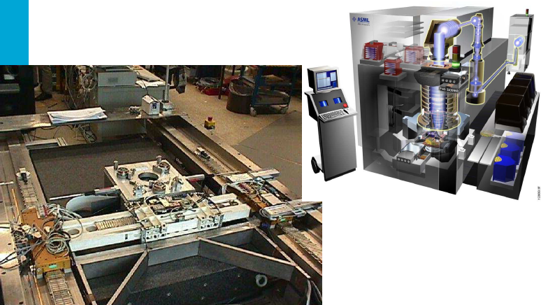
Actuators for wafer steppers
http://www.orientalmotor.com/applications/pin-lifter.html

Slide 21
Extremely wide variety
• Power levels 10^-6 – 10^9 W (watch – power station)
• Torque levels 10^-9 – 10^7 Nm
• Speed range 10 rpm – 300.000 rpm (wind turbine – spindle)
• Positioning accuracies to below 1 nm = 10^-9 m
• Different types

Slide 22
Electrical Machines
Mechanical Energy
Electrical Machine
Electrical Energy
Electrical Energy
Mechanical Energy
motor
Generator
Transformer
Electrical Energy
at another
voltage level
Electrical Energy
at one voltage level

Slide 23
TRANSFORMER
Transformer
Transformer changes Electrical Energy from one voltage level to Electrical Energy at another voltage level, depending on the action of a magnetic field
Example:
  Generators produce low voltage, typically 11, 13 or 15 KV.
  Step up the voltage for transmission, typically 110, 220, 500 or even 700 KV.
  Close to the city step it down to 11 kV and finally 415 V or 220 V.

Slide 24
Why do we step the voltage up at the generation
and then
step it down close to the distribution
???

Slide 25
TRANSFORMER,
The principle for operation of transformers and machines is through the magnetic field. Therefore, we study them together.
Why to use Generators?
    Electric Power is clean and efficient energy that is easy to transmit over long distance.
Why to use Motors?
    It does not need constant ventilation and fuel like internal combustion engine, environment friendly.
Why transformers?
    Reduce energy loss between point of generation and point of use of electric power.

Slide 26

Conclusion
Brief introduction to subject.
Objectives of Course
Grading Policy
Motivation

