Slide 1

School of Electrical Engineering and Computer Science
Department of Electrical Engineering
EE-260 : Electrical Machines
Lecture#10
Text Book: Chapter 02 (Stephen J. Chapman 4th Ed)
Instructor: Ms Neelma Naz
Class: BEE 12 C/D
2.9 THE AUTOTRANSFORMER Page 109

Slide 2
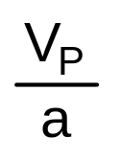
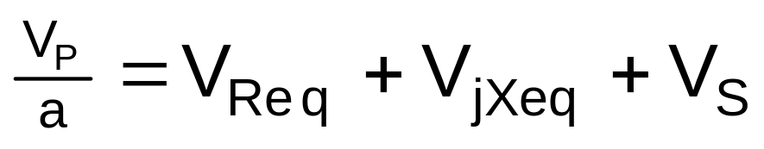
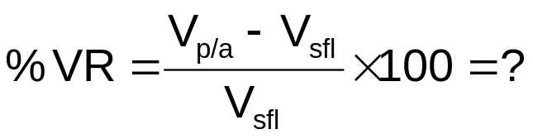
The Transformer Phasor Diagram
Fig 2-26 (page 101) Vector Dig
Lagging Power Factor
I_{S}
∠-θ
V_{Req}
V_{jXeq}
L
o
a
d
Lagging
Power Factor
Load
=R_{eq}I_{S}
=X_{eq}I_{S}
V_{S}
Phase relation between I_{S} & V_{Req} ?
Phase relation between I_{S} & V_{Xeq} ?
V_{S} is assumed to be at angle 0º ( V_{S}∠-θ). All other voltages & currents are compared to this reference
V_{P}/a
V_{Req}
V_{S}
V_{jXeq}
V_{P}/a > V_{S}
I_{S}
Positive

Slide 3
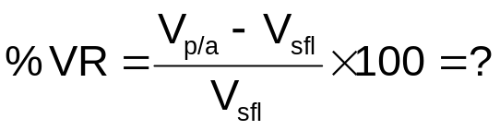
Fig 2-27(a) Vector Dig
Unity Power Factor
The Transformer Phasor Diagram
(cont...
I_{S}
∠-θ
V_{Req}
V_{jXeq}
=R_{eq}I_{S}
=X_{eq}I_{S}
L
o
a
d
Unity
Power Factor
Load
V_{S}
V_{P}/a
V_{jXeq}
V_{P}/a > V_{S}
V_{Req}
I_{S}
V_{S}
Fida Muhammad (Air University)
Positive

Slide 4
The Transformer Phasor Diagram
(cont…
Fig 2-27(a) Vector Dig
Leading PF
I_{S}
∠θ
V_{Req}
V_{jXeq}
L
o
a
d
Leading
Power Factor
Load
=R_{eq}I_{S}
=X_{eq}I_{S}
V_{S}
V_{jXeq}
V_{P}/a
V_{P}/a <V_{S}
I_{S}
Negative
V_{Req}
V_{S}

Slide 5
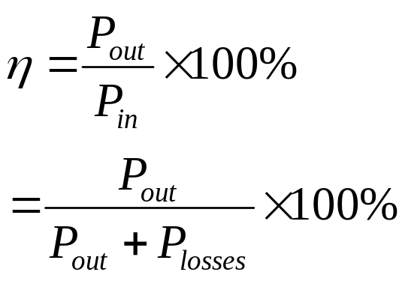
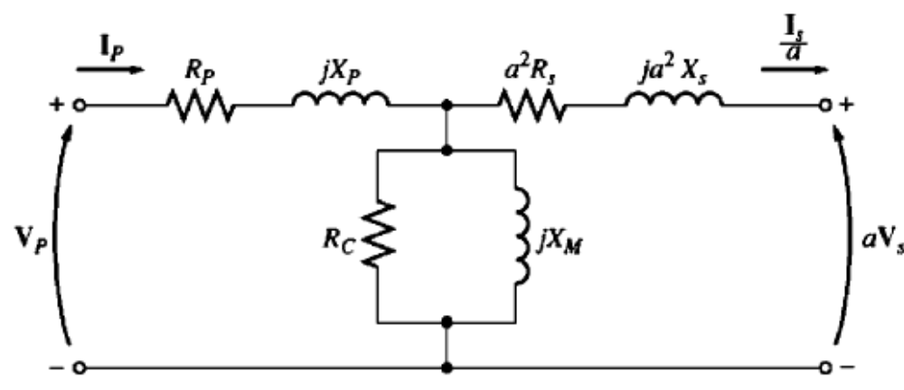
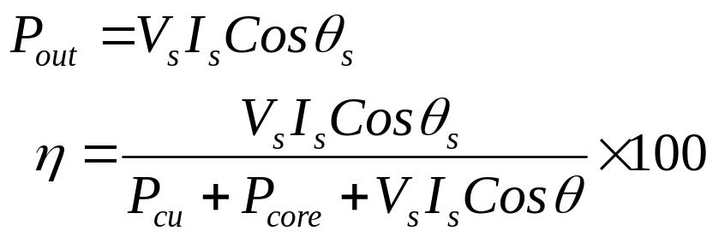
Transformer Efficiency
The efficiency is given by:
From the transformer equivalent circuit efficiency can be easily calculated
The power losses comprise
  Copper losses
  Hystersis losses
  Eddy current losses
  At any given load efficiency can be calculated as:
The efficiency for a power transformer is between 0.9 to 0.99.

Slide 6
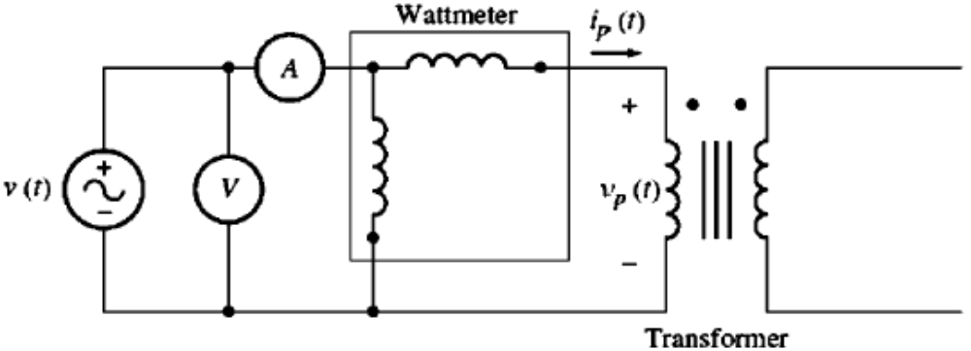
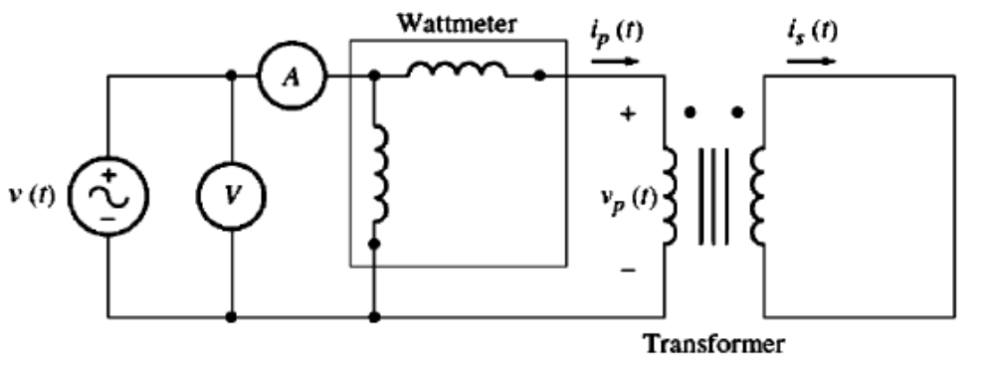
Example 2-5:
A 15 kVA, 2300/230-V transformer is to be tested to determine its excitation branch components, its series impedance and its voltage regulation. The test data listed in the table have been taken from the primary side of the transformer.
The data have been taken by using the connections shown in the following Figures.
Open-ckt test | Short-ckt test
V_{oc}=2300 V | V_{sc}=47 V
I_{oc}=0.21 A | I_{sc}=6.0 A
P_{oc}= 50 W | P_{sc}= 160 W

Slide 7
Example 2-5:
Find the equivalent circuit of this transformer referred to the high-voltage side.
Find the equivalent circuit of this transformer referred to the low-voltage side.
Calculate the full-load voltage regulation at 0.8 lagging power factor, 1.0 power factor, and at 0.8 leading power factor.
Plot the voltage regulation as load is increased from no load to full load at power factors of 0.8 lagging, 1.0, and 0.8 leading.
What is the efficiency of the transformer at full load with a power factor of 0.8 lagging?

Slide 8
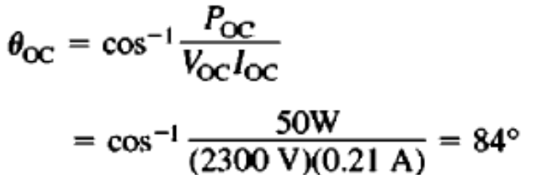
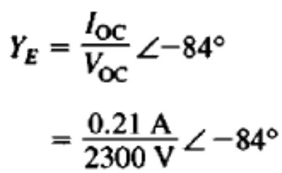
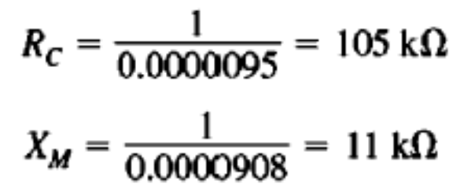
Example 2-5: (Solution)
a.
The open-circuit impedance angle
The excitation admittance
The elements of the excitation branch referred to the primary are

Slide 9
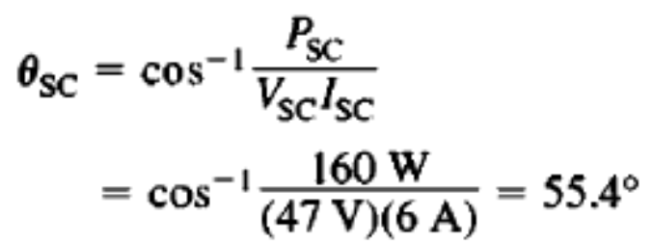
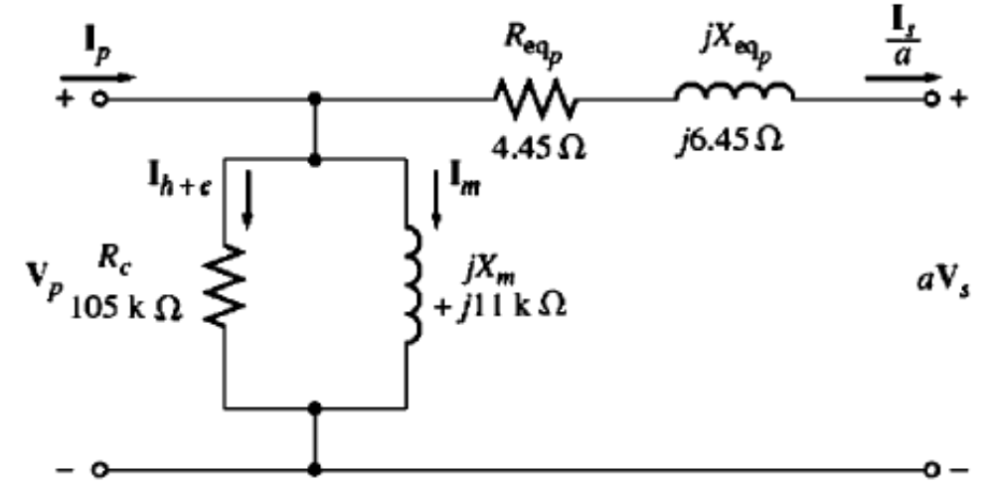
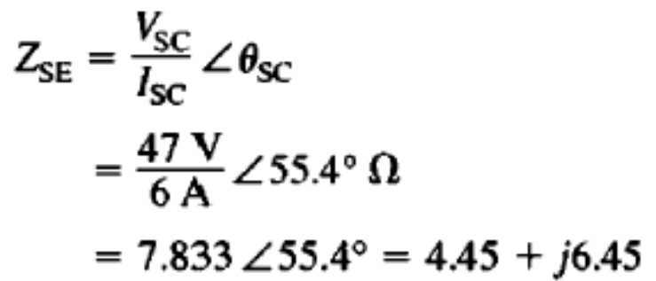

Example 2-5: (Solution)
The short-circuit impedance angle
The equivalent series impedance
The series elements referred to the primary
The transformer equivalent circuit referred its primary side

Slide 10
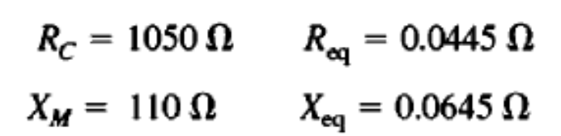
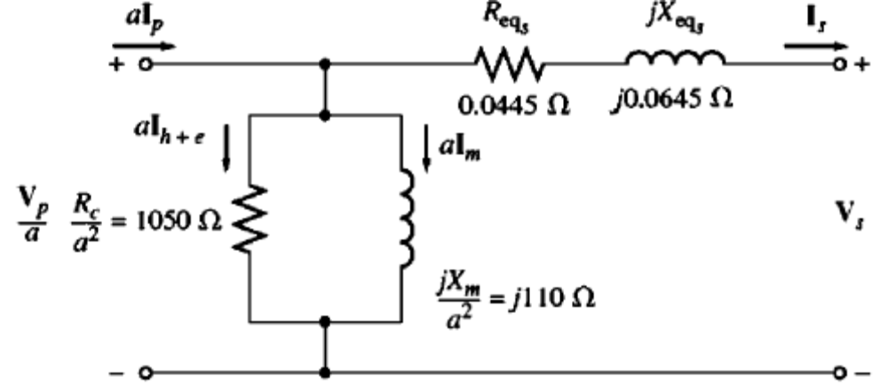
Example 2-5: (Solution)
b. To find the equivalent circuit referred to the low-voltage side, the impedance is divided by a².
Since a = N_{p}/N_{s} = 10, the resulting values are
The transformer equivalent circuit referred its secondary side
6

Slide 11

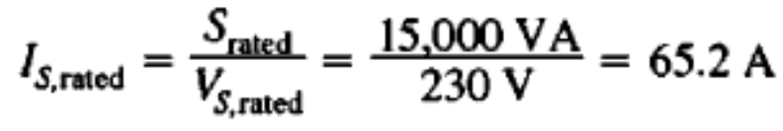
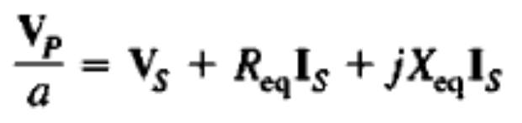
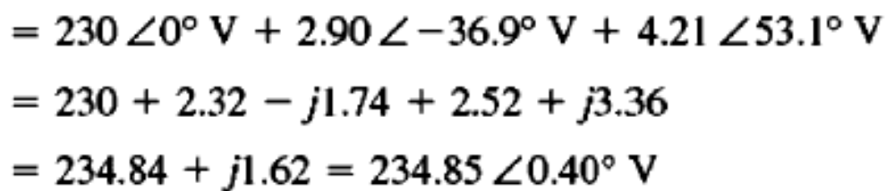
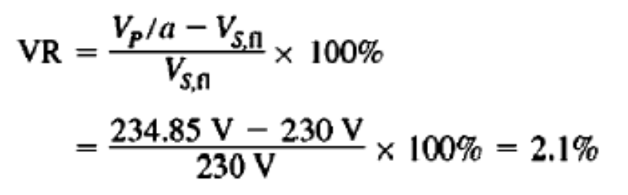
Example 2-5: (Solution)
c.
Full -load current on the secondary side
From the circuit
The Voltage regulation is
7

Slide 12
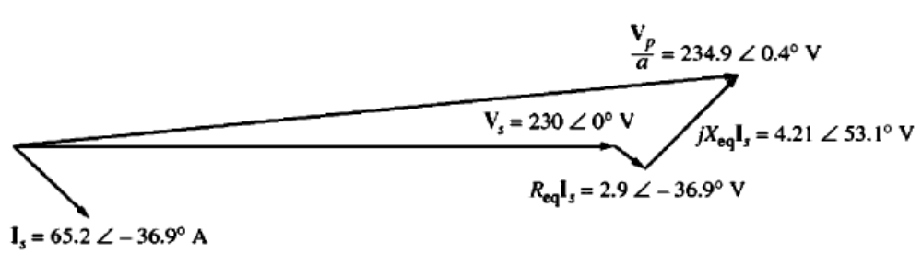
Example 2-5: (Solution)
The Voltage regulation is
8

Slide 13
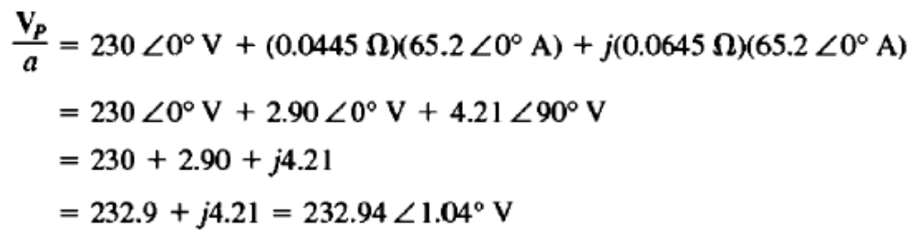
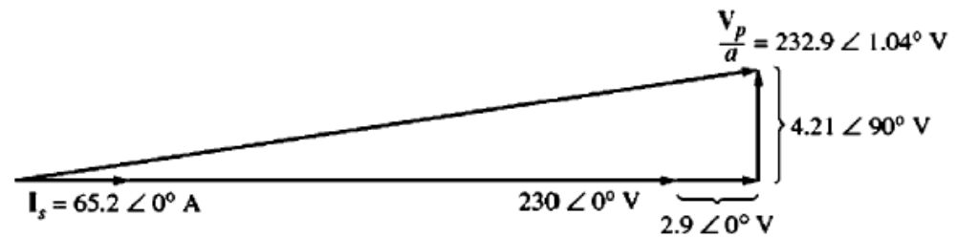
Example 2-5: (Solution)
c.
At PF = 1.0, current I_{s} = 65.2 L 0° A
9

Slide 14
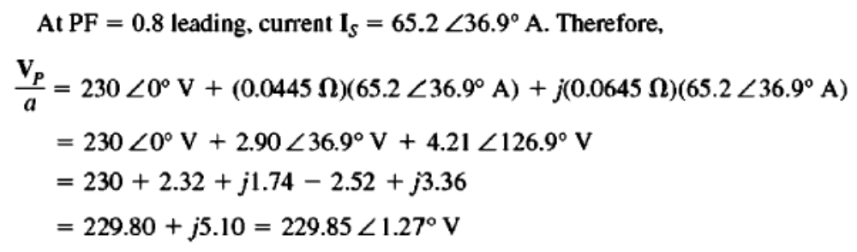
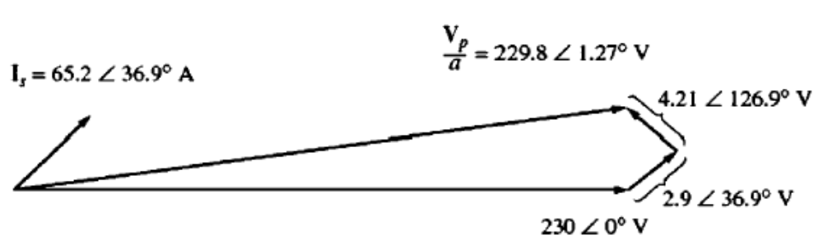
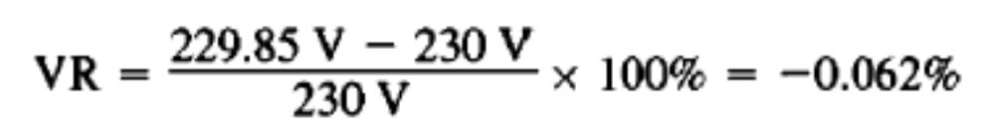
Example 2-5: (Solution)
10

Slide 15
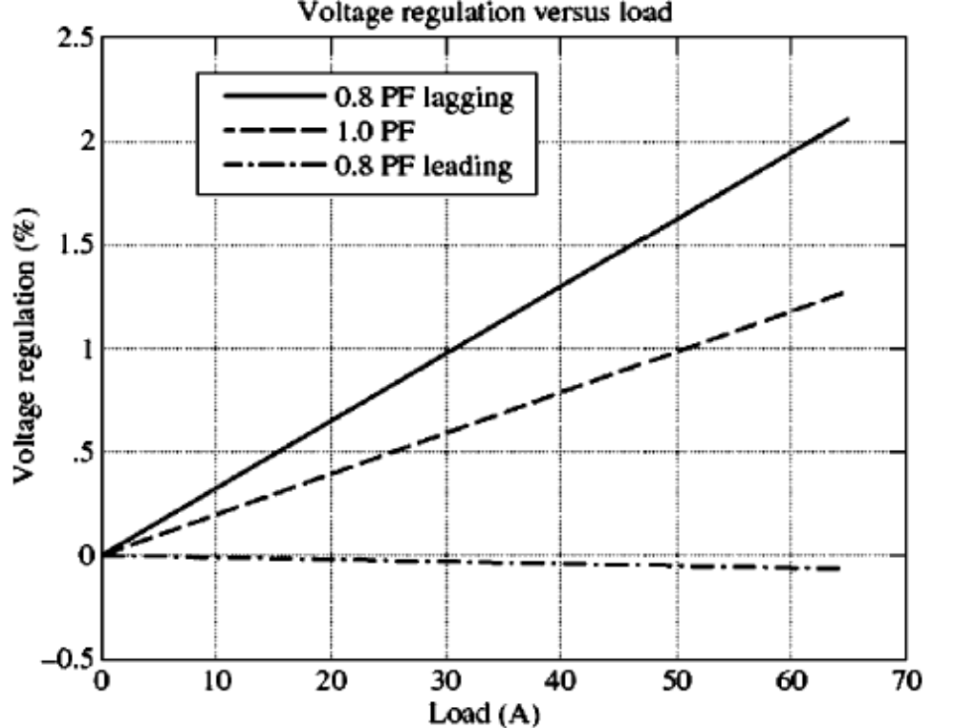
Example 2-5: (Solution)
d.
Plot of voltage regulation versus load
11

Slide 16
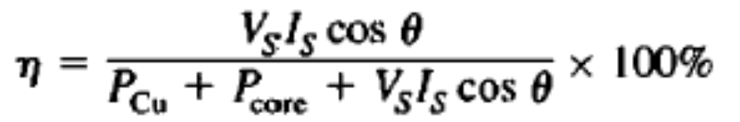
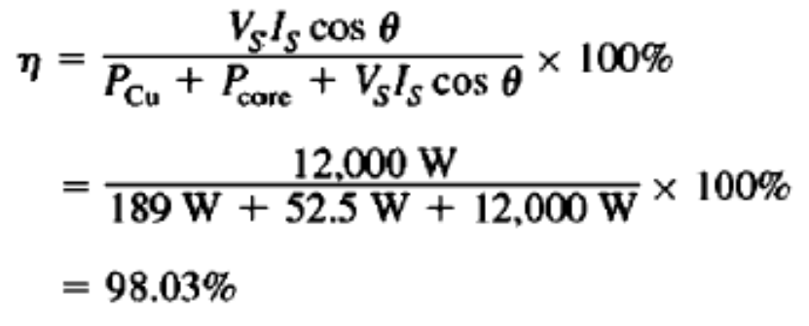
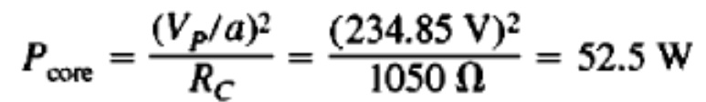
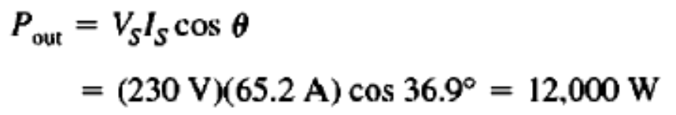
Example 2-5: (Solution)
e.
To find the efficiency of the transformer. first calculate its losses.
The copper losses are:
The core losses are
The output power at 0.8 leading PF
12

Slide 17
Transformer Taps
So far we considered transformer’s turn ratio to be fixed.
Practically, almost all the distribution transformers have taps in the winding which allows small changes in transformer’s turns ratio in the field.
Typically 4 taps are designed, in addition to nominal setting with spacing of ± 2.5 percent of full load voltage between them.
Taps accommodate the variations in local voltages. These taps normally can not be changed while the power system is operating and power is being supplied to the load.
The secondary voltage is given by: Vs=(Ns/Np)*Vp. Therefore, if Vp increases, increase Np to keep Vs constant and vice versa.
Tap Changing Under Load (TCUL) Transformer or Voltage Regulator: It is transformer with built-in voltage sensing circuitry that automatically changes taps to keep the system voltage constant.

Slide 18
Transformer Taps
Example 2-6:
A 500 KVA, 13,200/480 V distribution transformer has four 2.5% taps on the primary winding. What are the voltage ratios of transformer at each tap setting.
+ 5.0% taps | 13,860/480
+2.5% taps | 13,530/480
Nominal rating | 13,200/480
-2.5% taps | 12,870/480
-5.0% taps | 12,540/480
The secondary voltage is given by:
Vs=(Ns/Np) * Vp
If Vp increases, increase Np to keep Vs constant and vice versa.

Slide 19
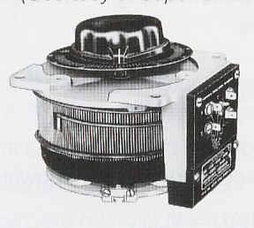
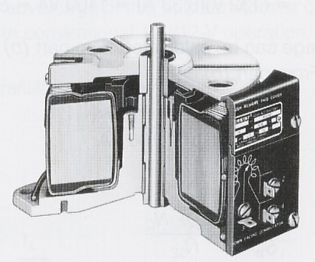
Auto-Transformer
Auto-Transformer is a transformer with only one winding.
That means, the primary and secondary windings are not electrically isolated form each other. In other words, the primary and the secondary of autotransformer are physically connected.
The theory is almost the same as two winding transformer.

Slide 20
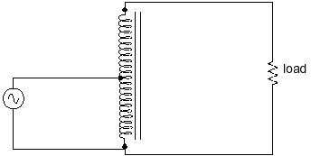
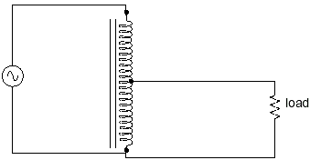
Sec 2.9 (page 109) Autotransformer
The advantage of an autotransformer is that the same boosting or bucking function is obtained with only a single winding, making it cheaper and lighter to manufacture than a regular (isolating) transformer having both primary and secondary windings
More Turns on Load side
Less Turns on Load side
Step-up Autotransformer (Slight Boost)
Step-down Autotransformer (Slight Down)

Slide 21
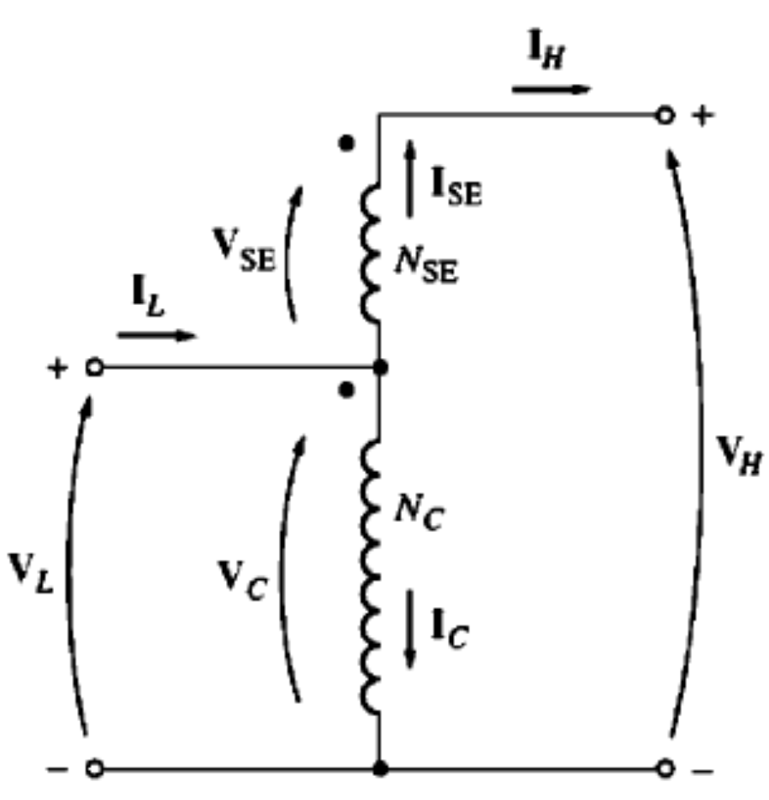
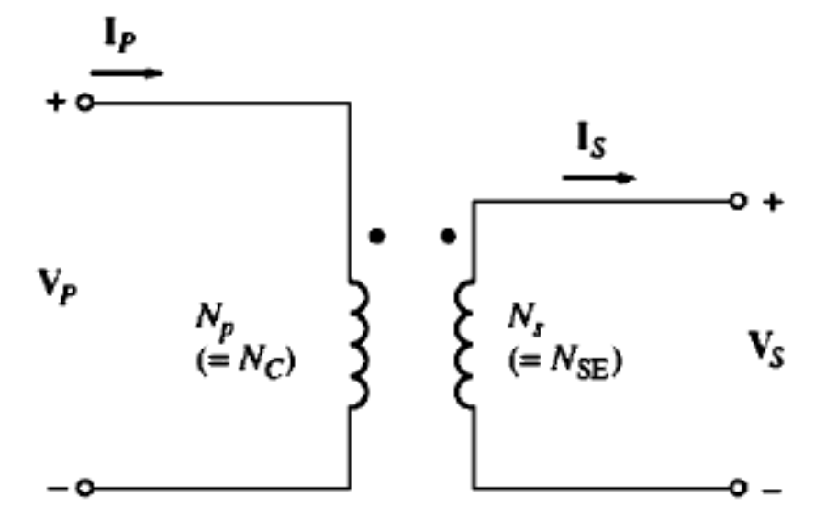
Autotransformer
Some times it is desirable to change voltage levels by only small amount.
For example
110 V to 120 V or 13.2 kv to 13.8 kv.
Conventional Transformer
Autotransformer

Slide 22
The Autotransformer (cont…
The voltage at the output of the autotransformer is the sum of the voltage on the first winding and voltage on the second winding.
The winding across which both the primary and secondary voltages appear is called Common Winding and the smaller winding which is connected in series with the common winding and across which only one voltage (primary/secondary) appears is called Series Winding.
3

Slide 23
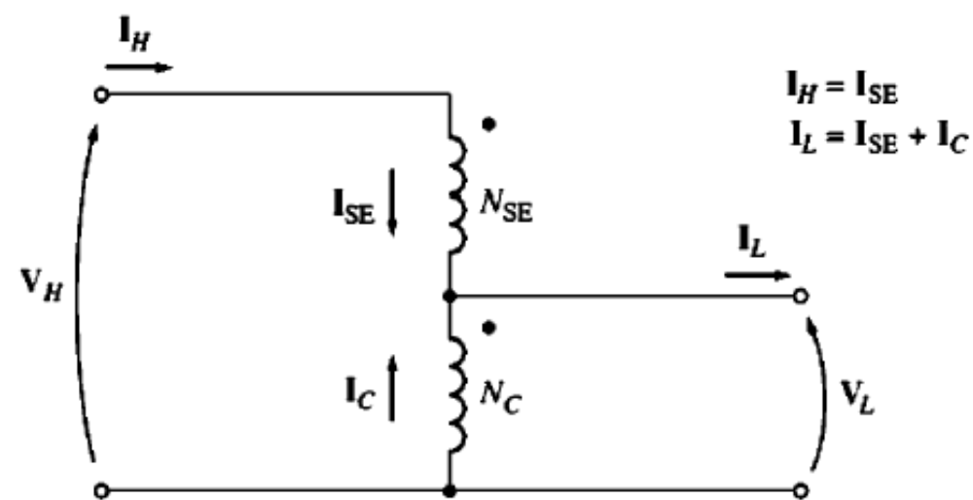
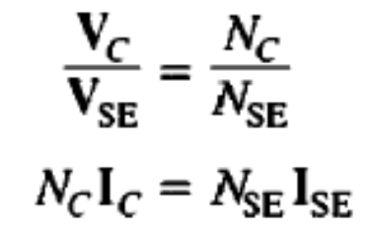
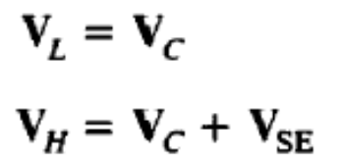
The Autotransformer (cont…
Step down autotransformer
Step up autotransformer

Slide 24
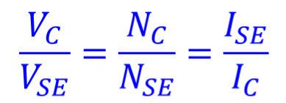

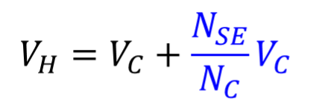
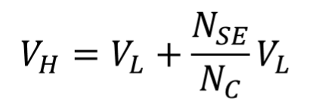
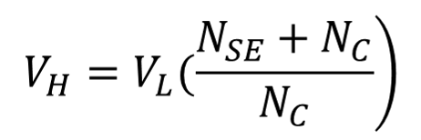
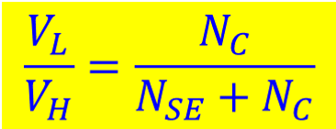
The Autotransformer Voltage Relationships (cont..

Slide 25
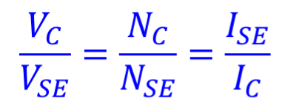

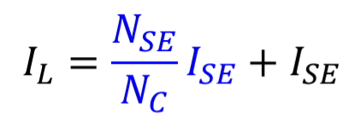
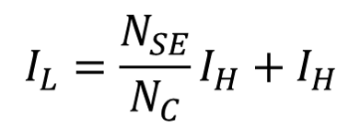
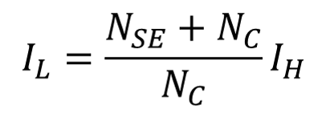

The Autotransformer Current Relationships (cont..

Slide 26







The Apparent Power Rating Advantage (cont…
The input and output apparent power may be defined as:

Slide 27








The Apparent Power Rating Advantage (cont…
The apparent power in the transformer winding is given by:

Slide 28
The Apparent Power Rating Advantage (cont…
Note that not all the power traveling from the primary to the secondary in the autotransformer goes through the windings.
If conventional transformer is reconnected as an autotransformer, it can handle much more power than it was originally rated for.

Slide 29

The Apparent Power Rating Advantage (cont…
The equation describes the apparent power rating advantage of the transformer over a conventional transformer.
The S_{IO} is the apparent power entering the primary and leaving the secondary of transformer,
The S_{w} is the apparent power actually traveling through the transformer’s windings, the rest passes from primary to secondary without being coupled through the transformer winding.
The smaller the series winding the greater the advantage will be.
10

Slide 30

Home Work
Example 2-7

Slide 31

Conclusion
Auto Transformer
Efficiency of transformers

