Slide 1

School of Electrical Engineering and Computer Science
Department of Electrical Engineering
EE-260 : Electrical Machines
Lecture#11
Text Book: Chapter 02 (Stephen J. Chapman 4th Ed)
Instructor: Ms Neelma Naz
Class: BEE 12 C/D
2.9 THE AUTOTRANSFORMER Page 109
2.10 THREE-PHASE TRANSFORMER Page 116

Slide 2
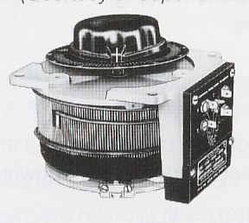
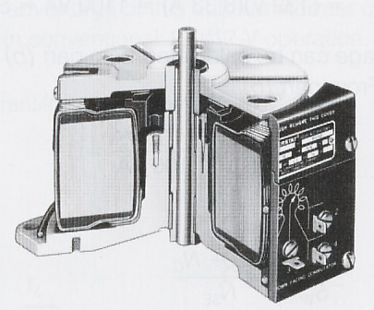
1. Auto-Transformer
Auto-Transformer is a transformer with only one winding.
That means, the primary and secondary windings are not electrically isolated form each other. In other words, the primary and the secondary of autotransformer are physically connected.
The theory is almost the same as two winding transformer.

Slide 3
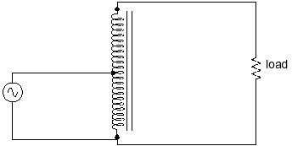
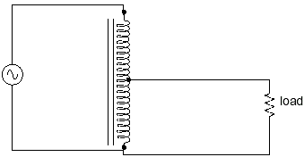
Sec 2.9 (page 109) Autotransformer
The advantage of an autotransformer is that the same boosting or bucking function is obtained with only a single winding, making it cheaper and lighter to manufacture than a regular (isolating) transformer having both primary and secondary windings
More Turns on Load side
Less Turns on Load side
Step-up Autotransformer (Slight Boost)
Step-down Autotransformer (Slight Down)

Slide 4
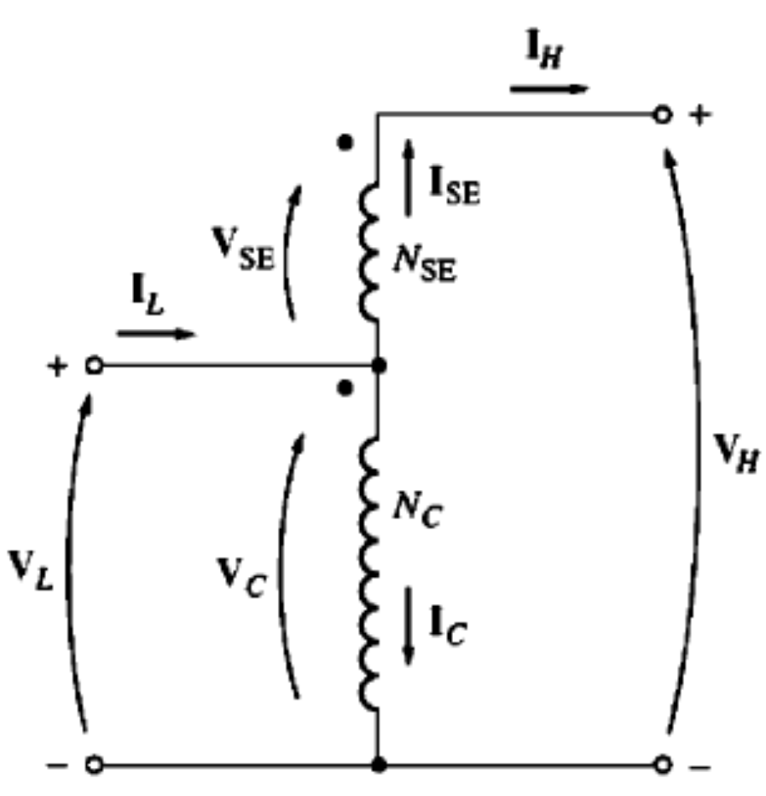
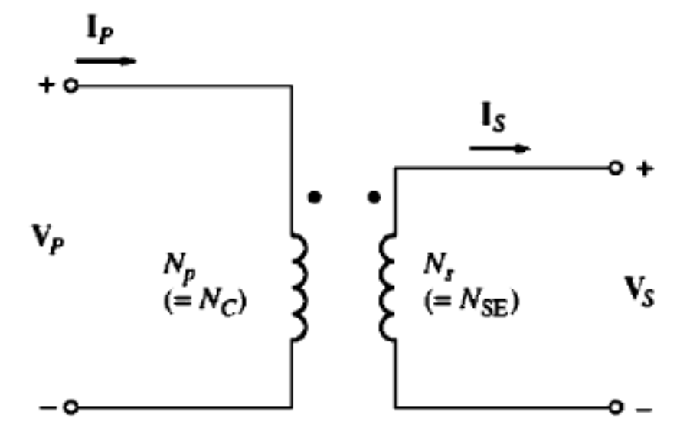
1. Autotransformer
Some times it is desirable to change voltage levels by only small amount.
For example
110 V to 120 V or 13.2 kv to 13.8 kv.
Conventional Transformer
Autotransformer

Slide 5
1. The Autotransformer (cont…
The voltage at the output of the autotransformer is the sum of the voltage on the first winding and voltage on the second winding.
The winding across which both the primary and secondary voltages appear is called Common Winding and the smaller winding which is connected in series with the common winding and across which only one voltage (primary/secondary) appears is called Series Winding.
3

Slide 6
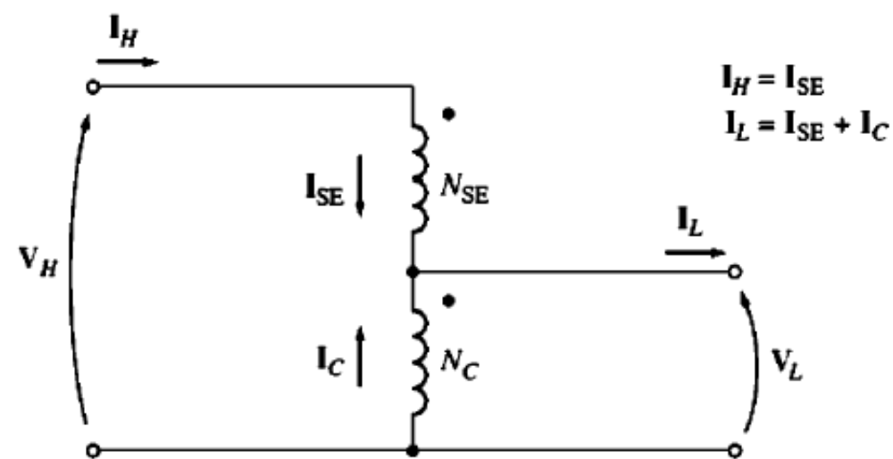
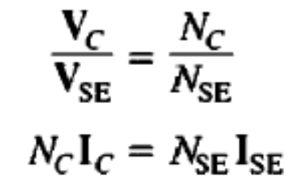
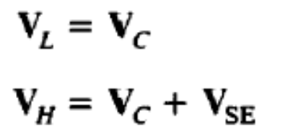
1. The Autotransformer (cont…
Step down autotransformer
Step up autotransformer

Slide 7
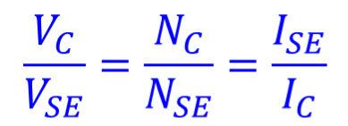

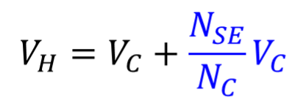
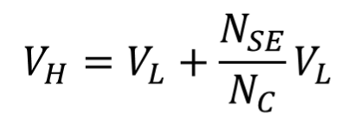
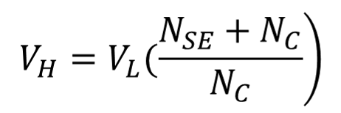
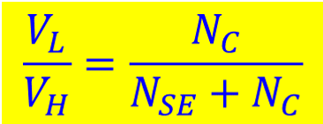
1. The Autotransformer Voltage Relationships (cont..

Slide 8
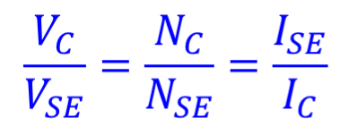

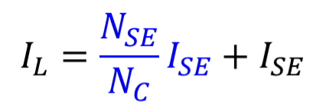
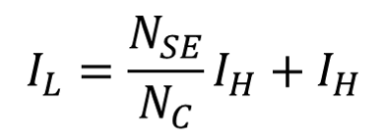
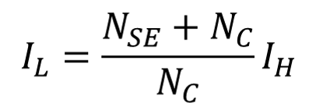
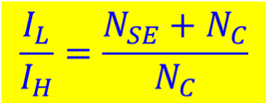
1. The Autotransformer Current Relationships (cont..

Slide 9
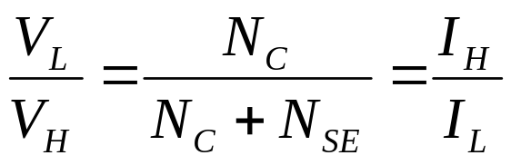



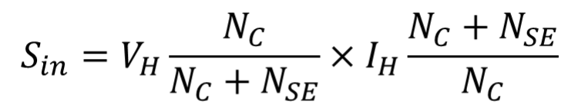


1. The Apparent Power Rating Advantage (cont…
The input and output apparent power may be defined as:

Slide 10




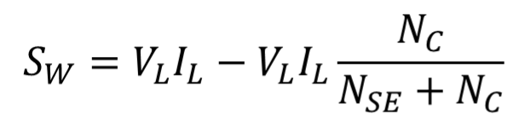
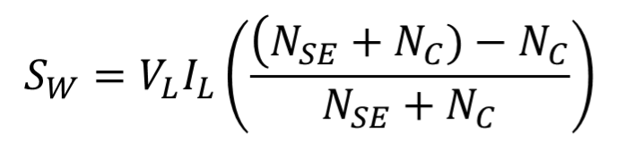
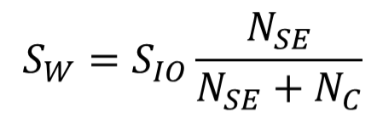
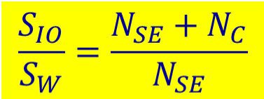
1. The Apparent Power Rating Advantage (cont…
The apparent power in the transformer winding is given by:

Slide 11
1. The Apparent Power Rating Advantage (cont…
Note that not all the power traveling from the primary to the secondary in the autotransformer goes through the windings.
If conventional transformer is reconnected as an autotransformer, it can handle much more power than it was originally rated for.
8

Slide 12

1. The Apparent Power Rating Advantage (cont…
The equation describes the apparent power rating advantage of the transformer over a conventional transformer.
The S_{IO} is the apparent power entering the primary and leaving the secondary of transformer,
The S_{w} is the apparent power actually traveling through the transformer’s windings, the rest passes from primary to secondary without being coupled through the transformer winding.
The smaller the series winding the greater the advantage will be.
10

Slide 13
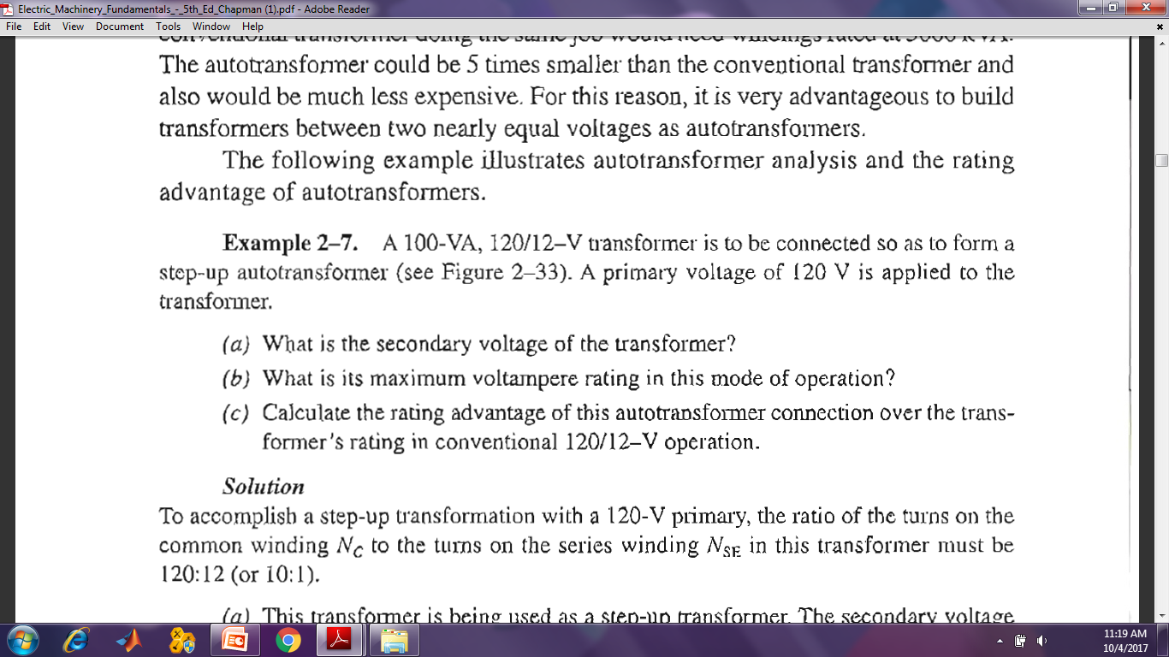
Home Work
Example 2-7

Slide 14
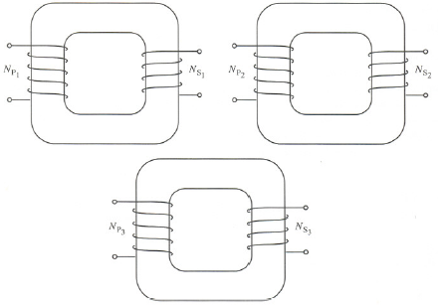
2. Three Phase Transformers
The major power generation, transmission, and distribution systems are three phase systems. Therefore, it is necessary to understand the design and operation of a three phase transformers.
A three phase transformer can be constructed in one of the two ways:
  Simply take three single phase transformers and connect them in three phase bank.
Three phase transformers bank with independent transformers

Slide 15
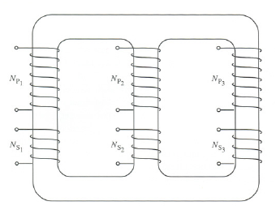
2. Three Phase Transformers Bank (cont…
  b. Make a three phase transformer consisting of three sets of windings wrapped around a common core.
A single three phase transformer is the preferred practice today because it is lighter, smaller, cheaper, and slightly more efficient.
Three phase transformers bank on a single three legged core

Slide 16
2. Three Phase Transformer Connections (cont…
The Primary and secondary winding of a three phase transformer can be independently connected in either wye (Y) or delta (Δ).
Four possible connections for a three phase transformer.
1. Y-Y 2. Y-Δ 3. Δ-Y 4. Δ-Δ
Any single transformer in the bank behaves exactly like a stand alone single phase transformer.
The impedance, voltage regulation, efficiency, and similar calculations for three phase transformer can be done on per phase basis using the techniques established for single phase transformer.

Slide 17
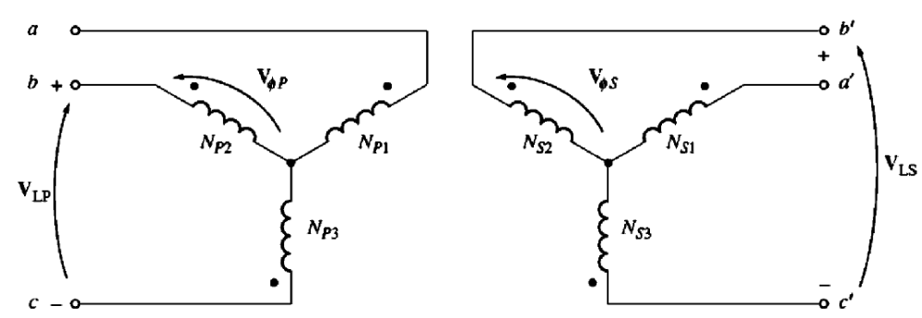
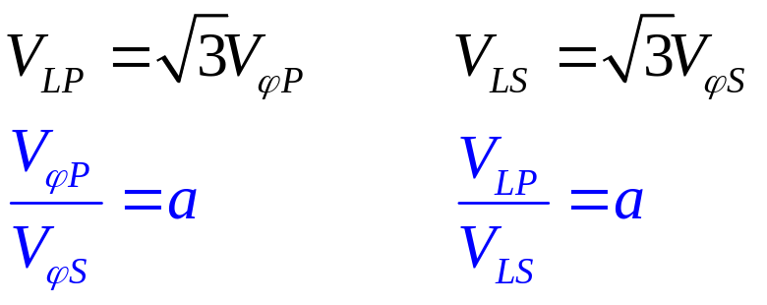
2. Three Phase Transformer a. Y-Y Connections

Slide 18
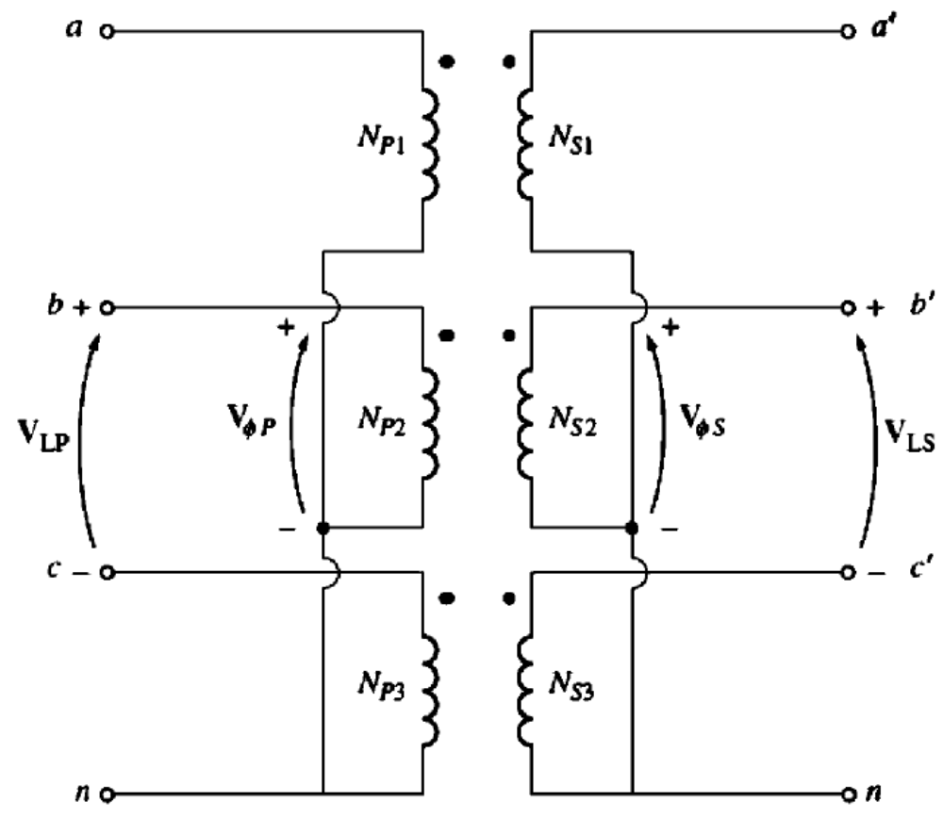
2. Three Phase Transformer
a. Y-Y Connections
16

Slide 19
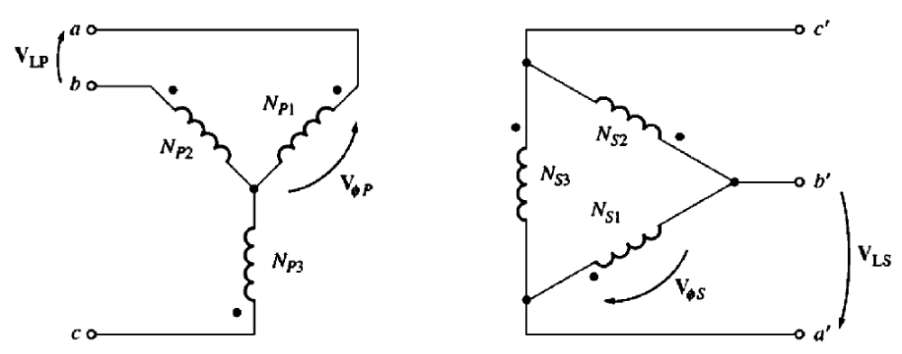
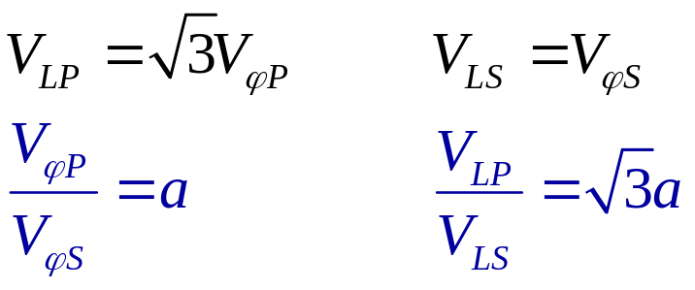
2. Three Phase Transformer (cont…
b. Y-Δ Connections
17

Slide 20
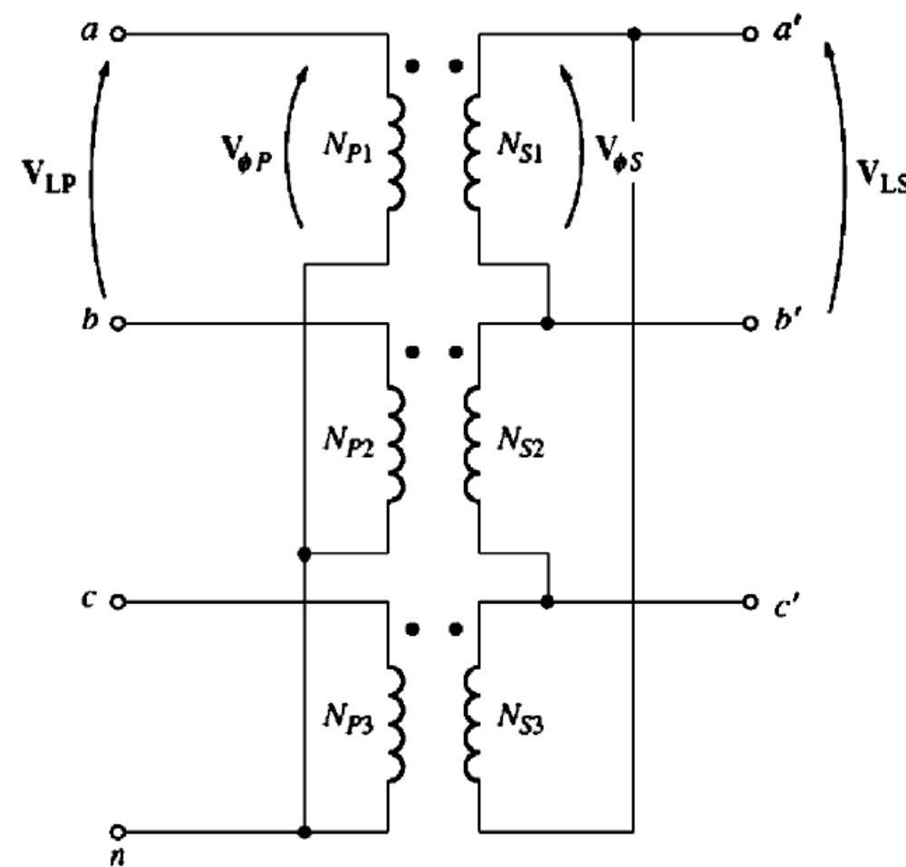
2. Three Phase Transformer (cont…
b. Y-Δ Connections

Slide 21
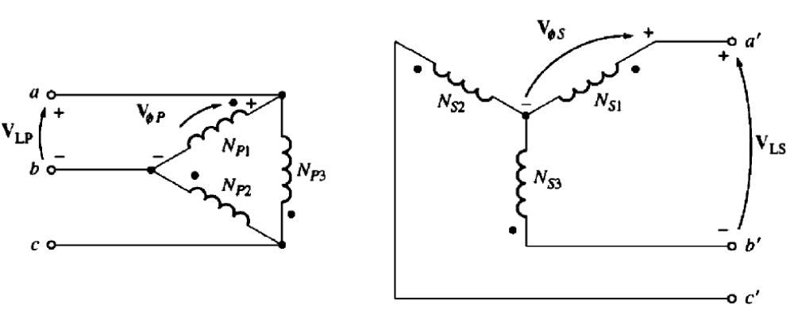
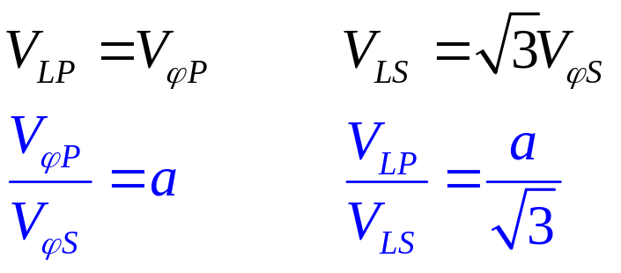
2. Three Phase Transformer (cont…
c. Δ-Y Connections

Slide 22
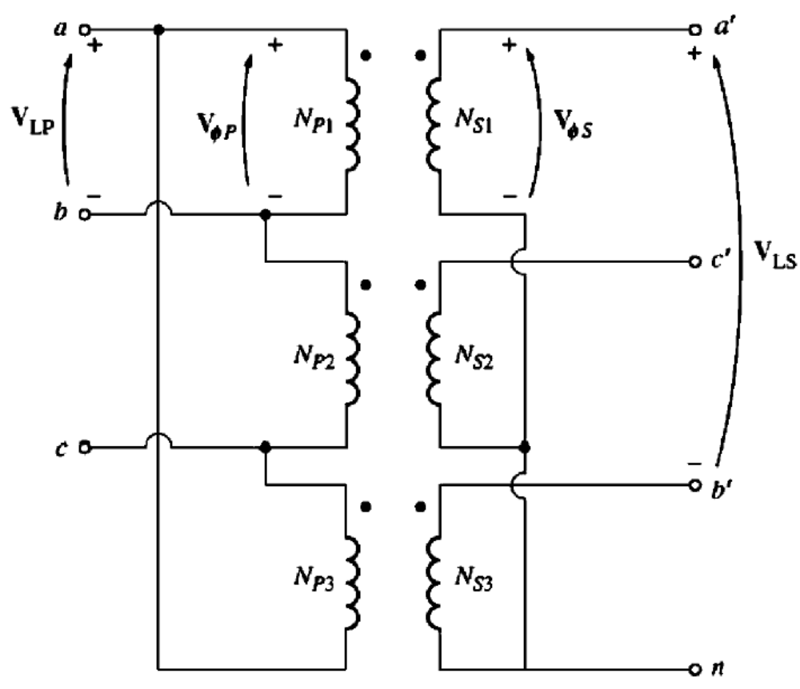
2. Three Phase Transformer (cont…
c. Δ-Y Connections

Slide 23
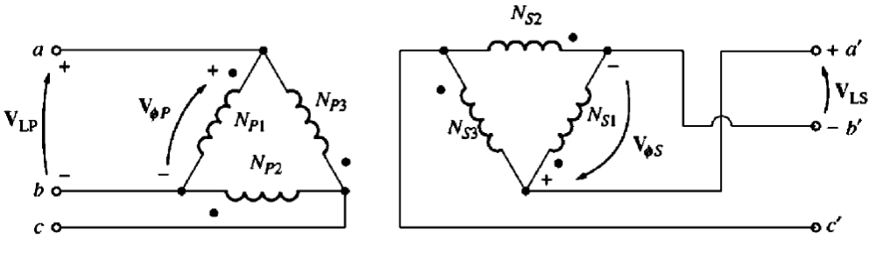
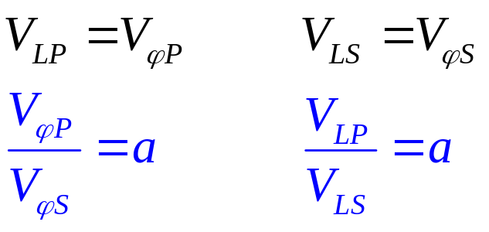
2. Three Phase Transformer (cont…
d. Δ- Δ Connections

Slide 24
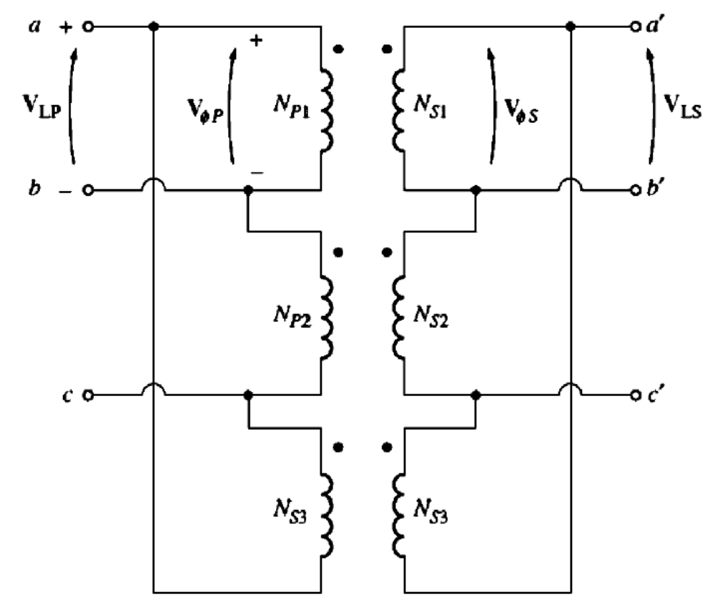
2. Three Phase Transformer (cont…
d. Δ- Δ Connections
22

Slide 25
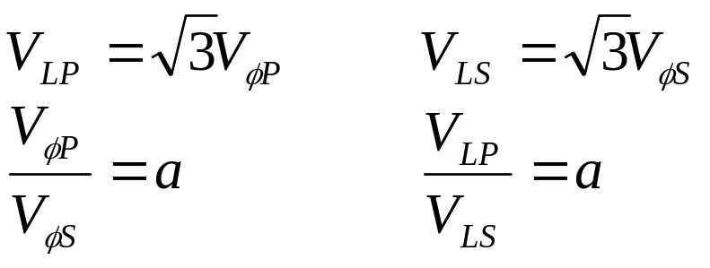
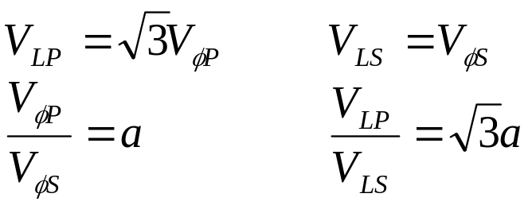
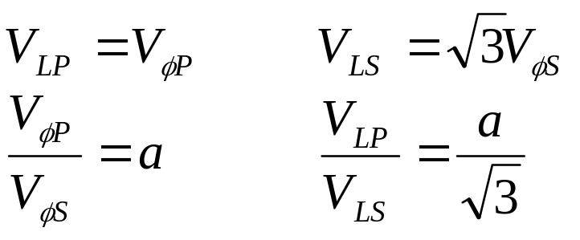
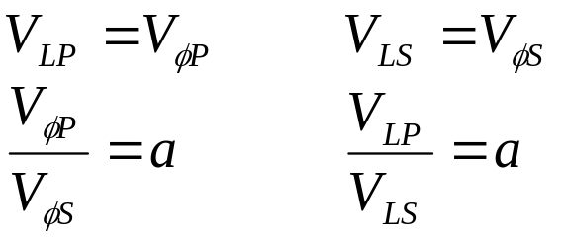
Three Phase Transformer Connections
    Y-Y
    Y-Δ
    Δ-Y
    Δ-Δ

Slide 26

Conclusion
Auto Transformers
Three Phase Transformers

