Slide 1

School of Electrical Engineering and Computer Science
Department of Electrical Engineering
EE-260 : Electrical Machines
Lecture#14
The rotating Magnetic Field Page #238
The Relationship between Electrical Frequency and Speed of Magnetic Field Rotation Page #242
  Reversing the Direction of the Magnetic Field page #244
  Winding Insulation in an AC Machine page #258
  AC machine Power Flow and Losses page #261
  Voltage Regulation and Speed Regulation page #262
Text Book: Chapter 04 (Stephen J. Chapman 4th Ed)
Instructor: Ms Neelma Naz
Class: BEE 12 C/D

Slide 2
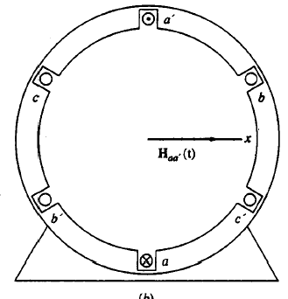
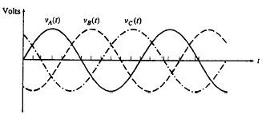
1: The Rotating Magnetic Field (1/7)
A rotating magnetic field induces three phase set of voltages in the three-phase windings of a stator
What happens if three-phase set of voltages are applied to the three windings of the stator?
Fundamental principle of ac machine operation

Slide 3
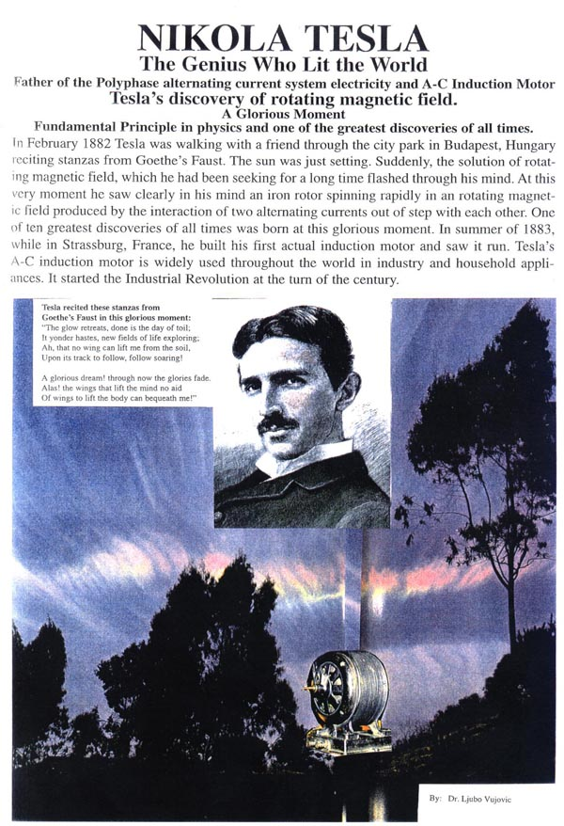
http://www.teslasociety.com/magnetic.htm

Slide 4
1: The Rotating Magnetic Field (2/7)
How the stator magnetic field be made to rotate?
The fundamental principle of ac machine operation is that:
IF a 3-phase set of currents, each of equal magnitude and differing in phase by 120⁰, flows in a 3-phase winding, then it will produce a rotating magnetic field of constant magnitude (1.5 times the peak value).

Slide 5
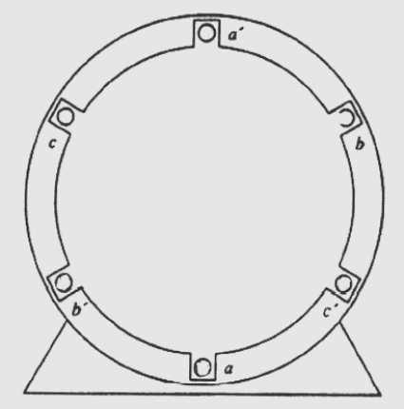
1: Production of Rotating Magnetic Field (3/7)
The rotating magnetic field concept is illustrated by an empty stator containing just three coils, 120º apart.
Since such a winding produces only one north and one south magnetic pole, it is a two pole winding.
To understand the concept of the rotating magnetic field, apply a set of currents to the stator of the machine shown in the Figure and see what happens at specific instants of time (i.e. ωt=0º, ωt=90º)

Slide 6
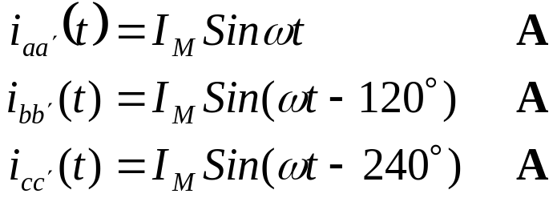
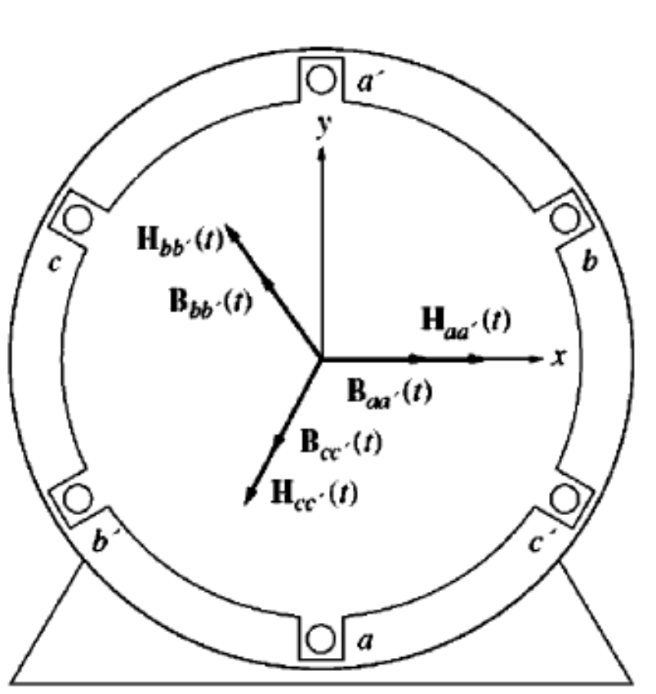
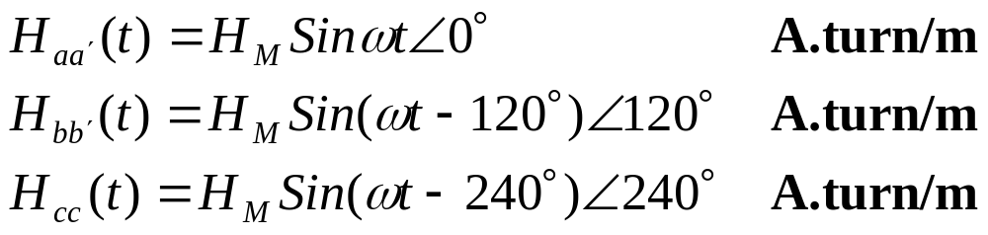
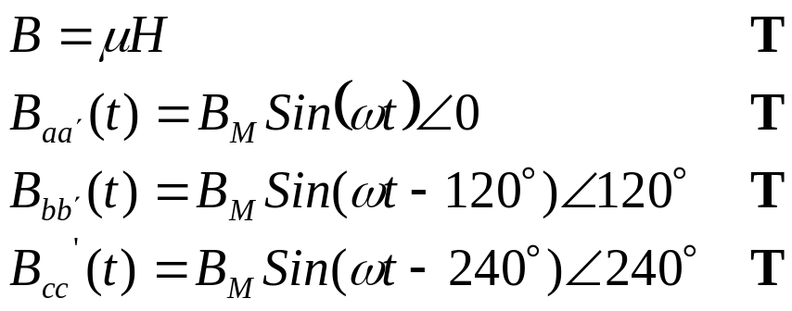
1: The Rotating Magnetic Field (4/7)
The three phase current are given by:
The current produces magnetic field intensity:
The resultant flux density is given by:

Slide 7
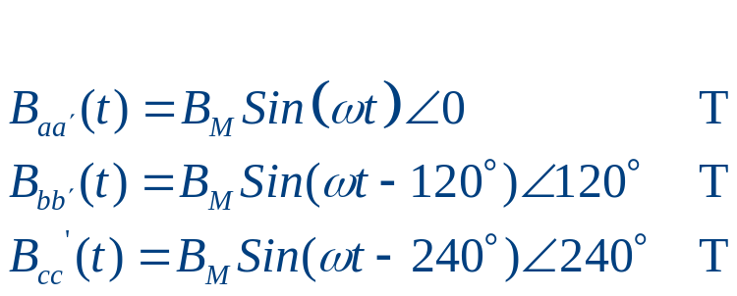
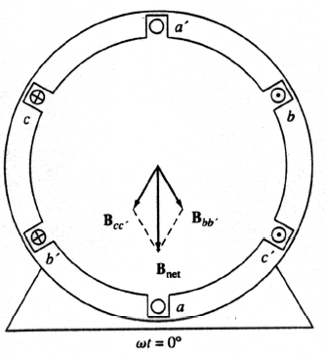
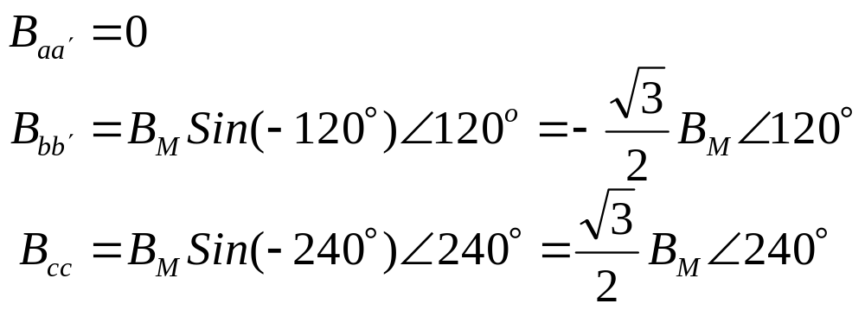
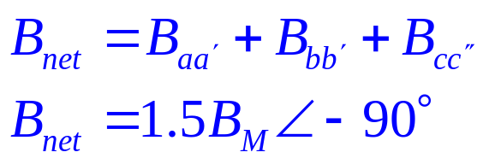
1: The Rotating Magnetic Field (5/7)
Flux densities at various instants of time
At ωt=0º

Slide 8
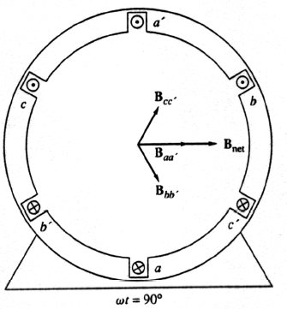
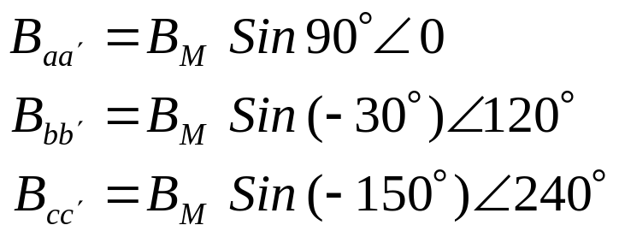
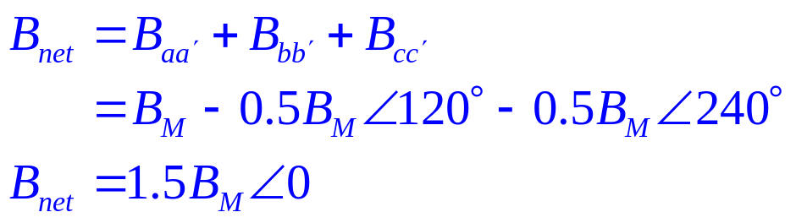
1: The Rotating Magnetic Field (6/7)
Flux densities at various instants of time
At ωt=90º

Slide 9
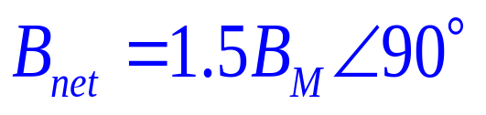
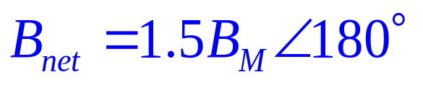
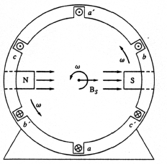
1: The Rotating Magnetic Field (7/7)
Similarly at ωt=180º and at ωt=270º, the net magnetic field is:
and
Thus the direction of B_{net} changes but magnitude remains constant. The net magnetic field is rotating in a circle
This rotating magnetic field in the stator can be represented as rotating north and south poles

Slide 10
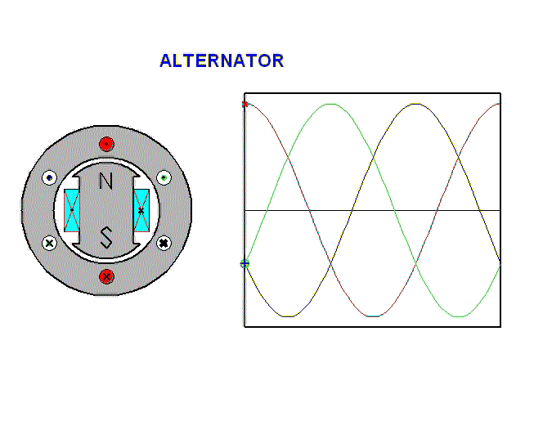
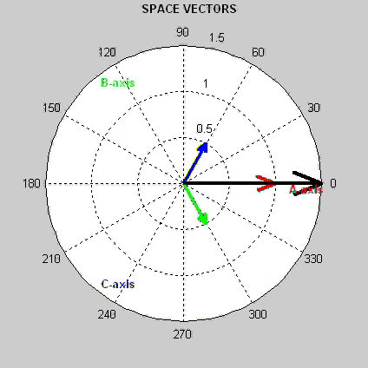
The Rotating Magnetic Field
ALTERNATOR (AC Generator or Synchronous Generators)
The elementary 3-phase 2-pole synchronous generator has a stator equipped with 3 coils displaced 120o from each other; although shown as concentrated, they actually are distributed. When the rotor is excited with dc and rotated, the resultant field will also rotate so that sinusoidal voltages are generated in the 3 stator phases, displaced 120o in time and having a frequency directly related to rotor speed.

Slide 11
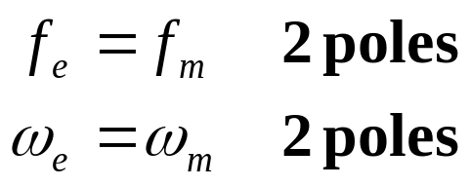
2: Relationship between Electrical Frequency and Speed of Magnetic Field Rotation (1/3)
Where the flux leaves is denoted as North Pole, and where it enters is called South Pole
When the electrical cycle of the applied current completes one rotation the magnetic poles also complete one mechanical rotation
Therefore, mechanical speed of rotation of magnetic field in revolution per second is equal to the electric frequency in Hertz

Slide 12
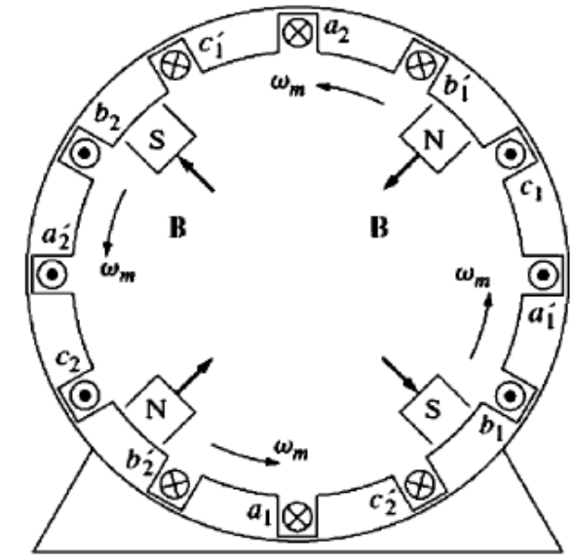
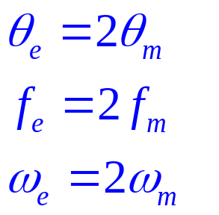
2: Relationship between Electrical Frequency and Speed of Magnetic Field Rotation (2/3)
The windings on the two pole stator occur in the order (taken counter clockwise): a-c’-b-a’-c-b’.
If the winding pattern is repeated twice;
a-c’-b-a’-c-b’ - a-c’-b-a’-c-b’
When the 3 phase current is applied, two
north and two south poles will be created.
A pole moves only half way around the stator surface in one electrical cycle.
The electrical frequency of the
current is twice the mechanical
frequency of rotation

Slide 13
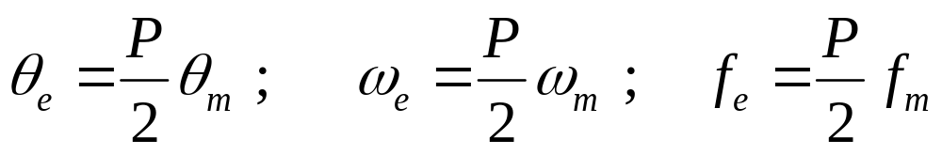
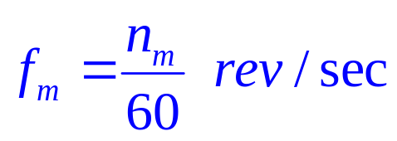
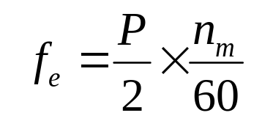
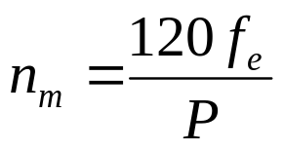
2: Relationship between Electrical Frequency and Speed of Magnetic Field Rotation (3/3)
If P are the magnetic poles then P/2 are repetition of windings sequence around the inner surface of the stator
The electrical and mechanical quantities on the stator are related as:
The electrical frequency in hertz can be related to the resulting mechanical speed of the magnetic fields in revolution per minute
If n_{m} is revolution per minute

Slide 14
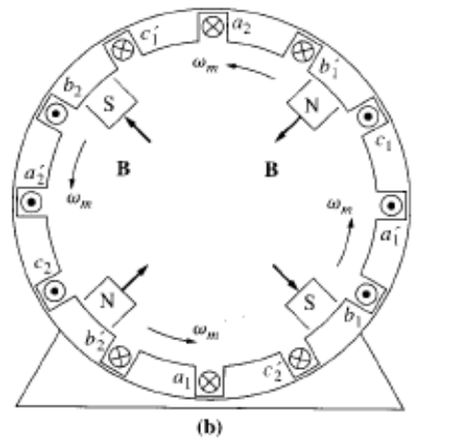
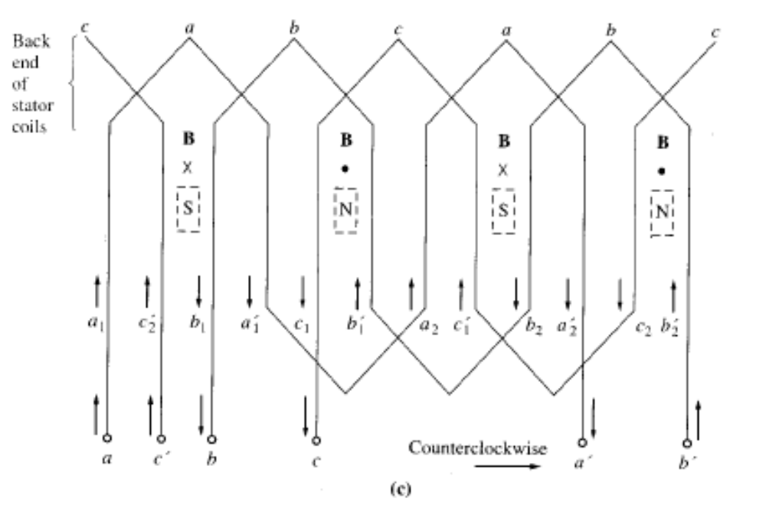
3. The Stator Seen from its Inner Surface

Slide 15
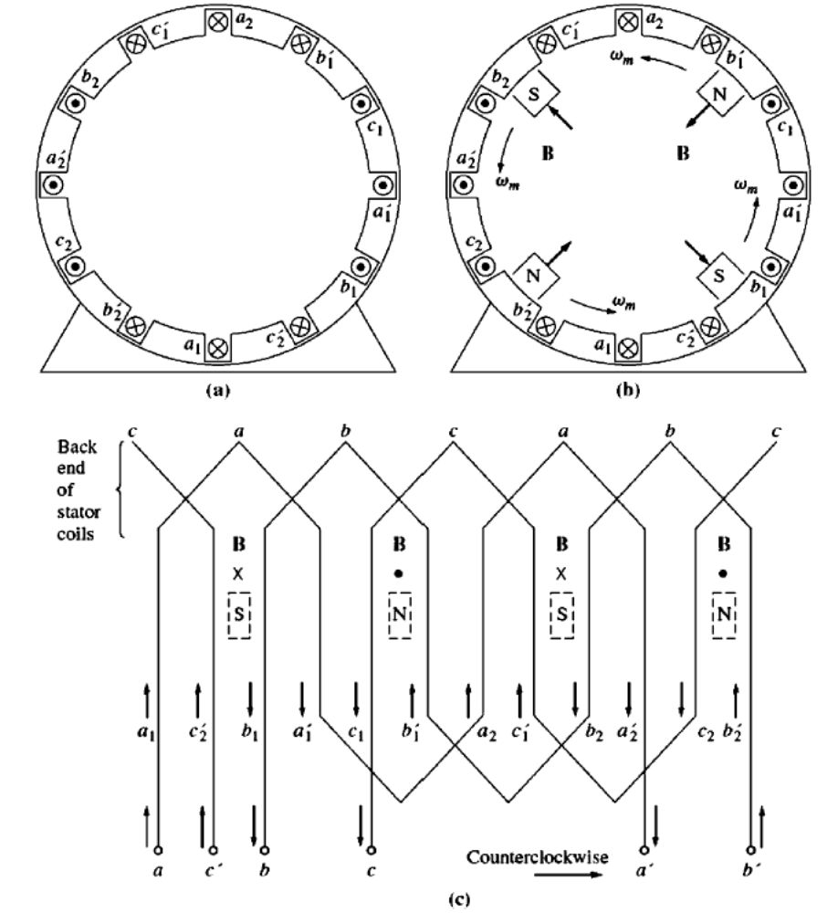
Winding diagram of the stator as seen from its inner surface, showing how the stator currents produce north and south magnetic poles

Slide 16
3: Reversing the Direction of the Magnetic Field
If the current in any of the two phases is swapped, the direction of the magnetic field rotation will be reversed
It is possible to reverse the direction of rotation of an ac motor just by switching the connection on any two of the three coils
Take the winding sequence when you start your HW and prove it to yourself…

Slide 17
4: Winding Insulation in an AC Machine (1/2)
The winding insulation is one of the most critical parts of an ac machine design
If the winding insulation breaks down the machine will be shorted
Overheating due to high winding temperature is one of the most common reason for the insulation breakdown

Slide 18
4: Winding Insulation in an AC Machine (2/2)
The overheating can be prevented by limiting the winding temperature by providing cooling air circulation in the machine
The increased temperature will not cause an instantaneous winding breakdown, it will rather decrease the overall life of the machine
15

Slide 19
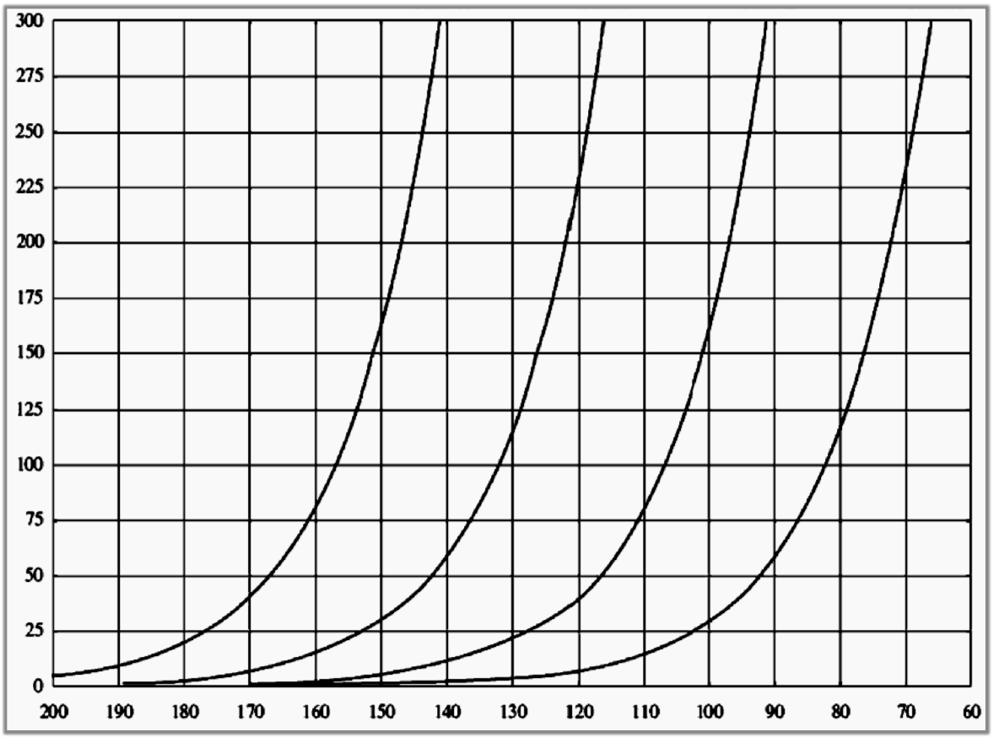
Mean insulation life versus winding temperature for various insulation classes
Class H
Class F
Class B
Class A
Insulation Life (Hours X10³)
Winding Temperature ºC
16

Slide 20
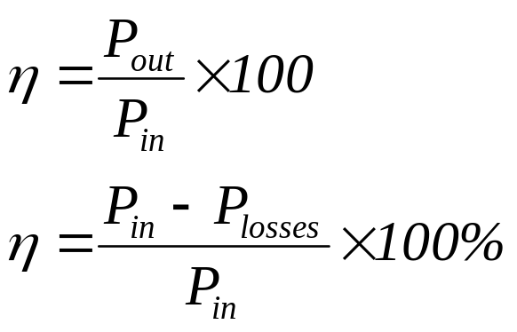
5: AC Machines Power Flow and Losses (1/4)
The AC generator takes in mechanical energy and produces the electrical energy, while ac motor takes in electric power and produce mechanical power.
All the power that is input to the machine does not appear at the output of the machine, there are always some losses associated with the process.
The efficiency is defined by:

Slide 21
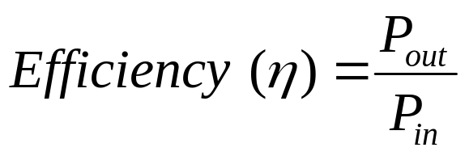
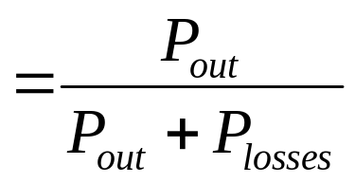
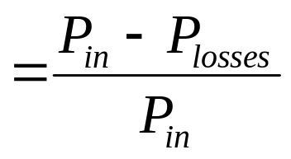
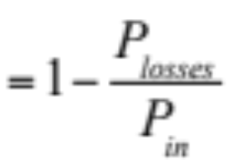


5: AC Machines Power Flow and Losses (2/4)
1. Electrical Losses or Copper Losses (I²R)
Armature (Stator) Losses
Field (Rotor) Losses ( Fixed ∝ I_{F} )
2. Core Losses=Hysteresis+Eddy Current Losses (Proportional to Speed & φ)
3. Mechanical Losses (Proportional to speed)
4. Stray Load Losses 1% of the Full Load rated Capacity (100 W → 1 W)
18

Slide 22
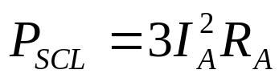
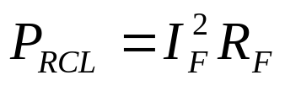
5: AC Machines Power Flow and Losses (3/4)
The losses that occur in the ac machine can be divided in to four basic types: :
    Electrical or copper losses (I²R losses)
    Core Losses
    Mechanical Losses
    Stray Load Losses
Electrical or Copper Losses (I²R losses): These are the resistive heating losses that occur in the stator (armature) or rotor (field) windings of the machine.

Slide 23
5: AC Machines Power Flow and Losses (4/4)
Core Losses: The core losses are hysteresis or eddy current losses occurring in the metal of the motor.
Mechanical Losses: These losses are of two types; the Friction and Windage Losses
  Friction losses are caused by the friction of the bearing in the machine,
  Windage losses are caused by the friction between the moving parts of the machine and the air in the machine’s casing
  Stray Load Losses: No matter how carefully losses are accounted for, some losses escape inclusion in one of the above categories, all such losses are lumped into Stray Losses. For most of the machines these are taken by convention to be 1 percent of the full load

Slide 24
5: 3-Phase AC Generator Power Flow Diagram
(1/2)
P_{out} = P_{in} - Losses
P_{conv}
Mechanical
P_{in}= τ_{app} ω_{m}
P_{out}=V_{φ}I_{A}cosθ
=√3 V_{L}I_{L}cosθ
τ_{ind} ω_{m}
I²R Losses = Armature
+ Field
Losses
Core Losses
= Eddy
Current
+ Hystersis
Losses
Mechanical Losses
= Friction
+ Windage
Losses
Stray
Losses
1% of Rating

Slide 25
5: 3-Phase AC Generator Power Flow Diagram
(2/2)
P_{out} = P_{in} - Losses
P_{conv}
P_{in}=V_{φ}I_{A}cosθ
=√3 V_{L}I_{L}cosθ
Mechanical
P_{out}= τ_{ind}ω_{m}
τ_{ind} ω_{m}
Stray
Losses
1% of Rating
Core Losses
= Eddy
Current
+ Hystersis
Losses
Mechanical Losses
= Friction
+ Windage
Losses
I²R Losses = Armature
+ Field
Losses

Slide 26
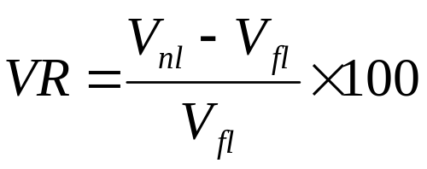
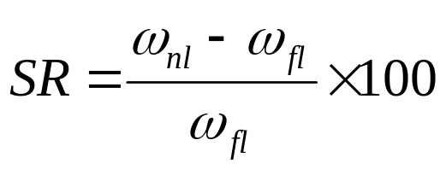
6: Voltage Regulation and Speed Regulation (1/2)
Generators are compared using a figure of merit called Voltage Regulation.
The voltage regulation for a Generator is the measure of its ability to keep a constant voltage at its terminals as the load varies.
Motors are compared by using the figure of merit called speed regulation.
It is the ability of the motor to keep a constant shaft speed as the load varies.

Slide 27
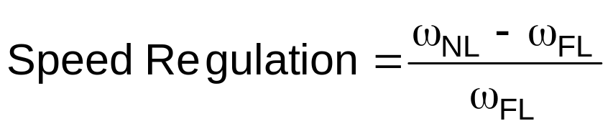
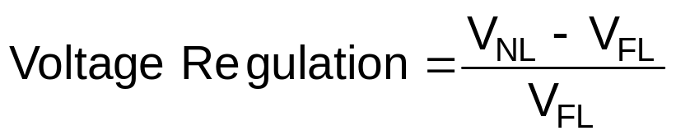
6: Voltage Regulation and Speed Regulation (2/2)
AC Motors are compared by their:
SPEED
POWER RATINGS
EFFCIENCIES
SPEED REGULATIONS
AC Generator are compared by their
VOLTAGE
POWER RATINGS
EFFCIENCIES
VOLTAGE REGULATIONS
Assume the Motors are run from a constant source (V_{T}), unless voltage change is specified
Assume the Generators are are run from a constant Speed source called Prime Mover, unless speed change is specified

Slide 28


