Slide 1

School of Electrical Engineering and Computer Science
Department of Electrical Engineering
EE-260 : Electrical Machines
Lecture#16
5.3 The Internal Generated Voltage of a Synchronous Generator Page 273
5.4 The Equivalent Circuit of a Synchronous Generator Page 274
5.5 The Phasor Diagram of a Synchronous Generator Page 279
Text Book: Chapter 05 (Stephen J. Chapman 4th Ed)
Instructor: Ms Neelma Naz
Class: BEE 12 C/D

Slide 2
Supplying DC to the Rotor Field Circuit:
Brushless Exciter
For larger machines Brushless exciters are used. It is a small AC generator with its field circuit on the stator and armature circuit on the rotor.
Three phase output of the exciter generator is rectified to direct current by a three-phase rectifier circuit also mounted on the shaft of the generator and is then fed into the main dc field circuit.
The field current on the main machine can be controlled by controlling the small dc field current of the exciter generator located on the stator, thus adjusting the field current of the main machine without slip rings and brushes.

Slide 3

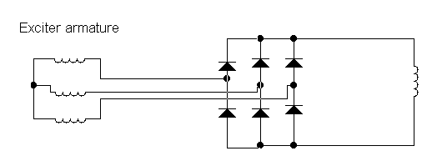
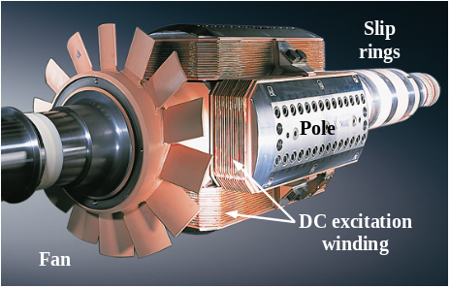
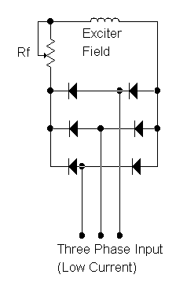
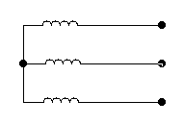
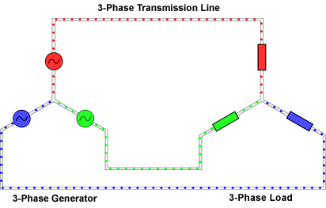
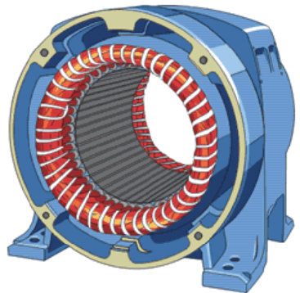
Fig 5-3 (Page 253) Brushless exciter
Synchronous Machine Main Field
ROTOR
STATOR
Main Armature
Red
Yellow
Three-Phase output
Blue

Slide 4
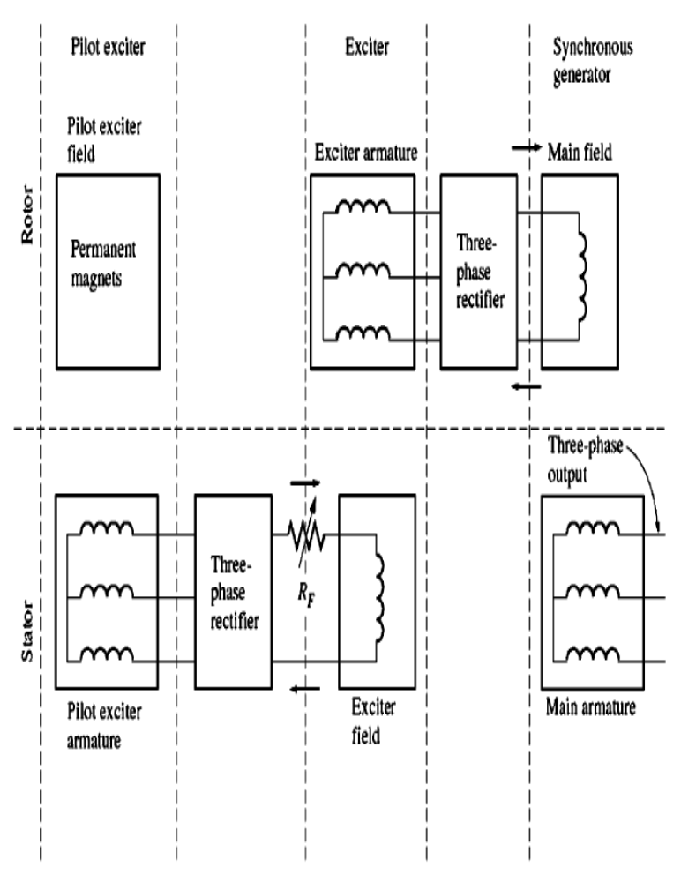
Supplying DC to the Rotor Field Circuit:
Brushless Exciter
19

Slide 5
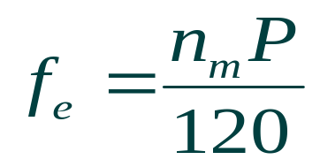
5.2: The Speed of Rotation of a Synchronous Generator
The electrical frequency produced is locked in or synchronized with the mechanical rate of the rotation of generator.
The rotor magnetic field points in whatever direction the rotor is turned.
The rate of rotation of the magnetic field is related to the stator electrical frequency by:
The rotor turns at the same speed as the magnetic field, this equation relates the speed of rotor rotation to the resulting electrical frequency.

Slide 6
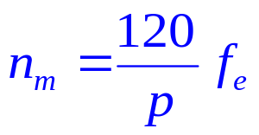
The Speed of Rotation of a Synchronous Generator
Electric power is generated at 50 or 60 Hz, so the generator must turn at a fixed speed
For 2 pole generator the rotor speed to produce the 60 and 50 Hz frequency must be 3600 and 3000 rpm respectively.
For 60 Hz operation (f=60)
No. of Poles (p) Synchronous speed (n_{m})
------------------- -----------------------------
2 3600
4 1800
6 1200
8 900
10 720
12 600

Slide 7
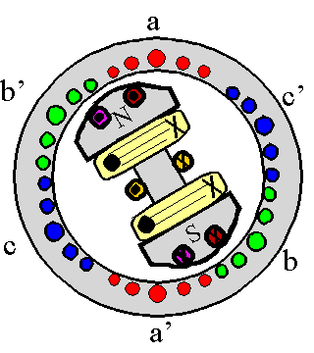
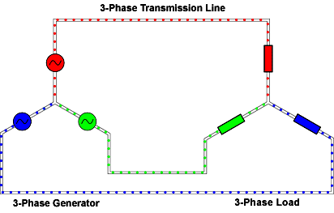

Slide 8
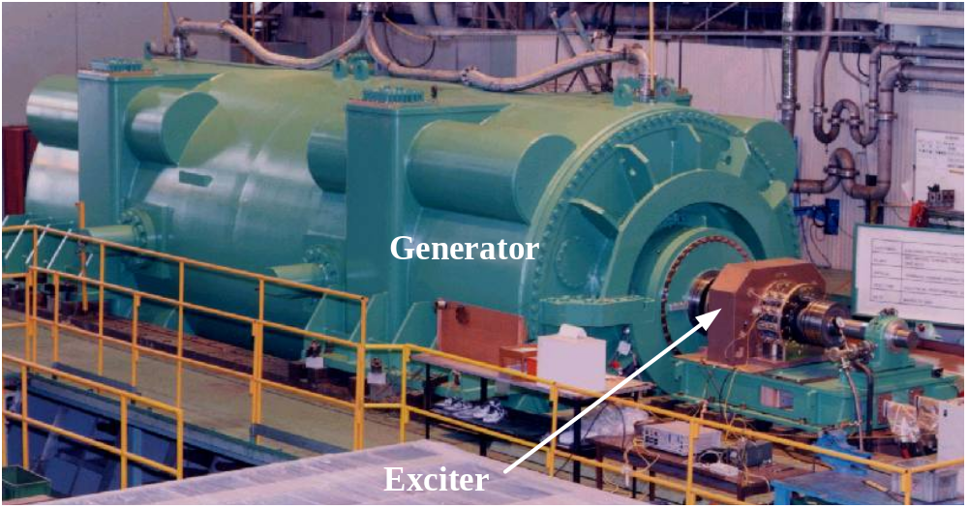
Synchronous Machines
View of a two-pole round rotor generator and exciter.

Slide 9
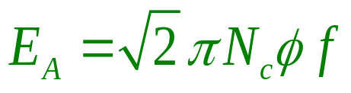
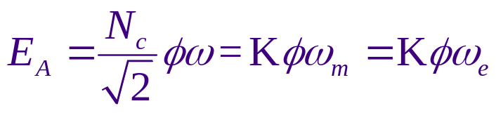
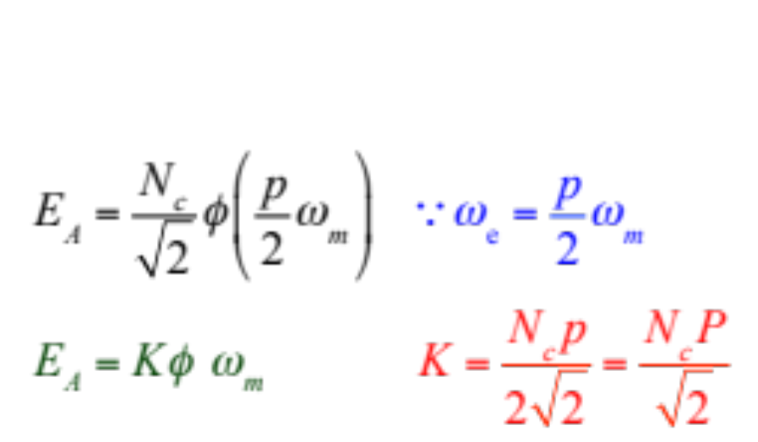
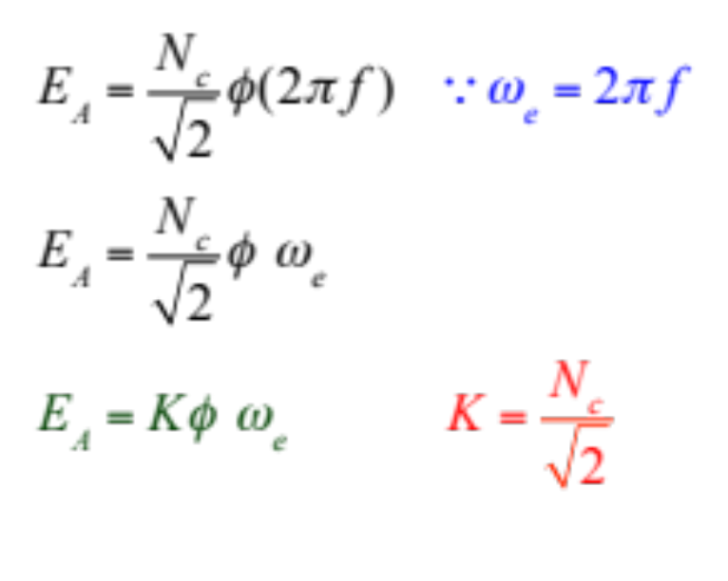
5.3: The Internal Generated Voltage
The magnitude of the rms voltage induced in a given stator phase is (derived in chapter 4):
The expression can be modified in terms of machine design constant, and the parameters that are variable during machine operation (i.e. the flux and the angular speed of the rotor or electrical frequency in rad/sec)
Expression in terms of ω_{e}
Expression in terms of ω_{m}
Small p is number of poles while capital P are pole pairs of the machine.

Slide 10




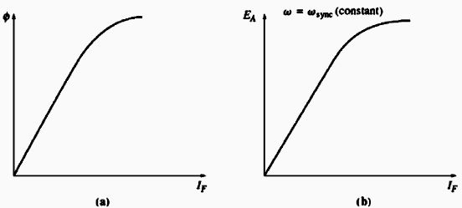
5.3: Internal Generated Voltage
E_{A} is proportional to the flux and to the rotor speed
Flux depends upon the (I_{F}) in the rotor circuit Figure (a)
E_{A} can be directly related with the field current Figure (b)
Magnetization Curve or the Open Circuit Characteristics of the machine.

Slide 11
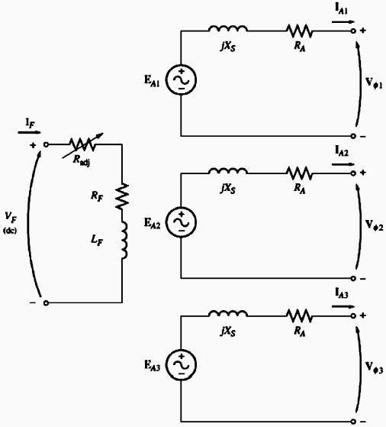
5.4: The Equivalent Circuit of Synchronous Generator
4

Slide 12
The Equivalent Circuit of Synchronous Generator
E_{A} is the internal generated voltage. The same voltage appears at the terminals of the machine only if there is no current in the stator winding, (i.e. the generator is operating at no load)
Factors effecting the terminal voltage Under load conditions:
  Distortion of air gap magnetic field by current flowing in the stator, called Armature Reaction.
  Self inductance of armature coil.
  Resistance of armature coil.
  The effect of salient-pole rotor shape (no discussion in this course).

Slide 13
Effects of Load Current on the Terminal Voltage
  Distortion of air gap magnetic field by current flowing in the stator, called Armature Reaction.
  Self inductance of armature coil.
  Resistance of armature coil.
  The effect of salient-pole rotor shape (no discussion in this course).
We will explore the effect of first three and derive the model of the machine assuming a non-salient or cylindrical rotor.

Slide 14
Armature Reaction
When rotor spins, E_{A} is induced in stator windings. If loaded, a current flows in the stator winding which will produce another magnetic field.
The stator magnetic field distorts the original rotor magnetic field which will change the resulting phase voltage.
The armature (stator) current effects the magnetic field which produced it. The effect is, thus, called:
the Armature Reaction

Slide 15
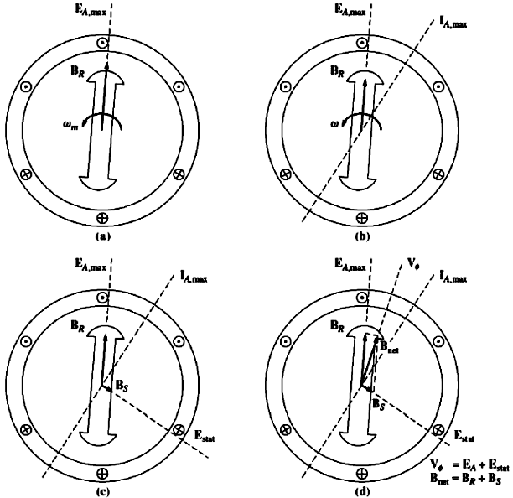
Generator Output Voltage Under No-Load Condition
E_{A} is the internal generated voltage. The same voltage appears at the terminals of the machine only if there is no current flowing in the stator winding (i.e. the generator is operating at no load).

Slide 16
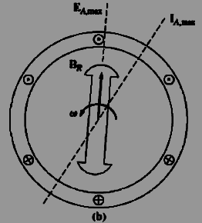
Armature Reaction Voltage
Now suppose that the generator is connected to a lagging load. Because the load is lagging, the peak current will occur at an angle behind the peak voltage.
The effect is shown in the Figure (b).
The current flowing in the stator windings produces a magnetic field B_{S} of its own. This direction of B_{S} is given by the right hand rule to be as shown in Figure (c)
The stator magnetic field B_{S} produces a voltage E_{stat} of its own in the stator known as the armature reaction voltage

Slide 17
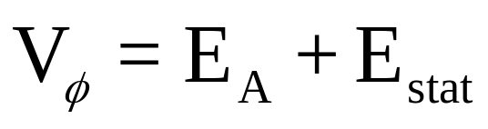
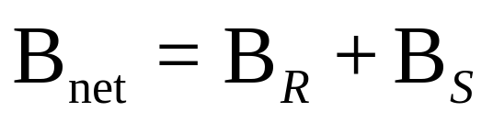
Generator Output Voltage With Lagging Load
The total voltage in a phase is just the sum of the internal generated voltage E_{A} and the armature reaction voltage E_{stat}
The net magnetic field is the sum of the rotor and stator magnetic fields

Slide 18
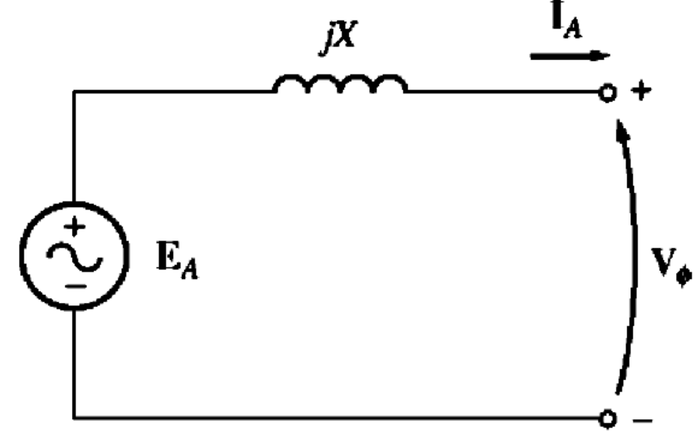

The Equivalent Circuit of Synchronous Generator
Modeling the Armature Reaction
E_{stat} lies at an angle 90º behind the plan of maximum current I_{A}.
E_{stat} is directly proportional to the current I_{A}.
If X is the constant of proportionality , then the armature reaction can be expressed as:

Slide 19
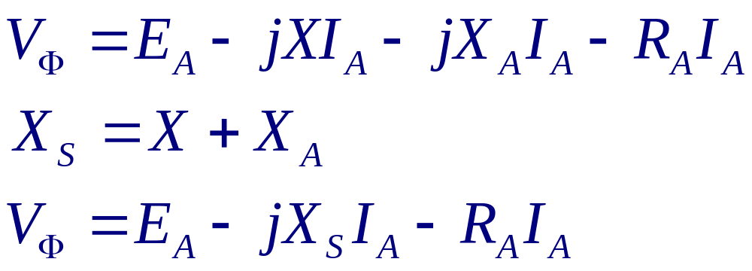
The Equivalent Circuit of Synchronous Generator
The stator coil have a self inductance and resistance.
If the self inductance is modeled by L_{A} and resistance by R_{A}, then V_{Φ} is given by:

Slide 20
The Equivalent Circuit of
Synchronous Generator
These three phases can be connected in
∆ or Y

Slide 21
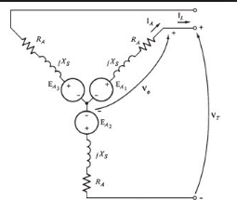
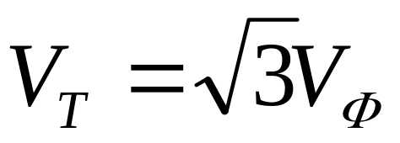
The Equivalent Circuit of Y Connected
Synchronous Generator
In Y connected the terminal voltage is given by:

Slide 22
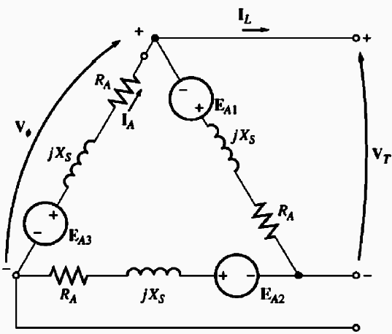
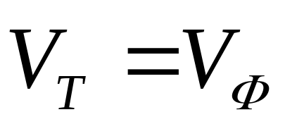
The Equivalent Circuit of ∆ Connected
Synchronous Generator
In ∆ connected the terminal voltage is given by:

Slide 23
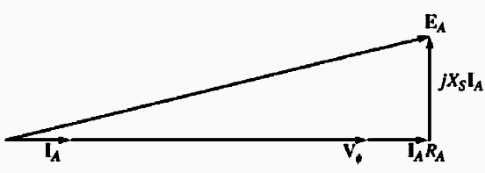
5.5: The Phasor Diagram of A Synchronous
Machine
At unity power factor the internal generated voltage E_{A} differs from the terminal voltage V_{Φ} by the resistive and inductive voltage drops.
Phasor Diagram with Unity PF
In the real synchronous generators, the winding reactance X_{S} is much larger than the winding resistance R_{A}, so R_{A} can be often neglected.

Slide 24
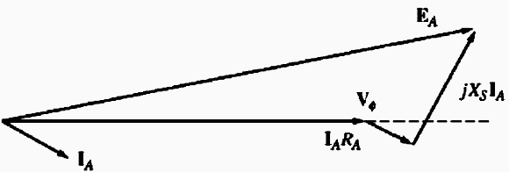
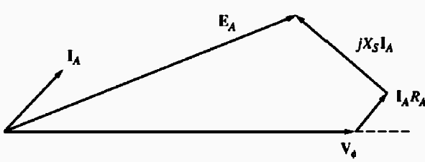

5.5: The Phasor Diagram of A Synchronous
Machine
Phasor Diagram with Lagging PF
For a given phase voltage and armature current, a larger internal generated voltage E_{A} is needed for lagging loads than for leading loads.
A larger field current is needed with lagging loads to get the same terminal voltage, because
Phasor Diagram with Leading PF
In the real synchronous generators, the winding reactance X_{S} is much larger than the winding resistance R_{A}, so R_{A} can be often neglected.

Slide 25

Conclusion
5.3 The Internal Generated Voltage of a Synchronous Generator Page 273
5.4 The Equivalent Circuit of a Synchronous Generator Page 274
5.5 The Phasor Diagram of a Synchronous Generator Page 279

