Slide 1

School of Electrical Engineering and Computer Science
Department of Electrical Engineering
EE-260 : Electrical Machines
Lecture#17
5.5 The Phasor Diagram of a Synchronous Generator Page 279
5.6 Power and Torque in Synchronous Generators Page 280
Text Book: Chapter 05 (Stephen J. Chapman 4th Ed)
Instructor: Ms Neelma Naz
Class: BEE 12 C/D

Slide 2
The Equivalent Circuit of Synchronous Generator
E_{A} is the internal generated voltage. The same voltage appears at the terminals of the machine only if there is no current in the stator winding, (i.e. the generator is operating at no load)
Factors effecting the terminal voltage Under load conditions:
  Distortion of air gap magnetic field by current flowing in the stator, called Armature Reaction.
  Self inductance of armature coil.
  Resistance of armature coil.
  The effect of salient-pole rotor shape (no discussion in this course).

Slide 3
Effects of Load Current on the Terminal Voltage
  Distortion of air gap magnetic field by current flowing in the stator, called Armature Reaction.
  Self inductance of armature coil.
  Resistance of armature coil.
  The effect of salient-pole rotor shape (no discussion in this course).
We will explore the effect of first three and derive the model of the machine assuming a non-salient or cylindrical rotor.

Slide 4
Armature Reaction
When rotor spins, E_{A} is induced in stator windings. If loaded, a current flows in the stator winding which will produce another magnetic field.
The stator magnetic field distorts the original rotor magnetic field which will change the resulting phase voltage.
The armature (stator) current effects the magnetic field which produced it. The effect is, thus, called:
the Armature Reaction

Slide 5
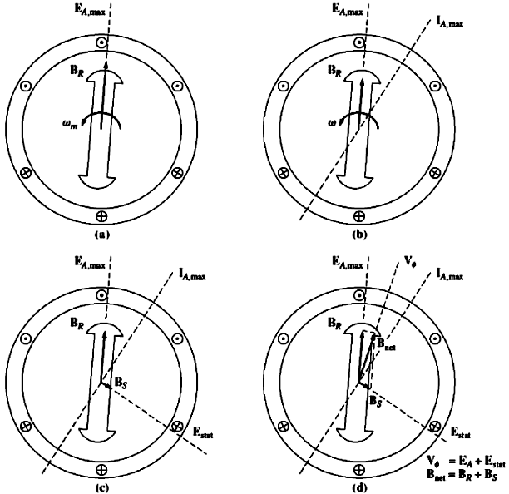
Generator Output Voltage Under No-Load Condition
E_{A} is the internal generated voltage. The same voltage appears at the terminals of the machine only if there is no current flowing in the stator winding (i.e. the generator is operating at no load).

Slide 6
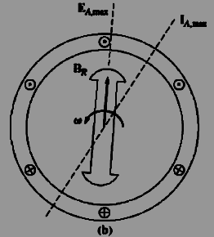
Armature Reaction Voltage
Now suppose that the generator is connected to a lagging load. Because the load is lagging, the peak current will occur at an angle behind the peak voltage.
The effect is shown in the Figure (b).
The current flowing in the stator windings produces a magnetic field B_{S} of its own. This direction of B_{S} is given by the right hand rule to be as shown in Figure (c)
The stator magnetic field B_{S} produces a voltage E_{stat} of its own in the stator known as the armature reaction voltage

Slide 7
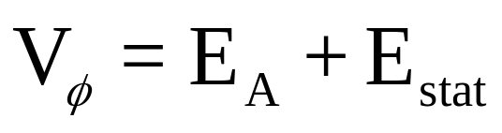
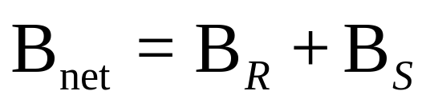
Generator Output Voltage With Lagging Load
The total voltage in a phase is just the sum of the internal generated voltage E_{A} and the armature reaction voltage E_{stat}
The net magnetic field is the sum of the rotor and stator magnetic fields

Slide 8
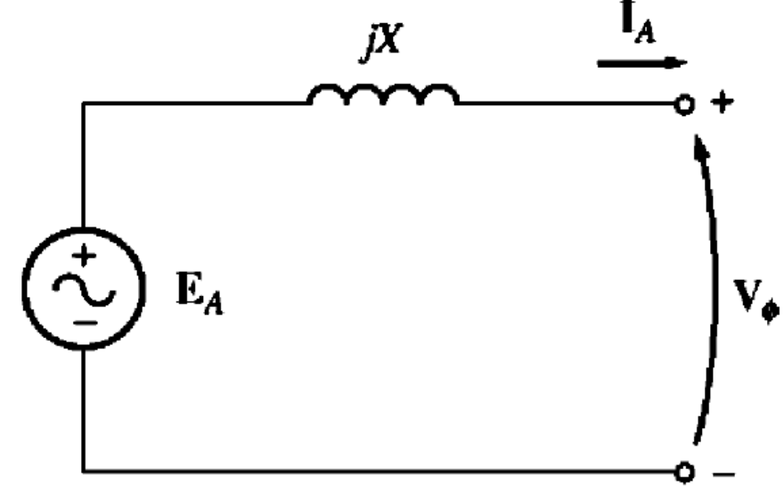

The Equivalent Circuit of Synchronous Generator
Modeling the Armature Reaction
E_{stat} lies at an angle 90º behind the plan of maximum current I_{A}.
E_{stat} is directly proportional to the current I_{A}.
If X is the constant of proportionality , then the armature reaction can be expressed as:

Slide 9
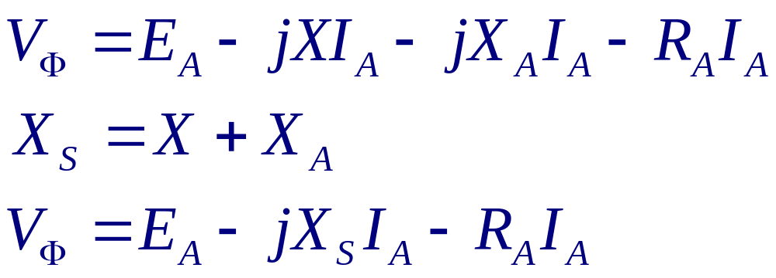
The Equivalent Circuit of Synchronous Generator
The stator coil have a self inductance and resistance.
If the self inductance is modeled by L_{A} and resistance by R_{A}, then V_{Φ} is given by:

Slide 10
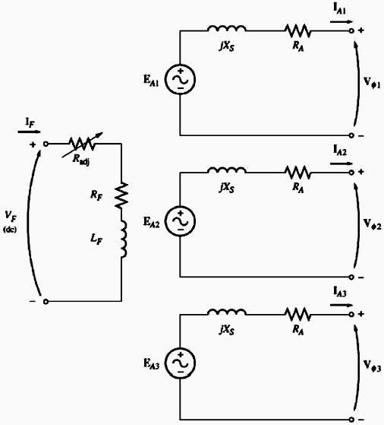
The Equivalent Circuit of
Synchronous Generator
These three phases can be connected in
∆ or Y

Slide 11
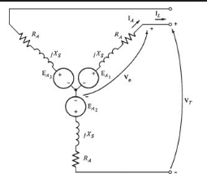
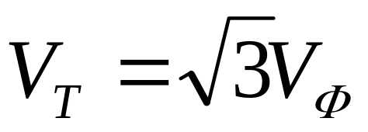
The Equivalent Circuit of Y Connected
Synchronous Generator
In Y connected the terminal voltage is given by:

Slide 12
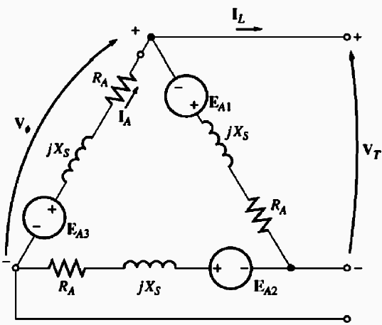
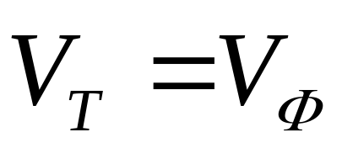
The Equivalent Circuit of ∆ Connected
Synchronous Generator
In ∆ connected the terminal voltage is given by:

Slide 13
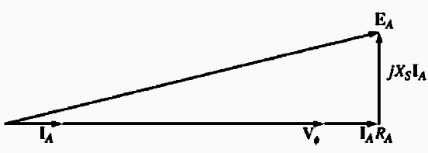
5.5: The Phasor Diagram of A Synchronous
Machine
At unity power factor the internal generated voltage E_{A} differs from the terminal voltage V_{Φ} by the resistive and inductive voltage drops.
Phasor Diagram with Unity PF
In the real synchronous generators, the winding reactance X_{S} is much larger than the winding resistance R_{A}, so R_{A} can be often neglected.

Slide 14
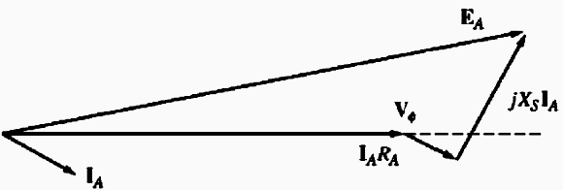
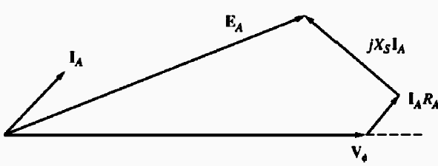

5.5: The Phasor Diagram of A Synchronous
Machine
Phasor Diagram with Lagging PF
For a given phase voltage and armature current, a larger internal generated voltage E_{A} is needed for lagging loads than for leading loads.
A larger field current is needed with lagging loads to get the same terminal voltage, because
Phasor Diagram with Leading PF
In the real synchronous generators, the winding reactance X_{S} is much larger than the winding resistance R_{A}, so R_{A} can be often neglected.

Slide 15
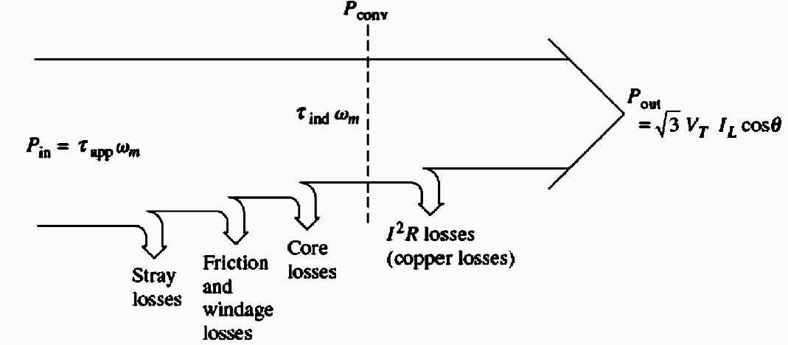
5.6: Power and Torque in Synchronous Generators
The synchronous generator is a synchronous machine working as a generator which converts mechanical power to three-phase electrical power.
Whatever the source of mechanical power, it must have the basic property that it’s speed is almost constant.
Consequence of variation in the rotational speed??????

Slide 16
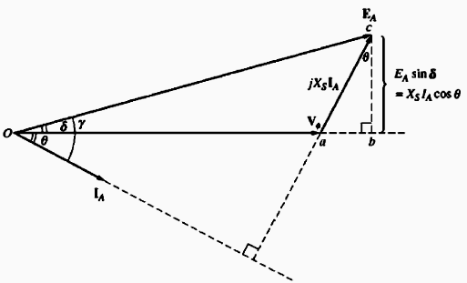
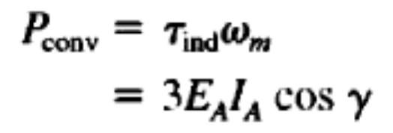




Power and Torque in Synchronous Generators
Power converted from mechanical to electrical form:
The real electrical output power
In phase quantities
The reactive power output

Slide 17
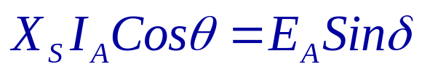
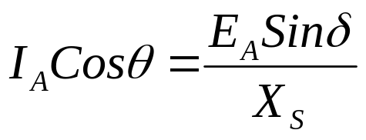
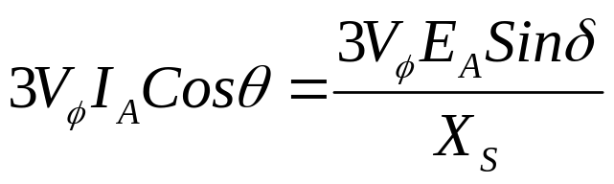
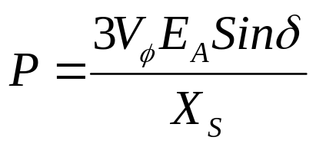
5.6 : Power and Torque in Synchronous Generators
The armature resistance R_{A} can be ignored (as X_{S}>> R_{A})
With assumption (R_{A} = 0), the phasor diagram is simplified as shown in the figure.
The vertical segment bc can be expressed as
There are no electrical losses and this equation is valid for both P_{conv} and P_{out}.

Slide 18
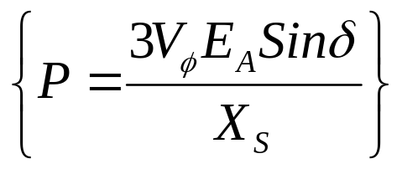
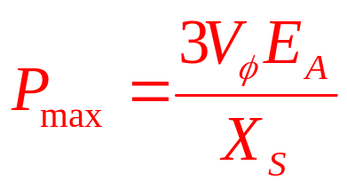
5.6 : Power and Torque in Synchronous Generators
The power produced by a synchronous generator depends upon the angle δ between V_{Φ} and E_{A}.
The angle δ is known as torque angle of the machine. The generator will supply maximum power when δ = 90º.
The maximum power indicated by this equation is called static stability limit of the generator.
Practically, the real generators never even come close to this limit. Typical Full-load torque angles of the real machines are 20 to 30º

Slide 19
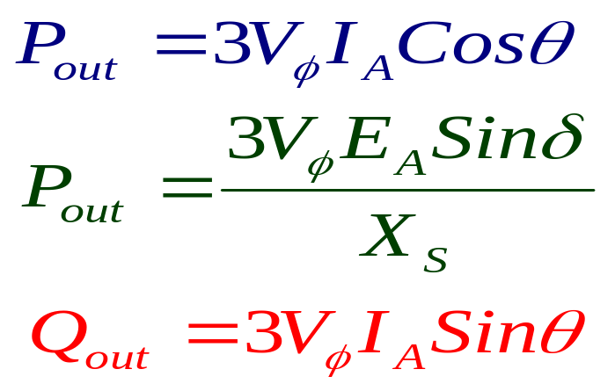
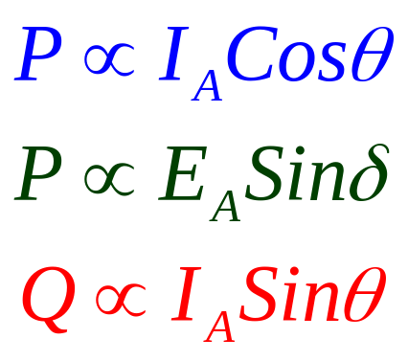
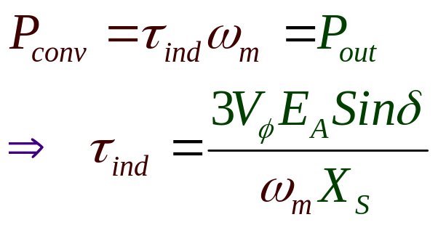
5.6 : Power and Torque in Synchronous Generators
Consider the three equations for P and Q.
If V_{Φ} is assumed constant then it is obvious that:
In case of zero Copper Loss

Slide 20
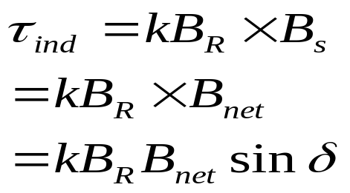
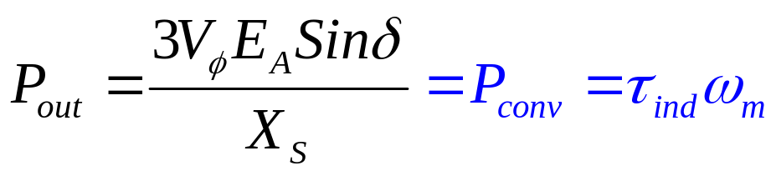
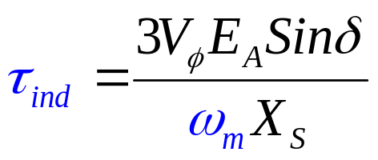
5.6 : Power and Torque in Synchronous Generators
The induced torque in a generator is:
delta is the angle between the rotor and net magnetic fields, so called torque angle.
Since armature resistance is assumed to be zero, thus no electrical losses
Thus the mechanical and electrical power can be related as:

Slide 21
5.7: Measuring Synchronous Generator Model Parameters

Slide 22
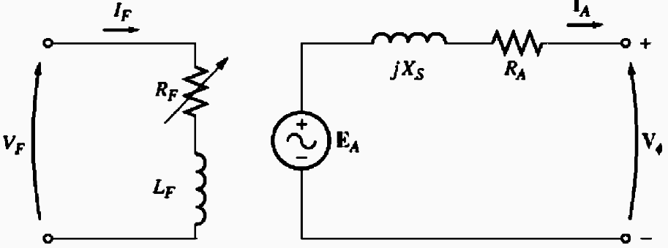
5.7: Measuring Synchronous Generator Model Parameters
Three quantities in the equivalent circuit must be determined to completely describe the behavior of synchronous generator:
  The relationship between field current I_{F} and flux, and thus between field current and E_{A}.
  The synchronous reactance X_{S}.
  The armature resistance R_{A}.
These parameters are determined through the open circuit and short circuit test

Slide 23
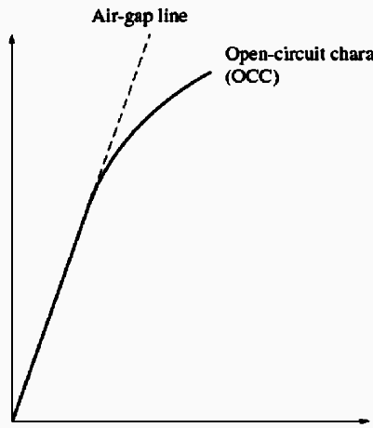
Open Circuit Test
The open circuit test is performed as follows:
The generator is turned at the rated speed, the terminals are disconnected from all the loads and field current is set to zero.
V_{T}, V
The field current is gradually increased in steps, and terminal voltage is measured at each step along the way.
OCC
With open terminals (I_{A}=0; E_{A}=V_{T}), plot of E_{A} or V_{T} versus I_{F} can be constructed. The plot is called Open Circuit Characteristic (OCC) of the generator.
This (OCC) gives the internal generated voltage of the generator for any given field current.
I_{F}, A

Slide 24
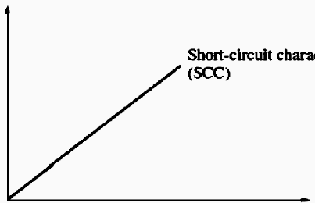
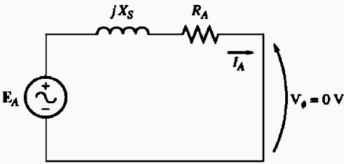
Short Circuit Test
Adjust the field current to zero and short circuit the terminals of the generator through an ammeter.
Increase the field current slowly and measure the armature current I_{A} or the line Current I_{L}.
It is thus possible to construct a plot of I_{L} versus I_{F}. Such a plot is called Short Circuit Characteristic (SCC).
I_{A}, A
I_{F}, A
In the short circuit test the rotor and stator magnetic fields tend to cancel each other. Thus the net magnetic field in the machine is so small that the machine remains unsaturated and SCC is linear.

Slide 25
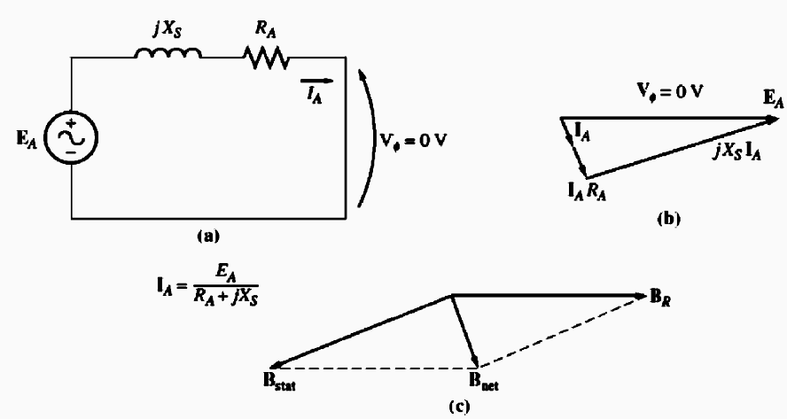
Short Circuit Test
The phasor diagram and the magnetic fields for SCT are shown.
Since B_{S} almost cancels B_{R}, the net magnetic field B_{net} is very small.
The net magnetic field in the machine is quite small, thus the machine is unsaturated and SSC is linear.
I_{A}, A
I_{F}, A

Slide 26
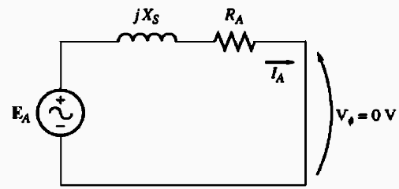
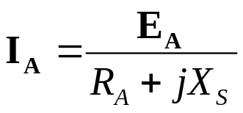
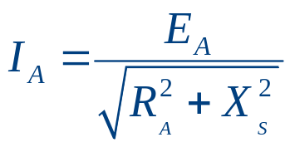
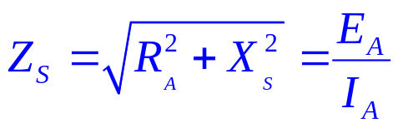
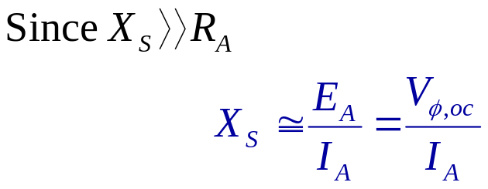
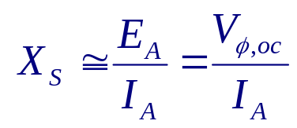
Determining the Parameters from Tests Results
From the equivalent circuit for the SCT, the armature current can be expressed as:
Magnitude of I_{A} is:
To determine X_{S} at a given field current:
Get the internal generated voltage E_{A} from the OCC at the desired field current.
Get the short-circuit current I_{A,SC} at the same field current from SCC.
Find X_{S} by applying the Eq.
The armature impedance is:
If E_{A} and I_{A} are known, the synchronous reactance can be found.

Slide 27
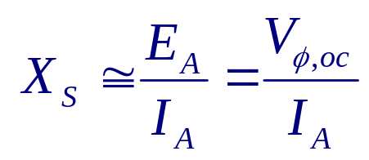
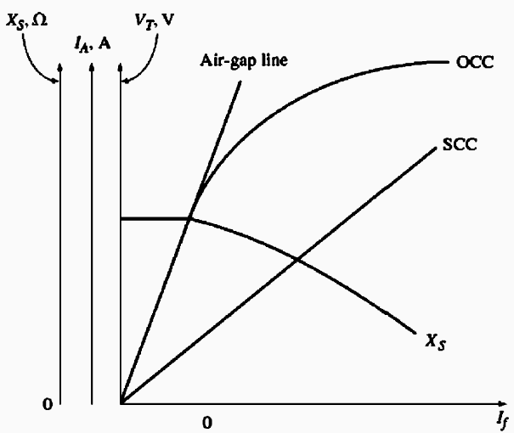
Determining the Parameters from Tests Results
E_{A} comes from the OCC, where the machine is saturated for large field current
I_{A} is taken from the SCC, where the machine is unsaturated at all field currents.
At higher field currents, the E_{A} taken from OCC at a given field current is not the same as E_{A} at the same field current under short circuit conditions, and this difference makes the resulting value only an approximate of X_{S} .

Slide 28
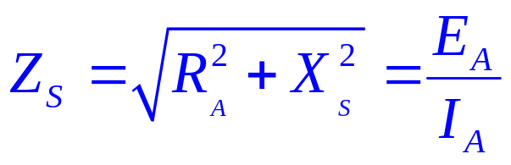
Determining the Parameters from Tests Results
The winding resistance R_{A} can be approximately calculated by applying DC voltage to the winding while machine is stationary and measure the resulting current.
The measured values of the resistance can be plugged into the Impedance equation to improve the estimate of X_{S}.
Short Circuit Ratio:(Definition)
The ratio of field current required for rated voltage at open circuit to the field current required for rated armature current at short circuit.

Slide 29
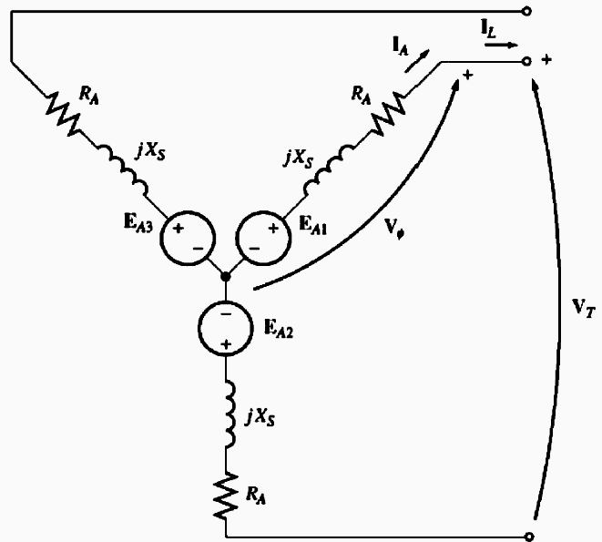
Class Activity 1:
A 200-kVA, 480-V, 50-Hz, Y-connected synchronous generator with a rated field current of 5 A was tested, and the following data were taken:
    V_{T,oc} at the rated I_{F} was measured to be 540 V.
    I_{L,sc} at the rated I_{F} was found to be 300 A.
    When a dc voltage of 10 V was applied to two of the terminals, a current of 25 A was measured.
Find the values of the armature resistance and the approximate synchronous reactance in ohms that would be used in the generator model at the rated conditions.
15

Slide 30
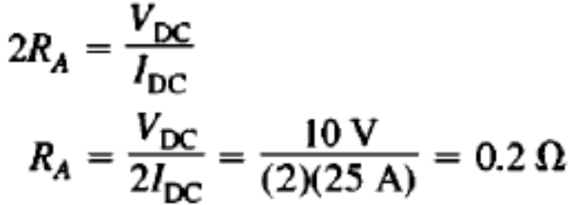
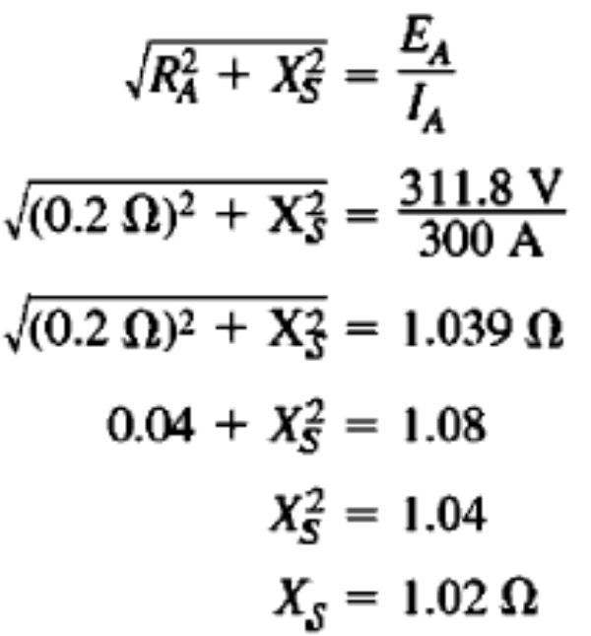
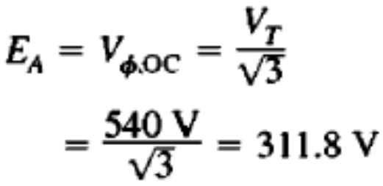
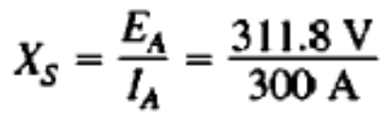

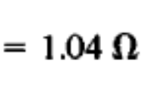
Solution
The generator is Y-connected, so the direct current in the resistance test flows through two windings. Therefore, the resistance is given by:
X_{S} can be calculated as
The internal generated voltage is
Ignoring R_{A}
The short-circuit current I_{A,sc} is
16

Slide 31

Conclusion
5.5 The Phasor Diagram of a Synchronous Generator
5.6 Power and Torque in Synchronous Generators

