Slide 1

School of Electrical Engineering and Computer Science
Department of Electrical Engineering
EE-260 : Electrical Machines
Lecture#18
5.7: Measuring Synchronous Generator Model Parameters
5.8: The Synchronous Generator Operating Alone
Text Book: Chapter 05 (Stephen J. Chapman 4th Ed)
Instructor: Ms Neelma Naz
Class: BEE 12 C/D

Slide 2
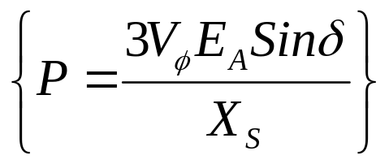
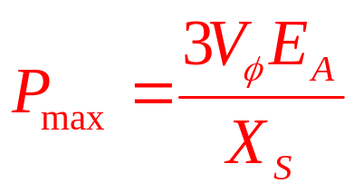
5.6 : Power and Torque in Synchronous Generators
The power produced by a synchronous generator depends upon the angle δ between V_{Φ} and E_{A}.
The angle δ is known as torque angle of the machine. The generator will supply maximum power when δ = 90º.
The maximum power indicated by this equation is called static stability limit of the generator.
Practically, the real generators never even come close to this limit. Typical Full-load torque angles of the real machines are 20 to 30º

Slide 3
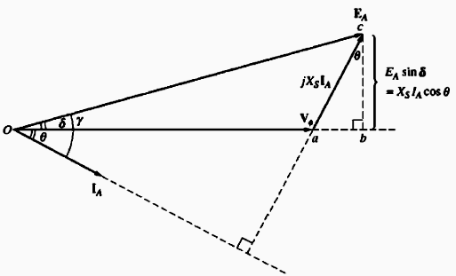
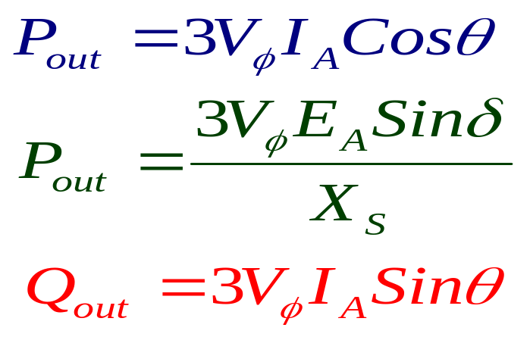
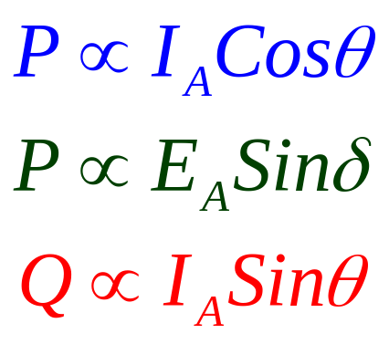
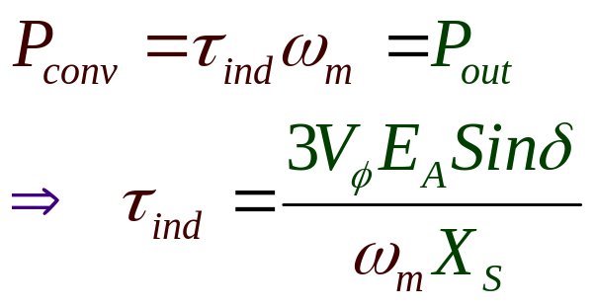
5.6 : Power and Torque in Synchronous Generators
Consider the three equations for P and Q.
If V_{Φ} is assumed constant then it is obvious that:
In case of zero Copper Loss

Slide 4
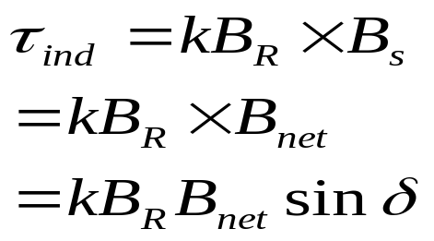
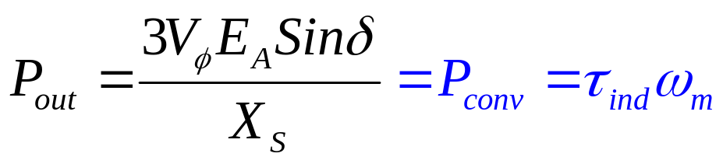
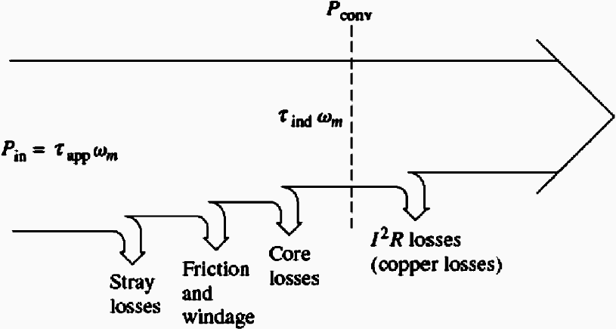
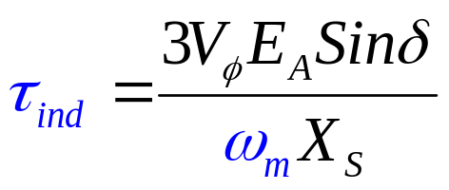
5.6 : Power and Torque in Synchronous Generators
The induced torque in a generator is:
delta is the angle between the rotor and net magnetic fields, so called torque angle.
Since armature resistance is assumed to be zero, thus no electrical losses
Thus the mechanical and electrical power can be related as:

Slide 5
5.7: Measuring Synchronous Generator Model Parameters

Slide 6
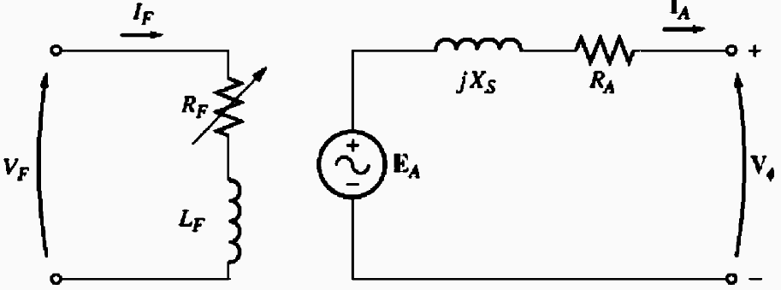
5.7: Measuring Synchronous Generator Model Parameters
Three quantities in the equivalent circuit must be determined to completely describe the behavior of synchronous generator:
  The relationship between field current I_{F} and flux, and thus between field current and E_{A}.
  The synchronous reactance X_{S}.
  The armature resistance R_{A}.
These parameters are determined through the open circuit and short circuit test

Slide 7
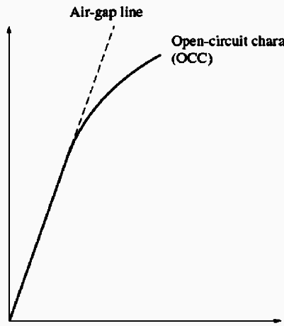
Open Circuit Test
The open circuit test is performed as follows:
The generator is turned at the rated speed, the terminals are disconnected from all the loads and field current is set to zero.
V_{T}, V
The field current is gradually increased in steps, and terminal voltage is measured at each step along the way.
OCC
With open terminals (I_{A}=0; E_{A}=V_{T}), plot of E_{A} or V_{T} versus I_{F} can be constructed. The plot is called Open Circuit Characteristic (OCC) of the generator.
This (OCC) gives the internal generated voltage of the generator for any given field current.
I_{F}, A

Slide 8
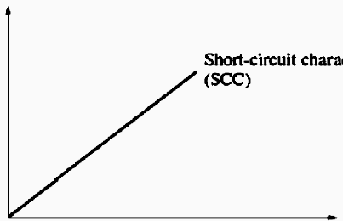
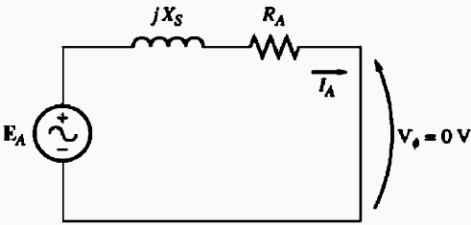
Short Circuit Test
Adjust the field current to zero and short circuit the terminals of the generator through an ammeter.
Increase the field current slowly and measure the armature current I_{A} or the line Current I_{L}.
It is thus possible to construct a plot of I_{L} versus I_{F}. Such a plot is called Short Circuit Characteristic (SCC).
I_{A}, A
I_{F}, A
In the short circuit test the rotor and stator magnetic fields tend to cancel each other. Thus the net magnetic field in the machine is so small that the machine remains unsaturated and SCC is linear.

Slide 9
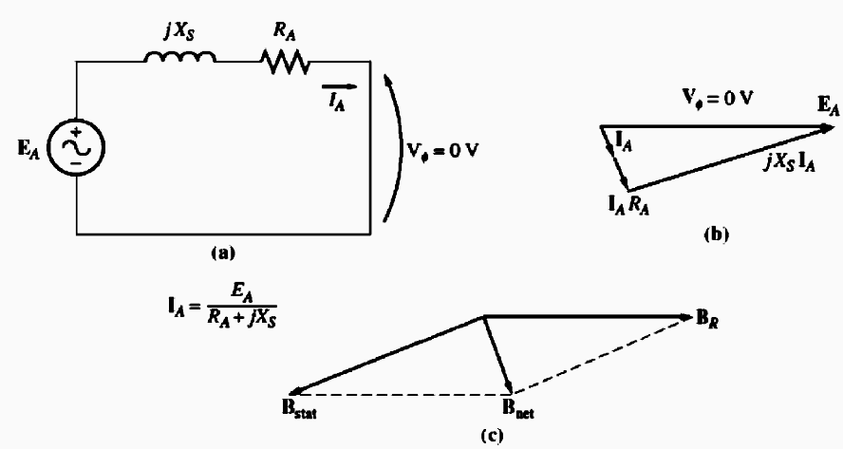
Short Circuit Test
The phasor diagram and the magnetic fields for SCT are shown.
Since B_{S} almost cancels B_{R}, the net magnetic field B_{net} is very small.
The net magnetic field in the machine is quite small, thus the machine is unsaturated and SSC is linear.
I_{A}, A
I_{F}, A

Slide 10
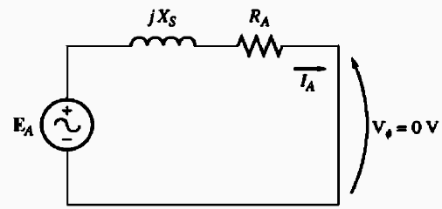
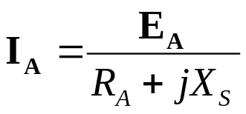
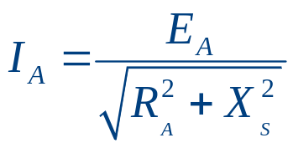
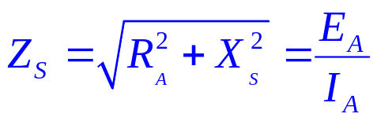
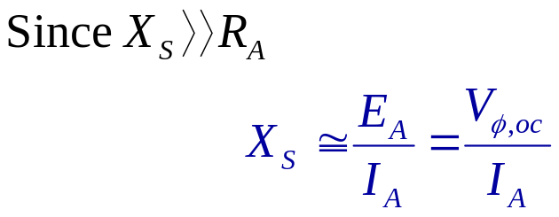
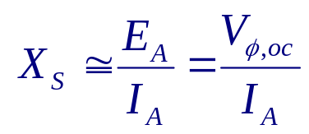
Determining the Parameters from Tests Results
From the equivalent circuit for the SCT, the armature current can be expressed as:
Magnitude of I_{A} is:
To determine X_{S} at a given field current:
Get the internal generated voltage E_{A} from the OCC at the desired field current.
Get the short-circuit current I_{A,SC} at the same field current from SCC.
Find X_{S} by applying the Eq.
The armature impedance is:
If E_{A} and I_{A} are known, the synchronous reactance can be found.

Slide 11
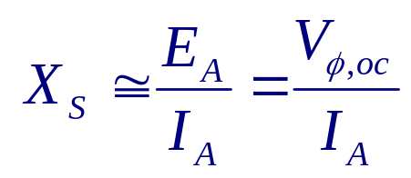
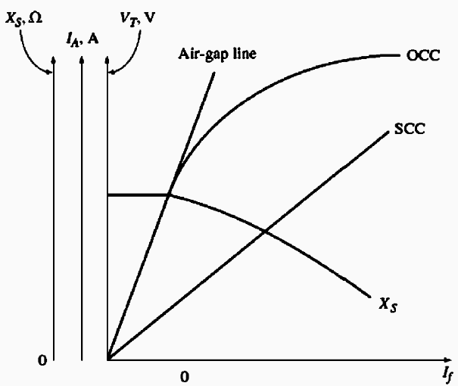
Determining the Parameters from Tests Results
E_{A} comes from the OCC, where the machine is saturated for large field current
I_{A} is taken from the SCC, where the machine is unsaturated at all field currents.
At higher field currents, the E_{A} taken from OCC at a given field current is not the same as E_{A} at the same field current under short circuit conditions, and this difference makes the resulting value only an approximate of X_{S} .

Slide 12
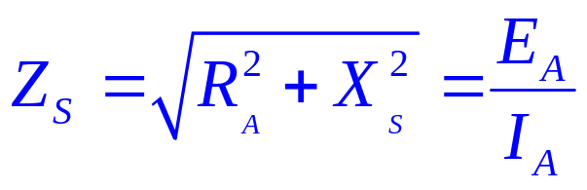
Determining the Parameters from Tests Results
The winding resistance R_{A} can be approximately calculated by applying DC voltage to the winding while machine is stationary and measure the resulting current.
The measured values of the resistance can be plugged into the Impedance equation to improve the estimate of X_{S}.
Short Circuit Ratio:(Definition)
The ratio of field current required for rated voltage at open circuit to the field current required for rated armature current at short circuit.

Slide 13
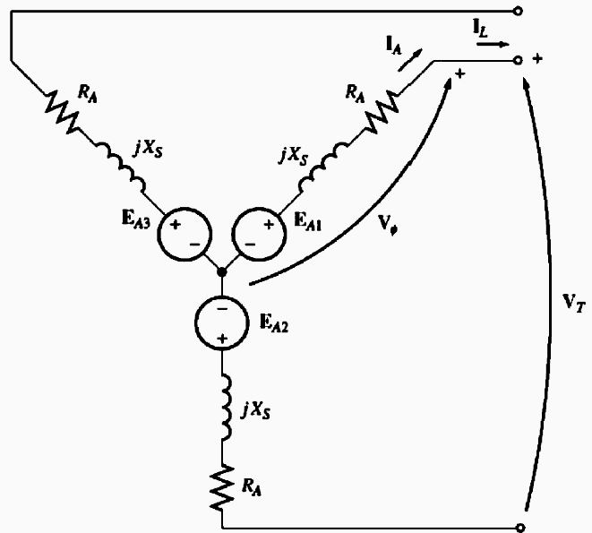
Class Activity 1:
A 200-kVA, 480-V, 50-Hz, Y-connected synchronous generator with a rated field current of 5 A was tested, and the following data were taken:
    V_{T,oc} at the rated I_{F} was measured to be 540 V.
    I_{L,sc} at the rated I_{F} was found to be 300 A.
    When a dc voltage of 10 V was applied to two of the terminals, a current of 25 A was measured.
Find the values of the armature resistance and the approximate synchronous reactance in ohms that would be used in the generator model at the rated conditions.
15

Slide 14
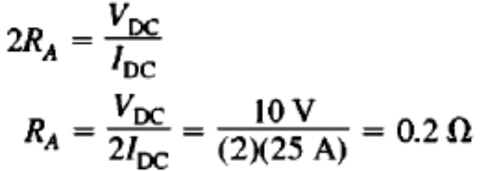
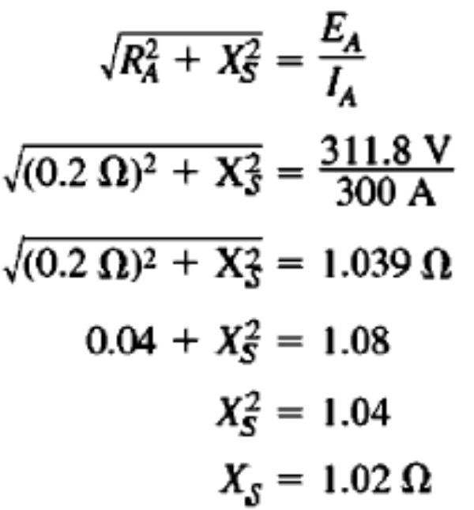
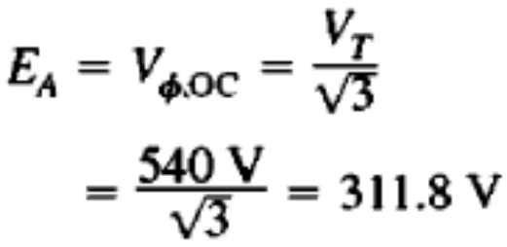
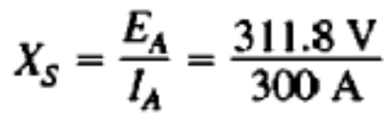

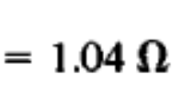
Solution
The generator is Y-connected, so the direct current in the resistance test flows through two windings. Therefore, the resistance is given by:
X_{S} can be calculated as
The internal generated voltage is
Ignoring R_{A}
The short-circuit current I_{A,sc} is
16

Slide 15
5.8: The Synchronous Generator Operating Alone

Slide 16
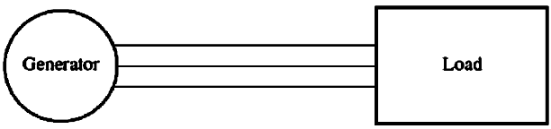
Synchronous Generator Operating Alone
The behavior of the synchronous generator under load varies greatly depending on the power factor of the load and on whether the generator is operating alone or in parallel with other synchronous generators.
We will study the generator operating alone with simplified phasor diagrams ignoring the effect of R_{A}.
The speed and the rotor flux of the generator is assumed to be constant.

Slide 17
Synchronous Generator Operating Alone
Understand the effect of load changes on a generator operating alone.
The speed of the generator ω is constant, and field current I_{F} is constant. Which means E_{A}= kΦω will remain constant.
Consider the three different types of loads connected, and analyze the effect of changes in the loads.

Slide 18
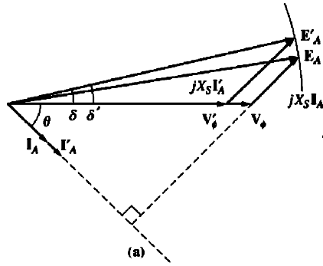
The Effect of Load Changes
Lagging Load
If lagging loads(+Q or inductive loads) are added to a generator, V_{Φ} and the terminal voltage V_{T} decreases significantly.

Slide 19
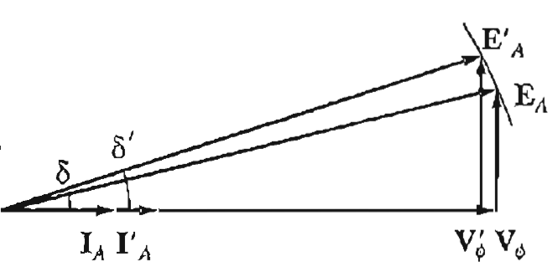
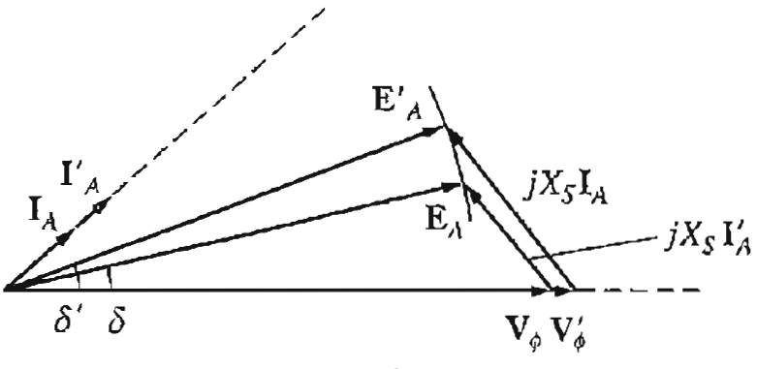
The Effect of Load Changes
If unity power factor loads are added to a generator, there is a slight decrease in the V_{Φ} and the terminal voltage V_{T}.
Unity Load
If leading load (-Q or capacitive load) are added to a generator, V_{Φ} and the terminal voltage V_{T} will rise
Leading Load
21

Slide 20
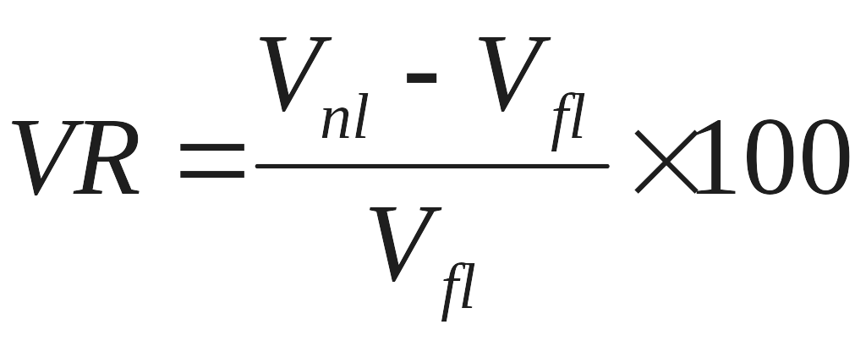
The Voltage Regulation
A convenient way to compare the voltage behavior of two generators is by their voltage regulation.
Voltage Regulation Under Various Load Conditions
Lagging PF | Large +ve VR
Unity PF | Small +ve VR
Leading PF | -ve VR

Slide 21
Maintaining Constant Terminal Voltage
It is desirable to keep the voltage supplied to the load constant even though the load varies.
This can be accomplished by controlling the flux of the machine.
Suppose that a lagging load is added to a generator. Then the terminal voltage will fall; to restore it to its previous level, decrease the field resistance R_{F}, which will increase the field current I_{F}. An increase in I_{F} increases the flux, which in turn increases E_{A}. An increase in E_{A} increases the terminal voltage.
The process can be reversed to decrease the terminal voltage of the generator.

Slide 22
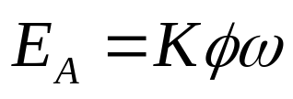
I. Decreasing the field resistance in the generator increases its field current.
2. An increase in the field current increases the flux in the machine.
3. An increase in the flux increases the internal generated voltage
4. An increase in E_{A}, increases V_{Φ} and the terminal voltage of the generator.

Slide 23
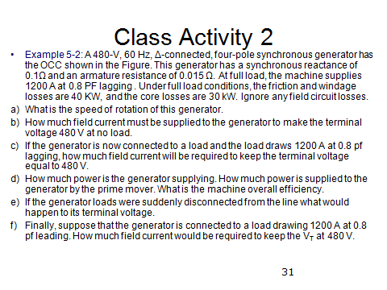

Slide 24
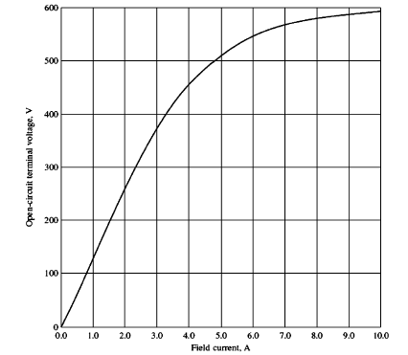
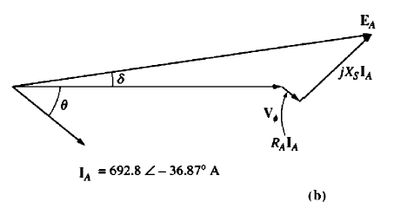

Slide 25
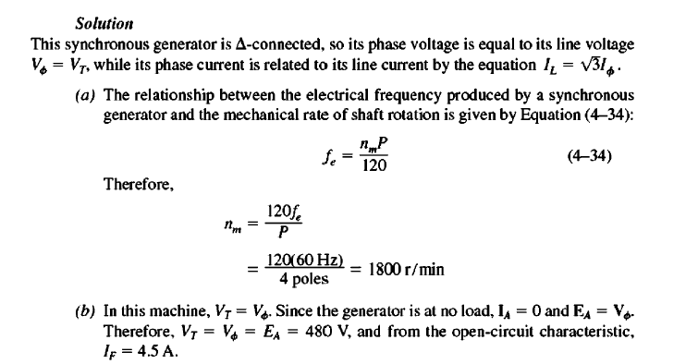

Slide 26
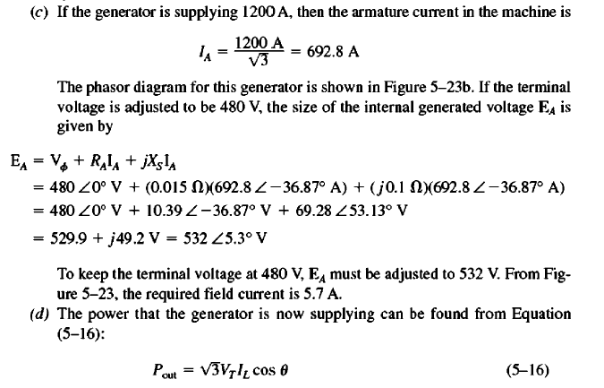

Slide 27
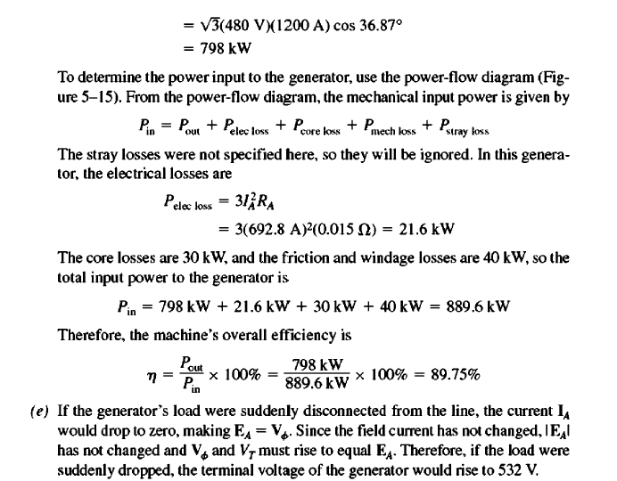

Slide 28
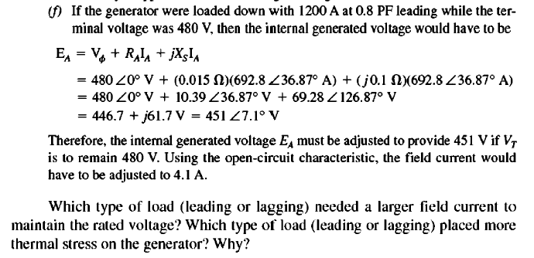

Slide 29
Generator Operation Analysis
Analyze the two cases through the phasor diagrams.
  If the load changes and field is kept constant, what happens to the terminal voltage, Example 5-3.
  How must the generator field current be adjusted to keep V_{T} constant as the load changes, Example 5-2.
Home Work

Slide 30

Conclusion
5.7: Measuring Synchronous Generator Model Parameters
5.8: The Synchronous Generator Operating Alone

