Slide 1

School of Electrical Engineering and Computer Science
Department of Electrical Engineering
EE-260 : Electrical Machines
Lecture#19
5.9: Parallel Operation of AC Generators
Text Book: Chapter 05 (Stephen J. Chapman 4th Ed)
Instructor: Ms Neelma Naz
Class: BEE 12 C/D

Slide 2
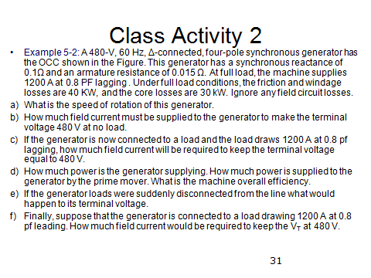

Slide 3
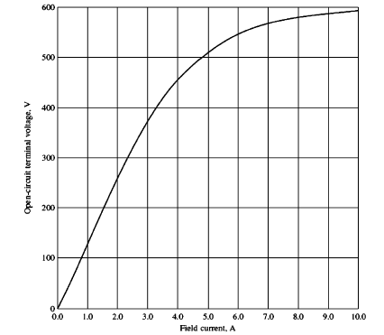
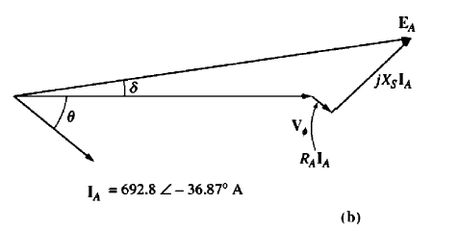

Slide 4
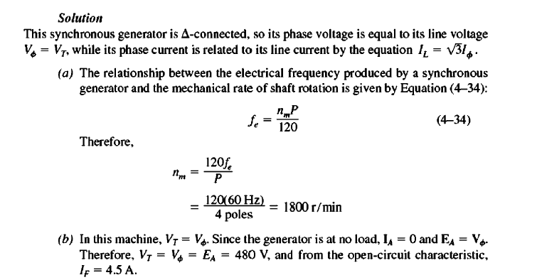

Slide 5
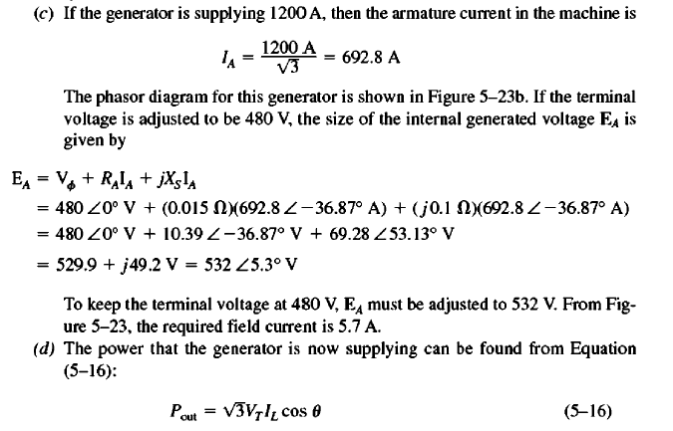

Slide 6
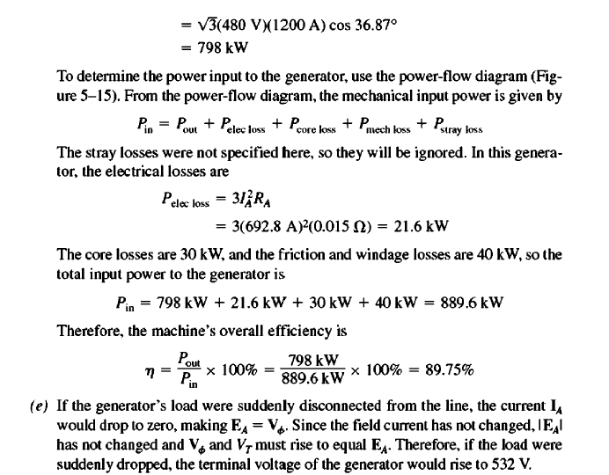

Slide 7
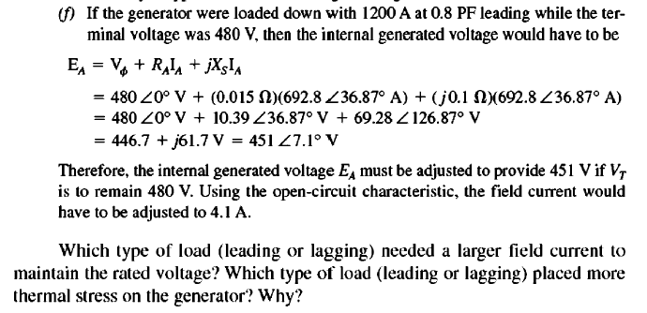

Slide 8
Generator Operation Analysis
Analyze the two cases through the phasor diagrams.
  If the load changes and field is kept constant, what happens to the terminal voltage, Example 5-3.
  How must the generator field current be adjusted to keep V_{T} constant as the load changes, Example 5-2.
Home Work

Slide 9
5.9: Parallel Operation of AC Generators

Slide 10
Parallel Operation of AC Generators
Practically, there is more than one generator operating in parallel to supply the power demand.
Advantages of Parallel Operation:
Several generators can supply bigger loads than one machine by itself.
High reliability of the power system, since failure of one out of many generators does not cause a total power loss to the load.
Allows removal of one or more of the generators for shut down and preventive maintenance.
High efficiency due to operation near full load.

Slide 11
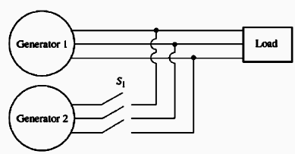
Conditions Required for Paralleling
Generator G1 is supplying power to a load, with another generator G2 about to be paralleled with G1 by closing switch S1.
What conditions must be met before the switch can be closed and the two generators connected together?

Slide 12
Conditions Required for Paralleling
The rms line voltages of the two generators must be equal. (Voltage adjustment by adjusting field current)
The two generators must have same phase sequence. (Induction motor and 3-light-bulb methods)
The phase angle must be the same.
The frequency of the two generator must be about the same.
a
Load
Generator 1
b
c
Switch
a/
Generator 2
b/
c/

Slide 13
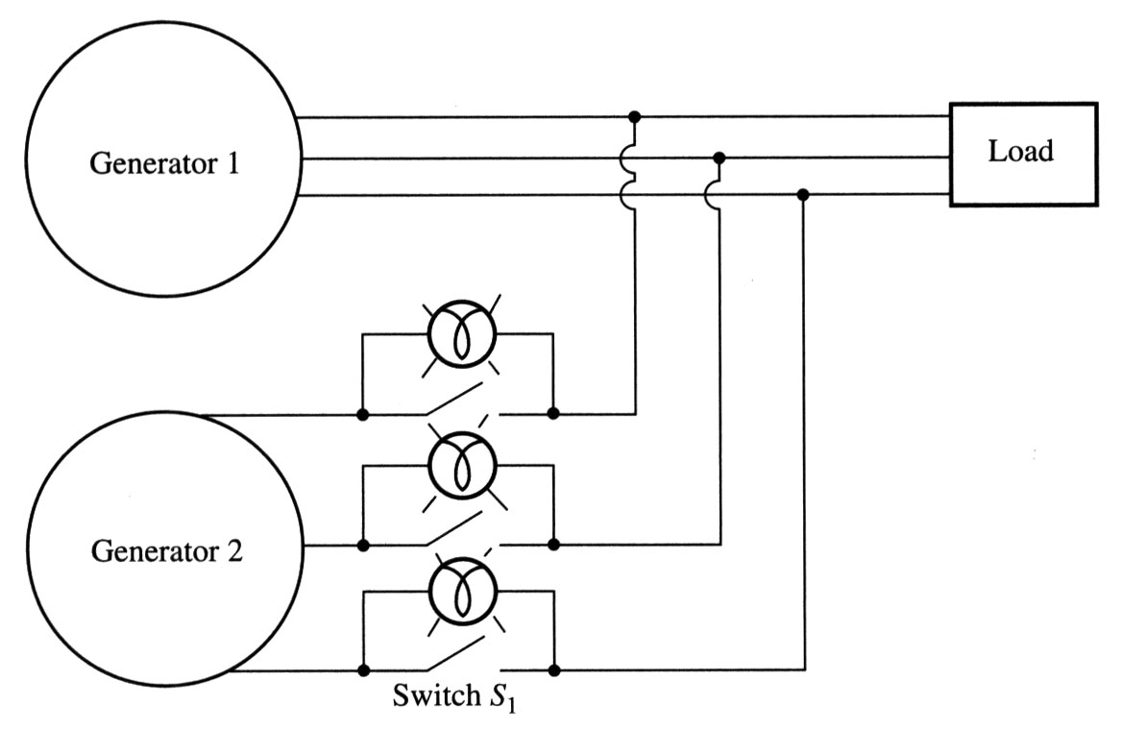
General procedure for paralleling generators
When connecting the generator G₂ to the running system, the following steps should be taken:
Adjust the field current of the oncoming generator to make its terminal voltage equal to the line voltage of the system (use a voltmeter).
Compare the phase sequences of the oncoming generator and the running system. This can be done by different ways:
  Connect a small induction motor to the terminals of the oncoming generator and then to the terminals of the running system. If the motor rotates in the same direction, the phase sequence is the same;
2) Connect three light bulbs across the open terminals of the switch. As the phase changes between the two generators, light bulbs get brighter (large phase difference) or dimmer (small phase difference). If all three bulbs get bright and dark together, both generators have the same phase sequences.

Slide 14
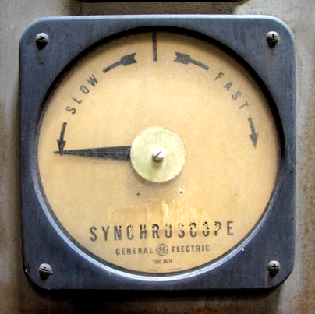
General procedure for paralleling generators
If phase sequences are different, two of the conductors on the oncoming
generator must be reversed.
3. The frequency of the oncoming generator is adjusted to be slightly higher than
the system’s frequency.
4. Turn on the switch connecting G₂ to the system when phase angles are equal.
The simplest way to determine the moment when two generators are in phase is by observing the same three light bulbs. When all three lights go out, the voltage across them is zero and, therefore, machines are in phase.
A more accurate way is to use a synchroscope – a meter measuring the difference in phase angles between two a phases. However, a synchroscope does not check the phase sequence since it only measures the phase difference in one phase.
The whole process is usually automated…

Slide 15
Frequency-Power & Voltage-Reactive Power Characteristics of a Synchronous Generator

Slide 16
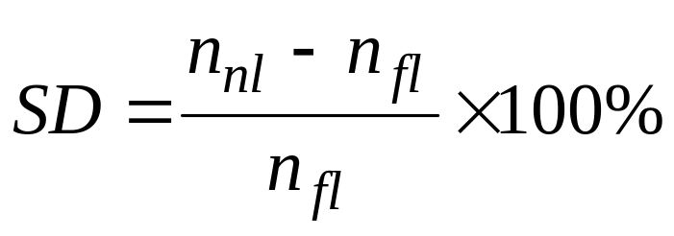
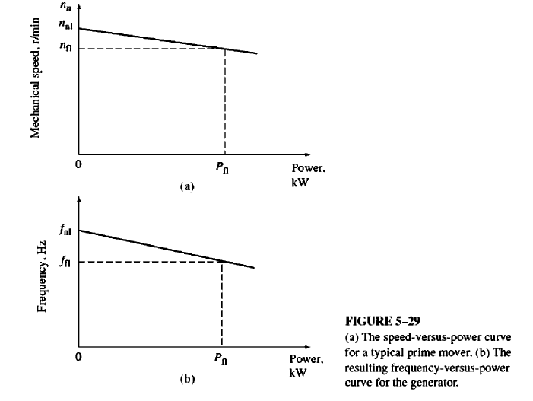
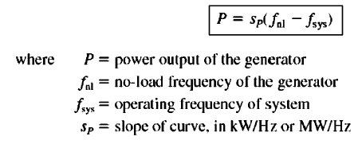
Frequency-Power & Voltage-Reactive Power Characteristics of a Synchronous Generator
The Speed droop (SD) of a prime mover is defined by the equation.
Most generator prime movers
have a speed droop of 2-4%.

Slide 17
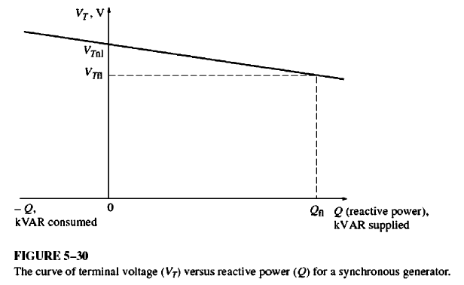
Frequency-Power & Voltage-Reactive Power Characteristics of a Synchronous Generator

Slide 18
Operation of generators in parallel with large power systems

Slide 19
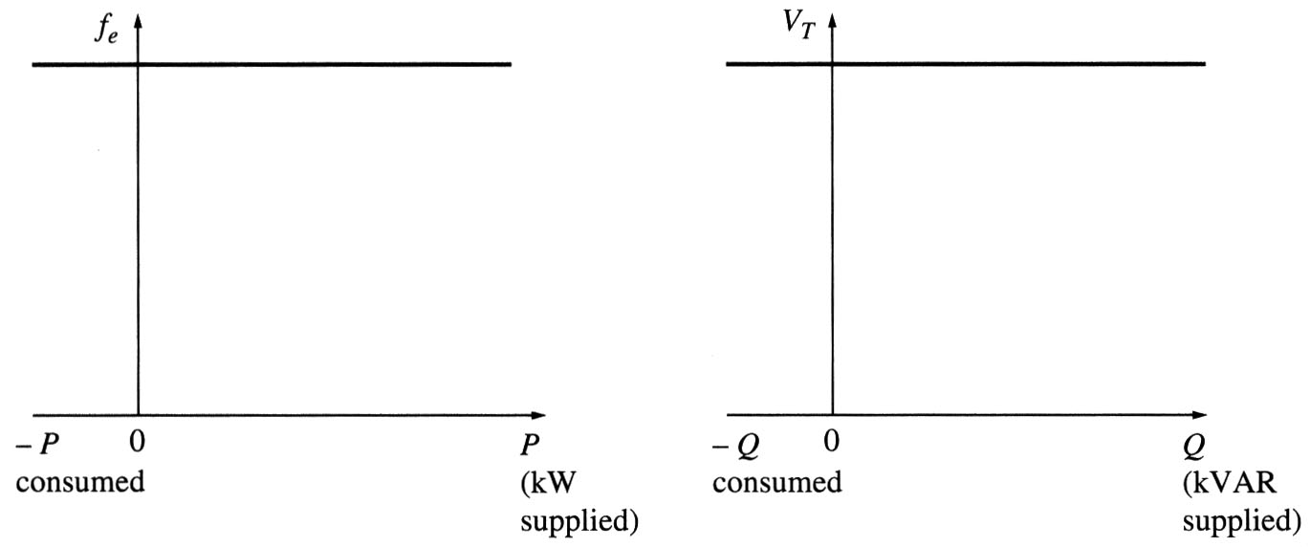
Operation of generators in parallel with large power systems
Often, when a synchronous generator is added to a power system, that system is so large that one additional generator does not cause observable changes to the system. A concept of an infinite bus is used to characterize such power systems.
An infinite bus is a power system that is so large that its voltage and frequency do not vary regardless of how much real and reactive power is drawn from or supplied to it. The power-frequency and reactive power-voltage characteristics are:

Slide 20
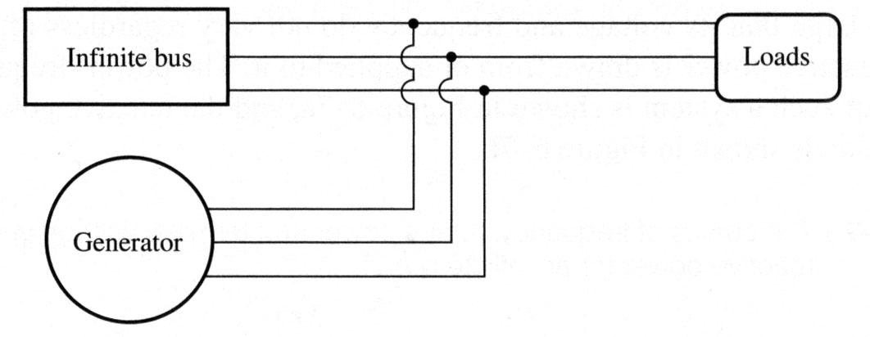
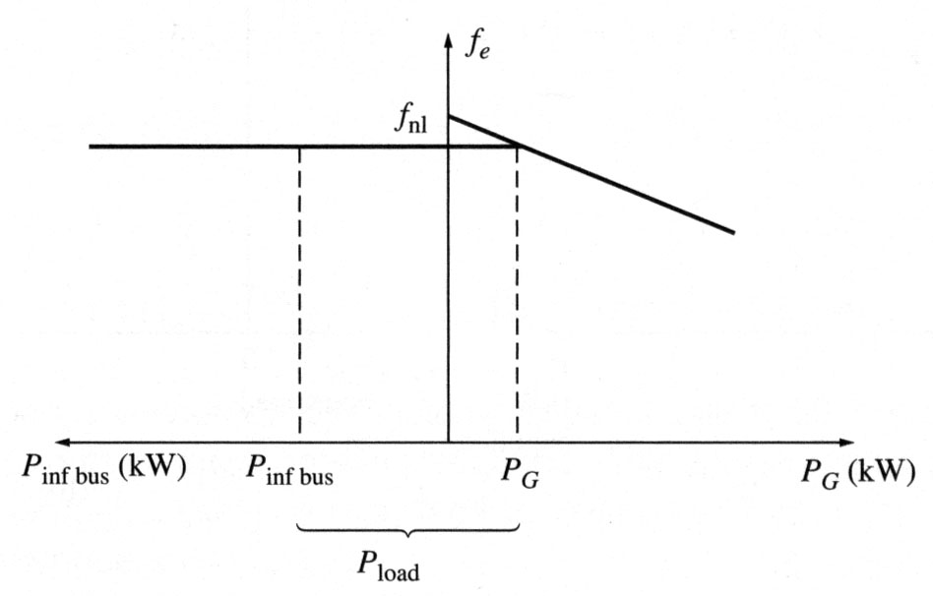
Operation of generators in parallel with large power systems
Consider adding a generator to an infinite bus supplying a load.
The frequency and terminal voltage of all machines must be the same. Therefore, their power-frequency and reactive power-voltage characteristics can be plotted with a common vertical axis.
Such plots are called sometimes as house diagrams.

Slide 21
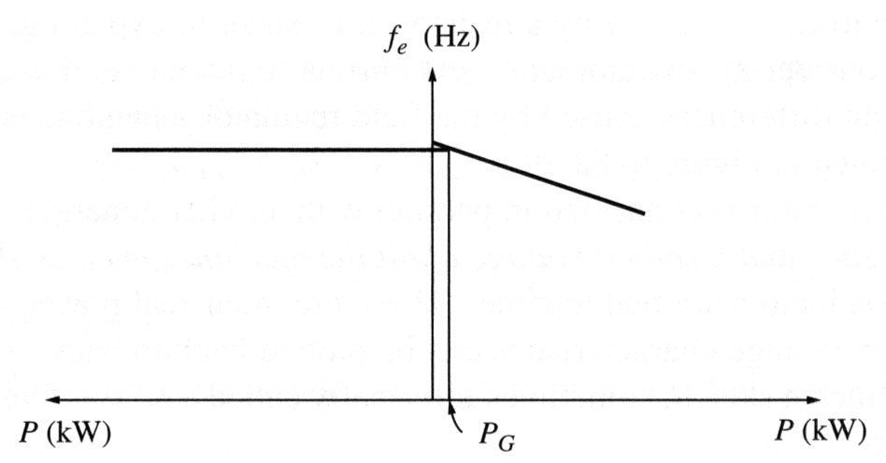
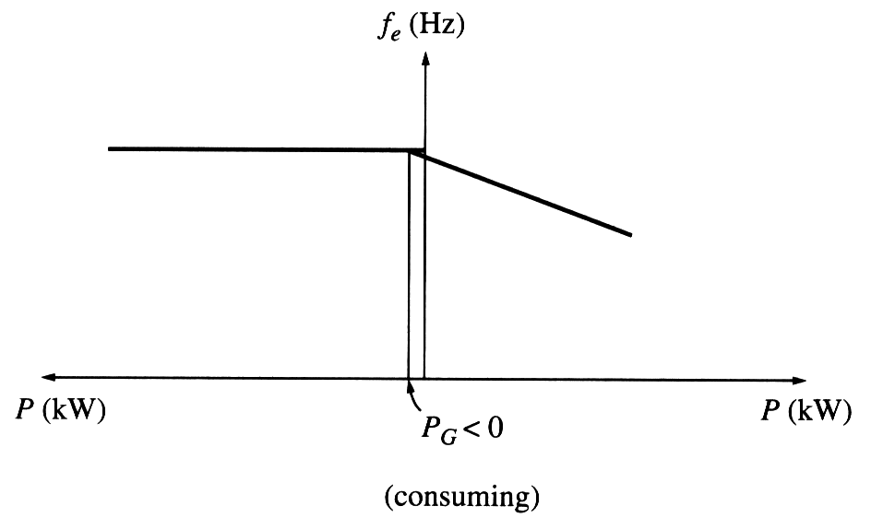
Operation of generators in parallel with large power systems
If the no-load frequency of the oncoming generator is slightly higher than the system’s frequency, the generator will be “floating” on the line supplying a small amount of real power and little or no reactive power.
If the no-load frequency of the oncoming generator is slightly lower than the system’s frequency, the generator will supply a negative power to the system: the generator actually consumes energy acting as a motor!
Many generators have circuitry automatically disconnecting them from the line when they start consuming energy.

Slide 22
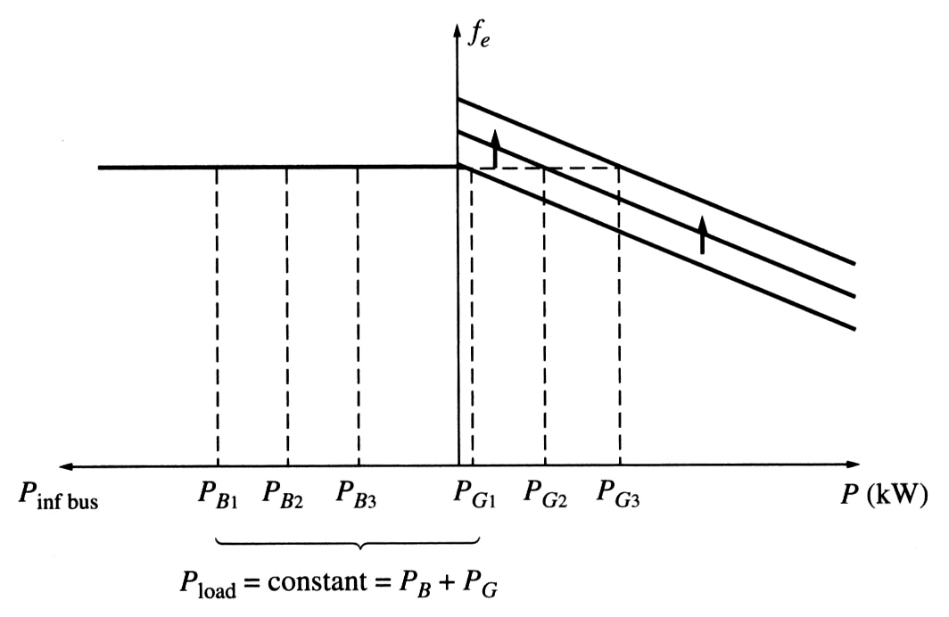
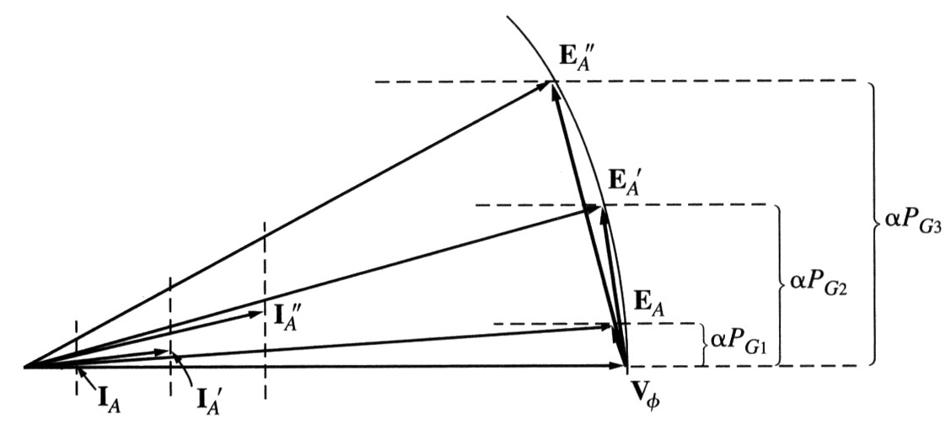
Operation of generators in parallel with large power systems
If the frequency of the generator is increased after it is connected to the infinite bus, the system frequency cannot change and the power supplied by the generator increases.
Notice that when E_{A} stays constant (field current and speed are the same), E_{A}sinδ (which is proportional to the output power if V_{T} is constant) increases.
If the frequency of the generator is further increased, power output from the generator will be increased and at some point it may exceed the power consumed by the load. This extra power will be consumed by the infinite bus.

Slide 23
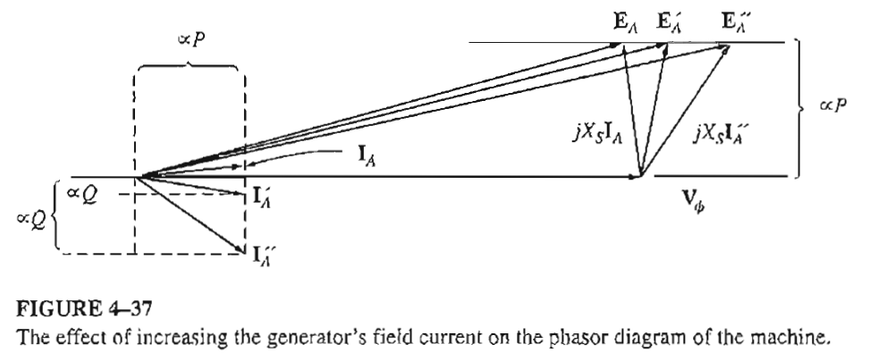
Operation of generators in parallel with large power systems

Slide 24
Operation of generators in parallel with large power systems
After the real power of the generator is adjusted to the desired value, the generator will be operating at a slightly leading PF acting as a capacitor that consumes reactive power. Adjusting the field current of the machine, it is possible to make it to supply reactive power Q to the system.
Summarizing, when the generator is operating in parallel to an infinite bus:
The frequency and terminal voltage of the generator are controlled by the system to which it is connected.
The governor set points of the generator control the real power supplied by the generator to the system.
The generator’s field current controls the reactive power supplied by the generator to the system.

Slide 25

Conclusion
5.8: The Synchronous Generator Operating Alone
5.9: Parallel Operation of AC Generators

