Slide 1

School of Electrical Engineering and Computer Science
Department of Electrical Engineering
EE-260 : Electrical Machines
Lecture#02
Text Book: Chapter 01 (Stephen J. Chapman 4th Ed)
Instructor: Neelma Naz
Class: BEE 12 C/D

Slide 2
Topics to be Covered
Motivation
Fundamentals of Rotational Motion
Production of Magnetic Field
Magnetic Circuits

Slide 3
Motivation
Why do we talk about machines and not motors or generators?
Why is this course important?
Many Applications
Over 30 machines in house - where?
Industry
Transportation
Positioning
Generation

Slide 4
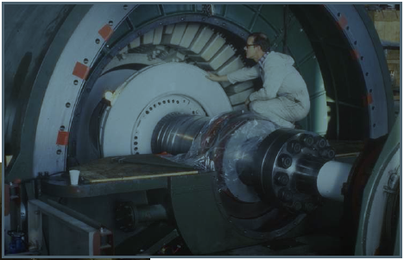
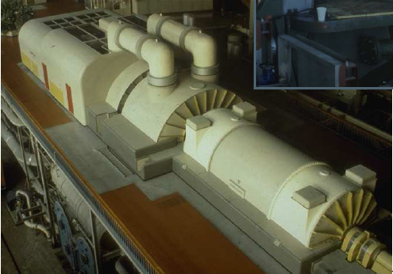
GENERATION

Slide 5
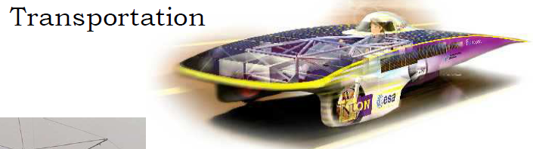
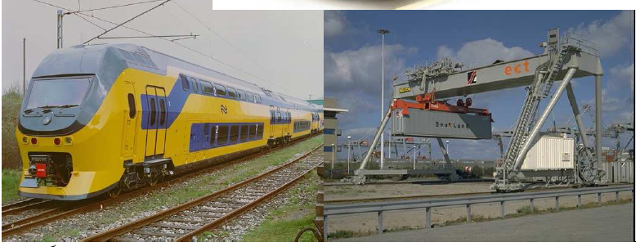

Slide 6
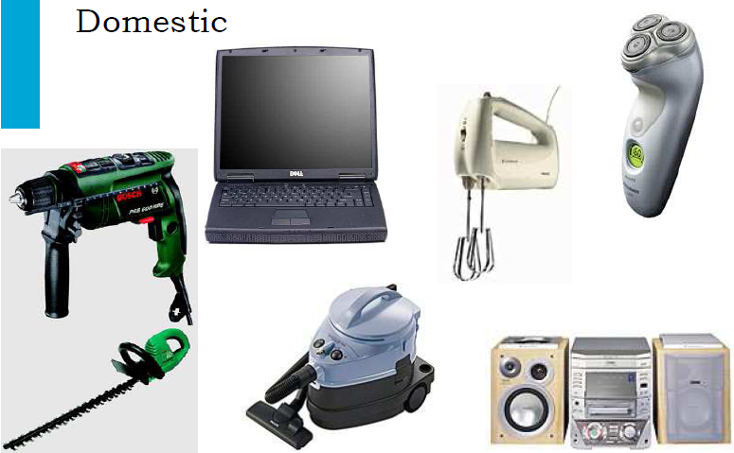

Slide 7
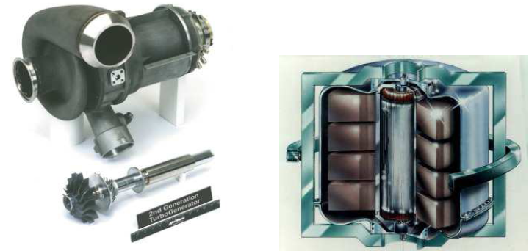
High speed generator and flywheel
for hybrid vehicles
http://www.explainthatstuff.com/flywheels.html

Slide 8
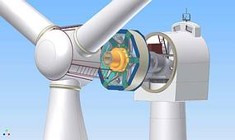
Generators for (direct-drive) wind
turbines
http://www.setec-dresden.com/index.php?id=226

Slide 9
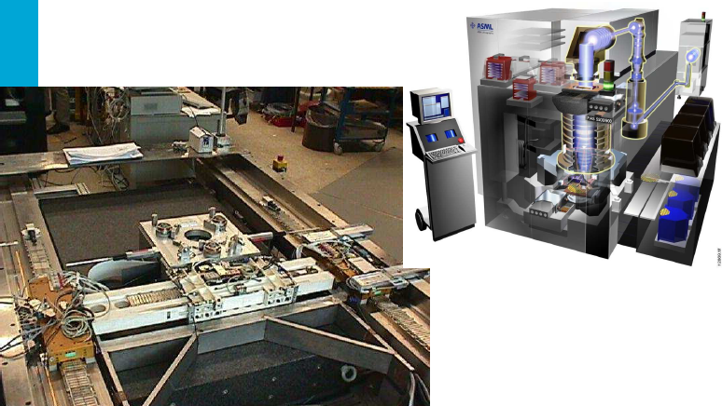
Actuators for wafer steppers
http://www.orientalmotor.com/applications/pin-lifter.html

Slide 10
Extremely wide variety
• Power levels 10^-6 – 10^9 W (watch – power station)
• Torque levels 10^-9 – 10^7 Nm
• Speed range 10 rpm – 300.000 rpm (wind turbine – spindle)
• Positioning accuracies to below 1 nm = 10^-9 m
• Different types

Slide 11
Electrical Machines
Mechanical Energy
Electrical Machine
Electrical Energy
Electrical Energy
Mechanical Energy
motor
Generator
Transformer
Electrical Energy
at another
voltage level
Electrical Energy
at one voltage level

Slide 12
Transformer
Transformer changes Electrical Energy from one voltage level to Electrical Energy at another voltage level, depending on the action of a magnetic field
Example:
  Generators produce low voltage, typically 11, 13 or 15 KV.
  Step up the voltage for transmission, typically 110, 220, 500 or even 700 KV.
  Close to the city step it down to 11 kV and finally 415 V or 220 V.

Slide 13
Why do we step the voltage up at the generation
and then
step it down close to the distribution
???

Slide 14
Transformer, Generator, and Motor
The principle for operation of transformers and machines is through the magnetic field. Therefore, we study them together.
Why to use Generators?
    Electric Power is clean and efficient energy that is easy to transmit over long distance.
Why to use Motors?
    It does not need constant ventilation and fuel like internal combustion engine, environment friendly.
Why transformers?
    Reduce energy loss between point of generation and point of use of electric power.

Slide 15
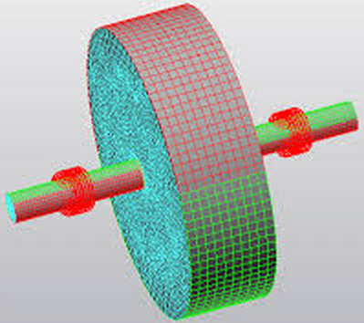
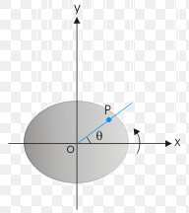
Fundamentals of Rotational Motion
Rotational motion
  All the electrical machines rotate about an axis called SHAFT of the machine
  This rotation is called +ve
  if it is Counter Clock Wise
  and –ve if it is Clock Wise.
Angular position θ
  It is object’s angle w.r.t. a reference point, similar to distance in linear motion.

Slide 16
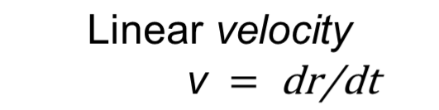
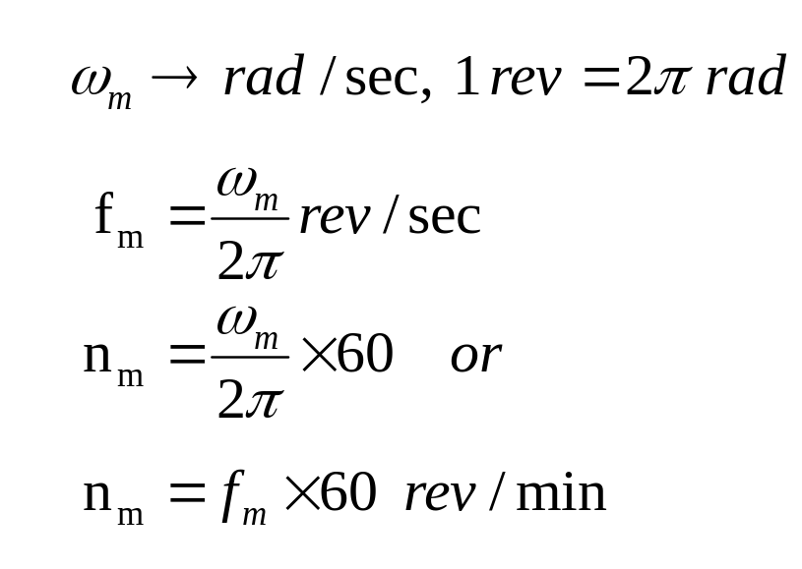
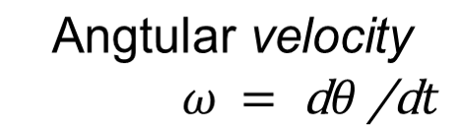


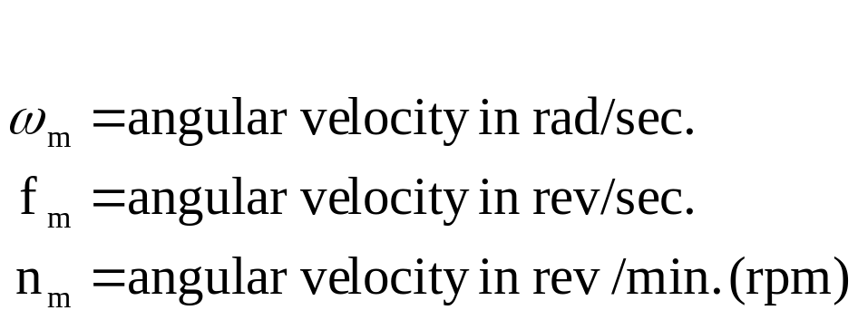
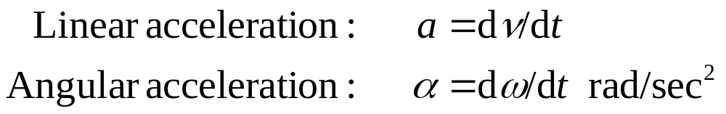
Angular Velocity ω and Angular Acceleration α
angular

Slide 17
Torque, τ
In linear motion when force increases the velocity will increase.
In angular motion when Torque increases the angular velocity ω increases.
The greater the torque on the object, the more rapidly it will move.
Torque can be called as “Twisting Force” on an object.

Slide 18
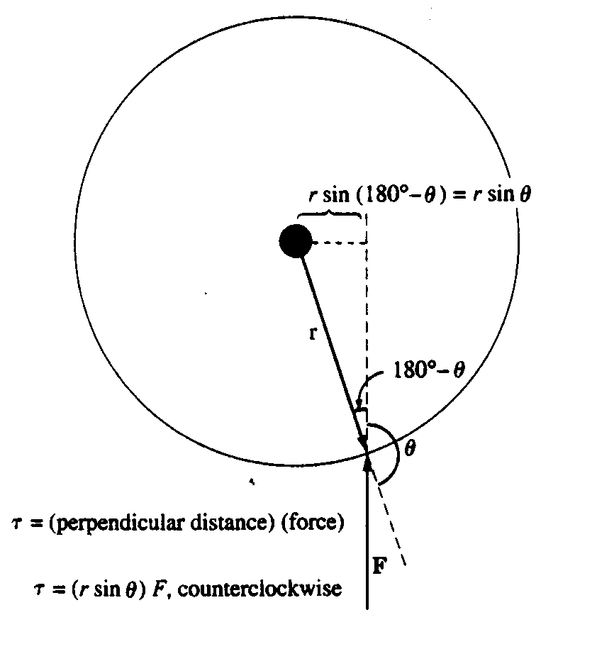
Torque τ
If line of action passes to the right or left of axis, the ball will rotate.
τ = (force applied) x (perpendicular distance)
τ = F r sin θ
= r F sin θ
Units: (N-m) or (lb- feet)

Slide 19
Newton Law of Motion
In Linear motion: F = ma
  F: Net force applied to the object (lb/Newton)
  m: Mass of the object (Slug/kg)
  a : Resulting acceleration (ft/sec² or m/sec²)
In Angular motion τ = jα
  τ: Net torque applied (N-m/lb-ft)
  J: Moment of inertia (kg-m²/slug-ft²)
  α: Angular acceleration (rad/sec²)

Slide 20
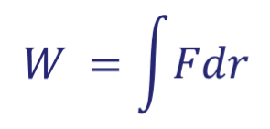

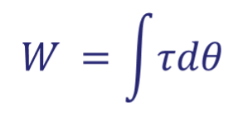

Work & Power
In linear motion work is application of a force through a distance
If the force is collinear with direction of motion
In angular motion work is application of torque through an angle.
If torque is constant,

Slide 21
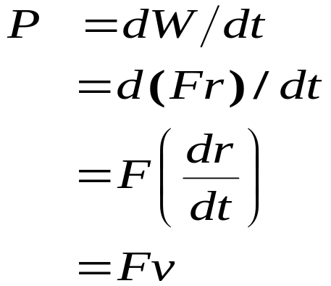
Work & Power
Rate of change of work is power.
Units: joules/sec (watts) or
foot lb/sec, or Horse Power (HP)

Slide 22
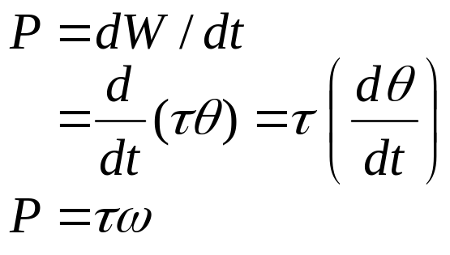
Power
For constant torque, the power at the shaft of the machine is given by:
Torque is commonly measured in Newton-meter or pound-feet,
speed in revolution per minute (rpm),
and power either in watts or in horse power.

Slide 23
The fundamental mechanism by which energy is converted from one form to another in motors, generators, and transformers
THE MAGNETIC FIELDS
The four basic principles
A current-carrying wire produces a magnetic field in the area around it.
A time-changing magnetic field induces a voltage in a coil of wire if it passes through that coil.
A current-carrying wire in the presence of a magnetic field has a force induced on it.
A moving wire in the presence of a magnetic field has a voltage induced in it.
transformer action
motor action
generator action

Slide 24
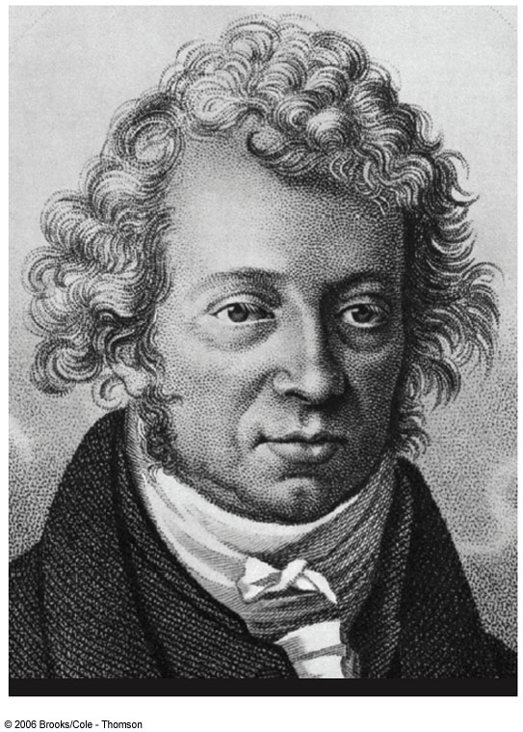
André-Marie Ampère
1775 – 1836
Credited with the discovery of electromagnetism
  Relationship between electric currents and magnetic fields

Slide 25
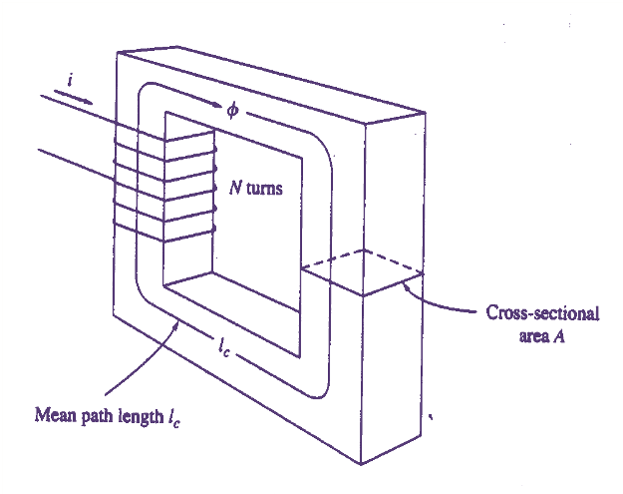
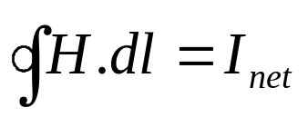
1. Production of Magnetic Field
Ampere’s Law: is the basic law governing the production of a magnetic field by a current.
H is the magnetic field intensity produced by the current I_{net}
I_{net} is the net current passing within the path of integration
The magnitude of magnetic field intensity H applied over the entire length l is equal to the net current applied.
Notes:
A vector quantity indicating the ability of a magnetic field to exert a force on moving electric charges. It is equal to the magnetic fluxdensity divided by the magnetic permeability of the space where the field exists. It is measured in amperes per meter. Also calledmagnetic intensity.

Slide 26
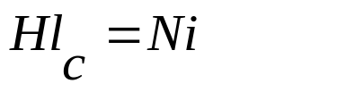
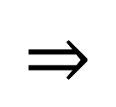
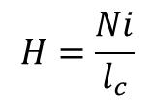
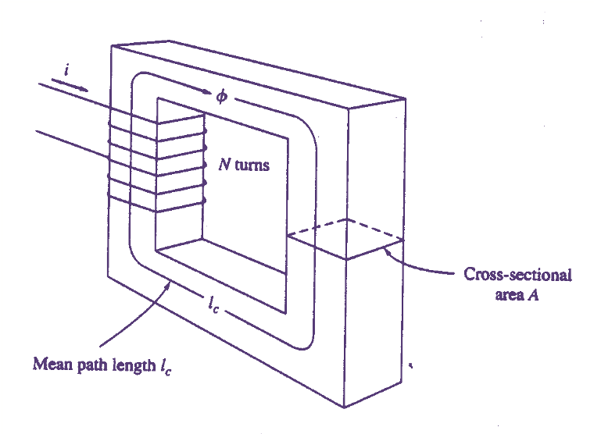
1. Production of Magnetic Field
Since the coil of wire cuts the path of integration N times while carrying current i, the Ampere's law can be written as:
The magnetic field intensity H is a measure of the "effort" that a
current is putting into the establishment of a magnetic field
For a rectangular core the path of integration in the Ampere’s law is the mean path length of core.

Slide 27
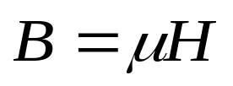
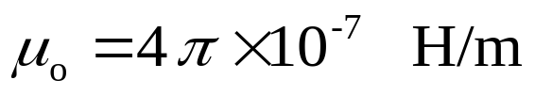
1. Production of Magnetic Field
The strength of the magnetic field flux produced in the core also depends on the material of the core?
Magnetic flux density= (permeability of the material)
x (magnetic field intensity)
H = magnetic field intensity
µ = magnetic permeability of material
B = resulting magnetic flux density
{ampere-turns per meter}
{henrys per meter}
{webers per m², or teslas (T)}
µ : is the relative ease of establishing a magnetic field in a given material
H : is the effort exerted by the current to establish a magnetic field
The permeability of free space is:

Slide 28
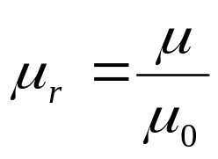
1. Production of Magnetic Field
Relative permeability: It is the permeability of any other material compared to free space.
Relative permeability helps to compare material’s magnetizability.
For steel μ_{r} varies from 2000 to 6000. what does it mean?
High permeability of iron (core material) implies flux will tend to flow through the iron and will not go out.
Notes:
? For a given amount of current, 2000 to 6000 times more flux is established in a piece of steel than in corresponding area of air.

Slide 29
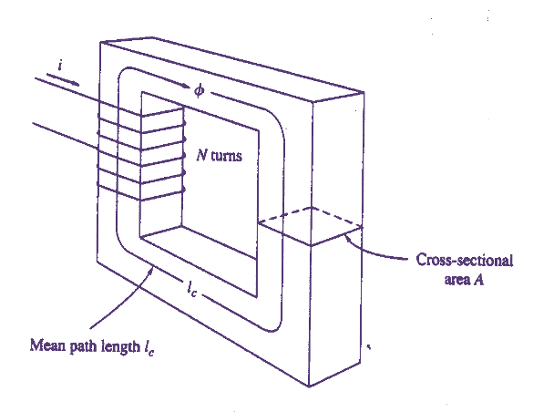
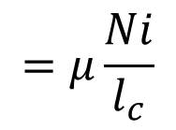
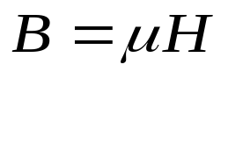
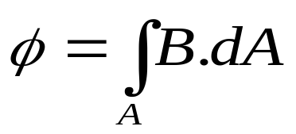
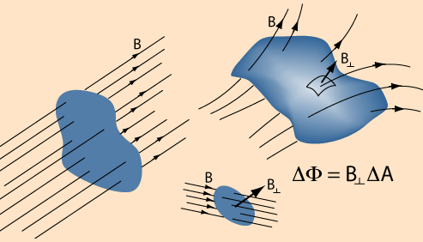

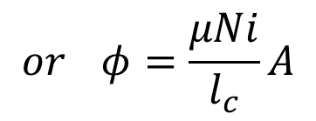
1. Production of Magnetic Field
For the given core the flux density is given by:
Total flux due to this flux density can be written as:
If flux density vector B is perpendicular
to a plane of area A and B is constant then

Slide 30
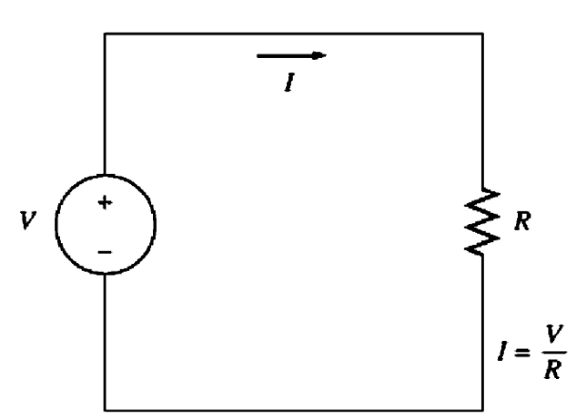
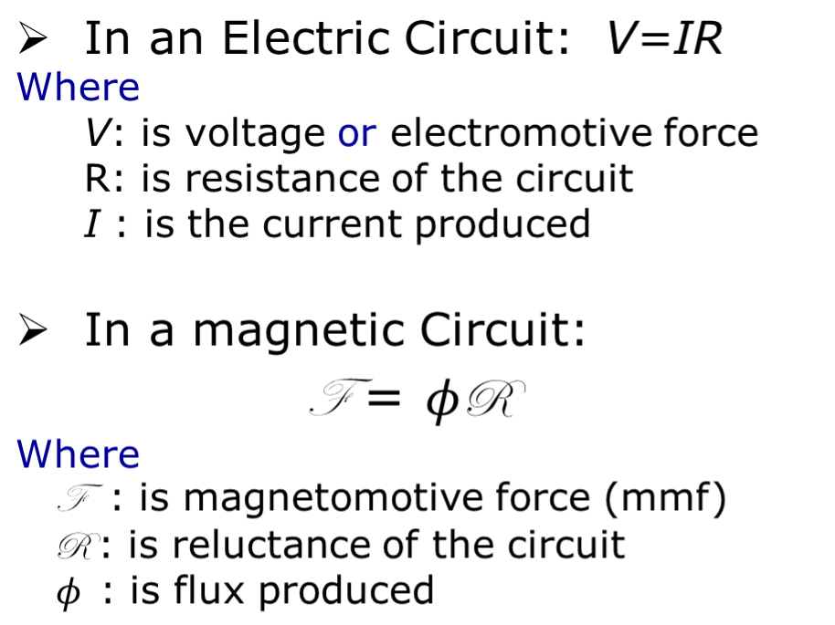
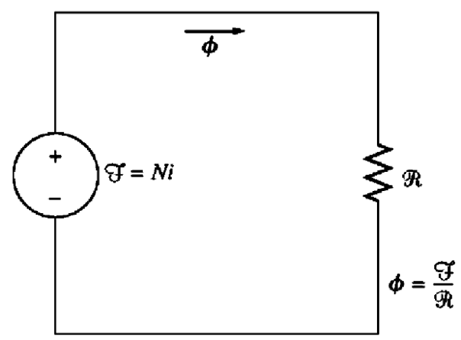

2. Magnetic Circuits
The +ve end of the mmf source is the end from which the flux exits, and the -ve end of the mmf source is the end at which the flux reenters.
Notes:
The mmf of magnetic circuit is equal to the effective current applied to the core.
Magnetomotive force, also known as magnetic potential, is the property of certain substances or phenomena that gives rise to magnetic field s. Magnetomotive force is analogous to electromotive force or voltage in electricity.

Slide 31
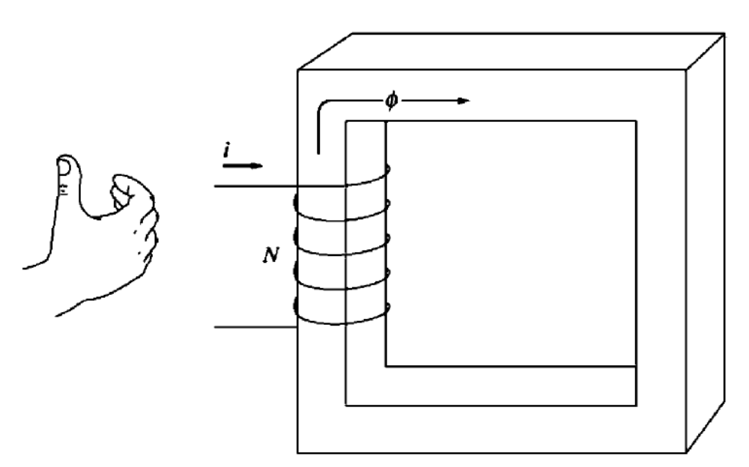
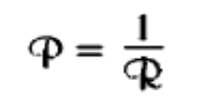

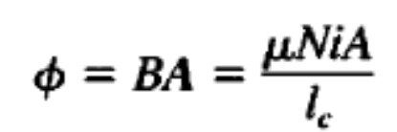
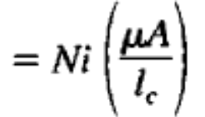
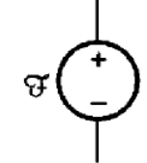
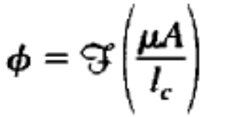
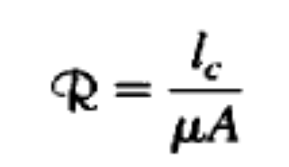
2. Magnetic Circuits
Magnetic analog of conductance is permeance P.
Reluctance of the core
Right hand Rule: If the fingers of the right hand curl in the direction of the current flow in a coil of wire then the thumb will point in the direction of the flux i.e., +ve mmf.
F R F R F R F R F R

Slide 32

Conclusion
Production of Magnetic Field
Magnetic Circuits

