Slide 1

School of Electrical Engineering and Computer Science
Department of Electrical Engineering
EE-260 : Electrical Machines
Lecture#20
5.9: Parallel Operation of AC Generators
Text Book: Chapter 05 (Stephen J. Chapman 4th Ed)
Instructor: Ms Neelma Naz
Class: BEE 12 C/D

Slide 2
5.9: Parallel Operation of AC Generators

Slide 3
Parallel Operation of AC Generators
Practically, there is more than one generator operating in parallel to supply the power demand.
Advantages of Parallel Operation:
Several generators can supply bigger loads than one machine by itself.
High reliability of the power system, since failure of one out of many generators does not cause a total power loss to the load.
Allows removal of one or more of the generators for shut down and preventive maintenance.
High efficiency due to operation near full load.

Slide 4
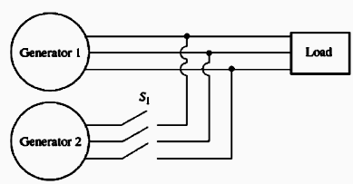
Conditions Required for Paralleling
Generator G1 is supplying power to a load, with another generator G2 about to be paralleled with G1 by closing switch S1.
What conditions must be met before the switch can be closed and the two generators connected together?

Slide 5
Conditions Required for Paralleling
The rms line voltages of the two generators must be equal. (Voltage adjustment by adjusting field current)
The two generators must have same phase sequence. (Induction motor and 3-light-bulb methods)
The phase angle must be the same.
The frequency of the two generator must be about the same.
a
Load
Generator 1
b
c
Switch
a/
Generator 2
b/
c/

Slide 6
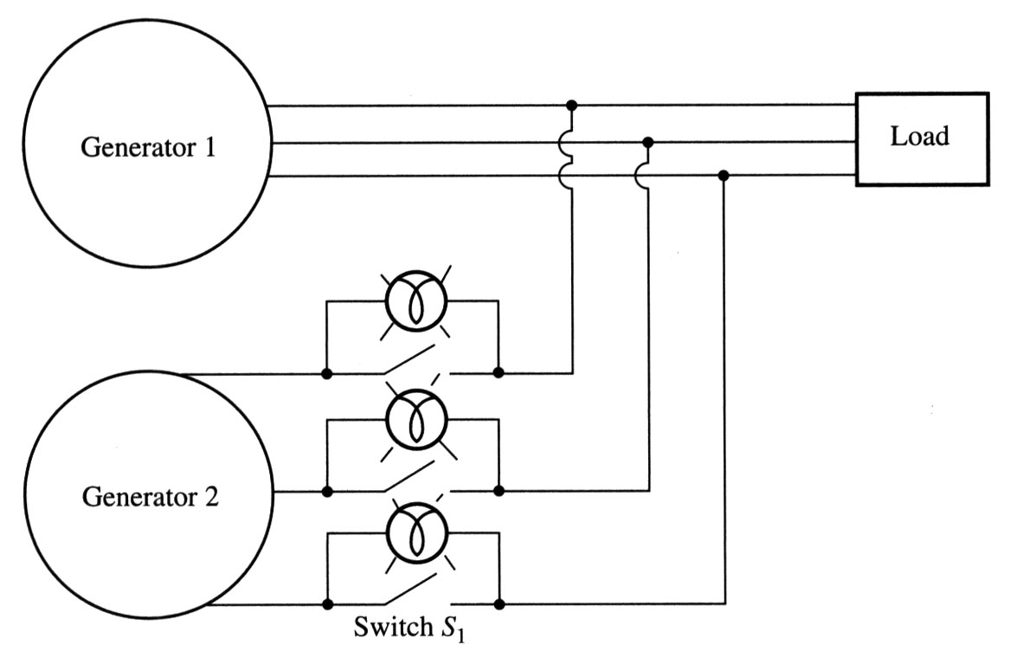
General procedure for paralleling generators
When connecting the generator G₂ to the running system, the following steps should be taken:
Adjust the field current of the oncoming generator to make its terminal voltage equal to the line voltage of the system (use a voltmeter).
Compare the phase sequences of the oncoming generator and the running system. This can be done by different ways:
  Connect a small induction motor to the terminals of the oncoming generator and then to the terminals of the running system. If the motor rotates in the same direction, the phase sequence is the same;
2) Connect three light bulbs across the open terminals of the switch. As the phase changes between the two generators, light bulbs get brighter (large phase difference) or dimmer (small phase difference). If all three bulbs get bright and dark together, both generators have the same phase sequences.

Slide 7
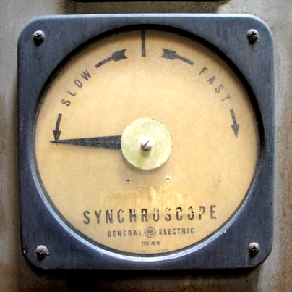
General procedure for paralleling generators
If phase sequences are different, two of the conductors on the oncoming
generator must be reversed.
3. The frequency of the oncoming generator is adjusted to be slightly higher than
the system’s frequency.
4. Turn on the switch connecting G₂ to the system when phase angles are equal.
The simplest way to determine the moment when two generators are in phase is by observing the same three light bulbs. When all three lights go out, the voltage across them is zero and, therefore, machines are in phase.
A more accurate way is to use a synchroscope – a meter measuring the difference in phase angles between two a phases. However, a synchroscope does not check the phase sequence since it only measures the phase difference in one phase.
The whole process is usually automated…

Slide 8
Frequency-Power & Voltage-Reactive Power Characteristics of a Synchronous Generator

Slide 9
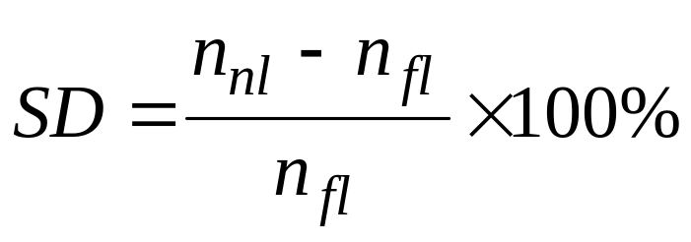
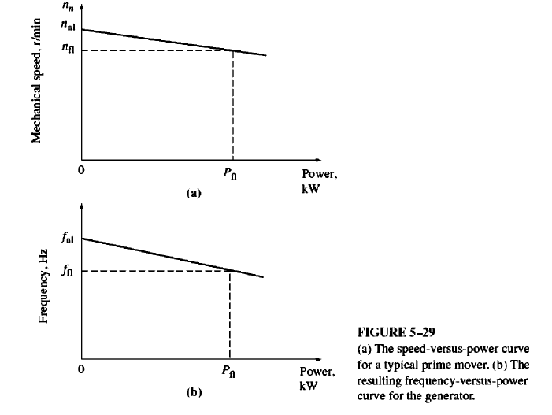
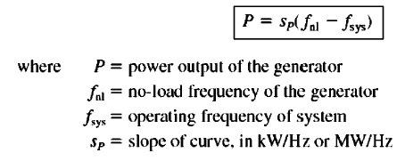
Frequency-Power & Voltage-Reactive Power Characteristics of a Synchronous Generator
The Speed droop (SD) of a prime mover is defined by the equation.
Most generator prime movers
have a speed droop of 2-4%.

Slide 10
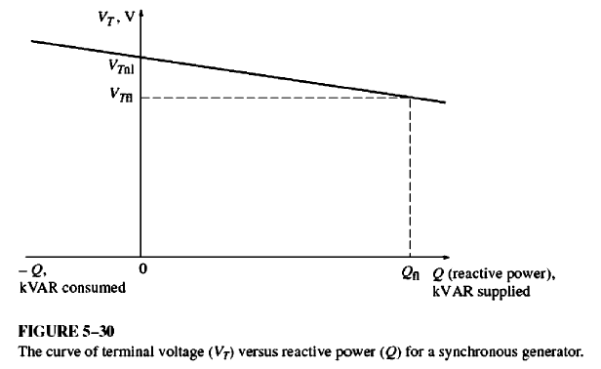
Frequency-Power & Voltage-Reactive Power Characteristics of a Synchronous Generator

Slide 11
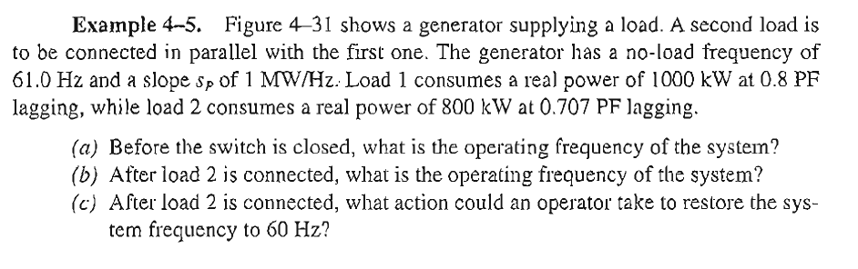
Class Activity

Slide 12
Operation of generators in parallel with large power systems

Slide 13
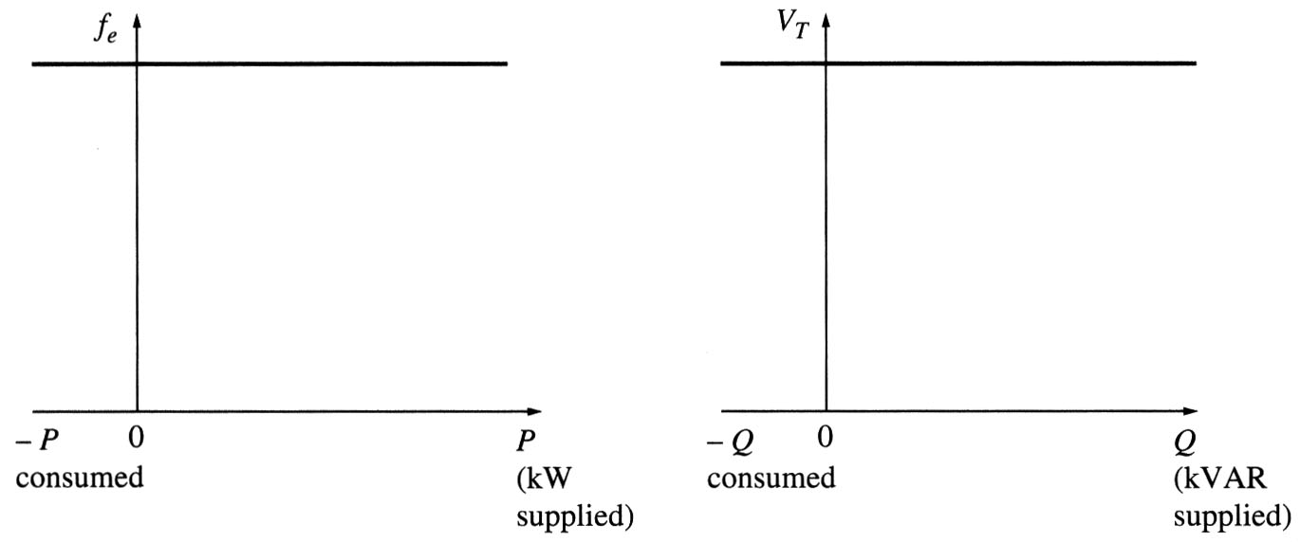
Operation of generators in parallel with large power systems
Often, when a synchronous generator is added to a power system, that system is so large that one additional generator does not cause observable changes to the system. A concept of an infinite bus is used to characterize such power systems.
An infinite bus is a power system that is so large that its voltage and frequency do not vary regardless of how much real and reactive power is drawn from or supplied to it. The power-frequency and reactive power-voltage characteristics are:

Slide 14
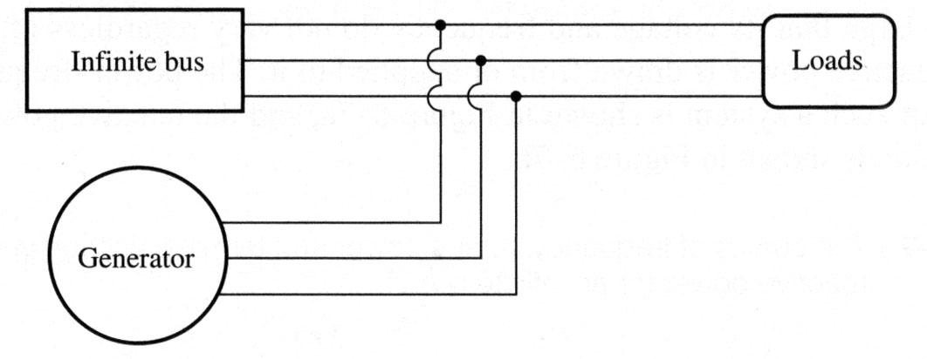
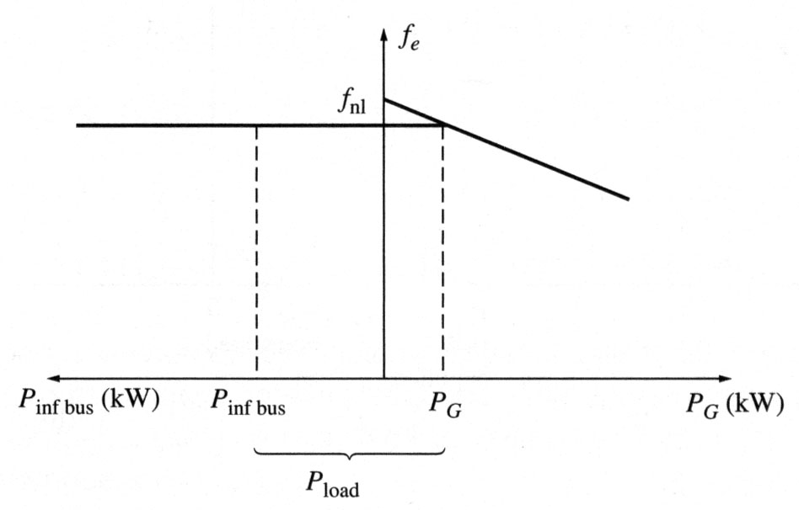
Operation of generators in parallel with large power systems
Consider adding a generator to an infinite bus supplying a load.
The frequency and terminal voltage of all machines must be the same. Therefore, their power-frequency and reactive power-voltage characteristics can be plotted with a common vertical axis.
Such plots are called sometimes as house diagrams.

Slide 15
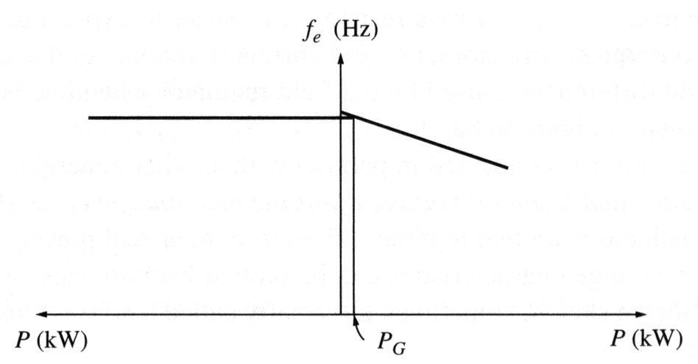
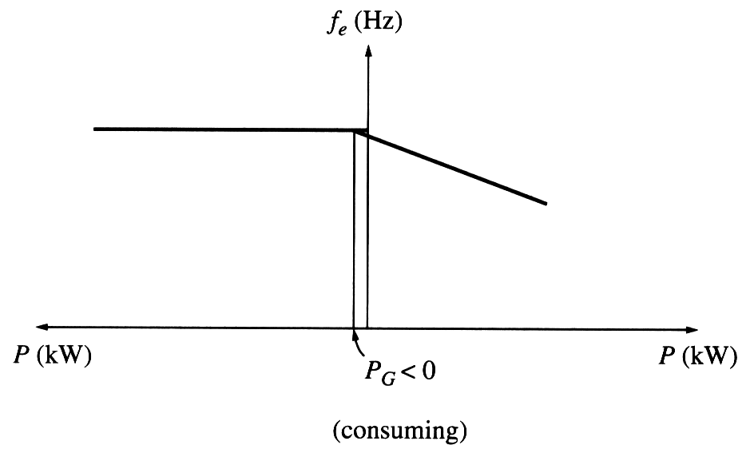
Operation of generators in parallel with large power systems
If the no-load frequency of the oncoming generator is slightly higher than the system’s frequency, the generator will be “floating” on the line supplying a small amount of real power and little or no reactive power.
If the no-load frequency of the oncoming generator is slightly lower than the system’s frequency, the generator will supply a negative power to the system: the generator actually consumes energy acting as a motor!
Many generators have circuitry automatically disconnecting them from the line when they start consuming energy.

Slide 16
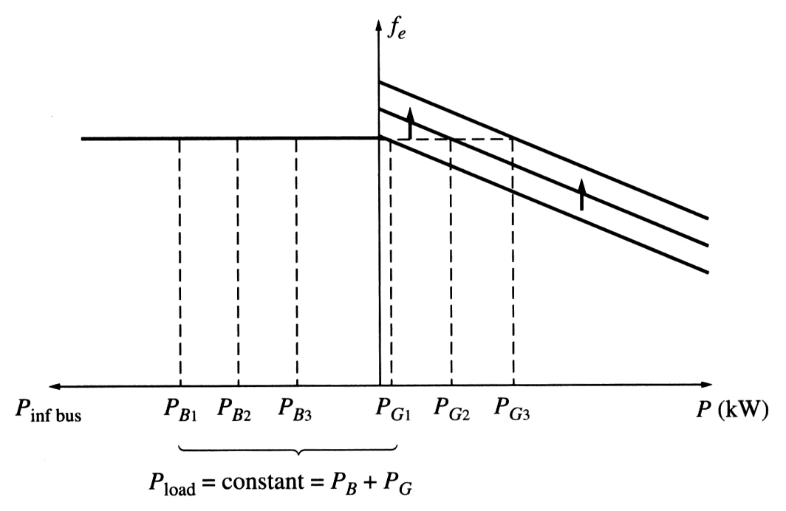
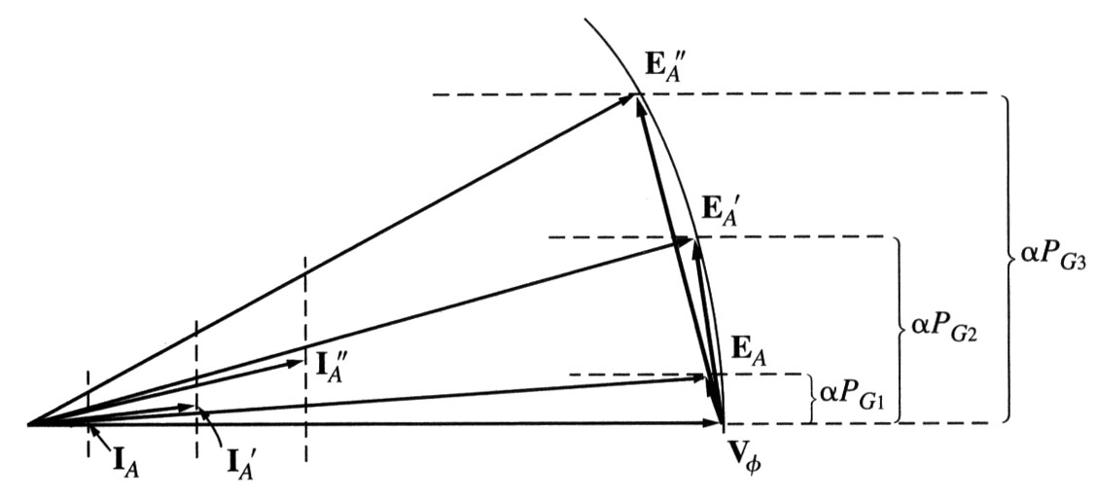
Operation of generators in parallel with large power systems
If the frequency of the generator is increased after it is connected to the infinite bus, the system frequency cannot change and the power supplied by the generator increases.
Notice that when E_{A} stays constant (field current and speed are the same), E_{A}sinδ (which is proportional to the output power if V_{T} is constant) increases.
If the frequency of the generator is further increased, power output from the generator will be increased and at some point it may exceed the power consumed by the load. This extra power will be consumed by the infinite bus.

Slide 17
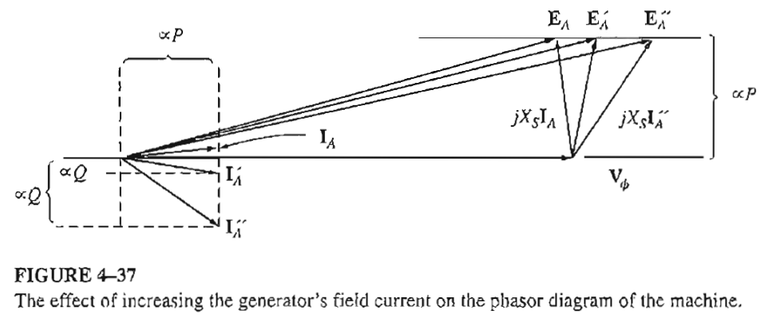
Operation of generators in parallel with large power systems

Slide 18
Operation of generators in parallel with large power systems
After the real power of the generator is adjusted to the desired value, the generator will be operating at a slightly leading PF acting as a capacitor that consumes reactive power. Adjusting the field current of the machine, it is possible to make it to supply reactive power Q to the system.
Summarizing, when the generator is operating in parallel to an infinite bus:
The frequency and terminal voltage of the generator are controlled by the system to which it is connected.
The governor set points of the generator control the real power supplied by the generator to the system.
The generator’s field current controls the reactive power supplied by the generator to the system.

Slide 19
Generators in parallel with other generators of the same size

Slide 20
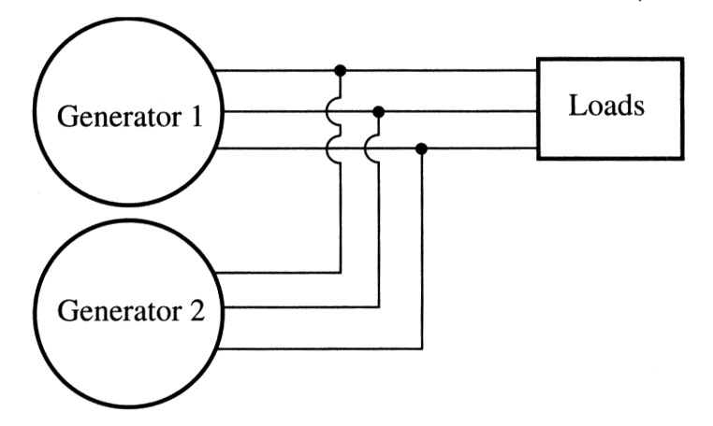
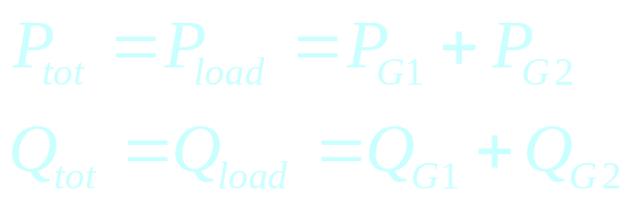
Generators in parallel with other generators of the same size
When a generator is working alone, its real and reactive power are fixed and determined by the load.
When a generator is connected to an infinite bus, its frequency and the terminal voltage are constant and determined by a bus.
When two generators of the same size are connected to the same load, the sum of the real and reactive powers supplied by the two generators must equal the real and reactive powers demanded by the load:
(7.59.1)
(7.59.2)

Slide 21
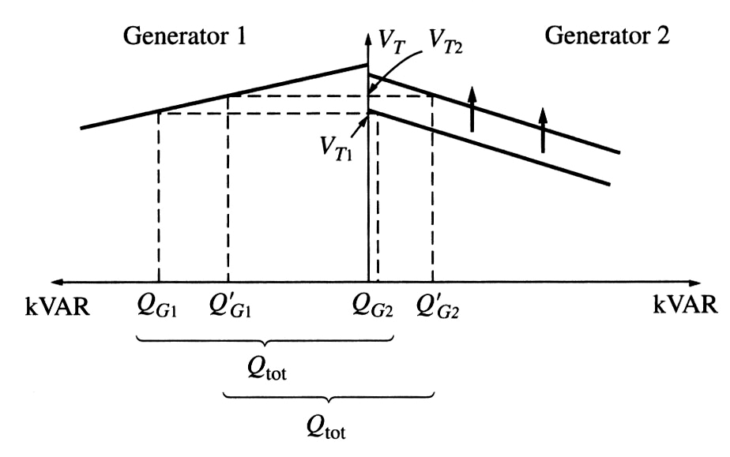
Generators in parallel with other generators of the same size
Therefore, when two generators are operating together, an increase in frequency (governor set point) on one of them:
Increases the system frequency.
Increases the real power supplied by that generator, while reducing the real power supplied by the other one.
When two generators are operating together, an increase in the field current on one of them:
Increases the system terminal voltage.
Increases the reactive power supplied by that generator, while reducing the reactive power supplied by the other.
If the frequency-power curves of both generators are known, the powers supplied by each generator and the resulting system frequency can be determined.
Example 4-5 (HOME WORK)

Slide 22
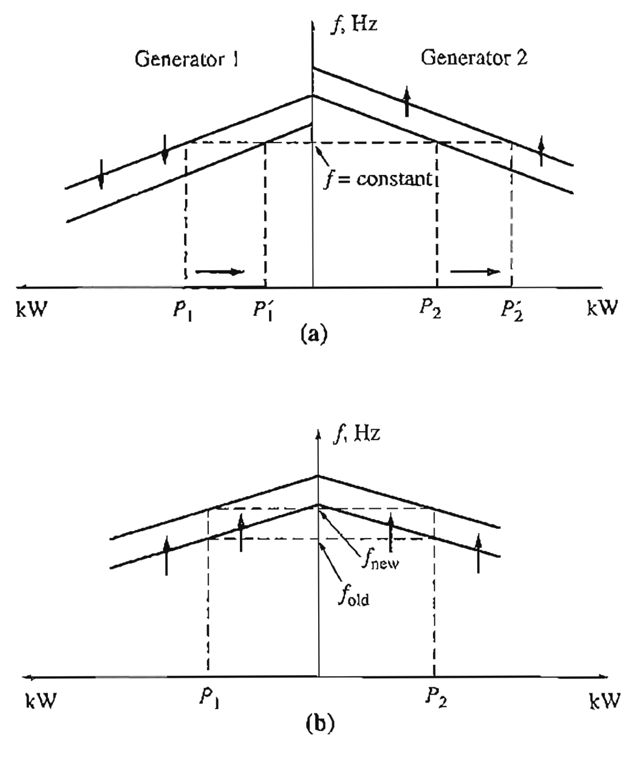
Generators in parallel with other generators of the same size
To adjust the real power sharing without changing the frequency, we need to increase simultaneously the no load frequency of one generator and decrease the no load frequency of the other generator.
To adjust the frequency without changing the real power sharing, we need to simultaneously increase or decrease the no load frequency of both generators.

Slide 23
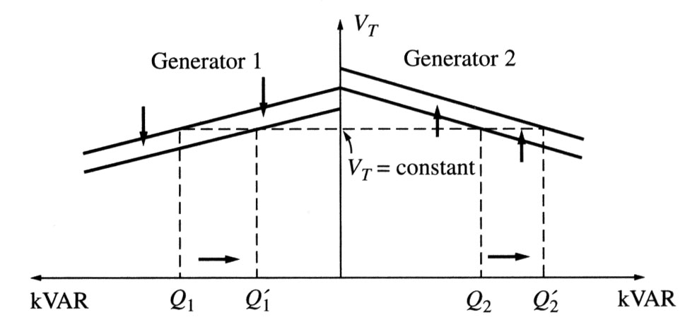
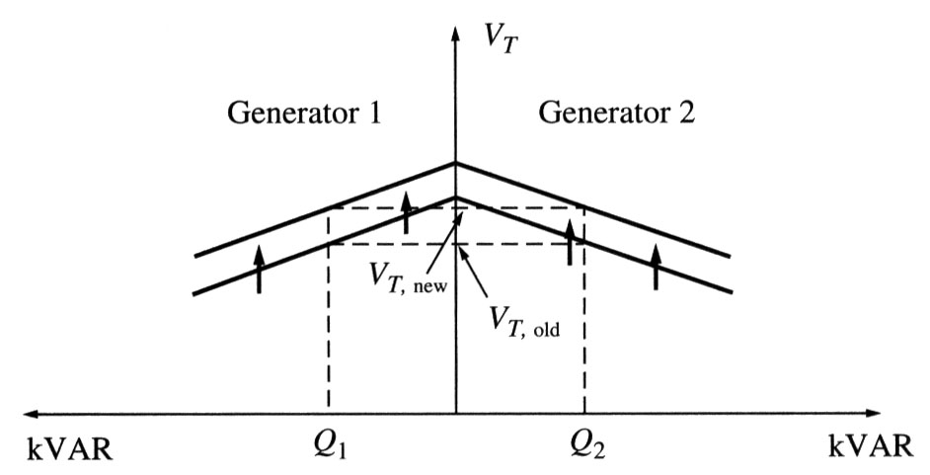
Generators in parallel with other generators of the same size
Similarly, to adjust the reactive power sharing without changing the terminal voltage, we need to increase simultaneously the field current of one generator and decrease the field current of the other generator.
To adjust the terminal voltage without changing the reactive power sharing, we need to simultaneously increase or decrease the field currents of both generators.

Slide 24
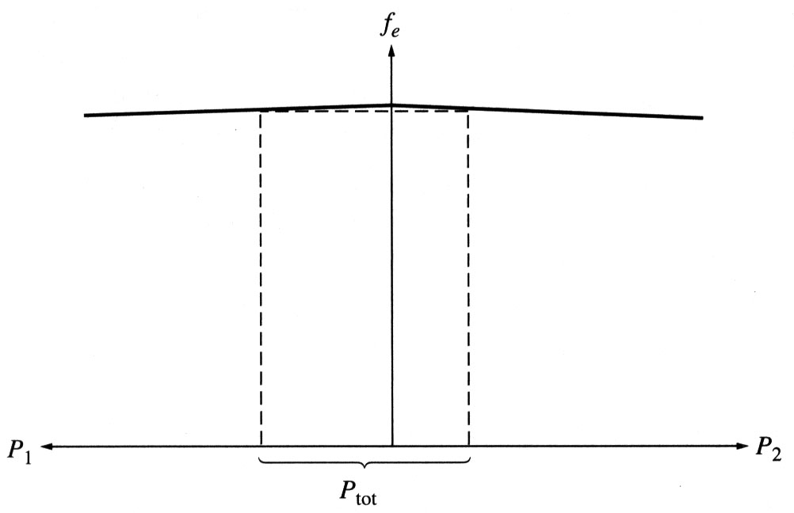
Generators in parallel with other generators of the same size
It is important that both generators being paralleled have dropping frequency-power characteristics.
If two generators have flat or almost flat frequency-power characteristics, the power sharing between them can vary widely with only finest changes in no-load speed. For good of power sharing between generators, they should have speed drops of 2% to 5%.

Slide 25

Conclusion
5.8: The Synchronous Generator Operating Alone
5.9: Parallel Operation of AC Generators

