Slide 1

School of Electrical Engineering and Computer Science
Department of Electrical Engineering
EE-260 : Electrical Machines
Lecture#22
5.9: Parallel Operation of AC Generators
Text Book: Chapter 05 (Stephen J. Chapman 4th Ed)
Instructor: Ms Neelma Naz
Class: BEE 12 C/D

Slide 2
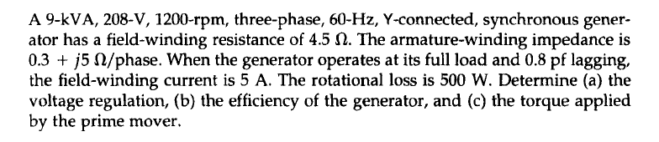
Class Activity

Slide 3

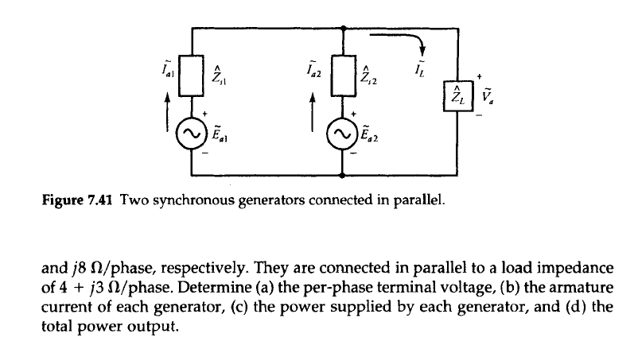
Class Activity

Slide 4
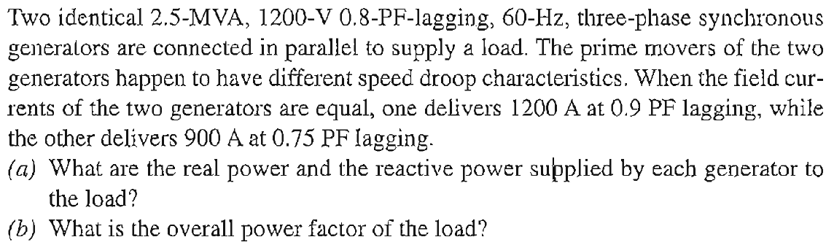
Class Activity

Slide 5
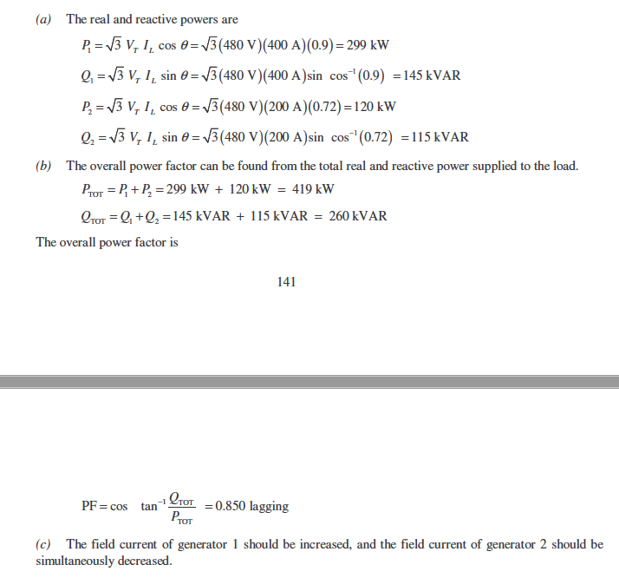

Slide 6
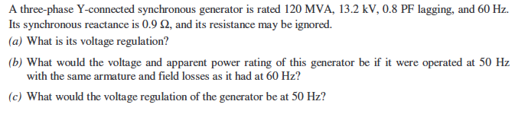
Class Activity

Slide 7
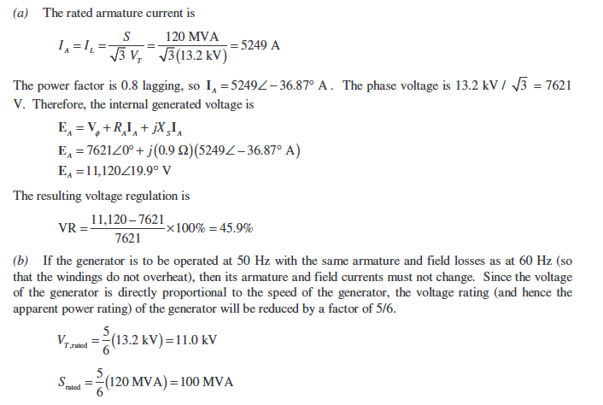

Slide 8
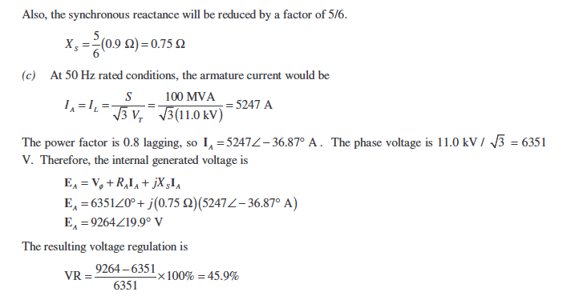


Slide 9

Conclusion
5.8: The Synchronous Generator Operating Alone
5.9: Parallel Operation of AC Generators

