Slide 1

School of Electrical Engineering and Computer Science
Department of Electrical Engineering
EE-260 : Electrical Machines
Lecture#26
Text Book: Chapter 07 Induction Motors
(Stephen J. Chapman 4th Ed)
Instructor: Ms Neelma Naz
Class: BEE 12 C/D
7.3 THE EQUIVALENT CIRCUIT OF AN INDUCTION MOTOR Page 388

Slide 2
7.3: Equivalent Circuit of Induction Motor

Slide 3
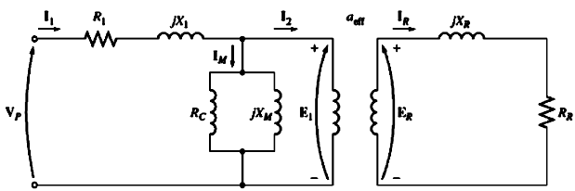
Equivalent Circuit of Induction Motor
An induction motor is a singly excited machine (as opposed to a doubly excited synchronous machine), since power is supplied only to the stator circuit.
Begin with the transformer model
Include the variable frequency and other similar induction motor effects
E₁ coupled to E_{R} by an ideal transformer with an effective turn ratio a_{eff}.

Slide 4
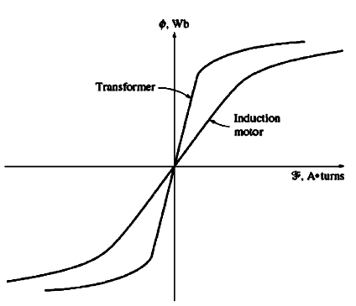
Equivalent Circuit of Induction Motor
Due to the air gap in an induction machine, the reluctance of the flux path is increased
Coupling between primary (stator) and secondary winding (rotor) is reduced.
Due to higher reluctance caused by the air gap, higher magnetizing current is required to obtain a given flux. Therefore, magnetizing reactance will be much smaller.
The voltage E_{R} produced in the rotor in turn produces a current flow in the shorted rotor (or secondary) circuit of the machine.

Slide 5
Rotor Circuit Model
In an induction motor when voltage is applied to stator winding, a voltage is induced in the rotor winding of the machine.
The greater the relative motion (Slip Speed) the greater the resulting rotor voltage and rotor frequency.
The largest relative motion occurs when the rotor is stationary, called Locked Rotor or Blocked Rotor condition.
The smallest voltage (0 V) and frequency (0 Hz) occurs when the rotor moves at the same speed as the stator magnetic field, resulting in no relative motion.
The magnitude and frequency of the voltage induced in the rotor at any speed is proportional to the slip of the rotor.

Slide 6
Rotor Circuit Model
An induction motor equivalent circuit differs from a transformer equivalent circuit primarily in the effects of varying rotor frequency on the rotor voltage E_{R} and impedance R_{R} and X_{R}.
5

Slide 7
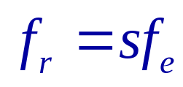

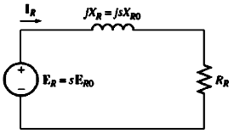
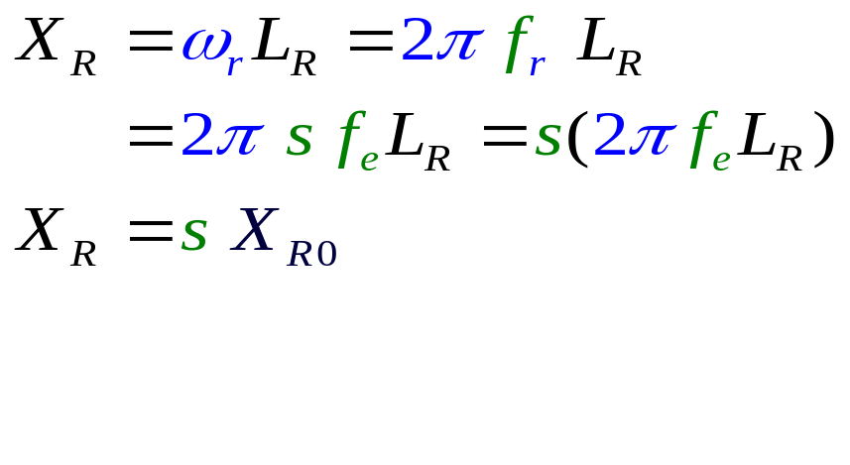
Rotor Circuit Model
The frequency f_{r} and magnitude E_{R} of the voltage induced on the rotor at any slip are :
;
E_{R0} : magnitude of the induced voltage at locked rotor condition.
The rotor resistance is independent of slip.
The reactance of the rotor depends on the inductance of the rotor, and the frequency of the voltage in the rotor.
X_{R0} is the blocked rotor reactance.
The resulting equivalent circuit is:

Slide 8
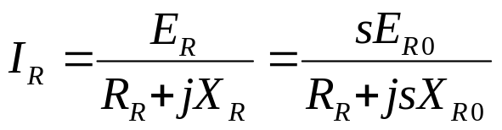
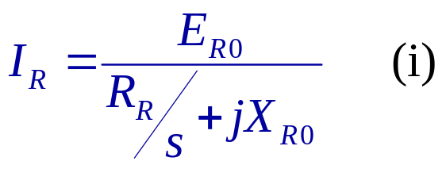
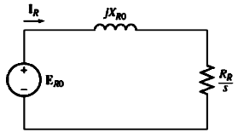
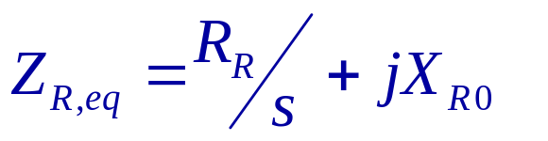
Rotor Circuit Model
The rotor current in this circuit can be written as:
From Eq.(i), it is possible to treat all of the rotor effects due to varying rotor speed as being caused by a varying impedance supplied with a power from a constant voltage source E_{RO}.
The equivalent rotor impedance is:
The modified equivalent rotor circuit is:

Slide 9
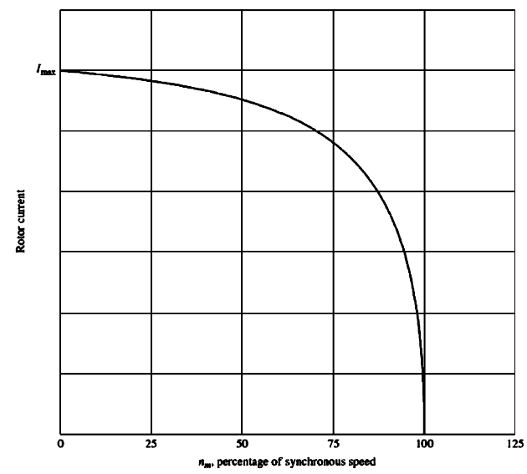
8

Slide 10
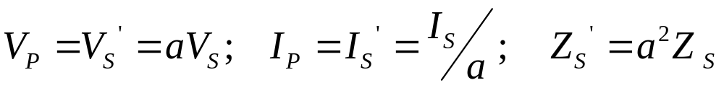
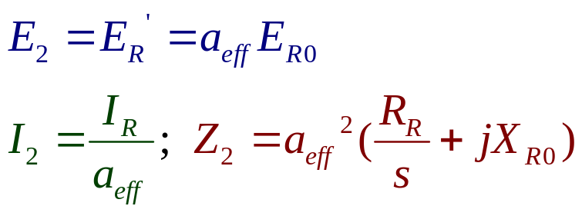
Final Equivalent Circuit
To produce the final equivalent circuit, refer rotor part of the model to the stator side.
The rotor circuit model has all the speed effects concentrated in the impedance term R_{R}.
In an ordinary transformer, the voltage, current and impedances on the secondary side can be referred to primary side by means of turn ratio.
Same transformation can be applied to induction machine.

Slide 11

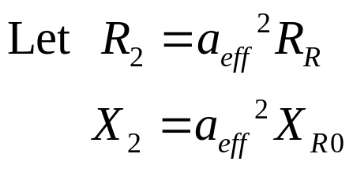
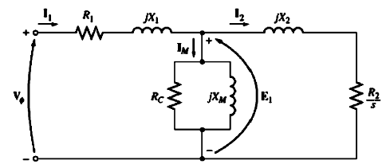
Final Equivalent Circuit
The per-phase equivalent circuit of an induction motor becomes:

Slide 12
Final Equivalent Circuit
The rotor resistance R_{R} , reactance X_{R0} and the effective turn ratio a_{eff} are very difficult to determine on a cage rotor.
It is possible to make measurements that will directly give the referred resistance and reactance R₂ and X₂, even though R_{R} ,X_{R0} and a_{eff} are not known separately.

Slide 13
Losses and the Power-Flow Diagram

Slide 14
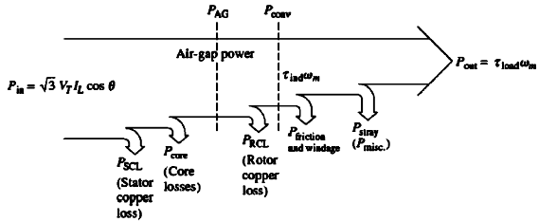
Losses and the Power-Flow Diagram
Induction motor -- a rotating transformer – Electrical power input and mechanical power output
For a transformer the output is electric power from secondary winding
The secondary (rotor) of an induction machine is shorted. Therefore, no electrical output form induction motor; the output is mechanical.

Slide 15
Losses and the Power-Flow Diagram
The core losses of an induction motor come from both the stator and rotor circuit.
Since an induction motor operates at a speed near synchronous speed, the relative motion of the magnetic field over the rotor surface is quite low, and the rotor core losses are very small compared to the stator circuit.
Since the largest fraction of the core losses comes from the stator circuit, all the core losses are lumped together at that point on the diagram.

Slide 16
Losses and the Power-Flow
The higher the speed of an induction machine, the higher its friction, windage and stray losses.
The higher the speed of the motor the lower its core losses.
The three categories of losses are sometimes lumped together and called rotational losses.
Since the component losses change in opposite directions with a change in speed, the total rotational losses of a motor may be considered constant with the changing speed.

Slide 17
Losses and the Power-Flow Diagram

Slide 18
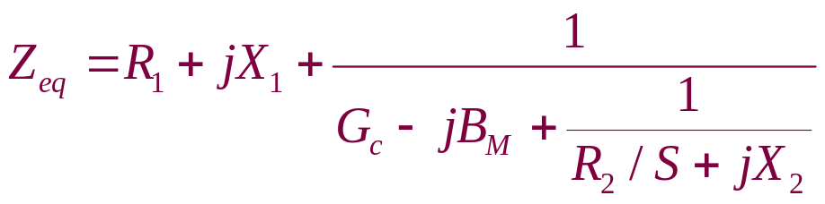
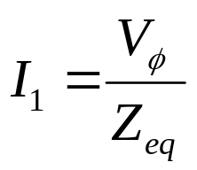
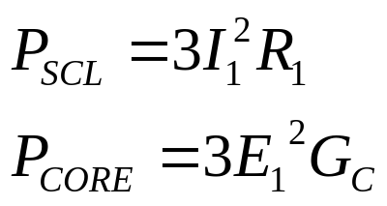

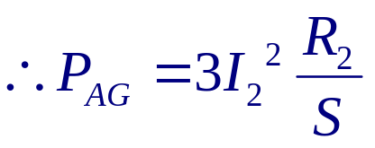
Power and Torque in an Induction Motor
The stator copper losses and the core losses are:
Per-phase equivalent circuit of IM
The AG power is consumed in R₂/s

Slide 19
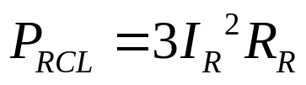
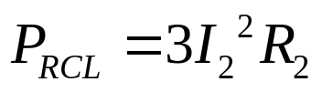


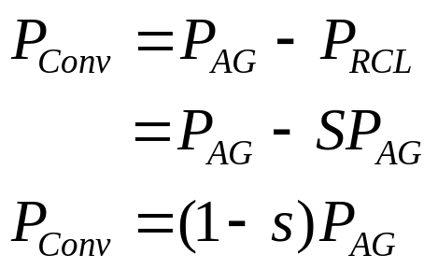
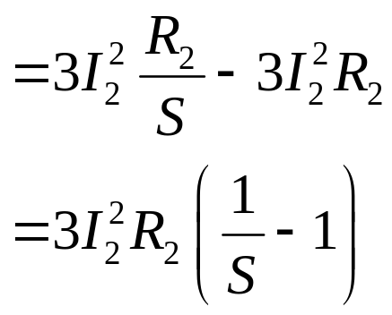
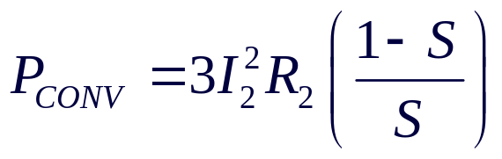
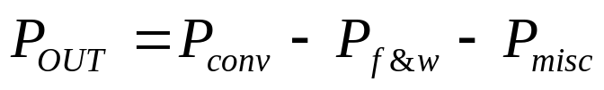

Power and Torque in Induction Machine
The actual resistive losses in the rotor circuit are given by:
When referred to the stator side
After stator copper losses, core losses, and rotor copper losses are subtracted from the input power to the motor, the remaining power is converted into mechanical power.

Slide 20
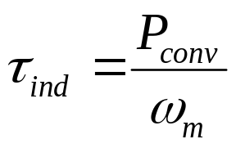
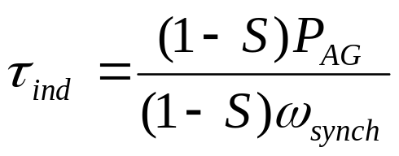
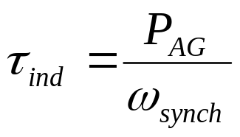
Power and Torque in Induction Machine
The induced torque in the machine is the torque generated by the internal electric-to-mechanical power conversion.
This torque differs from the torque actually available at the terminals of the motor by an amount equal to friction and windage torque in the machine.

Slide 21
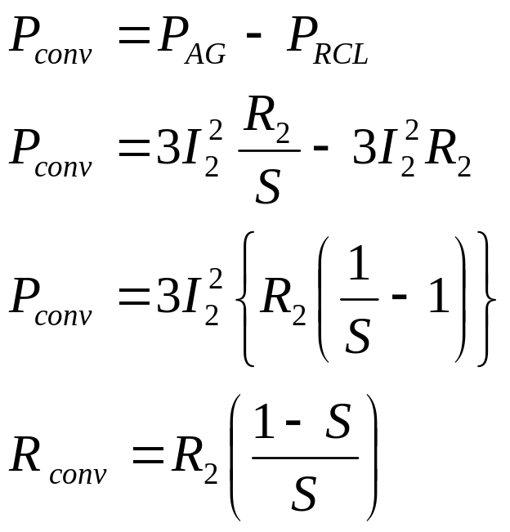
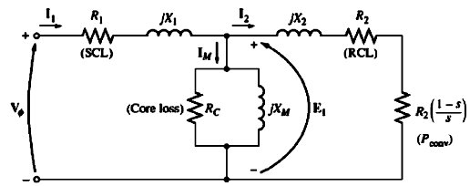
Separating the Rotor Copper Losses and the Power Converted in an Induction Motor’s Equivalent Circuit
Part of the power coming across the air gap in an induction motor is consumed in the rotor copper losses, and part of it is converted to mechanical power to drive the motor’s shaft. These two uses of air gap power can be separately indicated on the motor equivalent circuit.

Slide 22
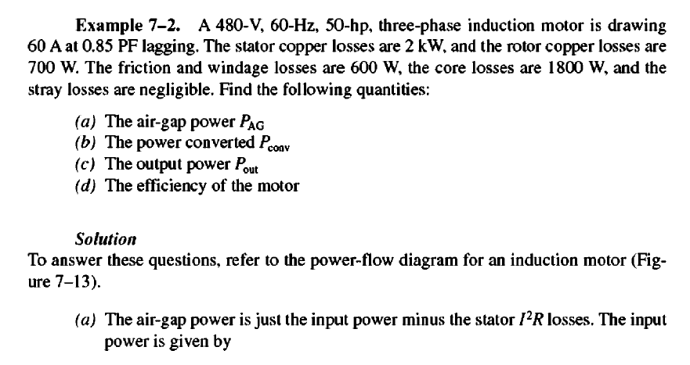

Slide 23
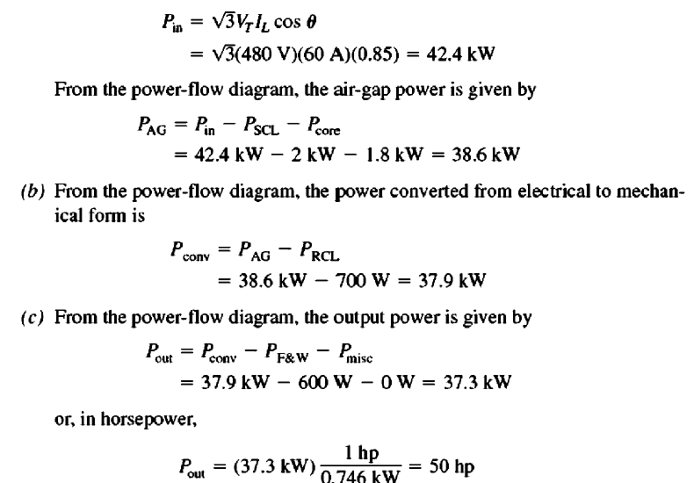

Slide 24
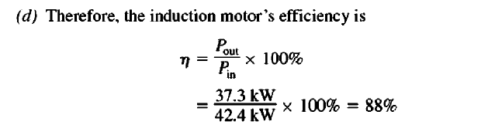

Slide 25
Home Work
Example 7.3

Slide 26

Conclusion
7.3 THE EQUIVALENT CIRCUIT OF AN INDUCTION MOTOR Page 388

