Slide 1

School of Electrical Engineering and Computer Science
Department of Electrical Engineering
EE-260 : Electrical Machines
Lecture#27
Text Book: Chapter 07 Induction Motors
(Stephen J. Chapman 4th Ed)
Instructor: Ms Neelma Naz
Class: BEE 12 C/D
7.4: Power and Torque in Induction Motor page Page 394

Slide 2
Losses and the Power-Flow Diagram

Slide 3
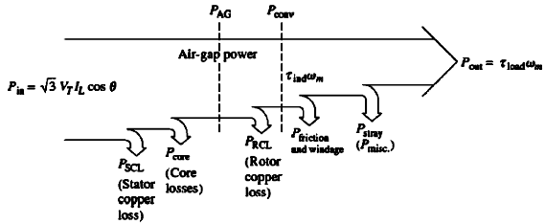
Losses and the Power-Flow Diagram
Induction motor -- a rotating transformer – Electrical power input and mechanical power output
For a transformer the output is electric power from secondary winding
The secondary (rotor) of an induction machine is shorted. Therefore, no electrical output form induction motor; the output is mechanical.

Slide 4
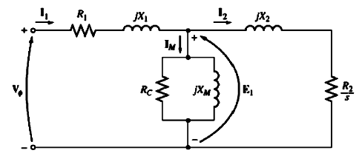
Losses and the Power-Flow Diagram
The core losses of an induction motor come from both the stator and rotor circuit.
Since an induction motor operates at a speed near synchronous speed, the relative motion of the magnetic field over the rotor surface is quite low, and the rotor core losses are very small compared to the stator circuit.
Since the largest fraction of the core losses comes from the stator circuit, all the core losses are lumped together at that point on the diagram.

Slide 5
Losses and the Power-Flow
The higher the speed of an induction machine, the higher its friction, windage and stray losses.
The higher the speed of the motor the lower its core losses.
The three categories of losses are sometimes lumped together and called rotational losses.
Since the component losses change in opposite directions with a change in speed, the total rotational losses of a motor may be considered constant with the changing speed.

Slide 6
Losses and the Power-Flow Diagram

Slide 7
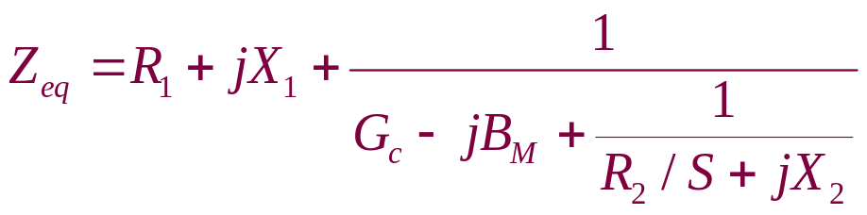
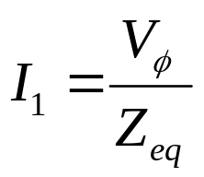
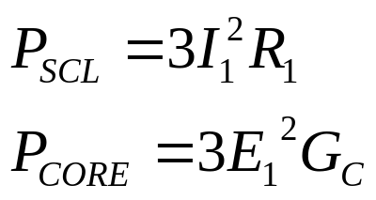

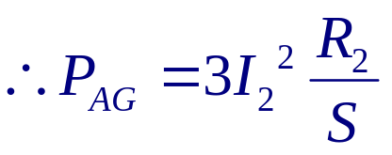
Power and Torque in an Induction Motor
The stator copper losses and the core losses are:
Per-phase equivalent circuit of IM
The AG power is consumed in R₂/s

Slide 8
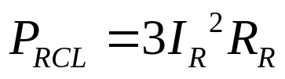
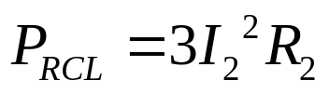


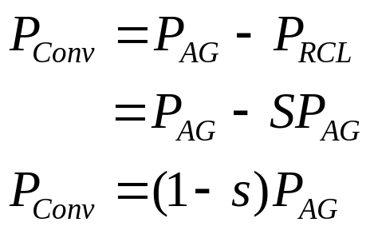
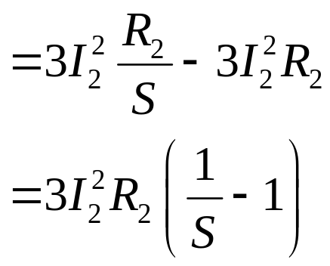
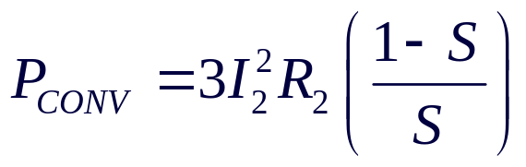
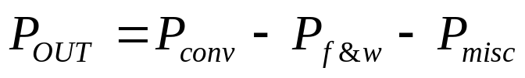

Power and Torque in Induction Machine
The actual resistive losses in the rotor circuit are given by:
When referred to the stator side
After stator copper losses, core losses, and rotor copper losses are subtracted from the input power to the motor, the remaining power is converted into mechanical power.

Slide 9
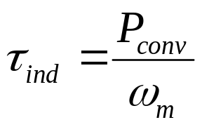
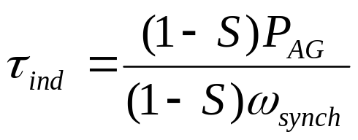
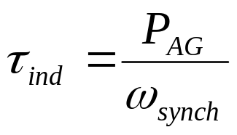
Power and Torque in Induction Machine
The induced torque in the machine is the torque generated by the internal electric-to-mechanical power conversion.
This torque differs from the torque actually available at the terminals of the motor by an amount equal to friction and windage torque in the machine.

Slide 10
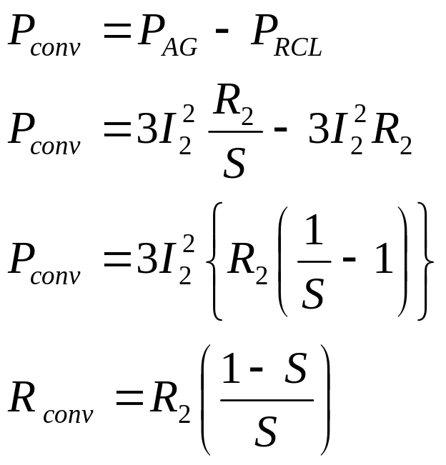
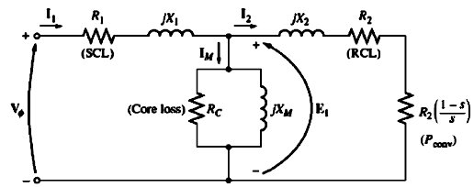
Separating the Rotor Copper Losses and the Power Converted in an Induction Motor’s Equivalent Circuit
Part of the power coming across the air gap in an induction motor is consumed in the rotor copper losses, and part of it is converted to mechanical power to drive the motor’s shaft. These two uses of air gap power can be separately indicated on the motor equivalent circuit.

Slide 11
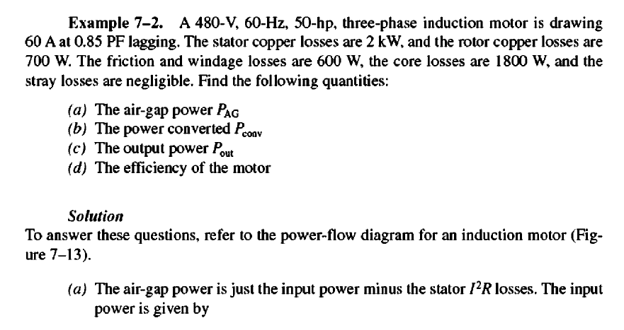

Slide 12
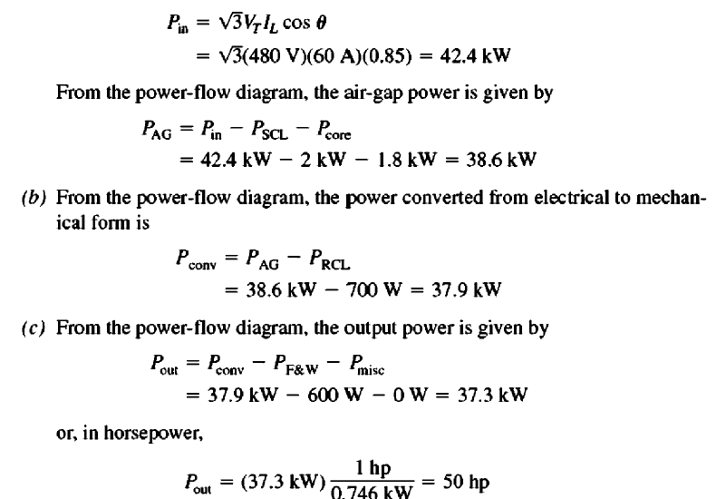

Slide 13
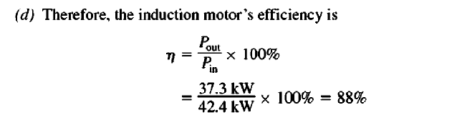

Slide 14
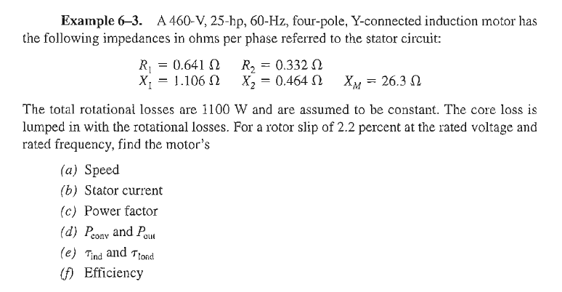
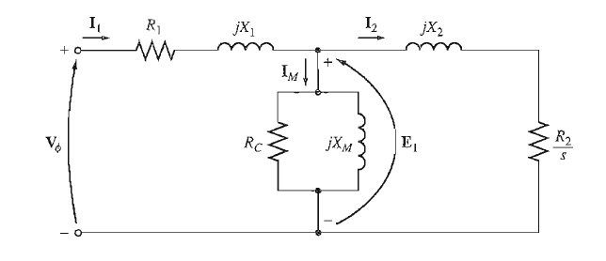
Example 6.3 (Chapman-5th Edition)

Slide 15

Conclusion
7.4: Power and Torque in Induction Motor Page 394

