Slide 1

School of Electrical Engineering and Computer Science
Department of Electrical Engineering
EE-260 : Electrical Machines
Lecture # 28,29
Text Book: Chapter 07 Induction Motors
(Stephen J. Chapman 4th Ed)
Instructor: Ms Neelma Naz
Class: BEE 12 C/D
7.5: INDUCTION MOTOR TORQUE-SPEED CHARACTERISTICS Page 401
The Derivation of the Induction Motor Induced-Torque Equation Page 405

Slide 2
7.5: Induction Motor Torque-Speed Characteristics

Slide 3
Induction Motor Torque-Speed Characteristics
How does the torque of an induction motor changes as the load changes?
How much torque can an induction motor supply at starting conditions?
How much the speed of an induction motor drops as its shaft load increases?
To answer these questions, it is necessary to understand the relationships among the motor’s torque, speed, and power.

Slide 4
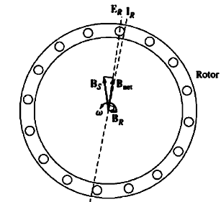
Induced Torque from a Physical Standpoint
No Load Condition
At no load the rotor slip is very small and so the relative motion between the rotor and the magnetic fields is small.
The voltage E_{R} induced in the bars of the rotor is very small and the resulting current flow I_{R} is very small.
As the rotor frequency is very small, the reactance of the rotor is nearly zero, and the rotor current I_{R} is almost in phase with the rotor voltage E_{R}.

Slide 5
Induced Torque from a Physical Standpoint
No Load Condition
The rotor current produces a small magnetic field B_{R} at an angle slightly greater than 90º behind the net magnetic field B_{net}.
The stator current must be quite large even at no load, since it must supply most of B_{net}.

Slide 6
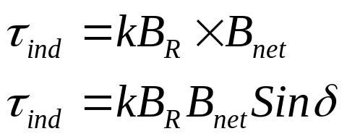
Induced Torque from a Physical Standpoint:
No Load Condition
The induced torque which keeps the motor running is given by:
Since the rotor magnetic field is very small, the induced torque is also quite small---just large enough to overcome the motor rotational losses.

Slide 7
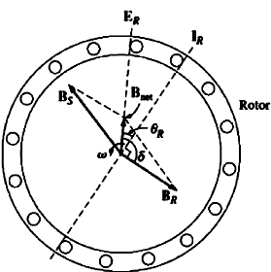
Induced Torque from a Physical Standpoint
(Machine is Loaded)
The induction motor is loaded. As the motor’s load increases, its slip increases, and the rotor speed falls.
As the rotor speed is slower, there is more relative motion between the rotor and the stator magnetic fields.
Greater relative motion produces a stronger rotor voltage E_{R} and thus a larger rotor current I_{R}. The rotor magnetic field B_{R} increases.
Since the rotor slip is larger, the rotor frequency (f_{r}=sf_{e}), and the rotor reactance increases (ωL_{R}).
The rotor current now lags further behind the rotor voltage, and the rotor magnetic field shifts with the current.

Slide 8
Induced Torque from a Physical Standpoint:
(Machine is Loaded)
Figure shows induction motor operating at a fairly high load. The rotor current I_{R} , the MF B_{R} , and the angle δ has increased
The increase in B_{R} tends to increase the torque while increase in angle δ tends to decrease the torque (T_{ind} is proportional to sin δ and δ>90º).
Since the effect of B_{R} is larger than that of angle δ, the overall induced torque increases with increase of load.
When does the induction motor reaches pullout torque?

Slide 9
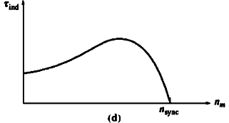

Induced Torque from a Physical Standpoint
(Machine is Loaded)
This happens when the point is reached where, as the load on the shaft is increased, the sin δ term decreases more than the B_{R} term increases. At that point a further increase in load decreases Ƭ_{ind}, and the motor stops.
For a typical induction motor, the pullout torque on the curve will be 200 to 250 percent of rated full load torque of the machine.

Slide 10
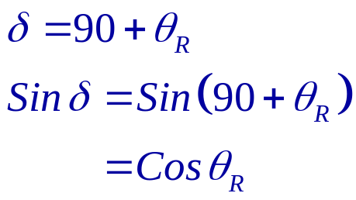
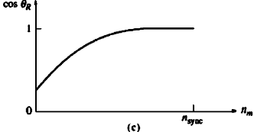

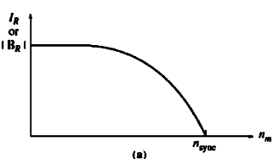

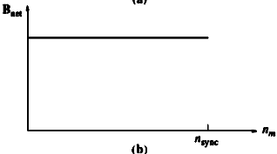
Torque speed Characteristic curve

Slide 11
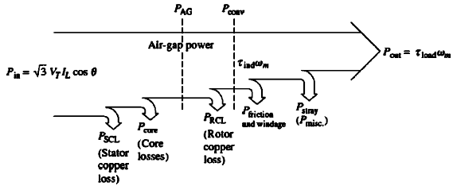
Losses and the Power-Flow Diagram

Slide 12
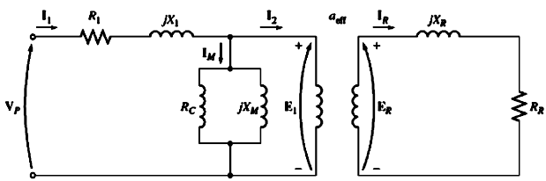
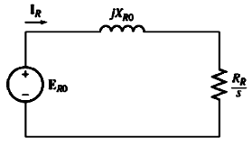

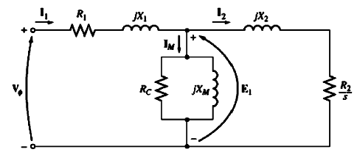
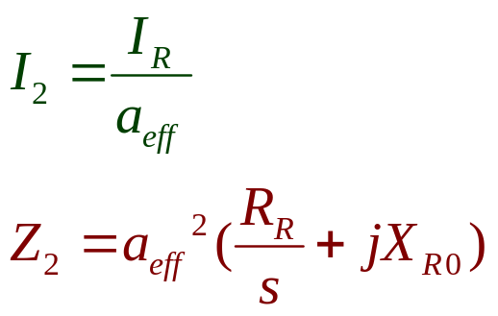
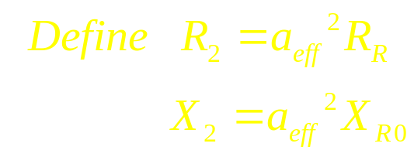
Equivalent Circuit of Induction Motor

Slide 13
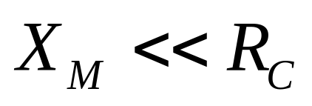
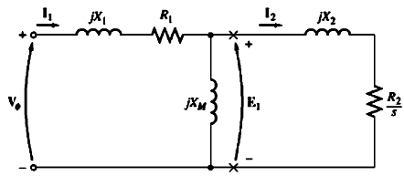
Induced-Torque Equation

Slide 14
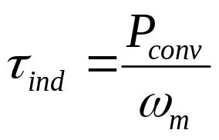
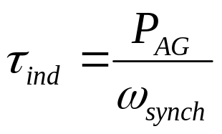
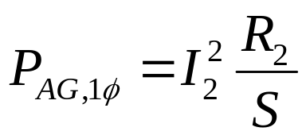
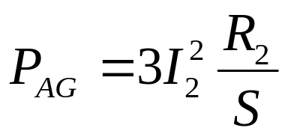
Induced-Torque Equation
The air-gap power is the power crossing the gap from stator circuit to rotor circuit. It is equal to power absorbed in resistance R₂/S.
If I₂ can be determined, the air-gap power and the induced torque will be known.

Slide 15
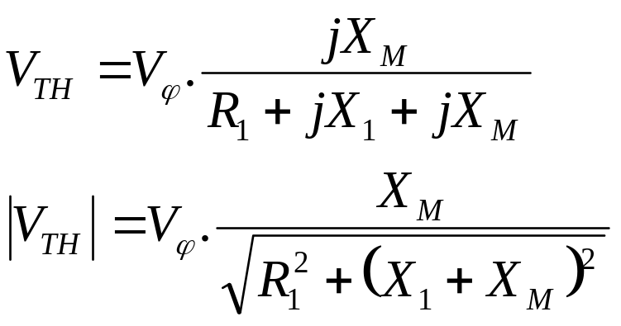
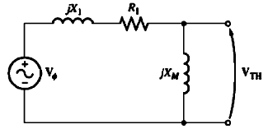
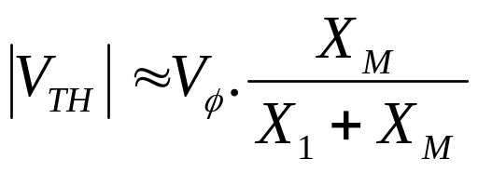
Induced-Torque Equation
As X_{M} >> R₁

Slide 16
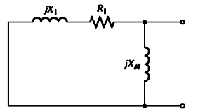
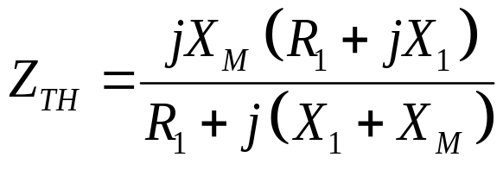

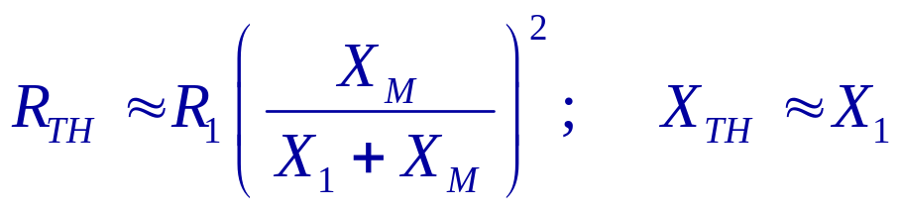
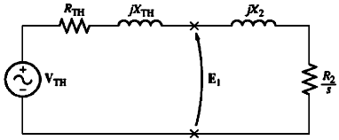
Induced-Torque Equation

Slide 17
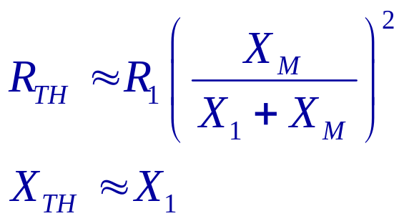
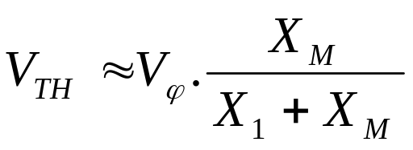
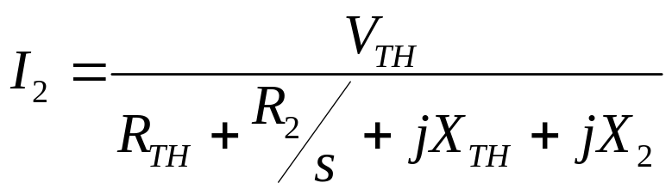
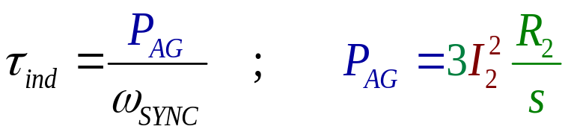
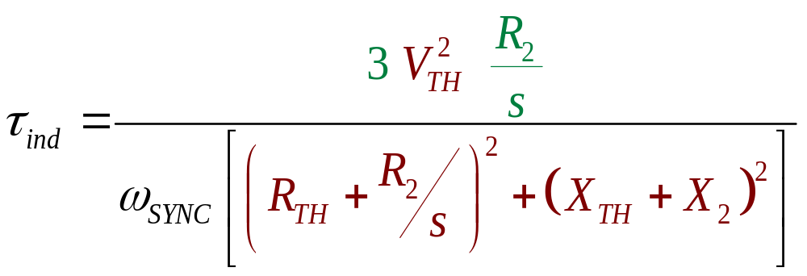
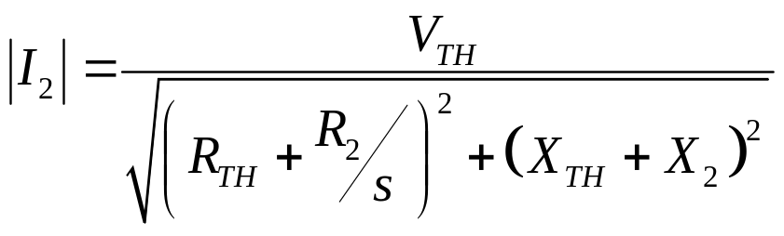
Induced-Torque Equation

Slide 18
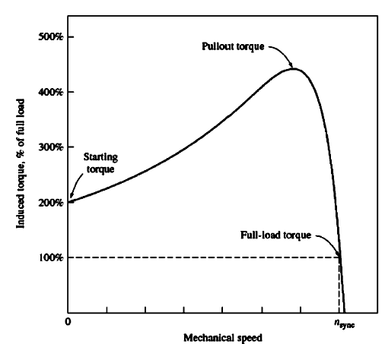
Induced-Torque Equation

Slide 19
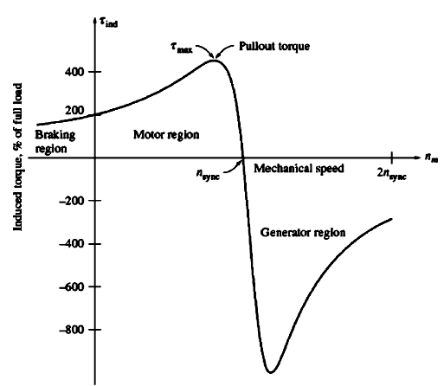
Induced-Torque Equation

Slide 20

Conclusion
7.5: INDUCTION MOTOR TORQUE-SPEED CHARACTERISTICS Page 401
The Derivation of the Induction Motor Induced-Torque Equation Page 405

