Slide 1

School of Electrical Engineering and Computer Science
Department of Electrical Engineering
EE-260 : Electrical Machines
Lecture # 30
Text Book: Chapter 07 Induction Motors
(Stephen J. Chapman 4th Ed)
Instructor: Ms Neelma Naz
Class: BEE 12 C/D
7.5: INDUCTION MOTOR TORQUE-SPEED CHARACTERISTICS Page 401
The Derivation of the Induction Motor Induced-Torque Equation Page 405

Slide 2
7.5: Induction Motor Torque-Speed Characteristics

Slide 3
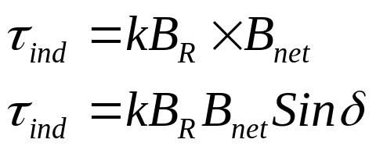
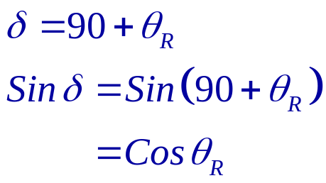
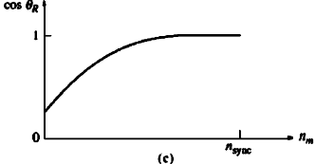

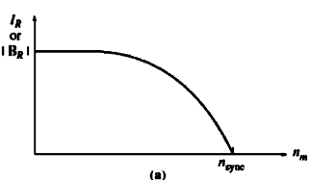

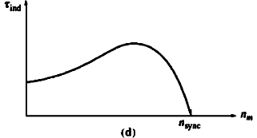
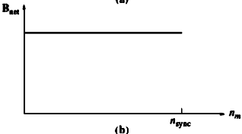
Torque speed Characteristic curve

Slide 4
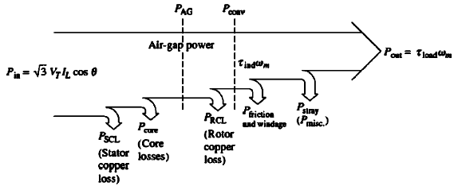
Losses and the Power-Flow Diagram

Slide 5
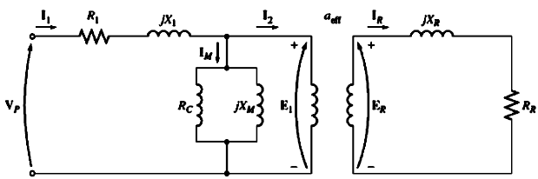
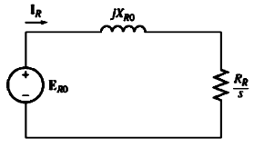

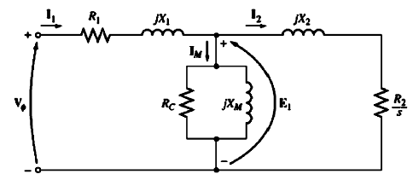
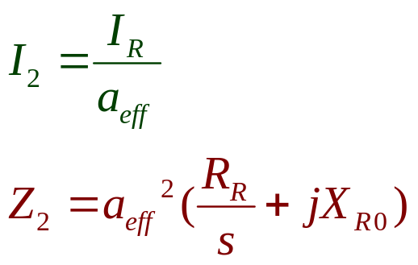
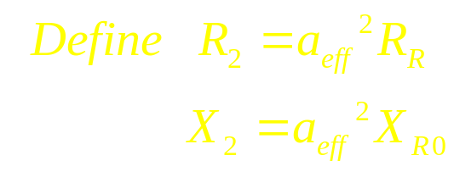
Equivalent Circuit of Induction Motor

Slide 6
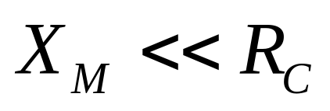
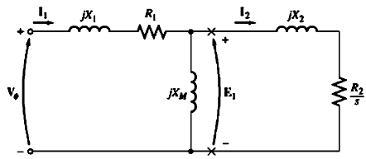
Induced-Torque Equation

Slide 7
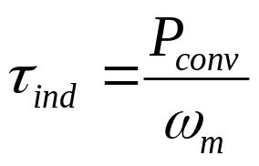
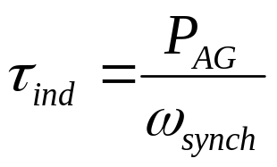
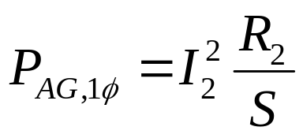
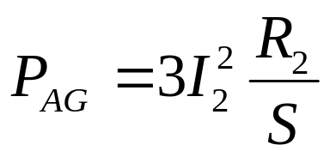
Induced-Torque Equation
The air-gap power is the power crossing the gap from stator circuit to rotor circuit. It is equal to power absorbed in resistance R₂/S.
If I₂ can be determined, the air-gap power and the induced torque will be known.

Slide 8
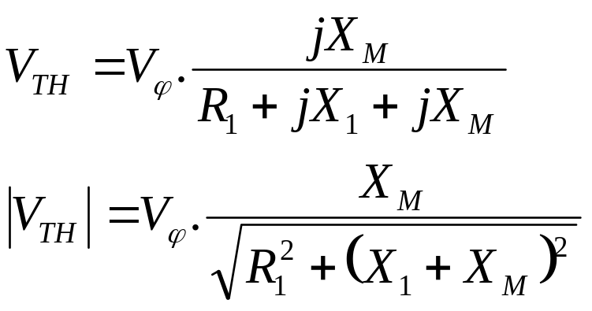
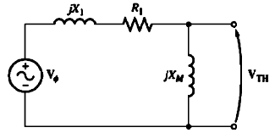
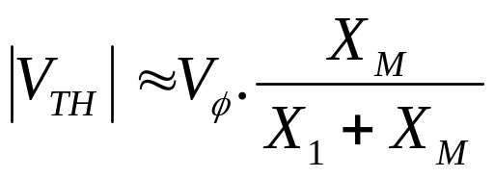
Induced-Torque Equation
As X_{M} >> R₁

Slide 9
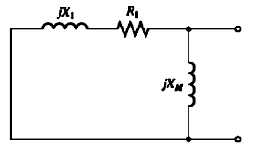
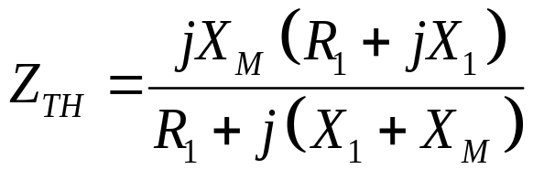

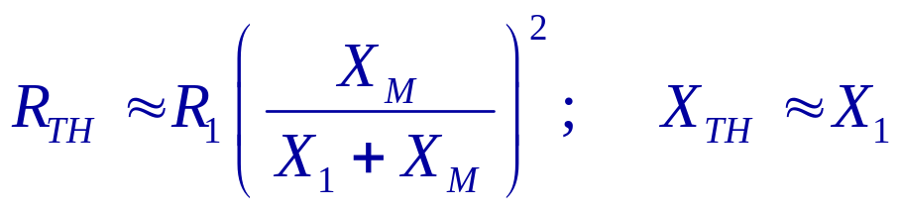
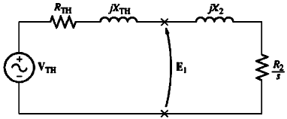
Induced-Torque Equation

Slide 10
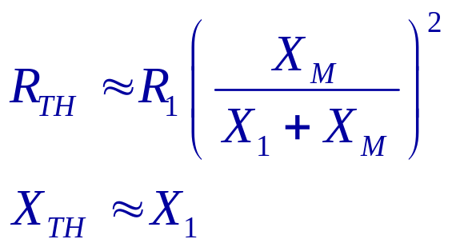
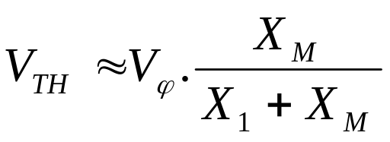
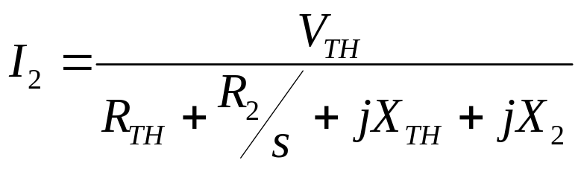
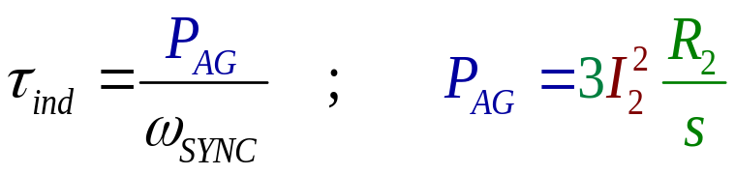
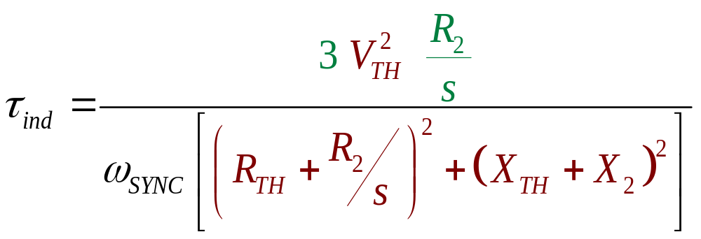
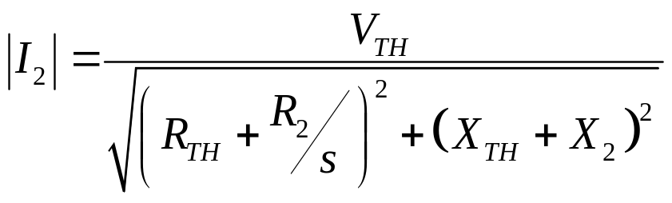
Induced-Torque Equation

Slide 11
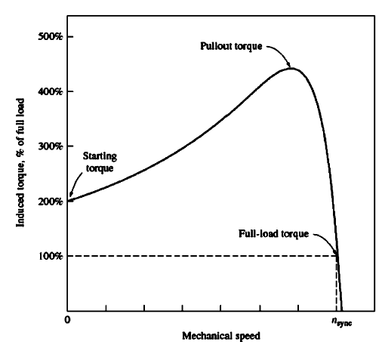
Induced-Torque Equation

Slide 12
Induced-Torque Equation

Slide 13
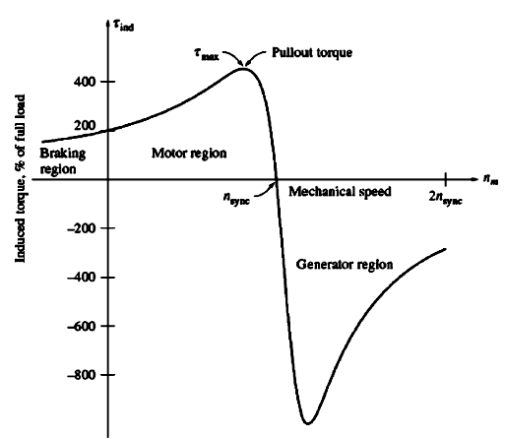
Induced-Torque Equation

Slide 14
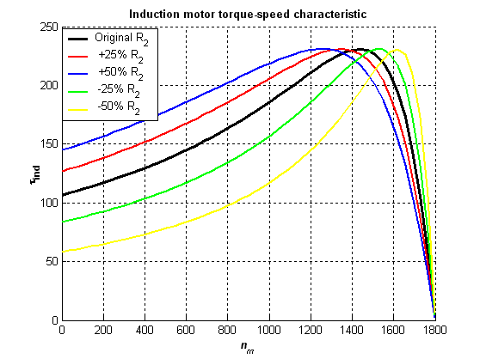
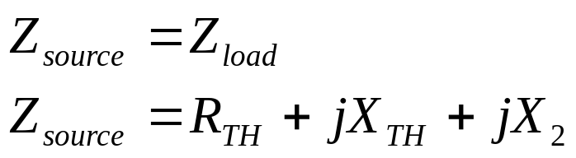
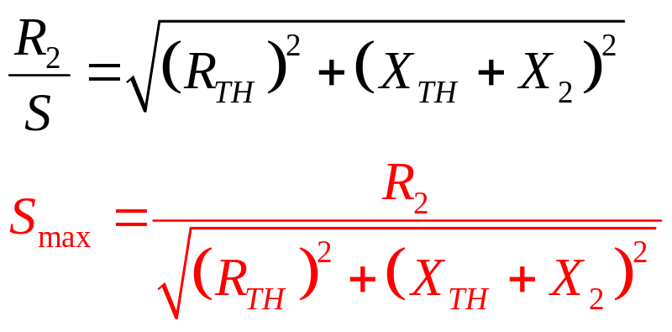
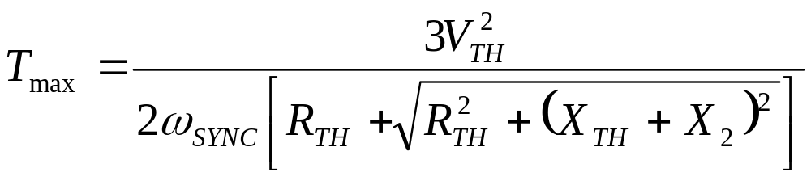
Induced-Torque Equation
Max power transfer

Slide 15
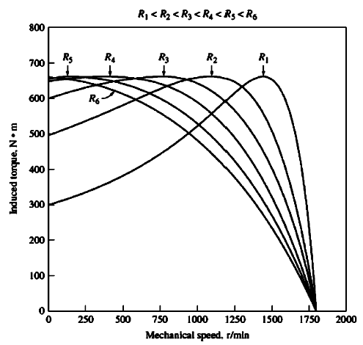
Induced-Torque Equation

Slide 16
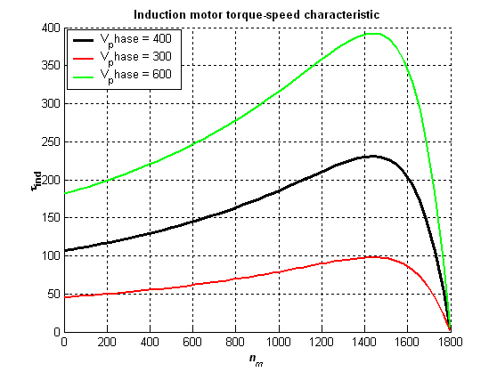
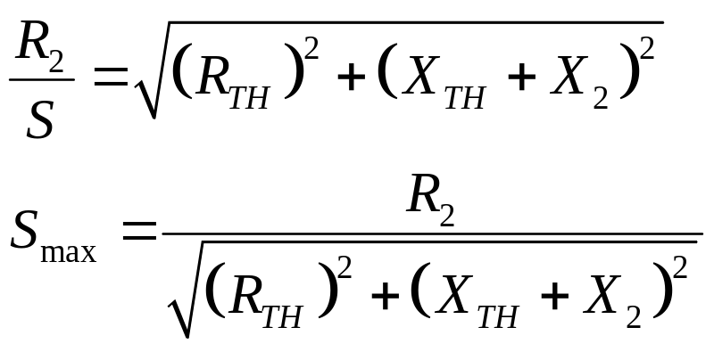
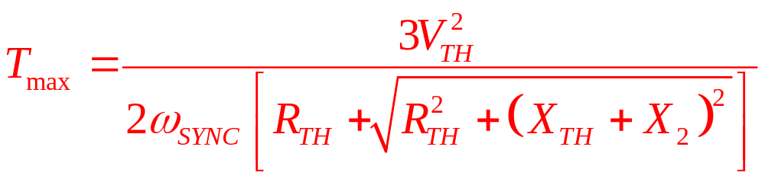
Induced-Torque Equation

Slide 17
Example 7-4:
A two pole, 50 Hz induction motor supplies 15 kW to a load at a speed of 2950 rpm.
  What is the motor slip.
  What is the induced torque in the motor in N.m. under these conditions.
  What will the operating speed of the motor be if its torque is doubled.
  How much power will be supplied by the motor when the torque is doubled.

Slide 18
Example 7-5:
A 460 V, 25-hp, 60 Hz, four pole, Y-connected induction motor has the following impedances in ohms per phase referred to stator circuit:
R1=0.641 Ω R2=0.332 Ω
X1=1.106 Ω X2=0.464 Ω, X_{M}=26.3 Ω
  What is the maximum torque of the motor. At what speed and slip does it occur.
  What is the starting torque of this motor.
  When the rotor resistance is doubled, what is the speed at which the maximum torque occurs. What is the new starting torque of the motor.
  Calculate and plot the torque-speed characteristics of this motor both with the original rotor resistance and with the rotor resistance doubled.

Slide 19
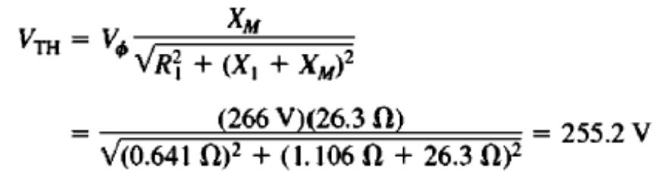
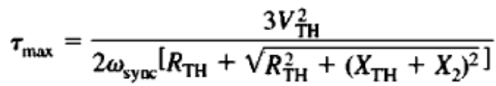
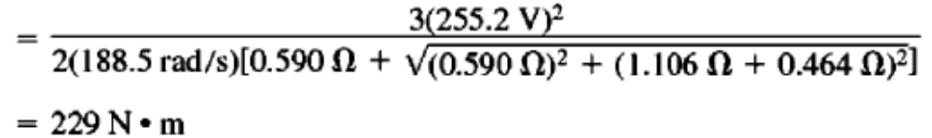
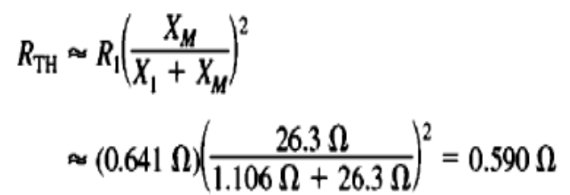
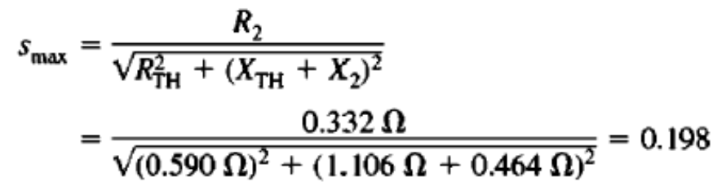

Example 7-5:
A 460 V, 25-hp, 60 Hz, four pole, Y-connected induction motor has the following impedances in ohms per phase referred to stator circuit:
R1=0.641 Ω R2=0.332 Ω
X1=1.106 Ω X2=0.464 Ω, X_{M}=26.3 Ω
  What is the maximum torque of the motor? At what speed and slip does it occur?

Slide 20
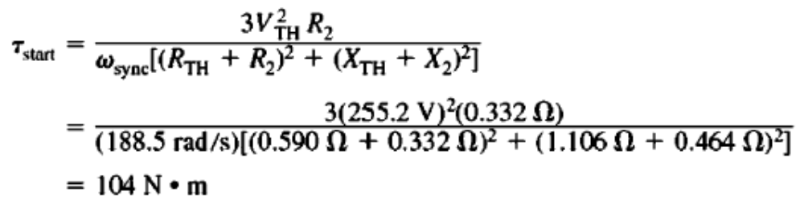
Example 7-5:
A 460 V, 25-hp, 60 Hz, four pole, Y-connected induction motor has the following impedances in ohms per phase referred to stator circuit:
R1=0.641 Ω R2=0.332 Ω
X1=1.106 Ω X2=0.464 Ω, X_{M}=26.3 Ω
  What is the starting torque of this motor.
To find the starting torque, Set s =1

Slide 21
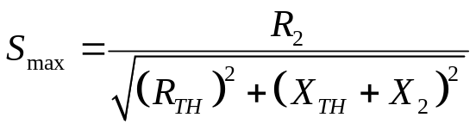
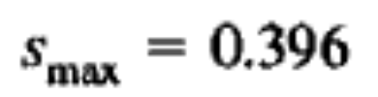

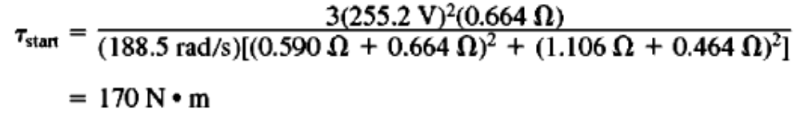
Example 7-5:
A 460 V, 25-hp, 60 Hz, four pole, Y-connected induction motor has the following impedances in ohms per phase referred to stator circuit:
R1=0.641 Ω R2=0.332 Ω
X1=1.106 Ω X2=0.464 Ω, X_{M}=26.3 Ω
  When the rotor resistance is doubled, what is the speed at which the maximum torque occurs. What is the new starting torque of the motor.
As R_{R} is doubled S_{max} is also doubled
Max torque occurs at
The new starting torque

Slide 22

Conclusion
7.5: INDUCTION MOTOR TORQUE-SPEED CHARACTERISTICS Page 401
The Derivation of the Induction Motor Induced-Torque Equation Page 405

