Slide 1

School of Electrical Engineering and Computer Science
Department of Electrical Engineering
EE-260 : Electrical Machines
Lecture # 31
Text Book: Chapter 07 Induction Motors
(Stephen J. Chapman 4th Ed)
Instructor: Ms Neelma Naz
Class: BEE 12 C/D
7.5: INDUCTION MOTOR TORQUE-SPEED CHARACTERISTICS Page 401
The Derivation of the Induction Motor Induced-Torque Equation Page 405

Slide 2
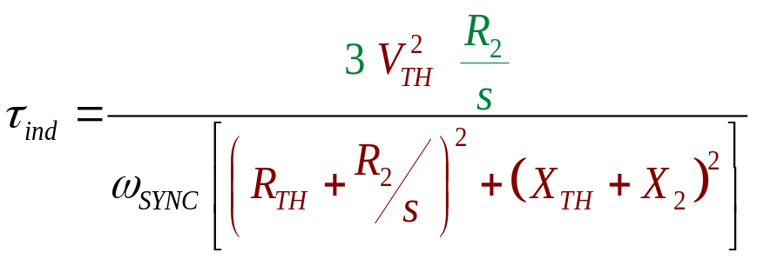
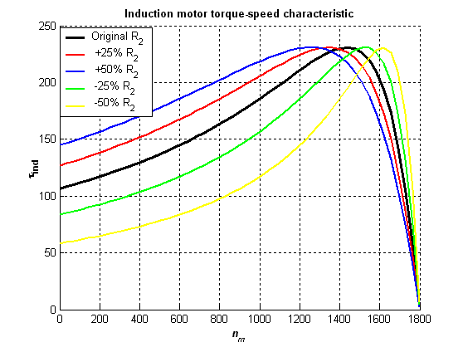
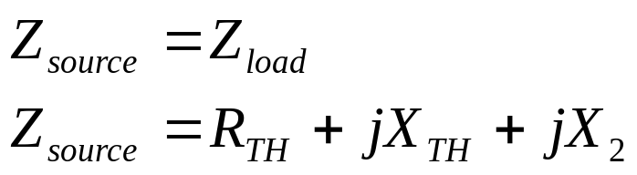
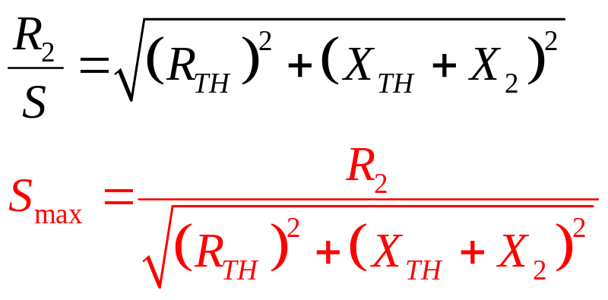
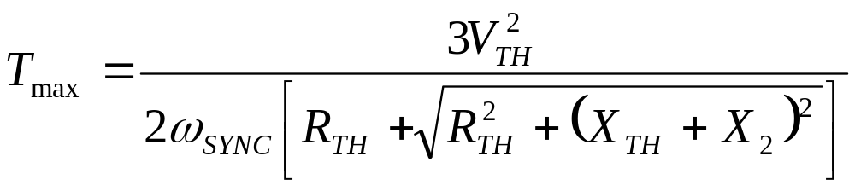
Induced-Torque Equation
Max power transfer

Slide 3
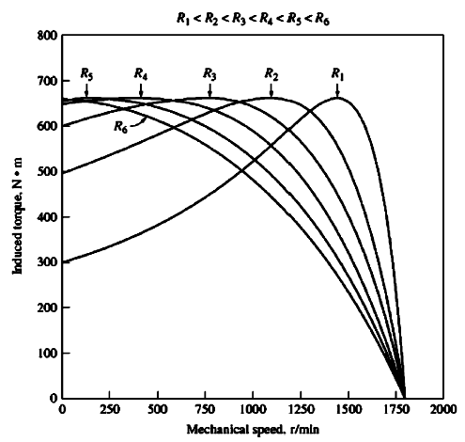
Induced-Torque Equation

Slide 4
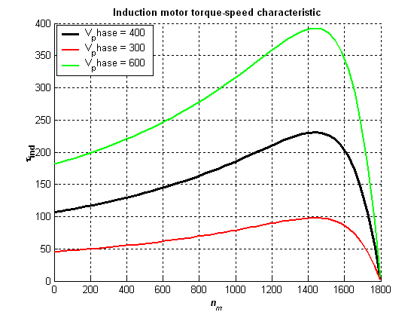
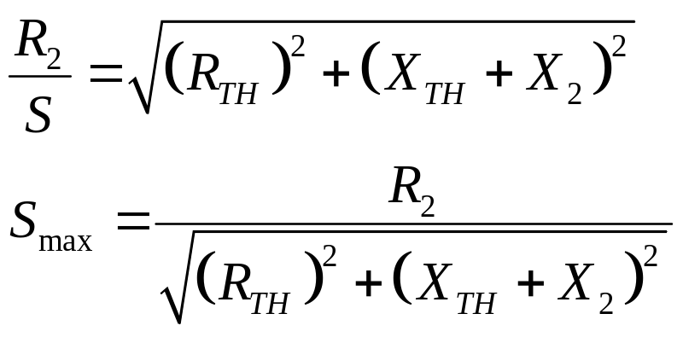
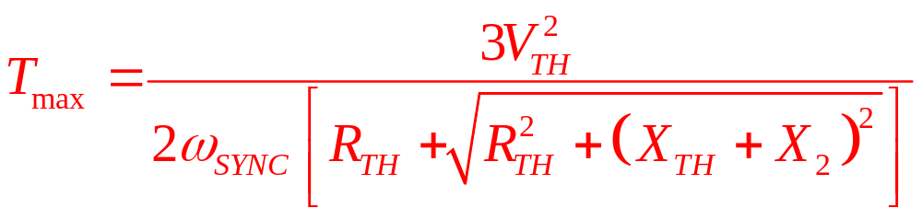
Induced-Torque Equation

Slide 5
Example 7-5:
A 460 V, 25-hp, 60 Hz, four pole, Y-connected induction motor has the following impedances in ohms per phase referred to stator circuit:
R1=0.641 Ω R2=0.332 Ω
X1=1.106 Ω X2=0.464 Ω, X_{M}=26.3 Ω
  What is the maximum torque of the motor. At what speed and slip does it occur.
  What is the starting torque of this motor.
  When the rotor resistance is doubled, what is the speed at which the maximum torque occurs. What is the new starting torque of the motor.
  Calculate and plot the torque-speed characteristics of this motor both with the original rotor resistance and with the rotor resistance doubled.

Slide 6
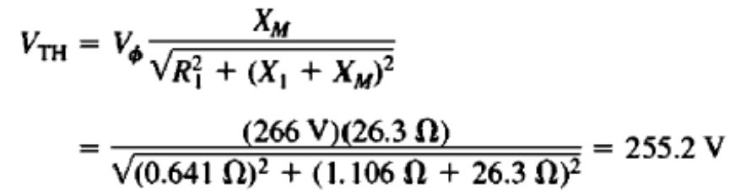
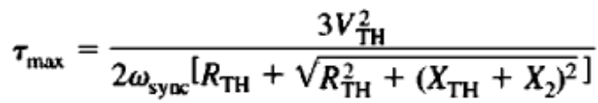
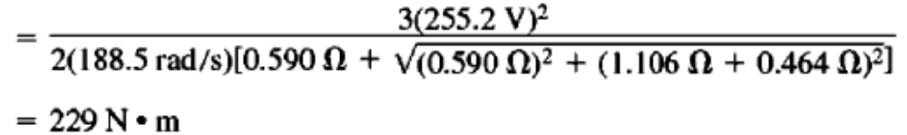
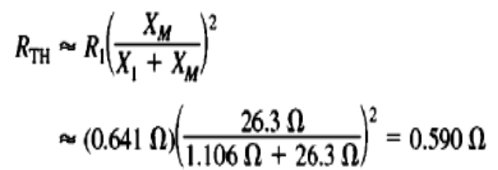
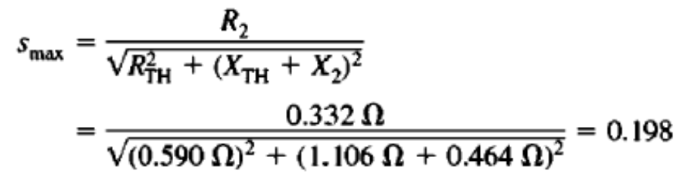

Example 7-5:
A 460 V, 25-hp, 60 Hz, four pole, Y-connected induction motor has the following impedances in ohms per phase referred to stator circuit:
R1=0.641 Ω R2=0.332 Ω
X1=1.106 Ω X2=0.464 Ω, X_{M}=26.3 Ω
  What is the maximum torque of the motor? At what speed and slip does it occur?

Slide 7
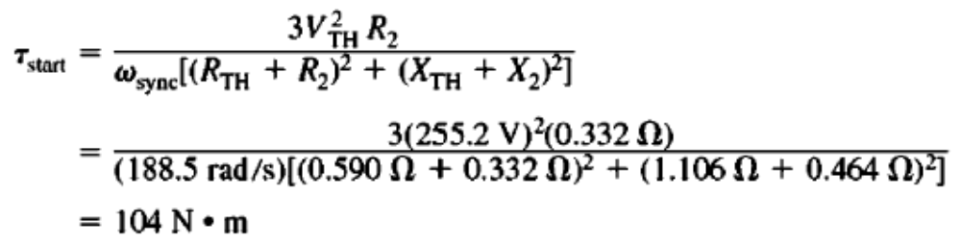
Example 7-5:
A 460 V, 25-hp, 60 Hz, four pole, Y-connected induction motor has the following impedances in ohms per phase referred to stator circuit:
R1=0.641 Ω R2=0.332 Ω
X1=1.106 Ω X2=0.464 Ω, X_{M}=26.3 Ω
  What is the starting torque of this motor.
To find the starting torque, Set s =1

Slide 8
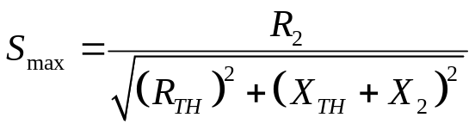
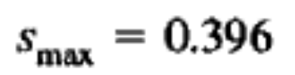

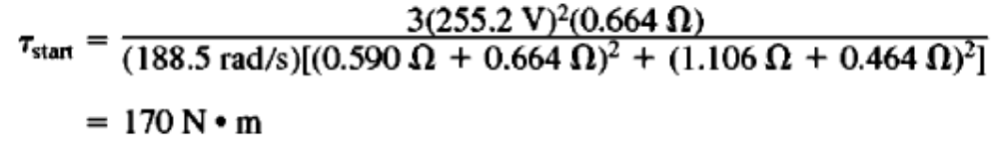
Example 7-5:
A 460 V, 25-hp, 60 Hz, four pole, Y-connected induction motor has the following impedances in ohms per phase referred to stator circuit:
R1=0.641 Ω R2=0.332 Ω
X1=1.106 Ω X2=0.464 Ω, X_{M}=26.3 Ω
  When the rotor resistance is doubled, what is the speed at which the maximum torque occurs. What is the new starting torque of the motor.
As R_{R} is doubled S_{max} is also doubled
Max torque occurs at
The new starting torque

Slide 9
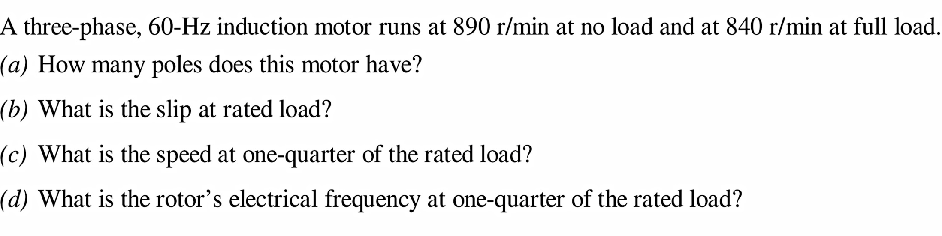
Class Activity # 01

Slide 10

Conclusion
7.5: INDUCTION MOTOR TORQUE-SPEED CHARACTERISTICS Page 401
The Derivation of the Induction Motor Induced-Torque Equation Page 405

