Slide 1

School of Electrical Engineering and Computer Science
Department of Electrical Engineering
EE-260 : Electrical Machines
Lecture # 32
Text Book: Chapter 07 Induction Motors
(Stephen J. Chapman 4th Ed)
Instructor: Ms Neelma Naz
Class: BEE 12 C/D
7.5: INDUCTION MOTOR TORQUE-SPEED CHARACTERISTICS Page 401
The Derivation of the Induction Motor Induced-Torque Equation Page 405

Slide 2
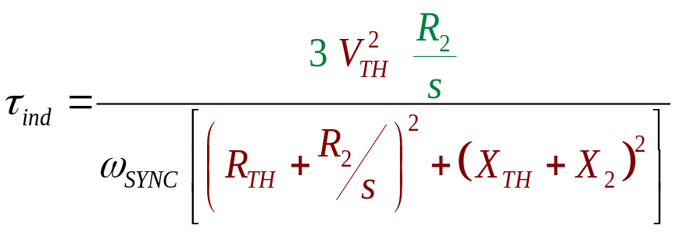
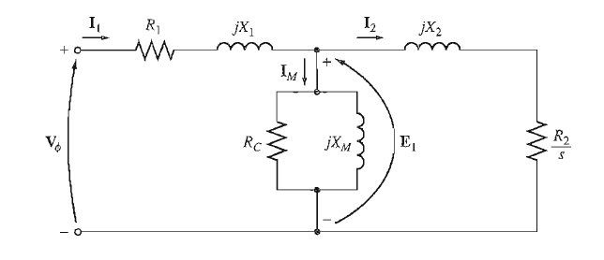
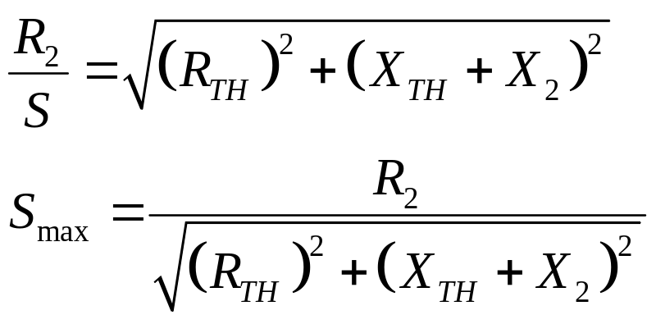
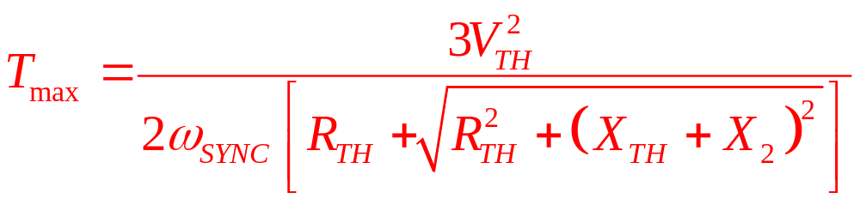
Induced-Torque Equation

Slide 3
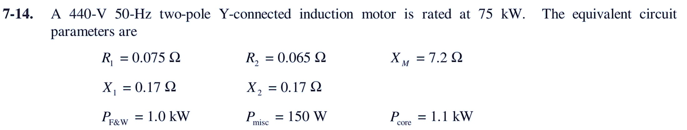
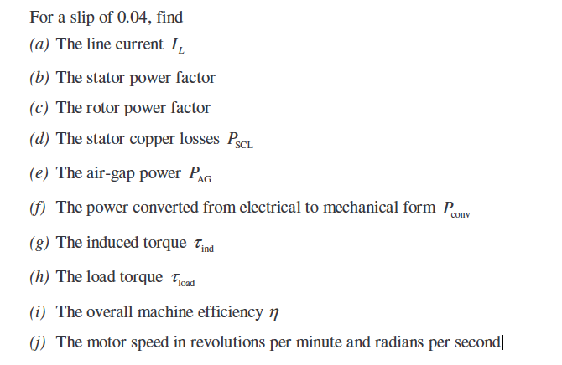
Class Activity # 01

Slide 4
Class Activity # 02
What will be the slip at pullout torque?
What will be the pullout torque?
If motor is to be driven from a 440-V, 60-Hz power supply what will be the pullout torque and slip at pullout torque?

Slide 5
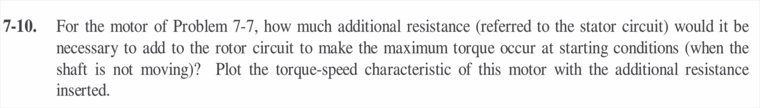
Class Activity # 03
Previous problem

Slide 6

Conclusion
7.5: INDUCTION MOTOR TORQUE-SPEED CHARACTERISTICS Page 401
The Derivation of the Induction Motor Induced-Torque Equation Page 405

