Slide 1

School of Electrical Engineering and Computer Science
Department of Electrical Engineering
EE-260 : Electrical Machines
Lecture#35
Text Book: Chapter 07 Induction Motors
(Stephen J. Chapman 4th Ed)
Instructor: Ms Neelma Naz
Class: BEE 12 C/D
7.11 DETERMINING CIRCUIT MODEL PARAMETERS Page 452

Slide 2
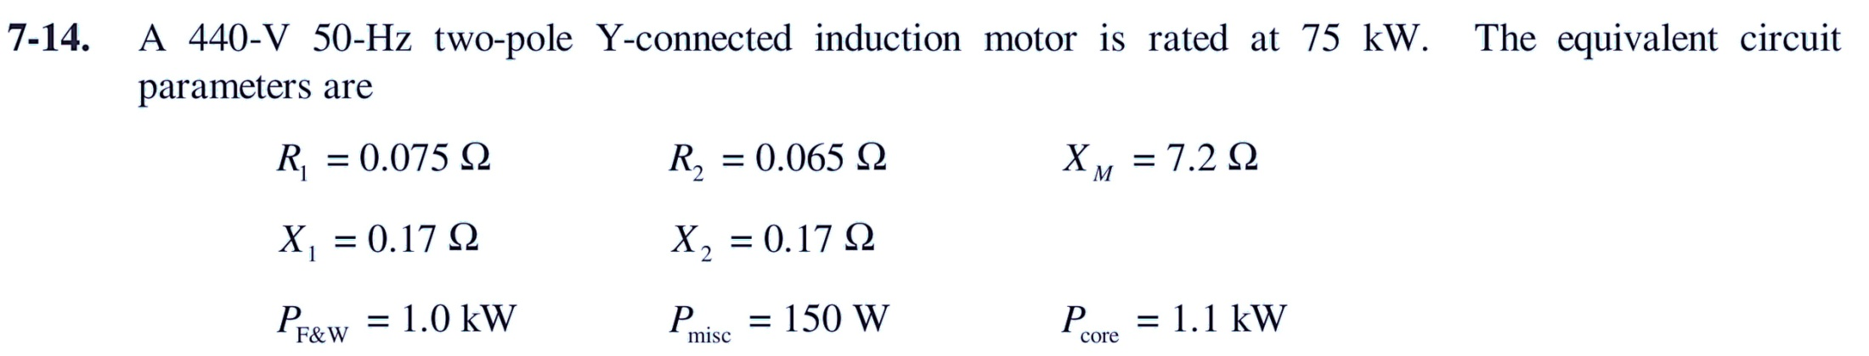
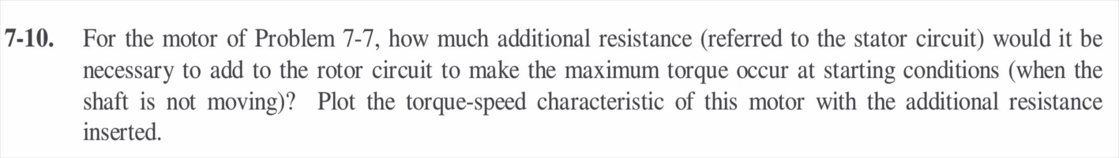
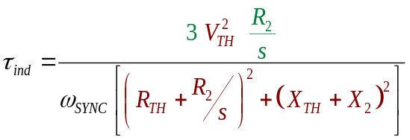
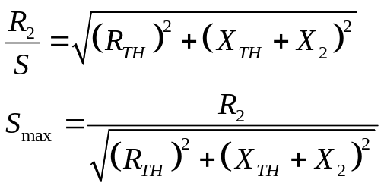
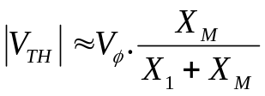
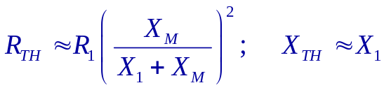
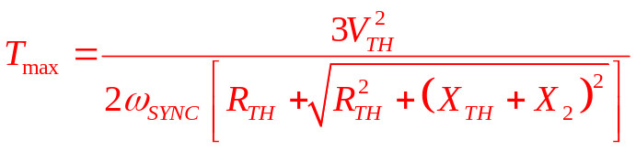
Class Activity # 01
7-14

Slide 3
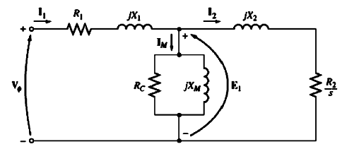
Determining Circuit Model Parameters
The equivalent circuit of an induction motor is a very useful tool for its analysis (i.e. determining the motor's response to changes in load).
We need to know the values of the elements that comprise the model
How can R₁, R₂, X₁, X₂, and X_{M} be determined for a real motor?

Slide 4
The No-Load Test
(analogous to open cct test for a transformer)
The DC Test for Stator Resistance
The Locked-Rotor Test
(analogous to short cct test for a transformer)

Slide 5
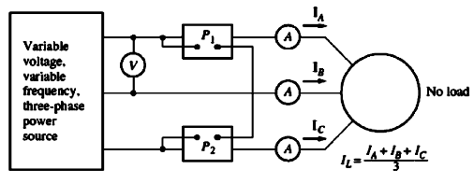
The No-Load Test
Corresponds to the open-circuit test on a transformer
The test measures rotational losses of the motor and provides information about its magnetization current.
The only load on the motor is the friction and windage losses, so all P_{conv} in this motor is consumed by mechanical losses
The slip of the motor is very small (about .001)

Slide 6
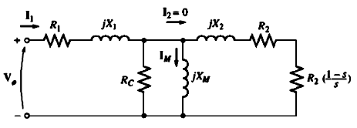


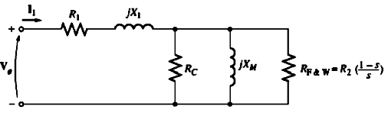
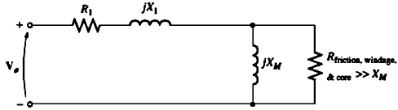
The No-Load Test
Rotor copper losses
P_{conv}
As the slip is very small
and

Slide 7
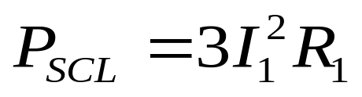
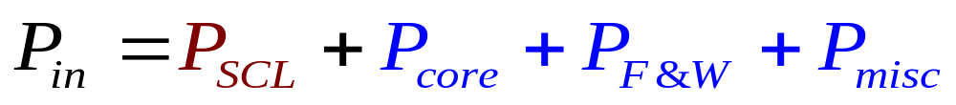
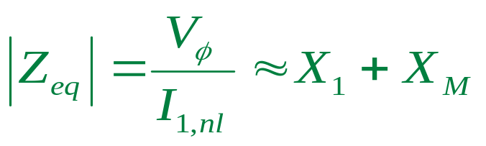
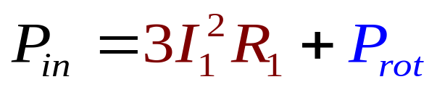
The No-Load Test
At no-load conditions, the input power measured by the meters must equal the losses in the motor
To determine P_{SCL} we need to know R₁
?????

Slide 8
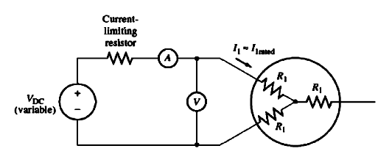
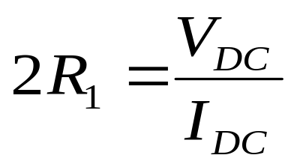
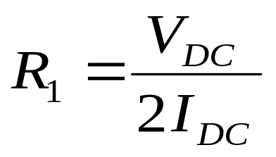
The DC Test for Stator Resistance
Precaution:
Current in the stator windings is adjusted to the rated value to heat the windings to the same temperature they would have during normal operation
Imprecision ----- skin effect neglected

Slide 9
The Locked-Rotor Test
This test corresponds to the short-circuit test on a transformer
The rotor is locked so that it cannot move. A voltage is applied to the motor, and the resulting voltage, current, and power are measured.
The current flow is adjusted to full-load value
Since the rotor is not moving, the slip s = 1, and the rotor resistance R₂/s is just equal to R₂

Slide 10
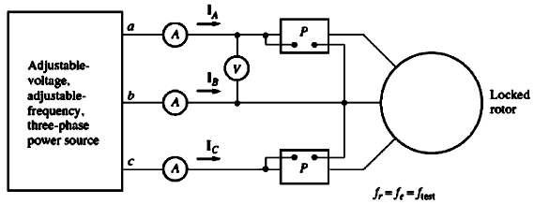
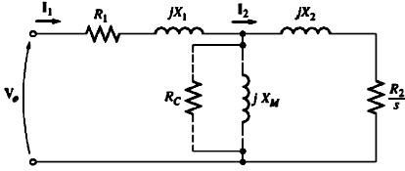

The Locked-Rotor Test

Slide 11

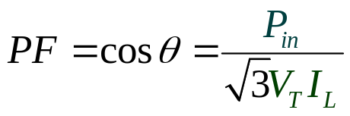
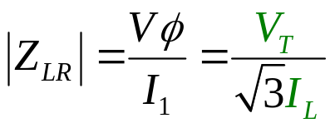



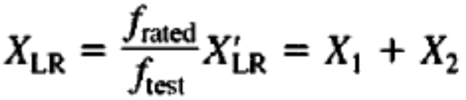


The Locked-Rotor Test

Slide 12
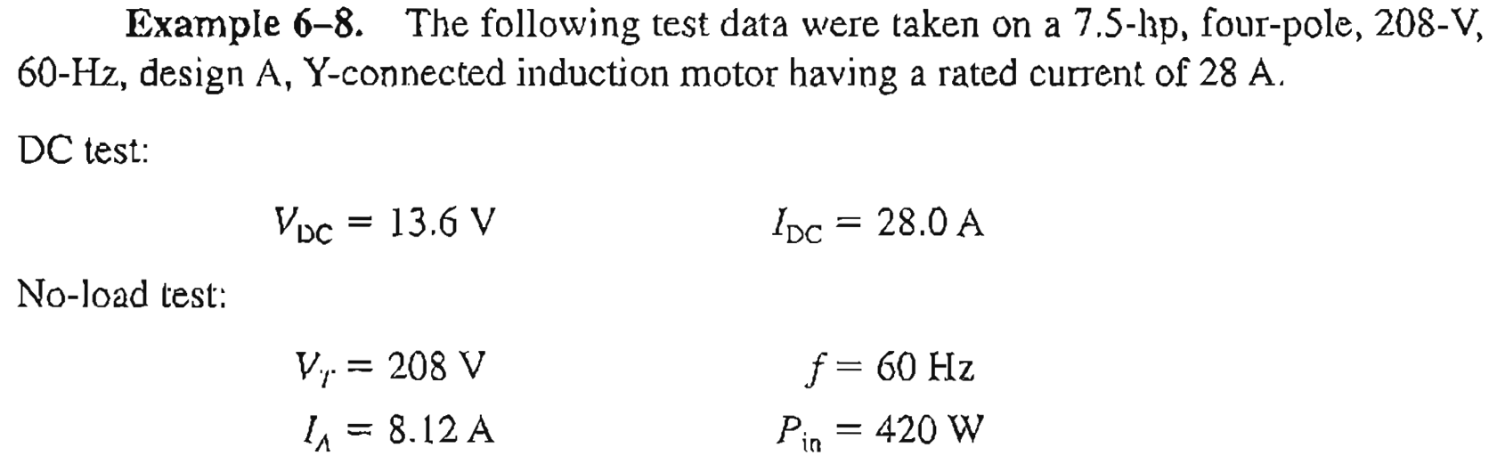
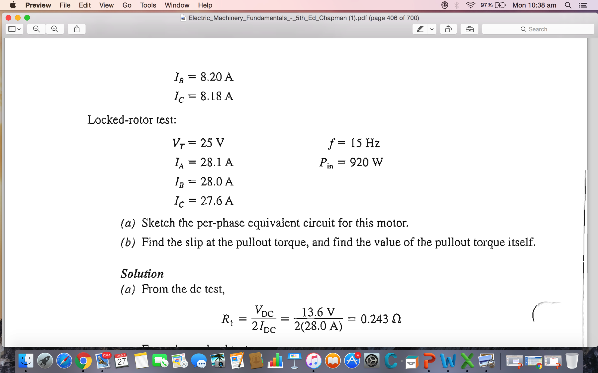
Example – 7-8 (HW)

Slide 13

Conclusion
7.11 DETERMINING CIRCUIT MODEL PARAMETERS Page 452

