Slide 1

School of Electrical Engineering and Computer Science
Department of Electrical Engineering
EE-260 : Electrical Machines
Lecture#34
Text Book: Chapter 08 DC Machinery Fundamentals
(Stephen J. Chapman 4th Ed)
Instructor: Ms Neelma Naz
Class: BEE 12 C/D
8.1: A Simple Rotating Loop Between Curved Pole Faces

Slide 2
Chapter # 8
DC Machinery Fundamentals

Slide 3
Direct Current (DC) Machines Fundamentals
Generator action: An emf (voltage) is induced in a conductor if it moves through a magnetic field.
Motor action: A force is induced in a conductor that has a current going through it and placed in a magnetic field.
Any DC machine can act either as a generator or as a motor.

Slide 4

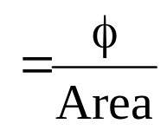
Generator
S
e_{ind}= induced voltage
Induced voltage (e_{ind})
Motion (V)
B = Flux density
•
L=length of the conductor
e_{ind(output)} = B L V _{(input)}
N
Un-known: found by FRHR
Know the prim-mover direction of rotation

Slide 5
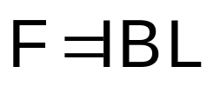
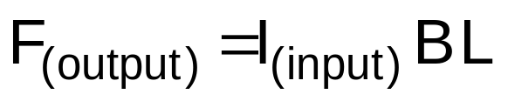
Motor
S
F = Force exerted on a conductor
B = Flux density
X
Force (F)
L=length of the conductor
Current Direction
N
Know the current direction from the Battery

Slide 6
An Introduction to DC Machines
Most DC machines are like ac machines in the sense that they have ac voltages and currents within them.
DC machines have a dc output only because a mechanism exists that converts the internal ac voltages to dc voltages at their terminals.
Since this mechanism is called Commutator, dc machinery is also know as Commutating Machinery.

Slide 7
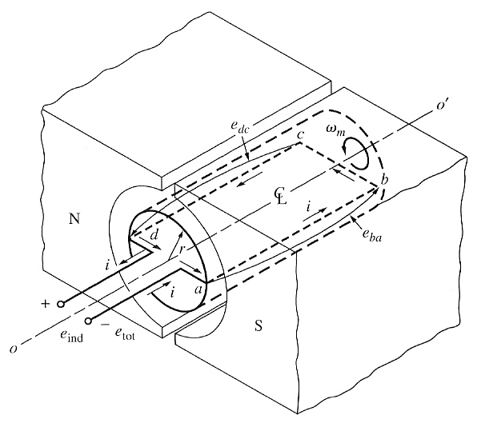
8.1: Simplest rotating dc machine
It consists of a single loop of wire rotating about a fixed axis.
The rotating part is called rotor, and the stationary part is the stator.
The magnetic field for the machine is supplied by the magnetic north and south poles. With uniform air gap, the reluctance is same under the pole faces.

Slide 8
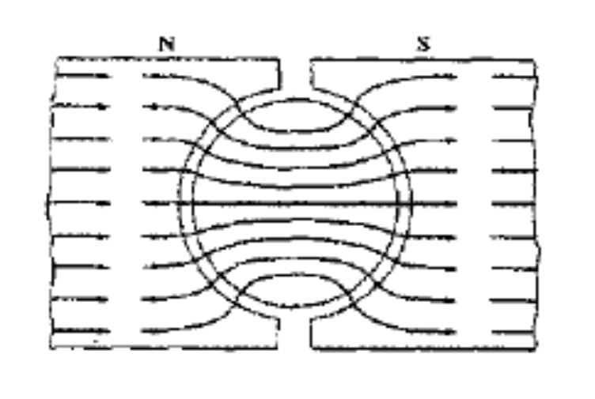
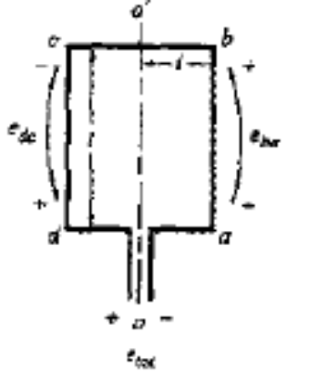
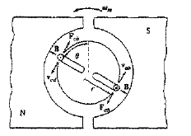
8.1: Simplest rotating dc machine
Since the magnetic flux must take the shortest path through the air, it is perpendicular to the rotor surface everywhere under the pole faces.
Also, since the air-gap is of uniform width, the reluctance is the same everywhere under the pole faces.
The uniform reluctance means that the magnetic flux density is constant everywhere under the pole faces.

Slide 9
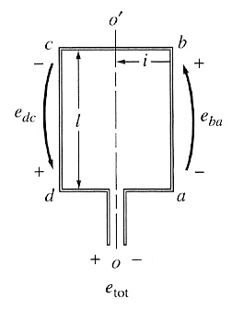
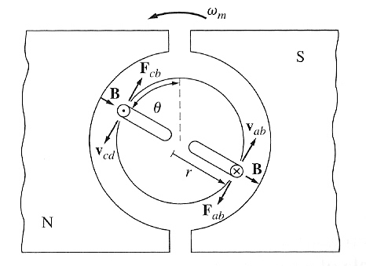
8.1: The Voltage Induced in a Rotating Loop
If the rotor is rotated, a voltage will be induced in the wire loop.
The voltage on each segment is given by eind = (v x B) . l
The total induced voltage on the loop is: eind = 2vBl

Slide 10
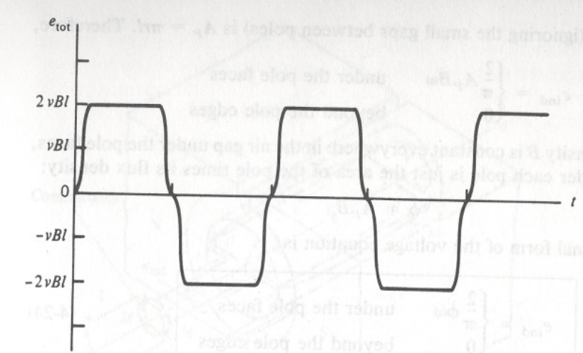
8.1: The Voltage Induced in a Rotating Loop
When the loop rotates through 180°,
  segment ab is under the opposite pole face
  the direction of the voltage on the segment reverses
  its magnitude remains constant
The resulting voltage e_{tot}

Slide 11
https://people.ucalgary.ca/~aknigh/electrical_machines/fundamentals/f_dc_simple.html

Slide 12

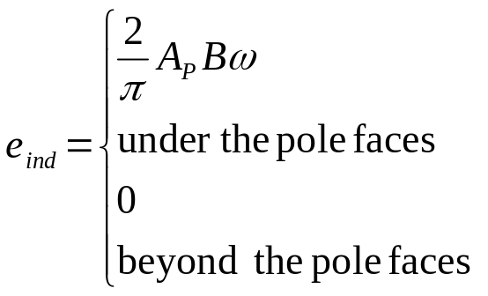
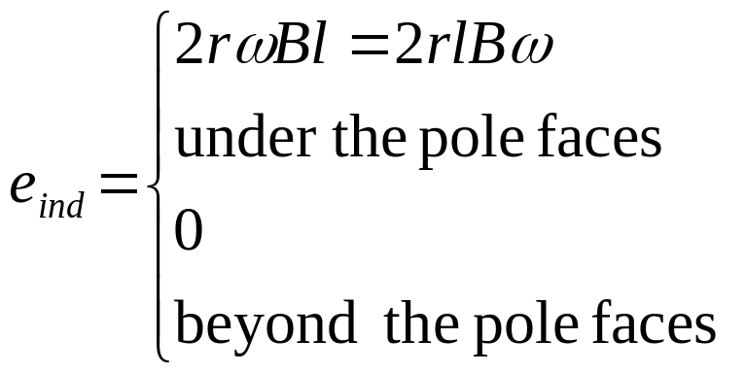

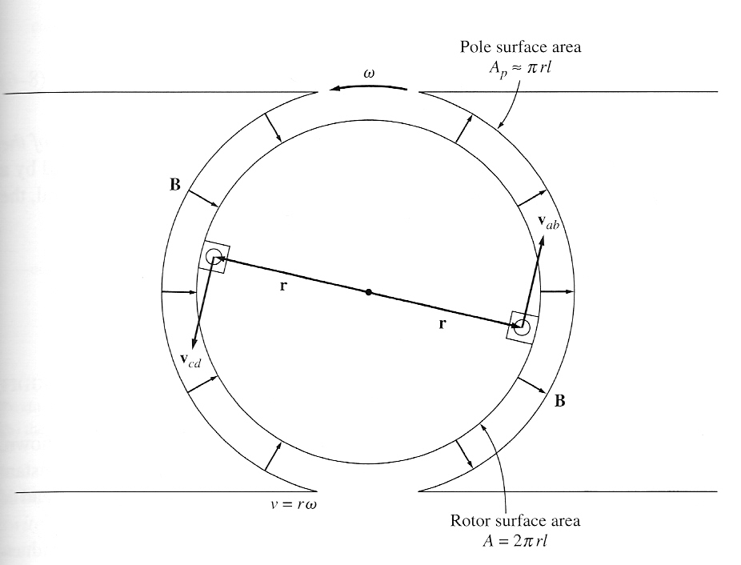
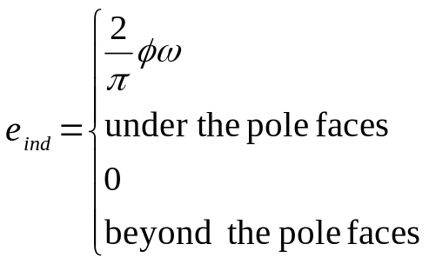
8.1: The Voltage Induced in a Rotating Loop
The induced voltage equation can be expressed alternatively as

Slide 13
8.1: The Voltage Induced in a Rotating Loop
In general, the voltage in any real machine will depend on the same 3 factors:
  the flux in the machine
  The speed of rotation
  A constant representing the construction of the machine.

Slide 14
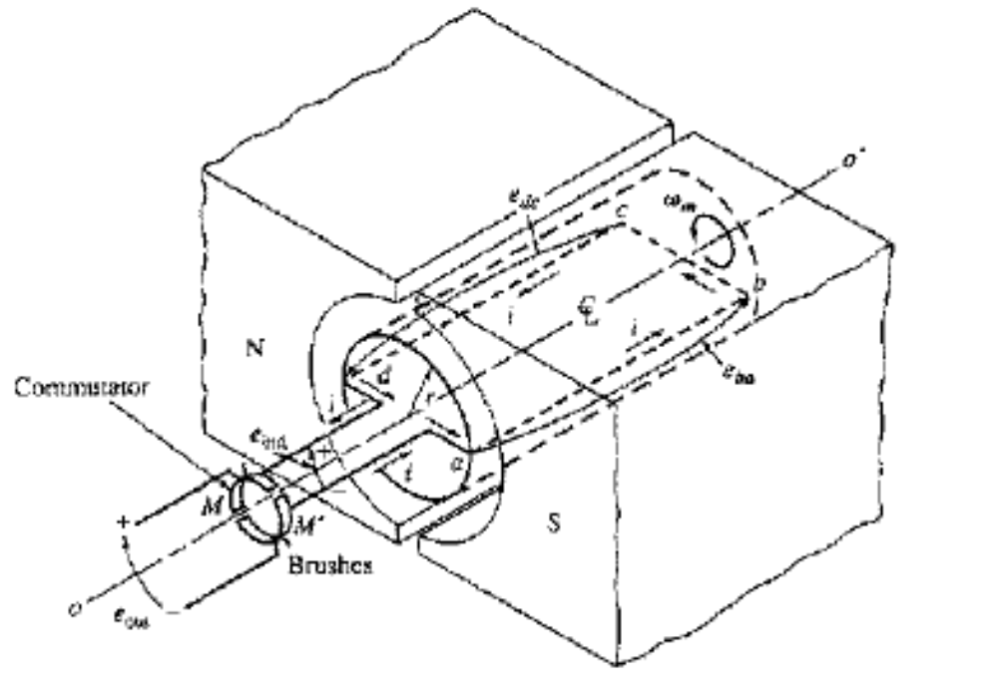
Getting DC voltage out of the Rotating Loop

Slide 15
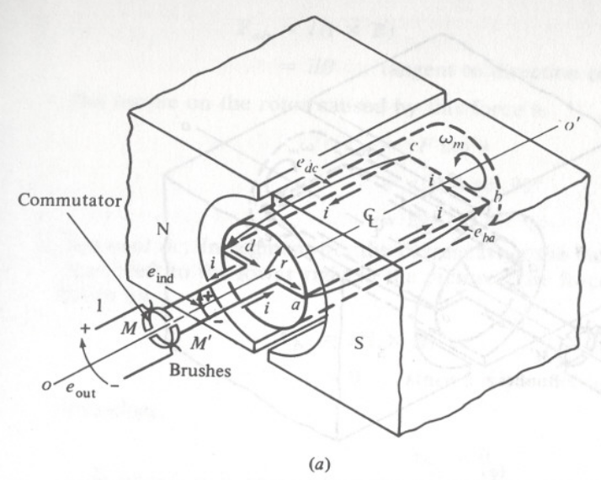
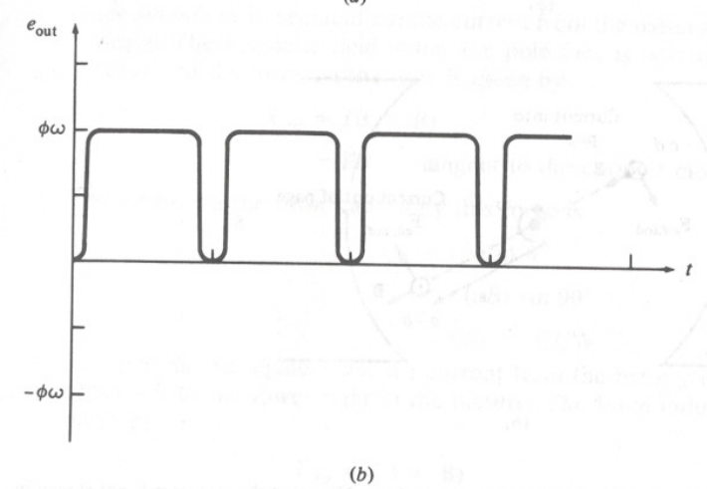
Getting DC voltage out of the Rotating Loop
Using a mechanism called commutator and brushes dc voltage can be obtained from ac voltage
  at the instant when the voltage in the loop is zero, the contacts short-circuit the two segments
  every time the voltage of the loop switches direction, the contacts also switches connections
This connection-switching process is known as commutation

Slide 16
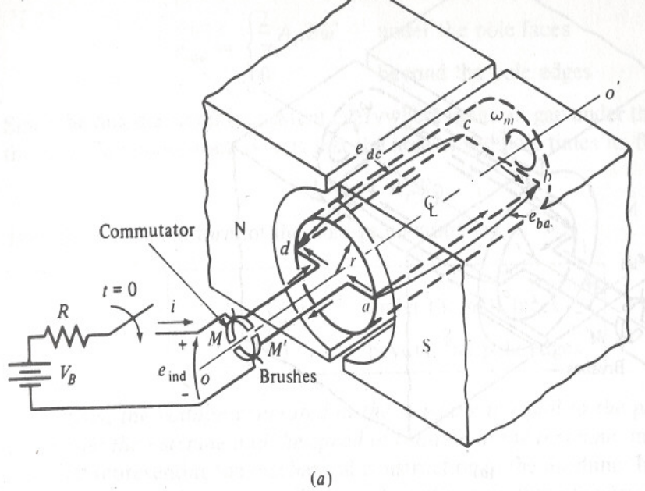
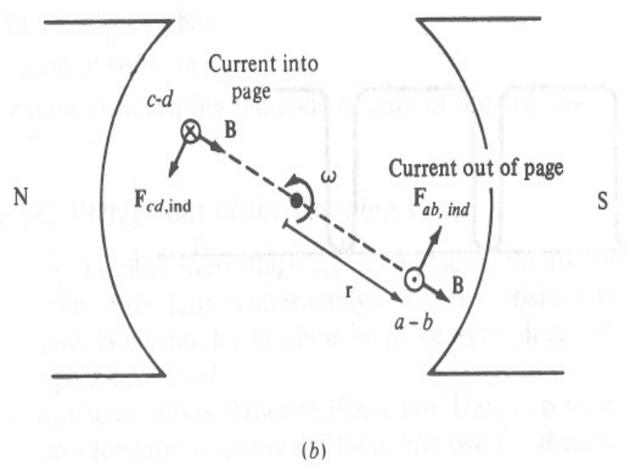
8.1: Induced Torque in the Rotating Loop
The force and the torque on a segment of the loop is given by

Slide 17
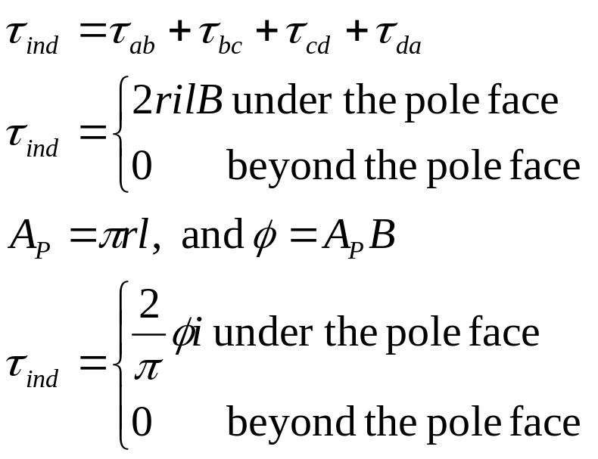
8.1: Induced Torque in the Rotating Loop
The resulting induced torque on the loop is given by:

Slide 18
Induced Torque in the Rotating Loop
In general, the torque in any real machine will depend on the same 3 factors:
1. The flux in the machine
2. The current in the machine
3. A constant representing the construction of the machine.

Slide 19

Conclusion
8.1: A Simple Rotating Loop Between Curved Pole Faces

