Slide 1

School of Electrical Engineering and Computer Science
Department of Electrical Engineering
EE-260 : Electrical Machines
Lecture#35
Text Book: Chapter 08 DC Machinery Fundamentals
(Stephen J. Chapman 4th Ed)
Instructor: Ms Neelma Naz
Class: BEE 12 C/D
8.1: A Simple Rotating Loop Between Curved Pole Faces
9.2: The Equivalent Circuit of a DC Motor

Slide 2
Chapter # 8
DC Machinery Fundamentals

Slide 3
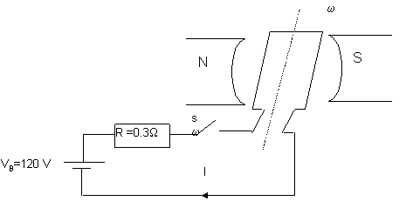
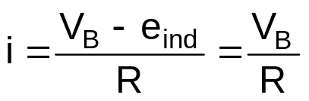
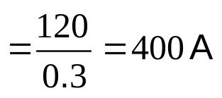
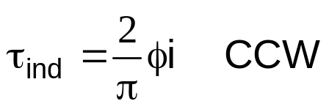
Example 8-1 (Page 482)
Figure 8-6 The physical dimensions and characteristics of this machine are
CCW
r = 0.5 m
L = 1m
R =0.3 Ω
1 m
0.5 m
B = 0.25 T
V_{B} = 120 V
(a) What happens when the switch is closed?
Solution:
Before closing the switch - Loop is stationary e_{ind} = 0
0
i-produces a Torque in the loop:
This Torque produces an angular acceleration in a CCW direction– hence e_{ind} increases

Slide 4
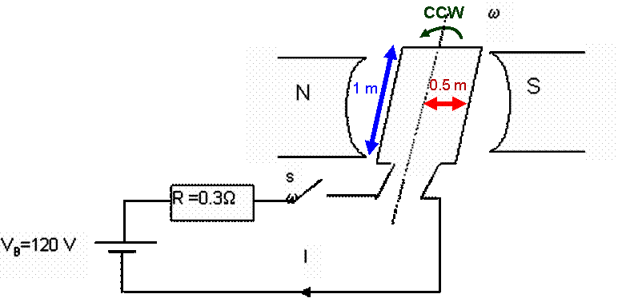
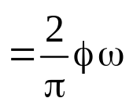
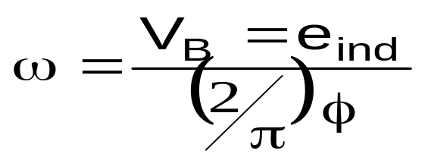
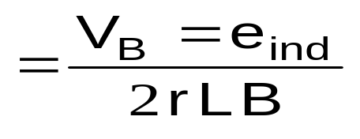
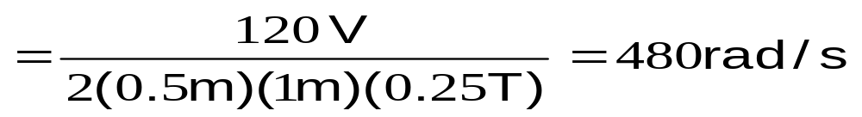
Example 8-1 (Page 482)
Figure 8-6 The physical dimensions and characteristics of this machine are
r = 0.5 m
L = 1m
R =0.3 Ω
B = 0.25 T
V_{B} = 120 V
(b) (i) Starting current ? (ii) steady state ω (angular velocity) at no load?
0
Solution:
(i) At start loop e_{ind} = 0
0
(ii) At NO-Load theoretically i = 0
V_{B} = e_{ind} + iR
therefore V_{B} = e_{ind}

Slide 5
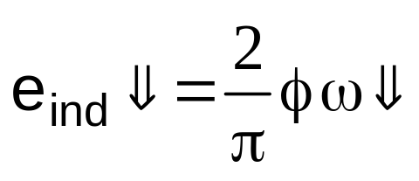
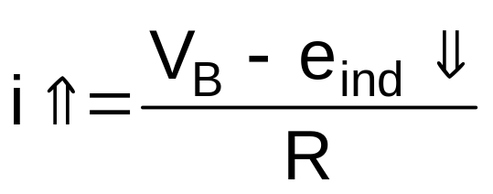
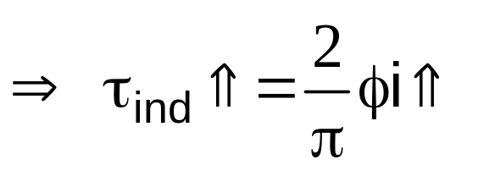

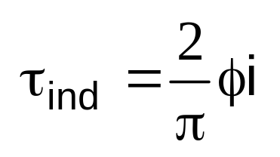
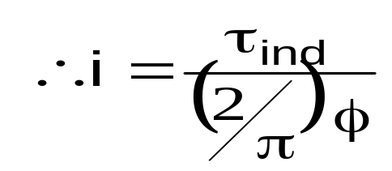
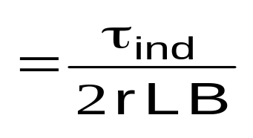
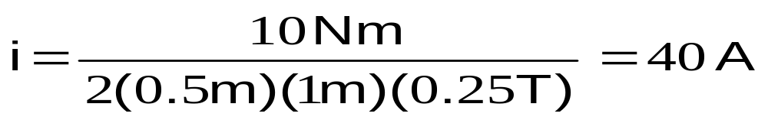
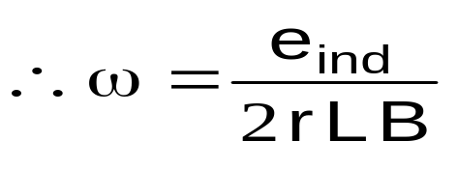
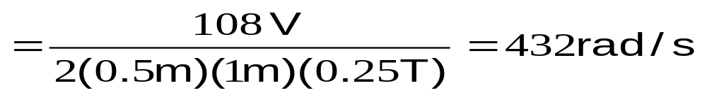
(c) Suppose a load is attached to the loop, and the resulting load torque is 10 Nm.
(i) What is the new steady-state speed?
At NO-LOAD (τ_{load} =0) ω =480 rad/sec
Solution:
Speed slow (ω↓) down as the load torque (τ_{load}=10Nm) is applied;
at a lower speed till
NO-LOAD WITH LOAD
e_{ind}=120 e_{ind}=108V
I = 0 I = 40 A
τ_{load}=0 τ_{load}=10Nm
ω = 480 ω = 432
e_{ind} = V_{B} + iR
e_{ind} = 120 V– (40A)().3Ω) =108V
-

Slide 6
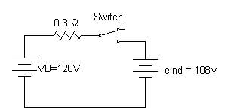
(c) Suppose a load is attached to the loop, and the resulting load torque is 10 Nm.
(ii) How much power is supplied to the shaft of the machine.
Solution:
The power supplied to shaft P_{shaft} = τω
P_{shaft} = (10 N.M) (432 rad/s) =4320 W
P_{Battery} = V_{B} i
P_{Batteryt} = (120)(40A) = 4800 W
P_{Battery} > P_{Shaft}
Motor Action
40A
Motor Action: Converting electrical energy into mechanical energy

Slide 7
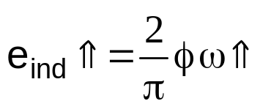
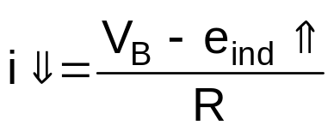

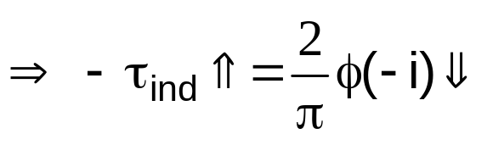
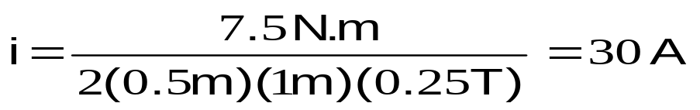
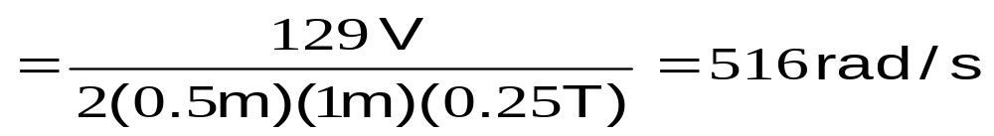
(d) Suppose a load torque of 10 Nm is applied to the loop shaft in the direction of rotation of the motor.
7.5 Nm
What is the new steady-state speed? Is the machine M/R or G/R?
Solution: Speed increases (ω↑) as the load torque (τ_{load} =10Nm) is applied to the shaft in the direction of rotation.
=7.5 Nm
Hence e_{ind}>V_{Battery}
e_{ind}>V_{Battery} current start flowing from loop into the battery
P_{shaft} > P_{Battery}
Generator Action
e_{ind} = V_{B} + iR
-
e_{ind} = 120 V– (30A)().3Ω) =129V
+

Slide 8
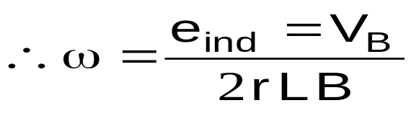
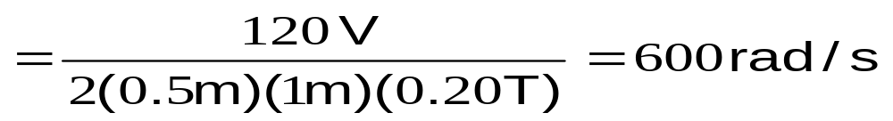
(e) Suppose the machine is running unloaded. What would the final steady-state speed of the rotor (loop) be if the flux density (B) were reduced to 0.20 T?
Solution: the unloaded steady-state speed (ω = 480 rad/s) form part (b).
What do you think about the new speed ? i.e more/less than 480 rad/sec ?
NOTE: When flux in the machine is decreased, its speed increases.
Please note, both for motors and generators this phenomena is very important

Slide 9
Chapter # 9
DC Motors

Slide 10
Classification of Motors
Generators
Alternating Current
(AC)
Motors
Direct Current
(DC)
Motors
Generators
Generators
Induction
Separately
Excited
Self
Excited
Synchronous
Single
Phase
Three
Phase
Shunt
Series
Compound
Split Phase
Capacitor
Squirrel
Cage
Wound
Shaded Pole

Slide 11
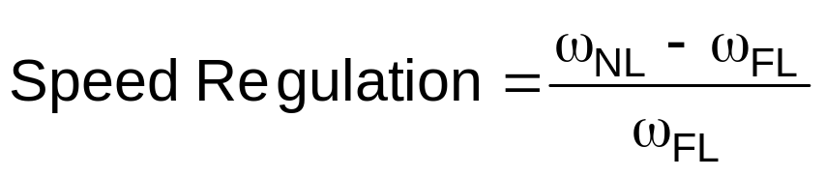
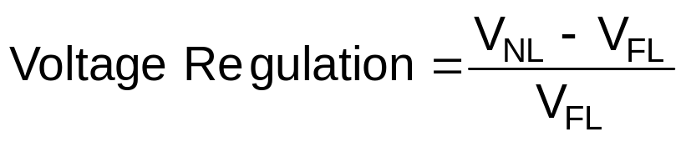
DC Motors are compared by their:
SPEED
POWER RATINGS
EFFCIENCIES
SPEED REGULATIONS
DC Generator are compared by their
VOLTAGE
POWER RATINGS
EFFCIENCIES
VOLTAGE REGULATIONS
Assume the Motors are run from a constant source (V_{T}), unless voltage change is specified
Assume the Generators are are run from a constant Speed source called Prime Mover, unless speed change is specified

Slide 12
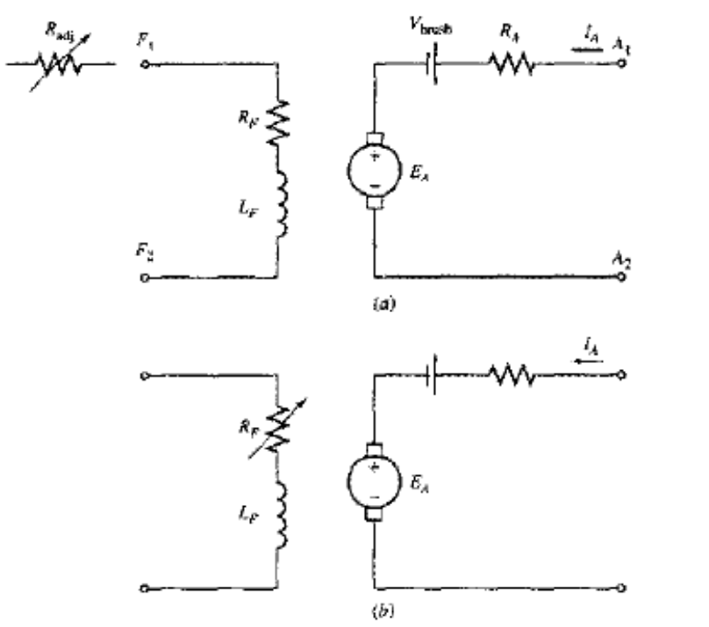
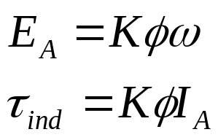
9.2: The Equivalent Circuit of a DC Motor
The armature circuit of a dc machine is represented by an ideal voltage source E_{A} and resistor R_{A}.
The brush voltage drop is represented by a small battery V_{brush} opposing the direction of current flow in the machine.
The field coils, which produce the magnetic flux are represented by L_{F} and R_{F}.
The separate resistance R_{adj} represents an external variable resistor used to control the amount of current in the field circuit.

Slide 13
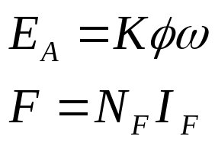
9.3: The Magnetization Curve of a DC Motor
The internal generated voltage E_{A} of a dc motor or generator is given by Eq.
Thus E_{A} is directly proportional to the flux in the machine and the speed of the machine.
The field current in a DC machine produces magnetomotive force which produces a flux in the machine according the magnetization curve.
Since field current is directly proportional to the mmf, and E_{A} is directly proportional to the flux, It is customary to present the magnetization curve as a plot E_{A} versus field current for a given speed ω_{o}.

Slide 14
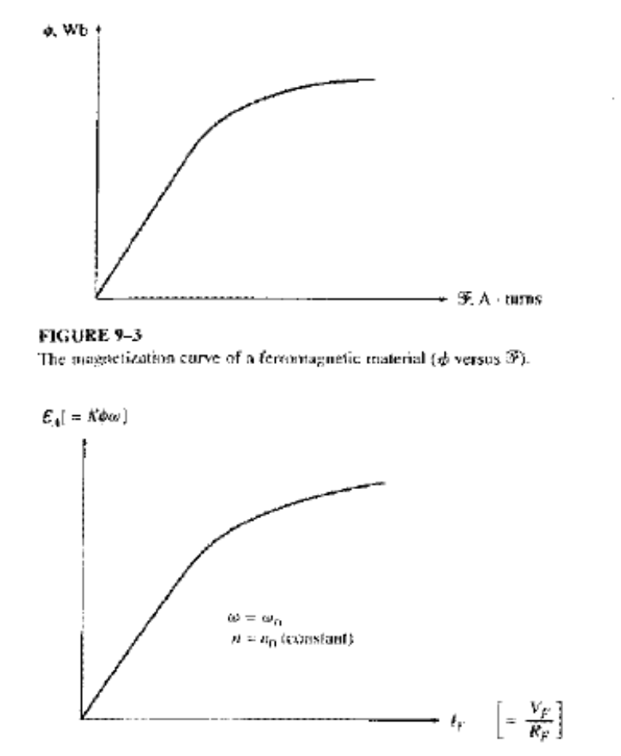
9.3: The Magnetization Curve of a DC Motor
It is worth noting that, to get the maximum possible power per pound of weight out of machine, most motors and generators are designed to operate near the saturation point on the magnetization curve (at knee point).
This implies that a fairly large increase in field current is often necessary to get a small increase in E_{A} when operation is near full load.

Slide 15
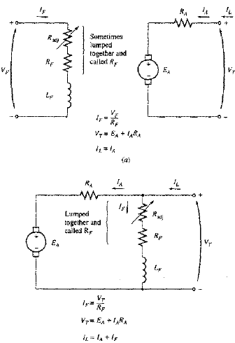

9.4: Separately Excited and Shunt DC Motors
A separately excited motor is a motor whose field circuit is supplied from a separate constant-voltage power supply.
A shunt motor is a motor whose field circuit gets its power directly across the armature terminals of the motor.
When the supply voltage is assumed constant, there is no practical difference in the behavior of these machines.
KVL for these motors is:

Slide 16
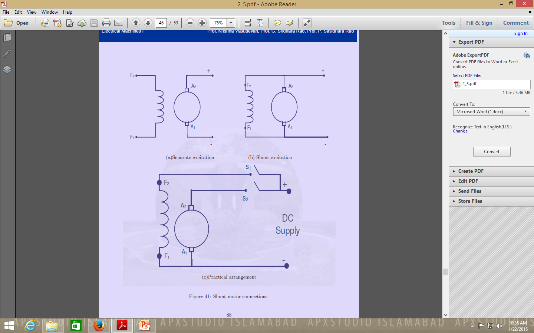
9.4: Separately Excited and Shunt DC Motors

Slide 17
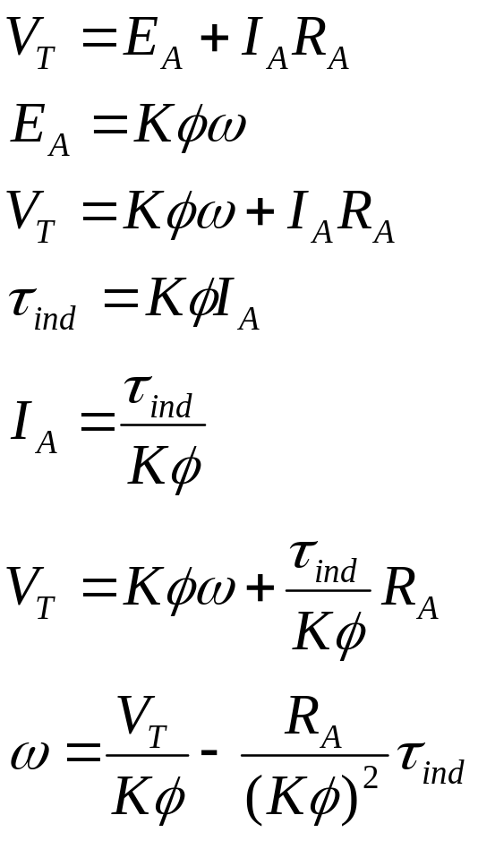
The Terminal Characteristics of a Shunt DC Motor
The terminal characteristics of a motor is the plot of its output torque versus speed.
When the load on the shaft of shunt DC motor is increased, then the load torque will exceed the torque induced in the machine, and the motor will slow down.
When the motor slows down, its internal generated voltage drops which will increase the armature current.
The increase in the armature current increases the induced torque, and finally the induced torque will be equal to the load torque at a lower mechanical speed.

Slide 18
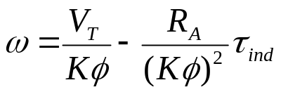
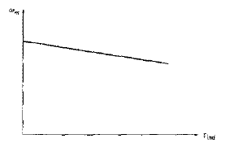
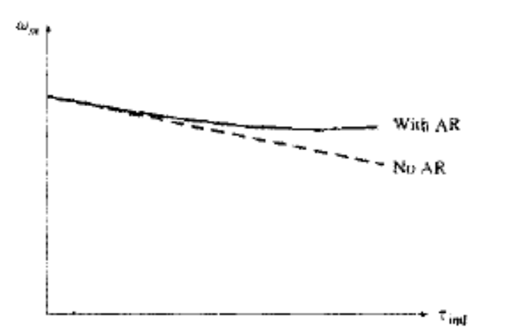
The Terminal Characteristics of a Shunt DC Motor
The final equation is just a straight line equation with a negative slope.
Another effect internal to the motor that can effect the torque-speed curve is the armature reaction.
If the motor has armature reaction, then as the load increases, the flux-weakening effect reduces its flux.
The effect of reduction in the flux is to increase motor’s speed at any given load over the speed it would run without armature reaction.

Slide 19
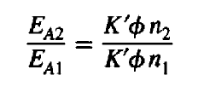
The Terminal Characteristics of a Shunt DC Motor
If a shunt motor has a compensating windings so that its flux is constant regardless of load, and the motor speed and armature reaction are known at any one value of the load, then it is possible to calculate its speed at any other value of load, as long as armature current at that load is known or can be determined.
The relationship between internal generated voltages and speeds at two different loading conditions is given by

Slide 20

Conclusion
9.1: introduction to DC Motors
9.2: The Equivalent Circuit of a DC Motor
9.3: the Magnetization Curve of DC Machine

