Slide 1

EE-260 : Electrical Machines
Lecture#36
9.1: introduction to DC Motors
9.2: The Equivalent Circuit of a DC Motor
9.3: the Magnetization Curve of DC Machine
9.4: Separately Excited and Shunt DC Motors
Text Book: Chapter 09 DC Motors & Generators
(Stephen J. Chapman 4th Ed)
Instructor: Ms Neelma Naz
Class: BEE 12 C/D
School of Electrical Engineering and Computer Science
Department of Electrical Engineering

Slide 2
Chapter # 9
DC Motors

Slide 3
9.1: Introduction to DC Motors
DC motors are machines used as motors, and dc generators are dc machines used as generators. However, the same physical machine can be operated as either a motor or a generator---it is simply a questions of direction of the power flow through it.
There were several reasons for continued popularity of dc motors:
  DC power systems are still common in cars, trucks, and aircrafts. Thus, when a vehicle has dc power system, it makes sense to consider using dc motors.
  The other reason for the application of DC machines is a situation in which wide variations in speed are needed.

Slide 4
Classification of Motors
Generators
Alternating Current
(AC)
Motors
Direct Current
(DC)
Motors
Generators
Generators
Induction
Separately
Excited
Self
Excited
Synchronous
Single
Phase
Three
Phase
Shunt
Series
Compound
Split Phase
Capacitor
Squirrel
Cage
Wound
Shaded Pole

Slide 5
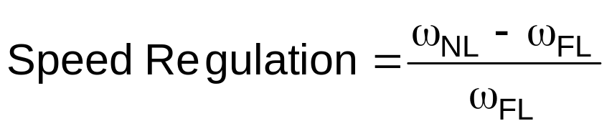
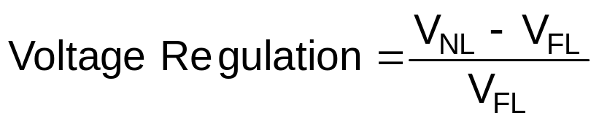
DC Motors are compared by their:
SPEED
POWER RATINGS
EFFCIENCIES
SPEED REGULATIONS
DC Generator are compared by their
VOLTAGE
POWER RATINGS
EFFCIENCIES
VOLTAGE REGULATIONS
Assume the Motors are run from a constant source (V_{T}), unless voltage change is specified
Assume the Generators are are run from a constant Speed source called Prime Mover, unless speed change is specified

Slide 6
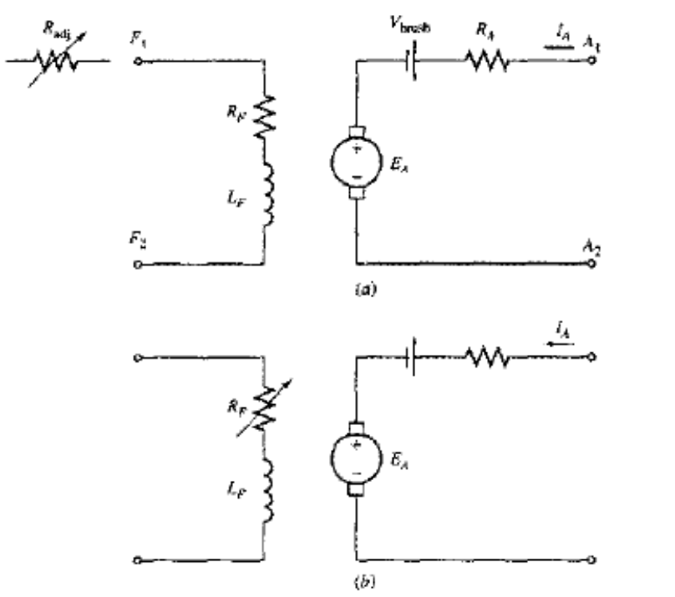
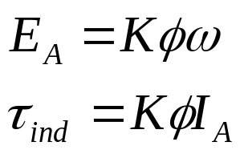
9.2: The Equivalent Circuit of a DC Motor
The armature circuit of a dc machine is represented by an ideal voltage source E_{A} and resistor R_{A}.
The brush voltage drop is represented by a small battery V_{brush} opposing the direction of current flow in the machine.
The field coils, which produce the magnetic flux are represented by L_{F} and R_{F}.
The separate resistance R_{adj} represents an external variable resistor used to control the amount of current in the field circuit.

Slide 7
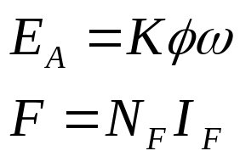
9.3: The Magnetization Curve of a DC Motor
The internal generated voltage E_{A} of a dc motor or generator is given by Eq.
Thus E_{A} is directly proportional to the flux in the machine and the speed of the machine.
The field current in a DC machine produces magnetomotive force which produces a flux in the machine according the magnetization curve.
Since field current is directly proportional to the mmf, and E_{A} is directly proportional to the flux, It is customary to present the magnetization curve as a plot E_{A} versus field current for a given speed ω_{o}.

Slide 8
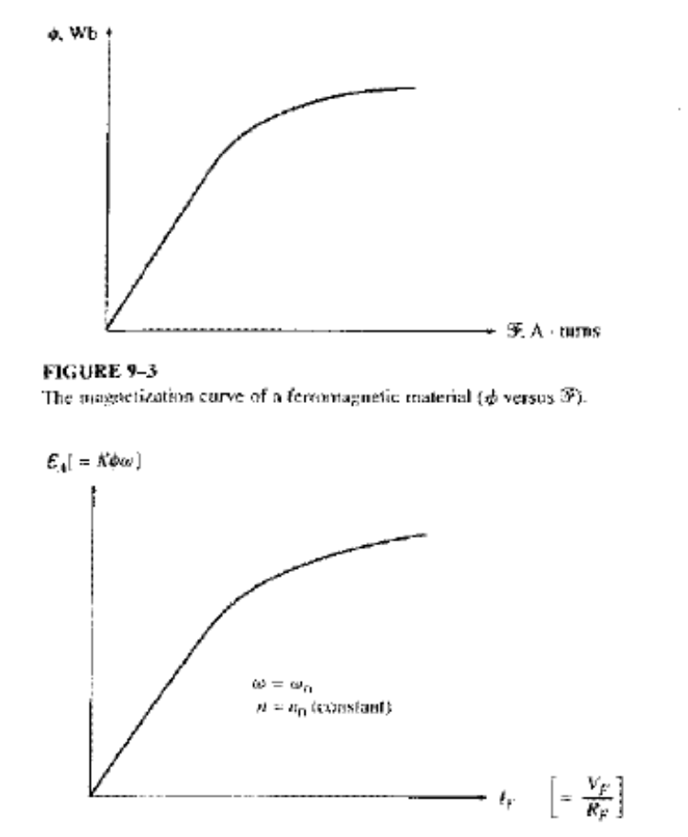
9.3: The Magnetization Curve of a DC Motor
It is worth noting that, to get the maximum possible power per pound of weight out of machine, most motors and generators are designed to operate near the saturation point on the magnetization curve (at knee point).
This implies that a fairly large increase in field current is often necessary to get a small increase in E_{A} when operation is near full load.

Slide 9
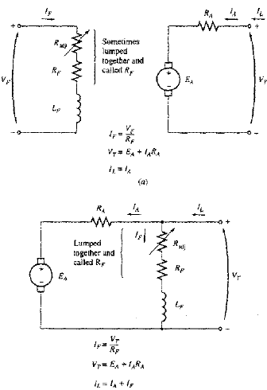

9.4: Separately Excited and Shunt DC Motors
A separately excited motor is a motor whose field circuit is supplied from a separate constant-voltage power supply.
A shunt motor is a motor whose field circuit gets its power directly across the armature terminals of the motor.
When the supply voltage is assumed constant, there is no practical difference in the behavior of these machines.
KVL for these motors is:

Slide 10
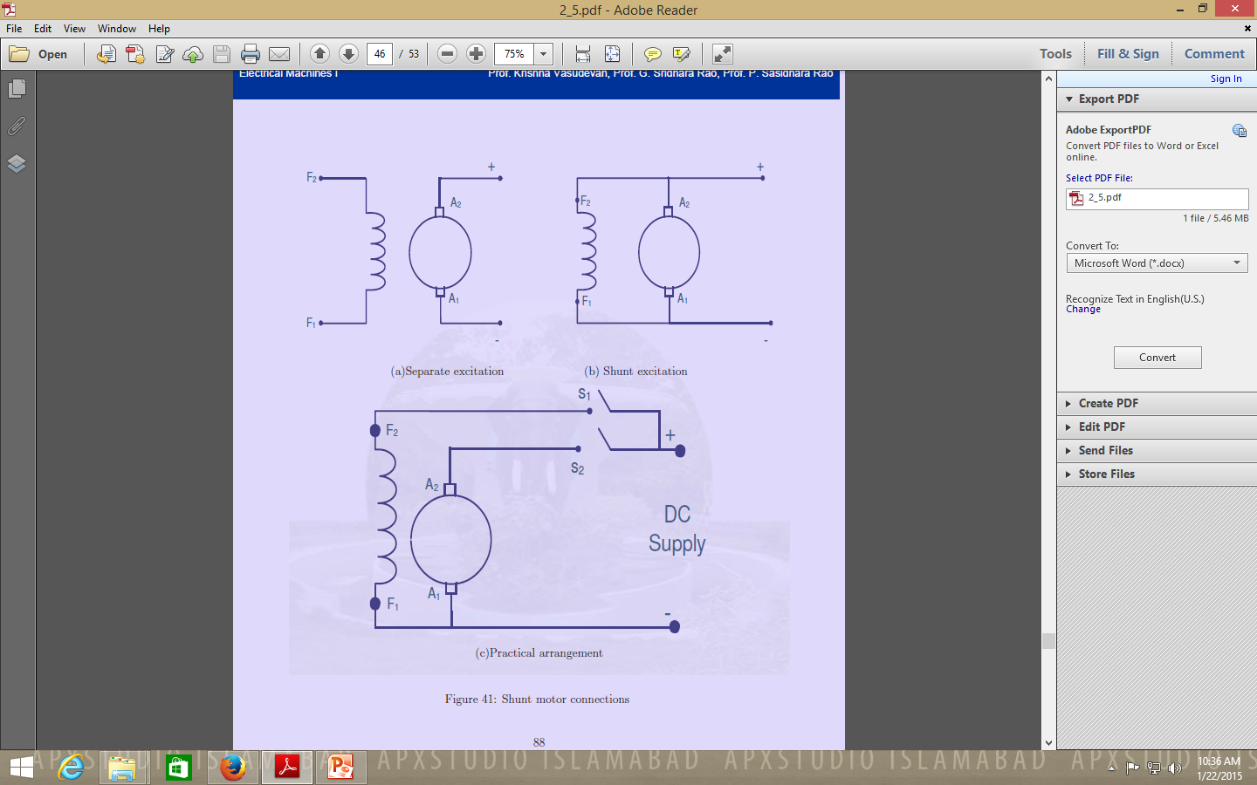
9.4: Separately Excited and Shunt DC Motors

Slide 11
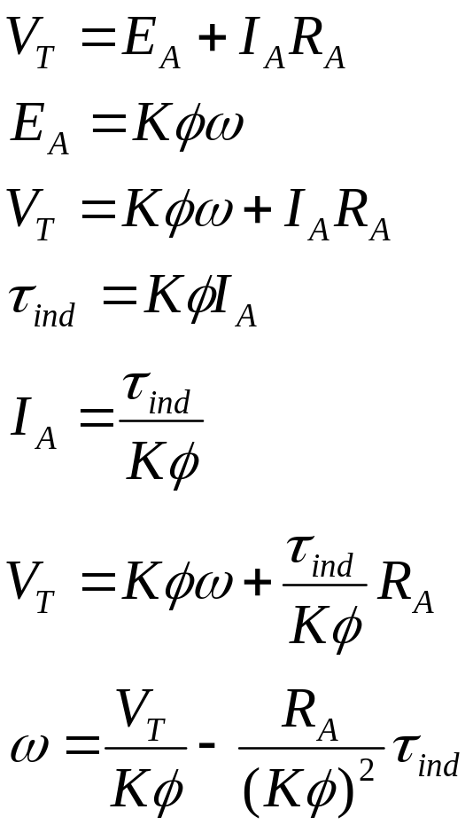
The Terminal Characteristics of a Shunt DC Motor
The terminal characteristics of a motor is the plot of its output torque versus speed.
When the load on the shaft of shunt DC motor is increased, then the load torque will exceed the torque induced in the machine, and the motor will slow down.
When the motor slows down, its internal generated voltage drops which will increase the armature current.
The increase in the armature current increases the induced torque, and finally the induced torque will be equal to the load torque at a lower mechanical speed.

Slide 12
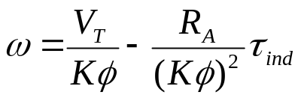
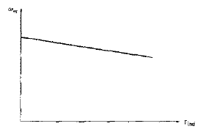
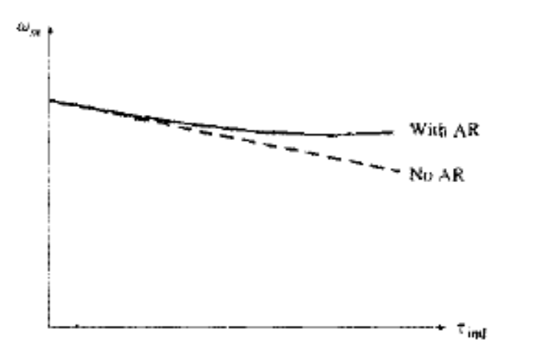
The Terminal Characteristics of a Shunt DC Motor
The final equation is just a straight line equation with a negative slope.
Another effect internal to the motor that can effect the torque-speed curve is the armature reaction.
If the motor has armature reaction, then as the load increases, the flux-weakening effect reduces its flux.
The effect of reduction in the flux is to increase motor’s speed at any given load over the speed it would run without armature reaction.

Slide 13
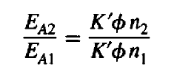
The Terminal Characteristics of a Shunt DC Motor
If a shunt motor has a compensating windings so that its flux is constant regardless of load, and the motor speed and armature reaction are known at any one value of the load, then it is possible to calculate its speed at any other value of load, as long as armature current at that load is known or can be determined.
The relationship between internal generated voltages and speeds at two different loading conditions is given by

Slide 14

Conclusion
9.1: introduction to DC Motors
9.2: The Equivalent Circuit of a DC Motor
9.3: the Magnetization Curve of DC Machine
9.4: Separately Excited and Shunt DC Motors

